Slide 1
Head and Neck 1 Neck Mass
Dr. Manal Bin Manie
Assistant Professor – ORL H&N surgery
King Saud University

Slide 2
Objectives
Anatomy of the neck
History / physical examination
Pathology / differential diagnosis
Management/ investigation and treatment

Slide 3
Triangles of the neck

Slide 4
Anterior triangle
Posterior triangle

Slide 5
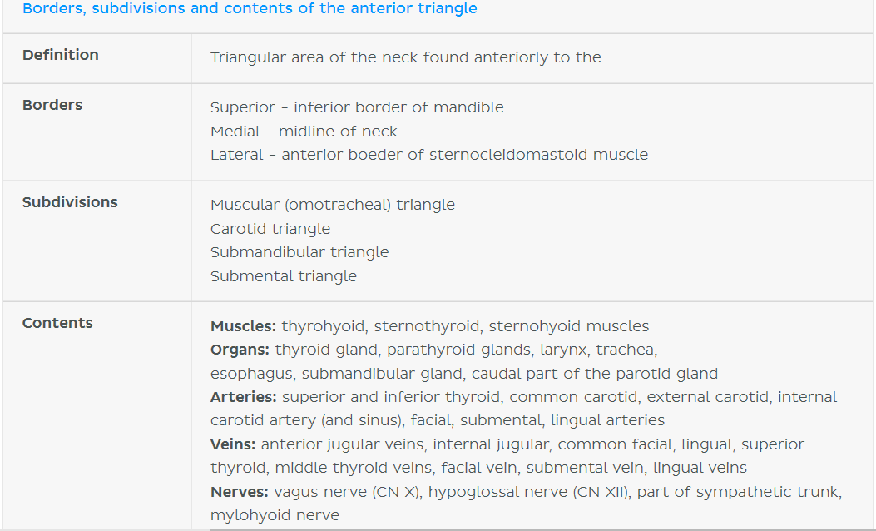

Slide 6
Carotid triangle

Slide 7
Submandibular triangle

Slide 8
Submental triangle

Slide 9
Posterior triangle

Slide 10
Occipital triangle

Slide 11
Supraclavicular triangle

Slide 12
Cervical lymph nodes

Slide 13
Thyroid gland anatomy
Butterfly-shaped gland
Isthmus :overlying 2nd to 4th tracheal rings
Parathyroids

Slide 14
Thyroid gland anatomy

Slide 15
Parotid gland
Lies over the angle of mandible
Superficial and deep lobe
Facial nerve
Stenson’s duct : opens in the mouth opposite to maxillary second molar

Slide 16
Submandibular gland
Lies inferior and posterior to the mandible
Mylohyoid muscle runs through the lobules of the gland and section it into superficial and deep parts
Wharton’s duct opens at the lingual papilla

Slide 17
Approach to neck mass
History
Physical exam
Age, gender, ethnicity
Duration of neck mass
Progression
Associated symptoms :URTI
Voice change
Hx of cough, fever, sore throat, night sweats,weight loss
Recent travel
Insect bite
Dental problems
Tobacco and alcohol use
Exposure to Radiation
Family history of malignancy
Full head and neck examination including the cranial nerves and nasopharyngolaryngoscopy
Location of the mass: midline , lateral
Size, consistency, tenderness, mobility
Pulsation
Skin changes
Movement with swallowing or tongue protrusion

Slide 18
Differential diagnosis
Pediatric
Adult
Infective and inflammatory masses
Congenital masses
Vascular masses
Traumatic masses
Metabolic, idiopathic and autoimmune conditions
Infective and inflammatory masses
Neoplastic masses
Vascular masses
Traumatic masses
Metabolic, idiopathic and autoimmune conditions
Thyroid gland masses
Salivary gland masses
Parapharyngeal masses

Slide 19
Differential diagnosis

Slide 20
General approach to a neck mass
Patient with a neck mass
Diagnosis suggested by history and physical exam
Congenital mass
Infectious/ inflammatory
Neoplastic
CT scan
Course of broad spectrum antibiotics with close FU in 2-4 weeks
FNA+/-
CT scan +/-
Endoscopy
Further management based on stage and histology
Excisional biopsy

Slide 21
Infectious/inflammatory masses

Slide 22
Cervical lymphadenitis:
Most common in children and adolescents
Etiology :
Bacterial – streptococcal and staphylococcal infections , mycobacterial infections, secondary to dental or tonsillitis and rarely cat-scratch disease and actinomyces
Viral- EBV, CMV ,herpes simplex virus, others
Parasitic – toxoplasmosis
Fungal- coccidiomycosis
Sialadenitis
Diagnosis: CBC, CT scan if needed
Treatment: antibiotics

Slide 23
Cervical lymphadenitis:

Slide 24
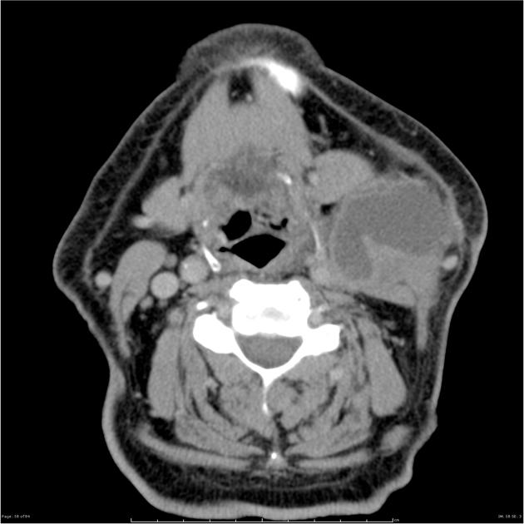
Cervical lymphadenitis:
Rule out Neck abscess formation if no improvement with antibiotics
CT neck with contrast
Incision and drainage

Slide 25
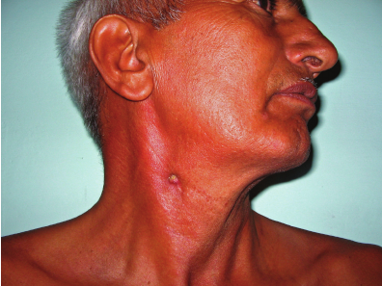
Tuberculous cervical lymphadenitis:
Scrofula
Most common manifestation of extrapulmonary TB
Non tender
If untreated , spontaneous discharge and sinus formation
CT scan may show necrotic/cystic nodal matting
FNA/ excisional biopsy
Treatment: antimycobacterial medications

Slide 26
Mumps ( viral parotitis):
Viral infection caused by paramyxovirus
Droplet infection and fomites
Children are more affected
Fever, malaise, parotid swelling
Orchitis , ophritis, aseptic meningitis , unilateral SNHL
Treatment is supportive , hydration and analgesics

Slide 27
Acute suppurative parotitis/sialadenitis :
Commonly seen in elderly , diabetic , debilitated and dehydrated patients
Staph aureus is the usual causative organism
Fever, swelling , pus from stenson’s duct
Antibiotics and hydration

Slide 28
Neoplastic masses

Slide 29
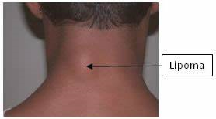
Neoplastic masses
Benign :
Lipoma , fibroma, neuroma and schwannoma
Malignant:
Primary neck tumors – sarcoma, salivary gland tumors, thyroid gland tumors, parathyroid gland tumors
Lymphoma
Metastasis

Slide 30
Thyroid gland nodules:
benign thyroid nodules are very common
5-10 % are malignant
Hot vs cold

Slide 31
Thyroid Nodule - Evaluation
U/S
FNA
Thyroid Function Tests
CT

Slide 32
Thyroid gland nodules:
Risk factors for malignancy:
History :
External radiation during childhood
Age <20 or >60 years
Male gender
Family history of thyroid cancer
Hoarseness, dysphagia
Rapid growth
Physical exam :
Firm or hard
Fixed to soft tissue
Lymphadenopathy

Slide 33
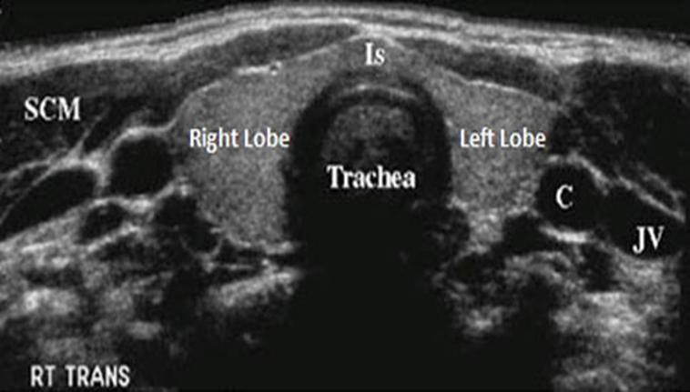
Ultrasound characteristics of thyroid nodules that increase suspicious of malignancy :
Taller than wide shape
Speculated margin
Microcalcifications
Marked hypo echogenicity
Increased vascularity

Slide 34
Fine needle aspiration FNA:
Safe and minimally invasive
Indicated for nodules > 1 cm or nodules with suspicious features of malignancy
US guided FNA

Slide 35
CT scan indications:
Recurrent disease
Lymph node metastasis
Vocal cord paralysis
Fixation of tumor to adjacent structures or skin
Huge goiter , retrosternal extension

Slide 36
Malignant Thyroid Lesions
1. Well Differentiated (85%)
Papillary Thyroid Carcinoma (PTC)
Follicular Thyroid Carcinoma (FTC)
Hurthle Cell Carcinoma (HCC)
2. Poor differentiated malignant neoplasms
- Medullary thyroid carcinoma (MTC)
- Anaplastic thyroid carcinoma (ATC)
3. Other malignant tumors:
- Lymphoma
- Metastatic tumors

Slide 37
Treatment :
Observation
FU
Thyroidectomy :
Malignancy or Suspicious for malignancy
Compression symptoms
Cosmetic
Graves disease
Toxic nodule

Slide 38
Post op complications :
RLN Injury
Hypocalcemia
Hematoma

Slide 39
Salivary gland tumors:
Pleomorphic adenoma is the most common benign tumor of salivary gland
It can arise from parotid, submandibular or minor salivary glands
Slow growing , usually seen in the third or fourth decade , with propensity to females
Encapsulated, Pseudopods

Slide 40
Salivary gland tumors:
Mucoepidermoid carcinoma is the most common malignant tumor of salivary gland
Can invade the facial nerve
Slow growing
Low grade and high grade
Surgical excision

Slide 41
Congenital masses

Slide 42
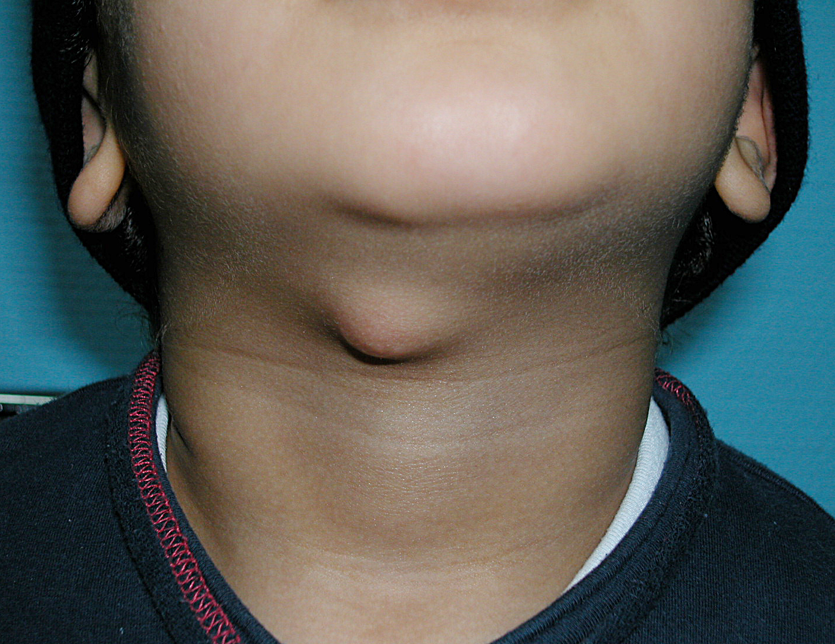
Thyroglossal duct cyst:
Cystic midline swelling
Affecting young children but can occur at any age
Increases in size with URTI
+_ sinus

Slide 43
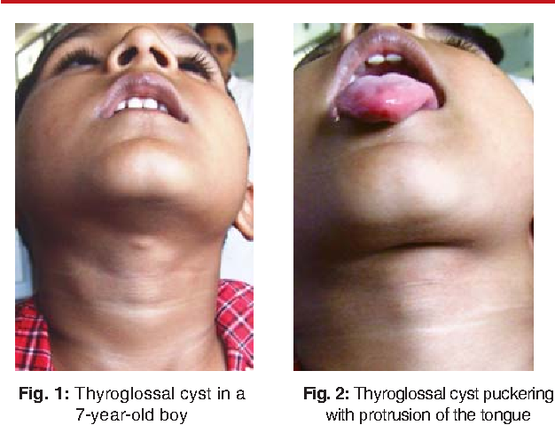
Thyroglossal duct cyst:
Moves with tongue protrusion because of its attachment to foramen cecum
It may contain the only functioning thyroid tissue
Rarely malignant <1%
Investigations :Ultrasound

Slide 44
Thyroglossal duct cyst:

Slide 45
Thyroglossal duct cyst:
Treatment :
Surgical excision including the body of hyoid bone and core of tongue tissue to prevent recurrence ( Sistrunk’s procedure)

Slide 46
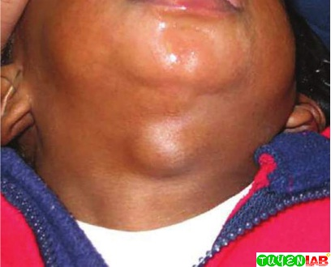
Dermoid/epidermoid cyst :
Cystic mass resulting from congenital epithelial inclusion or rest
Epidermoid : epithelial elements only, fluid content
Dermoid : epithelial elements plus dermal substructure ( hair, sebaceous glands)
Typically seen in the midline of the neck , usually in the submental region
Treatment is complete surgical excision

Slide 47
Branchial cyst :
Common in the second decade of life
Swelling in the upper part of the neck anterior to SCM
Anomalies of second branchial arch are the most common
May be associated with a sinus or a fistula

Slide 48
Branchial cyst :
A second arch branchial sinus has an external opening at the junction of the lower and middle third of the anterior border of SCM and may excrete mucoid discharge , it may have internal opening in the tonsillar fossa
Treatment is surgical excision along with its tract , if present

Slide 49
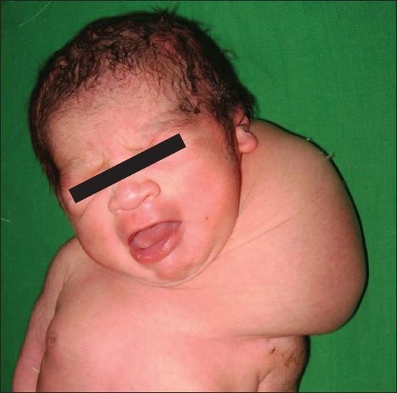
Cystic hygroma :
It occurs most commonly in the posterior triangle of the neck
It arises from obstruction or sequestration of jugular lymph sac
Seen in neonate, early infancy or childhood
May cause difficulty in labor
Soft, cystic and partially compressible
Treatment is surgical excision

Slide 50
Vascular masses

Slide 51
Hemangioma :
Congenital hemangioma present at birth
Infantile hemangioma start to appear in the first 4 weeks of life, early rapid growth, plateau then involution
GLUT-1
Markers of hemangioma proliferation : VEGF, urinary beta-fibroblast growth factor,urinary matrix mettaloprotinease MMP
MRI
Management : observation , surgical excision,laser, propranolol

Slide 52
In conclusion
Neck masses are common and most often due to lymphadenopathy secondary to self-limited infection or inflammation
A basic knowledge of neck anatomy is required
Thorough history and physical examination usually suggests a diagnosis
Appropriate investigation should be performed by specialist and managed accordingly

Slide 53
Thank you

