Slide 1
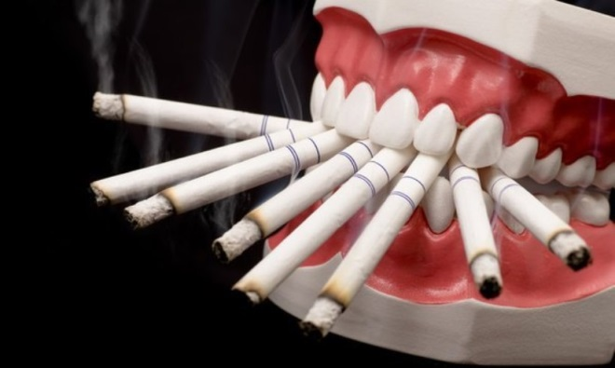
Head and Neck 2 Pre malignant and malignant oral cavity lesions
Dr. Manal Bin Manie
Assistant Professor – ORL H&N surgery
King Saud University

Slide 2
Objectives
Pre malignant lesions : submucous fibrosis and leukoplakia
Oral cavity cancer

Slide 3
Oral submucous fibrosis (OSMF)
OSMF is a high risk precancerous condition that predominantly occurs among Indians
Factors implicated in the pathogenesis of sub mucous fibrosis:
Chilly consumption
betel-nut chewing
Genetic predisposition

Slide 5
Oral submucous fibrosis (OSMF)
OSMF is a chronic mucosal condition affecting any part of the oral mucosa.
Mucosal rigidity of varying intensity due to fibroelastic transformation of the juxtaepithelial connective tissue layer.
The presence of palpable fibrous bands is a diagnostic criterion for submucous fibrosis.

Slide 6
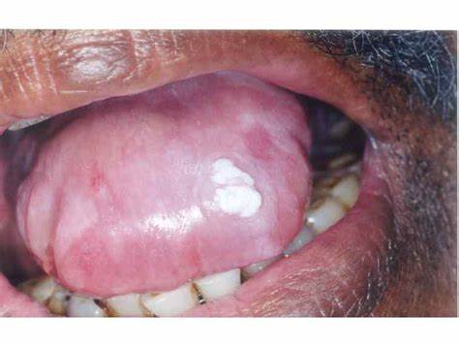
Oral submucous fibrosis (OSMF)
When the tongue is affected, it is devoid of papillae and its mobility, especially the protrusion, is impaired
The opening of the mouth is restricted
In severe OSMF, the patient cannot protrude the tongue beyond the incisal edges and there is a progressive closure of the oral opening

Slide 7
Oral submucous fibrosis (OSMF)
The most serious aspect of this disease is the high risk for the development of oral cancer
The epithelium is atrophic in this condition which renders it susceptible to the action of carcinogens

Slide 8
Oral submucous fibrosis (OSMF)
Treatment :
Some temporary relief from the symptoms and improvement in the oral opening with medicinal treatment such as local injections of cortisone
It is essential to follow-up the patients regularly.
Patient education to discontinue the use of betel nut and tobacco in any form.

Slide 9
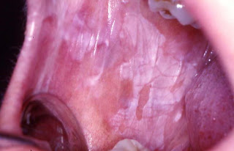
Leukoplakia
Leukoplakia is the most common premalignant or "potentially malignant" lesion of the oral mucosa
It is a predominantly white lesion of the oral mucosa

Slide 10
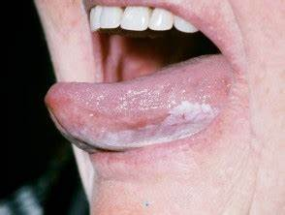
Leukoplakia
In general the reported prevalence ranges from 0.2 to 5%
It is seen most frequently in middle-aged and older men.
Men are more affected in some countries

Slide 11
Leukoplakia
Clinical presentation
Leukoplakia can be either solitary or multiple
It may appear on any site of the oral cavity
the most common sites being: buccal mucosa, alveolar mucosa, floor of the mouth, tongue, lips and palate

Slide 12
Leukoplakia
Classically two clinical types of leukoplakia are recognized
Homogeneous leukoplakia is defined as a predominantly white lesion of uniform flat and thin appearance that may exhibit shallow cracks. This type is usually asymptomatic.
Non-homogeneous leukoplakia has been defined as a predominant white or white-and red lesion ("erythroplakia") that may be either irregularly flat, nodular ("speckled leukoplakia) or exophytic ("exophytic or verrucous)

Slide 13
Homogenous
Non homogenous

Slide 14
Leukoplakia
Risk factors:
Smoking
Alcohol
Inadequate diet, Vitamin deficiency (e.g. vitamin A and C),
areca nut (betel)
Chronic traumatic irritation
Poor oral hygiene
Poor socio-economic status.

Slide 15
Leukoplakia
Treatment:
risk of malignant transformation is not completely eliminated by any of the current therapies.
Initial treatment of a white oral lesion is the elimination of the possible aetiological factors.
Complete surgical removal (leaving free-lesion borders) is recommended in cases with epithelial dysplasia.
Apart from surgical excision, other treatment modalities available include cryosurgery, laser surgery, retinoids, beta-carotene, bleomycin, calcipotriol, photodynamic therapy.

Slide 16
Leukoplakia
Prognosis and complications
The malignant transformation rate of oral leukoplakia varies from 0 to 33%.
Regular check-up of these patients is essential, probably every 3, 6 and then 12 months, both in treated and untreated patients

Slide 17
Oral cancer

Slide 18
Oral cancer
Tobacco and alcohol have synergistic effect
Treatment of early oral cancer is surgery.
Locally advanced T3/4 are best treated with combined surgery and Radiotherapy.
High risk of second primary cancer

Slide 19
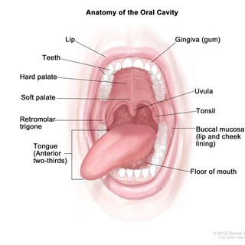
Oral cancer
The Oral cavity extends from vermilion border of lips to the plane between junction of the hard palate and soft palate.
Include: Lips and oral cavity(buccal mucosa,tongue, ginggiva, retromolar trigone, floor of mouth, hard palate)

Slide 20
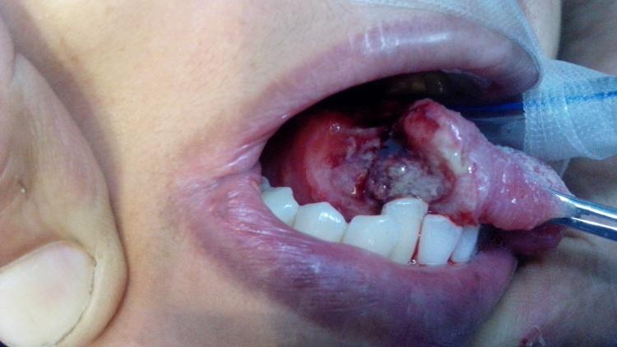

Slide 21
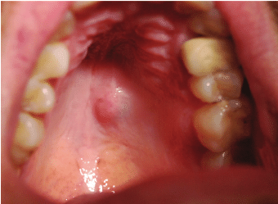

Slide 22
Risk factors
• Heavy tobacco
•Alcohol.
• Syphilis
• Viruses (EB, HSV, HPV, HIV)
• Neglect of oral dental hygiene(chronic
infection, unfit dentures)
• Lichen planus, Plummer Vinson syndrome
•Immunosuppression, malnutrition

Slide 23
Pathology
• 90% SCC:
Well/Moderate/Poorly/Undifferentiated
• Exophytic, Ulcerative, Infiltrative,verucous
• Other: Adeno Ca / from malignant minor salivary gland tumors, Melanoma, Sarcomas.
• Premalignant lesions:
Leucoplakia, hyperplasia, Erythroplakia, and dysplasia
• Regional Lymph node metastasis related to size and thickness
of primary tumor

Slide 24
Clinical presentation
•Non healing ulcers
•Induration
•Verucous/cauliflower
•Hot potato chewing
•Trismus
•Lnn enlargement

Slide 25
Diagnosis
• Clinical:
• History
Detail clinical examination (used head
lamp, mirror)
Bimanual palpation
• Cervical lymph node examination
• Endoscopy
• Biopsy
• Staging: CT/MRI/PET Scan

Slide 26
Treatment
Treatment Goals:
To eradicate of the primary tumor and LN metastasis
to maintain the function
cosmetic reconstruction.
Factors affecting choice of treatment:
Tumor factors
Patient factors
Resource factors

Slide 27
Surgery : Addressing the tumor , neck , reconstruction and secure the airway
Radiothrepy
Chemotherapy
Concomittant Radio+Chemotherapy
Palliative Chemotherapy for advanced diseases

Slide 28
Prognosis
• Location/thickness/depth of primary tumor
• Staging
• Type of histology
• Grading
• Presence of perineural spread
• Mandibular invasion
• Lymph node extention (Level, size, extracaps of meta)

Slide 29
Thank you

