Slide 1
The Pharynx
Dr. Manal Bin Manie
Assistant Professor – ORL H&N surgery
King Saud University

Slide 2
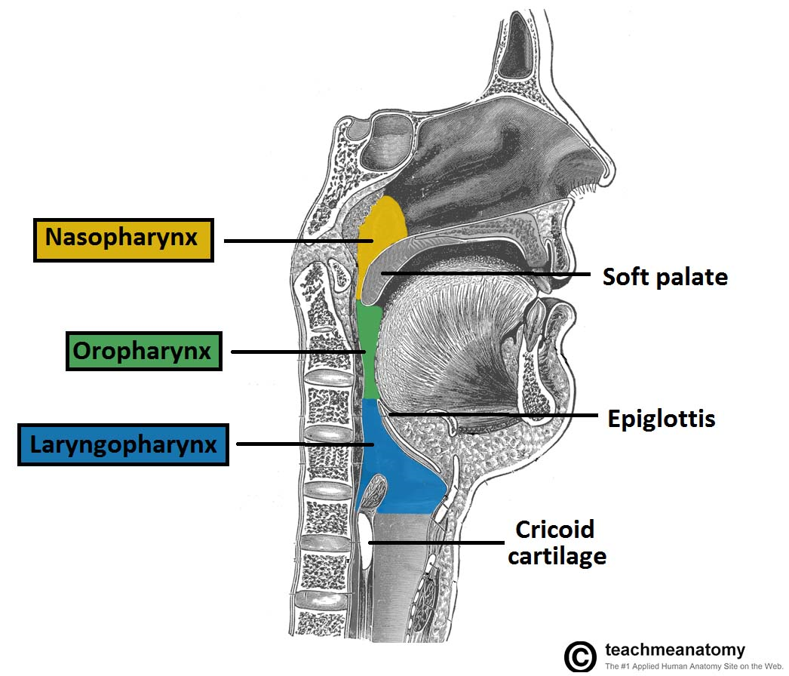
The pharynx
The pharynx divided into 3 anatomic regions:
Nasopharynx
Oropharynx
Hypopharynx

Slide 4
The pharynx
It is 12-14 cm long , extending from base of the skull (basiocciput and basisphenoid) to the lower border of cricoid cartilage where it becomes continuous with the esophagus.
The width of pharynx is 3.5 cm at its base and this narrows to 1.5 cm at pharyngo-esophageal junction which is narrowest part of digestive tract apart from the appendix.

Slide 5
The pharynx
Structure of Pharyngeal Wall
From within outwards it consists of four layers:
1-Mucous membrane
2-Pharyngeal aponeurosis
3- Muscular coat
4- Buccopharyngeal fascia

Slide 6
Waldeyer's Ring:
1-Adenoids
2-Palatine tonsil
3- Lingual tonsils
4-Tubal tonsils ( in fossa of Rosenmuller)
5- Lateral pharyngeal bands
6- Nodules ( in posterior pharyngeal wall)

Slide 7
Nasopharynx

Slide 8
Nasopharynx (Epipharynx):
It lies behind the nasal cavities and extends from the base of skull to the soft palate or the level of the horizontal plane passing through the hard palate
Roof: basisphenoid and basiocciput
Posterior: prevertebral muscles and fascia
Floor: soft palate
Anterior wall: posterior choanae
Lateral wall: ET

Slide 9
Nasopharynx
Opening of eustachian tube situated 1.25 cm behind the posterior end of inferior turbinate.
Above and behind the tubal elevation is a recess called fossa of Rosenmuller which is the commonest site for origin of carcinoma.

Slide 10
Nasopharynx
Nasopharyngeal Tonsil (Adenoids)
It is a subepithelial collection of lymphoid tissue.
It increases in size up to the age of six years and then gradually atrophies.

Slide 11
Nasopharynx
Epithelial Lining of Nasopharynx
It is lined by pseudostratified ciliated columnar epithelium.
Lymphatic drainage
Drain into upper deep cervical nodes either directly or indirectly through retropharyngeal and parapharygeal lymph nodes. They also drain into spinal accessory chain of the nodes in the posterior triangle of the neck

Slide 12
Nasopharyngeal Fibroma ( Juvenile Nasopharyngeal Angiofibroma):
It is a rare tumor, though it is the commonest of all benign tumors of nasopharynx.
The exact cause is unknown
Adolescent males

Slide 13
Nasopharyngeal Fibroma ( Juvenile Nasopharyngeal Angiofibroma):
Such patients have a hamartomatrous nidus of vascular tissue in the nasopharynx and this is activated to form angiofibroma when male sex hormone appears.
Site of Origin and Growth
Arise from the posterior part of nasal cavity close to the superior margin of sphenopalatine foramen.
Pathology
Made up of vascular and fibrous tissues
Mostly , the vessels are just endothelium-lined spaces with no muscle coat
Extensions of nasopharyngeal Fibroma
Benign
Locally invasive

Slide 14
Nasopharyngeal Fibroma ( Juvenile Nasopharyngeal Angiofibroma):
Clinical Features
1-Age and sex(10-20 years)
2-Profuse and recurrent epistaxis
3-Progressive nasal obstruction and denasal speech
4- Conduction hearing loss and serous otitis media
5-Mass in the nasopharynx
Depend on the extent of tumour

Slide 15
Nasopharyngeal Fibroma ( Juvenile Nasopharyngeal Angiofibroma):
Investigations
1-Soft tissue lateral film of nasopharynx
2-X-rays of paranasal sinuses and base of skull
3-CT scan of the head with contrast enhancement is now the investigation of choice
MRI
Carotid angiography
Biopsy Avoided

Slide 16
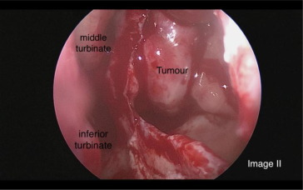
Nasopharyngeal Fibroma ( Juvenile Nasopharyngeal Angiofibroma):
Treatment
Surgical excision is now the treatment of choice
Endoscopic vs open approach
Pre op Embolization
Recurrence

Slide 17
Nasopharyngeal malignant tumors
Chinese
Epstein-Barr virus
Pathology
Squamous cell carcinoma
Lymphomas
Rhab-domyosarcoma, malignant mixed salivary tumour or malignant chordoma

Slide 18
Nasopharyngeal malignant tumors
Clinical Features
Nasal obstruction
Unilateral OME
Nearly all the cranial nerves may be involved
Jugular foramen syndrome
Cervical lymphadenopathy ( most common) (60-90%)
WHO Classification
These types have also been correlated to titres of Epstein-Barr(EB) virus and also to response to radiotherapy

Slide 19
Nasopharyngeal malignant tumors
Diagnosis :
Biopsy
CT scan with contrast
MRI , bone scan
TNM staging
Rx chemoradiation , salvage surgery

Slide 20
Oropharynx

Slide 21
Oropharynx
Applied Anatomy
Oropharynx extends from the plane of hard palate above to the plane of hyoid bone.
Boundaries of Oropharynx
It is related to retropharyngeal space and lies opposite the second and the upper part of the third cervical vertebrae.
a-Base of tounge, posterior to circumvallate papillae
b-Lingual tonsils

Slide 22
Oropharynx
Palatine tonsils are a collection of lymphoid tissue present in the submucosa of the oropharynx
Located in the tonsillar fossa , one on each side
Boundaries of the tonsillar fossa:
Anterior: palatoglossal arch
Posterior: palatopharyngeal arch
Inferior: dorsal surface of posterior 1/3rd of the tongue
Lateral: lateral wall of the oropharynx(superior constrictor muscle)

Slide 23
Palatine tonsils
Blood Supply
1-tonsillar artery a branch of the facial artery
2-external carotid
3-lingual artery
4- maxillary artery
Lymphatic drainage: jugulodigastric lymph nodes

Slide 24
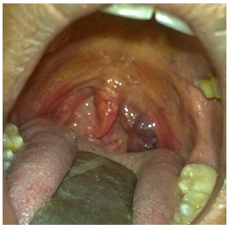
Benign tumors of the Oropharynx:
Papilloma: It is usually pedunculated, arises from the tonsil, soft palate or faucial pillars.
Hemangioma
Pleomorphic Adenoma

Slide 25
DDx of midline lingual mass :
Thyroglossal duct cyst
Lingual thyroid

Slide 26
Malignant Tumors
The common sites of malignancy in the oropharynx are:
1-Posterior one third (or base) of tongue
2-Tonsil and tonsillar fossa
3-Faucial palatine arch, soft palate and anterior pillar
4-Posterior and lateral pharyngeal wall

Slide 27
Subsites in the oropharynx
- Base of tongue
- Tonsil, tonsillar fossa
- Faucial arch
- Pharyngeal wall

Slide 28
Malignant Tumors
histologically , the tumor may be:
1-Squamous cell carcinoma( the most common )
2-Lymphoepithclioma
3-Adenocarcinoma
4-Lymphomas

Slide 29
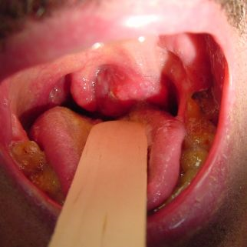
Malignant Tumors
Carcinoma Tonsil and Tonsillar Fossa
Squamous cell carcinoma is the most common and presents as an ulcerated lesion with necrotic base.
Lymphomas may present as unilateral tonsillar enlargement with or without ulceration and may simulate indolent peritonsillar abscess

Slide 30
Malignant Tumors
Carcinoma of Posterior One-third or Base of Tongue
The lesion remains asymptomatic for long time and patient presents when metastases in cervical nodes
Earlier symptoms of sore-throat, feeling or lump in the throat and slight discomfort on swallowing referred pain in the ear, dysphagia, bleeding from the mouth, and the change in the quality of speech

Slide 31
Malignant Tumors
Diagnosis
Biopsy
CT scan with contrast
MRI
TNM staging
Treatment options:
Surgery
Chemotherapy
Radiotherapy
Combination

Slide 32
Hypopharynx

Slide 33
Hypopharynx
Lowest part of the pharynx
Superior limit: the plane passing from the body of hyoid bone to the posterior pharyngeal wall
Inferior limit: lower border of the cricoid cartilage
Subdivisions :
Pyriform sinus (fossa)
Post-cricoid region
Posterior pharyngeal wall

Slide 34
Hypopharynx
Functions of hypopharynx:
Common pathway for air and food
Provides a vocal tract for resonance of certain speech sounds
Helps in deglutition

Slide 35
Hypopharynx
Benign tumors of hypopharynx are uncommon
malignant tumors involves various subsites :
Pyriform sinus
Post-cricoid region
Posterior pharyngeal wall

Slide 36
Carcinoma of pyriform sinus
Constitutes 60 % of all hypopharyngeal cancer
Mostly affecting males above 40 years of age
Metastatic neck nodes may be the first presentation

Slide 37
Carcinoma of pyriform sinus

Slide 38
Carcinoma of post-cricoid region :
30% of hypopharyngeal cancer
Associated with Paterson-Brown-Kelly ( Plummer-Vinson) syndrome characterized by hypochromic microcytic anemia
Young female

Slide 39
Carcinoma of posterior pharyngeal wall :
Only 10% of hypopharyngeal cancer
Mostly seen in males above 50 years of age

Slide 40
Pharyngeal pouch :
Zenker’s diverticulum
Pulsion diverticulum where pharyngeal mucosa herniates through the Killian’s dehiscence
Killian’s dehiscence is a weak area between tow parts of the inferior constrictor

Slide 41
Pharyngeal pouch :
Cause is unknown
? Due to spasm of cricopharyngeal sphincter or its incoordinated contractions during the act of deglutition
It is usually seen after 60 years of age
CF:dysphagia , regurgitation of undigested food
Barium swallow
Rx excision of pouch and cricopharyngeal myotomy

Slide 42
Larynx

Slide 43
Recurrent respiratory papillomatosis

Slide 44
Glottic cancer

Slide 45
Thank you

