Slide 1
Pharynx
I&II
Dr. Manal Bukhari
King Saud University
Otolaryngology
Associated professor
consultant Phonosurgeon
King Saud University

Slide 2
The objectives
To know the basic pharynx anatomy and physiology.
To recognize assessment and management of common pharyngeal diseases, include ability to obtain patients’ history, perform comprehensive physical and mental status assessment, interprets findings
To know how to handle common pharyngeal emergencies.
To be aware of common pharyngeal operations.

Slide 3
Pharynx I
- anatomy of the pharynx and deep neck spaces (retro and parapharyngeal)
- physiology ( function of pharynx in brief)
- acute and chronic pharyngitis ( non-specific and specifec) e.g scarlet fever,
infectious monoliasis, fungal, Vincent angina, diphtheria
- Zenker diverticulation (in brief)
Pharynx II
- adenoid and tonsil diseases.
- complication of pharyngeal diseases (Quinsy, para and retropharyngeal,
Ludwig's angina) + Radiological illustrations)
adenotonsillectomy (indications, complication and management)

Slide 4
My child has snoring ,he is mouth breather.
I have sore throat every day.
I have fever sore throat , dysphagia, I can’t open my mouth.

Slide 5
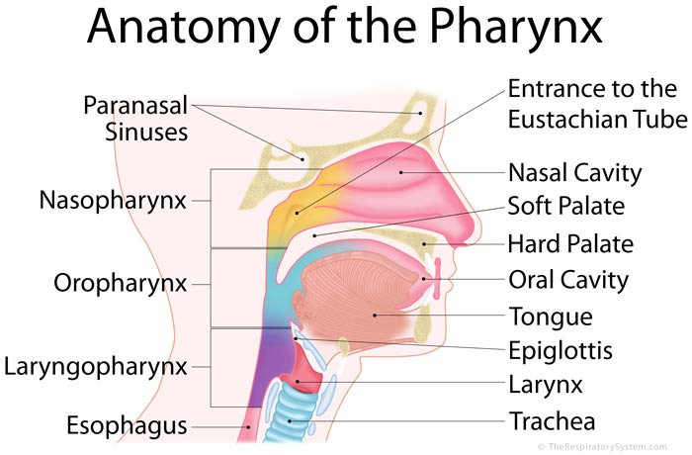
pharynx
It extend from the base of the skull to the level 6 cervical vertebra at the lower border of cricoid cartilage.
Funnel shaped,10 cm length

Slide 6
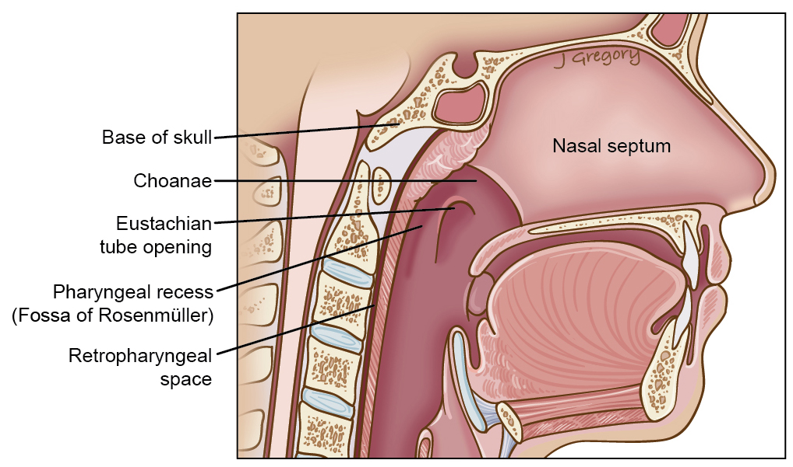
Parts of the pharynx:
1-Nasopharynx:
Open ant to the nose ,
Above: the base of skull
below: soft palate
Laterally :opening of the eustachain tube
torus tuberous
Pharyngeal recess (fossa of rosenmuller)
Adenoid
Nasopharyngeal isthmus

Slide 7
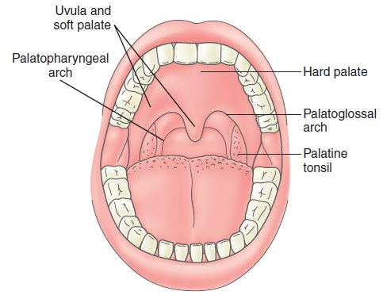
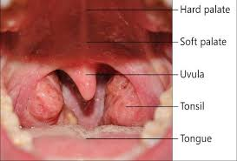
Oropharynx
Open ant to mouth.
Above: soft palate.
below : the upper border of epiglottis.
Palatine tonsils between the ant pillars and post pillars.

Slide 8
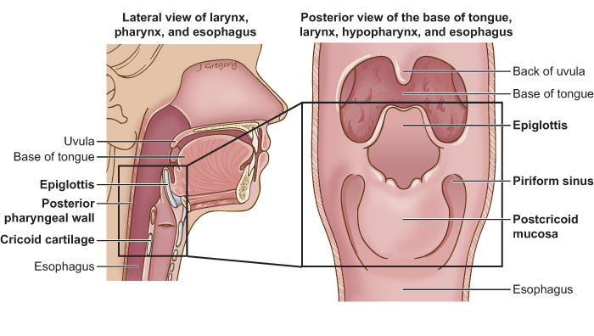
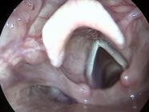
Laryngopharynx (hyoppharynx)
Open ant to the larynx
Above : the upper border of the epiglottis
Below :lower border of cricoid
Three parts:
Pyriform fossa
Posterior criocoid area
Posterior pharyngeal wall

Slide 9
Structure of the pharynx
Fibro muscular tub:
Four layers:
1-mucous membrane:
Ciliated epithelium
Stratified squamous epithelium
Transitional epithelium
Subepithelial lymphoid tissue of the pharynx( waldeyer’s ring)

Slide 10
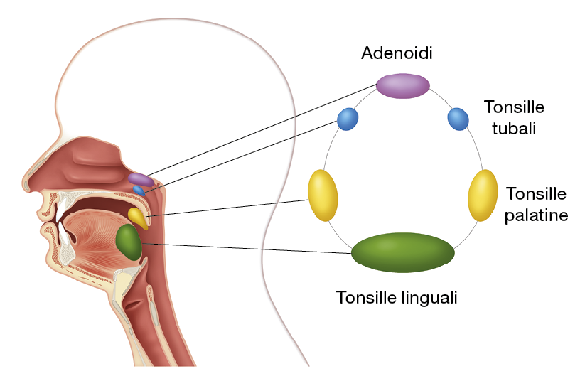

Slide 11
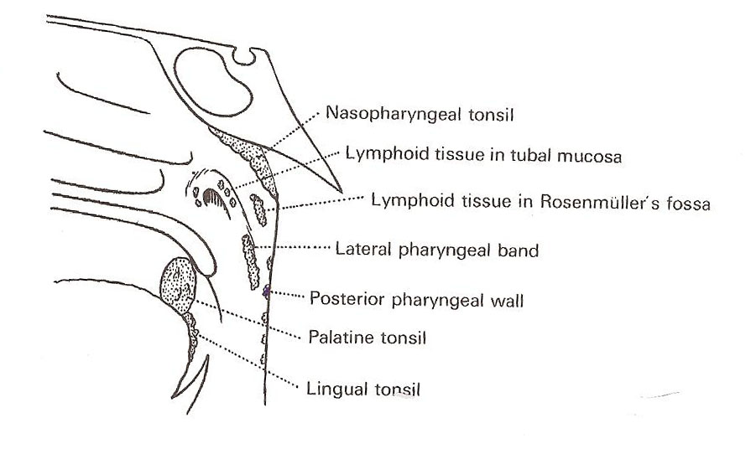
Adenoid
No capsule
Lingual tonsils
Tubal tonsils
Lateral pharyngeal bands
discrete nodules

Slide 12
Palatine tonsils
12-----15 crypt
The deep surface is separated from the constrictor muscles of the pharynx by connective tissue’ capsule’

Slide 13
Pharyngeal aponeurosis
Incomplete connective tissue coat in the lateral and posterior walls of the pharynx between the muscular layers
Pharyngobasilar fascia

Slide 14
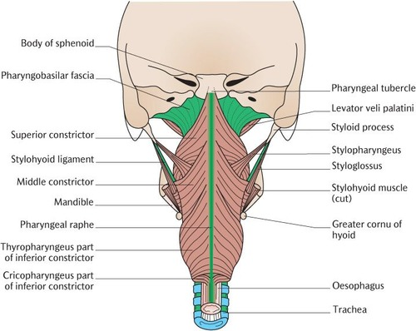

Slide 15
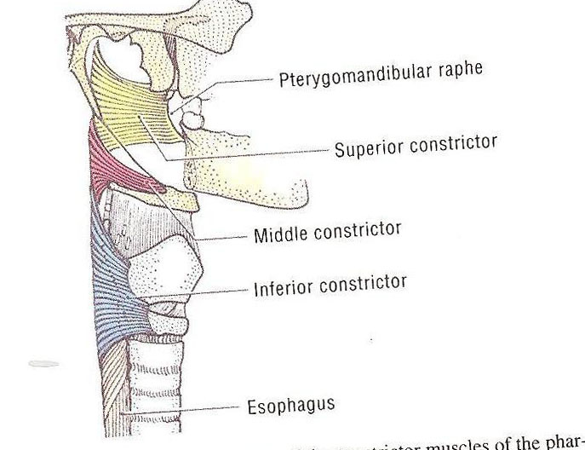
Muscular coat
External :
Three constrictor muscles:
Superior constrictor
arise from pterygoid , ptergomandibular ligament post end of mylohyoid fibers
Middle constrictor:
Arise from the hyoid bone and stylohyod ligament
Inferior constrictor:
Thyropharyngeus
Cricopharyngus
Killian’s dehiscence
Potential gap between the thyropharyngus and cricopharyngus

Slide 16
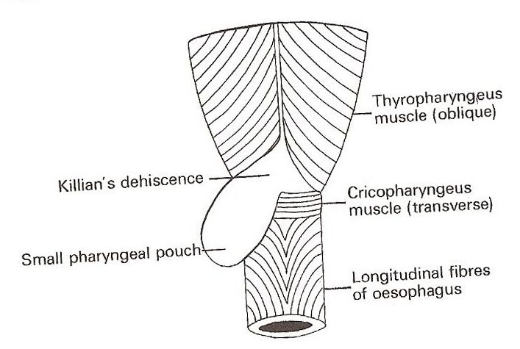
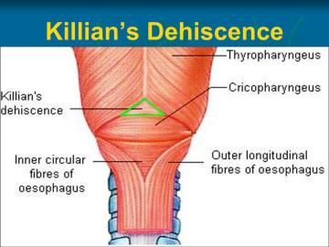

Slide 17
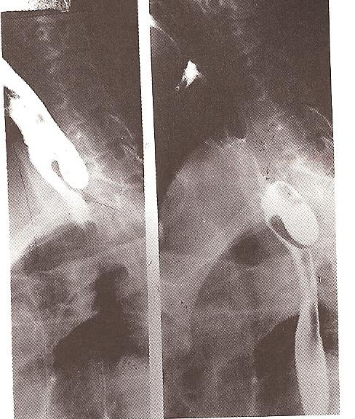

Slide 18
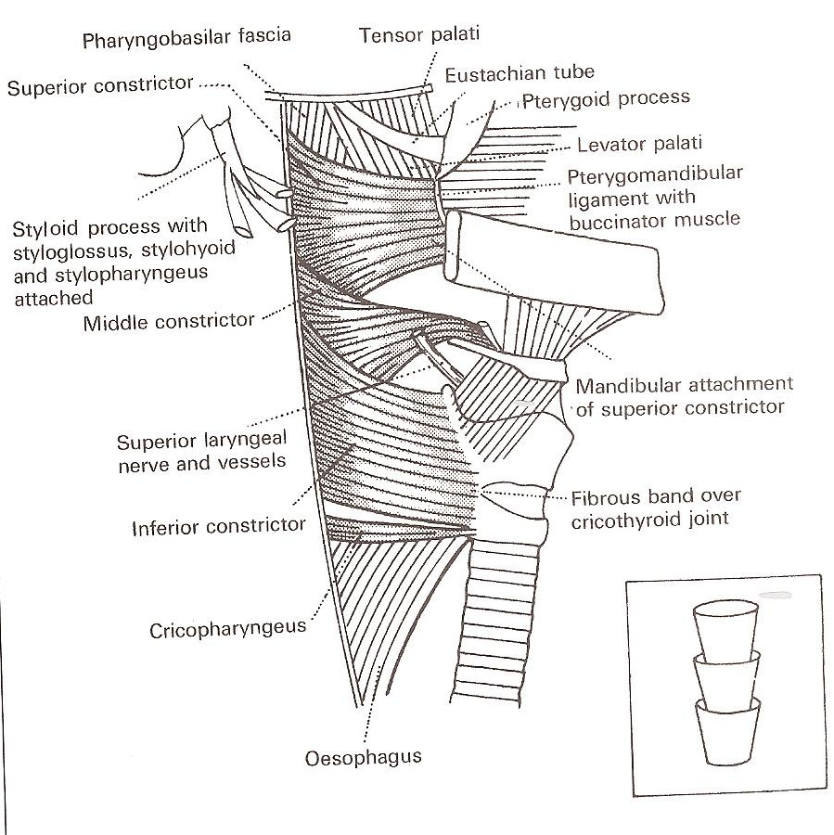
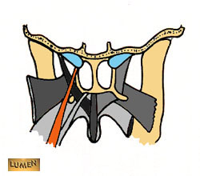
Internal:
Three muscles:
Stylopharyngus
Salpingopharyngus
palatopharyngus

Slide 19
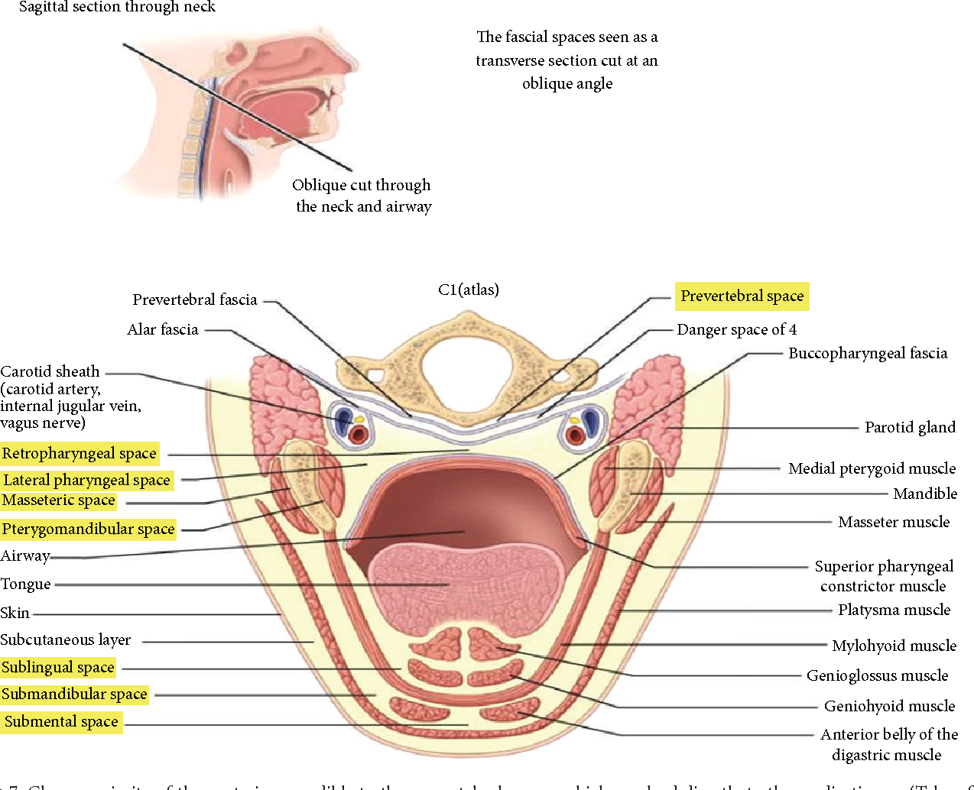
Buccopharyngeal fascia

Slide 20
Relation of the pharynx
Posteriorly :
prevertebral fascia
Anteriorly:
Parapharyngeal space

Slide 21
Parapharyngeal space
Potential space lies out side the pharynx
Triangular in cross section , it extend from the base of the skull above to the sup mediastinum and apex of hyoid bone
Anteromedial wall: buccopharyngeal fascia
Posteromedial wall : cervical vertebrae, prevertebral muscle and fascia
Lateral wall: (up) the mandible ,tergoid muscle, pparotid gland
(Lower) sternomastoid muscle
Compartment :
prestyloid:
internal maxillary artery, fat,inferior alveolar ,lingual, and auricultemporal nerves.
Poststyloid:
neurovascular bundle (carotid artery,, internal jugular vein, sympathatic chain ,CN IX,X and,XI

Slide 22
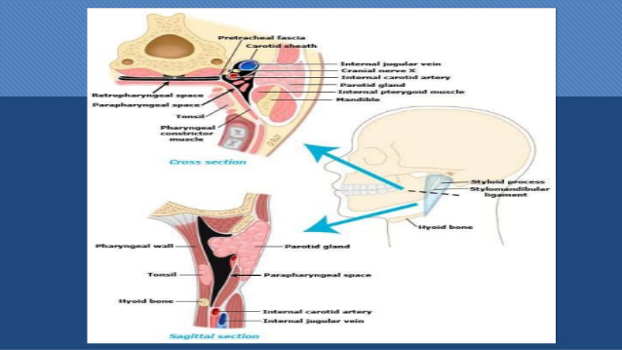

Slide 23
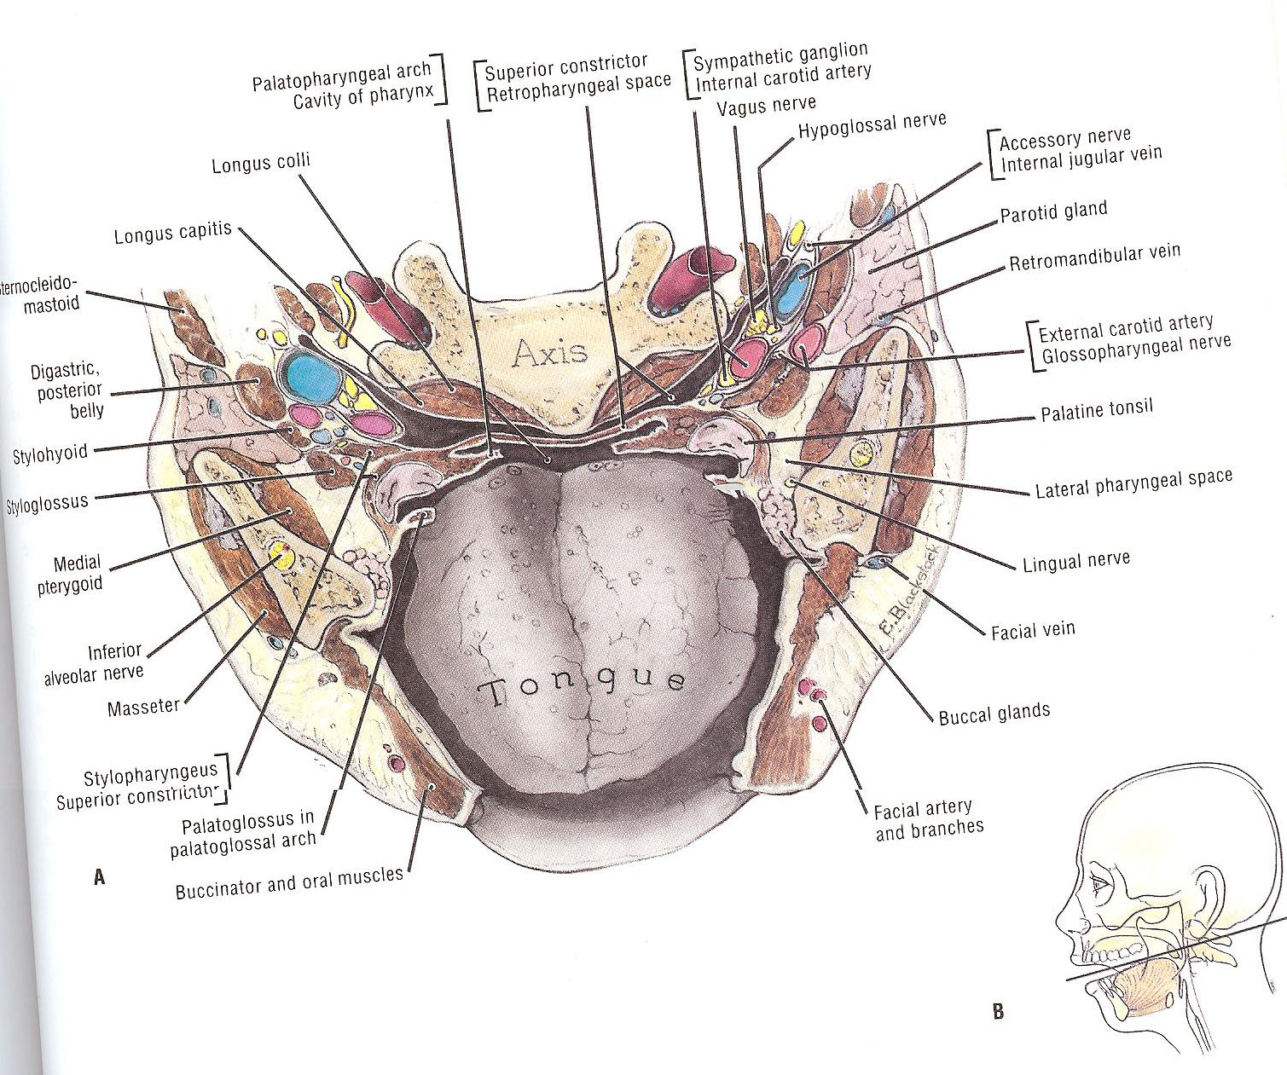
Retropharyngeal space :
It extend from the base of skull to supr mediastinum
Lies behind the pharynx
Ant: posterior pharyngeal wall and its covering buccopharyngeal fascia
Post: cervical vertebrae and muscles and fascia
Contents :
Reteropharyngeal lymph nodes

Slide 24
physiology
Functions of the sub epithelial lymphoid tissue:
Protective functions :
Formation of lymphocytes
Formation of antibodies
Acquisition of immunity
Localization of infection
Salivation:

Slide 25
Deglutition:
Three stages
Oral stage: voluntary,closure of mouth,cessation of respiration ,rasing of larynx ,sudden elevation of the tongue,press the tongue against the palate, and pushes it backwards towards the oropharynx
Pharyngeal stage :reflux, contraction of nasopharynx sphincter, larynx rises more, laryngeal inlet closure , epiglottis diverts the food into cricopharyngeal sphincter ,contraction of constrictor muscles ,relaxed cricopharyngeal sphincter

Slide 26
Respiration
Speech
Resonating cavity
Articulation
Taste:
taste buds

Slide 27
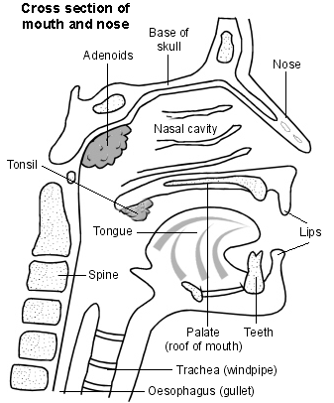
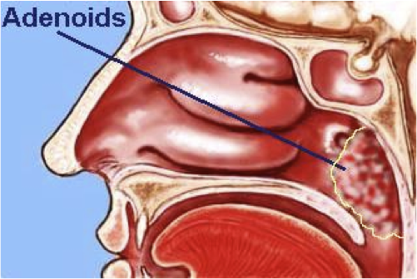
Adenoid
A hypertrophy of the nasopharyngeal tonsil to produce symptoms , most commonly between the age of 3---7 years
Pathological types:
1- simple inflammatory
2- tuberculosis
Clinical features:
Mouth breathing , snoring ,hyopnasality , adenoid face, nasal discharge
Eustchain tube obstruction
Diagnosis :
x ray
flexible fiberoptic
Treatment:
conservative
Surgical: adenoidectomy

Slide 28
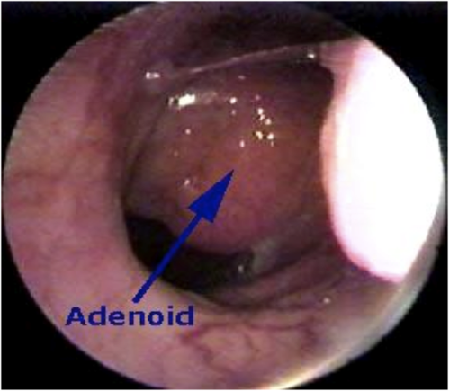
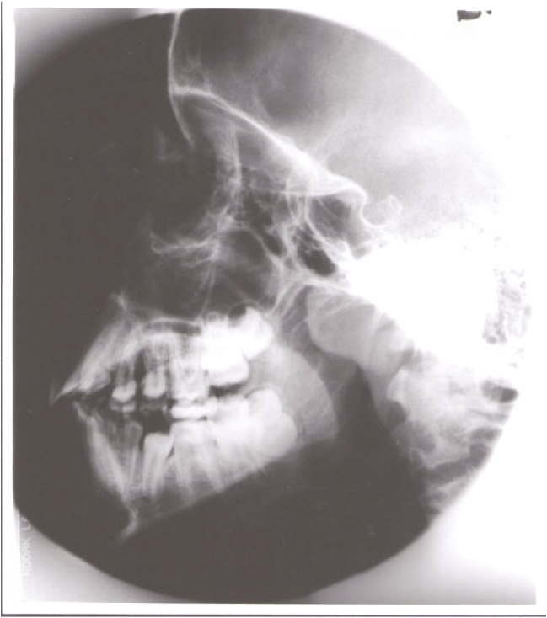
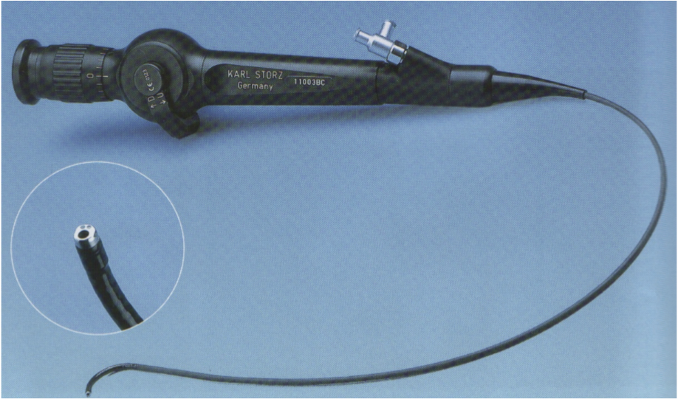

Slide 29
Sleep apnea and snoring
Snoring is a sign of partial obstruction of the upper airway during sleep
Snoring is always present during type of sleep apnea
Sleep apnea:
Cessation of airflow at the mouth and nostrils lasting 10 seconds for at least 30 apnoeioc episodes
Types :
central sleep apnea:
Failure of respiratory drive from the brain
Obstructive sleep apnea (OSA)
Due to anatomical narrowing of the upper airway
Mixed

Slide 30
Stage of sleep
Slow wave sleep :
Brain waves are slow deep restful sleep decrease in vascular tone and respiratory rate and basal metabolic rate
Rapid eye movement :
Brain quite active active dream
pathophysiology of OSA:
During REM or deep sleep ,obstructive occurs resulting in decrease arterial oxygen and increased arterial carbon dioxide pressure
Nocturnal desaturation arouses patient and causes increase pulmonary artery, systemic arterial pressure
lead to hypersomnolence

Slide 31
Investigation
Sleep study:
EEG,EKG,EOG,pulse oximeter, respiration rate , nasal and oral air flow
Treatment:
Nonsurgical :
behavior modification :
medical treatment
CPAP
Surgical :
UPPP

Slide 32


Slide 33
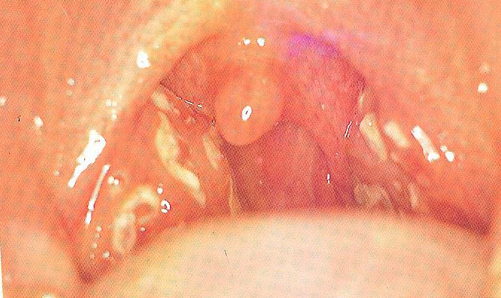
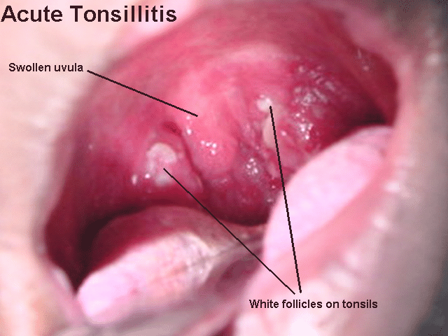
Acute infection of oropharynx
Acute tonsillitis:
Causes: viral fellow by bacterial (group AB-hemolytic streptococcus , moraxella, H. influenza, bacteroides
SSX: fever ,sore throat odynophagia trismus, halitosis
Phases: erythema,exudative ,follicular tonsillitis
Complication:
peritonsillar abscess parapharyngeal or retropharyngeal abscess , rheumatic fever ,glomerulonephritis
Rx:
ABX, bed rest ,hydration , analgesia

Slide 34
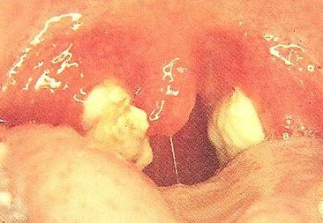
Infectious mononucleosis
Pathogen: Epstein barr virus
SSX: fever, lymphadenopath malaise, exudative tonsilitis, hepatosplenomegaly
DX: monosopt test ,paul bunnel test (heterophil antibodies in serum)
80% mononuclear and 10% atypical lymphocytes on smear
Complication: cranial nerves involvement ,meningitis ,autoimmune hemolytic anemia , splenic rapture
RX: hydration, analgesia oral hygiene

Slide 35
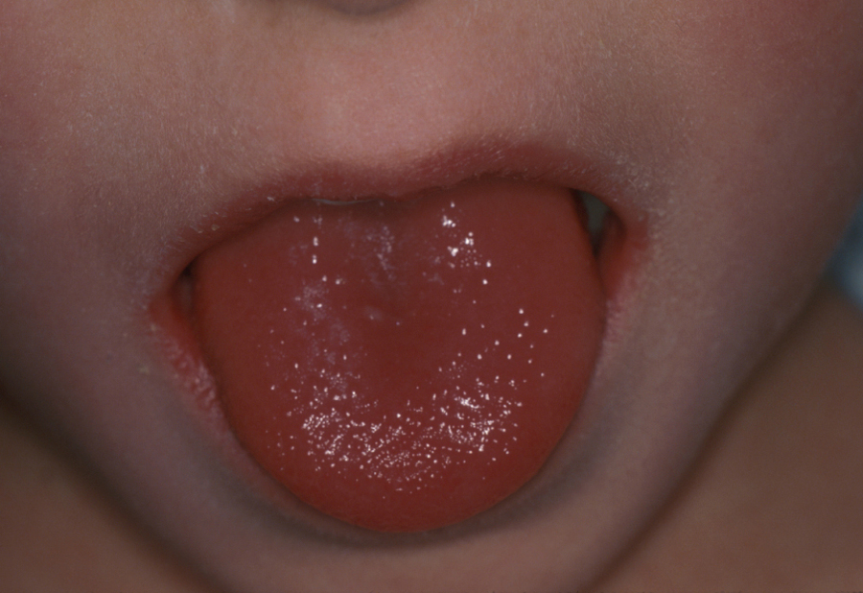

Scarlet fever
Endotoxin produced by by type A B-hemolytic streptococcus
SSX:
red pharynx , strawberry tongue, perioral skin erythema and desquamation, dysphagaia ,malaise,sever cervical lymphodenopathy
DX
dick test
RX:
ABX

Slide 36
Diphtheria
Corynbeactrium diphtheria
SSX: sore throat, fever, green plaques friable membrane
DX: culture
Complication :nephritis, airway obstruction, death
RX: ABX, antitoxin
Vincen’ts angina:
Acute ulcerative lesion
Gram negative fusiform bacillus and a spirillum with anaerobic
SSX:
Sudden in onset,pain,fever, cervical adenitis, the base of the deep ulcers bleeds when the membranous slough is removed ,the symptoms subside in 4—7 days
RX: metronidazole, antiseptic , mouthwash

Slide 37
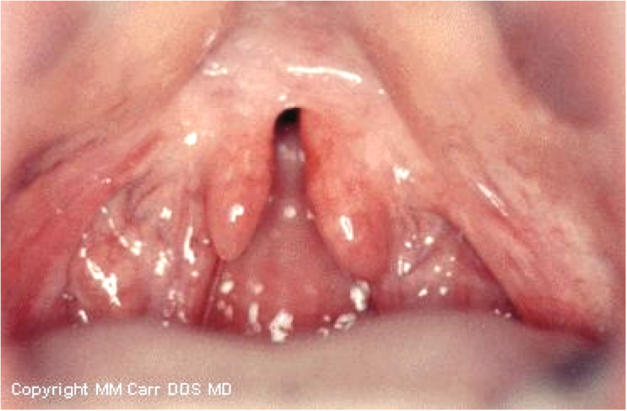
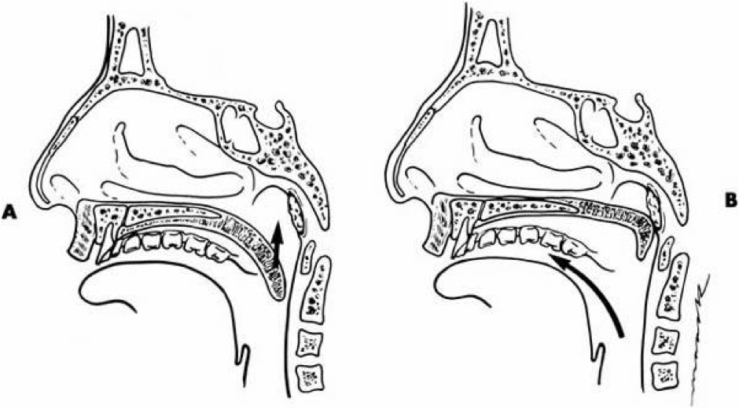

Slide 38


Slide 39
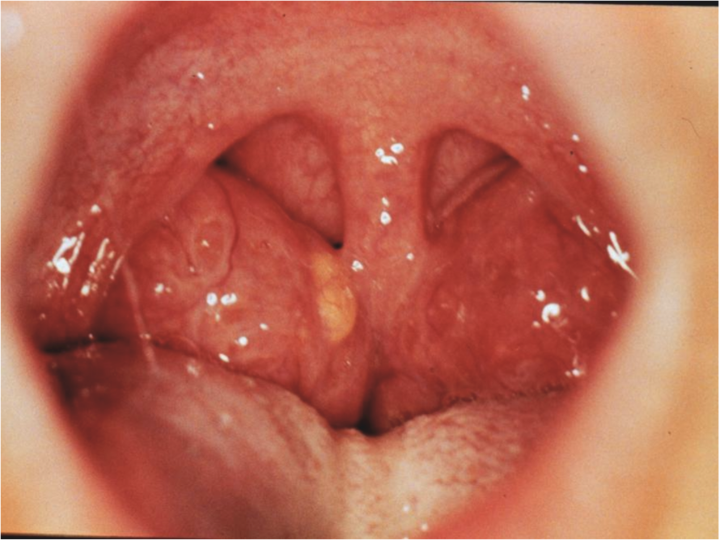
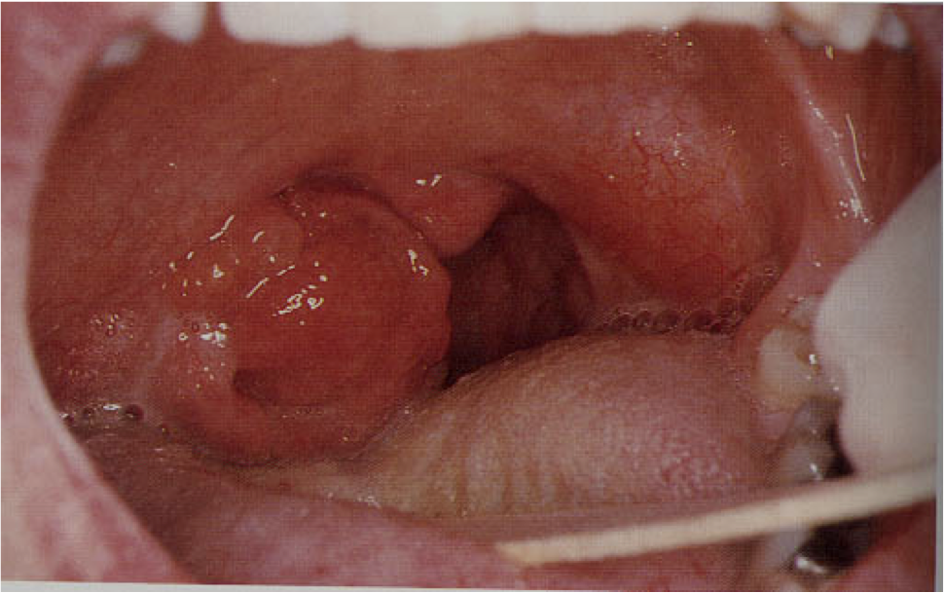

Slide 40
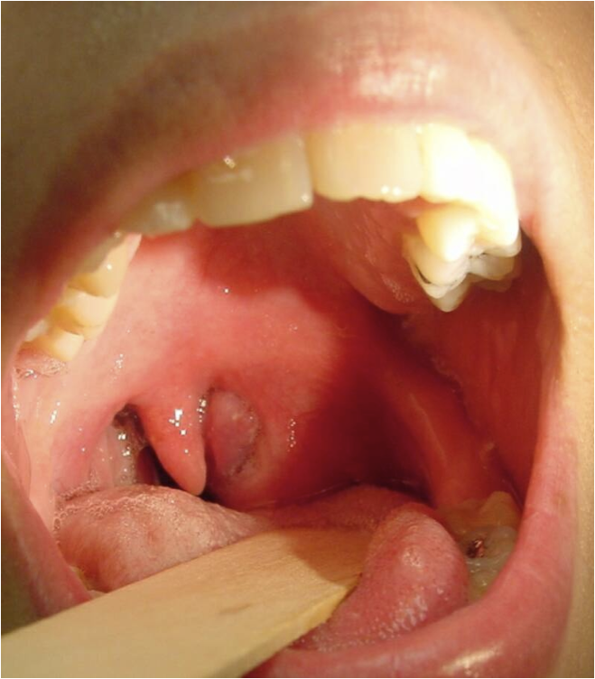

Slide 41
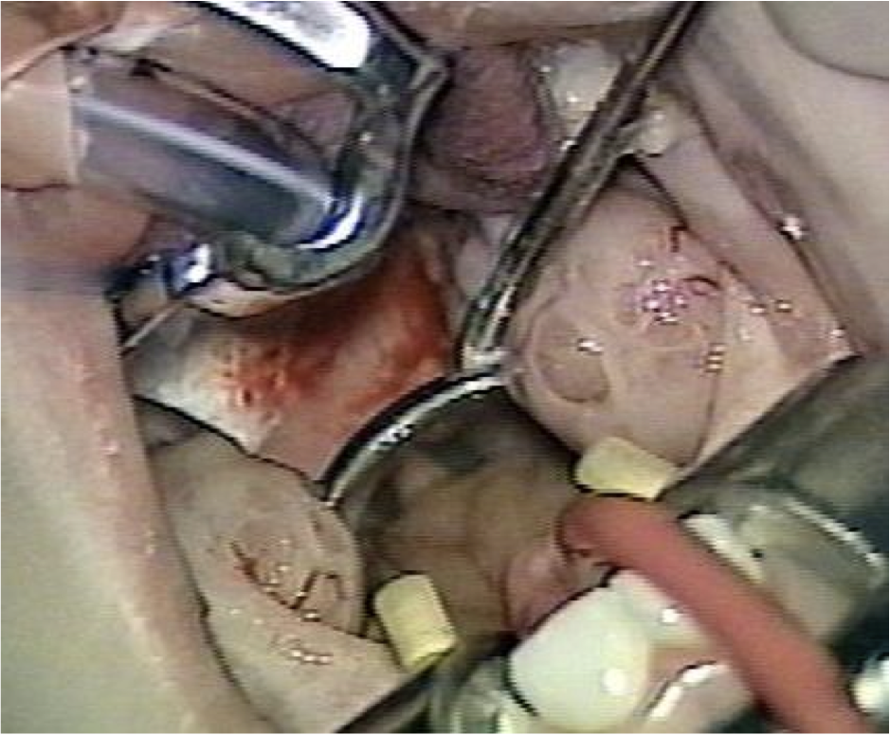
tonsillectomy

Slide 42
complication
Hemorrhage
  Primary
  Reactionary
  Secondary
Respiratory obstruction
Injury to near-by structures
Pulmonary and distant infections

Slide 43
Primary hemorrhage
Bleeding occurring during the surgery
Causes
  Bleeding tendency
  Acute infections
  Bad technique
Management
  General supportive measures
  Diathermy, ligature or stitches
  Packing

Slide 44
Reactionary hemorrhage
Bleeding occurring within the first 24 hours postoperative period
Causes
  Bleeding tendency
  Slipped ligature
Diagnosis
  Rising pulse & dropping blood pressure
  Rattle breathing
  Blood trickling from the mouth
  Frequent swallowing
  Examination

Slide 45
Treatment
  General supportive measures
  Take patient back to OR
  Control like reactionary hemorrhage

Slide 46
Secondary hemorrhage
Occur 5-10 days posoperatively
Due to infection
Treated by antibiotics
May need diathermy or packing

Slide 47
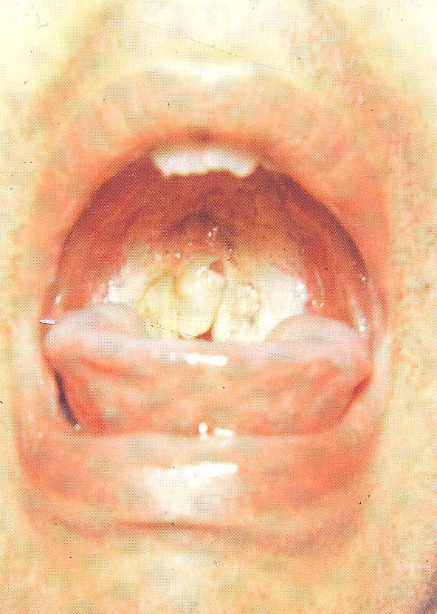

Slide 48
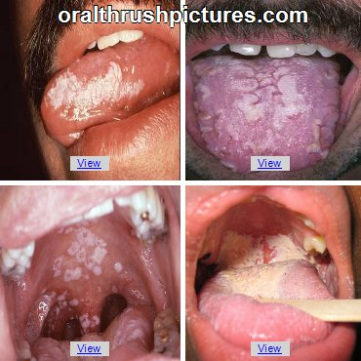
monoliasis
White patches caused by candidaalbicans fungus
RX: nystatin

Slide 49
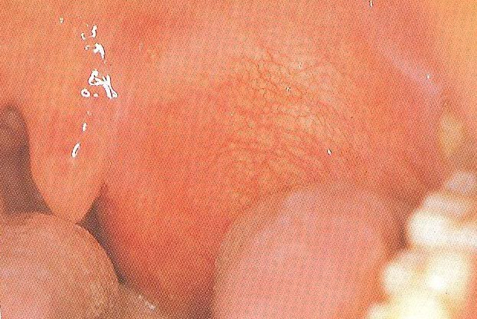
Peritonsillar abscess (quinsy):
An abscess between the tonsil capsule and the adjacent lateral pharyngeal wall
SSX: fever, otalgeia odynophagia, uvular deviation, trismus ,drooling of saliva
Complication:
Para and retrpharyngeal abscess, aspiration pneumonia
Rx:
I&D
aspiration
Iv ABX

Slide 50
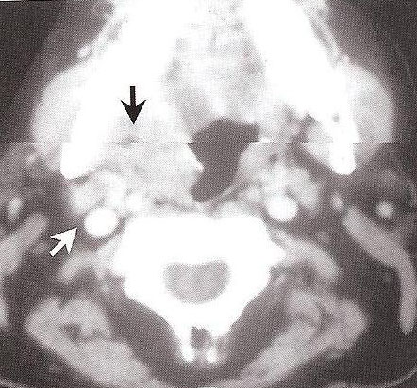
Parapharyngeal abscess
Source of the infection: odontogenic ,tonsils, , parotid
SSX:
trismus, fever, muffled voices , intraoral bulge
Complication:
aspiration,cranial nerve palsy, airway compromise, septic hrombophlepitis, carotid blowout
,endocarditis
RX:
external drainage, iv ABX ,airway management

Slide 51
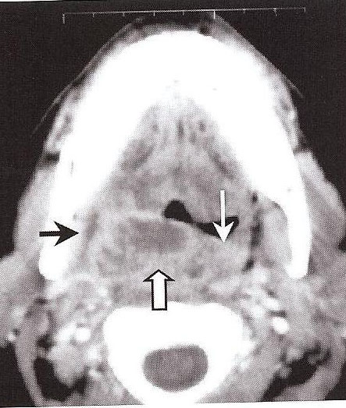
Retropharyngeal abscess
More common in children
SSX: odynophagia ,hot potato voice, drooling ,stiff neck fever ,stridor
Complication :mediastnitis , respiratry distress, rupture abscess,
RX: drainge , IV ABX

Slide 52
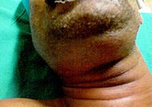
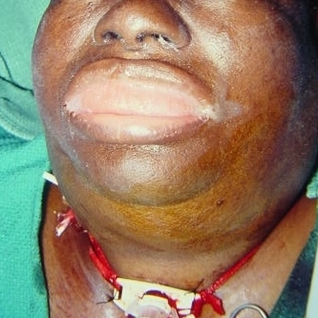
Ludwig’s angina
Bilateral cellulitis of submandibular and sublingual spaces
SSX:
wooden floor of the mouth , neck swelling and indurations , drooling , respiratory distress ,swollen tongue ,dysphagia trismus ,
Complication:
airway distress , sepesis
RX:
tracheotomy ,external drainge IV ABX

Slide 53
Chronic pharyngitis
Pathogenesis :
postnasal drip, irritant ( dust. Dry heat, smoking, alcohol),reflux esophagitis chronic mouth breathing ,allergy granulomatoues disease connective tissue disease , malignancy
SSX:
constant mouth clearing , dry throat pharyngeal crusting, thick granular wall
RX:
address underlying etiology

Slide 54
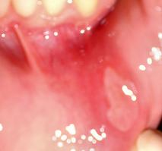
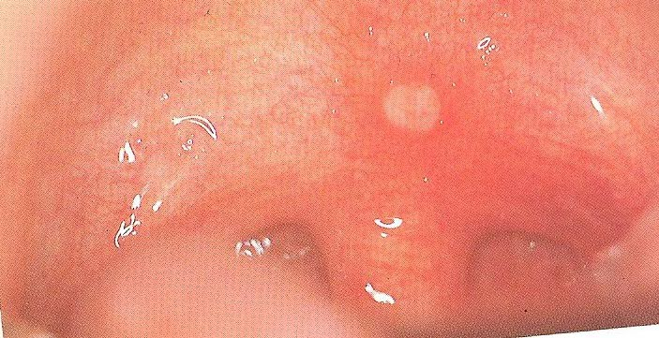
Aphthous ulcer

Slide 55
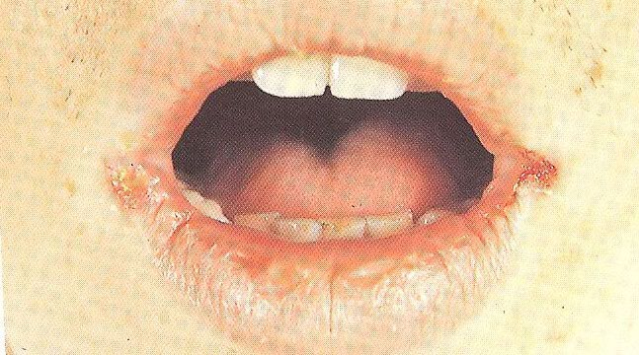

Slide 56
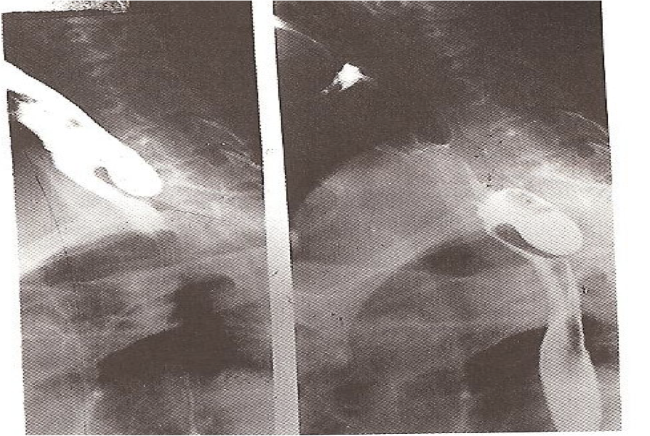
zanker’s diverticulum
Herniation of the mucosa at killian’s triangle due to increase intraluminal pressure
SSX:
dysphagia, regurgitation of undigested food aspiration
DX: barium swallow
RX:
Cricopharyngeal myotomy.
Diverticulectomy

Slide 57
THANK YOU

