Slide 1
UPPER AIRWAY OBSTRUCTION
Dr. manal bin manie
Assistant professor ORL H&N Surgery

Slide 2
Anatomy

Slide 3
Anatomy

Slide 4
Anatomy

Slide 6
Anatomy in pediatric
Soft tissue - are less adherent to the
underlying cartilage
- susceptible to collapse
- less resistant to develop
submucosal edema
Omega shape Epiglottis
Subglottis is the narrowest part of AW in children.
In adults glottis is the narrowest.

Slide 7
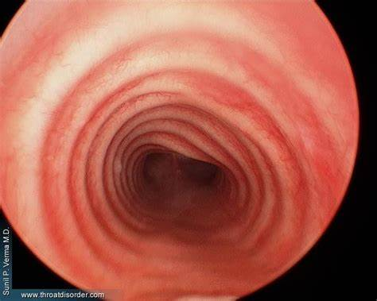
Anatomy of trachea
consists of 16 to 20 incomplete cartilaginous rings
the post wall is a membranous part
length is approximately 11 cm
Diameter 19 mm male
16 mm female

Slide 8
Anatomy of trachea
Pediatric trachea:
Diameter: At Birth 6 mm
6 mons 7.2 mm
1 year 7.8 mm
4 years 11 mm

Slide 9
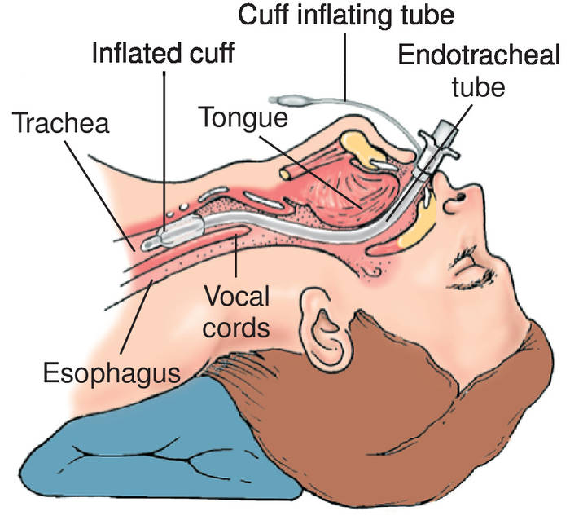
Endotracheal tube

Slide 10
Endotracheal tube
Uncuffed endotracheal tube

Slide 12
Signs of Airway Obstruction
- Stridor is harsh high pitched musical sound produced by turbulance of air flow through a partial obstruction of the AW - Stridor is a vary important sign of UAW obstruction It indicates - pathologic narrowing of AW - potential respiratory obstruction - even death

Slide 13
Signs of Airway Obstruction
Other signs of UAW obstruction
flaring of the nasal alae
retraction of the neck, intercostal and abdominal
muscles
Dyspnea
Tachypnea
Restlessness
Cyanosis
Subcutaneous emphysema

Slide 14
Diagnostic assessment HISTORY
Time of onset
Possible trauma
Characteristic of cry
Relation of airway problem to feeding, position
History of previous intubation
Questions about possible aspiration of FB

Slide 15
HISTORY
If stridor is present since birth:
* congenital laryngomalacia
* subglottic stenosis
* vocal cord paralysis
* vascular rings
If onset of stridor is gradual and progressing:
* subglottic hemangioma appear between 1-3 months of age
* papilloma of the larynx appear at 6 months of age

Slide 16
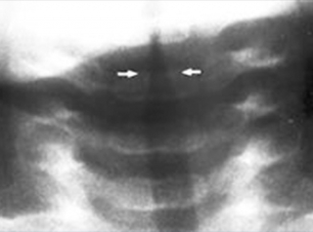
RADIOLOGIC EVALUATION
Indicated for patient without respiratory distress
* Plain views - soft tissue neck A.P. lateral
- chest
* Mobile pharyngeal tissue may bulge during
expiration in normal infants
* High-kilovoltage technique ( croup series) AP
view assesses subglottic region
* Flouroscopy: dynamic AW changes

Slide 17
RADIOLOGIC EVALUATION
* Barium swallow
- Assess - swallowing
- R/O - presence of vascular rings
* CT scan and MRI : good in evaluating mediastinum

Slide 18
Barium swallow

Slide 19
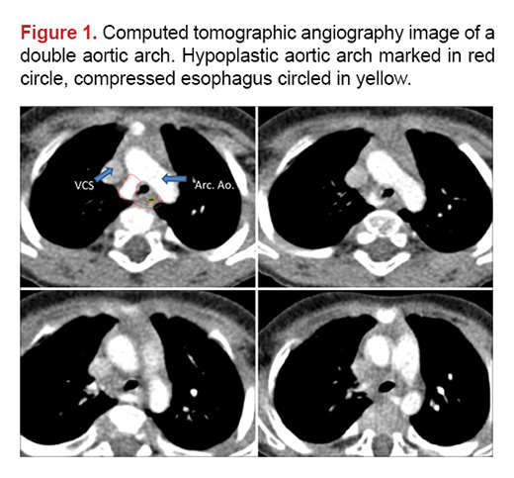

Slide 20
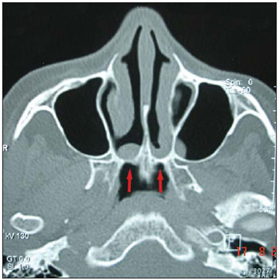
CT scan

Slide 21
ENDOSCOPIC EVALUATION
Mirror Examination: is not endoscopic.
In older children and adults can provide information about hypopharynx and larynx.
Telescopic Examination
* Fibroeptic Endoscopy - excellent to assess the movement of VC.
* Rigid bronchoscopy - done under GA
- may enable removal of FB
- assess the AW down to the main stem bronchi

Slide 22
Indirect laryngoscopy

Slide 23
Rigid endoscope

Slide 24
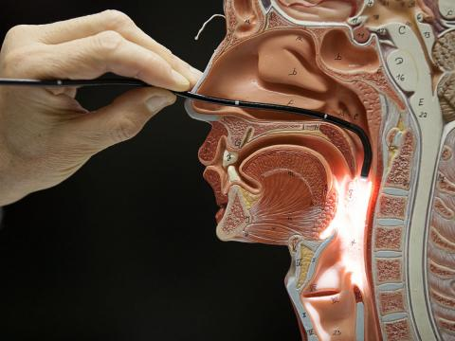
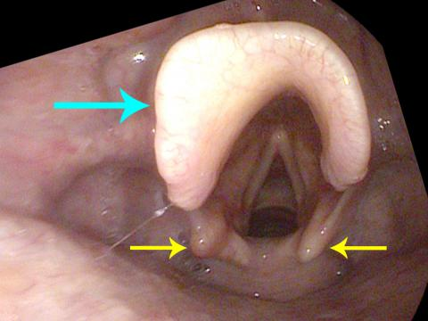
Flexible fiberoptic endoscope

Slide 25
Diagnostic assessment
ABG
- late indicator of airway obstruction
- should not be used routinely to assess degree of obstruction

Slide 26
THERAPEUTIC OPTIONS
1. Observation/Medical Support
a. ICU
b. Airway team availability
c. Oxygenation
d. Steroids
e. Antibiotics
2. Heimlich maneuver
3. N. P. Airway
4. Oral Airway
5. Esophageal airway
6. Transoral intubation

Slide 27
Therapeutic Options
7. Nasal intubation
8. Flexible fiberoptic intubation
9. Trans tracheal jet ventilation
10. Cricothyroidotomy
11. Tracheostomy

Slide 28
Surgical Techniques
1. Trans tracheal needle ventilation
- where immediate ventilation is required
- can support ventilation for several hours
- Technique
- 12, 14 or 16 gauge cannula
- high press ventilation system (50 p.s.I.)
attached

Slide 29
Surgical Techniques
- Complication
* failure to establish an AW
* misplaced catheter in soft tissue of the
neck (esp. in children)
- pneumo mediastinum
- pneumothorax
* total obstruction of the airway prevents
adequate ventilation *

