Slide 1
Therapeutic Options
7. Nasal intubation
8. Flexible fiberoptic intubation
9. Trans tracheal jet ventilation
10. Cricothyroidotomy
11. Tracheostomy

Slide 2
Surgical Techniques
1. Trans tracheal needle ventilation
- where immediate ventilation is required
- can support ventilation for several hours
- Technique
- 12, 14 or 16 gauge cannula
- high press ventilation system (50 p.s.I.)
attached

Slide 3
Surgical Techniques
- Complication
* failure to establish an AW
* misplaced catheter in soft tissue of the
neck (esp. in children)
- pneumo mediastinum
- pneumothorax
* total obstruction of the airway prevents
adequate ventilation *

Slide 4
Cont. Surgical Techniques
Cricothyroidotomy
Indications :
- generally for emergency upper airway obstruction.
(failed or contraindication intubation)
- elective for head and neck or
cardiovascular procedures
- where access to tracheal rings is limited

Slide 5
Cricothyroidotomy
- Procedure
- may utilize horizontal or vertical
incision
- use small trach. tube or
endotracheal tube
Complications
- injury of anterior jugular vein, great vessels
- injury of recurrent laryngeal nerve
- subglottic and laryngeal stenosis (especially in children)

Slide 6
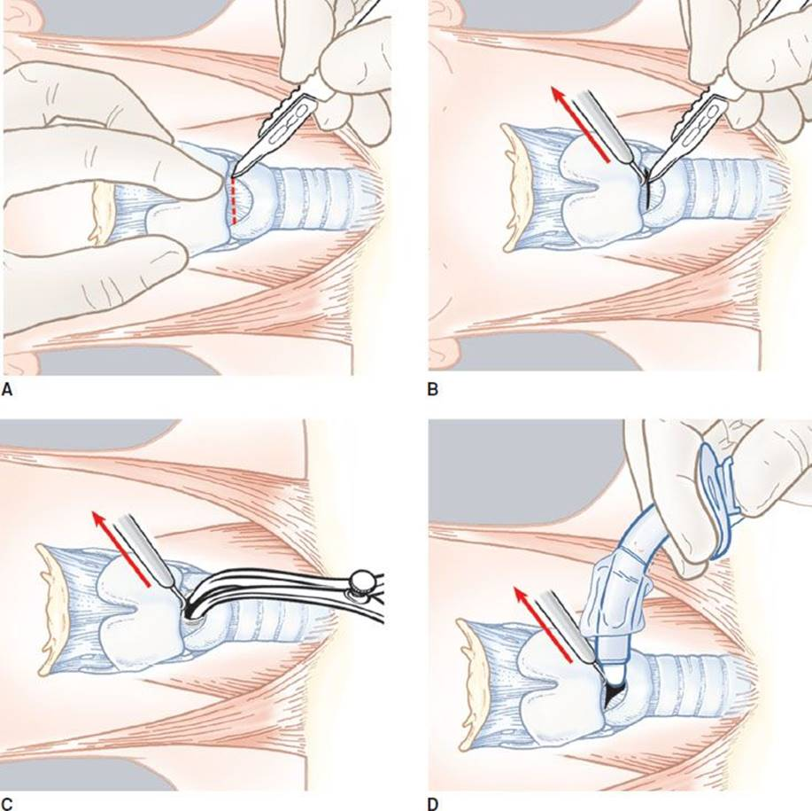
Cricothyroidotomy

Slide 7
Surgical Technique
4. Tracheostomy
for emergency or elective-airway obstruction
acute or chronic-airway obstruction
* in emergency tracheostomy
- vertical incision is preferred
- hemostasis after establishing airway
obstruction

Slide 8
Tracheostomy
Indications :
Prolonged mechanical ventilation : pulmonary dysfunction, neuromuscular diseases, infections
Upper airway obstruction : subglottic stenosis, bilateral vocal cord paralysis
Elective for major head and neck surgery

Slide 9
Percutaneous tracheostomy

Slide 10
Surgical Tracheotomy

Slide 11
Tracheostomy

Slide 12
Tracheostomy Complications :
Immediate :
Bleeding
Tracheal tube obstruction
Pneumomediastinum
Pneumothorax
Loss of airway
Injury to thyroid or nearby structures
Late :
Infection
Granulation tissue formation
Tracheal tube displacement or malposition
Tracheo esophageal fistula
Tracheo vascular fistula

Slide 13
Tracheostomy

Slide 14
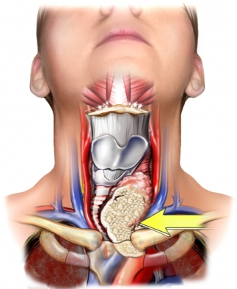
AIRWAY EMERGENCY
A. Tumor
- commonly tumors of aerodigestive
tract or thyroid
- typically present with gradual airway
obstruction
- initial management
- 02, humidification
steroids and IV antibiotics

Slide 15
Airway stabilization
- organization between Surgeon and Anesthetist
- avoid blind attempt of intubation
- if available, fiberoptic intubation (experience)
- percutaneous jet ventilation to stabilize patient

Slide 16
(Airway stabilization in tumor)
- elective awake tracheostomy under local
anaesthesia is the safest method to secure
the airway
- precipitation of complete obstruction
necessitates emergent cricothyroidotomy or
tracheostomy

Slide 17
B. TRAUMA
* Presenting SX
- Hoarseness
- Pain tenderness
- Hemoptysis
- Dysphagia
- SC emphysema
- Impaired respiration
- Haematoma

Slide 18
Laryngeal trauma

Slide 19
C . SUPRAGLOTTITIS / EPIGLOTTITIS
-Paediatric
- sudden onset
- rapidly progressive course
- high fever, respiratory distress
- drooling, painful swallowing

Slide 20
ADULT
- dysphagia, severe sore throat
- fever, stridor, voice change

Slide 22
MANAGEMENT
- Children
- secure airway
ET tube
tracheostomy
- Adult
- frequently observed in an ICU
- may need intubation

Slide 23
FOREIGN BODY
Death from FB aspiration in USA is about 3000 per year for all ages
Complete AW obstruction may be recognized in the conscious child as sudden - resp. distress
- inability to speak or cough

Slide 24
FOREIGN BODY
Types of FB
* vegetable matter are the most common in the
children’s AW
* metal
* plastic

Slide 25
FOREIGN BODY
Location of FB in the AW
* commonly the final destination is one of the main bronchi right more common than left
* Larynx -sharp objects
* Trachea if there is narrowing in the trachea

Slide 29
FOREIGN BODY
PRESENTATION
Usually coughing, choking, gaging and wheazing
No symptoms or signs
Mimik different acute or chronic disease of lung e.g. croups, bronchial asthma.
Stage of complications

Slide 30
FOREIGN BODY
DIAGNOSIS
Radiologic - extended soft tissue neck}
- PA, lateral chest }
most efficacious
It can demonstrate - FB
- Emphysema, atelectasis of the lung

