Slide 1
LARYNGOMALACIA
Accounts for 60% of laryngeal problems in newborn
Due to falcidity or incoordination of supra laryngeal cartilages which are pulled inside the lumen during inspiration leading to UAW obstruction
Characterized by stridor in the first few weeks

Slide 2
LARYNGOMALACIA
Cause is unknown:
* edema of the Aryepiglottic folds and loose
suspension of the epiglottis.
* embryologically - rapid growth of the third branchial arch
causes the epiglottis to curl open itself forming an omega
shape.
* Neurologic immaturity of Brainstem & vagus - infolding
of the aryteroids in the AW

Slide 3
LARYNGOMALACIA
Diagnosis:
* can only be confirmed by direct observation of
movement of supraglottis during respiration
* fiberoptic evaluation is the most appropriate
method of visualization
* Radiologic evaluation by (high voltage X-ray PA lateral)
may help in excluding the presence of associated AW
problem: e.g. - SGS. - Innominate artery compression.

Slide 5
Complications of laryngomalacia “
Feeding difficulty
Failure to thrive

Slide 6
Treatment:
Reassurance
Infant can outgrow this problem
Tracheostomy for severe cases.
Epiglottoplasty or supraglottoplasty for severe cases

Slide 7
SUBGLOTTIC STENOSIS
It is a narrowing of the subglottis.
in newborn SG diameter of less than 3.5 mm.
Two types of Subglottic Stenosis:
* congenital
* acquired - the commonest

Slide 8
SUBGLOTTIC STENOSIS

Slide 9
SUBGLOTTIC STENOSIS
Presentation:
Mild cases may present as recurrent croup secondary to URTI
Generally present with symptoms and signs of URT obstruction
Diagnosis:
Plain film of the neck (high KV)
confirm the diagnosis by endoscopy

Slide 10
Cotton-Myer classification of subglottic stenosis

Slide 11
SUBGLOTTIC STENOSIS
* Endotracheal intubation :
emergency situations
* Tracheotomy
* Cricothyroidotomy
* Endoscopic Techniques
- dilatation
- laser

Slide 12
SUBGLOTTIC STENOSIS
Open Surgical Technique
* Cricoid split
* Laryngotracheoplasty + Rib graft + stent
* Recection and primary anastomosis

Slide 13
* Laryngotracheoplasty + Rib graft

Slide 14
Cricotracheal resection

Slide 16
Choanal atresia
Uncommon anomaly 1/ 5000- 8000
Unilateral: present late
Bilateral : birth emergency
Mixed bone-membranous CA account for 90%
Remaining bony CA

Slide 17
Choanal atresia
CA may be associated with other anomalies in 20-50% of cases CHARGE ayndrome
VATER
craniofacial anomalies

Slide 18
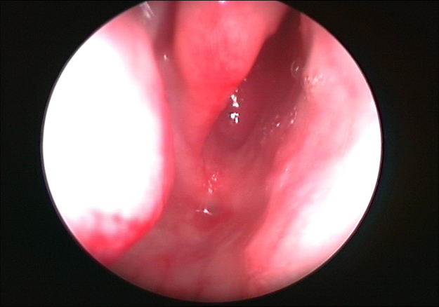
Choanal atresia
Diagnosis:
Infants; failure to pass # 6- 8 catheter
- pyriform aperture stenosis (1 CM)
- choanal atresia (3.5 cm)
Fiberoptic nasoscope

Slide 19
Choanal atresia
Many surgical approaches;
- transpalatal - transnasal - transantral - trans-septal
Endoscopic repair
Success rates reported to range between 20-80%

Slide 20
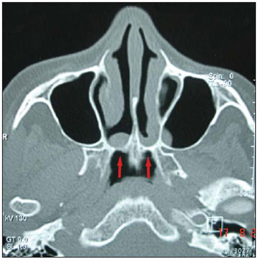
CT scan

Slide 21
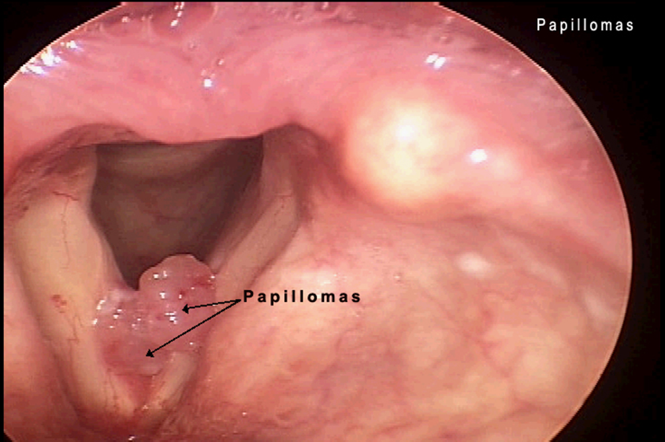
Recurrent respiratory papillomatosis
HPV type 6,11
Rare risk of malignancy type16,18
Juvenile and senile
Risk factor : warts
Treatment:
surgical debulking and cidofovir injection if needed
Avoid tracheostomy

Slide 22
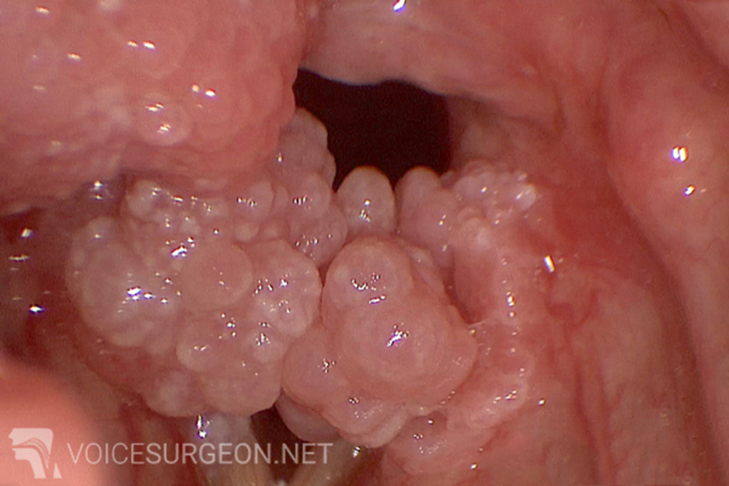
Recurrent respiratory papillomatosis

Slide 23
Glottic web

Slide 24
Subglottic hemangioma
Common in subglottic region
50% of subglottic hemangiomas associated with cutaneous involvement
Treatment:
Observation
Tracheostomy
Steriods
Beta blockers- propranolol
Surgical excision

Slide 25
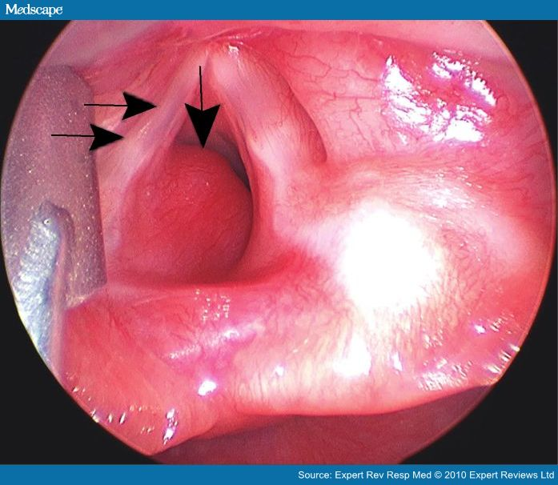
Subglottic hemangioma

Slide 26
Micrognathia- difficult intubation

Slide 27
Pierre Robin syndrome

Slide 28
Thank you

