Slide 1

Dysphagia
Mohammed Jomah MD, MSc
Lecturer, Senior Registrar ORL – H&NS
College of Medicine, King Saud University
ORL 432
December 2020

Slide 2
Definition
Swallowing:
  successful passage of food and drinks from the mouth to the stomach
Dysphagia:
  Dys = difficult Phagia: to eat
  Subjective sensation of difficulty or abnormality of swallowing
  Symptom not a diagnosis
Odynophagia:
  Painful swallowing
Globus sensation:
  (= Foreign body sensation)
  Non-painful sensation of a lump, tightness, foreign body or retained food bolus in the pharyngeal or cervical area

Slide 3
Dysphagia
Oropharyngeal
Esophageal
Structural
Neuromuscular
Mechanical
[Solids]
Neuromuscular
(Esophageal
Dysmotility)
[Solids & Liquids]
Head & Neck
Surgery
CVA
Tumors
Achalasia

Slide 4
Swallowing phases
Oro-Pharyngeal phase (voluntary phase)
Esophageal phase (involuntary phase)
  Involuntary wave of contraction mediated by the enteric nervous system.

Slide 5
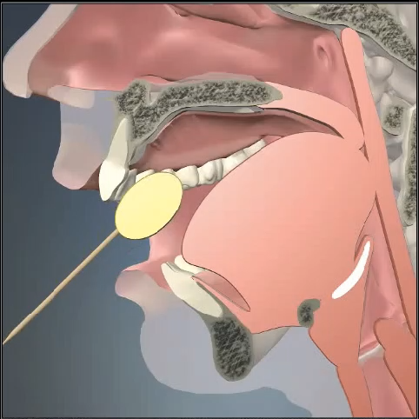
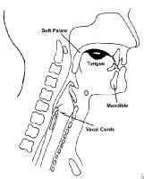
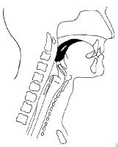
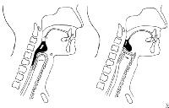
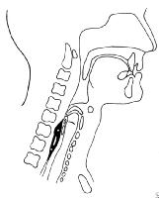
Swallowing phases
1. Oral preparatory phase
2. Oral propulsive phase
3. Pharyngeal phase
4. Esophageal phase

Slide 6
Clinical assessment
I. History taking.
II. Physical examination:
III. Investigations:

Slide 7
History
History of Present Illness:
  Onset, Duration, Progression (Constant or Intermittent), Alleviating/Aggravating factors
  Liquid, Solids, or Both
  Patient current diet
  Events at onset: Trauma, Surgery
  Voice (Hoarseness)
  Breathing (SOB, Stridor)
  Associated Sx: Odynophagia, Chocking, Cough, nasal regurgitation,
Past medical & Surgical Hx:
  Chronic diseases, rheumatological, Aspiration pneumonia, Plummer-Vinson, Caustic ingestions, H&N & chest Surgeries
Medication Hx
Fm Hx:
  Malignancy, rheumatological, Swallowing disorders
Social Hx:
  Smoking, Alcohol, Sexual Hx, Occupation, Diet
Review Of Systems:
  Type B sx, LaryngoPharyngeal Reflux/ GastroEsophageal Reflux Disease

Slide 8
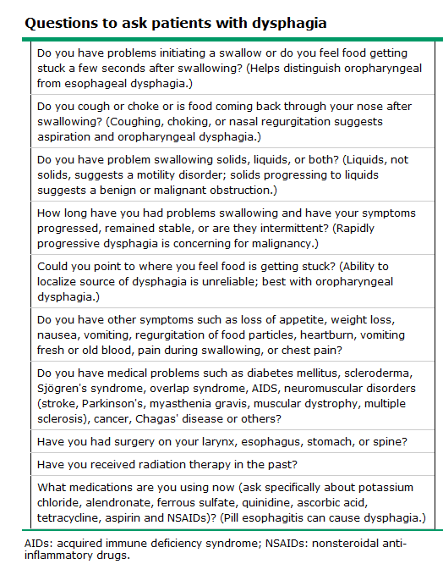

Slide 9
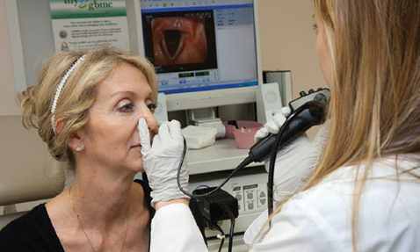
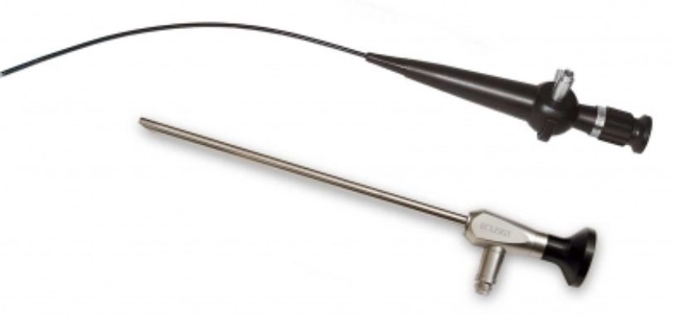
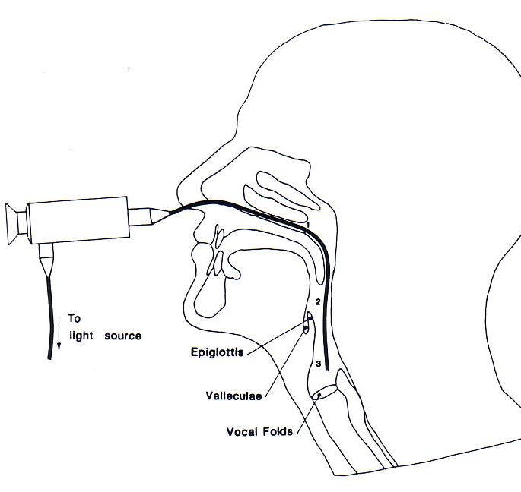
Physical Examination
Vital signs & General look
Complete ENT - H&N exam, focusing on Oral cavity, Oropharynx, Hypopharynx & neck
Flexible Naso-pharyngo-laryngoscopy
Cranial Nerve exam
Language and Speech assessment (SLP)
Neuro exam (as indicated)

Slide 10
Differential diagnoses
Structural / Mechanical
Neuromuscular
Functional

Slide 11
Differential diagnoses
Structural/ Mechanical
Intrinsic:
  Neoplasm: Oral cavity, Oropharyngeal, Hypopharyngeal, Esophageal
  Stenosis: Hypopharyngeal (ie. Scleroderma), Esophageal (Traumatic, Post-Surgical, Congenital)
  Web: Esophageal (Plummer-Vinson)
  Diverticula: Zenker’s
  Foreign Body (Acute presentation)
Extrinsic
  Neoplasm: Thyroid, Mediastinal
  Vascular: Aberrant subclavian artery
  Infectious: Abscess (Acute presentation)

Slide 12
Differential diagnoses
Neuromuscular
Neurologic
  Incoordination: Stroke, ALS, MS
  Sensory loss: SLN injury
  Neuritis: Mono- or Polyneuritis (any of the CN’s)
Muscular
  Weakness: Myasthenia gravis
Inflammation:
  Polymyositis

Slide 13
Differential diagnoses
Functional
Laryngopharyngeal Reflux/ Gastroesophageal Reflux Disease
Esophageal dysmotility
  Achalasia
  Cricopharyngeal spasm
  Esophageal spasm
Inflammatory
  Eosinophilic Esophagitis
  Scleroderma: decreased LES pressure
Infectious
  Viral: HSV
  Bacterial: Chagas disease (Trypanosoma cruzi)
  Fungal: Candida
Low Saliva:
  Post-XRT,
  Medications (ie. Anti-Cholingerics, Scopolamine, Glycopyrolate)

Slide 14
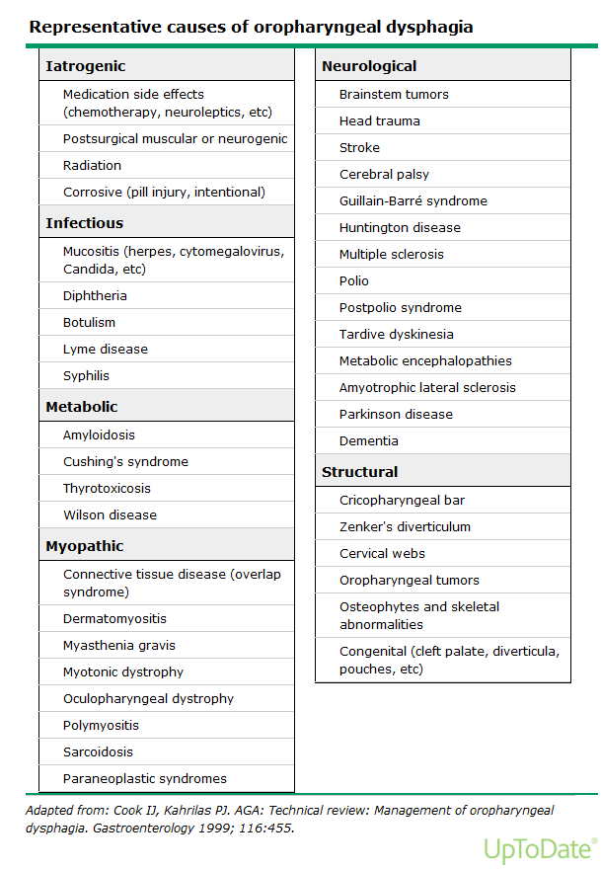
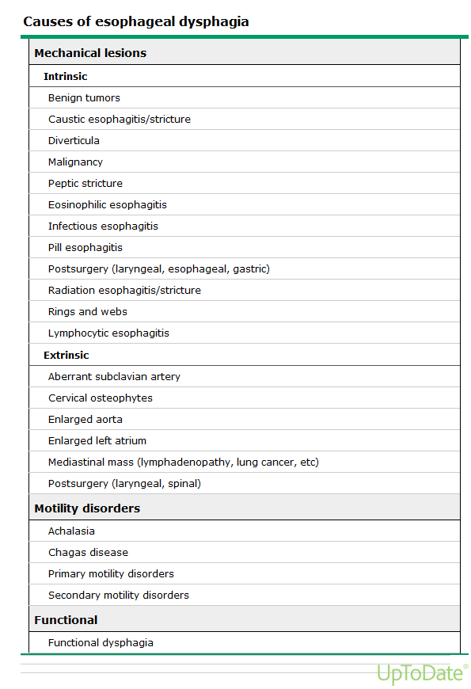

Slide 15
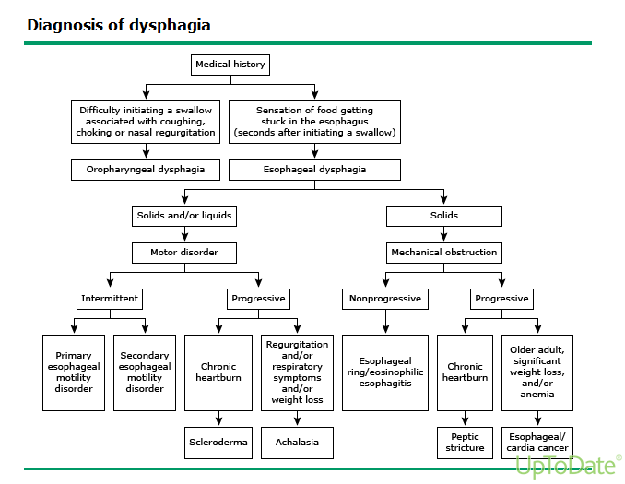

Slide 16
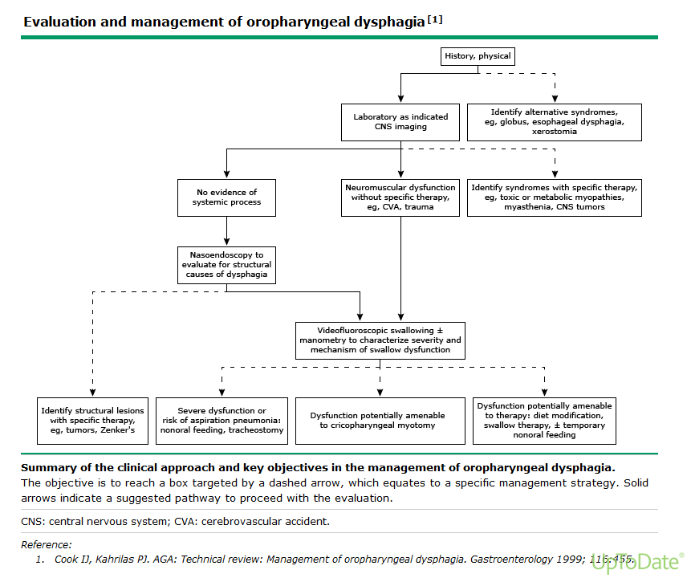

Slide 17
Work up
Mechanical
  Radiographic imaging: MBS, FEES, CT / MRI
Neuromuscular
  Radiographic imaging: MBS, FEES
  EMG, Manometry
  Neurology consult
Functional
  Radiographic imaging: MBS, FEES
  GERD w/u
  Systemic Inflammatory disease w/u
  Infectious C&S

Slide 18
Work up
CT / MRI
  When a structural lesion suspected
MBS
  Evaluates Oral and Pharyngeal phase
FEES +/- Sensory testing
  Increased sensitivity to detect Aspiration
  Thin liquids, Thickened liquids, Pureed, Solids
  Swallowing with maneuvers

Slide 19
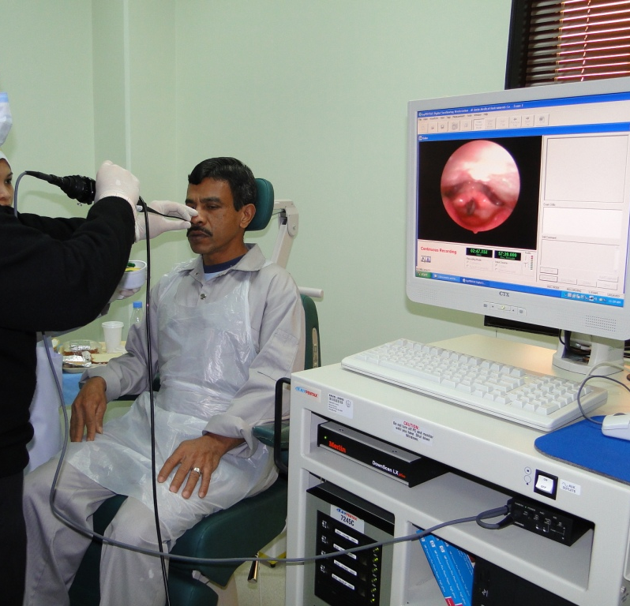
Work up
FEES look for:
  Position of Velopharynx at rest
  Symmetry of pharynx and larynx at rest
  Secretions --- quality and quantity
  Vocal cord movement
  Early spillage
  Post-swallow
    residual
    Penetration
    Aspiration
  “Penetration” = bolus enters Supraglottic larynx --- NOT thru cords
  “Aspiration” = bolus moves thru the glottis

Slide 20
FEES
https://www.mayoclinic.org/vid-20471914

Slide 21
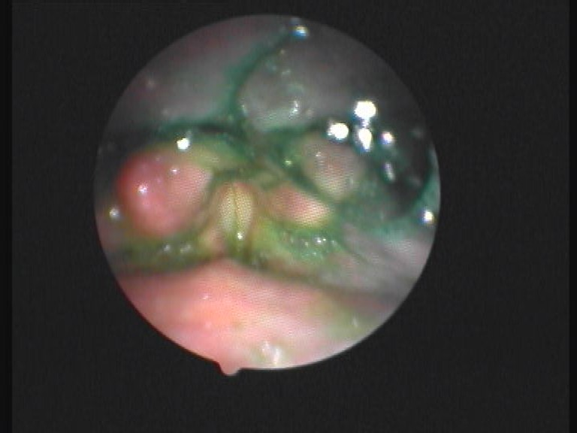
Residue
Penetration
Aspiration

Slide 22
MBS
https://youtu.be/xu_YYOAlZEw

Slide 23
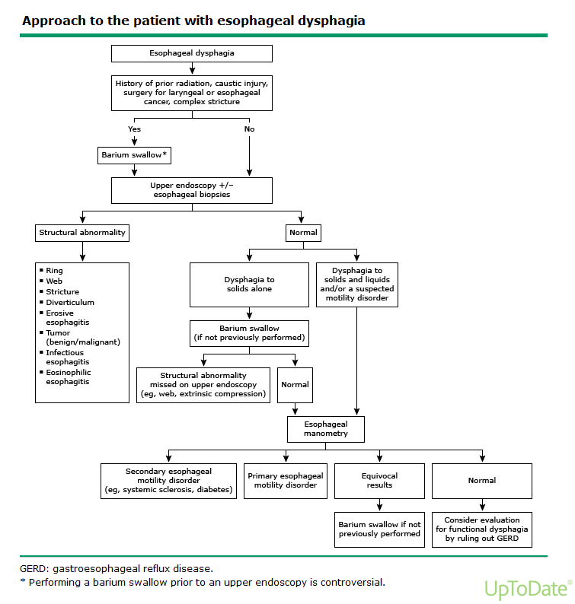

Slide 25
Management
Swallowing therapy
  Diet modification
  Postural techniques
  Swallowing maneuvers
  Sensory enhancement techniques.
  Motor exercises.
Surgical treatment
Medical treatment
Intraoral prosthesis.
Alternative routes of feeding (NG tube feeding)

Slide 26
Surgical Treatment
Procedures for underlying disorder
Aspiration
  Tracheotomy
  Alternative Feeding --- NPO, G-tube, J-Tube
  Adjunctive --- VC medialization, Laryngeal suspension, Cricopharyngeal myotomy
- Definitive Procedures:
  Tracheotomy with Laryngeal stent (occludes larynx)
  Tracheotomy with Supraglottic closure --- VC or False Cords sutured
  Tracheoesophageal Diversion --- Lindemann Procedure
  Tracheoesophageal Separation
  Total Laryngectomy

Slide 27
Case
48-year-old lady presented with c/o voice change and difficulty swallowing

Slide 28
History
Onset, Duration, Progression (Constant or Intermittent), Alleviating/Aggravating factors
Events at onset: Trauma, Surgery
Liquid, Solids, or Both
Patient current diet
Voice (Hoarseness)
Breathing (SOB, Stridor)
Associated Sx: Odynophagia, Chocking, Cough, nasal regurgitation, Neurologic weakness)
Pm Hx: Aspiration pneumonia, H&N Surgeries, Caustic ingestions, Plummer-Vinsons, rheumatological
Medication Hx
Fm Hx: SCC, Swallowing disorders
Social Hx: Smoking, EtOH, Sexual Hx, Occupation, Diet
Review Of Systems: Wt. Loss, Type B sx, LPR/ GERD, Full ENT review, Dental review

Slide 29
History
48-year-old lady
Hx of present illness: Hoarseness of voice and choking with cough after eating More with liquid diet
Started 9 months ago
No hx of SOB, stridor
No hemoptysis
No neck masses
Past surgical: total thyroidectomy for benign thyroid nodule 9 months
Past medical hx: unremarkable, No hx of pneumonia
Medication Hx: thyroxin 100 mcg daily
Family hx: unremarkable
Risk factors: No hx of smoking, alcohol consumption

Slide 30
DDx

Slide 31
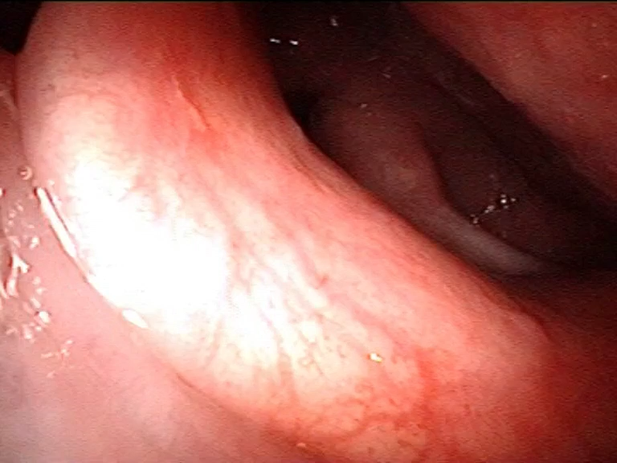
Physical examination
Vital signs WNL
Not in distress
Ears: normal
Nose: Normal
Oral cavity: normal
Neck: old healed midline scar, no palpable masses
Scope

Slide 32
Management

Slide 33
Case
35-year-old lady presented with difficulty swallowing

Slide 34
History
35-year-old lady
History of present illness: Difficulty swallowing with feeling of food getting stuck in throat, more with solid diet
Started 2 years ago and progressing
No change of voice
No SOB, stridor
No hemoptysis
Hx of neck swelling increasing in size gradually
No hx of hyper- or hypo-thyroid sx
No hx of radiation exposure, smoking, alcohol consumption
No constitutional sx (weight loss, fever, night sweating)
Family hx of thyroid cancer in mother

Slide 35
DDx

Slide 36
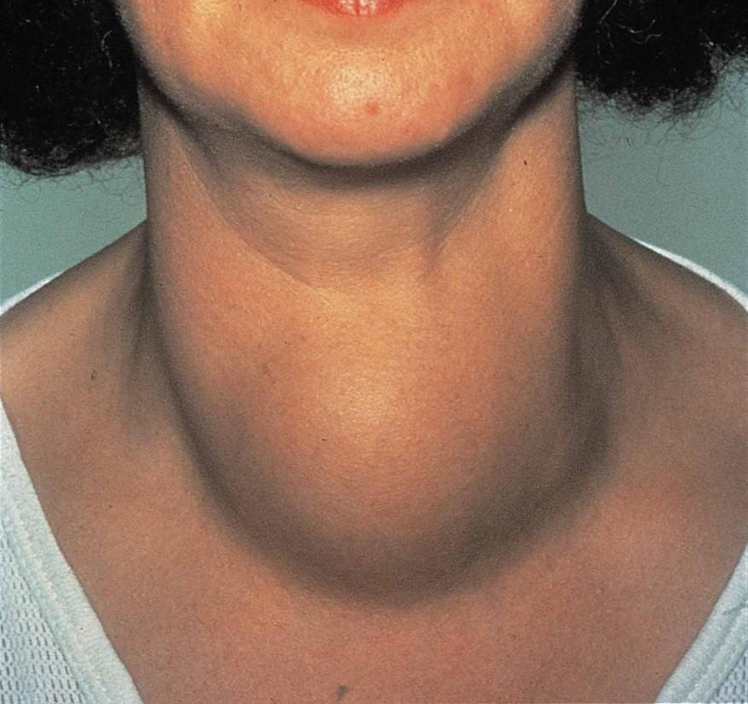
Physical examination
Vital signs WNL
Not in distress
Ears: normal
Nose: Normal
Oral cavity: normal
Neck: Midline neck swelling firm in consistency, non tender, smooth surface, no pulsating or transilluminating, no fluctuation, normal temperature, skin intact, moving with swallowing
Scope: normal

Slide 37
Management

Slide 38
Case
27-year-old gentleman presented with foreign body sensation in throat & frequent throat clearing

Slide 39
History
27-year-old male
History of present illness: feeling of foreign body stuck in throat especially at morning time with frequent throat clearance for 2 years
Rough voice at morning that improved through the day
No SOB, stridor
No hemoptysis
No neck swellings
Hx of smoking 1 pack/ day for 10 years
No hx of radiation exposure, alcohol consumption
No constitutional sx (weight loss, fever, night sweating)
Family hx unremarkable
Medication history: none

Slide 40
DDx

Slide 41
Physical examination
Vital signs WNL
Not in distress
Ears: normal
Nose: Normal
Oral cavity: normal
Neck: no palpable masses
Scope: erythema and edema of laryngeal mucosa with normal mobile vocal folds

Slide 42
Management

Slide 43
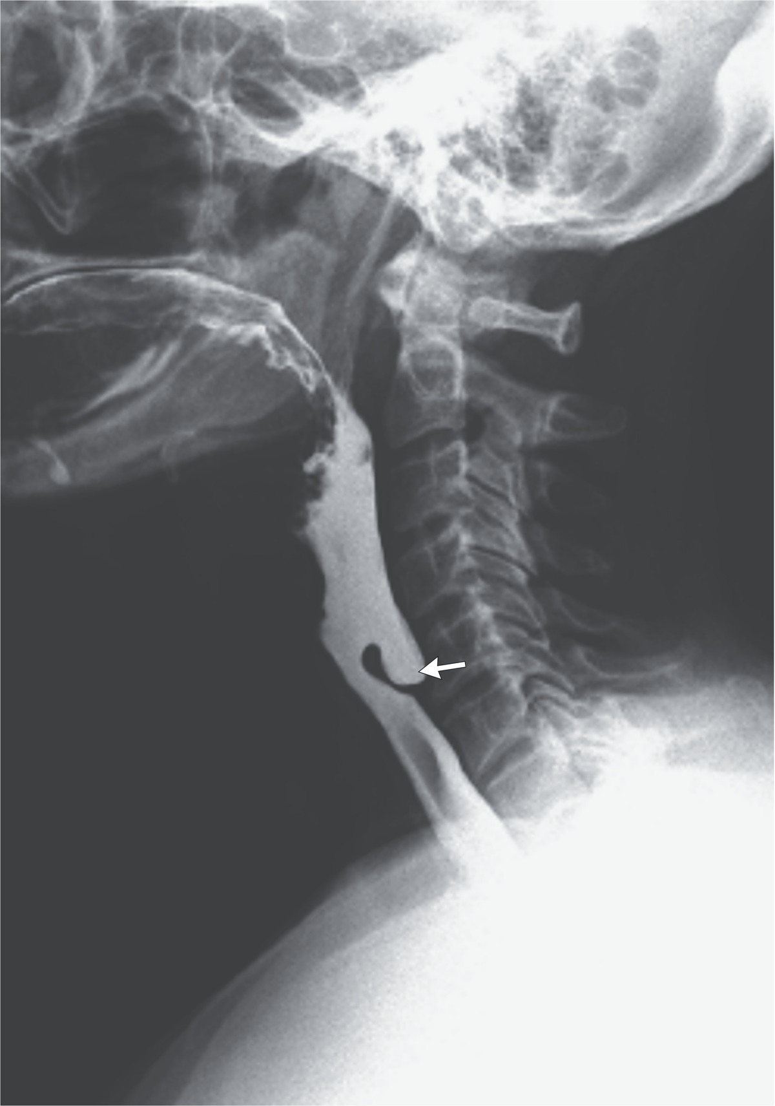
Spot diagnosis

Slide 44
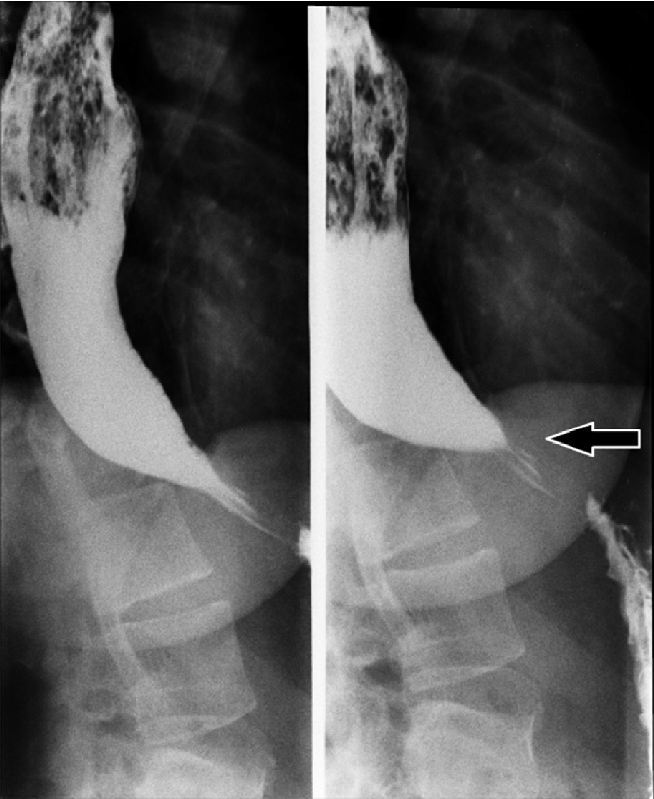
Spot diagnosis

Slide 45
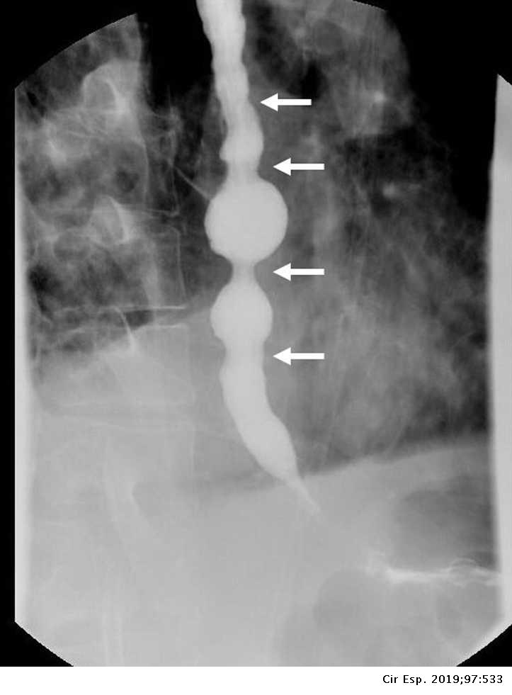
Spot diagnosis

Slide 46
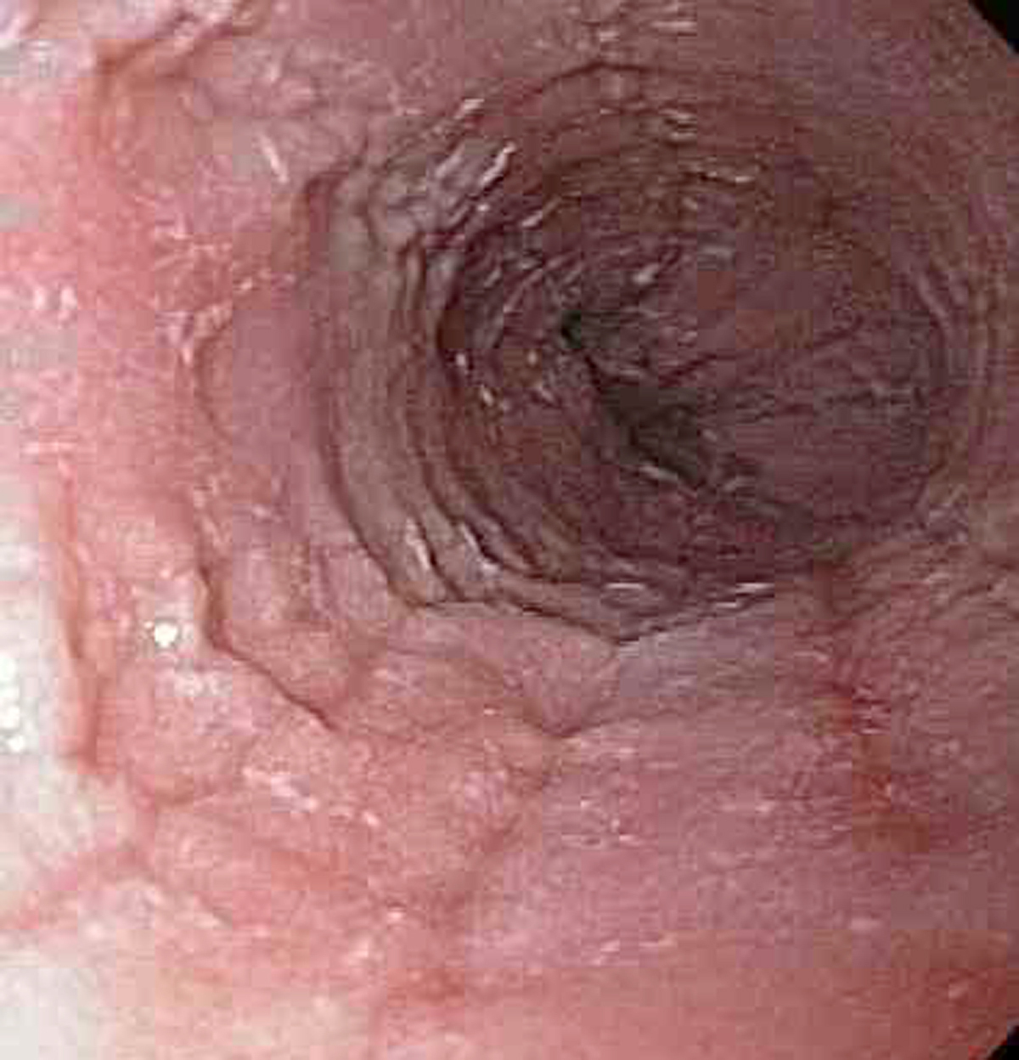
Spot diagnosis

Slide 47
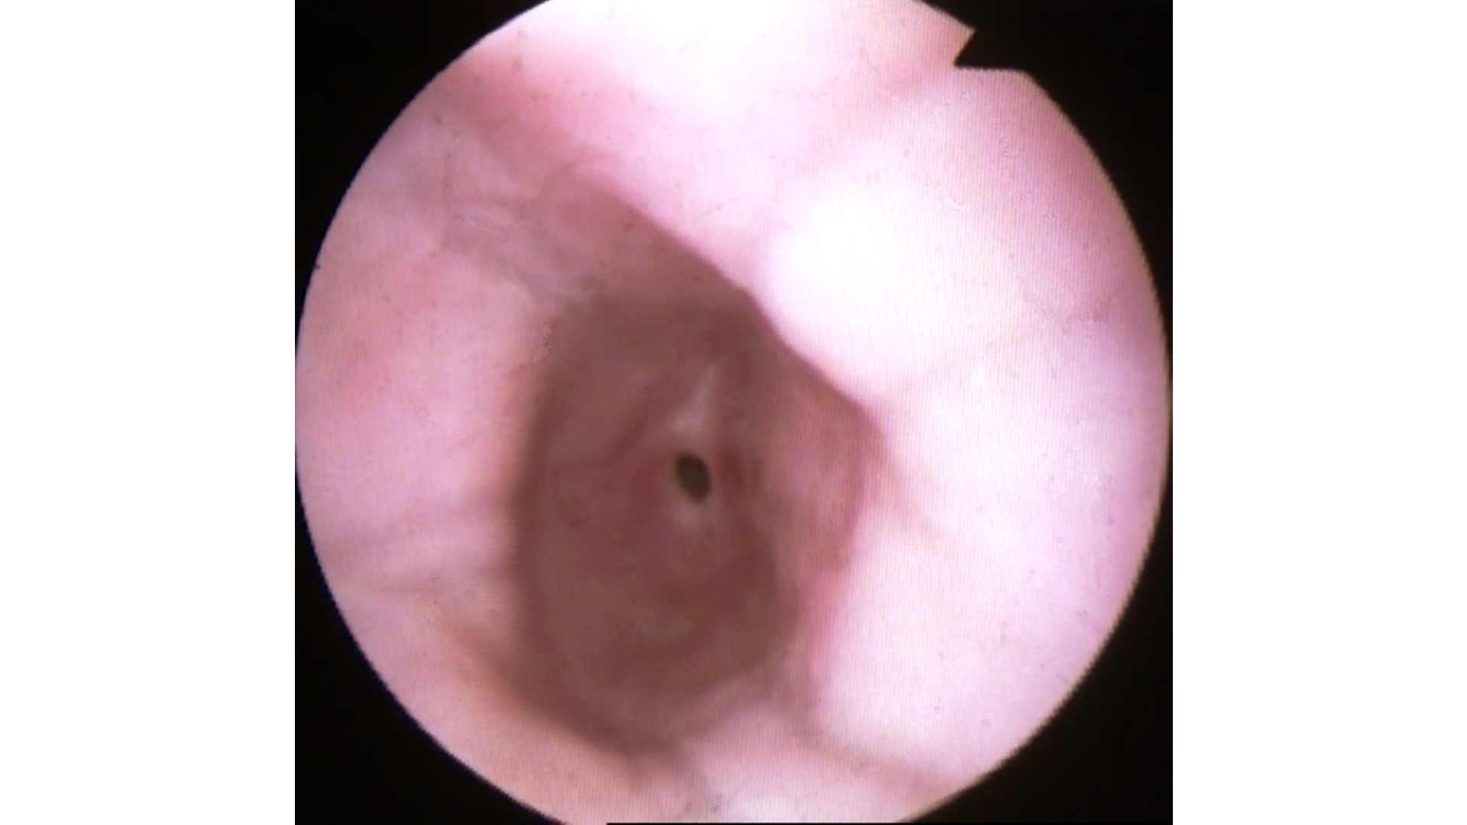
Spot diagnosis

Slide 48
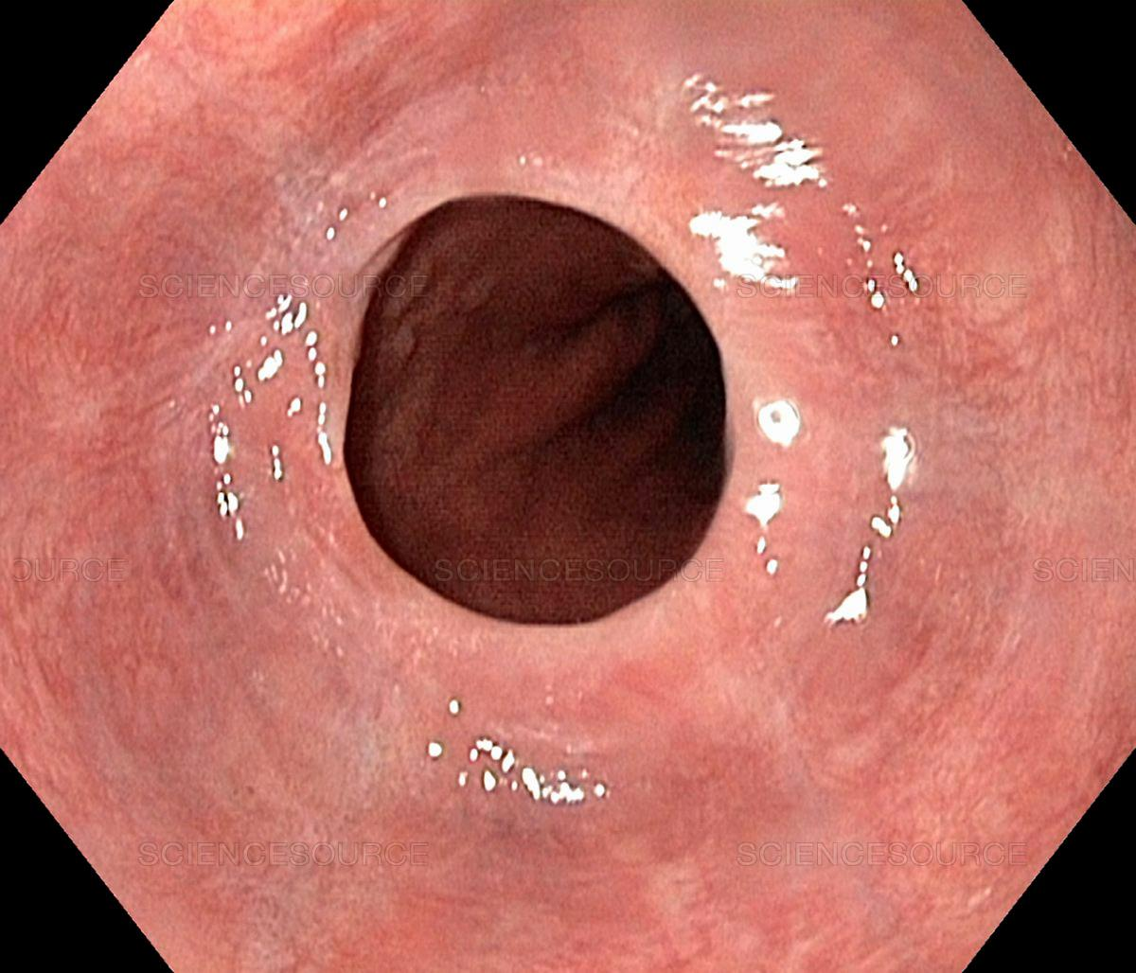
Spot diagnosis

Slide 49
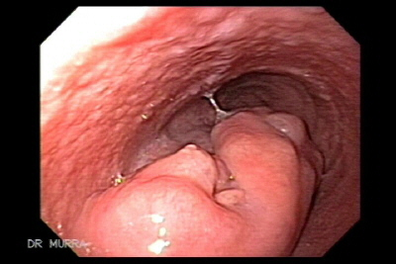
Spot diagnosis

Slide 50
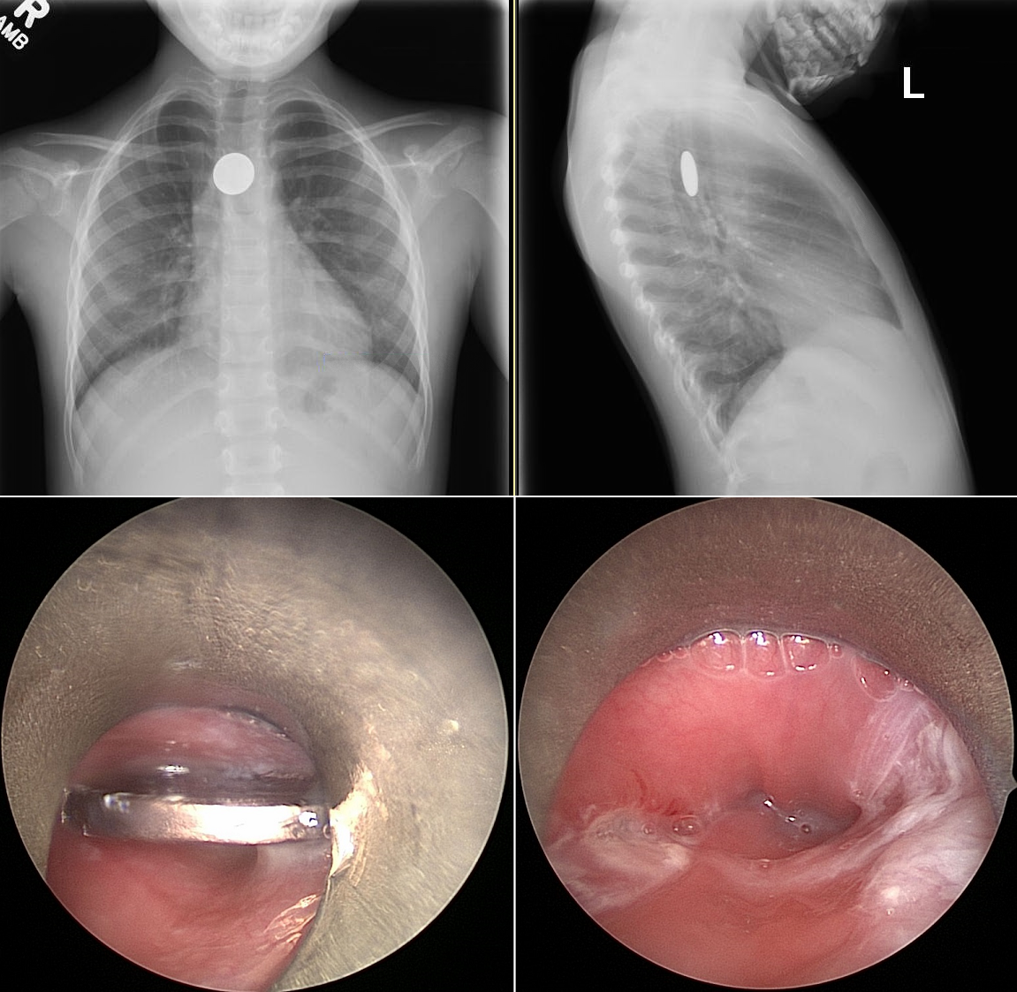
Spot diagnosis

Slide 51
Thank You dr.jomah@gmail.com
Abeeraj18@gmail.com

