Slide 1
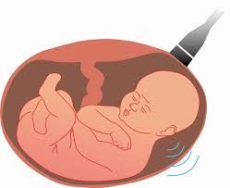
Antenatal Fetal assessment

Slide 2
Objectives:
Describe how to test for each of the following
Fetal well-being
Fetal growth
Fetal movement
Amniotic fluid
Fetal lung maturity

Slide 3
Fetal assessment (fetal well-being)
Fetal assessment is to identify fetuses at risk of neurologic injury or death in order to prevent it
To prevent prenatal mortality & morbidity
FETAL AND NEONATAL COMPLICATIONS OF
ANTEPARTUM ASPHYXIA
Stillbirth (Mortality)
Metabolic acidosis at birth
Hypoxic renal damage
Necrotizing enterocolitis
Intracranial hemorrhage
Seizures
Cerebral palsy

Slide 4
Rational
fetal oxygenation challenged:
- blood flow directed to brain, heart & adrenal & blood flow away from the kidney decrease fetal urine production decrease AF volume.
- CNS hypoxia Fetal movement decrease
-chemoreceptor's vegally-mediated reflex
Fetal heart rate abnormality late deceleration.

Slide 5
CONDITIONS ASSOCIATED WITH INCREASED PERINATAL MORBIDITY/MORTALITY
Small for gestational age fetus
Decreased fetal movement
Postdates pregnancy (>294 days)
Pre-eclampsia/chronic hypertension
Pre-pregnancy diabetes
Insulin requiring gestational diabetes
Preterm premature rupture of membranes
Chronic (stable) abruption

Slide 6
When to start fetal Assessment antenatally
** Risk assessed individually
**For D.M. fetal assessment should start from 32 weeks onward if uncomplicated
***If complicated D.M. start at 24 weeks onward
**For Post date pregnancy start at 40 weeks
**For any patient with decrease fetal movement start immediately
** Fetal assessment is done once or twice weekly

Slide 7
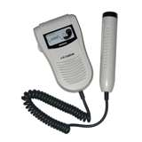
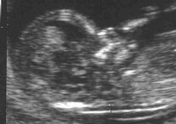
Early pregnancy assessment
Fetal heart activity
fetal auscultation (special stethoscope or Doppler)
~12weeks
Nuchal translucency measurement for early screening for chromosomal abnormality Between 11-13+ weeks

Slide 8
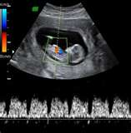
fetal heart activity seen by USS
Can be seen from 6weeks

Slide 9
Early pregnancy assessment
Fetal movement
Fetal movement are usually first perceptible to mother ~17w-20w (quickening)
50% of isolated limb movements are perceived
80% of trunk and limb movements
Fetal growth
Fundal height
USS

Slide 10
Fetal growth
By fundal height measurement in the clinic
By ultrasound
Biometry:
Biparietal diameter (BPD)
Abdominal Circumference (AC)
Femur Length (FL)
Head Circumference (HC)
Amniotic fluid

Slide 11
Growth chart

Slide 12
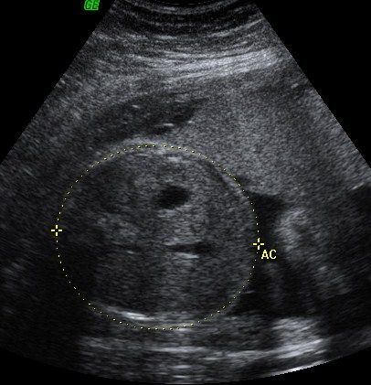
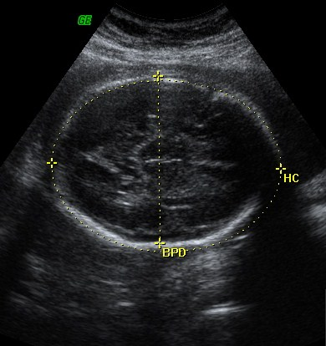
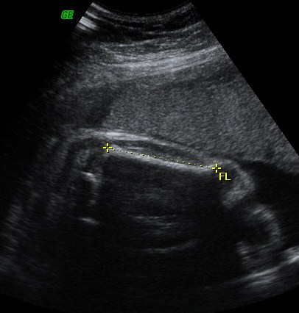
Assessment of fetal growth by ultrasound
AC
BPD
FL

Slide 13
Late pregnancy assessment
Fetal movement counting kick chart
Contraction stress test CST
Non stress test NST
Doppler Velocimetry UAV
amniotic fluid index AFI

Slide 14
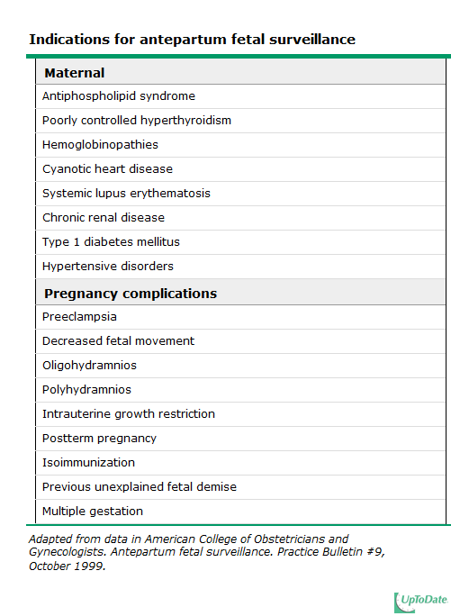

Slide 15
fetal movement counting
It should be started ~28w in normal pregnancy
&~24w in high risk pregnancy
It can reduce avoidable stillbirth
CARDIFF TECHNIQUE
-10 movement in 12 hours
-If abnormal patient should get further assessment
SADOVSKY TECHNIQUE
-4 movement /hour if not felt another hour
If not patient need more assessment

Slide 16
Contraction stress test (CST)
Causing uterine contraction over 20minutes
At least 2 uterine contractions
Uterine contraction restrict O2 delivery to the fetus
Normal fetus will tolerate contraction
Hypoxic fetus will have late deceleration
High false positive rate ~50%
100% true negative rate

Slide 17
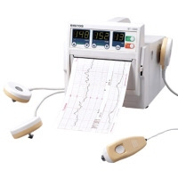
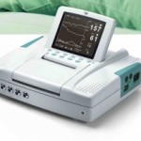
Non stress test (NST)
Main advantage over CST is no need for contraction
False +ve & false –ve higher than CST
done

Slide 18
Non stress test
The base line 120-160 beats/minute
Different criteria in fetuses <32w
Reactive:
At least two accelerations from base line of 15 bpm for at least 15 sec within 20 minutes
Non reactive:
No acceleration after 20 minutes- proceed for another 20 minutes

Slide 19
Non stress test (NST)
If non reactive in 40 minutes---proceed for contraction stress test or biophysical profile
The positive predictive value of NST to predict fetal acidosis at birth is 55%

Slide 20
NST

Slide 21
Interpretation of CTG
Normal Baseline FHR 110–160 bpm
– Moderate bradycardia 100–109 bpm
– Moderate tachycardia 161–180 bpm
– Abnormal bradycardia < 100 bpm
– Abnormal tachycardia > 180 bpm

Slide 22
Acceleration

Slide 23
Deceleration
EARLY : Head compression
LATE : U-P Insufficiency
VARIABLE : Cord compression
Primary CNS dysfunction

Slide 24
Early deceleration

Slide 25
Late deceleration

Slide 26
Variable Deceleration

Slide 27
Reduced Variability

Slide 28
Tachycardia Hypoxia Chorioamnionitis Maternal fever B-Mimetic drugs Fetal anaemia,sepsis,ht failure,arrhythmias

Slide 29
Amniotic fluid volume ~AFI
Amniotic fluid index AFI
-the sum of the maximum vertical fluid pocket diameter in four quarters
-the normal value 5-25cm
-<5~ oligohydraminous
->24cm polyhydraminous

Slide 30
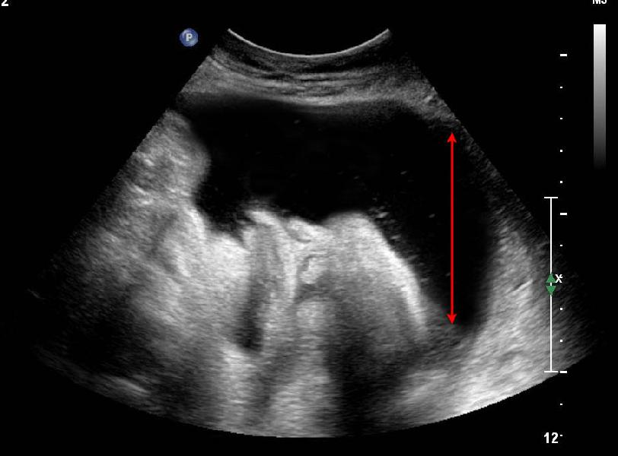
Amniotic fluid volume

Slide 31
Biophysical profile (BPP)
Combines NST with USS estimation AFV, fetal breathing, body movement & reflex/tone/extension-flexion movement .
it is a scoring system
it is done over 30minute
It measure acute hypoxia(NST, body mov. &breathing) & chronic hypoxia (AFI)

Slide 32
Fetal Biophysical profile/NST+
Abnormal (score= 0) | Normal (score=2) | Biophysical Variable
Absent FBM or no episode >30 s in 30 min | 1 episode FBM of at least 30 s duration in 30 min | Fetal breathing movements
2 or fewer body/limb movements in 30 min | 3 discrete body/limb movements in 30 min | Fetal movements
Either slow extension with return to partial flexion or movement of limb in full extension Absent fetal movement | 1 episode of active extension with return to flexion of fetal limb(s) or trunk. Opening and closing of the hand considered normal tone | Fetal tone
Either no AF pockets or a pocket<2 cm in 2 perpendicular planes | 1 pocket of AF that measures at least 2 cm in 2 perpendicular planes | Amniotic fluid volume

Slide 33
BPP
The risk of fetal death within 1 week if BPP is normal~ 1/1300
Modified BPP (mBPP)
-NST & AFI
-low false negative 0.8/1000
-high false positives ~60%

Slide 34
Doppler velocimetry
Measurement of blood flow velocities in maternal & fetal vessels
Reflect feto-placental circulation
Doppler indices from UA, Uterine A & MCA
Doppler studies is mostly valuable IUGR
In IUGR absent or reversed EDF (end diastolic flow) associated with fetal hypoxia

Slide 35
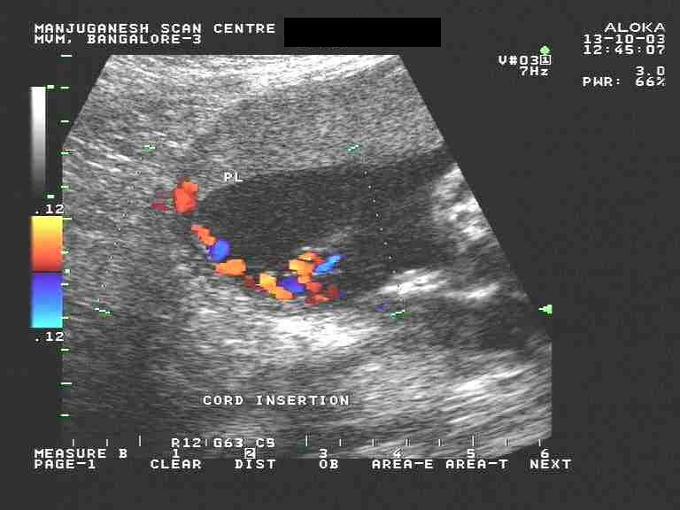
umbilical artery waveform

Slide 36
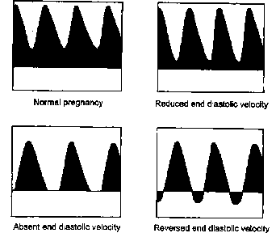
Umbilical Artery Doppler

Slide 37
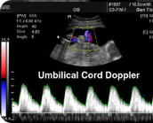

Slide 38
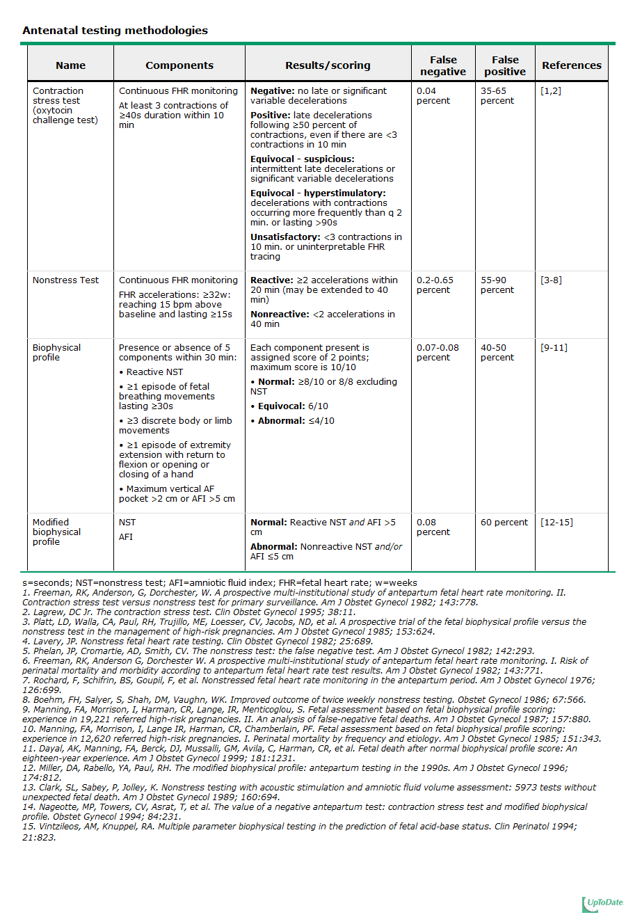

Slide 39
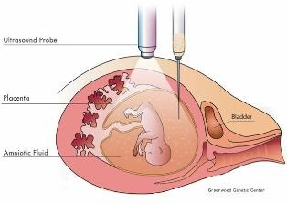
Invasive fetal assessment
Amniocentesis

Slide 40
Amniocentesis
Obtaining a sample of amniotic flui during pregnancy.
Usullay done after 15w (can be done after 11w)
Indication
-genitic (karyotype)
-billirubin level (RH-isimunisation)
-fetal lung maturity (L/S)
-therputic in polyhydramnios
Risks: ROM ~1%, abortion 0.5%, infection 1/1000

Slide 41
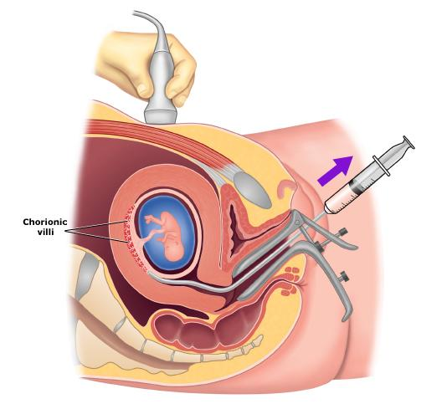
CVS chorionic villus sampling

Slide 42
CVS chorionic villus sampling
Usually done after 10w
It is the procedure of choice for first trimester prenatal diagnosis of genetic disorders
Complication: fetal loss (0.7 percent within 14 days of a TA CVS procedure and 1.3 percent within 30 days), Procedure-induced limb defects
Second trimester amniocentesis is associated with the lowest risk of pregnancy loss; chorionic villus samplings safer than early (i.e, before 15 weeks) amniocentesis.
.

Slide 43
cordocentesis

Slide 44
cordocentesis
Indication: - rapid karyotyping
-diagnosis of inherited disorders
-fetal HB assessment
-fetal plt level
-fetal blood transfusion
Complication: bleeding, bradycardia, infection….

Slide 45
Fetal lung maturity
A test for fetal lung maturity is performed before semi-elective but medically indicated births <39 weeks
Tests for fetal lung maturity are generally not performed before 32 weeks of gestation
RDS develops as a consequence of surfactant deficiency and immature lung development.
L/S ratio is the most commonly used (ratio should be 2:1

Slide 46
-FLM testing may have value in the following clinical situations:
-Premature rupture of membranes (≥32 weeks) – if FLM test is mature, delivery is likely safer than “wait and see” approach
Assessment of need for NICU – possible only if early delivery has medical mandate and time allows for FLM testing
Other selected late preterm and early preterm pregnancy issues where FLM may guide management of at-risk pregnancy

Slide 47
Fetal lung maturity FLM
All tests require amniocentesis for obtaining amniotic fluid
Comparison of FLM Laboratory Testing Options
Lamellar body count (LBC) | Phosphatidylglycerol (PG) | Lecithin-sphingomyelin ratio (L/S)
Initial FLM of choice Rapid, sensitive New data indicates that one can estimate risk of respiratory distress syndrome (RDS) as a function of gestational age and LBC | Not useful unless gestational age ≥35 weeks Limited availability Sensitive | Main role is in adjudication of immature LBC or PG Last test of choice Labor intensive, imprecise Limited availability Results take >24 hrs unless performed at a local laboratory

Slide 48
Thank you

