Slide 1
King Saud University Medical City Department of Obstetrics & Gynecology Course 482
Pelvic Inflammatory Disease / Pelvic Abscess

Slide 2
Outline
Identify the prevalence of Pelvic Inflammatory Disease (PID)
Explain the etiology and pathogenesis of PID
Describe the symptoms and signs of PID / Diagnosis
Describe the management of PID
Discuss the tubo-ovarian abscess
List the complications of PID

Slide 3
PID
Pelvic Inflammatory Disease presents as a spectrum of infection-induced inflammation of the upper genital tract that includes endometritis, salpingitis, pelvic peritonitis, and/or tubo-ovarian abscess (TOA).

Slide 4
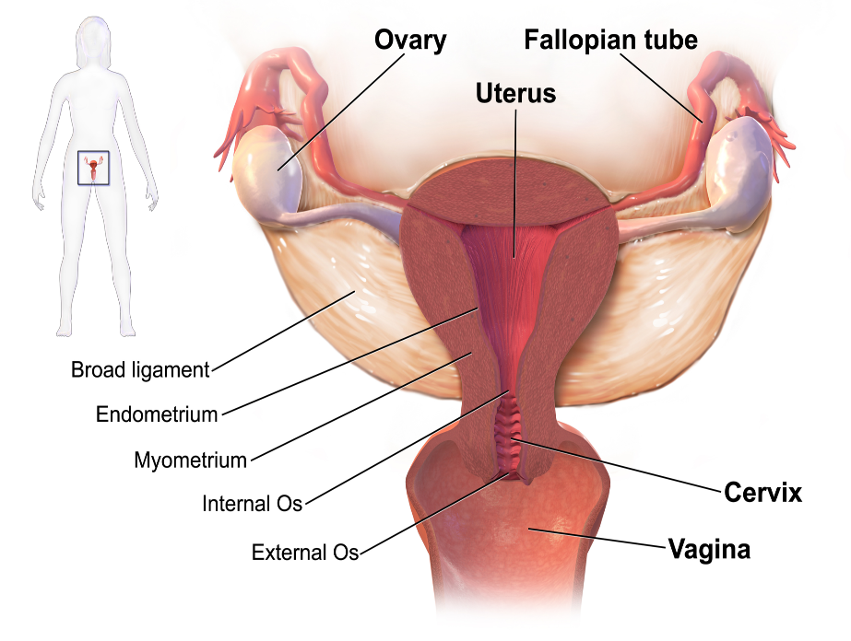

Slide 5
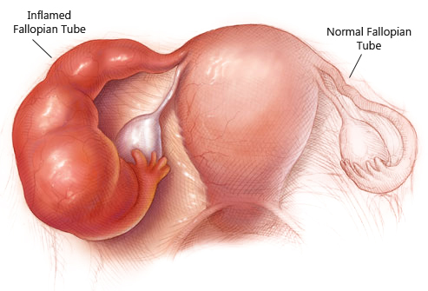

Slide 6
PID
Most often , ascending spread of microorganisms from vagina & endrocervix to endometrium, tubes, contiguous structures.

Slide 7
The Prevalence of PID
The CDC has estimated that more than 1 million women in the USA experience an episode of PID every year.
The disease leads to approximately 2.5 million office visits and 125,000-150,000 hospitalizations yearly.
No specific international data is available for PID incidents worldwide.
The annual rate of PID in high-income countries has been reported to be as high as 10-20 per 1000 women of reproductive age.

Slide 8
Etiology
85% of infection in sexually active female of reproductive age
15% of infection occur after procedures that break mucous barrier
Bacteria culture direct from tubal fluid common: N. gonorrhoeae, C. trachomatis, endogenous aerobic, anaerobic, genital mycoplasma spp.

Slide 9
Etiology
Nisseria gonorrhoeae
C. trachomatis
Mycoplasma genitalium
Polymicrobial flora
Prevatella sp.
Peptostreptococcus sp.
Escherichia
Anaerobic gram-negative rods.

Slide 10
Pathogenesis of PID
C. trachomatis
Produce mild form of salpingitis
Slow growth (48-72 hours)
Intercellular organism
Insidious onset
Remain in tubes for months or years after initial colonization of upper genital tract
More severe tubes involvement

Slide 11
N. Gonorrhoeae
Gram –ve diplococcus
Rapid growth ( 20-40 minutes)
Rapid and intense inflammatory response
2 Major sequelae [Infertility and ectopic pregnancy, strong association with prior chlamydia infection]

Slide 12
Risk factors
Strong correlation between exposure to STD
Age of 1st intercourse
Frequency of intercourse
Number of sexual partners
Marital status; 33% in nulliparous

Slide 13
Risk factors
Increase risk
IUD user (multifilament string)
Surgical procedure
Previous acute PID
Reinfection if untreated male partner (80%)
Decrease risk
Barrier method
OCP

Slide 14
Signs and symptoms of PID
Abdominal pain
Abnormal Discharge
Intermenstrual bleeding
Postcoital bleeding
Fever
Urinary frequency
Lower back pain
Nausea/vomiting

Slide 15
Diagnosis Physical examination:
Assess the abdomen for tenderness.
Vaginal secretion examination to assess the presence of BV.
Microscopy of the vaginal secretion should be examined for the presence of leukocytes, clue cells, and trichomonads.
Cervical canal examination for the presence of yellow/green mucopus and friability.
Testing for C. trachomatis and N. gonorrhoeae.
A bimanual pelvic examination to assess for pelvic organ tenderness and pelvic mass (might suggest a TOA)

Slide 16
Other ancillary tests:
Lab tests:
A complete blood count
Erythrocyte sedimentation rate
C-reactive protein test
Imaging studies:
Pelvic ultrasonography (to rule out symptomatic ovarian cysts or those with pelvis mass noted on bimanual pelvic examination)
Computed tomography (to rule out appendicitis)

Slide 17
Dx
Laparoscopic visualization:
Most accurate method to confirm PID
All patients with uncertain diagnosis, no respond to treatment
Negative gram smear does not rule out PID

Slide 18
Management of PID
Therapeutic goal: eliminate acute infection & symptoms as well as prevent long term sequalae.
Mild to moderate PID
Treat as outpatient
Aim at microbiologic cure for N. gonorrhoeae and C. trachomatis (even in the presence of negative endocervical screening for these organisms)
Coverage for polymicrobial flora associated with BV.
Antibiotic therapy

Slide 19
CDC recommended oral regime

Slide 20
Severe PID & TOA:
Hospitalization and impatient parentral therapy (criteria noted)
Imaging should be considered
Surgical intervention is recommended for those who failed to antibiotic therapy alone:
Size of the TOA with abscesses 10 cm or greater in diameter
Patient who fail to respond to antibiotic treatment within 48-72 hrs. (persistent fever, increasing leukocytosis)
Drainage of TOA via laprotomy, laparoscopy, or image-guided percutaneous routes)

Slide 21
Criteria for hospitalization in women with PID
Surgical emergencies (e.g. appendicitis) cannot be excluded.
Patient is pregnant.
Patient does not respond clinically to oral antibiotic therapy.
Patient is unable to follow/tolerate an outpatient oral regimen.
Patient has severe illness, nausea and vomiting or high fever.
Patient has a tubo-ovarian abscess.

Slide 22
Treatment
Rx male partners & education for prevention reinfection
Rx male partners: Regimens for uncomplicated gonorrhoeae & chlamydial infection
Ceftriaxone 125 mg im followed by
Doxycycline (100) 1x2 pc x7 days or
Azithromycin 1gm or
Ofloxacin (300) 1x2 pc x7 days

Slide 23
Complications of PID
Chronic pelvic pain 25%
Infertility
Ectopic pregnancy (increased 15%-50%)
PID may produce TOA and extend to produce pelvic peritonitis and Fitz-Hugh Curtis syndrome (perihepatisis)
Acute rupture of TOA and peritonitis is a life threatening event that calls for urgent abdominal surgery.

Slide 24
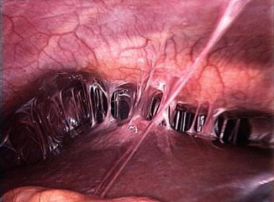
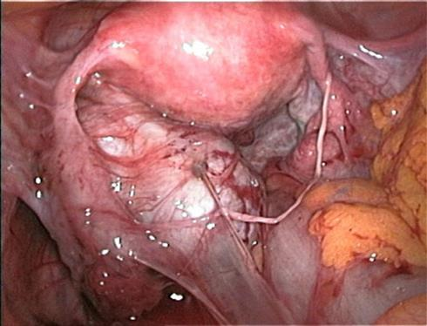
Perihepatitis
Peritonial adhesions

Slide 25
THE END

