Slide 1
Dr. Hazem Al-Mandeel Dept of OB / Gyne Course 482
Polycystic Ovary Disease

Slide 2
Objectives
Describe the Pathogenesis of PCO
Identify the clinical picture of PCO
List the investigations required to diagnose PCO
List the health hazards associated with PCO
Describe the management options of PCOS

Slide 3
PCOS
PCOS= Polycystic ovarian syndrome
It is a set of symptoms caused by Anovulation and Elevated Androgens in women
It is due to a combination of genetic and environmental factors
It is the most common endocrine disorder amongst women between 18-44 years old.
It affects approx. 2%-20% of this age group.
It is one of the leading causes of poor fertility.

Slide 4
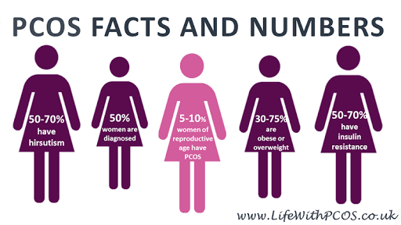
PCOS

Slide 5
PCOS - Pathophysiology
Women with PCOS have abnormalities in the metabolism of androgens and estrogen and in the control of androgen production.
Although the exact etiopathophysiology of PCOS is unclear, it can result from abnormal function of the hypothalamic-pituitary-ovarian (HPO) axis.
The biochemical features of PCOS:
Raised androgen production (e.g: testesterone, androstenedione, and dehydroepiandrosterone sulfate (DHEA-S)
Individual variation is considerable, and patients might have normal androgen levels.

Slide 6
Peripheral insulin resistance causing hyperinsulinemia, and obesity amplifies the degree of both abnormalities.
Anovulation and elevated androgen level is due to increased level of luteinizing hormone (LH) secreted by the interior pituitary
stimulations of the ovarian theca cells
increase androgen production (testosterone & androstenedione)
Decreased level of follicular-stimulating hormone (FSH) relative to LH
lack of aromatization of androgens to estrogens
decreased estrogen levels and hence anovulation

Slide 7
Polycystic ovaries are enlarged bilaterally and smooth thickened capsule. On cut section, subcapsular follicles in various stages of atresia are seen at the periphary, with hyperplasia of theca stromal cells.
PCOS is a genetically heterogeneuos syndrome, however the genetic contributions remain incompletely described. Studies of family members with PCOS indicate that an autosomal dominant mode of inheritance occurs for many families with the disease.

Slide 8
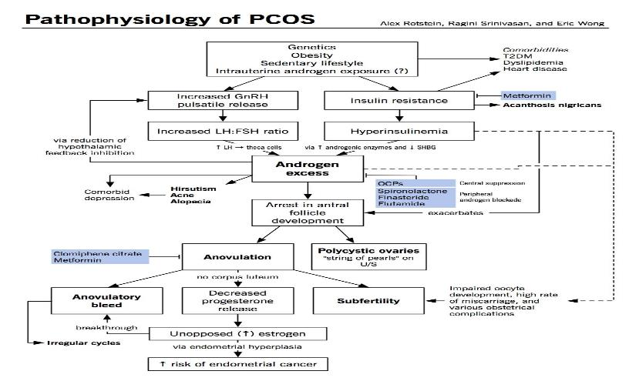
PATHOPHYSIOLOGY

Slide 9
PCOS
OA
~
Oligo-Anovulation
HA
~
Hyper-androgenism
PCOM
~
Polycystic Ovarian Morphology

Slide 10
Signs and symptoms
Menstrual dysfunction (amenorrhea, oligomenorrhea, menorrhagia)
Anovulation
Signs of hyperandrogenism (Hirsutism, acne, hair fall)
Infertility
Obesity and metabolic syndrome
Obstructive and sleep apnea

Slide 11
OA:Oligo-Anovulation
Primary / Secondary Amenorrhoea
Oligomenorrhoea
Less than 8 episodes of menses a year
Cycle length exceeding 35 days (n:21-35)
Complications PCOM diagnosis on US > No longer recommended in the presence OA

Slide 12
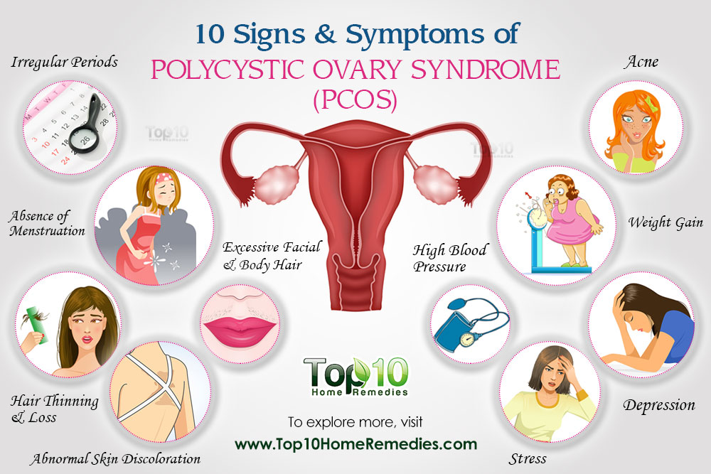

Slide 14
Diagnosis
On examination, findings in women with PCOS:
Virilizing signs
Acanthosis nigricans
Hypertension
Enlarged ovaries (may or may not be present)

Slide 15
Testing/Investigations
Exclude other disorders that can result in menstrual irregularities and hyperandrogenism:
Adrenal tumors
Ovarian tumors
Thyroid dysfunction
Congenital adrenal hyperplasia
Hyperprolactinemia
Acromegaly
Cushing syndrome

Slide 16
Diagnosis
Screening labs studies for PCOS:
Thyroid function tests (TSH, free thyroxine)
Serum Prolactin level
Total and free testosterone levels
Free androgen index
Serum hCG level

Slide 17
Other tests:
Androstenedione level
FSH and LH levels
GnRH stimulation levels
Glucose level
Insulin level
Lipid level

Slide 18
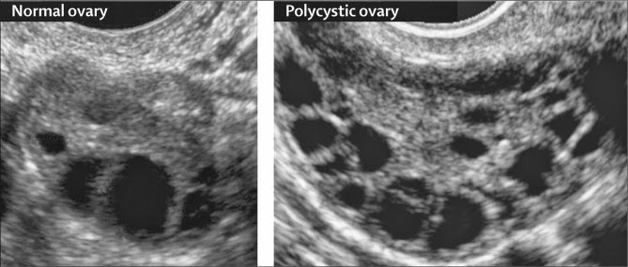
Imaging tests:
Ovarian ultrasonography, preferably using transvaginal approach
Pelvic CT scan or MRI to visualize the adrenals and ovaries

Slide 19
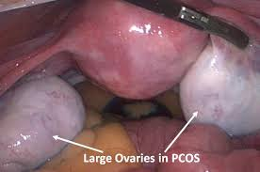
Procedures
Ovarian biopsy for histologic confirmation of PCOS
Ultrasonographic diagnosis of PCOS
Endometrial biopsy to evaluate for endometrial disease (malignancy)

Slide 20
Health hazards/Prognosis
Increased risk for cardiovascular and cerebrovascular disease
Elevated serum lipoprotein levels similar to those of men
Approx. 40% of patients with PCOS have insulin resistance hence increased risk of type 2 diabetes and cardiovascular complications.
Increased risk for endometrial hperplasia and carcinoma (chronic anovulation in PCOS leads to constant endometrial stimulation with estrogen without progesterone, and this increases the risk of endometrial hyperplasia and carcinoma)

Slide 21
Management of PCOS
Life style modifications= first-line treatment
Diet
Exercise
Weight loss

Slide 22
MULTI-DISCIPLINARY TEAM
Gynaecologist
Dietician
Physician/Endocrinologist
Fertility Specialist
Support Groups

Slide 23
Pharmacotherapy
=treat metabolic derangments (anovulation, hirsutism, and menstrual irregularities)
First-line medical therapy is oral contraceptive pills (OCP)
induce regular menses (eg ethinyl estradiol, medroxyprogesterone
Androgen blocking agent (eg spironolactone, leuprolide, finasteride) treat hirsutism
Clomiphene citrate or letrozole =selective estrogen receptor modulators for ovulation induction, as a first-line treatment
Hypoglycemic agents (metformin, insulin)

Slide 24
Topical hair-removal agents (eg eflornithine)
Topical acne agents (eg benzoyl peroxide, tretinoin topical cream (0.02-0.1%)/gel (0.01-0.1%)/solution (0.05%))

Slide 25
Surgery
=aim to restore ovulation
Method Laproscopically:
Electrocautery
Laser drilling
Multiple biopsy

