Slide 1
Endometrial cancer
DR KHALID AKKOUR MD FRCSC
ASSISTANT PROFESSOR AND CONSULTANT
GYNECOLOGIC ONCOLOGIST
KING SAUD UNIVERSITY

Slide 2
Endometrial ca
Fourth most common ca after breast, lung , and colorectal ca.
The lifetime risk of developing uterine cancer is 2.6 percent .
The average age of diagnosis of uterine cancer in the United States is 61 years old
Endometrioid histology accounts for most cases (80%) , The remaining 20% of cases consist of nonendometrioid.
It usually has a good prognosis.

Slide 3
2 different clinicopathological sub types:
Type 1:
E2 dependent,endometrioid
Average age 63
73% confined to the uterus.
Type 2:
Non E2 dependent, predominantly sero pap, ccc, carcinosarcoma. Grade 3 endometroid.
Average age 67 yrs
50 % of pt present with metastasis

Slide 4
Risk factors
unopposed estrogen
postmenopausal (median age at diagnosis is 61 years)
nulliparity
early menarche, late menopause
Obesity, diabetes, HTN
tamoxifen

Slide 5
Tamoxifen
potent antiestrogenic agent which compete with estrogen for binding sites in breast and other tissues, but not in the uterus.
Increases the risk of endo. Ca by 2-3 folds.
Changes are:
Cystic glandular dilatation
Stromal edema
Myometrial hyperplasia and edema

Slide 6
Hyperplasia
proliferation of endometrial glands resulting in a greater gland-to-stroma ratio.
The glandular pattern can be either simple or complex with or with out nuclear atypia.
Simple hyperplasia without atypia 1 %
Complex hyperplasia without atypia 3 %
Simple atypical hyperplasia 8 %
Complex atypical hyperplasia 29 %

Slide 7
Hyperplasia
Treatment:
Hormonal management – Progestins are the usual therapy, since they oppose the effect of estrogen on the endometrium.
Hysterectomy.

Slide 8
Hyperplasia
EIN:
Used in any lesion with cytologic atypia
Only 50% respond to MPA
Concurrent endo ca 40%

Slide 9
Diagnosis and Workup
Most patients (90%) with endometrial carcinoma have abnormal vaginal bleeding,
Hysteroscopy and D+C = GOLDEN STANDARD
Endometrila sample:
10 % false negative rate
So any symptomatic patient with –ve biopsy = HYSTEROSCOPY + D+C
US,CT ,MRI ,Colonoscopy ,Ca 125.

Slide 10
Treatment
Total extrafascial hysterectomy with bilateral salpingo-oophorectomy with pelvic and para-aortic lymph node dissection is the standard staging procedure for endometrial carcinoma.
Staging can be performed via a minimally invasive route or laparatomy.

Slide 12
FIGO 2010
Carcinoma of the Endometrium
IA Tumor confined to the uterus, no or < ½ myometrial invasion
IB Tumor confined to the uterus, > ½ myometrial invasion
II Cervical stromal invasion, but not beyond uterus
IIIA Tumor invades serosa or adnexa
IIIB Vaginal and/or parametrial involvement
IIIC1 Pelvic node involvement
IIIC2 Para-aortic involvement
IVA Tumor invasion bladder and/or bowel mucosa
IVB Distant metastases including abdominal metastases and/or inguinal lymph nodes

Slide 13
Grade
G 1: 5% or less of solid pattern
G 2: 6-50%
G 3: more than 50 %

Slide 14
Poor prognosis
Grade 3
Seropap, ccc, carsinosarcoma
+ LVI
+ peritoneal cytology
T size

Slide 15
H . Receptors
ER + PR levels are inversely proportional to the histologic grade.
Pts with + ER / PR or both , have better Px.
HER 2 NEU

Slide 16
Adjuvant therapy
Decisions about adjuvant therapy for endometrial carcinoma are based upon clinicopathologic factors (eg, grade, tumor size, and patient’s age).
Its usually brachythearpy,EBRT +- chemothearapy.

Slide 17
Adjuvant therapy

Slide 18
Adjuvant therapy

Slide 19
External beam radiation therapy

Slide 20
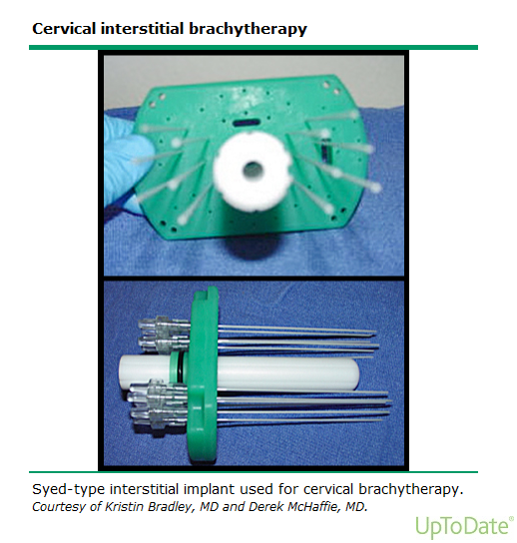
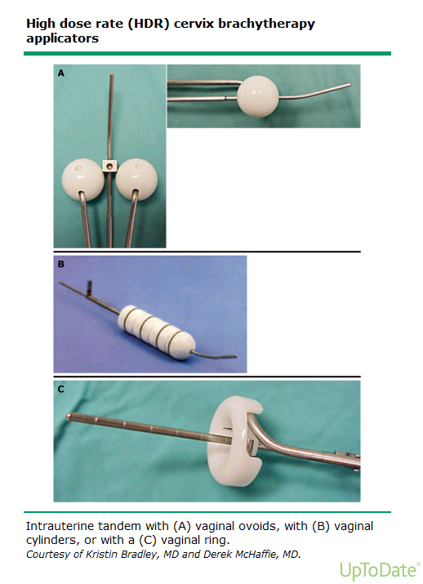
Brachytherapy

Slide 22
COMPLICATIONS:
TAH/BSO complications – mortality (<1%), infection, wound
dehiscence, fistula, bleeding
Frequency and urgency of urine and/or stool
Vaginal stenosis – use dilators
Thrombocytopenia with WART

Slide 23
FERTILITY PRESERVATION
Women with low-risk endometrial carcinoma who wish to preserve fertility may be candidates for treatment with progestin therapy .
Evaluation prior to medical therapy (eg, dilation and curettage, imaging studies) is necessary to try to confirm that the lesion is confined to the uterus and is grade 1.

Slide 24
Survival
In general, the rate of five-year for stage I disease is approximately 80 to 90 percent, for stage II it is 70 to 80 percent, and for stages III and IV it is 20 to 60 percent.

Slide 27
Lymphadenectomy
Lymph node metastases found in about 10% of patients with endometrial cancer clinically confined to the uterus.
Lymph node evaluation is part of FIGO staging for endometrial cancer.

Slide 28
Lymphadenectomy
Advantages:
Assigning patients to their proper FIGO stage.
Useful in planning post operative treatment.
Complications:
Prolong operative time.
Increase blood loss.
Injury to adjacent structures.
Lymphocele and lymphedema.

Slide 29
Sentinel node (SLN)
SLN is considered the standard of care in many solid tumors (breast, melanoma, vulva).
Precise and less invasive than complete lymphadenectomy.
Allow identification of aberrant drainage sites.
Detect more metastases (ultra-staging)

Slide 30
Goals of SLN
Avoid complete lymphadenectomy if SLN is negative bilaterally.
Reduce the morbidity of lymphadenectomy.
Avoid under/over treatment.

Slide 31
Sentinel lymph node mapping in endometrial cancer
Colometric detection with Patent Blue (PB) and/or radio-isotopic detection with Technetium (TC99) to identify SLN.
Injection site: cervix at 3 and 9 o’clock

Slide 32
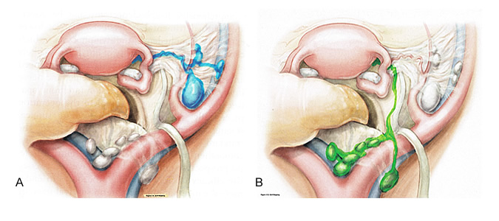

Slide 35
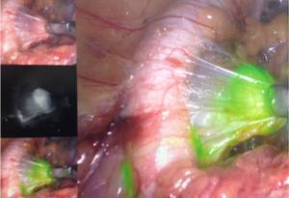

Slide 36
THANK YOU

