Slide 1
ATOPIC DERMATITIS AND ECZEMATOUS DISORDERS
Dr. Hend Alotaibi
Assistant professor & Consultant
College of Medicine, King Saud University
Dermatology Department /KKUH
Email: halotaibi1@ksu.edu.sa

Slide 2
Objectives
To know the definition & classification of Dermatitis/Eczema
To recognize the primary presentation of different types of eczema
To understand the possible pathogenesis of each type of eczema
To know the scheme of managements lines

Slide 3
Eczema - dermatitis
Definition: inflammation of the skin
What are the eczema phases?
Acute eczema: erosion, oozing and vesicles
Subacute eczema: Redness+ swelling, crust-+ scale +infection
Chronic eczema: lichenification, dark pigmentation and thick papules and plaques

Slide 4
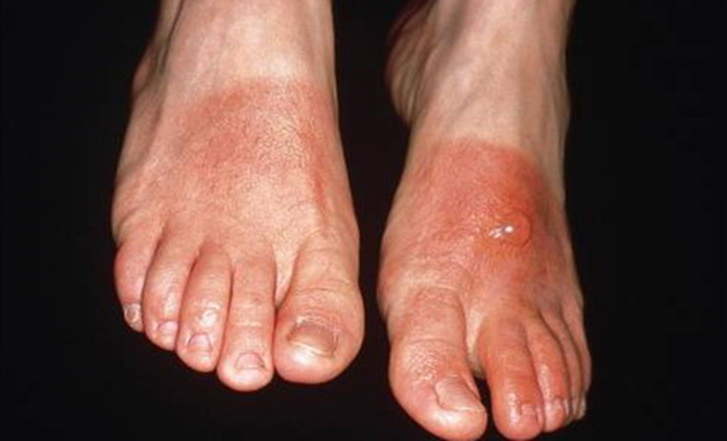
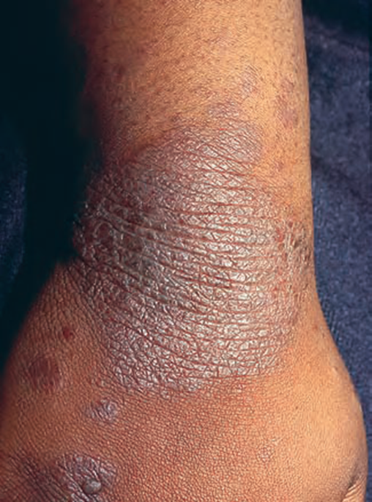
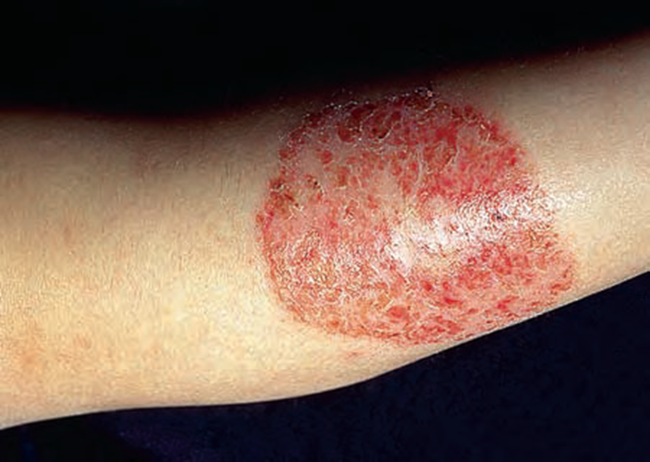

Slide 5
Atopic Dermatitis
Definition: chronic relapsing itchy skin disease in genetically predisposed patients.
Associated diseases: bronchial asthma, allergic rhinitis, allergic conjunctivitis( personal or family Hx)
Incidence: up to 15-20 % in early childhood
More in male
Age of onset:
60% ------ first 2 months of life
30 %------- by age of 5
10%-------- between age 6- 20 years
Improves in summer and flare in winter

Slide 6
Pathogenesis:
Cause :
Atopy”: genetic predisposition
Mutation of FLG (encodes filaggrin) → disturbed skin barrier function
skin barrier defect: Dry skin (decrease production of moisturizing lipids; sebum)
Immune dysregulation:
T cell activation
Ig E ? (Epiphenomenon)
Triggers:
Allergy, increased tendency to certain allergens (Autoallergen)
Infection : skin of pts with AD is colonized by S aureus. infection with S aureus often causes a flare of AD
AD and Food! minor role

Slide 7
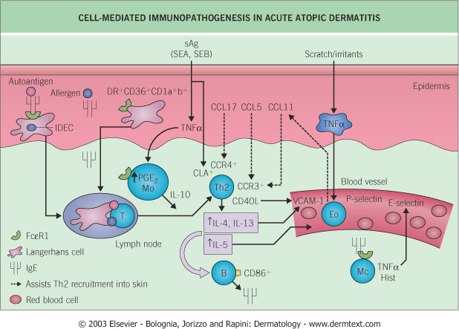

Slide 8
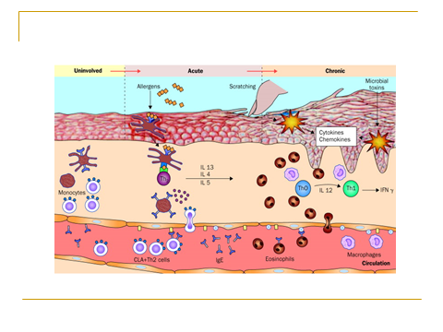

Slide 10
Clinical Variants:
Infantile AD
Childhood AD
Adult AD

Slide 11
Infantile AD
Distribution
Presentation
Red skin, tiny vesicles on
“puffy “ surface. Scaling, exudate
With wet crust and fissures.
Diaper area is usually spared

Slide 12
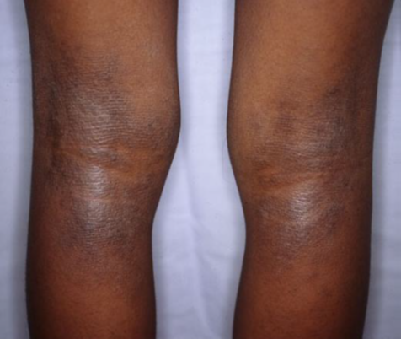
Childhood AD:
Distribution
Presentation
Antecubital, popliteal fossae, neck and face.
May be generalized
Papular, lichenified plaques, erosions, crusts.

Slide 13
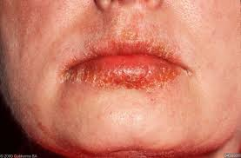
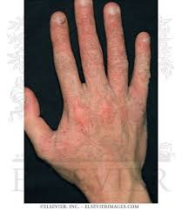
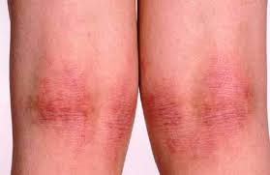
Adult AD:
Distribution
Presentation
Mostly flexural, face and neck.
May be generalized
Lichenification and excoriations

Slide 14
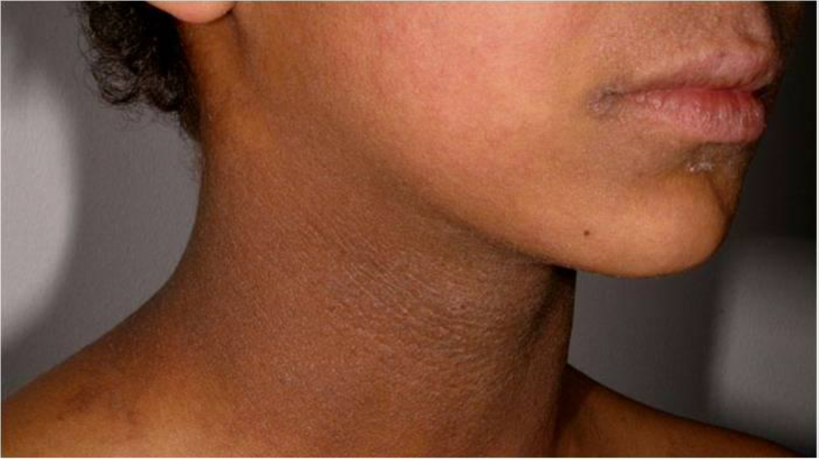

Slide 17
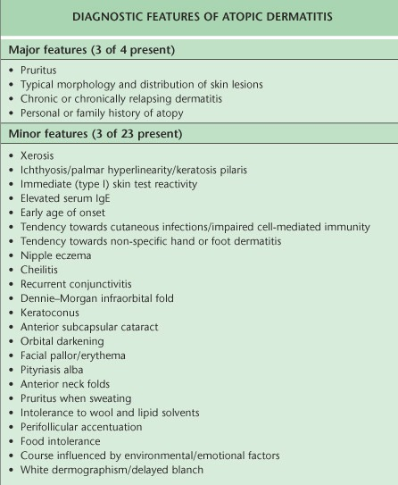

Slide 21
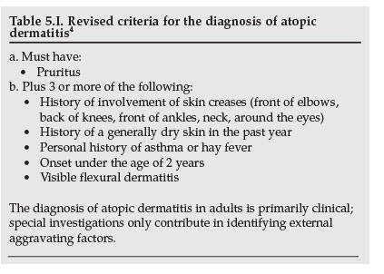

Slide 22
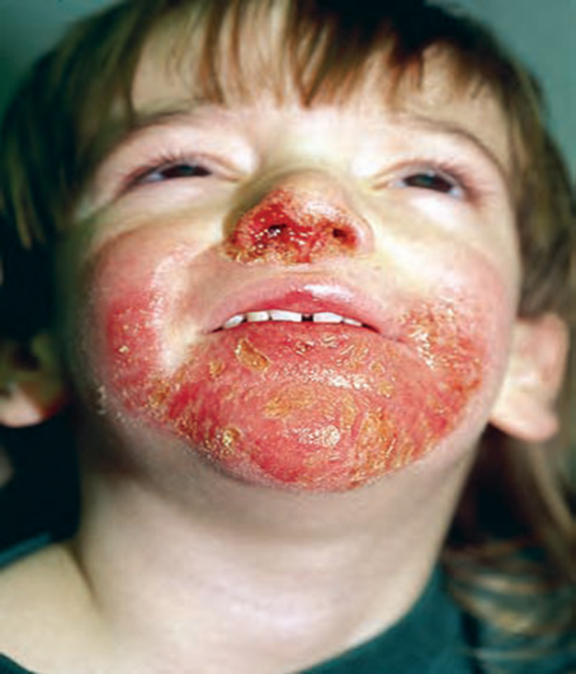
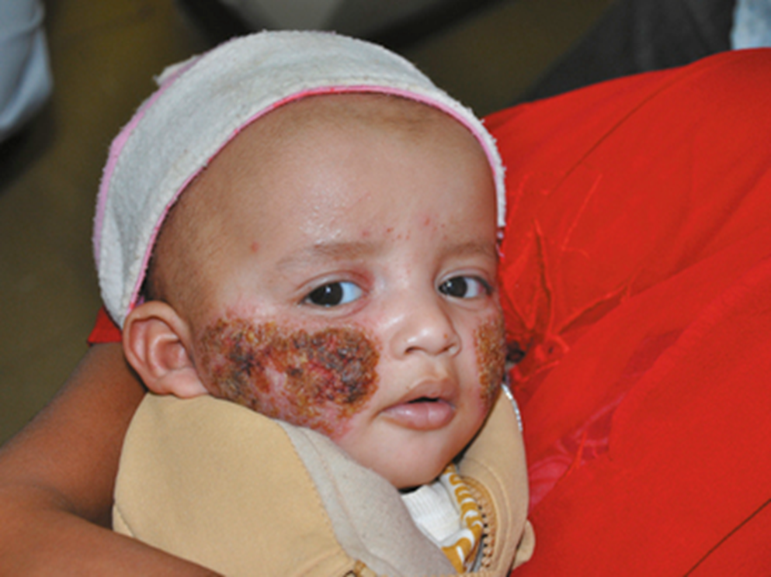
Complications:
Secondary infections

Slide 23
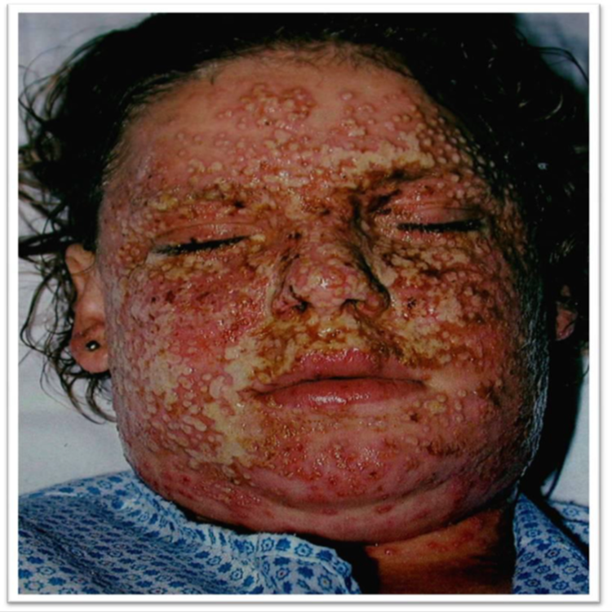
Complications:
Eczema herpeticum

Slide 24
Complications:
Growth retardation
psychological

Slide 25
Prognosis
Half of the cases improve by 2 years of age
Most improve by teenage years
<10% of patients have lifelong problems
30-50% will develop BA or hay fever

Slide 26
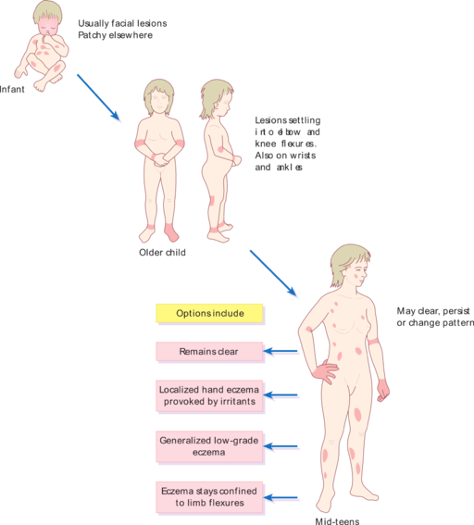

Slide 27
Management:
Education! Education! Education!
Psychological support!
Skin care: moisturizing the skin
Avoid irritant like soaps
Topical therapy: (topical steroids, Tacrolimus, Pimecrolimus)
Antibiotics--- Antistaphylococcal drugs
Sedative antihistamine ( Oral H1 antihistamine) to control itching and help sleep
Phototherapy
Systemic therapy: steroids, Cyclosporin, Methotrexate, Azathioprine

Slide 28
Management and treatment of Atopic dermatitis
Topical treatment
Phototherapy
Systemic therapy

Slide 29
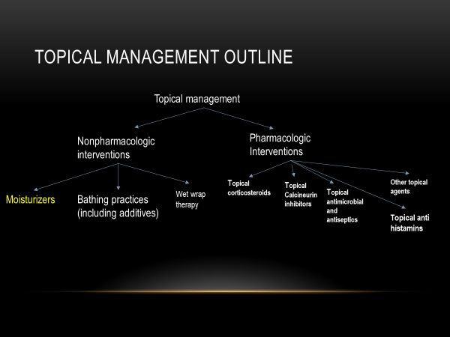

Slide 30
Pharmacologic Interventions
Topical cancineurin inhibitors→ level of recommendations is A
  Efficacy
    Tacrolimus ointments(0.03% and 0.1% strengths)
      Approved for moderate to severe disease
      0.1% as effective as the mid potency TCS hydrocortisone butyrate 0.1%.
      0.03% is less effective than hydrocortisone butyrate 0.1% but more effective than the low potency TCS hydrocortisone acetate 1%
    Pimecrolimus cream (1% strength)
      indicated for mild to moderate AD
        Less effective than mid and high potency TCS→ direct compression made

Slide 31
Topical management outline
Topical management
Nonpharmacologic interventions
Pharmacologic Interventions
Topical corticosteroids
Topical Calcineurin inhibitors
Other topical agents
Moisturizers
Bathing practices (including additives)
Wet wrap therapy
Topical antimicrobial and antiseptics
Topical anti histamins

Slide 32
Systemic agents
Immunosuppressive
Biologics
Antimicrobials
Antihistamines
Dupilumab
Omalizumab
Cyclosporine
Azathioprine
Methotrexate
Mycophenolate mofetil
Systemic corticosteroids

Slide 33
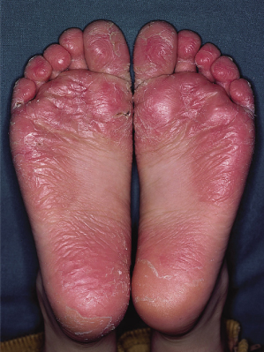
Juvenile planter dermatosis

Slide 34
Seborrhoeic Dermatits
Definition: redness and scaling in regions where the sebaceous glands are most active as the face, scalp, presternal area and body folds.
Very common chronic dermatosis.
Age: infancy, puberty , old age
More in male
Pathogenesis:
Increased Sebum!( seborrheic state)
Tendency
Pityrosporum ovale ( Maalassezia furfur )over growth
More in Parkinson, HIV/AIDS patients.

Slide 35
Clinical features
Presentation
Pruritus is variable
Gradual onset, worse in winter dry environment.
Orange- red greasy scaling macules, papules of varying size
Trunk: nummular, annular
Scalp: marked scaling, diffuse involvement

Slide 36
Distribution:
Hairy are of head, cradle cap
Face: forehead, nasolabial folds , glabella and eyebrows.
Trunk: DDx: PR vs pityriasis versicolor
Body folds: axillae, groins, anogenital area, submammary areas, umbilicus and diaper area (infants)--- sharply marginated erythematous eruption, erosions and fissures
Genitalia: with yellow crust and psoriasiform lesions.

Slide 37
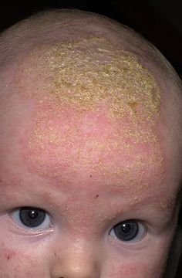

Slide 38
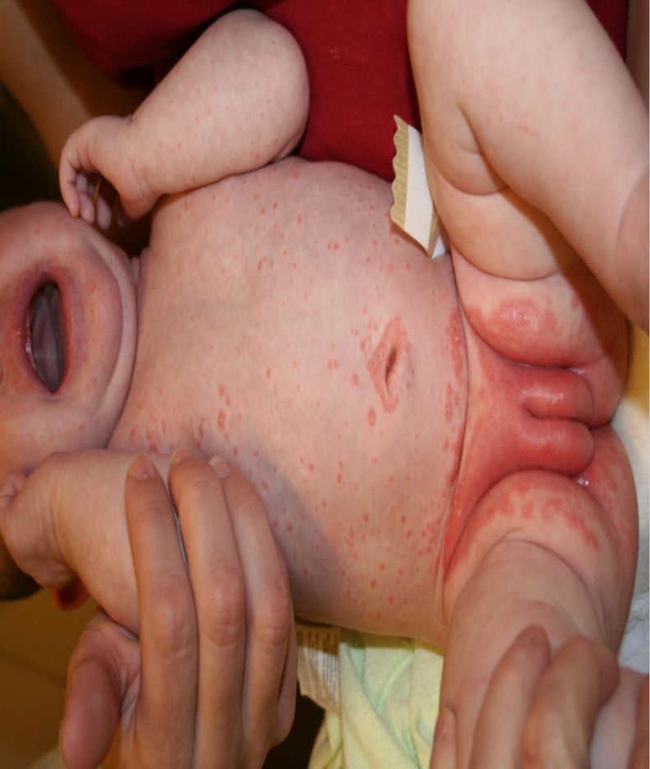

Slide 39
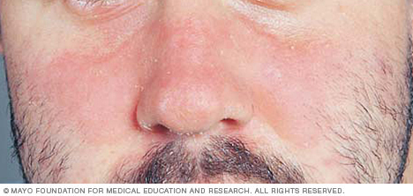

Slide 40
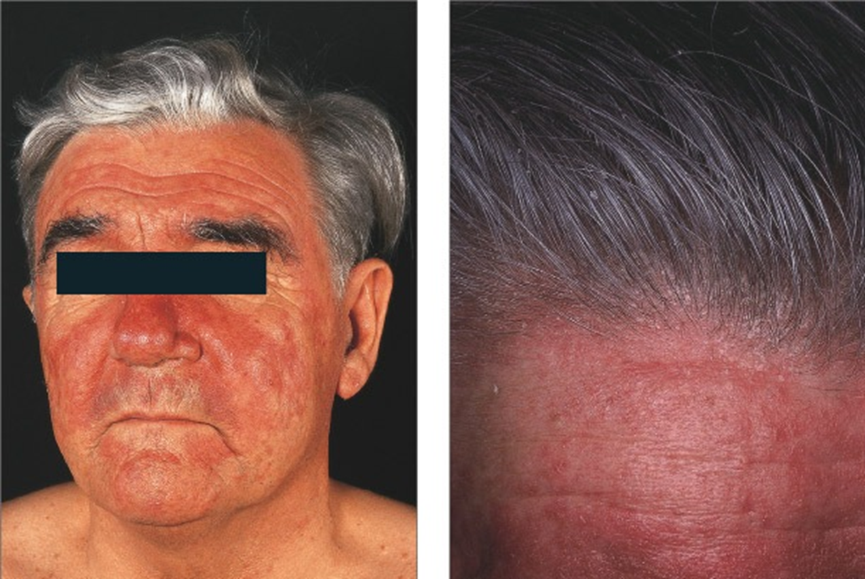

Slide 41
Management:
Scalp :
Zinc pyrithione Shampoo
Selenium sulfide 2.5% shampoo
2% ketoconazole shampoo
Low – potency glucocorticoid solution, lotion or gels.
Skin:
Topical: antifungals, glucocorticoid, pimecrolimus
Combined therapy
Maintenance & recurrence

Slide 42
Contact Dermatitis
Definition: dermatitis results from contact with external materials.
Pathogenesis:
Irritant vs. allergic : (cytotoxic vs type IV)
Common irritants: detergent, acids, dust, burning chemicals, etc
Common allergens: perfumes, hair dyes, nickels, leathers, metals, rubbers, latex, cosmetics, etc

Slide 43
IRRITANT CONTACT DERMATITIS
All people will react to an irritant if applied in a high enough concentration
At 1st exposure
Common causes:
Hands repeatedly exposed to water, cleansers
Lip-licking habit – wetting and drying caused by saliva
Napkin dermatitis

Slide 44
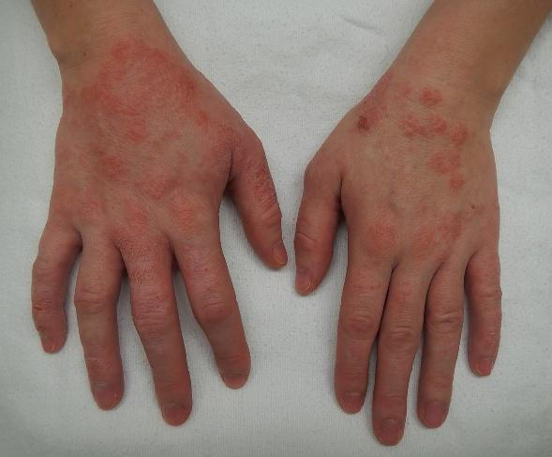

Slide 45
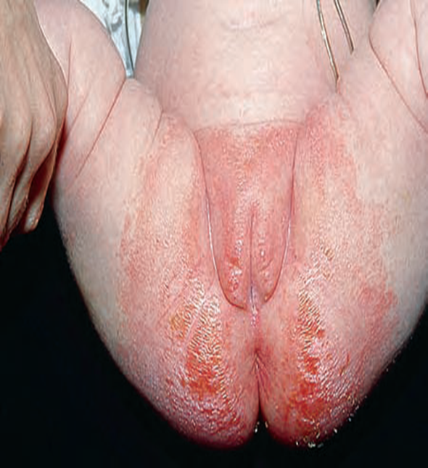

Slide 46
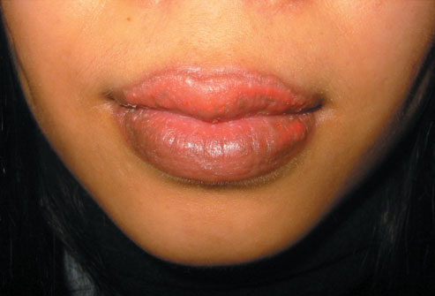

Slide 47
ALLERGIC CONTACT DERMATITIS
It is caused by allergen that trigger type IV hypersensitivity reaction in a sensitized person.
Characteristics
First exposure does not cause a reaction
Begins 24 h after subsequent exposure if already allergic
Commonest: Nickel, chromates, rubber, preservatives, topical Abx, topical cs
Diagnosis: Skin patch tests( read at 48, 96 h)

Slide 48

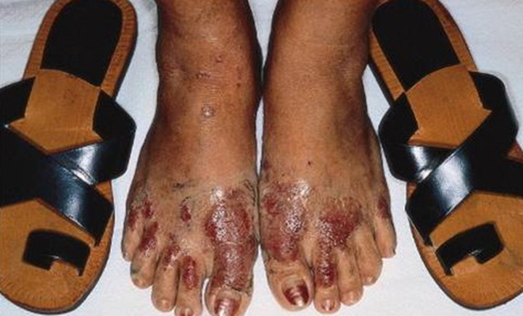
Shoe dermatitis
Causes:
a. Rubber (most common)
b. Chromates (in leather)
c. Glutaraldehyde (in leather)
d. Adhesives
e. Dyes

Slide 49
Clinical features
Predilection sites: site of contact
Distribution & configuration

Slide 52
Management:
Identification removal of causes.
Patch testing:
for allergic contact dermatitis not for irritant
Avoidance allergens
Topical corticosteroids

Slide 53
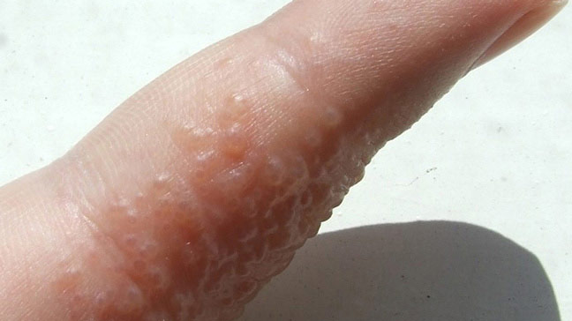
Dyshidrotic eczema

Slide 55
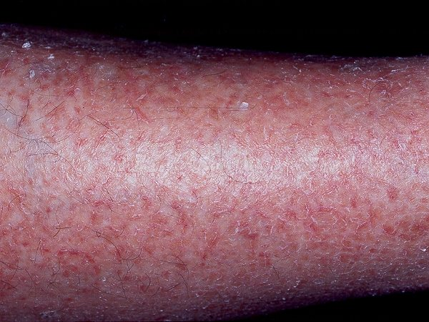
Asteatotic eczema

Slide 56
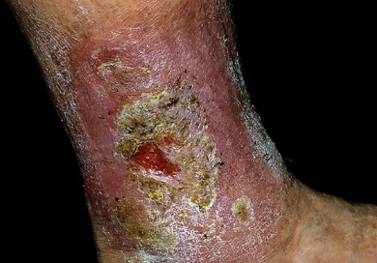
Stasis eczema

Slide 57
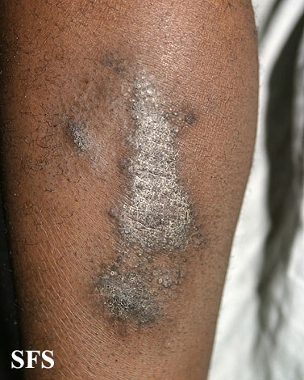
Lichen simplex Chronicus

Slide 58

THANK YOU

