Slide 1
Blistering Disorders
Dr. hadeel Mitwalli
Assistant Professor Dermatology & dermatologic surgery
Department of dermatology, college of medicine
King Saud university

Slide 2

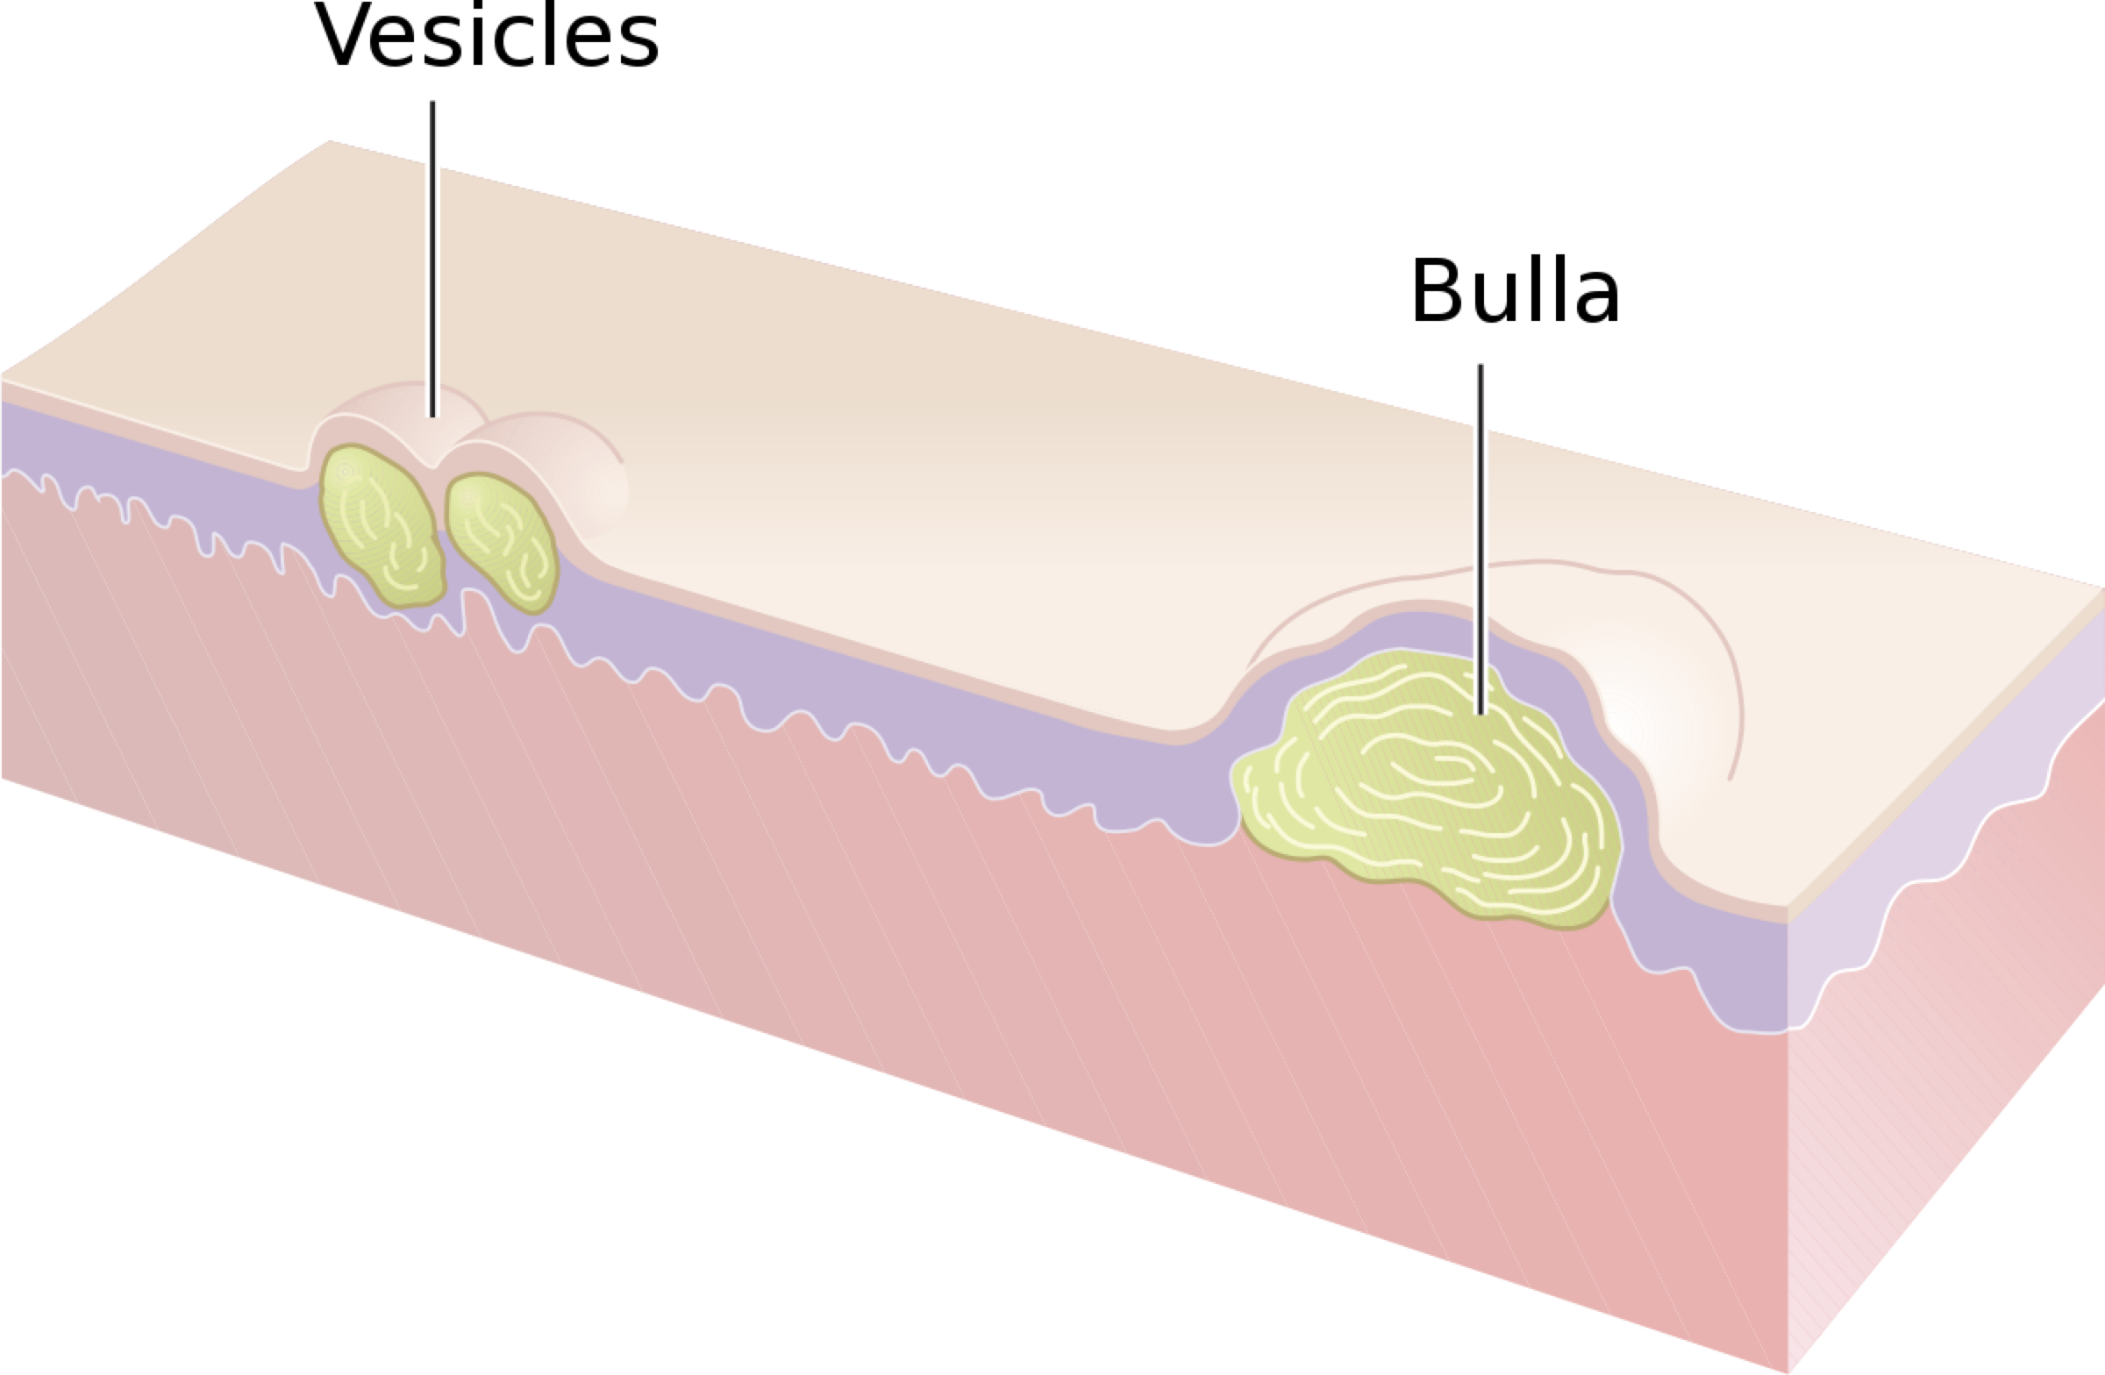
Vesicle: an elevation that contains clear fluid ( < 5cm in diameter)
Bulla: Localized fluid collection ” large vesicle” ( > 5 cm in diameter)

Slide 3
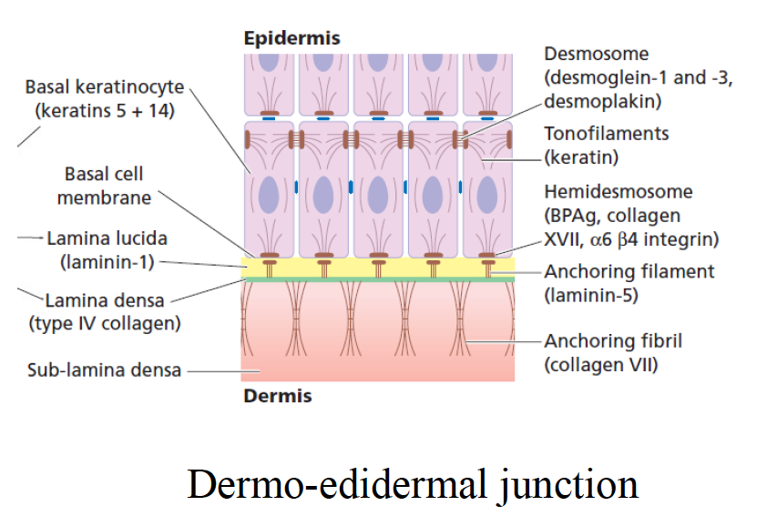

Slide 4
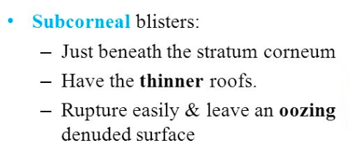
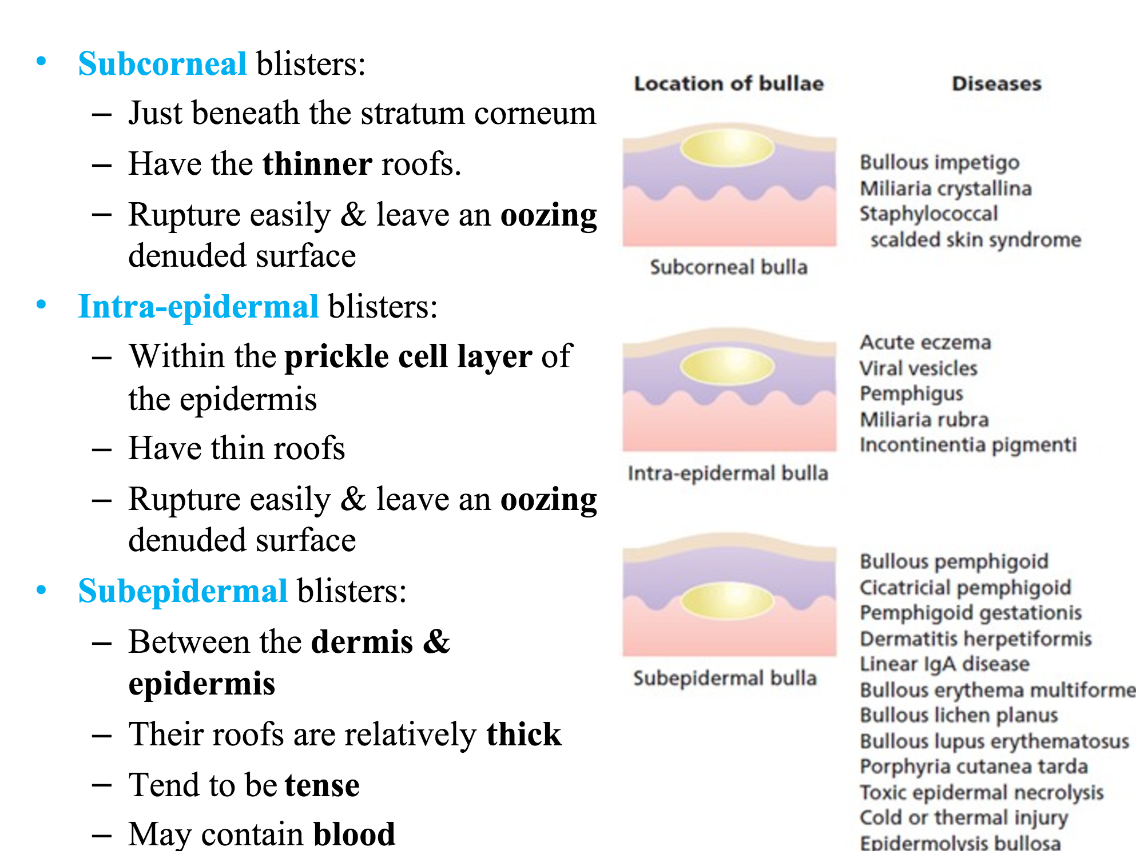
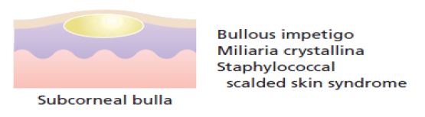
Classification Of Vesiculobullous Diseases:

Slide 5
Blistering Disorders
In Adults:
the main group of blistering disorders is associated with auto-antibody formation
In Children: Genodermatosis, (epidermolysis bullosa), associated mainly with mechanical defects in and around the basement membrane zone

Slide 6
Blistering Disorders
Accurate pathological diagnosis requires a biopsy of a small newly formed lesions and perilesional skin of immunopathological studies
In the case of blisters in children, electron microscopy may be required

Slide 7
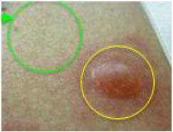
Dignostic tests
1. Routine Histology: lesional sample in formalin
2. Direct immunofluorescence – Perilesional skin
3. Indirect immunofluorescence – patient’s serum is addedto specific substrates that express antigen of interest
4. Electron microscopy

Slide 8
Epidermolysis Bullosa
Group of mechanobullous genodermatosis
Rare
Usually present at birth or infancy
Range from localized relatively mild trauma induced blisters to life threatening/debilitating conditions
Diagnosis is made based on family history, clinical examination, light and electron microscopy

Slide 9
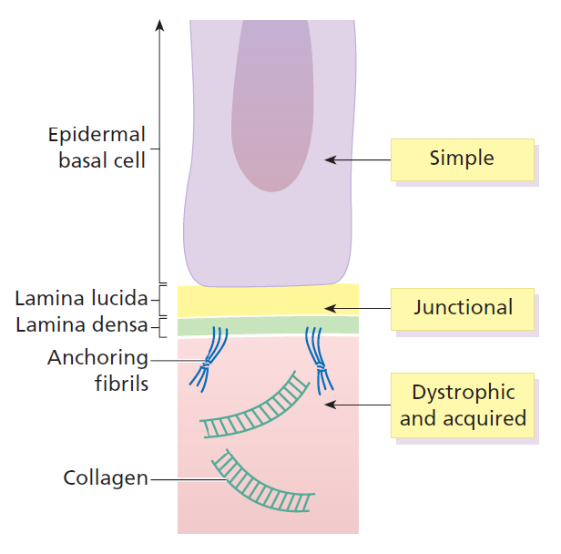
Epidermolysis Bullosa
The main subsets are:
  Epidermolysis bullosa simplex- mainly autosomal dominant
  Junctional epidermolysis bullosa- autosomal recessive
  Dystrophic epidermolysis bullosa- both autosomal dominant and autosomal recessive

Slide 10
Epidermolysis Bullosa
Epidermolysis Bullosa Simplex:
  Majority are autosomal dominant
  The pathological damage lies within the epidermis
  The main defect lies in defective genes coding for keratin 5 and 14 in the basal layer

Slide 11
Epidermolysis Bullosa
Epidermolysis Bullosa Simplex:
  Blisters may be present at birth, or when the child starts to walk or crawl, and they tend to develop mild blistering on the knees , hands, feet and other sites of friction
  The blisters quickly rupture and heal with no scarring

Slide 12
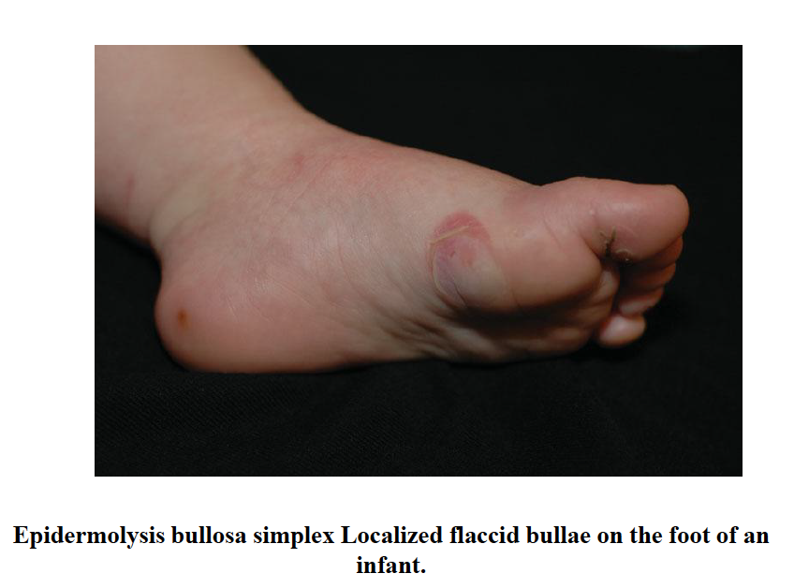

Slide 13
Epidermolysis Bullosa
Junctional epidermolysis bullosa:
  Autosomal recessive
  The gene which is abnormal is :
    Laminin 5, in 2 types of Junctional EB
    𝛂6 β4 in the third type
  Split is at the level of the lamina lucida

Slide 14
Epidermolysis Bullosa
Junctional epidermolysis bullosa:
  Clinical features may be present at birth either as blisters ( often around nails) or as raw denuded areas
  Mucous membranes may be severely involved
  Teeth are commonly abnormal

Slide 15
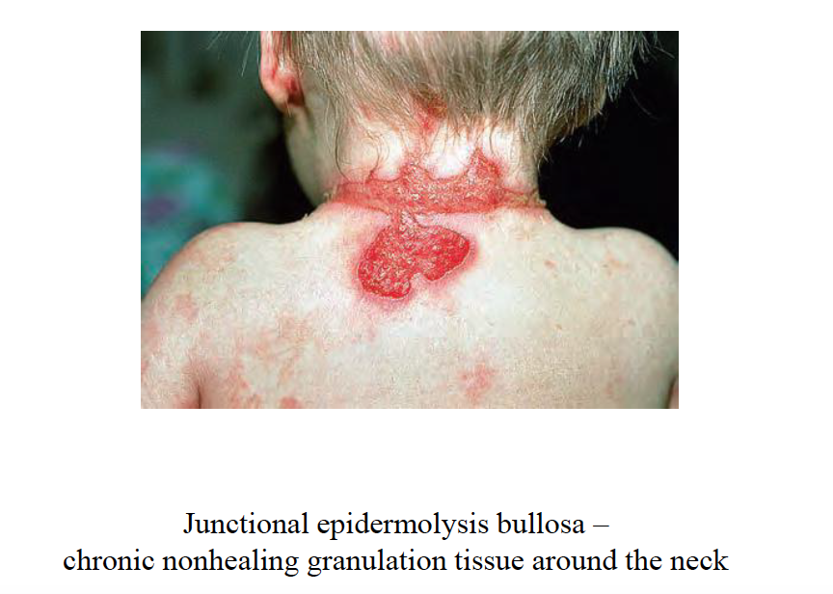

Slide 16
Epidermolysis Bullosa
Dystrophic epidermolysis bullosa:
  Autosomal dominant or autosomal recessive
  All types are associated with defects in type 7 collagen gene which causes defective anchoring fibrils
  Squamous cell carcinoma may develop on scar sites

Slide 17
Epidermolysis Bullosa
Dystrophic epidermolysis bullosa:
  In the dominant variant, blisters develop later in infancy or early childhood on friction sites and heal with scarring
  Hair and teeth develop normally

Slide 18
Epidermolysis Bullosa
Dystrophic epidermolysis bullosa:
  In the recessive variant, large bullae are present at birth and they heal with scarring
  Mucous membranes, hair, nails and teeth may be abnormal

Slide 19
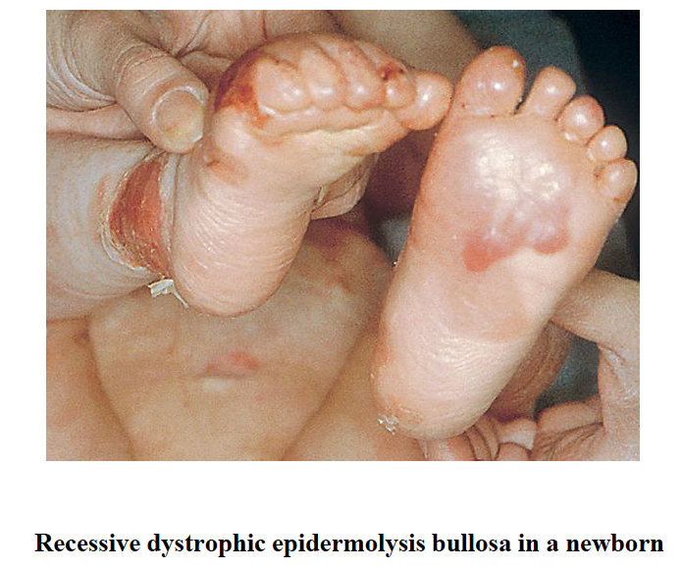

Slide 20
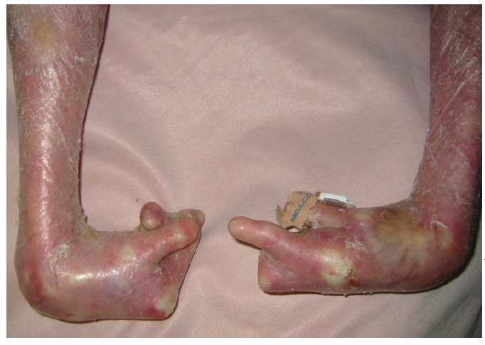


Slide 21
Epidermolysis Bullosa
Treatment:
  Team management
  Biopsies
  Prevention of frictional bullae
  Occupational therapy
  Dental care
  Skilled nursing care

Slide 22
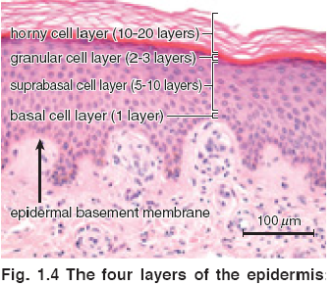
Staphylococcal scalded skin syndrome
Caused by an epidermolytic toxin of certain types of Staph aureus, which splits the epidermis at the level of the granular layer by cleaving desmoglein 1
Commoner in children

Slide 23
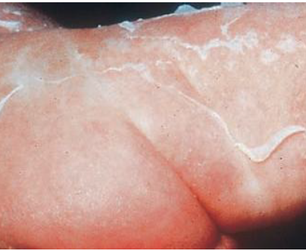
Staphylococcal scalded skin syndrome
Rapidly expanding shallow blisters which rupture quickly leaving painful raw areas
Swabs need to be taken and sent for bacterial cultures
Treatment is with systemic anti staphylococcal antibiotics
Dressings
Heal without scarring

Slide 24
Autoimmune Bullous Diseases
Loss of intraepidermal adhesion: “Pemphigus group”:
  Pemphigus vulgaris (PV) :
    Classic
    Pemphigus vegetans
  Pemphigus foliaceus :
    Classic
    Fogo selvagum
    Pemphigus erythematosus ( Senear- Usher Syndrome)
  Drug Induced pemphigus
  Paraneoplastic pemphigus
  IgA pemphigus

Slide 25
Autoimmune Bullous Diseases
Loss of subepidermal adhesion:
  Pemphigoid
    Bullous pemphigoid
    Cicatricial pemphigoid
    Pemphigoid gestationis
  Dermatitis herpatiformis
  Linear IgA disease
    Of Childhood
    Adult form
  Epidermolysis bullosa aquisita

Slide 26
Autoimmune Bullous Diseases
Pemphigus Group

Slide 27
Autoimmune Bullous Diseases
The Pemphigus Group:
a group of disorders with loss of intraepidermal adhesion due to autoantibodies directed against proteins of the desmosomal complex that hold keratinocytes together
The Desmosome is a complex structure, with many of it’s components being targets for autoantibodies.

Slide 28
Autoimmune Bullous Diseases
Fig. Structure of the Desmosome

Slide 29
Autoimmune Bullous Diseases
The Pemphigus Group:
Patients with PV and PF have IgG autoantibodies against desmoglein 3 and desmoglein 1, respectively, while patients with paraneoplastic pemphigus have IgG autoantibodies against plakin molecules in addition to autoantibodies against desmogleins
Pemphigus vulgaris
  Mucosal type → desmoglein 3
  Mucocutaneous type → desmoglein 3, desmoglein 1
Pemphigus foliaceus → desmoglein 1
Paraneoplastic pemphigus → Plakin

Slide 30
Autoimmune Bullous Diseases
Pemphigus Vulgaris:
Severe, potentially fatal disease with intraepidermal blister formation of the skin and oral mucosa caused by IgG autoantibodies against “desmogleins”
Epidemiology: The mean age of onset of disease is 50-60 years

Slide 31
Autoimmune Bullous Diseases
Pemphigus Vulgaris:
Pathogenesis:
  Genetic predisposition: HLA-DRQ402- DQ0505
  IgG autoantibodies against desmoglein 3 (Dsg 3) and later desmoglein1(Dsg 1). The bound antibodies activate proteases that damage the desmosome, leading to acantholysis
  Serum antibody titer usually correlates with severity of disease and course

Slide 32
Autoimmune Bullous Diseases
Pemphigus Vulgaris:
Clinical features:
  Mucous membranes:
    lesions usually present as painful erosions
    Intact blisters are rare
    Sites: oral mucosa, vermillion lip, throat, esophagus, conjunctivae, nasal mucosa, vagina, penis, anus, labia
    Most common sites: buccal & palatine mucosa
    Vermillion lip→ thick fissured hemorrhagic crust
    throat → hoarseness, difficulty swallowing
    70%, anti-Dsg3 (Dsg 3 is the main desmoglein in mucosal surfaces)
    Always check the scalp when confronted with unexplained oral erosions

Slide 33
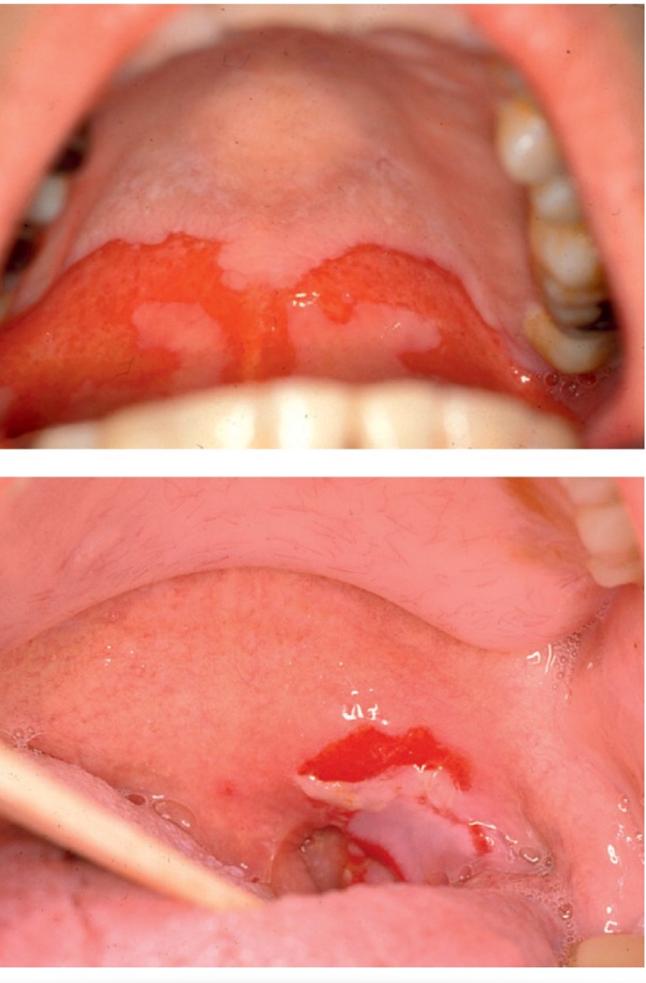
Autoimmune Bullous Diseases
Pemphigus Vulgaris:
Clinical features:
  Mucous membranes:

Slide 34
Autoimmune Bullous Diseases
Pemphigus Vulgaris:
Clinical features:
  Skin :
    Primary skin lesions of PV are flaccid, thin-walled, easily ruptured blisters
    They could arise on either normal-appearing skin or erythematous base
    The blisters are fragile and soon rupture to form painful erosions that ooze and bleed easily, later forming crusts
    Can become generalized
    Lesions that heal often leave hyperpigmented patches with NO scarring
    More generalized disease due to the development of IgG autoantibodies against Dsg1 which is present in the skin along with Dsg3

Slide 35
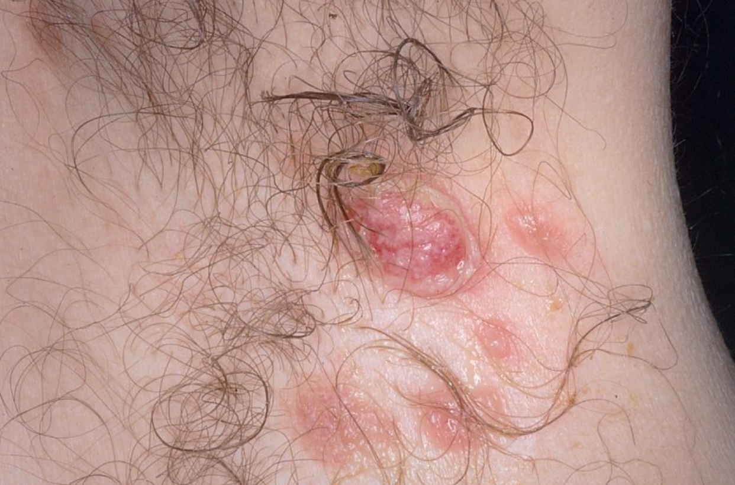
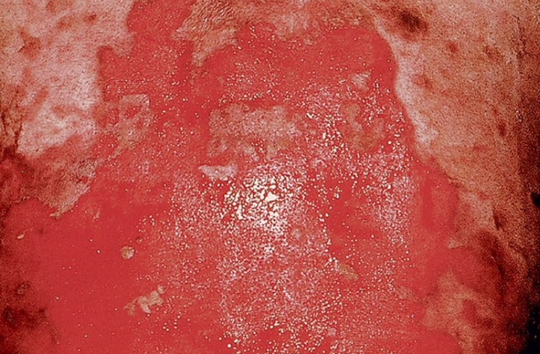
Pemphigus Vulgaris

Slide 36
Autoimmune Bullous Diseases
Pemphigus Vulgaris:
Pathology :
  Intraepidermal blister formation due to loss of cell-cell adhesion of keratinocytes (acantholysis) without keratinocyte necrosis
  They maintain their attachment to the basement membrane via hemidesmosomes, this giving the appearance of “ row of tombstones”
  Mild dermal perivascular infiltrates

Slide 37
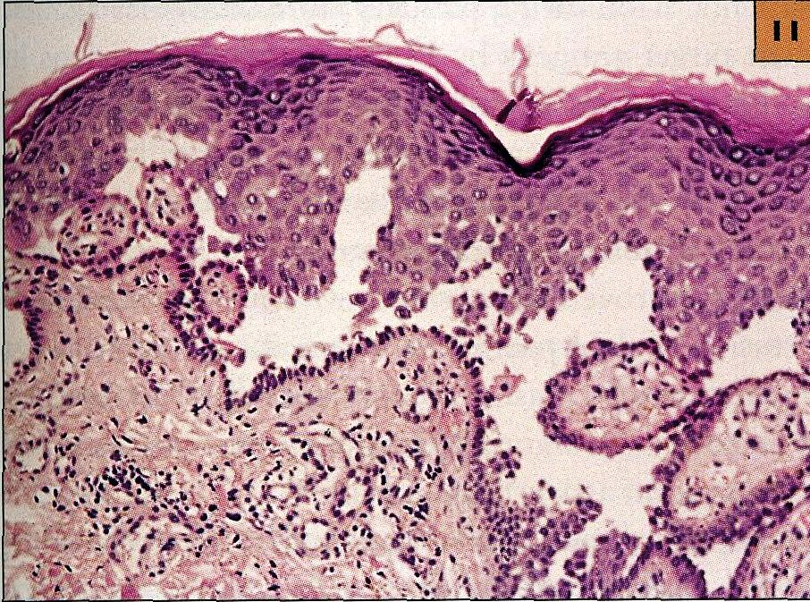
Pemphigus Vulgaris:
Pathology

Slide 38
Autoimmune Bullous Diseases
Pemphigus Vulgaris:
Diagnostic Approach:
  History ( always ask medication Hx)
  Physical examination → skin, mucous membranes, nails
    Nikolsky sign → because of an absence of cohesion within the epidermis, its upper layers easily move laterally with slight pressure or rubbing in active patients with pemphigus
    Asboe-Hansen sign→ “ bulla- spread phenomenon” – gentle pressure on an intact bulla forces the fluid to spread under the skin away from the site of pressure

Slide 39
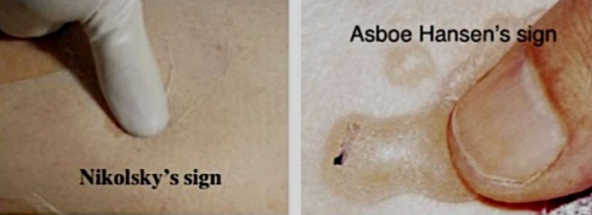
Autoimmune Bullous Diseases
Pemphigus Vulgaris:
Diagnostic Approach:

Slide 40
Autoimmune Bullous Diseases
Pemphigus Vulgaris:
Diagnostic Approach:
  Investigation
    skin biopsy: from lesional skin, intact vesicles if found
    DIF: from perilesional skin shows deposition of IgG (100%), C3 (80%)
    Indirect IF
    ELISA: to identify anti-Dsg3,1

Slide 41
Autoimmune Bullous Diseases
Pemphigus Vulgaris:
Differential Diagnosis :
When skin is involved :
Bullous impetigo
dyskeratotic acanthoytic disorders
  Hailey-Hailey
  Grover disease
When mucous membranes is involved:
Denture intolerance
Erosive candidiasis
Chronic recurrent aphthae
Erythema multiforme
Erosive lichen planus
Herpetic ginigivitis

Slide 42
Autoimmune Bullous Diseases
Pemphigus Vulgaris:
Treatment :
  Systemic corticosteroids are the mainstay of therapy for pemphigus and immunosuppressive agents are often used for their steroid sparing effect in order to reduce the side effects of the corticosteroids

Slide 43
Autoimmune Bullous Diseases
Pemphigus Vulgaris:
Treatment :
  Prednisone at 1.0 mg/Kg/day ( usually 60 mg/day) is a typical initial dosage
  The therapeutic effects are clinically estimated by the number of new blisters per day and the rate of healing of new lesions, and then the prednisone is gradually tapered

Slide 44
Autoimmune Bullous Diseases
Pemphigus Vulgaris:
Treatment :
  Immunosuppressive agents in combination with oral prednisone:
    Azathioprine
    Cyclophosphamide
    Mycophenolate mofetil
    Cyclosporine
    Pulse methylprednisolone
    IVIG
    Rituximab
    Extracorporeal photopheresis
Topical treatments:
Topical corticosteroids
Topical antibiotics
Topical immunomodulators ( e.g. topical tacrolimus

Slide 45
Autoimmune Bullous Diseases
Pemphigus Vegetans:
Is a rare vegetative variant of pemphigus vulgaris

Slide 46
Autoimmune Bullous Diseases
Pemphigus Vegetans:
Clinical Features:
  Characterized by flaccid blisters that become erosions and then form fungoid vegetations, especially in intertriginous areas, the scalp and face
  Early lesions start as pustules ( rather than vesicles), then they soon progress to vegetative plaques
Treatment: same as pemphigus vulgaris

Slide 47
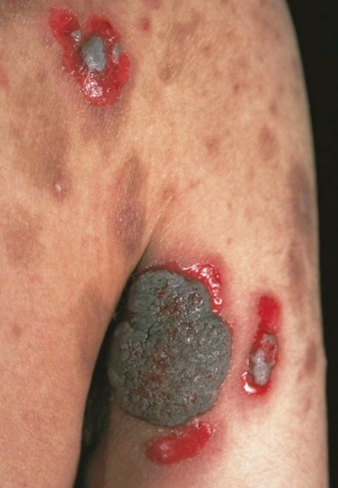
Autoimmune Bullous Diseases
Pemphigus Vegetans:

Slide 48
Autoimmune Bullous Diseases
Pemphigus Foliaceus:
Is a form of pemphigus in which patients develop scaly, crusted cutaneous erosions often on an erythematous base
Disease of middle-aged and older patients

Slide 49
Autoimmune Bullous Diseases
Pemphigus Foliaceus:
In this form of pemphigus they do not have mucosal involvement even with widespread disease
Lesions have a seborrheic distribution ( face, scalp, and upper trunk )
IgG autoantibodies against desmoglein 1
More often drug induced than pemphigus vulgaris
Patients with pemphigus foliaceus are not severely ill

Slide 50
Autoimmune Bullous Diseases
Pemphigus Foliaceus:
  Diagnostic Approach:
  History ( always ask medication Hx)
  Physical examination → skin, mucous membranes, nails
    Nikolsky sign → present
  Investigation
    DIF: from perilesional skin shows superficial deposition of IgG
    ELISA: to identify IgG antibodies against Dsg 1
  Treatment: same as pemphigus vulgaris

Slide 51
Autoimmune Bullous Diseases
Pemphigus Foliaceus:
  Treatment:
    Same as pemphigus vulgaris but usually more responsive to therapy
    Dapsone maybe helpful

Slide 52
Autoimmune Bullous Diseases
Pemphigus Erythematosus ( Senar-Usher Syndrome):
Localized variant of Pemphigus foliaceus
Scaly, crusted lesions of pemphigus foliaceus over the malar region and in other seborrheic areas
Patients have immunologic features of both Lupus erythematosus and pemphigus ( i.e. IgG and C3 deposition on cell surface of keratinocytes as well as the basement membrane zone, in addition to circulating ANA
Very rare, only reported in few patients

Slide 53
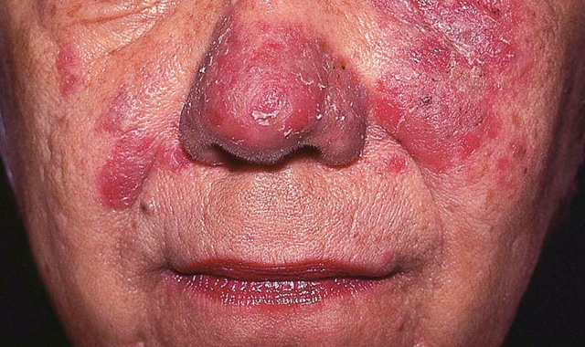
Autoimmune Bullous Diseases
Pemphigus Erythematosus

Slide 54
Autoimmune Bullous Diseases
Drug- Induced Pemphigus:
  Drugs that induce pemphigus can be divided into two groups:
Agents containing the sulfhydryl group:
    Penicillamine
    Captopril
    piroxicam
  Penicillamine → PF is seen more than PV, ratio 4:1
  sulfhydryl group of these drugs interacts with the sulfhydryl groups of Dsg1 & Dsg 3 ( acantholysis without antibodiy formation)
Agents without the sulfhydryl group:
  Beta- blockers
  Cephalosporines
  Penicillins
  Rifampin
Induce acantholysis via imuune mechanisms
Most patients with drug-induced pemghigus go into remission after the offending drug is discontinued

Slide 55
Autoimmune Bullous Diseases
IgA Pemphigus:
Represents a group of autoimmune intraepidermal blistering diseases presenting with:
  Vesicopustular eruption
  Neutrophilic infiltration of the skin
  Circulating IgA autoantibodies against the cell surface of keratinocytes, but with NO IgG autoantibodies

Slide 56
Autoimmune Bullous Diseases
IgA Pemphigus:
Two distinct types:
  Subcorneal pustular dermatosis (SPD)
  Intraepidermal neutrophilic type (IEN)

Slide 57
Autoimmune Bullous Diseases
IgA Pemphigus:
Both types present with flaccid vesicles or pustules that coalesce to form an annular pattern with central crusting
Sunflower-like configuration of pustules is a characteristic sign of the IEN type
Most common site: axilla, groin, trunk
NO mucous membrane involvement
Pruritus is a significant symptom

Slide 58
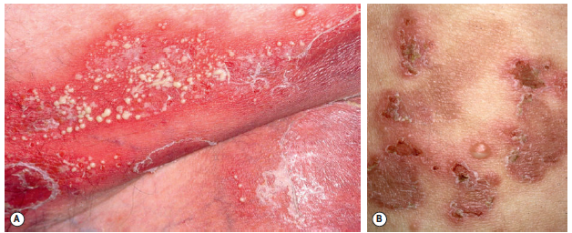
Autoimmune Bullous Diseases
IgA Pemphigus:

Slide 59
Autoimmune Bullous Diseases
IgA Pemphigus:
Diagnostic Approach:
  History
  Physical examination → skin, mucous membranes, nails
  Investigation
    DIF: IgA autoantibodies directed against keratinocyte cell surface
Treatment: most cases are responsive to dapsone, if not ,corticosteroids & other immunosuppressive agents

Slide 60
Autoimmune Bullous Diseases
Paraneoplastic Pemphigus:
Associated with underlying neoplasms, both benign and malignant
Most commonly associated neoplasms:
  non- Hodgkin lymphoma
  Chronic lymphocytic leukemia
  Castleman’s disease
  Malignant and benign thymomas
Not associated with common tumors such as adenocarcinomas and SCC

Slide 61
Autoimmune Bullous Diseases
Paraneoplastic Pemphigus:
  Clinical features:
    The most constant clinical feature is the presence of intractable stomatitis
    The Stomatitis consists of erosions and ulcerations that affect all layers of the oropharynx and characteristically extend onto the Vermilion lip
    Stomatitis is usually the earliest presenting sign and, after treatment, is the one that persists and is extremely resistant to therapy

Slide 62
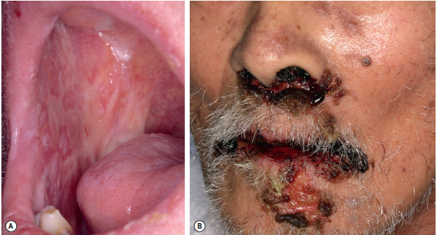
Paraneoplastic Pemphigus

Slide 63
Autoimmune Bullous Diseases
Paraneoplastic Pemphigus:
  Clinical features:
    Pseudomembranous conjunctivitis → scarring, blindness
    Could also affect: esophagus, nasopharynx, vagina, labia, penis
    cutaneous findings are “polymorphic”:
      Erythematous macules
      Flaccid blisters and erosions ( resembling pemphigus)
      Tense blisters ( resembling pemphigoid)
      Erythema multiforme like lesions
      Lichenoid eruptions

Slide 64
Autoimmune Bullous Diseases
Paraneoplastic Pemphigus:
  Histology is rarely helpful
  Treatment:
    Treat the underlying tumor
    Benign tumors: it may take 6-18 months to see complete resolution of lesions after excision of benign neoplasms
    Malignant tumors:
      No consensus on a standard effective therapeutic regimen
      Cutaneous lesions respond more rapidly than the stomatitis, which is refractory to treatment
    Prognosis of paraneoplastic pemphigus is poor due to its resistant nature to treatment

Slide 65
Autoimmune Bullous Diseases
Pemphigoid Group

Slide 66
Autoimmune Bullous Diseases
Bullous Pemphigoid (BP):
  The most common autoimmune subepidermal blistering disease, caused by autoantibodies to components of hemidesmosomes in the basement membrane zone (BMZ)
  Predominantly affects the elderly

Slide 67
Autoimmune Bullous Diseases
Bullous Pemphigoid (BP):
Pathogenesis:
  Tissue-bound and circulating autoantibodies directed against two hemidesmosomal proteins:
    BPAG 1“ BP230”
    BPAG 2 “BP180” → is most likely to be more involved in the initial immune response, since it is transmembrane

Slide 68
Autoimmune Bullous Diseases
Bullous Pemphigoid (BP):
Pathogenesis:
  Drug-induced bullous pemphigoid:
    Diuretics ( furosemide)
    D-penicillamine
    Antibiotics ( amoxicillin, ciprofloxacin)
    Potassium iodide

Slide 69
Autoimmune Bullous Diseases
Bullous Pemphigoid (BP):
Clinical features:
  BP is an intensely pruritic eruption with widespread blister formation
  In early stages and atypical variant: excoriated, eczematous, urticarial lesions
    always keep BP in mind when confronted with an elderly patient with persistent urticarial lesions
  Blisters are stable and tense
  Mucosal involvement in < 20 %

Slide 70
Autoimmune Bullous Diseases
Bullous Pemphigoid (BP):
Clinical features:
  Non-bullous phase: cutaneous manifestations are non-specific & polymorphic ( pruritus, excoriations, eczematous, urticarial lesions )
  Bullous phase: characterized by the development of vesicles and bullae on normal or erythematous skin along with urticarial lesions
    Bullae predominate on the flexural aspects of the limbs and the lower trunk

Slide 71
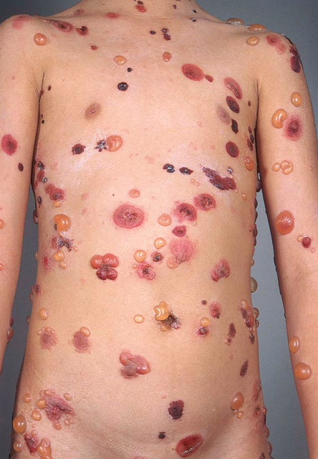
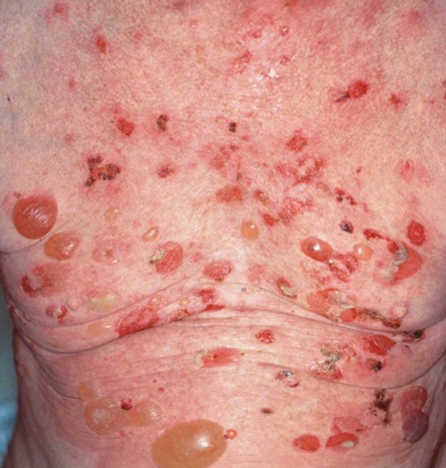
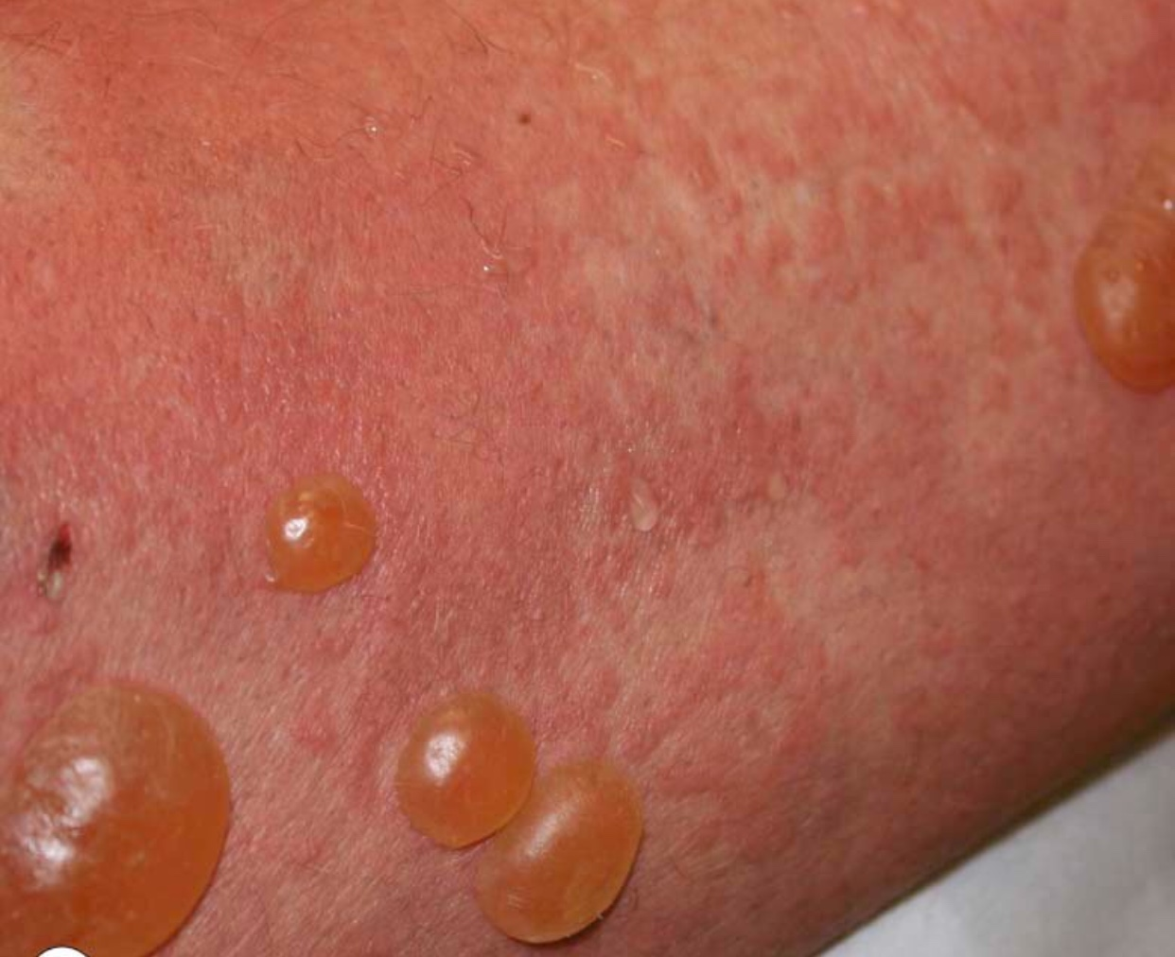
Autoimmune Bullous Diseases
Bullous Pemphigoid (BP)

Slide 72
Autoimmune Bullous Diseases
Bullous Pemphigoid (BP):
Diagnostic Approach:
  The diagnosis of BP is based upon the clinical presentation, histologic features, and positive findings on direct and indirect immunofluorescence

Slide 73
Autoimmune Bullous Diseases
Bullous Pemphigoid (BP):
Diagnostic Approach:
  History
  Physical examination
  Investigations
    CBC & Differential → eosinophils
    ESR →
    IgE →
eosinophils, ESR & IgE are elevated in 60% of patients with BP

Slide 74
Autoimmune Bullous Diseases
Bullous Pemphigoid (BP):
Diagnostic Approach:
  Investigations
    Skin Biopsy:
      Non-bullous phase → non- specific, eosinophilic inflammatory infiltrate
      Bullous phase → subepidermal blister, accompanied by a dermal inflammatory infiltrate composed of eosinophils
    DIF → from perilesional, uninvolved skin, linear, continuous deposits of IgG and C3 along the epidermal basement membrane

Slide 75
Autoimmune Bullous Diseases
Bullous Pemphigoid (BP):
Diagnostic Approach:
  Investigations
    Indirect IF → using salt-split human skin
    ELISA→ : identifies antibodies against both BP 230 &180 in 60-80% of patients

Slide 76
Autoimmune Bullous Diseases
Bullous Pemphigoid (BP):
Diagnostic Approach:
  Investigations
    Skin Biopsy:
      Bullous phase → subepidermal blister

Slide 77
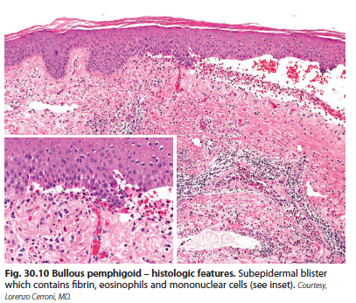
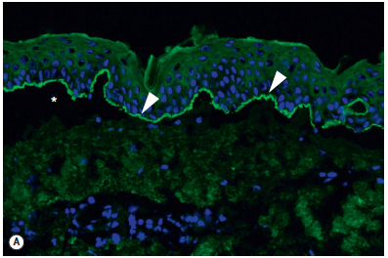

Bullous Pemphigoid

Slide 78
Autoimmune Bullous Diseases
Bullous Pemphigoid (BP):
Treatment
  Mild/localized disease
  Superpotent topical corticosteroids
  Dapsone
  Topical immunomodulators
Extensive/persistent cutaneous disease
Superpotent topical corticosteroids
Oral corticosteroids
Azathioprine
Methotrexate

Slide 79
Autoimmune Bullous Diseases
Cicatricial Pemphigoid:
Is a a chronic, autoimmune, subepithelial blistering disorder characterized by a predominant involvement of the external mucosal surfaces( mainly oral& conjunctival mucosa, but it could affect any mucosal site) and a tendency for scarring
Patients > 65 years

Slide 80
Autoimmune Bullous Diseases
Cicatricial Pemphigoid:
Clinical features:
  Conjunctiva:
    affected in 75% of cases.
    Starts unilaterally, within 2 years becomes bilateral
    adhesions, ectropian, corneal damage
  Oral mucosa→ lesions less painful than PV
  Esophagus& larynx→ can develop strictures that may require surgery

Slide 81
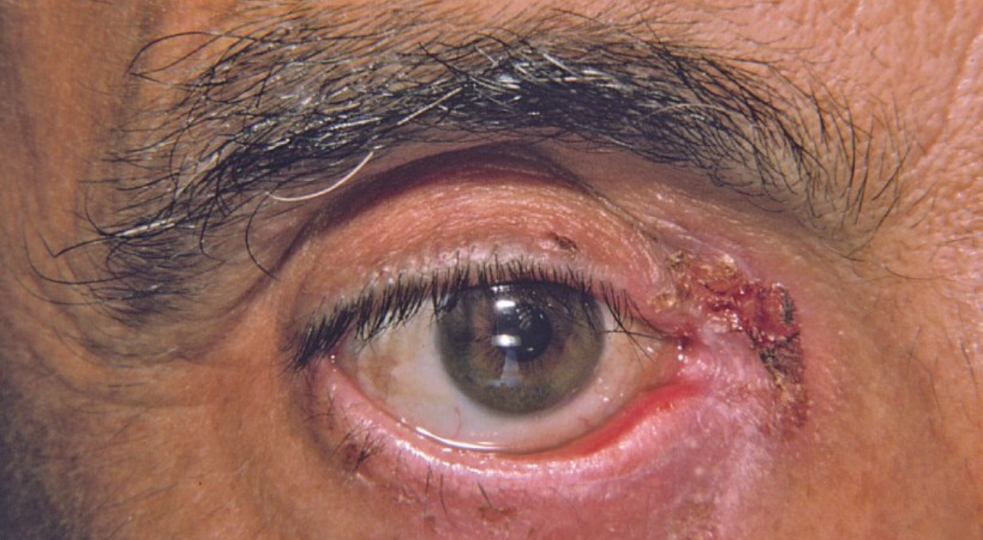
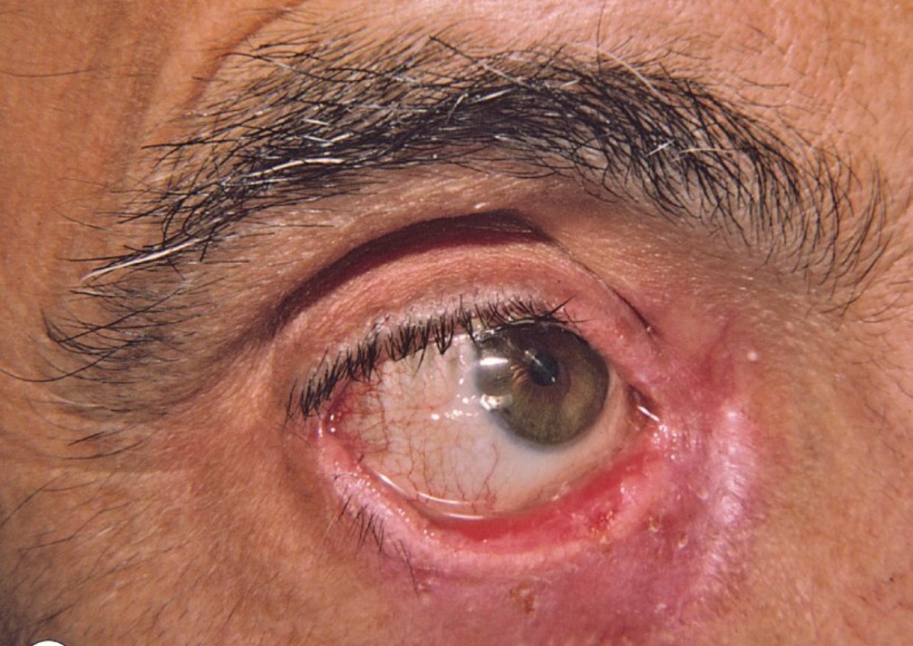
Cicatricial Pemphigoid:

Slide 82
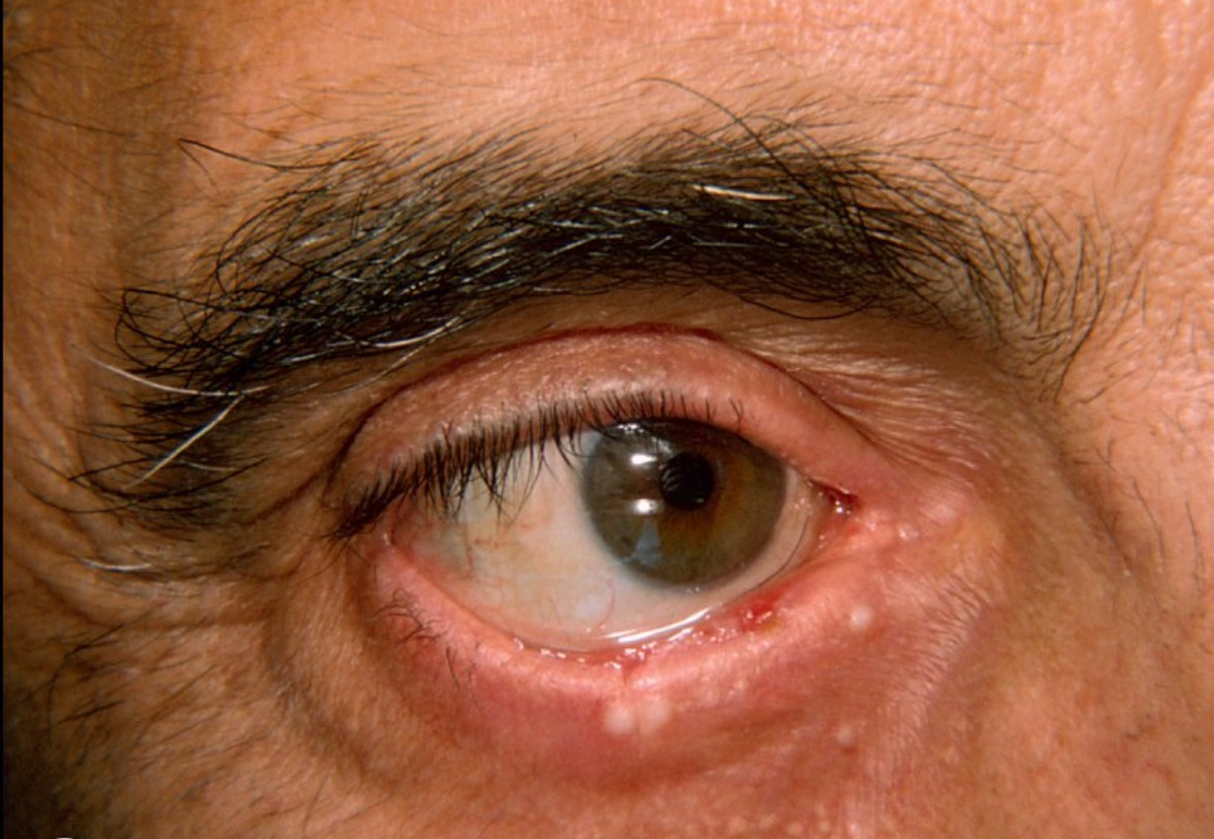
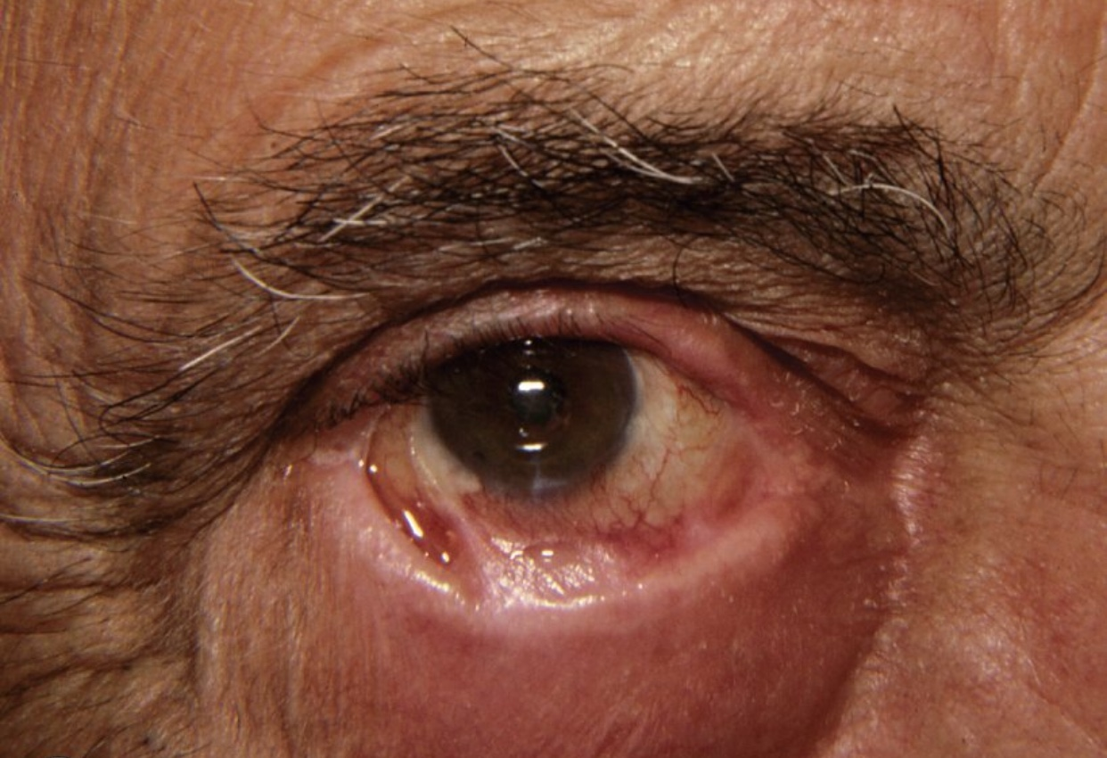
Cicatricial Pemphigoid:

Slide 83
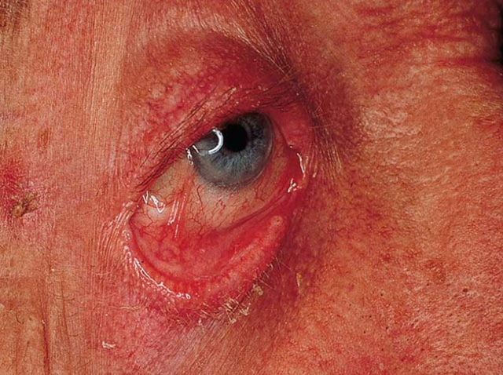
Cicatricial Pemphigoid:

Slide 84
Autoimmune Bullous Diseases
Cicatricial Pemphigoid:
Clinical features:
  Genitalia→ narrowing of vaginal orifice, adhesions between glans & foreskin
  Skin: only involved in 25% , face, scalp and upper trunk, atrophic scarring

Slide 85
Autoimmune Bullous Diseases
Cicatricial Pemphigoid:
  Diagnostic Approach:
    History
    Physical examinantion
    Investigation
      DIF → IgG autoantibodies directed against the basement membrane of mucosa and/or skin
      Indirect IF → salt-split skin

Slide 86
Autoimmune Bullous Diseases
Cicatricial Pemphigoid:
  Treatment:
    Local therapy such as potent topical corticosteroids is crucial and, in some cases, maybe sufficient
    Oral lesions → topical steroids (mouthwash, topical preparations),
    Nasal, pharyngeal, esophageal disease → steroid sprays/ inhalers
    Ocular--> topical / systemic cortecosteroids, ophthalmology referral

Slide 87
Autoimmune Bullous Diseases
Cicatricial Pemphigoid:
  Treatment:
    Severe disease:
      Oral corticosteroids
      Dapsone
      Cyclophosphamide
      Azathioprine
      Surgical therapy

Slide 88
Autoimmune Bullous Diseases
Pemphigoid Gestationis:
Synonym: « herpes gestationis »
A form of BP occuring during pregnancy
Occurs in 1/10000-40000 pregnancies
No maternal risk, no increase in birth defects. However, pregnancy complications and fetal death occurs in 15-30%

Slide 89
Autoimmune Bullous Diseases
Pemphigoid Gestationis:
Erythematous urticarial plaques, alone or with papules, vesicles, blisters in sub-epidermal area, erosions
Intense pruritus
Sites: abdomen, proximal extremities
Rarely appears postpartum, resolve within 3 months
Occasionally recurs with menses or ingestion of OCP, tends to be worse in next pregnancy
The antibodies cross the placenta, the newborn can have blisters for a few weeks

Slide 90
Autoimmune Bullous Diseases
Pemphigoid Gestationis:
Diagnostic approach
  History
  Physical examination
  Investigation
    Cbc & differential→ eosinophilia
    DIF & indirect IF

Slide 91
Autoimmune Bullous Diseases
Pemphigoid Gestationis:
Treatment
  Topical steroids
  Systemic steroids→ avoid in 1st trimester
  Skin care → to prevent infection
  Antihistamines→ for tx of pruritus

Slide 92
Autoimmune Bullous Diseases
Dermatitis Herpetiformis:
Pruritic vesicular disease caused by IgA autoantibodies directed against epidermal transglutaminase
DH is characterized by a granular IgA deposition at the basement membrane zone
DH is a cutaneous manifestation of celiac disease and is associated with gluten sensitivity in virtually all cases

Slide 93
Autoimmune Bullous Diseases
Dermatitis Herpetiformis:
DH and celiac disease are genetic disorders strongly associated with HLA-DQ2 genotype, in which IgA antiendomysial antibodies are directed against tissue transglutaminases (in the skin→ epidermal transglutaminase)

Slide 94
Autoimmune Bullous Diseases
Dermatitis Herpetiformis:
Clinical Features:
  Grouped ’herpetiform’ papules/vesicles/urticarial wheals over an erythematous base, associated with intense pruritus, burning, stinging and excoriations
  Sites: extensor surfaces of elbows/knees, sacrum, buttocks, scalp
  Spontaneous remissions may occur, but disease often lifelong

Slide 95
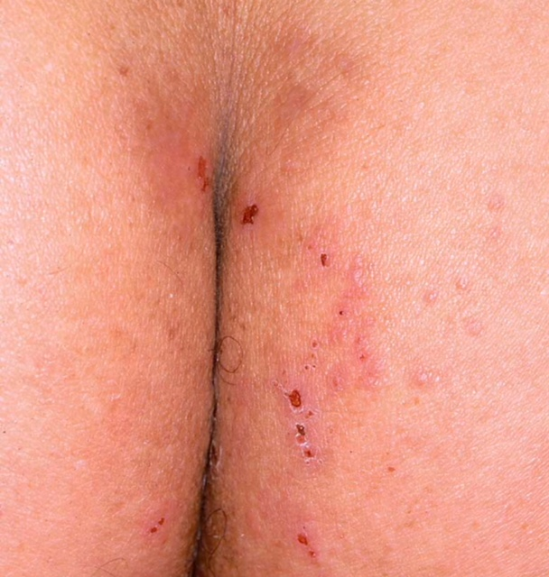
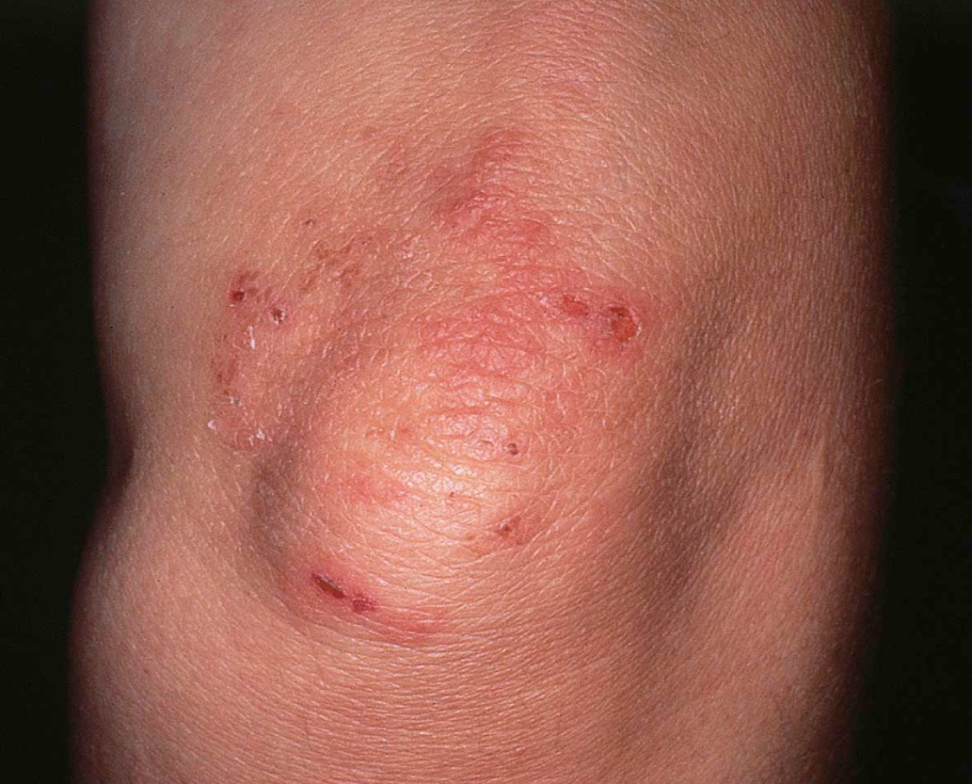
Dermatitis Herpetiformis:

Slide 96
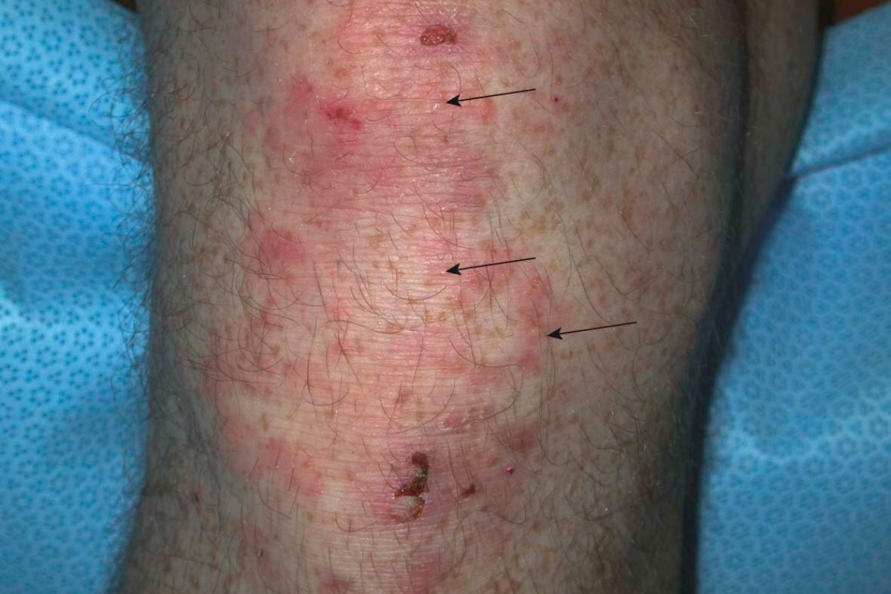
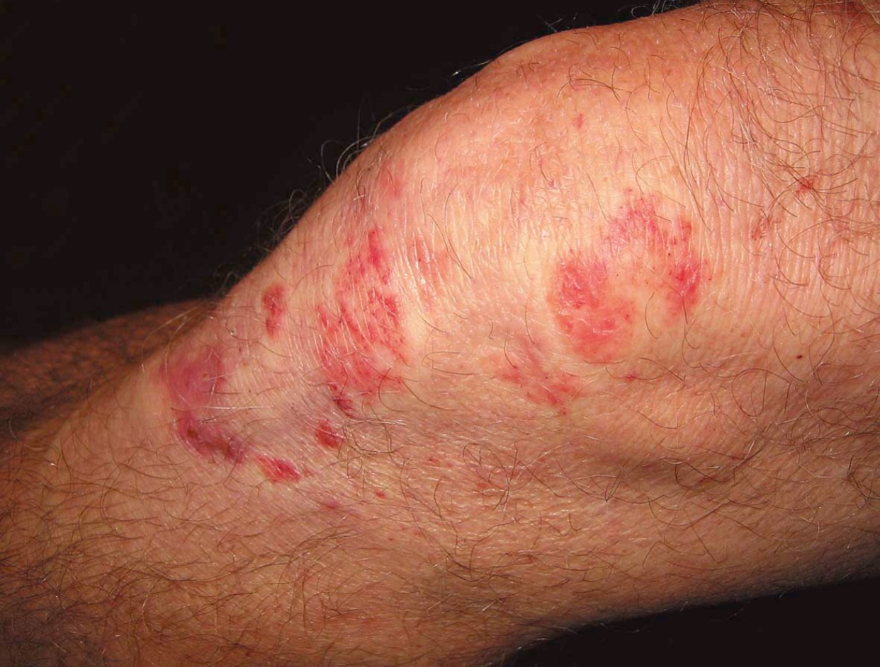
Dermatitis Herpetiformis:

Slide 97
Autoimmune Bullous Diseases
Dermatitis Herpetiformis:
Diagnostic Approach
  History
  Physical examination
  Investigations
    Skin biopsy: subepidermal blister, with neutrophilic micro-abscesses in the papillary dermis is the hallmark of the disease

Slide 98
Autoimmune Bullous Diseases
Dermatitis Herpetiformis:
Diagnostic Approach
  Investigations
    DIF → Granular deposits of IgA in the dermal papillae
    Indirect IF
    ELISA→ identifies IgA against transglutaminase in 80% of cases
    Jejunal Biopsy → flattening of the villi

Slide 99
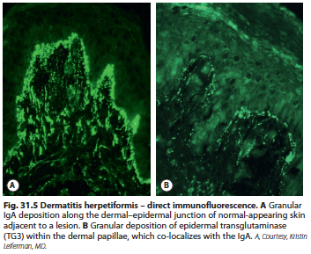
Dermatitis Herpetiformis:

Slide 100

Autoimmune Bullous Diseases
Dermatitis Herpetiformis:
Treatment
  Gluten free diet
  Dapsone

Slide 101
Autoimmune Bullous Diseases
Linear IgA Disease:
Subepidermal blistering disease caused by deposits of IgA along BMZ
Linear IgA disease is characterized by on linear IgA deposition at the basement membrane
Maybe identical to DH but WITHOUT GI involvement , or resemble BP
Over 50% have mucosal involvement

Slide 102
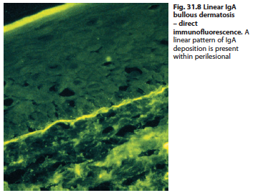
Linear IgA Disease

Slide 103
Autoimmune Bullous Diseases
Linear IgA Disease:
The childhood form
is most frequently termed “Chronic bullous disease of childhood”
Occurs in children ”preschool”, and resolves spontaneously
Characterized by annular erythema and tense blisters “crown of jewels”
They develop predominantly in flexural areas ( lower trunk, thigh, groin), axillae, face, mucous membranes
GI disease is rare
Usually remits within 2-4 years

Slide 104
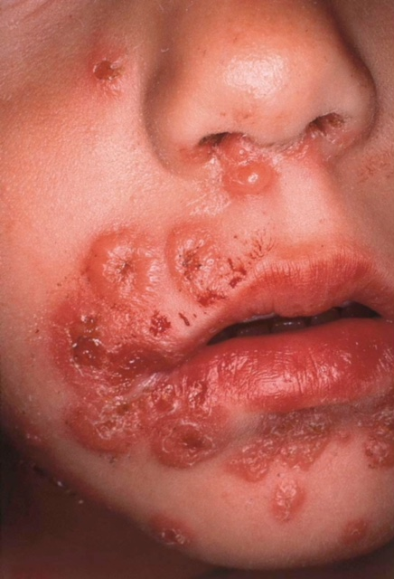
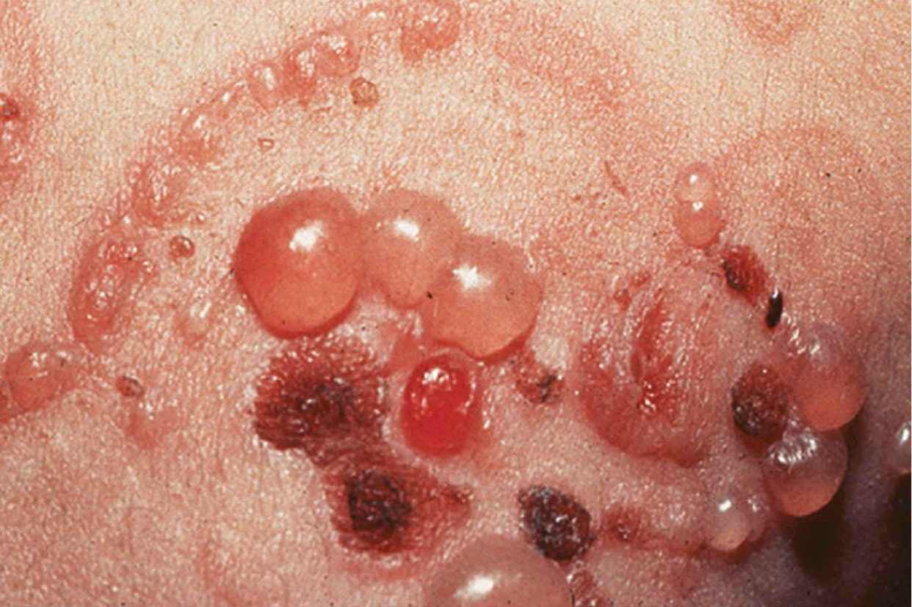
Linear IgA Disease

Slide 105
Autoimmune Bullous Diseases
Linear IgA Disease:
Diagnostic Approach
  History
  Physical examination
  Investigation
    DIF → linear IgA deposits along the basement membrane
    Indirect IF

Slide 106
Autoimmune Bullous Diseases
Linear IgA Disease:
Treatment:
  Dapsone
  Sulfapyridine
  Antibiotics : tetracycline, erythromycin, dicloxacillin
  Antibiotics are a good treatment for the childhood form, and were found to be better than dapsone in this age group

Slide 107
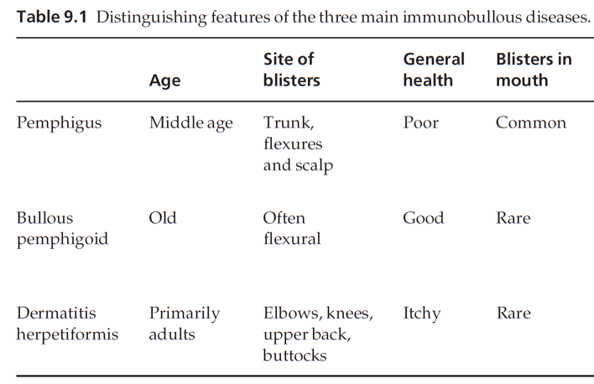
Autoimmune Bullous Diseases

Slide 108
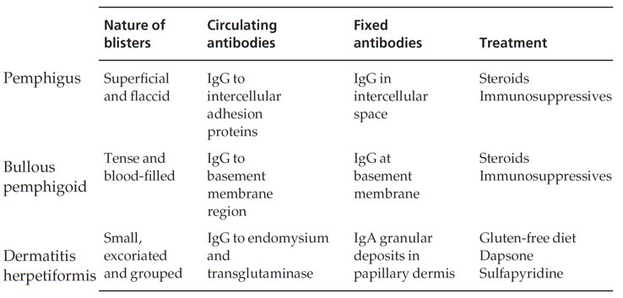
Autoimmune Bullous Diseases

Slide 109
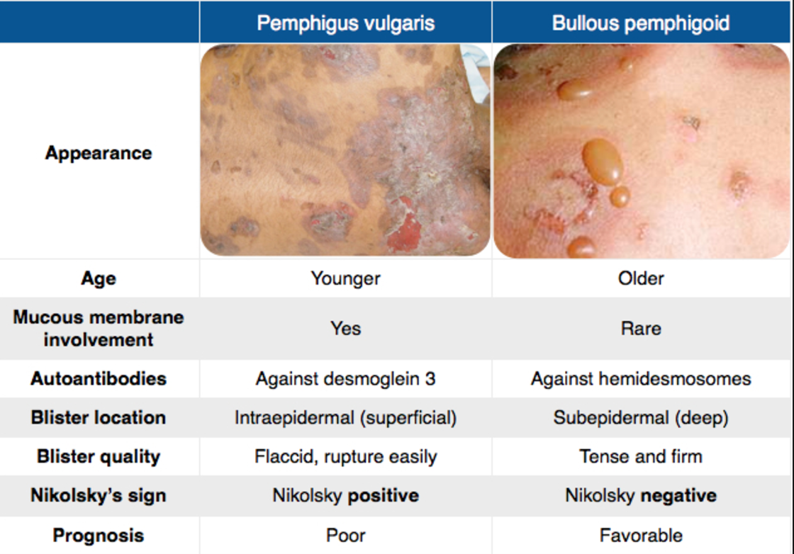
Autoimmune Bullous Diseases

