Slide 1
Vertigo
A. Alballaa
College of Medicine King Saud University ORL Course 432 ORL Department King Abdulaziz University Hospital

Slide 2
Definition
Vertigo: It is an allusion of rotary moving.
Instability : impossibility to maintain one’s body in desire position
Nystagmus : Is an involuntary conjugated rapid repetitive eye movement.
Side to side (horizontal)
Up and down (vertical)
In a circle (torsional)

Slide 3
The vestibular system: is the apparatus of the inner ear that provides stable vision during head movements.

Slide 4
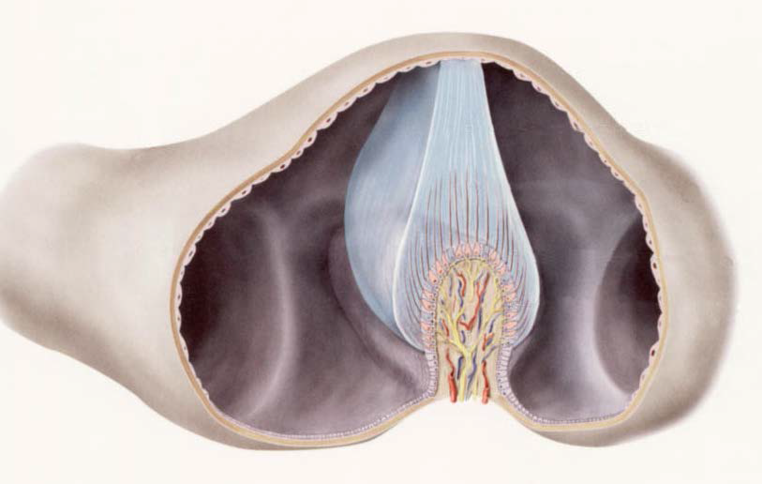
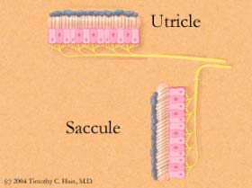
Semi-circular Canals (cristae)
Angular Acceleration
Utricle & Saccule:
Macule of the utricle : plan horizontal
Macule of the saccule: plan vertical
Linear acceleration horizontal & Vertical (gravity)

Slide 5
What are the balance organs?
Inner ear
3 semicircular canals
Otolith organ
Cerebellum
Vision (VOR)
Proprioception

Slide 6
History and Examination
(Pre- / underlying diseases, possible triggers, symptoms, time interval Sx, medications)
Physical examination (including blood pressure, pulse, eye movements)
Orientative balance tests: (Romberg- / Unterberger tread test, finger-nose-pointing test)
Vestibular examination: Caloric (ENG), swivel chair
Hearing test: Tone audio / speech audiogram (vestibulocochlear nerve)
Consultative: Neurology, Ophthalmology, Internal Medicine, Orthopedics, Psychiatry
Imaging: CT, MRI, Duplex sonography cervicals

Slide 7
Vestibulo-ocular reflex (VOR)
VOR Function: is to stabilize images on the retina during head movement by moving the eye in direction opposite to the direction of the head, thus keeping image on the center of the visual field.
The anatomical component of VOR are:
Semicircular canals.
Vestibular and ocular motor nuclei in the brainstem
Extra-ocular muscles.

Slide 8
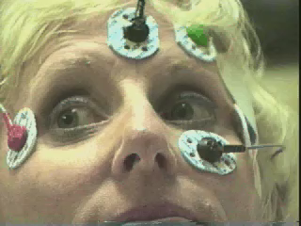
What type of Nystagmus??

Slide 9
Benign Paroxysmal Positional Vertigo (BPPV)
BPPV is the most common cause of vertigo seen by otolaryngologists.
Represent 20% to 40% of patients with peripheral vestibular disease.
Posterior semicircular canal (Post SCC ) is mostly affected in BPPV.
Vertigo of post SCC initiated with:
Change in head position;
Rolling over or getting into bed,
Looking up to take an object off a shelf,
Tilting the head back to shave,
Getting a haircut.
Symptoms occur suddenly and last in the order of seconds

Slide 10
Etiology: Most cases of BPPV have no identifiable etiology (48%).
The most common known cause was thought to be :
closed head injury
followed by vestibular neuronitis.
Post ear surgery
Diagnosis
History
Dix-Halpike maneuver

Slide 11
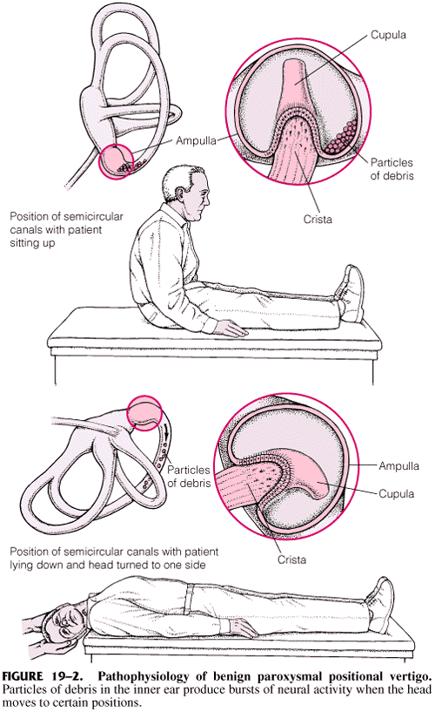
Nystagmus in BPPV
The nystagmus is a combined vertical upbeating and rotary (torsional) component beating toward the downward eye.
There is often a latency of onset of nystagmus (seconds).
Duration of nystagmus is short (<1 minute).
The nystagmus disappears with repeated testing (fatigable).

Slide 12
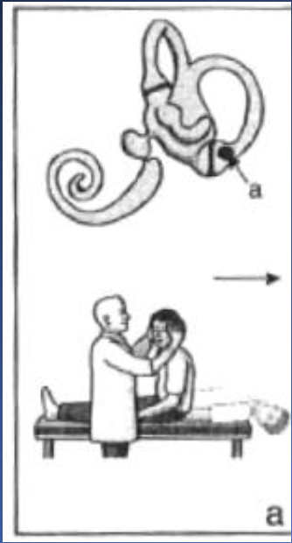
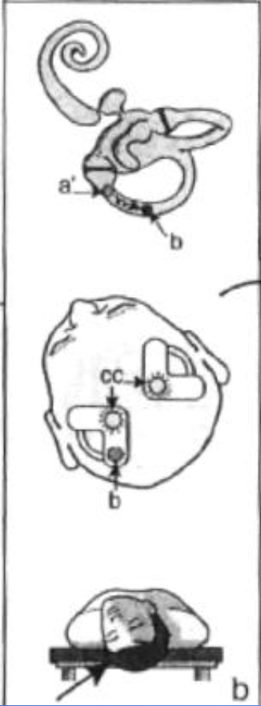
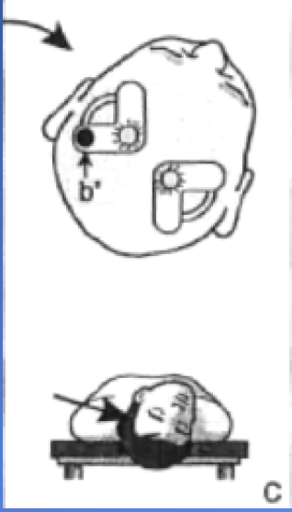
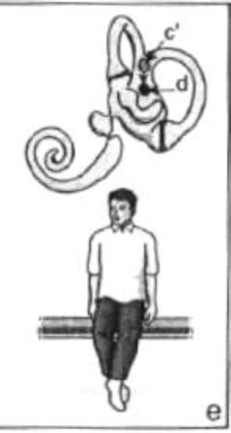
Treatment BPPV
BPPV posterior canal : Epley maneuvers.
Aim of the treatment is to move the debris (otoconia) out of the affected semicircular canal back into the vestibule.
Epley maneuvers:
Placement of the head into the Dix-Hallpike position
there is a 180-degree roll of the head to the position in which the offending ear is up.
patient is then brought to the sitting upright position.

Slide 13
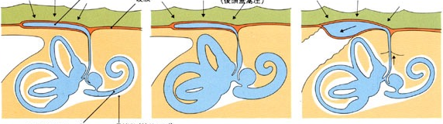
Meniere’s disease
Idiopathic endolymphatic hydrops
symptoms:
Fluctuating hearing loss (low frequency first )
Episodic vertigo (usually spinning sensation; lasts 20 minutes - 5hours)
Tinnitus (usually low-tone roaring)
Aural fullness
Due to increased hydraulic pressure within the inner ear endolymphatic system
Endolymphatic Sac

Slide 14
Meniere’s disease
Treatments:
Decrease intake of CATS:
C: chocolate
A: alcohol
T: tea
S: salts
Medical treatments (diuretics, trans-tympanic injection)
Surgeries

Slide 15
Vestibular Neuritis
Viral infection of vestibular organ
Affect all ages
patient presents acutely with
Spontaneous eye movement (nystagmus) ,
Vertigo
Nausea &vomiting
Patient is fully awake
Patient requires only symptomatic treatment
Neurological origin (stroke....)Should be eliminated.
Recovery from vestibular neuritis depend on the age of the patient

Slide 16
investigation
Audiogramme
VNG
v-HIT
CT Scan
MRI

Slide 17
consequences
Mental stress (possibly psychotherapy)
Impairment of the quality of life
possibility of deafness (M. Menière)
Increased danger of falling (fractures, especially older patients)
Serious health and social consequences
drive prohibition (safety issue - occupations requiring driver's license)
loss of occupations.

Slide 18
case scenario
50-year-old patient, medically free
Sudden dizziness with head movement 3 days ago
Horizontal Nystagmus to the left
No problems without Head movement
accompanying symptoms (nausea, vomitus)
No hearing problems, no tinnitus)

Slide 19
case scenario
32-year-old female patient with recurrent episodes of vertigo
Relapsing accompanying hearing loss, tinnitus
Frequently nausea / vomiting
Fall inclination both sides
Persistent hearing loss in the interval (weeks)
Recurrent inflammation of both eyes

Slide 20
Thanks

