Slide 1
Hearing loss
A. Alballaa
College of Medicine King Saud University ORL Course 432 ORL Department King Abdulaziz University Hospital

Slide 2
degree of hearing impairment

Slide 3
conductive
sensorineural

Slide 4
Hearing loss
conductive
outer ear
middle ear
inflammation
foreign body
trauma
Malformation
tumor
inflammation
trauma
Malformation
tumor

Slide 5
inflammatory
outer ear
herpes zoster optics
Acute otitis externa
auricular perichondritis

Slide 6
outer ear
foreign body
insekt
Q-tips

Slide 7
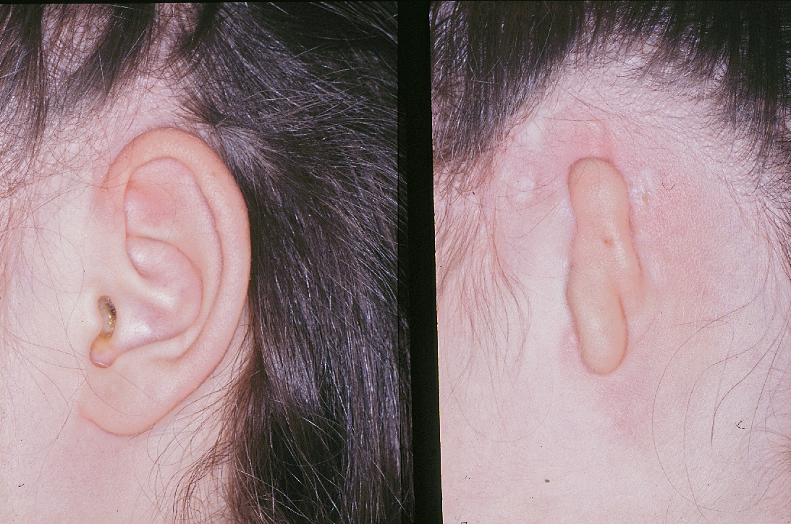
outer ear
Malformation
Microtia & Atresia
Stenosis

Slide 8
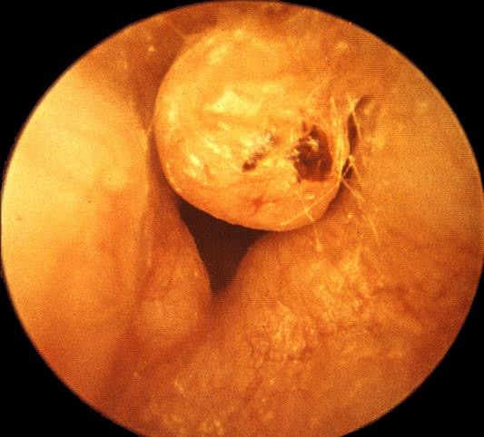
outer ear
Tumors
Osteoma
exostosis

Slide 9
Trauma
outer ear

Slide 10
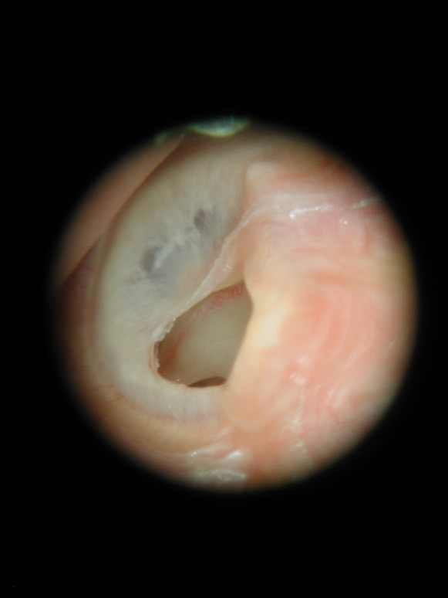
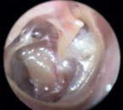
middle ear
inflammatory
chronic otitis media

Slide 11
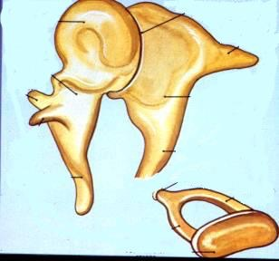
middle ear
Trauma
Barotrauma
Penetrating injuries of the TM
Disrupted trauma to the ossicles

Slide 12
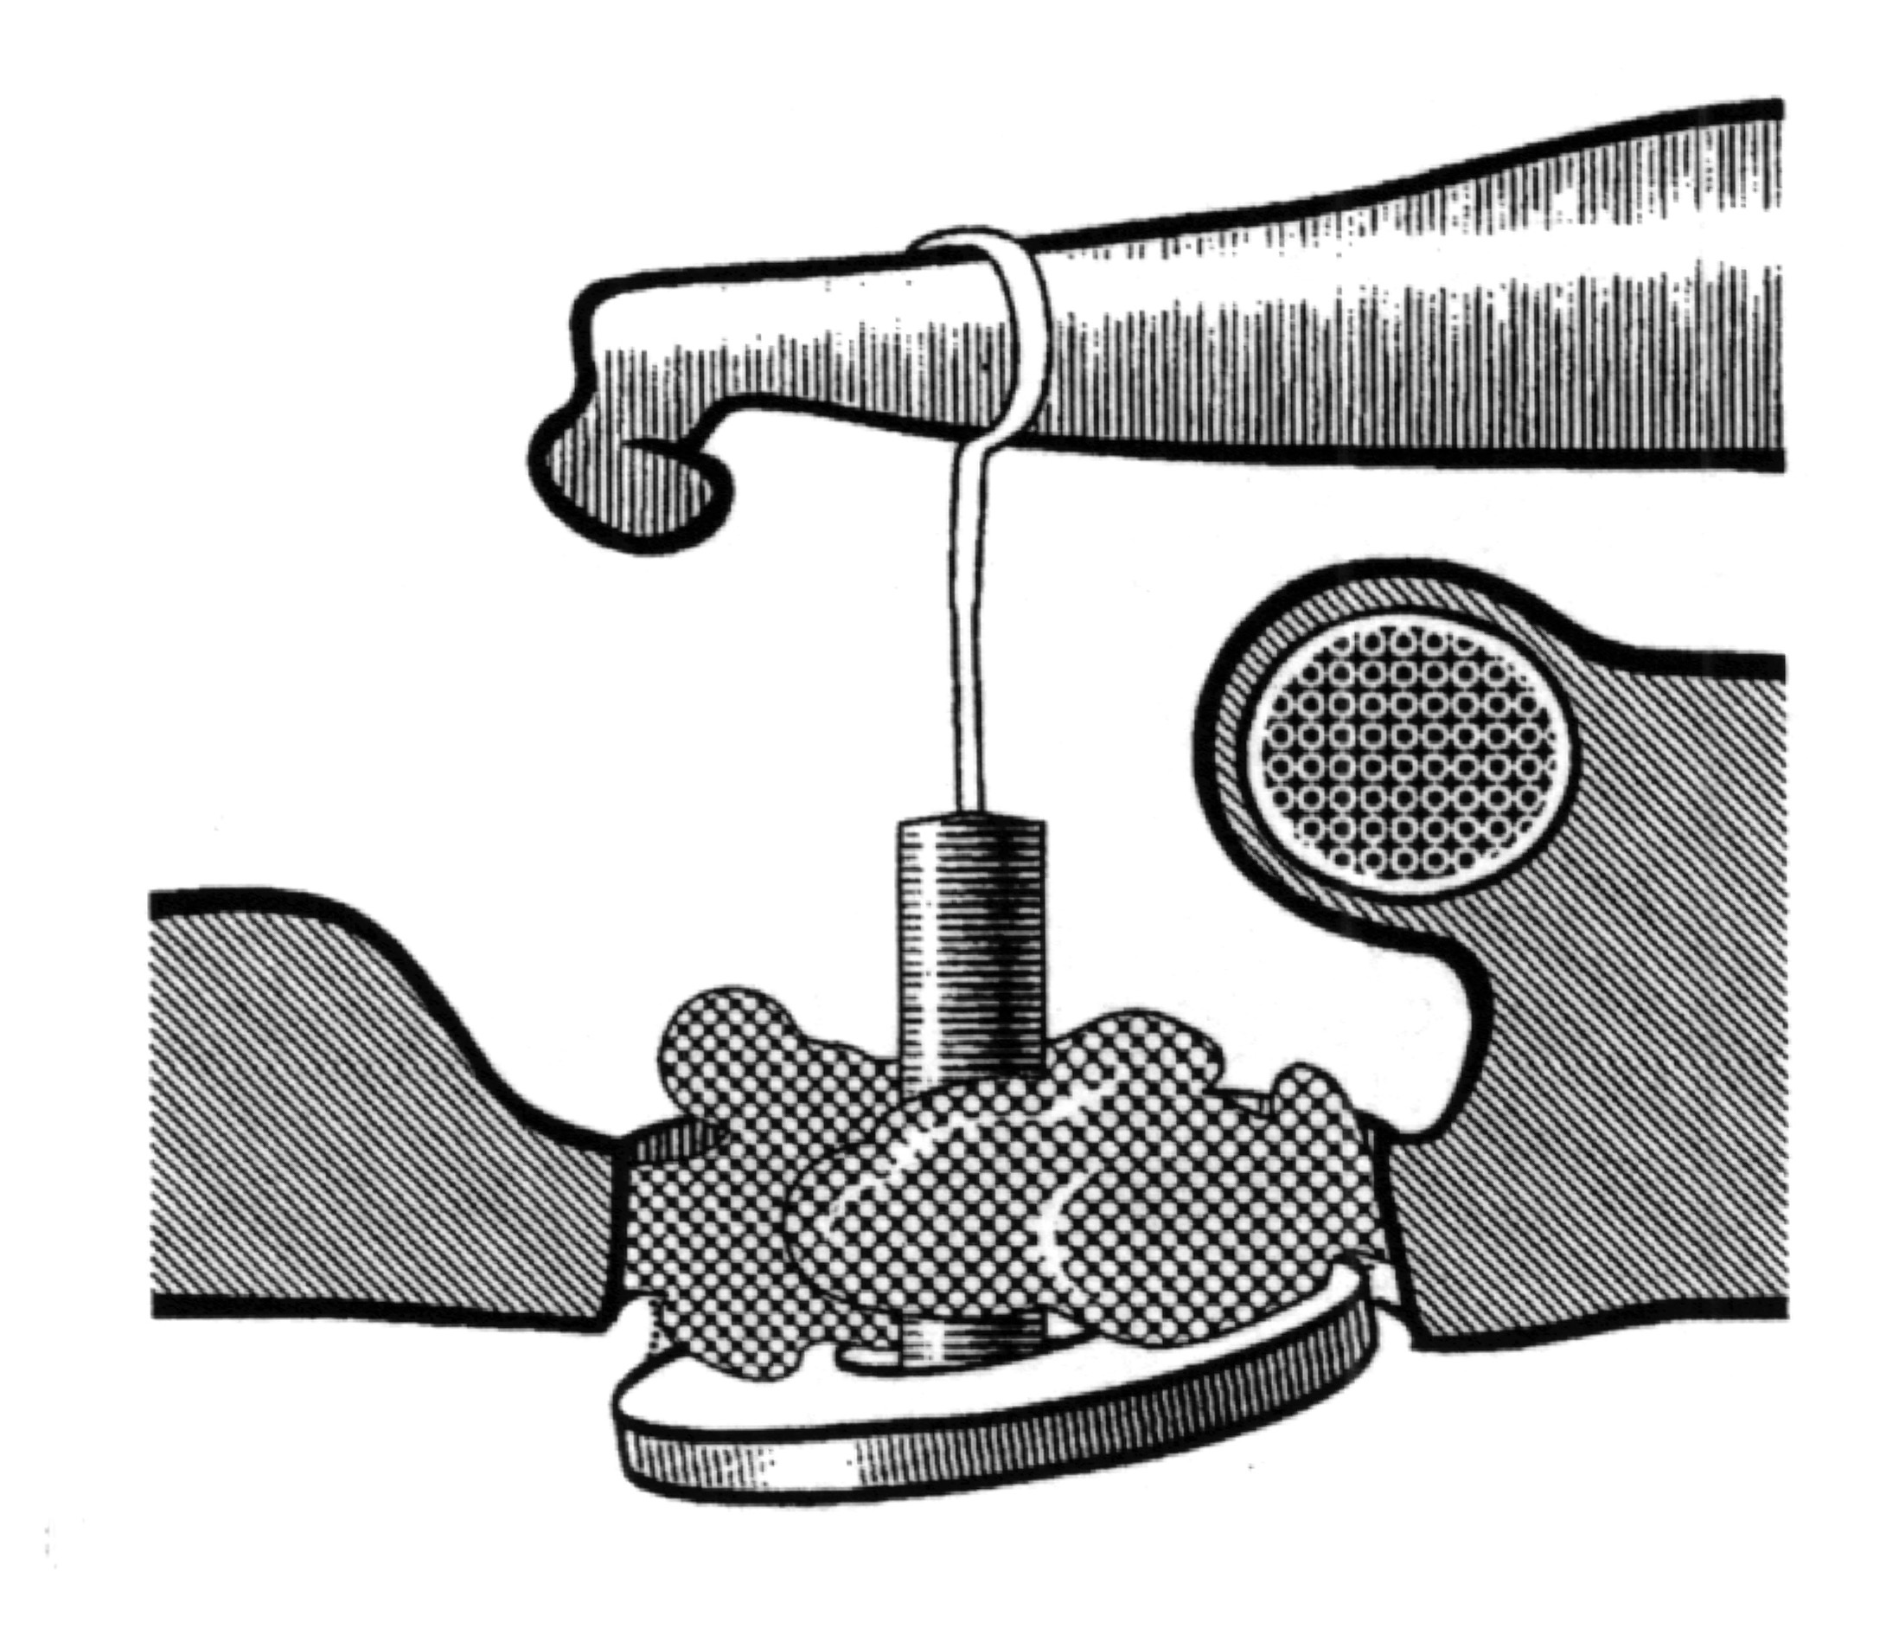
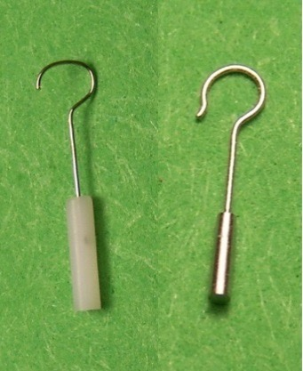
middle ear
Malformation
Fixation (otosclerosis)
Ossicular chains absent or erosion

Slide 13
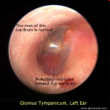
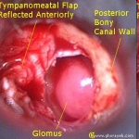
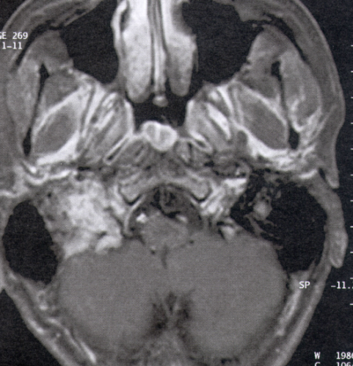
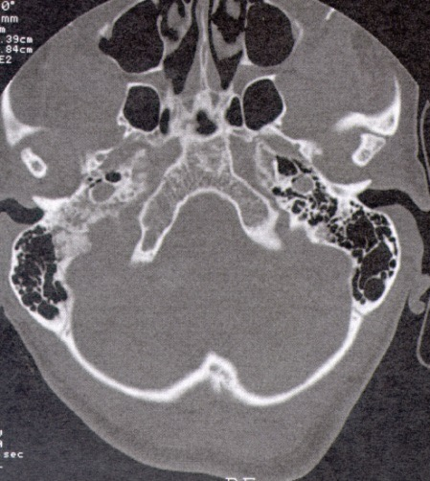
middle ear
Tumors
Paraganglioma
Squamous cell carcinoma
schwannoma

Slide 14
sensorineural
Two types :
Sensory (the pathology is within hair cells in cochlea) Neural (the pathology is with in the auditory nerve and it’s connection)

Slide 15
sensorineural
Congenital
Acquired
Malformation
tumor
inflammation
trauma

Slide 16
Congenital
Mondini malformation

Slide 17
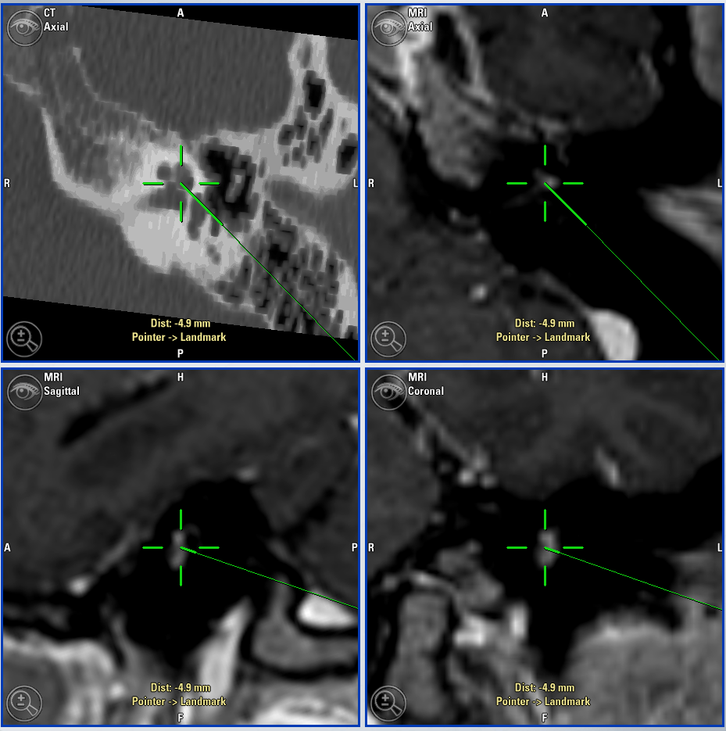
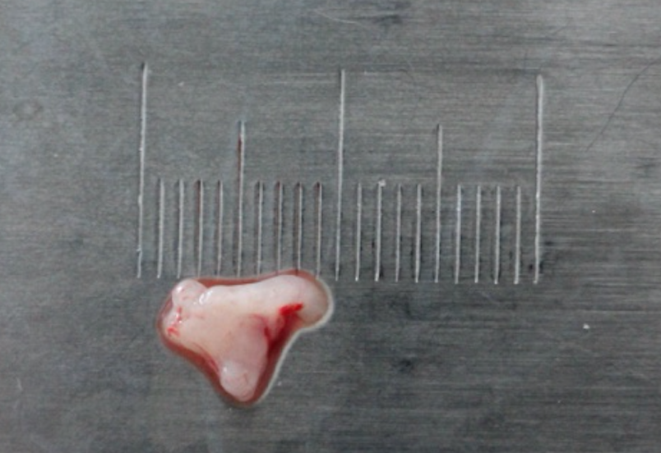
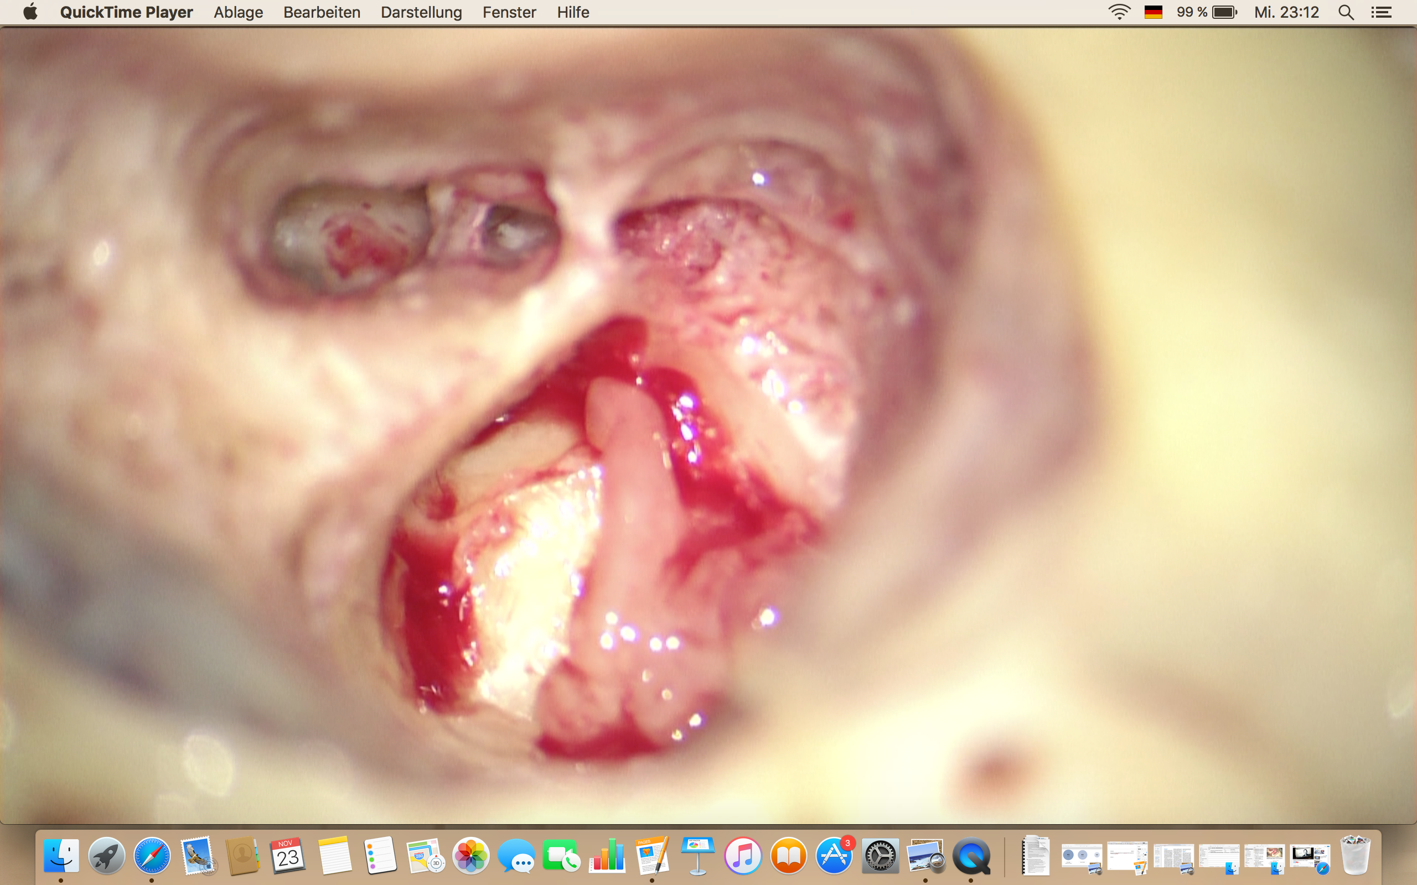
Tumors
Vestibular schwannoma

Slide 18
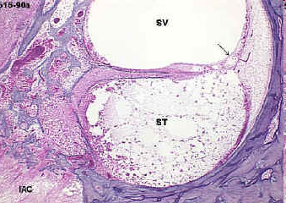
inflammatory
labyrinthitis ,meningitis
Autoimmune (Cogan syndrome)

Slide 19
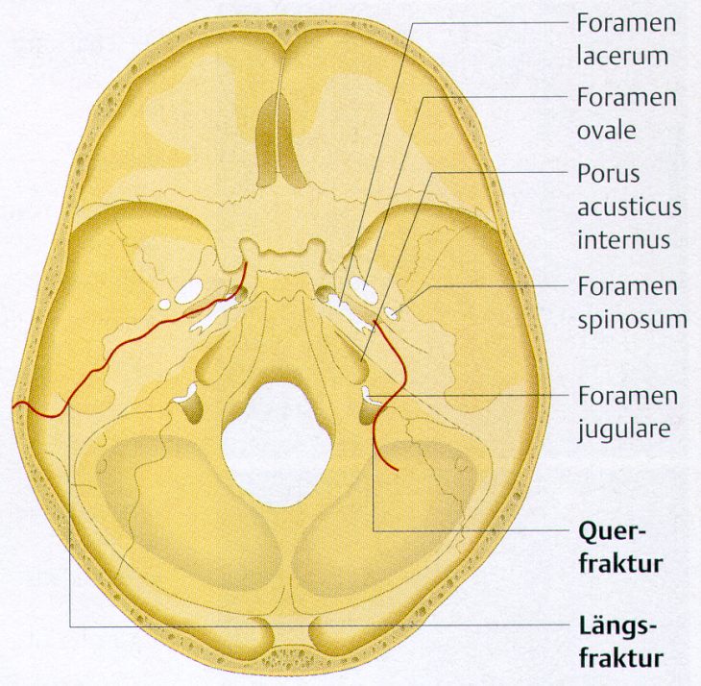
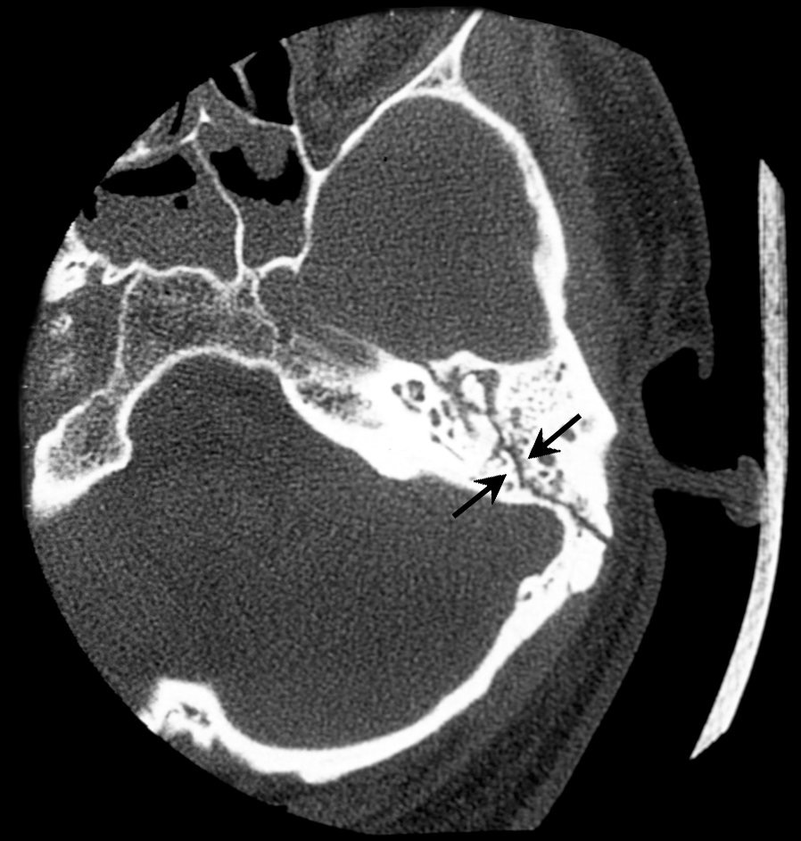
Trauma
Temporal bone fracture
Longitudinal fracture or Transeverse fracture

Slide 20
Trauma
Ototoxic drugs:
Aminoglycosides groups
Loop diuretics
Cisplatin

Slide 21
Trauma
Noise exposure
(acutely or chronic)

Slide 22
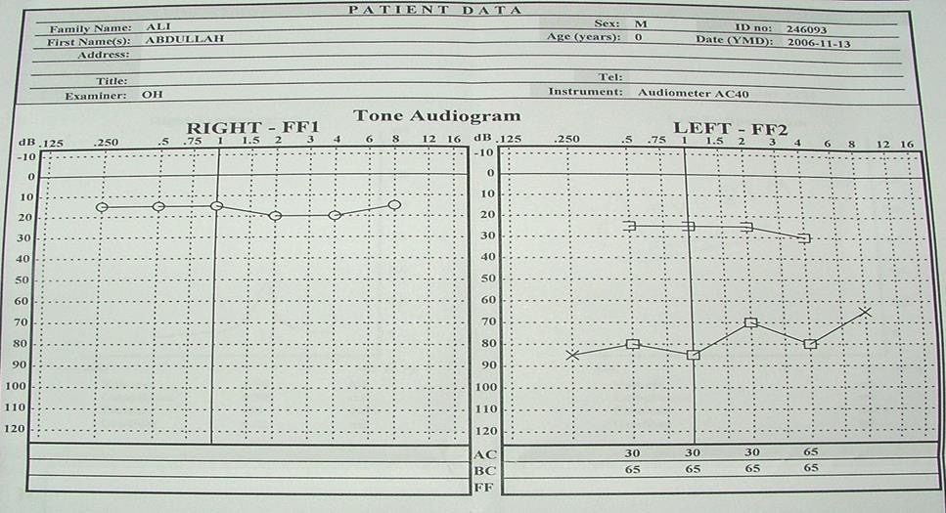

Slide 23
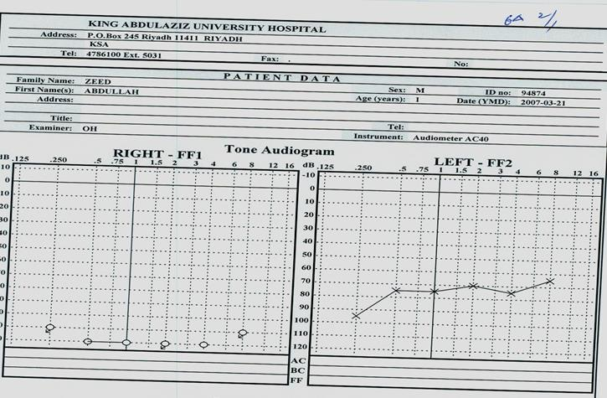

Slide 24
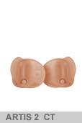
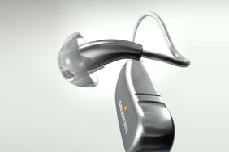
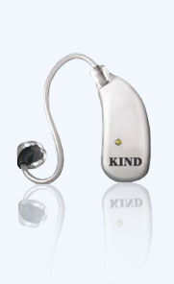
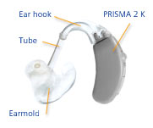
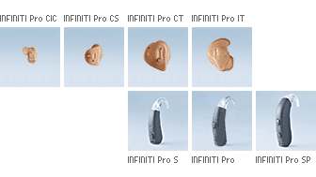
Management of hearing impairment

Slide 25
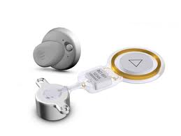
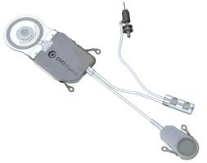
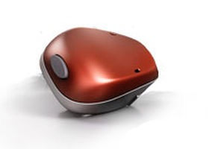
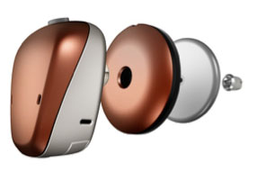
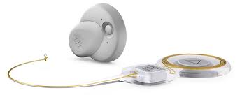
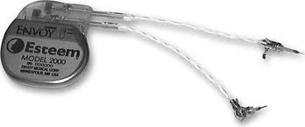
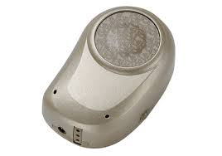
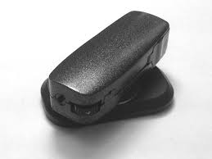
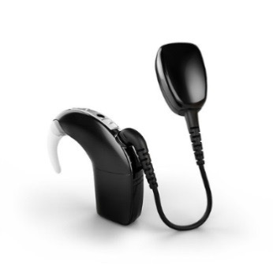
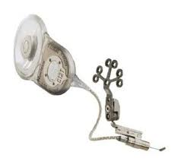
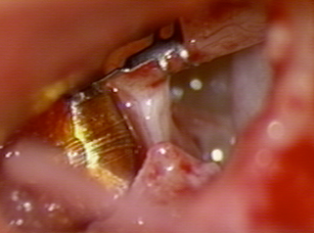
Management of hearing impairment
implantable hearing aids
partly implantable hearing aids fully implantable hearing aids
aktiv
Bonebridge
Vibrant Soundbridge
MET
CODACS
aktiv
Carina
Esteem
passiv
aktiv
Bonebridge
Vibrant Soundbridge
MET
CODACS
≈ç
transcutan
Baha Attract
Sophono
Baha super power

Slide 26
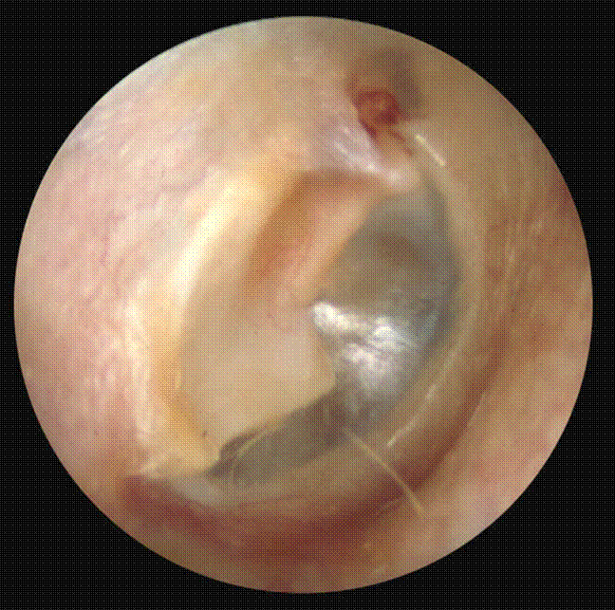
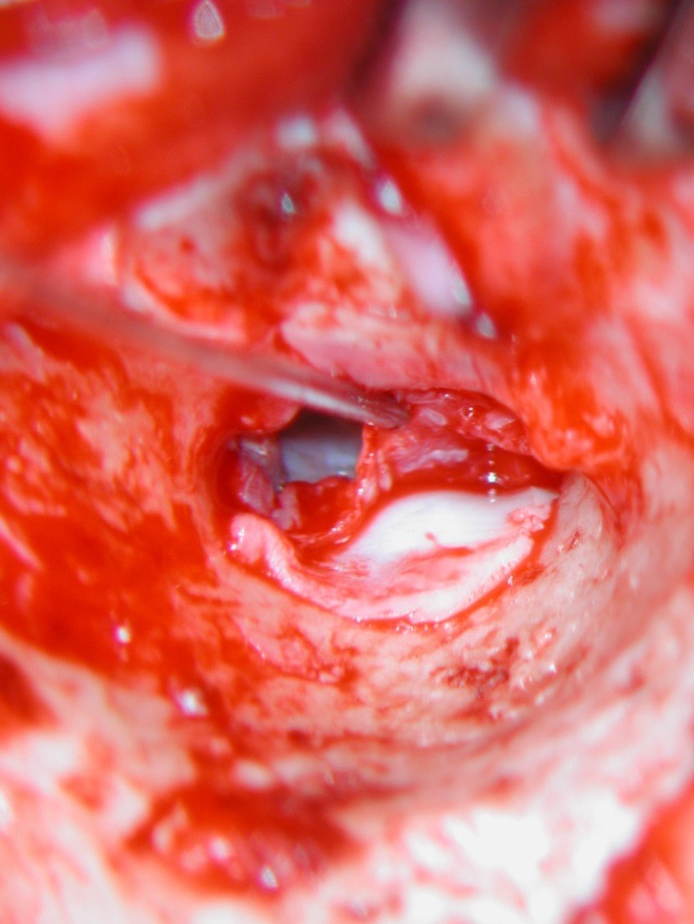
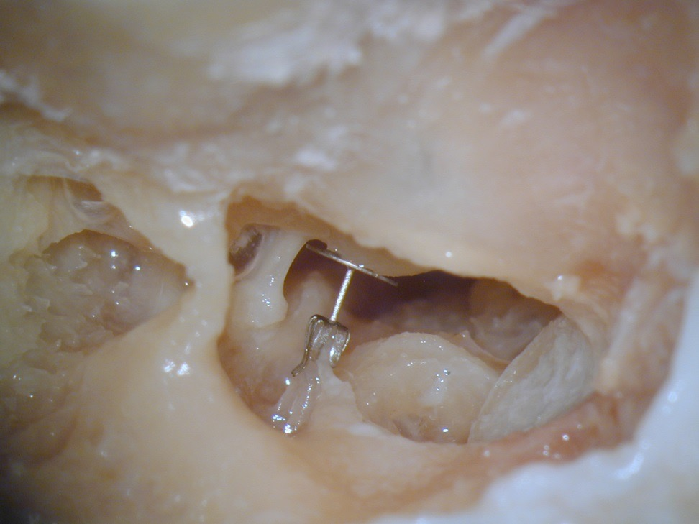
Management of hearing impairment
Myringplasty & tympanoplasty in case of CSOM
Ossiculoplassty

Slide 27
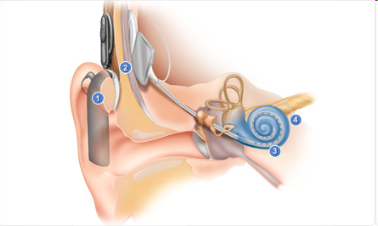
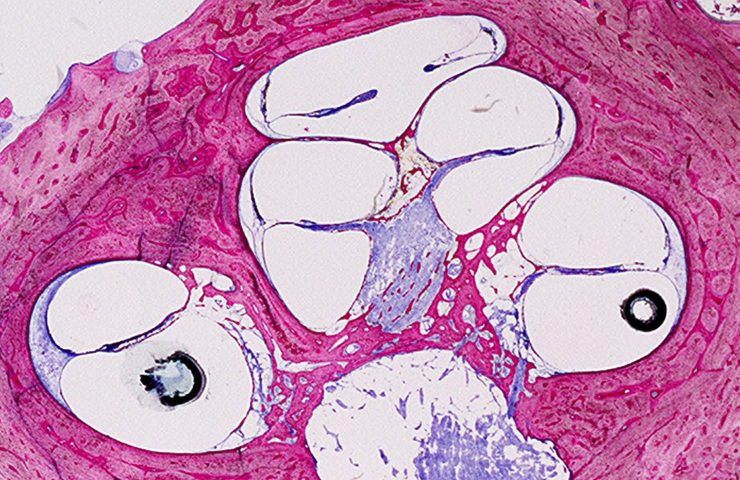
Cochlear implant
- prelingual children and postlingual adult
-it pass by the external ,middle and inner ear to
stimulate auditory nerve directly

Slide 28
„Thanks“

