Slide 1
Family Physician Desirable Competency
Dr. Norah Alshehri
MBBS, SBFM, ABFM, MSc in Diabetes
Assistant Professor and Consultant
Postgraduate trainer
Family and Community Medicine Department
King Saud University
drnora@ksu.edu.sa

Slide 2
To be aware of the history of Family Medicine.
To understand the concepts of Family Medicine, including its definition.
• To be familiar with the desirable qualities of a Family Physician.

Slide 3
What is the family medicine? Does Family Physicians differ from other physicians?

Slide 4
The history of family medicine
17th and 18th centuries, Relatively few physicians were available.
19th Century, Most physicians were “General Practitioners.”
A growing shift towards specialization took place throughout the 1920s and 1930s“General Practitioners” declined from 83% to 18.

Slide 5
The history of family medicine
Many people felt like the trend toward specialization had fragmented patient care and weakened the patient-physician relationship.
1940s, Generalist began to initiate steps to elevate general practice to “specialty” status.
1960s, WHO (1963) report:
"Training of Physicians for Family Practice" which recommended a postgraduate study program specifically designed to meet the needs of the General Practitioner.

Slide 6
2030 vision in Saudi Arabia
VISION 2030 : 15 STRATEGIC GOALS
7: PRIMARY CARE AND COMMUNITY CARE: DEVELOP QUALITY SERVICES
13: PUBLIC HEALTH: TACKLE OBESITY AND SMOKING

Slide 7
What is the family medicine?

Slide 8
Definition of Family Medicine
Family medicine is the medical specialty which provides continuing, comprehensive health care for the individual and family.
It is a specialty in breadth that integrates the biological, clinical and behavioral sciences.
The scope of family medicine encompasses ALL ages, both sexes, each organ system and every disease entity.
(1984) (2016 COD)

Slide 9
Principles of Family Medicine
Continuity of care.
Comprehensive care.
Coordinated care.
Community & family based care.
Central Patient doctor relationship.
Care as Evidence based.
Care for ALL.

Slide 10
How does Family Physicians differ from other physicians

Slide 11
How does Family Physicians differ from other physicians
The first contact and gate of health care system.
Provide continuity of care.
Provides comprehensive care.
Use holistic approach.
Shared care.
Patient centred approach.

Slide 12
The core competencies of the family physician

Slide 13
The core competencies of the family physician
The definition of the discipline of family medicine and of the specialist family doctor must lead directly the core competencies of the family doctor.
Core means essential to the discipline, irrespective of the health care system in which they are applied.

Slide 15
The core competencies of the family physician
1. Primary Care Management
2. Person-centred Care
3. Specific Problem Solving Skills
4. Comprehensive Approach
5. Community Orientation
6. Holistic Approach

Slide 16
1. Primary Care Management
Includes the ability:
to manage primary contact with patients, dealing with unselected problems.
to cover the full range of health conditions.
to co-ordinate care with other professionals in primary care and with other specialists.
to master effective and appropriate care provision and health service utilization.
to make available to the patient the appropriate services within the health care system.
to act as advocate for the patient - to continuously monitor, asses and improve quality and safety of care.

Slide 17
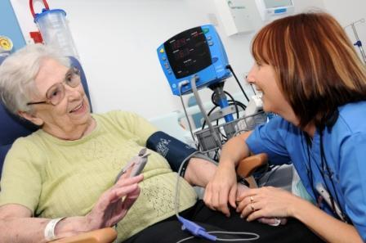
2. Person-centred Care
to adopt a person-centred approach in dealing with patients and problems in the context of patient’s circumstances;
to develop and apply the general practice consultation to bring about an effective doctor-patient relationship, with respect for the patient’s autonomy;
to communicate, set priorities and act in partnership;
to promote the goals of patient empowerment;
to provide longitudinal continuity of care as determined by the needs of the patient, referring to continuing and co-ordinated care management.

Slide 18
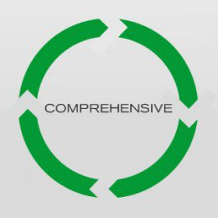
4. Comprehensive Approach
To manage simultaneously multiple complaints and pathologies, both acute and chronic health problems in the individual.
To promote health and well being by applying health promotion and disease prevention strategies appropriately.

Slide 19
3. Specific Problem Solving Skills
to relate specific decision making processes to the prevalence and incidence of illness in the community.
to selectively gather and interpret information from history-taking, physical examination, and investigations and apply it to an appropriate management plan in collaboration with the patient.
to manage conditions which may present early and in an undifferentiated way.
to make effective and efficient use of diagnostic and therapeutic interventions.

Slide 20
5. Community Orientation
Includes the ability:
to reconcile the health needs of individual patients and the health needs of the community in which they live in balance with available resources.

Slide 21
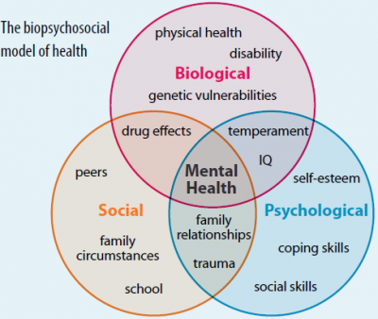
6. Holistic Approach
Includes the ability:
to use a bio-psycho-social model taking into account cultural and existential dimensions.

Slide 22
The competencies represent an ideal to which all family doctors can aspire.
Some of the elements in this definition are not unique to family doctors but are generally applicable to the profession as a whole.

Slide 24
ESSENTIAL APPLICATION FEATURES
1. Contextual Aspects
2. Attitudinal Aspects
3. Scientific Aspects

Slide 25
1. Contextual Aspects
Understanding the context of doctors themselves and the environment in which they work, including their working conditions, community, culture, financial and regulatory frameworks.

Slide 26
2. Attitudinal Aspects
Based on the doctor's professional capabilities, values, feelings and ethics.

Slide 27
3. Scientific Aspects
Adopting a critical and research based approach to practice and maintaining this through continuing learning and quality improvement.

Slide 28
CONCLUSION
4Cs
4Ps
Community Orientation.
Continuity of Care.
Comprehensive Care.
Coordination of Care.
Primary at First Contact Care.
Personalized Care.
Preventive Care.
Patient Oriented Care.

