Slide 1
Data Interpretation II
Dr. Muath Alsaidan Presented by:
College of Medicine
King Saud University

Slide 2
OBJECTIVES
At the end of the session, the student should be able to:
Explain different presentation of Hepatitis B markers
Explain different types of thyroid disorders
Recognize the likely explanations for hypocalcaemia or hypercalcemia.

Slide 3
Hepatitis B Markers
3 major structural antigens:
surface (HBsAg)
core (HBcAg)
e antigen (HBeAg).

Slide 4
Hepatitis B Markers
Spread via:
Infected blood
Sexual intercourse
From mother → newborn
human bites
Notes:
Babies born to hepatitis B +ve mothers are immunized <24h after birth ± HBIG

Slide 5
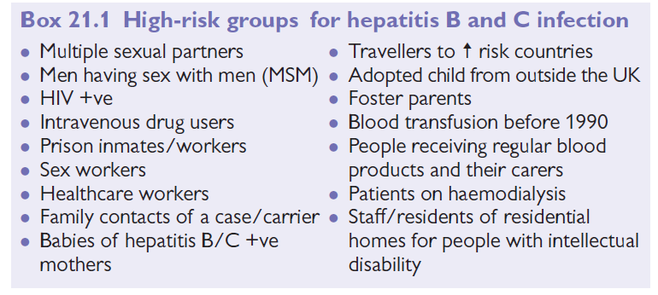
Hepatitis B High Risk Groups

Slide 6
Hepatitis B
Incubation: 6– 23wk (average 17wk).
Presentation: Asymptomatic or fever, malaise, fatigue, arthralgia, urticaria, pale stools, dark urine, and/ or jaundice.
<1% develop acute liver failure
>85% recover fully
10% become carriers/ have chronic hepatitis which may cause cirrhosis / liver cancer

Slide 7
Hepatitis B
Investigations:
LFTs (hepatic jaundice, ↑ bilirubin, ↑ ALT/ AST, ↑ alkaline phosphatase)
Hepatitis serology:
HBsAg Present from 1– 6mo after exposure. Carrier if present >6mo
HBeAg Present from 6wk– 3mo after acute illness. Indicates high infectivity
Anti- HBs Antibodies appear >10mo after infection; imply immunity

Slide 8
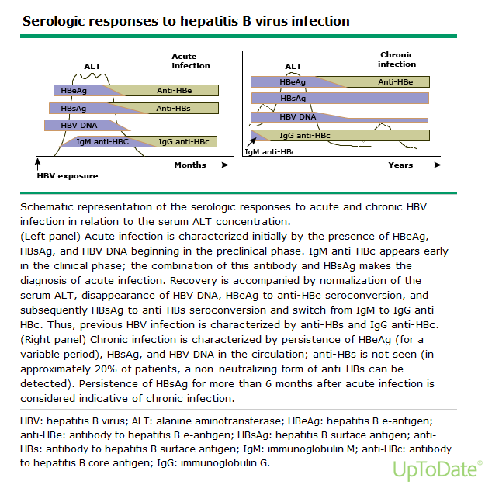

Slide 9
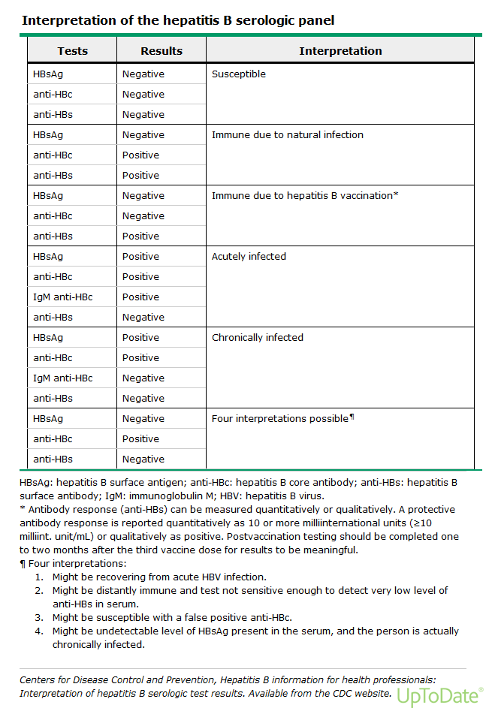

Slide 10
Cases

Slide 11
A patient that you follow has recently started volunteering at a drug treatment hospital and requires hepatitis B vaccination. You find that he is hepatitis B surface antibody positive. Which of the following would be the best guideline to follow in this case?
a. No vaccination is necessary based on his laboratory evaluation.
b. Administer one dose of hepatitis B vaccine.
c. Administer two doses of hepatitis B vaccine, at least 1 month apart.
d. Administer two doses of hepatitis B vaccine, at least 6 months apart.
e. Administer three doses of hepatitis B vaccine at the appropriate time interval.
Notes:
The answer is a. (ACIP, 2011.) Hepatitis B vaccination is recommended for adults in various risk categories. Behavioral risk categories include sexually
active persons with more than one sex partner in the last 6 months,persons seeking evaluation or treatment for a sexually transmitted disease,
current or recent injection-drug users, and men who have sex with men. Occupational risk categories include health care personnel and public
safety workers who may be exposed to blood or body fluids. Medical risk categories include persons with end-stage renal disease, persons with HIV
infection, and persons with chronic liver disease. In this question, having a positive surface antibody means that the patient is immune. If the patient
were to be surface antibody negative, the immunization schedule would be one injection at time 0, one between 1 and 2 months after that, and a third
injection between 4 and 6 months after the second.

Slide 12
A patient that you follow has recently started volunteering at a drug treatment hospital and requires hepatitis B vaccination. You find that he is hepatitis B surface antibody positive. Which of the following would be the best guideline to follow in this case?
a. No vaccination is necessary based on his laboratory evaluation.
b. Administer one dose of hepatitis B vaccine.
c. Administer two doses of hepatitis B vaccine, at least 1 month apart.
d. Administer two doses of hepatitis B vaccine, at least 6 months apart.
e. Administer three doses of hepatitis B vaccine at the appropriate time interval.
The answer is a
Notes:
The answer is a. (ACIP, 2011.) Hepatitis B vaccination is recommended for adults in various risk categories. Behavioral risk categories include sexually
active persons with more than one sex partner in the last 6 months,persons seeking evaluation or treatment for a sexually transmitted disease,
current or recent injection-drug users, and men who have sex with men. Occupational risk categories include health care personnel and public
safety workers who may be exposed to blood or body fluids. Medical risk categories include persons with end-stage renal disease, persons with HIV
infection, and persons with chronic liver disease. In this question, having a positive surface antibody means that the patient is immune. If the patient
were to be surface antibody negative, the immunization schedule would be one injection at time 0, one between 1 and 2 months after that, and a third
injection between 4 and 6 months after the second.

Slide 13
You check serologies on a patient exposed to hepatitis B. His serologies
are shown below:
• HBsAg: Negative
• HBeAg: Negative
• IgM anti-HBc: Negative
• IgG anti-HBc: Negative
• Anti-HBs: Positive
• Anti-HBe: Negative
Which of the following terms best describes his disease status?
a. Acute infection, early phase
b. Acute infection, window phase
c. Acute infection, recovery phase
d. Previous exposure with immunity
e. Vaccination
Notes:
229. The answer is e. (McPhee, pp 644-647.) The positivity of the anti- HBs indicates either exposure with immunity, recovery phase, or vaccination.
Because the IgG anti-HBc is negative, there is no evidence of past exposure or infection.

Slide 14
You check serologies on a patient exposed to hepatitis B. His serologies
are shown below:
• HBsAg: Negative
• HBeAg: Negative
• IgM anti-HBc: Negative
• IgG anti-HBc: Negative
• Anti-HBs: Positive
• Anti-HBe: Negative
Which of the following terms best describes his disease status?
a. Acute infection, early phase
b. Acute infection, window phase
c. Acute infection, recovery phase
d. Previous exposure with immunity
e. Vaccination
The answer is e
Notes:
229. The answer is e. (McPhee, pp 644-647.) The positivity of the anti- HBs indicates either exposure with immunity, recovery phase, or vaccination.
Because the IgG anti-HBc is negative, there is no evidence of past exposure or infection.

Slide 15
A 28 year old man, referred from Blood Bank because of being HBsAg positive.
The following HB markers are shown below:
Hepatitis B S antigen………….. Reactive
Anti-Hepa B Core IgG ………… Reactive
Hep-B e Antigen …………… Nonreactive
Anti- Hepa B e Antigen ……….. Reactive
Anti- Hepa B Surface …………. Nonreactive
■ What is your next step?
LFT, U/S liver, PCR
HEPATITIS B DNA QUALITATIVE ………… Positive
HEPATITIS B DNA QUANTITATIVE ……….. 889796 IU/ML
■ How are you going to deal with any patient in general?
Measures for the patient: Request LFT, U/S liver, PCR Referral to hepatologist, No blood donation
Measures for Family Contacts: Screen and Vaccinate the negative ones.

Slide 16
A 35 year old man came to the clinic for screening, as one member in his family is HBV positive.
The following HB markers are shown below:
Hepatitis B S antigen…….. Nonreactive
Anti-Hepa B Core IgG …… Reactive
Hep B e Antigen …………. Nonreactive
Anti- Hepa B e Antigen … Nonreactive
Anti- Hepa B Surface Antibodies …… Reactive
● What is your diagnosis?
Immune post exposure to HB virus
● How are you going to deal with patient?
Reassurance, No further actions could be taken

Slide 17
THYROID PROBLEMS

Slide 18
Hyperthyroidism
Affects 2% of females and 0.2% males
Peak age: 20– 49y.
Causes:
• Graves’ disease • Toxic nodular goiter older females with past history of goiter
• Thyroiditis • Amiodarone
• Kelp ingestion

Slide 19
Hyperthyroidism
Presentation:
• Weight loss • Tremor • Palpitations • Hyperactivity
• AF • Hyperhidrosis • Eye changes • Infertility
• Alopecia
In elderly patients, symptoms may be less obvious and include confusion, dementia, apathy, and depression.

Slide 20
Hypothyroidism
Common: 10% females >60y
Female: Male 88:1
Causes:
Chronic autoimmune thyroiditis
Post 131I
Thyroidectomy

Slide 21
Hypothyroidism
Presentation:
Onset tends to be insidious and may go undiagnosed for years.
Always consider hypothyroidism when a patient has non- specific symptoms, depression, fatigue, lethargy, or general malaise.
Other symptoms: ↑ weight, constipation, hoarse voice, or dry skin/ hair.
Signs are often absent, there may be a goiter, slow- relaxing reflexes, or non- pitting edema of the hands, feet, or eyelids.

Slide 22
Hypothyroidism
Screening thyroid functions in patients with :
• Persistent symptoms of tiredness/ lethargy without clear cause
• On amiodarone or with a history of 131I administration
• With hypercholesterolaemia, infertility, Turner’s syndrome, depression, dementia, obesity, DM, or other autoimmune disease

Slide 23
Subclinical Hypothyroidism
Indication of treatment:
Clinical symptoms
Presence of goiter
TSH > 10 miu/l
High positive antithyroid antibodies
If TSH < 10 and asymptomatic:
Repeat TSH after 3 – 6 months
Request thyroid antibodies, if high +ve then treat.

Slide 24
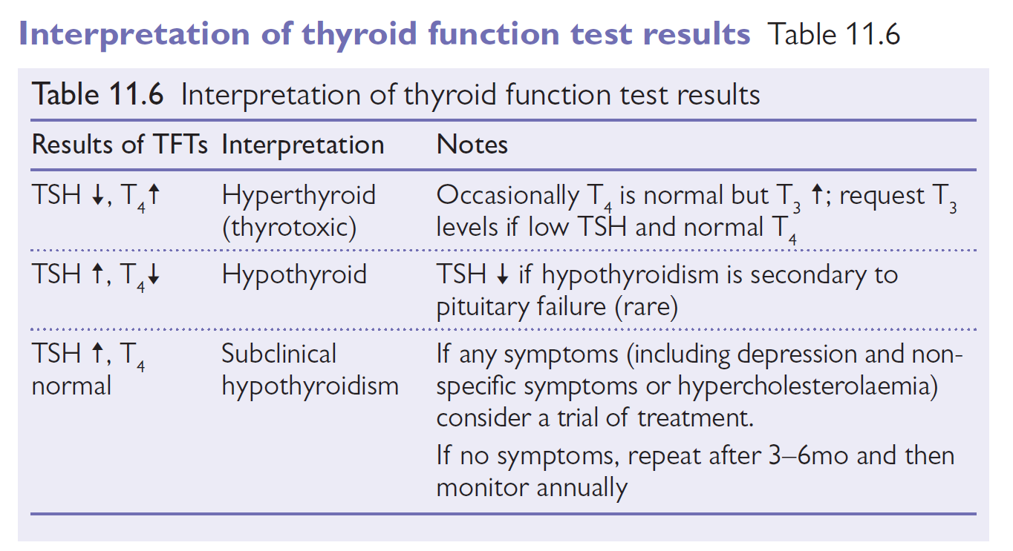

Slide 25
Cases

Slide 26
A 50 year- old man presents to your office with 6 month H/O of fatigue and weakness.. O/E: no objective positive findings.
TSH: 12.2 miu/l (0.25—5)
FT4: 11.6 pmol/l (10.3—25 .8)
What is your diagnosis?
a- Primary Hypothyroidism
b- Subclinical Hyperthyroidism
c- Subacute Thyroiditis
d- Subclinical Hypothyroidism
e- Secondary Hypothyroidism
Notes:
Answer D

Slide 27
A 50 year- old man presents to your office with 6 month H/O of fatigue and weakness.. O/E: no objective positive findings.
TSH: 12.2 miu/l (0.25—5)
FT4: 11.6 pmol/l (10.3—25 .8)
What is your diagnosis?
a- Primary Hypothyroidism
b- Subclinical Hyperthyroidism
c- Subacute Thyroiditis
d- Subclinical Hypothyroidism
e- Secondary Hypothyroidism The Answer D
Notes:
Answer D

Slide 28
A 19-year-old lady presents with 3 weeks H/O a neck swelling discovered incidentally. The swelling move with deglutition and related to left lobe of thyroid and no Lymph Node swellings. She is euthyroid. TSH and T4 are within normal.
What is the most appropriate step in management?
A- Observation
B- Referral urgent to endocrine
C- Thyroglobulin antibodies
D- Technetium thyroid scan
E- U/S thyroid
Answer E
(Note: U/S to see its type solid or cystic, size, one nodule or more and also to localize the nodule for biopsy)

Slide 29
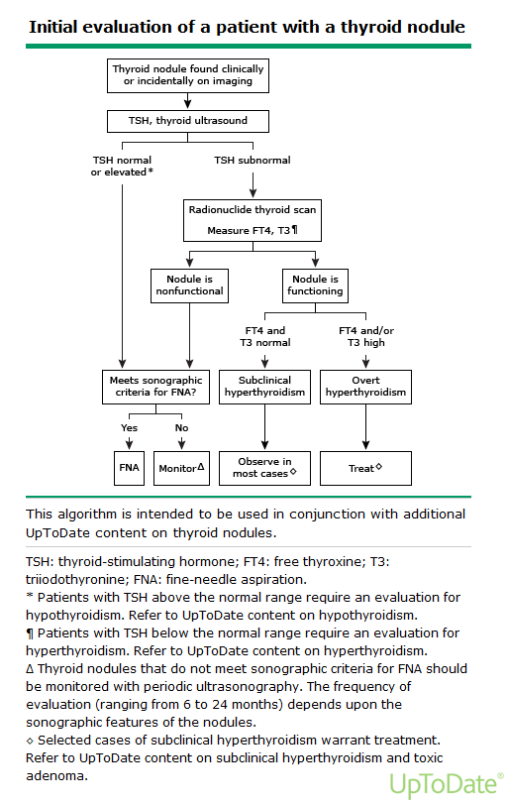

Slide 30
A 32-year-old lady, nurse, single presented with one month H/O palpitation and loss of weight.
O/E: pulse 116 / min Bp 140 / 70
Apart from fine tremors nothing was significant. The following investigations are shown:
WBC : ………8.4 ESR : ….. 4
TSH: < 0.01 miu/l (0.25—5)
FT4: 92.6 pmol/l (10.3—25 .8)
Thyroid scan: Reduced iodine uptake
Mention three causes of reduced iodine uptake.
1- Subacute thyroiditis
2- Post-partum thyroiditis
3- Factitious thyroiditis

Slide 31
A 42-year-old man booked recently in the clinic. Followed in a private psychiatry clinic because of depression mainly insomnia, weakness and fatigue, on 40 mg Paroxetine. Still not improving, so another antipsychotic drug was added.
The patient has good insight and very cooperative.
Mention one investigation of importance for this patient?
TSH : 329.0 H mIU/L (0.25 – 5)
FT4: 2.87 L pmol/L (10.3 - 25.8)
Cholesterol: 9.86 mmol/L
Trig.: ……….. 3.12 mmol/L
What is your diagnosis?
Primary hypothyroidism
Secondary hypercholesterolaemia

Slide 32
A 30-year-old lady with menstrual irregularities. desiring pregnancy
TSH: …… 44.58 miu/l (0.25 - 5)
FT4: …… 5.58 pmol/l (10.3- 25.8)
3 months later: (after 100 micgm thyroxin)
TSH: …… 7.37 miu/l (0.25 - 5)
FT4: …… 10.68 pmol/l (10.3- 25.8)
3 months later: (after 125 micgm thyroxin)
TSH: …… 2.3 miu/l (0.25 - 5)
FT4: …… 12.58 pmol/l (10.3- 25.8)

Slide 33
A 27-year-old woman presents with one month H/O weight loss, sweating and tremors. She has diffuse neck swelling. Pulse: 124 bpm
CBC: normal ESR: 12 mm/h
TSH: <0.001 miu/l (0.25 -5)
FT4: 139.2 pmol/l (10.3-25.8)
What are the differential diagnosis?
1- Graves’ disease
2- Subacute thyroiditis
3- Multinodular toxic goiter
4- Toxic nodule /adenoma
Mention one appropriate investigation to reach the diagnosis.
Thyroid Scan

Slide 34
A 28 year old woman presents to your office with 10 days H/O palpitation, sweating and neck discomfort. O/E: Wet hands and neck tenderness
pulse: 116/m temp. 37.7
CBC: normal ESR: 82 mm/h
TSH: <0.01 miu/l (0.25 -5)
FT4: 89.2 pmol/l (10.3-25.8)
What is the most likely diagnosis?
A- Graves’ disease
B- Subacute thyroiditis
C- Hashimotos thyroiditis
D- Multinodular toxic goiter
Answer B

Slide 35
Cont. A 28 year old woman with neck discomfort.
Select one investigation to confirm your diagnosis.
A- Ultrasound neck
B- Thyroid antibodies
C- Free T3 level
D- Radioactive Iodine thyroid uptake
E- Fine needle aspiration
Answer D
What is the treatment? Choose one or more.
A- L- Thyroxin
B- B Blockers
C- NSAID
D- Iodine therapy
E- Carbimazole
Answer B and C

Slide 36
Hypocalcaemia & Hypercalcemia

Slide 37
Hyper- and hypocalcaemia

Slide 38
Hypocalcaemia
↓ serum calcium (<2.15mmol/ L).
Causes:
• If phosphate ↑ : CKD, hypoparathyroidism (may be congenital or 2° to thyroid or parathyroid surgery, or malignant infiltration), pseudohypoparathyroidism (insensitivity to parathyroid hormone)
• If phosphate normal or ↓: Vitamin D deficiency (osteomalacia, rickets), malabsorption, lack of calcium in diet, overhydration, pancreatitis

Slide 39
Hypocalcaemia
Presentation:
• Tetany
• Irritability, depression or psychosis
• Perioral paraesthesia
• Carpo- pedal spasm (wrist flexion and fingers drawn together)
• Neuromuscular excitability: tapping over parotid causes facial muscles to contract (Chvostek’s sign)

Slide 40
Hypocalcaemia
Apparent hypocalcaemia may be an artefact of hypoalbuminaemia.
Management:
Check vitamin D levels. Supplement with calcium. Referral may be needed to investigate/ treat the underlying cause.

Slide 41
Hypercalcaemia
↑ level of serum calcium (>2.55mmol/ L).
Prevalence: 81 in 500; Male: Female 81:3. Rare <age 50y.

Slide 42
Hypercalcaemia
Common causes (90%):
• Primary hyperparathyroidism
• Malignancy (10% tumors usually myeloma, breast, lung, kidney, thyroid, prostate, ovary or colon)

Slide 43
Hypercalcaemia
Uncommon causes:
• Chronic renal failure
• Familial benign hypercalcaemia
• Sarcoidosis
• Thyrotoxicosis
• Milk alkali syndrome
• Vitamin D treatment

Slide 44
Hypercalcaemia
Presentation: Often very non- specific. May be an incidental finding. Other
symptoms: ‘bones, stones, groans, and abdominal moans’.

Slide 45
Hyperparathyroidism
Primary hyperparathyroidism:
Incidence 0.5/ 1000. Peak age 40– 60y. Female :male 82:1.
Circulating level of PTH is inappropriately high.
Most patients are hypercalcaemic (but may be normocalcaemic if coexistent vitamin D deficiency). Due to ↑ secretion of PTH from one or both parathyroid glands.
Management: Treatment is usually surgical. Drug treatment (e.g. with cinacalcet) may be an option if unsuitable for surgery

Slide 46
Hyperparathyroidism
Secondary hyperparathyroidism:
↑ PTH in response to chronic hypocalcaemia or hyperphosphataemia.
Management: Treat the underlying cause

Slide 47
Hyperparathyroidism
Tertiary hyperparathyroidism:
Inappropriately ↑ PTH → ↑Ca2+.
Follows prolonged secondary hyperparathyroidism.
Most common in patients with chronic kidney disease (especially if on dialysis) or chronic malabsorption.
Management: Treatment may be either surgical or medical (e.g. with cinacalcet or paricalcitol)

Slide 48
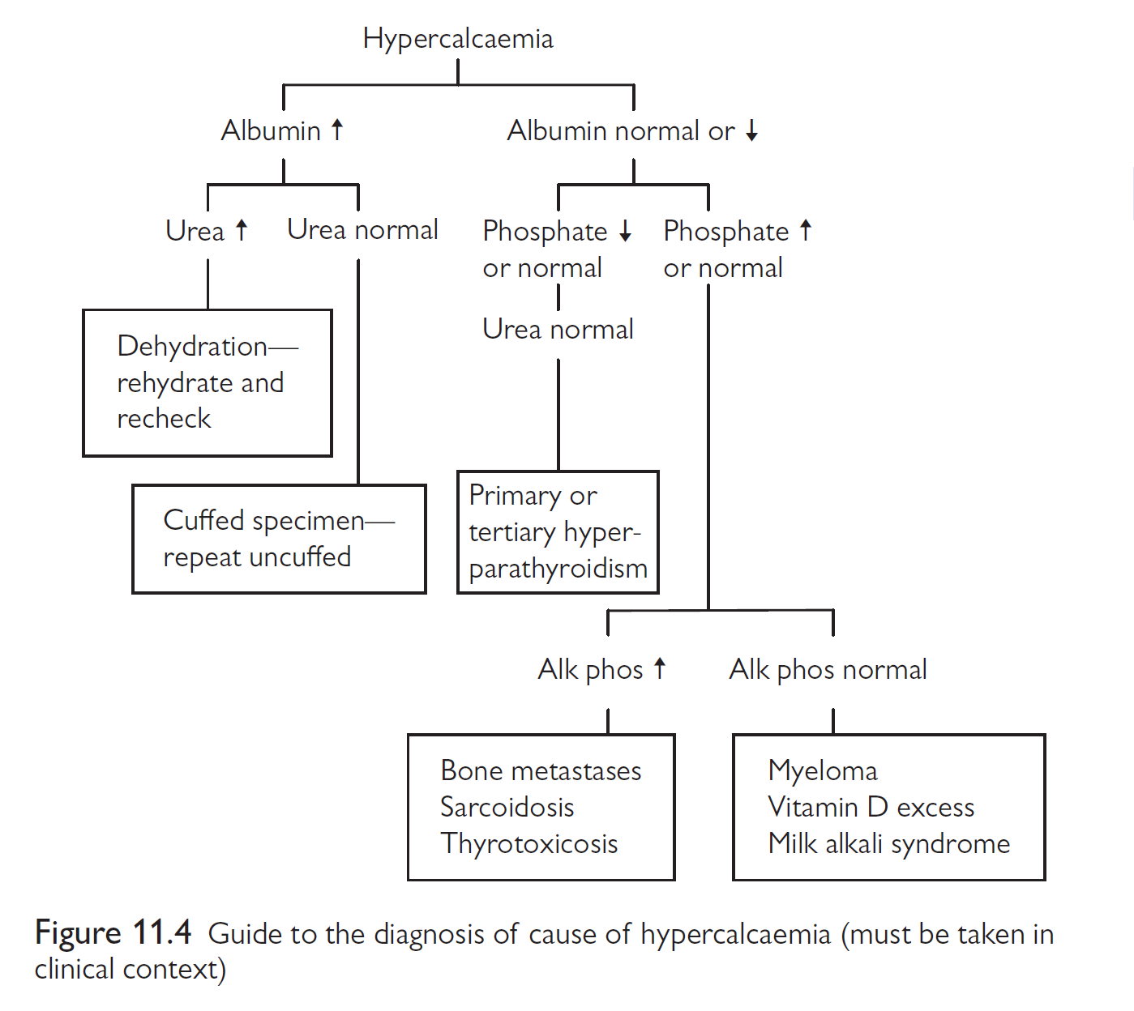

Slide 49
Cases

Slide 50
A 70-year-old blind man known case of hypothyroidism, vitiligo and left ventricle dysfunction presents with 2m H/O SOB, bouts of dry and irritating cough, loss of appetite, hoarseness of voice and low mood.
TSH: 0.288 miu/L …………(0.25 – 5)
T4: 20.5 pmol/L ………(10.3 – 25.8)
Ca. 1.4 mmol/L ………(2.10 – 2.55)
Ph. 1.67 mmol/L ………(0.74 – 1.30)
Alb. 35 gm/L ………. (30 – 50 )
Alk. Ph. 86 u/l …………..(50 – 136)
What is your diagnosis?
Primary hypoparathyroidism

Slide 51
Contin. A 70-year-old blind man known case of hupothyroidism, vitiligo
What is the next investigation of choice?
Parathyroid hormone 0.353 pmol/L ……..(1.65 – 6.9)
What is your management?
Vitamin D
Oral Calcium
What other organs or diseases you may screen for?
Diabetes (FPG)
Adrenal gland (Cortisol level)

Slide 52
A 52- year- old woman presents to your office with 6 month H/O polyuria and lethargy.
O/E: looks dehydrated and has a neck swelling (she has the swelling for years and informed to be a simple goitre)
Ca:……… 3.4 mmol/L (2.1 - 2.6)
Ph: …….. 0.62 mmol/L (0.8 - 1.4)
Urea: ….. 9.2 mmol/L (2.6 - 6.6)
Chloride:..113 mmol/L (95 - 105)
What is your diagnosis?
Hyperparathyroidism due to parathyroid adenoma
Which investigation of choice are you going to request?
Nuclear scan for parathyroid glands
Parathyroid hormone

Slide 53
A 48 year old woman presents with 5 month. H/O difficulty in raising from sitting position. The following investigation is shown below:
Calcium 1.65 mmol/L (2.1 – 2.6)
Phosph. 1.52 mmol/L (0.8 – 1.4)
Alk. Phos. 134 mmol/L (43 – 154)
Albumen 38 g/L (35 – 50)
What is your diagnosis?
Hypoparathyroidism
investigate
investigate

Slide 54
A 14-year-old girl presents with 1 year H/O pain in lower limbs.
O/E: unremarkable
The following results are shown:
Calcium …………………. 1.62 L 2.10 – 2.55 mmol/L
Corrected calcium ………… 1.6 L 2.10 – 2.55 mmol/L
Inorganic Phosphorus …… 1.13 0.87 – 1.45 mmol/L
Albumin ……………………… 39 35 – 50 g/L
Alkaline phosphatase …….. 1191 H 195 – 476 u/L
Vit D ………………….. …….. 4.0 nmol/L
[ Defeciency <25 Insuffeciency 25 – 75
Suffecient 75 – 250 Toxicity >250 ]
See attached X-Ray
What is your diagnosis and management?

Slide 55
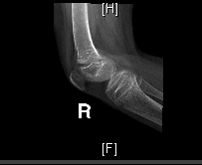
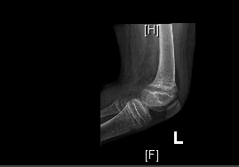
Widened growth plate
with fraying, splaying
And cupping of the
Metaphysis Involving
both distal both
Femurs and proximal
Tibias and fibulas
suggestive of Rickets.

Slide 56
Cont. A 14-year-old girl presents with 1 year H/O pain in lower limbs.
She was put on Vit. D3 45000 U /week and calcium carbonate 600 mg BID for 2 months.
The results are shown below:
Calcium …………………. 2.27 2.10 – 2.55 mmol/L
Corrected calcium ………… 2.30 2.10 – 2.55 mmol/L
Inorganic Phosphorus …… 2.00 H 0.87 – 1.45 mmol/L
Albumin ……………………… 39 35 – 50 g/L
Alkaline phosphatase …….. 687 H 195 – 476 u/L

Slide 57
Rickets / Osteomalacia
Hypoparathyroidism
Low calcium
Low or Normal phosphate
High alkaline phosphatase
Low calcium
High phosphate
Normal alkaline phosphatase

Slide 58
THANK YOU

