Slide 1
ECG

Slide 2
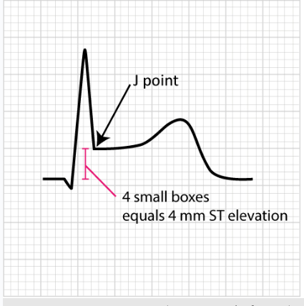

Slide 3
St segment depression

Slide 6
What are the Most Important causes of ST elevation in ECG?
MI
Acute pericarditis
LBBB
Benigni early repolarization

Slide 9
Reciprocal changes

Slide 10
Anteriorlatral STEMI

Slide 11
Inferior STEMI

Slide 12
Acute Pericarditis
• Usually diffuse ST elevation
• Can be associated with PR depression (except in aVR it will be elevated)
• No reciprocal changes
• The morphology of the ST segment

Slide 15
AnterioLateral STEMI

Slide 16
Anterolateral STEMI

Slide 17
Anterolateral STEMI

Slide 19
Thank you

