Slide 1



Evidence-Based Medicine Approach
Part 2
Dr. Nada A. AlYousefi
Associate Professor, Postgraduate Trainer and Consultant of Family Medicine
International Board-Certified Lactation Consultant
Department of Family and Community Medicine
College of Medicine, King Saud University (KSU)
nalyousefi@ksu.edu.sa
February 2022

Slide 2
Objectives
Part 2
  Critically appraise scientific papers (e.g. on therapeutic intervention and systematic review).
  Learn how to apply the results findings to a specific population.

Slide 3

Critical Appraisal
WHY APPRAISE THE EVIDENCE?
  Where an article is published, or who wrote it should not be an indication of its trustworthiness and relevance.
  Using critical appraisal skills and tools enables users of research evidence to reach their own judgements.

Slide 4
Critical Appraisal
Critical appraisal is the process of carefully and systematically assessing the outcome of scientific research (evidence) to judge its trustworthiness, value and relevance in a particular context. (Burls 2009)

Slide 5
Critical Appraisal
It is an essential skill for evidence-based practice because it allows public health professionals and clinicians to find and use research evidence reliably and efficiently to inform their decision-making.

Slide 6
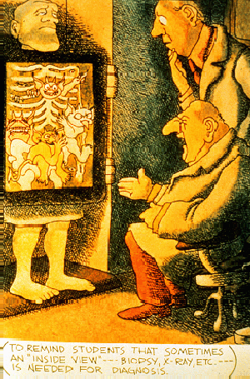
Critical Appraisal
Critical appraisal looks at the way a study is conducted and examines factors such as internal validity, generalizability and relevance.

Slide 7
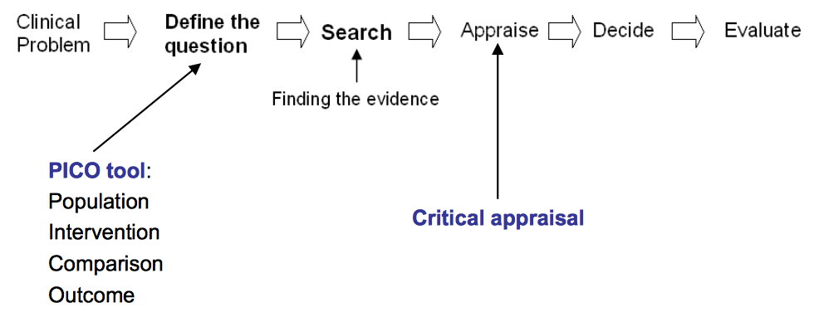
UCL GreatOrmondStreet Institute of Child Health Library
Last updated March 2017
www.ucl.ac.uk/ich/support-services/library

Slide 8
Critical Appraisal
Good research is needed to generate reliable information.
Research involves designing a study, gathering data, then collating and analysing it to produce meaningful information.
How can you tell whether a piece of research has been done properly and that the information it reports is reliable and trustworthy? How can you decide what to believe when research on the same topic comes to contradictory conclusions? This is where critical appraisal skills help.
Notes:
Good research is needed to generate reliable information. Research involves designing a study, gathering data, then collating and analysing it to produce meaningful information. However, not all research is good quality and many studies are biased and their results untrue. This can lead people who read it to draw false conclusions.

Slide 9


Slide 10
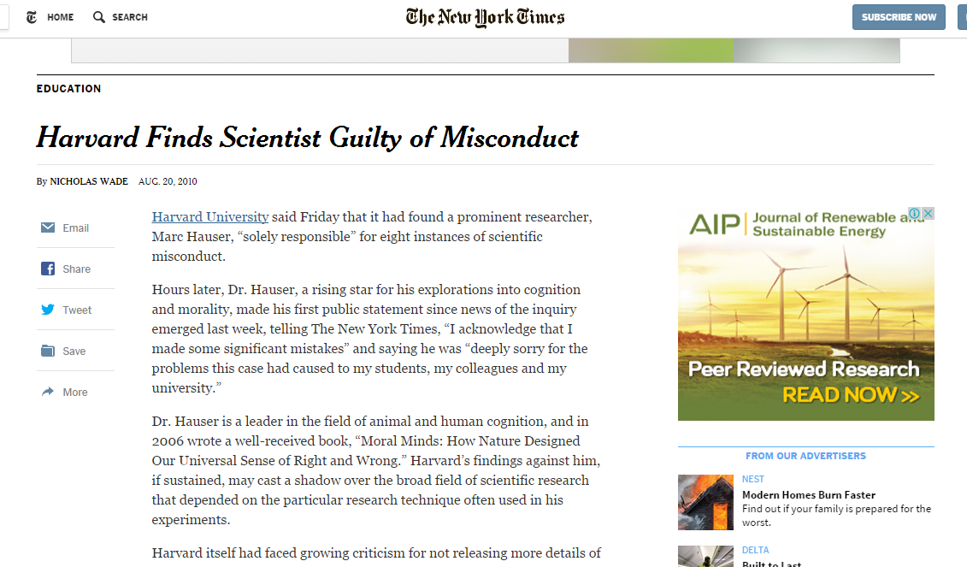

Slide 11

They concluded that Hauser had fabricated data in one study, manipulated results in multiple experiments, and incorrectly described how studies were conducted.

Slide 12
Importance
Combat information overload.
Identify papers that are clinically relevant.
Continuing Professional Development (CPD) - critical appraisal is a requirement for the evidence based medicine component of many membership exams.
Research interest.

Slide 13

Notes:
حسب سفر التكوين فبعد نهاية الطوفان شرع نسل نوح في بناء برج بابل في سهل شنعار بغية أن يجمعهم مكان واحد من الأرض فلا يتبددون على وجه البسيطة الواسعة. وكان في قصدهم جعل العالم كله مملكة واحدة عاصمتها هذا المكان الذي اختاروه في أرض شنعار وسمي بابل. وليقيموا لأنفسهم اسماً ومجداً دلالة على كبريائهم وتشامخ نفوسهم (تكوين 11: 4).
ولعدم توفر الحجر استعملوا اللبن أي صبُّوا الطين في قوالب وأحرقوا القوالب حتى لا تتأثر بالماء. واستعملوا الحمر بدل الطين والحمر هو المزيج اللزج الذي كان يكثر في بعض هذه البقاع بسبب وجود البترول. والحمر هو القار أو المادة الإسفلتية وعندما تيبس تثبت القوالب.
إلا أن الله لم يكن في قصده تجمّع الناس بعد الطوفان بل انتشارهم لتعمير الأرض. ثم لم يكن من صالح الناس أن يلجؤوا إلى طرقهم وكبريائهم في تحدّي الرب. فبلبل الله ألسنتهم، فكفوا عن العمل وتفرقوا فعمّروا الأرض وصارت الأرض وصارت البقعة اسمها بابل من الفعل "بلبل" العربي، والعبري القريب منه "بلل" وبسبب هذا التشتت والطقس والتربة واختلاف طرق المعيشة نشأت أجناس الناس وتكونت لغاتهم المختلفة

Slide 14


Bias!
Published in a major journal written in English (Tower of Babel bias)
Submitted and accepted for publication (publication bias)
Published in a journal indexed in a literature database, especially in less developed countries (database
bias)
Cited by other authors (citation bias)
Published repeatedly (multiple publication bias)
... and quoted by newspapers!
(Egger & Smith 1998; Gregoire, Derderian, & Le Lorier 1995)
Notes:
A bias introduced in a meta-analysis, when only English-language studies are included in the data being analysed.

Slide 15
In general
Don’t let yourself be taken in by scientific jargon and complex use of language. Good articles are written in plain English!
Even authorative journals with a high impact factor contain bad articles and vice versa.
Focus on research question, study design and outcome.
Be critical!! Always ask yourself: does this make sense?

Slide 16

How to read a research article?

Slide 17
Structure of an article
1. Title
2. Abstract
3. Introduction
4. Background / review of literature
5. Methodology
6. Results
7. Discussion

Slide 18
Structure of an article
Title
Not always a good indication of the content of the article
Example: “The Risks of Autonomy: Empirical Evidence for the Necessity of a Balance Management in Promoting Organizational Innovativeness” ??????

Slide 19
Structure of an article
2. Abstract
Sometimes unclear. What should be in it: a summary of the the research question, key methods, results and conclusions of the study

Slide 20
Structure of an article
3. Introduction
Should contain the research question (PICO) or hypotheses tested
4. Background / review of literature
Research questions occur in the context of an already-formed body of knowledge. The background should address this context, help set the rationale for the study, and explain why the questions being asked are relevant.

Slide 21
Structure of an article
5. Methodology
Should describe exactly how the research was carried out:
- Sample: characteristics, selection, number, non-response
- Measures: description of tests / questionnaires (validated?), data, outcome measures
- Procedure: study design (qualitative, quantitative, controlled?)

Slide 22
Structure of an article
6. Results
Should tell the reader what the findings were. All outcome measures must be reported and confidence intervals for effect sizes should be presented.
7. Discussion
Interpretation of the results / relation to theory
Comparison with the results of other studies
Weaknesses / limitations of the study
Implications
Recommendations

Slide 23
Critical appraisal is a systematic process used to identify the strengths and weaknesses of a research article in order to assess the usefulness and validity of research findings.
Young JM, Solomon MJ. How to critically appraise an article. Nature Clinical Practice Gastroenterology & Hepatology. 2009 Feb;6(2):82-91.

Slide 24
The most important components of a critical appraisal are an evaluation of the appropriateness of the study design for the research question and a careful assessment of the key methodological features of this design.
Young JM, Solomon MJ. How to critically appraise an article. Nature Clinical Practice Gastroenterology & Hepatology. 2009 Feb;6(2):82-91.

Slide 25
Other factors that also should be considered include the suitability of the statistical methods used and their subsequent interpretation, potential conflicts of interest and the relevance of the research to one’s own practice.
Young JM, Solomon MJ. How to critically appraise an article. Nature Clinical Practice Gastroenterology & Hepatology. 2009 Feb;6(2):82-91.

Slide 26


Critical appraisal of different study designs
To critically appraise a journal article, you would have to start by assessing the research methods used in the study.
Checklists - specific to the study design.
The following checklists are commonly used:
  https://www.cebm.net/2014/06/critical-appraisal/
  https://casp-uk.net/casp-tools-checklists/
Notes:
CASP: Critical Appraisal Skills Programme Checklists
Critically Appraised Topics: generic systematic reviews (ACP Journal club)
SIGN: Scottish Intercollegiate Guidelines Network
GATE Frame

Slide 27

  https://casp-uk.net/casp-tools-checklists/

Slide 28

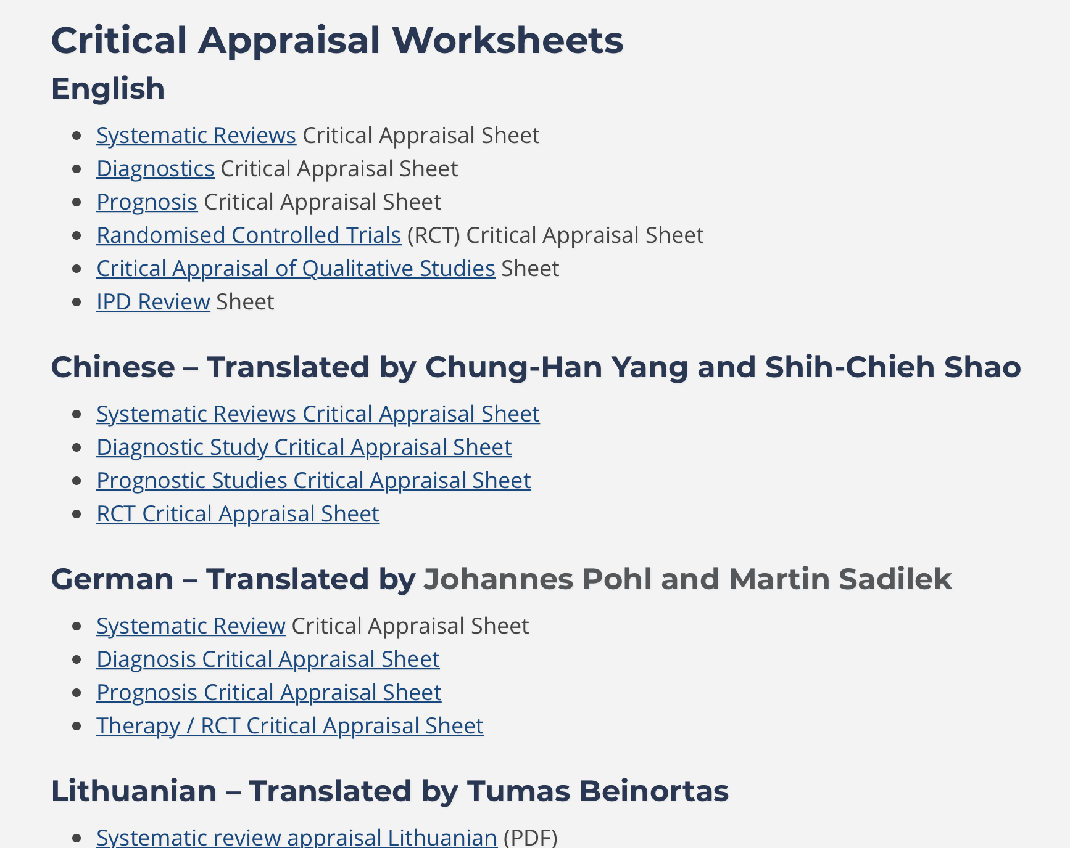
  https://www.cebm.net/2014/06/critical-appraisal/

Slide 29
5-step approach
EBM is a 5-step approach
Formulate an answerable question (PICOC)
Search for the best available evidence
Critically appraise the quality of the found evidence
Integrate the evidence with managerial expertise and organizational concerns and apply
Monitor and evaluate the results

Slide 30
Critical Appraisal tools
Critical appraisal is the systematic evaluation of clinical research papers in order to establish:
  Does question of this study address a clearly focused question?
  Did the study use valid methods to address this
  Are the valid results of this study important?
  Are these valid, important results applicable to my patient or population?
If the answer to any of these questions is “no”, you can save yourself the trouble of reading the rest of it.
Notes:
1. Is the study valid?
The first step is to decide whether the study was unbiased by evaluating its methodological quality. Different criteria for validity of articles are used for different types of questions on: treatment, diagnosis, prognosis and economic evaluation. Depending on the validity of an article we can classify it within a scale of levels of evidence and degrees of recommendation.
2. What are the results?
If we decide that the study is valid, we can go on to look at the results. At this step we consider whether the study’s results are clinically important. For example, did the experimental group show a significantly better outcome compared with the control group? We also consider how much uncertainty there is about the results, as expressed in the form of p values, confidence intervals and sensitivity analysis.
3. Are the results useful?
Once you have decided that your evidence is valid and important, you need to think about how it applies to your question. It is likely, for example, that your patient or population may have different characteristics to those in the study. Critical appraisal skills provides a framework within which to consider these issues in an explicit, transparent way.

Slide 31
Ten questions to ask when critically appraising a research article.
Is the study question relevant?
Does the study add anything new?
What type of research question is being asked? Was the study design appropriate for the research question?
Did the study methods address the most important potential sources of bias?
Was the study performed according to the original protocol?
Does the study test a stated hypothesis?
Were the statistical analyses performed correctly? Do the data justify the conclusions?
Are there any conflicts of interest?
Young JM, Solomon MJ. How to critically appraise an article. Nature Clinical Practice Gastroenterology & Hepatology. 2009 Feb;6(2):82-91.

Slide 32

Motivation
A patient may have brought in an Internet printout, or you may have heard it on the radio.
Keeping Up with the Medical Literature: How to Set Up a System. Am Fam Physician. 2009;79(1):25-26.

Slide 33

Notes:
This is an ad from Readers Digest. Many other magazines, Sunday newspaper sections, and medical journals carried full page ads. This is certainly where patients heard about it and began to ask for it. For many clinicians, this was also their first exposure, if not from their local neurologist who may even have been a paid speaker to enlighten the locals about the new effective drug.

Slide 34
Clarification
What study design could answer the question of whether this medication is useful in preventing migraine headaches in this patient?

Slide 35
What’s A Paper on Therapy?
Randomised Control Trials
Objectives
  Understand why randomised controlled trials produce the most reliable evidence for questions about effectiveness
  Understand the important elements of trial design to minimise bias
  Have critically appraised a randomised controlled trial

Slide 36
What’s A Paper on Therapy?
Clinical Trial (Controlled) Compares
INTERVENTION
with
CONTROL

Slide 37
Clinical Trial Compares
  INTERVENTION
    Drug (New)
    Structured exercise program (e.g. osteoporosis)
    Surgical procedure
  CONTROL
    Placebo, old drug or old intervention
    Usual regular advise given (osteoporosis)
    Another surgical procedure / No surgery

Slide 38
Process of RCTs
Preparation: Randomization, Computer generated list
Eligibility assessment (Inclusion/exclusion)
Consent
Allocation to study arms (Concealment)
Baseline assessment
Initiation of intervention (Blind)
Follow-up
Outcome assessment
Data analysis

Slide 39
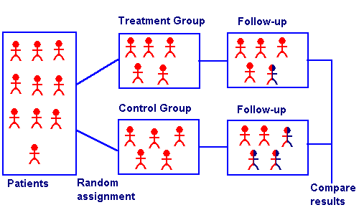

Slide 40
Appraise the Evidence
Internal validity:
  Assess validity? Correctness (likely to be true)
  What are the results? Clinically important
External validity:
  Can we apply the results to our patient? Applicable in and useful for my patients
Notes:
When we consider validity, we really need to look at two types of validity. Internal validity is, basically, how well methodologically was the study performed. In other words, was the study design rigorous enough so that we can be confident that the researchers found what they think they found? We’re asking how well do the results reflect the truth of what actually happens in the world.
External validity asks the results found in the study apply to people not included in the study. In other words, can I apply these results to my patients? We need to determine the generalizability of the study to the population of patients we see. Rarely do we have a study that includes all types of patients and there are usually many types of exclusion and inclusion criteria that frequently do not apply to our patients. It’s important for us to determine whether or not these results really have a probability of similarly affecting our particular patients.
For more on generalizability, see: Altman DG, Bland JM. Generalisation and extrapolation. BMJ 1998;317:409-10.

Slide 41
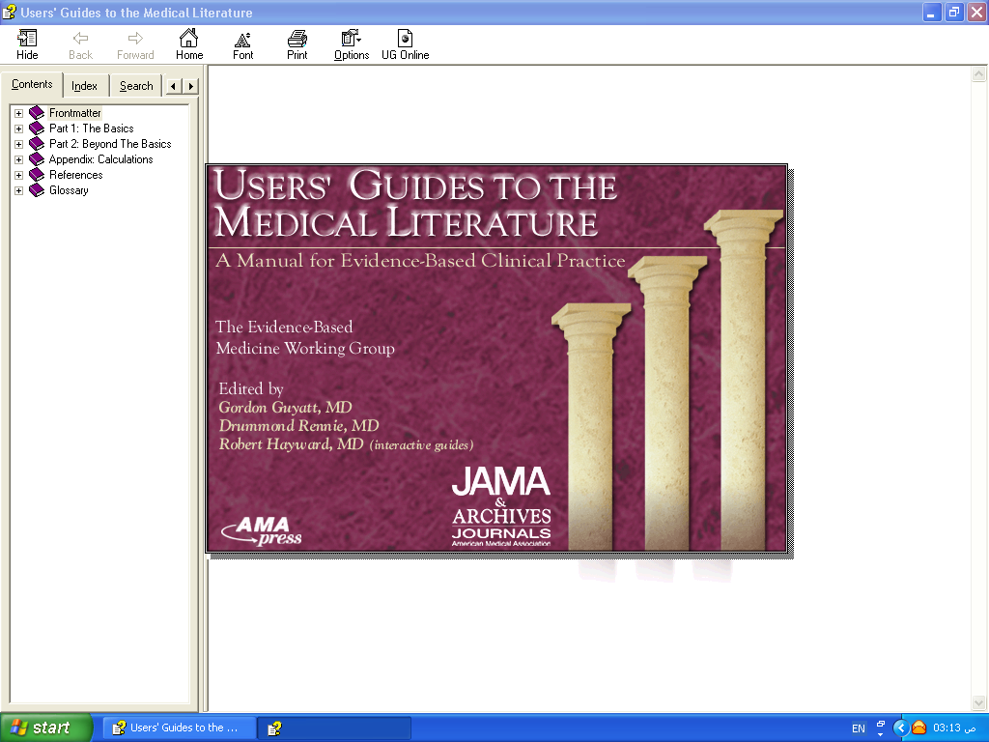
APPLICABILITY
VALIDITY
RESULTS

Slide 42
VALIDITY
Randomization.
Concealment.
Blindness.
Follow up complete.
Intention to treat.
Similar groups at start.
Both groups treated equally.

Slide 43
Are the results of this single preventive or therapeutic trial valid?
 | Was the assignment of patients to treatments randomised? Was the randomisation list concealed?
 | Was follow-up of patients sufficiently long and complete?
 | Were all patients analysed in the groups to which they were randomised?
 | Were patients and clinicians kept "blind" to treatment?
 | Were the groups treated equally, apart from the experimental treatment?
 | Were the groups similar at the start of the trial?

Slide 44
Randomization
Randomisation = similar groups at baseline
Equal (50%) chance to be in either group
How was it randomized?
Was randomization concealed?
- selection
- allocation

Slide 45

Generation of an unpredictable allocation sequence

Slide 46

Was allocation assignment “concealed”?
Did investigators know to which group the potential subject would be assigned before enrolling them?
Notes:
The gold standard for a therapeutic trial is no longer simply just the concept of randomization, but is also whether or not allocation assignment was concealed from the enrolling investigator (“concealed allocation). It has only been in the last 5 to 8 years that allocation concealment has been discussed or even mentioned in the medical literature. This is a very difficult concept for many and our goal in discussing it now is not for participants to fully understand it, but to grasp its importance. The definition of concealed allocation: Did the investigators know to which group a potential subject would be assigned before they were actually enrolled in this study?

Slide 47
Importance of concealed allocation
Trials with unconcealed allocation consistently overestimate benefit by ~40%
Schulz KF, Chalmers I, Hayes RJ, et al. JAMA 1995;273:408-12
Schulz KF, Grimes DA. Lancet 2002;359:614-18.
Pildal J, et al. Int J Epidemiol 2007;36:847-857
Moher D, et al. Lancet 1998;352:609-13.
Notes:
Dr. Schultz and his colleagues first identified the importance of concealing allocation assignment in 1995. Trials of certain interventions that did not use conceal allocation compared with similar trials that concealed allocation consistently overestimate the benefit of the treatment by 40%. Few clinicians and few studies knew about the importance of allocation concealment before 1995. What we think we know that was published before 1995 may be biased by the lack of allocation concealment.
See: Schulz KF, Chalmers I, Hayes RJ, et al. Subverting randomization in controlled trials. JAMA 1995;273:408-12. Schulz KF, Grimes DA. Allocation concealment in randomised trials: defending against deciphering. Lancet 2002;359:614-18.
Also: Altman DG, Schulz KF. Concealing treatment allocation in randomised trials. BMJ 2001;323:446-7. Schulz KF, Grimes DA. Generation of allocation sequences in randomised trials: change, not choice. Lancet 2002;359:515-9. Torgerson DJ, Roberts C. Randomisation methods: concealment. BMJ 1999;319:375-6.

Slide 48
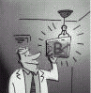
Ensuring Allocation Concealment
BEST – most valid technique
Central computer randomization
DOUBTFUL
Envelopes, etc
NOT RANDOMIZED
Date of birth, alternate days, etc

Slide 49
Conducting a Study
Potential Subjects
Concealed
Allocation
Trial starts
Actual
Subjects
A
Randomization
Blinding, etc
B
Notes:
This is a schematic of the difference between randomization and blindness and concealed allocation. Concealed allocation occurs before the trial even starts. Randomization and blinding occur after the study subjects are enrolled.

Slide 50
Selection bias
Reduced by:
centralised randomisation
on-site computer system with group assignments in a locked file
sequentially numbered, sealed, opaque envelopes
Not: alternation, dates of birth, day of week.

Slide 51
Blindness
Was study “double-blinded”?
Did the patients know to which group they were assigned?
Did the treating physician know?
Did investigators assessing outcomes know (“triple-blinding” – up to 7 levels!)?
  Judicial assessor blind + allocation concealment = surgery RCTs
Schulz KF. Ann Int Med 2002;136:254-9.
Notes:
Do the patients know to which group they were actually assigned? Did they know what treatment they received? Did the physician who gave the treatment know what treatment the patient received? Did the individual assessing the outcome know what treatment the patient received? This is called “triple blinding” when all three don’t know the group assignment. There are actually seven levels of blinding, but the most important are these three.

Slide 52
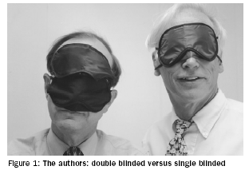
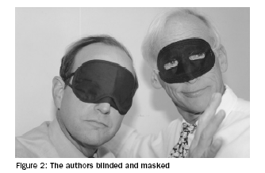
Measurement Bias - minimizing differential error
Blinding – Who?
  Participants?
  Investigators?
  Outcome assessors?
  Analysts?
Most important to use "blinded" outcome assessors when outcome is not objective!
Papers should report WHO was blinded and HOW it was done
Schulz and Grimes. Lancet, 2002

Slide 53
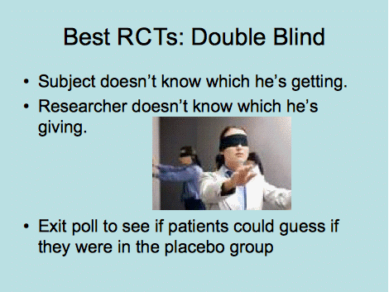

Slide 54
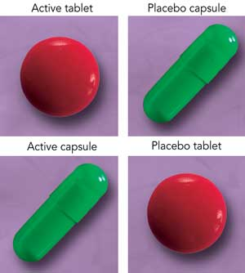
Notes:
54

Slide 55
Blindness
If patient knows: Placebo effect Those who are on effective treatment perform better than those who receive Placebo
If Physician knows: Overestimate Treatment effect (More care, Co-intervention)

Slide 56
Selection bias
Performance bias
Rx
Follow-up
Potential
Subjects
Outcome
Concealed
Allocation
Blindness
C
Intervention starts

Slide 57

Two balanced groups:
Start Balanced: All prognostic factors are equally distributed at the start (Concealed Randomization)
Run Balanced: All prognostic factors are maintained balanced throughout the study (Blindness and the 3C)
End Balanced: All prognostic factors are maintained balanced at the end of the study (ITT)
Intervention
Notes:
Compliance contamination co intervention

Slide 58
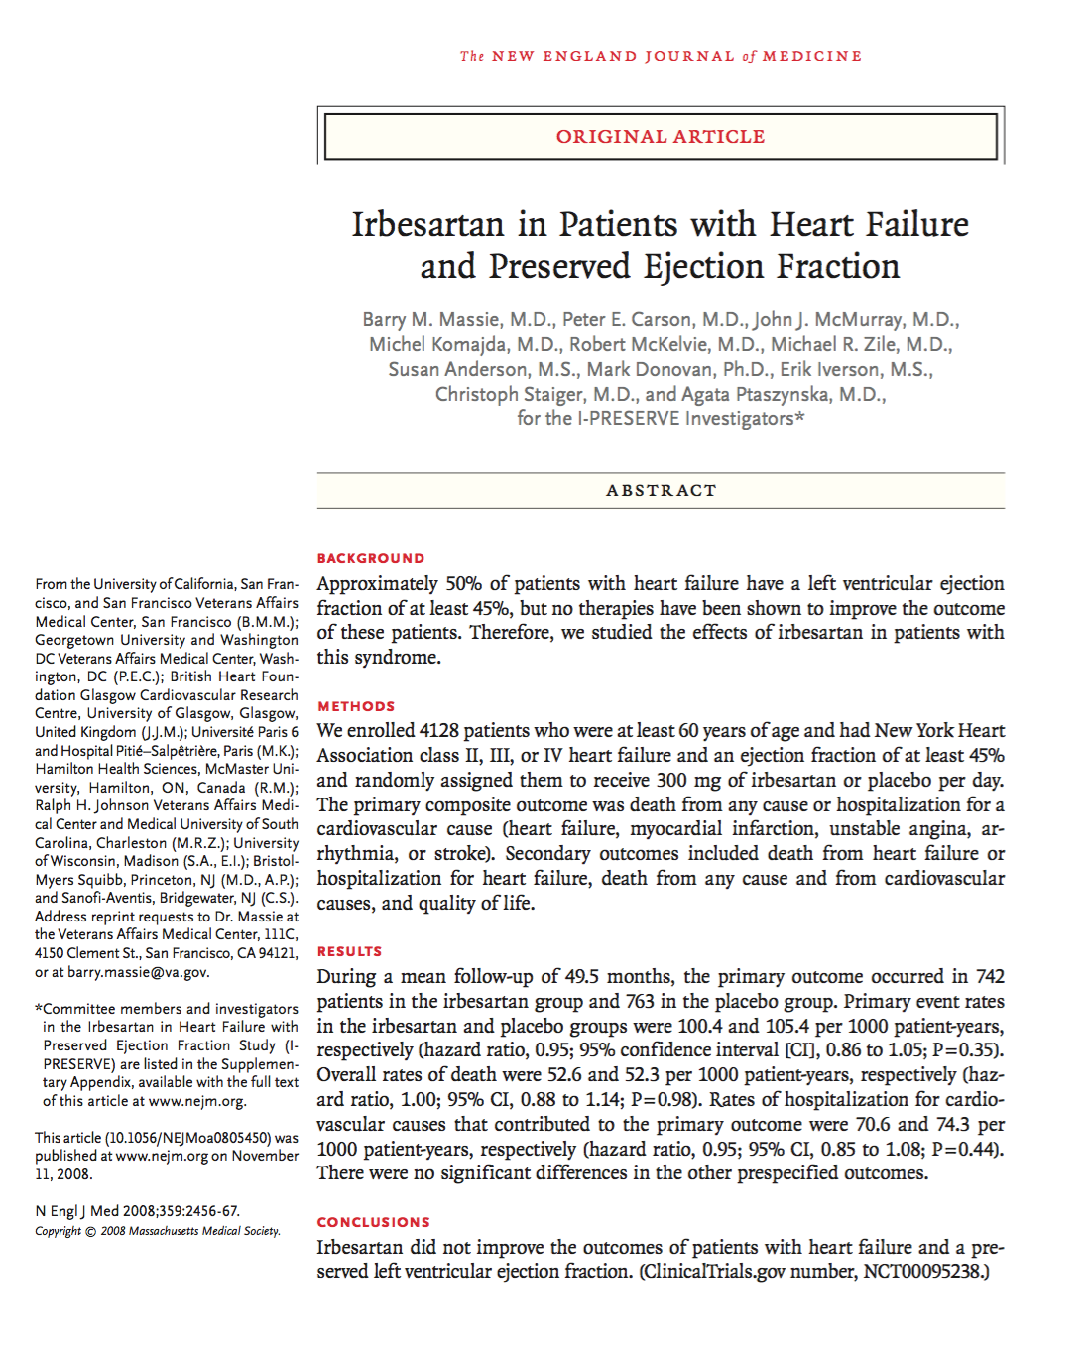

Slide 59
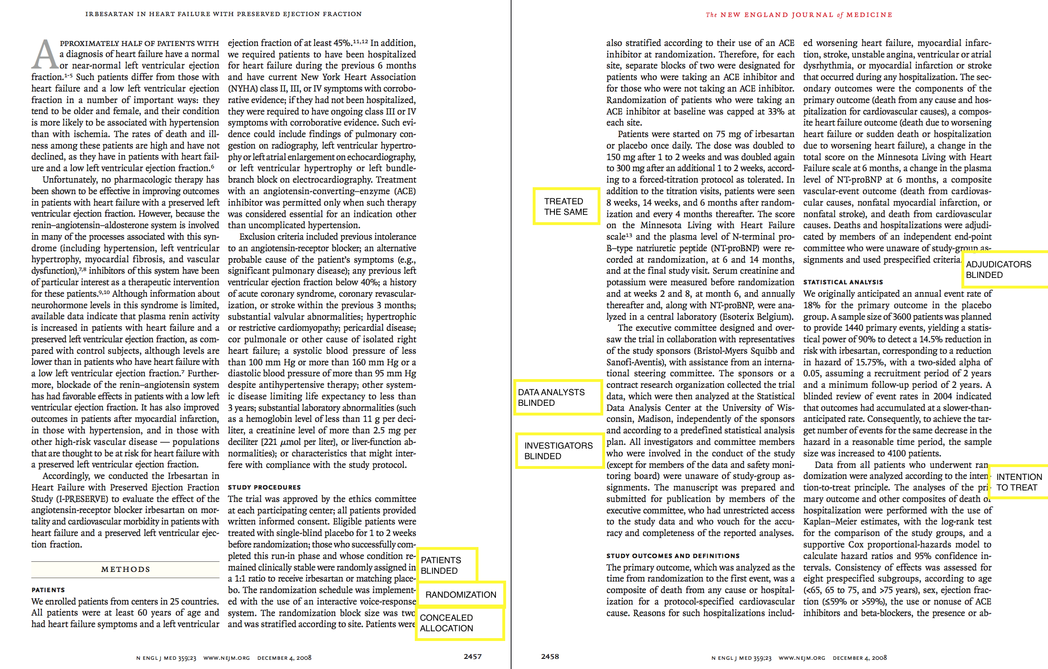

Slide 60
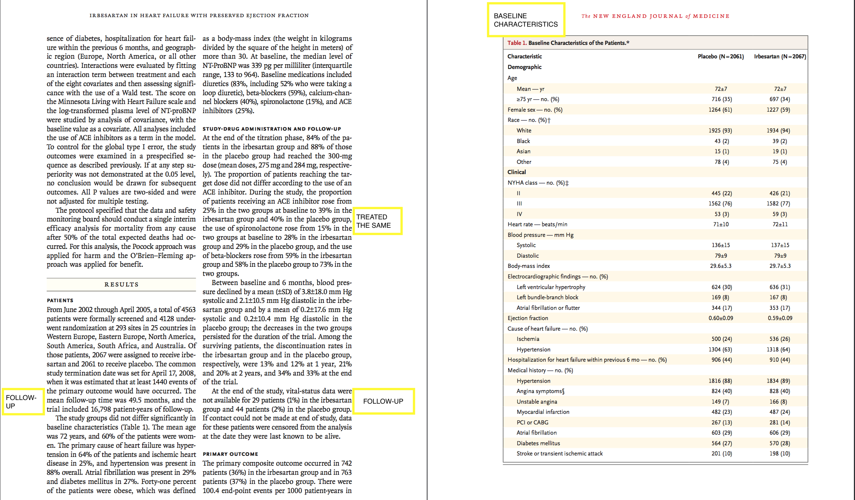

Slide 61
VALIDITY
Randomization.
Concealment.
Blindness.
Follow up complete.
Similar groups at start.
Both groups treated equally.
Intention to treat.

Slide 62
INTENTION TO TREAT
All patients analyzed in the groups
to which they were allocated

Slide 63
INTENTION TO TREAT (ITT)
200
intervention
control
100
100
50
30
Drop out
Drop out
50
70
40
IMPROVED
40
80%
OR
40%
57%
OR
40%

Slide 64
Were all patients analysed in the groups to which they were randomised?

Slide 65
2000 RANDOMIZED
A
1000
B
1000
200
100
800
270=IMPROVED
900
IMPROVED= 130
EER= 270/?
CER=130/?

Slide 66
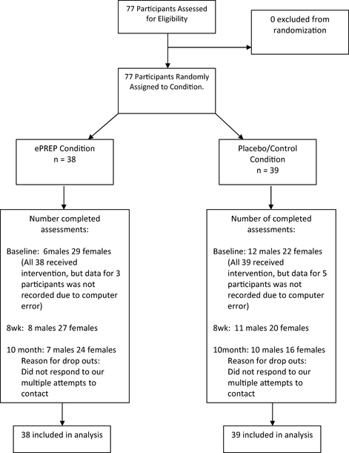

Slide 67
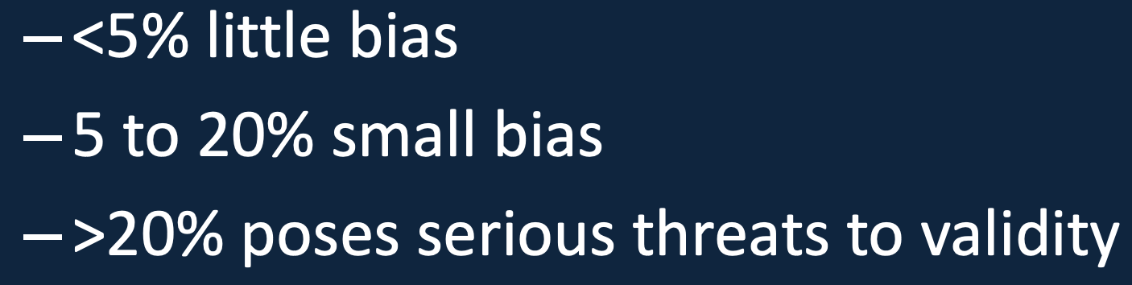
Follow up
Was follow-up of patients sufficiently long and complete?
Duration of study.
Drop out < 20%.
  “5-and-20 rule of thumb” for follow-up

Slide 68
Results
“Importance”
Magnitude (treatment effect)

Slide 69
Definition
Number Needed to Treat (NNT):
  NNT=1/ARR
  It denotes the number of patients that need to be treated to obtain a positive outcome in one patient.
  The smaller the value for the NNT for a particular intervention indicates the effectiveness of that intervention. Ideal NNT=1.
  The higher the NNT, the less effective the treatment.

Slide 70
2000 RANDOMIZED
A
1000
B
1000
200
100
800
270=IMPROVED
900
IMPROVED= 130
EER= 270/?
CER=130/?

Slide 71
EER=270/1000=27%=0.27
CEER=130/1000= 13%=0.13
ARR=0.27-0.13=0.14
NNT=1/0.14=7

Slide 72
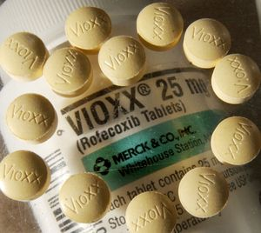
NUMBER NEED TO HARM(NNH)
When the outcome is unfavorable.
This statistic describes the number of patients that would need to be treated to develop side effects from an intervention.
If the NNH is smaller than the NNT then the intervention may be doing more harm than good.

Slide 73
Magnitude (treatment effect):
Absolute effects (ARR & NNT)
Relative effects (RR, RRR )

Slide 74
Result Tabulation
 | Event + Ve | Event - Ve | Total
Experimental | a | b | a+b
Control | c | d | c+d
EER = Experimental Event Rate (a/a+b)
CER = Control Event Rate (c/c+d)

Slide 75
Result Tabulation
 | Bleeding present | Bleeding Absent | Total
Drug A | 20 | 80 | 100
Drug B | 40 | 60 | 100
EER-A (Risk A) = 20/100 = 20% (0.2)
CER-B (Risk B) = 40/100 = 40% (0.4)

Slide 76
Calculations
ARR = CER - EER
NNT = 1 / ARR
RR = EER/CER (Risk A/Risk B)
RRR = 1- RR

Slide 77
Result Tabulation
 | Bleeding present | Bleeding Absent | Total
Drug A | 20 | 80 | 100
Drug B | 40 | 60 | 100
ARR = CER - EER NNT = 1 / ARR
RR = EER/CER RRR = 1- RR

Slide 78
Calculations
ARR = CER – EER = 0.4 – 0.2 = 0.2 (20%)
NNT = 1 / ARR = 1/0.2 = 5
RR = EER/CER = 0.2/0.4 = 0.5
RRR = 1- RR = 1- 0.5= 0.5 (50%)

Slide 79
Relative Risk or Risk Ratio (RR) - the risk of the outcome occurring in the intervention group compared with the control group.
RR= EER/CER
Absolute Risk Reduction or increase (ARR) - absolute amount by which the intervention reduces (or increases) the risk of outcome.
ARR= CER-EER
Relative Risk Reduction or increase (RRR) - amount by which the risk of outcome is reduced (or increased) in the intervention group compared with the control group.
RRR=ARR/CER
Odds of outcome - in each patient group, the number of patients with an outcome divided by the number of patients without the outcome.
Odds ratio - odds of outcome in treatment group divided by odds of outcome in control group.
If the outcome is negative, an effective treatment will have an odds ratio <1;
If the outcome is positive, an effective treatment will have an odds ratio >1.
(In case control studies, the odds ratio refers to the odds in favour of exposure to a particular factor in cases divided by the odds in favour of exposure in controls).

Slide 80
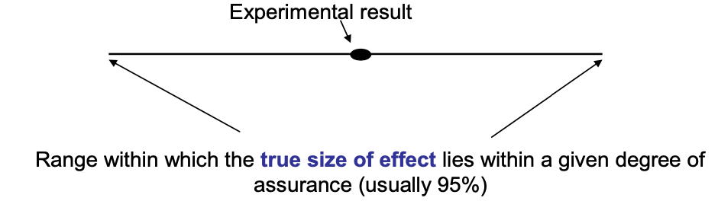
Precision
Confidence intervals:
  The range within which the likelihood of a true value is expected to be within a given degree of certainty, usually evaluated at 95% CI.
Notes:
Confidence interval - the same trial repeated hundreds of times would not yield the same results every time. But Services
on average the results would be within a certain range. A 95% confidence interval means that there is a 95% chance that the true size of effect will lie within this range.

Slide 81
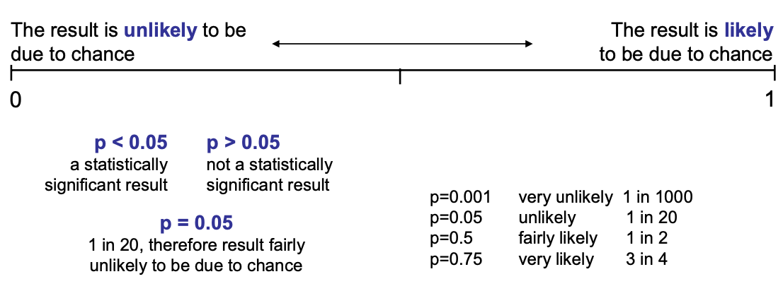
Precision
P value
    the p-value refers to the probability that any particular outcome would have arisen by chance.
    A p-value of less than 1 in 20 (p<0.05) is statistically significant.
Notes:
Confidence interval - the same trial repeated hundreds of times would not yield the same results every time. But Services
on average the results would be within a certain range. A 95% confidence interval means that there is a 95% chance that the true size of effect will lie within this range.

Slide 82
Continuous Variable
If the effect size is measured as a continuous variable (such as difference in blood pressure) then one would need the mean and standard deviation of the variable in each group in addition to type 1 and 2 error values to calculate the sample size.

Slide 83
APPLICABILITY

Slide 84
Can I apply these valid, important results to my patient?
Do these results apply to my patient?
Is our patient so different?
Is the treatment feasible?
Potential benefits and harms
Are my patient’s values and preferences satisfied by the intervention offered?

Slide 85

Summary
Validity - is the paper likely to be true
Importance - size of effect
  NNT
  Percision
Applicability - can it work for me/my setting

Slide 86
Critical Appraisal of Available Evidence
(MA/SR)

Slide 87
Types of reviews
Reviews
(narrative/literature/
traditional)
Systematic reviews
Meta-analysis

Slide 88
What is a systematic review?
A review of the evidence on a clearly formulated question that uses systematic and explicit methods to identify, select and critically appraise relevant primary research, and to extract and analyse data from the studies that are included in the review*
*Undertaking Systematic Reviews of Research on Effectiveness. CRD’s Guidance for those Carrying Out or Commissioning Reviews. CRD Report Number 4 (2nd Edition). NHS Centre for Reviews and Dissemination, University of York. March 2001.

Slide 89
Key elements of a systematic review
Structured, systematic process involving several steps :
  Formulate the question
  Plan the review
  Comprehensive search
  Unbiased selection and abstraction process
  Critical appraisal of data
  Synthesis of data (may include meta-analysis)
  Interpretation of results
  All steps described explicitly in the review

Slide 90
Advantages of systematic reviews
Reduce bias
Replicability
Resolve controversy between conflicting studies
Identify gaps in current research
Provide reliable basis for decision making
But there can also be conflicting systematic reviews due to different methodologies used.
Notes:
But there can also be conflicting systematic reviews due to different methodologies used.

Slide 91

The Cochrane Collaboration
International non-profit organisation that prepares, maintains, and disseminates systematic up-to-date reviews of health care interventions
1992
Notes:
The Cochrane Collaboration was established in October 1992.
The Collaboration relies on funding from a number of different sources to complete its work.
I like to think of a review as starting out as a jigsaw puzzle – especially if there is heterogeneity – ie. differences in interventions, settings, study designs, outcomes.

Slide 92
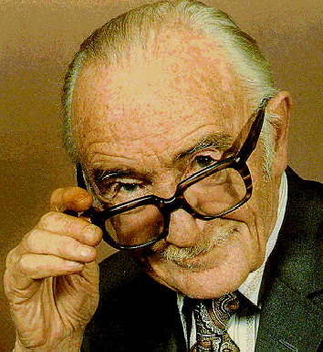
Cochrane Collaboration
Named in honour of Archie Cochrane, a British researcher
In 1979:
“It is surely a great criticism of our profession that we have not organised a critical summary, by specialty or subspecialty, adapted periodically, of all relevant randomised controlled trials”

Slide 93
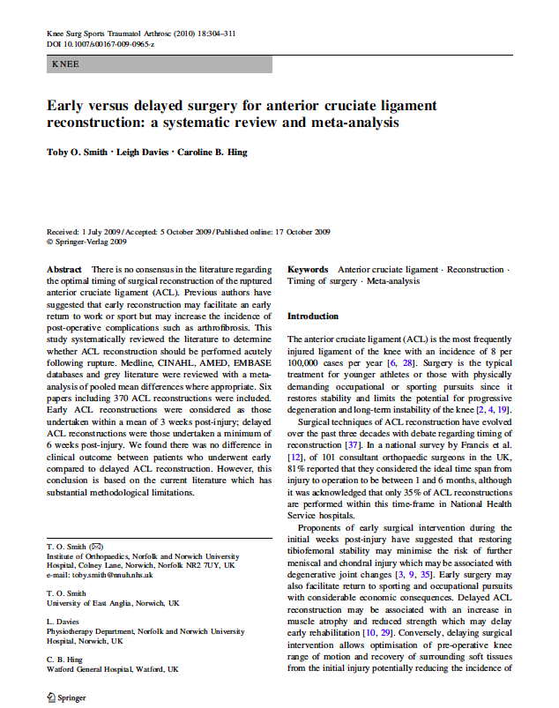
Appraising a systematic review
?

Slide 94
Appraisal of a systematic review
10 questions
  Clearly-focused question
  The right type of study included
  Identifying all relevant studies
  Assessment of quality of studies
  Reasonable to combine studies
  What were the results
  Preciseness of results
  Application of results to local population
  Consideration of all outcomes
  Policy or practice change as a result of evidence
CASP

Slide 95
Appraising a systematic review
3 minutes

Slide 96
Step 1 – Are the results of the review valid?
Question – what is the PICO (etc.)
Finding – comprehensive?
Appraise – did they select good ones?
Synthesise – numerically/appropriate?

Slide 97
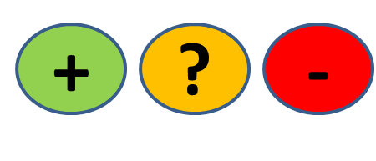
QUESTION
FIND
APPRAISE
SYNTHESISE
1. What question (PICO) did the systematic review address?
  Is question clearly stated early on?
  Treatment/exposure described?
  Comparator/control described?
  Outcome(s) described?
Title, abstract, introduction
Notes:
1 min them, 1 min feedback
Title, abstract or final paragraph of the introduction should state the question.
Our PICO:
P = patients with ACL injury = yes (initial injury suggests not chronic condition but no info on age)
I = Early ACL reconstruction = yes
C = Delayed reconstruction = yes
O = clinical and radiological = unclear
So overall we happy to say yes?
Tip = If cannot ascertain what the focused question is after reading these sections, search for another paper.

Slide 98
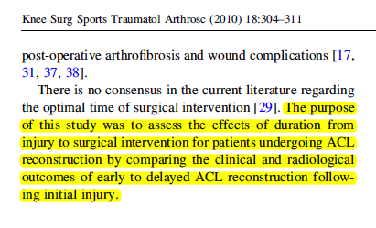
QUESTION
FIND
APPRAISE
SYNTHESISE
P
O’s
I
C
Notes:
1 min them, 1 min feedback
Title, abstract or final paragraph of the introduction should state the question.
Our PICO:
P = patients with ACL injury = yes (initial injury suggests not chronic condition but no info on age)
I = Early ACL reconstruction = yes
C = Delayed reconstruction = yes
O = clinical and radiological = unclear
So overall we happy to say yes?
Tip = If cannot ascertain what the focused question is after reading these sections, search for another paper.

Slide 99
QUESTION
FIND
APPRAISE
SYNTHESISE
2. Is it unlikely that important, relevant studies were missed?
Look for
  Which bibliographic databases were used? More than 1?
  Search terms used (text and MeSH)?
  Search for unpublished as well as published studies?
  Search for non-English studies?
Methods
Notes:
1 min them, 1 min feedback
Title, abstract or final paragraph of the introduction should state the question.
Our PICO:
P = patients with ACL injury = yes (initial injury suggests not chronic condition but no info on age)
I = Early ACL reconstruction = yes
C = Delayed reconstruction = yes
O = clinical and radiological = unclear
So overall we happy to say yes?
Tip = If cannot ascertain what the focused question is after reading these sections, search for another paper.

Slide 100
Is finding all published studies enough?
QUESTION
FIND
APPRAISE
SYNTHESISE
Negative studies less likely to be published than ‘Positive’ ones
How does this happen?
Positive studies SUBMITTED 2.5x more often than negative (Dickersin, JAMA, 1992)

Slide 101
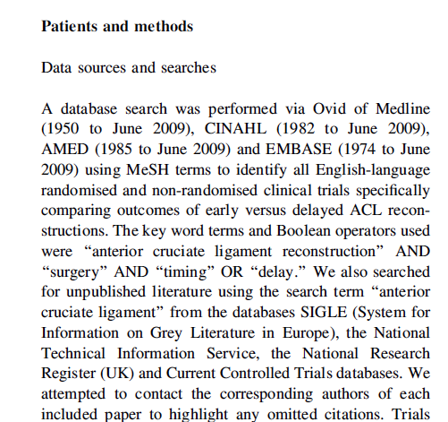
QUESTION
FIND
APPRAISE
SYNTHESISE
Notes:
2 min + 1
Methods and results sections.
1. Was the search strategy described sufficiently? Major bibliographic databases but also reference lists from relevant studies, Citation index, experts. Did they use MESH terms? = yes
2. Search terms used = yes
3. Limited = Yes - English language only. We should use all studies, getting non-English translated. Maybe resources did not allow for this.
4. Unpublished = yes – contacted authors
Results section will tell you numbers of titles/abstracts etc – in this case they also present a nice flow chart which tells us that an additional paper was found by contacting the authors (page 306)
One more aspect of the search strategy that was good and ensured studies were not missed = two investigators selected articles.
Overall it is unlikely important/relevant studies were missed.
Boolean operators – if anyone brings this up these are = AND, OR, NOT as you learnt with Nia last Thursday/Friday?

Slide 102
QUESTION
FIND
APPRAISE
SYNTHESISE
3. Were the criteria used to select articles for inclusion appropriate?
Look for
  Inclusion/exclusion criteria a priori?
  Are eligibility criteria related to PICO?
  Types of studies?
Methods
Notes:
1 min them, 1 min feedback
Title, abstract or final paragraph of the introduction should state the question.
Our PICO:
P = patients with ACL injury = yes (initial injury suggests not chronic condition but no info on age)
I = Early ACL reconstruction = yes
C = Delayed reconstruction = yes
O = clinical and radiological = unclear
So overall we happy to say yes?
Tip = If cannot ascertain what the focused question is after reading these sections, search for another paper.

Slide 103
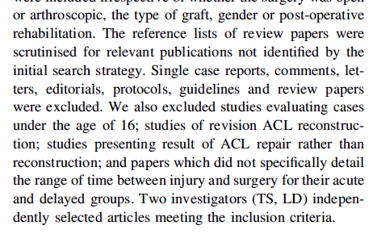
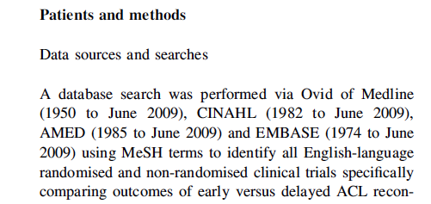
QUESTION
FIND
APPRAISE
SYNTHESISE
Notes:
2 min + 1
1st = Yes in methods section
2nd = Excluded all non-trial studies, under age 16, studies on revised ACL reconstruction, studies that did not detail time between injury and surgery for acute and delayed groups; are they related to PICO = yes.
3rd = Can anyone see a major point about the types of studies selected? = Non-randomised trials also included.
Anyone willing to suggest why? = Nature of the study – impossible to blind patients to early or delayed surgery. But…
…could have blinded surgeons to this (although ethically and logistically difficult)
…but could easily have blinded the assessors.

Slide 104
QUESTION
FIND
APPRAISE
SYNTHESISE
4. Were the included studies sufficiently valid for the type of question?
Look for
  Criteria for quality assessment defined?
  Appropriate for the question?
  Were the assessment results provided?
Methods, Results
Notes:
1 min them, 1 min feedback
Title, abstract or final paragraph of the introduction should state the question.
Our PICO:
P = patients with ACL injury = yes (initial injury suggests not chronic condition but no info on age)
I = Early ACL reconstruction = yes
C = Delayed reconstruction = yes
O = clinical and radiological = unclear
So overall we happy to say yes?
Tip = If cannot ascertain what the focused question is after reading these sections, search for another paper.

Slide 105
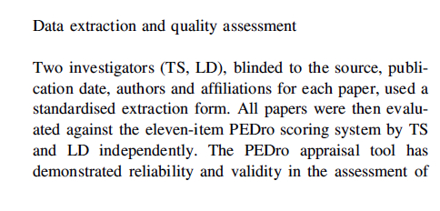
QUESTION
FIND
APPRAISE
SYNTHESISE
  Criteria for quality assessment defined?
Notes:
2 min + 1
Yes = the PEDro scale
Yes = validated for RCTs (unclear whether this holds for non-RCT)
Yes = table in the results section and appraisal page 307
[PEDro: gives score out of 11
Concealment allocation = person(s) deciding eligibility is unaware which arm of study subject is assigned to. If randomization is done at a central location then concealment is typicall assured.
Baseline comparability =must provide demographic details including details of severity of condition and minimum 1 outcome measure
Adequate follow up = score given if study provides info on #allocated to treatment and #assessed for final outcomes plus this #must be at least 85% of overall n.
Intention-to-treat = analysis is based on data from all subjects allocated to treatment and not just those completing the study]….
So are we happy that the studies were sufficiently valid = No or unclear
Okay if you turn over your appraisal sheets we’re now going to look at the actual results themselves.

Slide 106
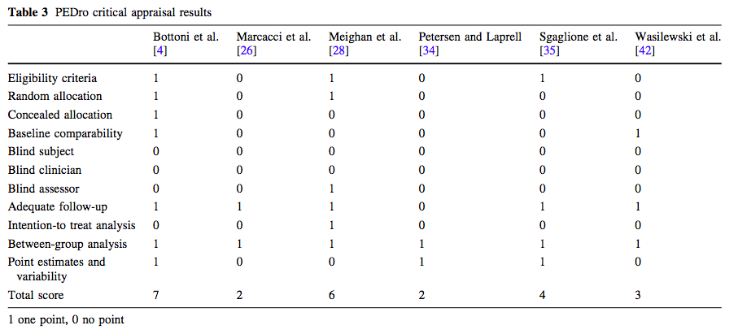
Appropriate for the question?
Were assessment results provided?
QUESTION
FIND
APPRAISE
SYNTHESISE
Notes:
2 min + 1
Yes = the PEDro scale
Yes = validated for RCTs (unclear whether this holds for non-RCT)
Yes = table in the results section and appraisal page 307
[PEDro: gives score out of 11
Concealment allocation = person(s) deciding eligibility is unaware which arm of study subject is assigned to. If randomization is done at a central location then concealment is typically assured.
Baseline comparability =must provide demographic details including details of severity of condition and minimum 1 outcome measure
Adequate follow up = score given if study provides info on #allocated to treatment and #assessed for final outcomes plus this #must be at least 85% of overall n.
Intention-to-treat = analysis is based on data from all subjects allocated to treatment and not just those completing the study]….
So are we happy that the studies were sufficiently valid = No or unclear
Okay if you turn over your appraisal sheets we’re now going to look at the actual results themselves.

Slide 107
QUESTION
FIND
APPRAISE
SYNTHESISE
5. Were the results similar from study to study?
Consider whether
  The results of all the included studies are clearly displayed
  The results are combined (meta-analysis)
    Are studies sufficiently similar
  The reasons for any variations in results are discussed
Notes:
1 min them, 1 min feedback
Title, abstract or final paragraph of the introduction should state the question.
Our PICO:
P = patients with ACL injury = yes (initial injury suggests not chronic condition but no info on age)
I = Early ACL reconstruction = yes
C = Delayed reconstruction = yes
O = clinical and radiological = unclear
So overall we happy to say yes?
Tip = If cannot ascertain what the focused question is after reading these sections, search for another paper.

Slide 108
Meta-analysis
QUESTION
FIND
APPRAISE
SYNTHESISE
= calculated “best guess” of the true effect size
The statistical combination of the results gives a pooled, weighted average of the primary results
It weights the effect size (result) of each study in relation to sample size of the study
Optional part of SR
Systematic
reviews
Meta
analyses
Notes:
P1 - ….from each of the studies included in the meta-analysis
P2 -

Slide 109
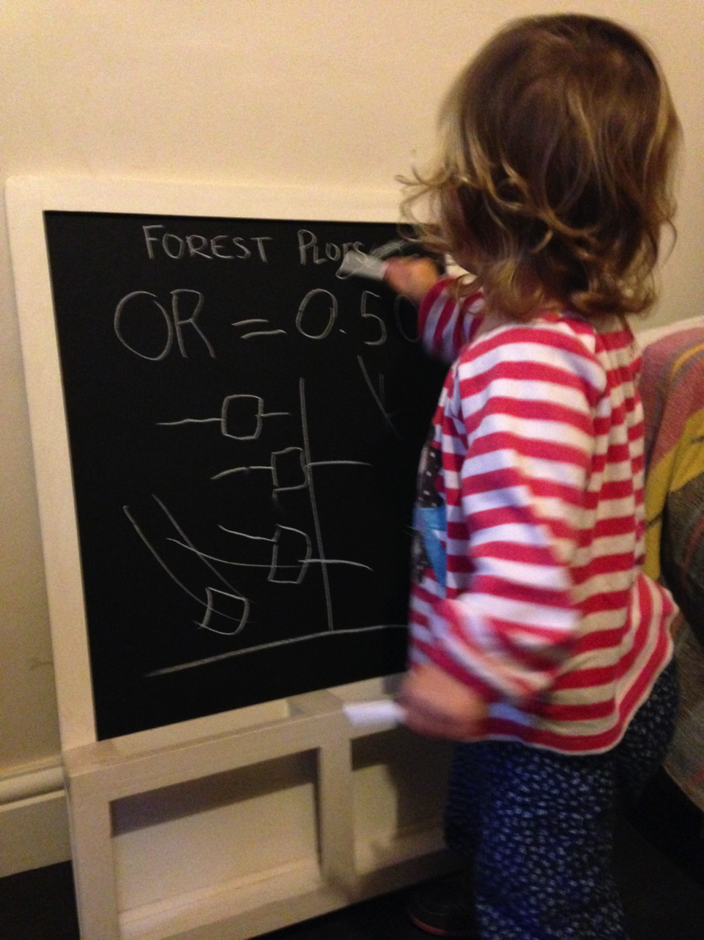
FOREST PLOTS
Line of no effect
trials
Confidence interval
Overall effect
Measure of effect

Slide 110
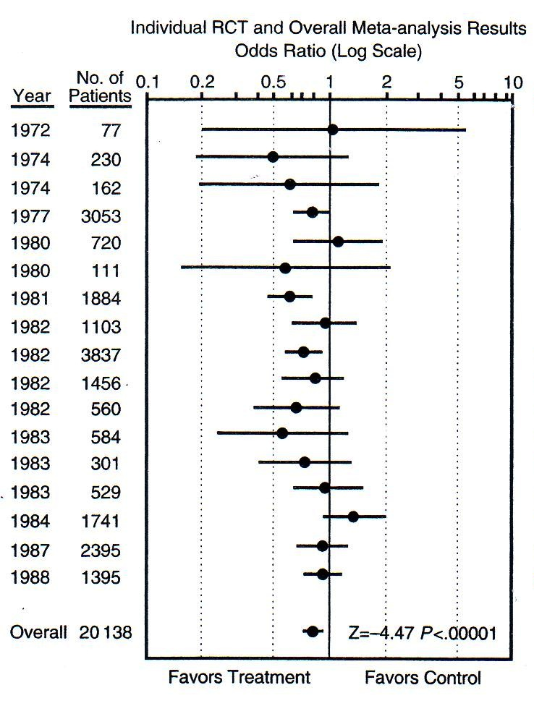
QUESTION
FIND
APPRAISE
SYNTHESISE
Which is the smallest study?
Which is the largest study?
How many are statistically significant?
Smallest
P<0.05
P<0.05
Largest
Is treatment better than control?
How much better?
Notes:
Smallest, largest, significant etc….
Can anyone tell the acute illness of our patient? = MI (streptokinase for reducing risk of mortality post MI from thrombotic event)
Now, based on this forest plot do we give an antithrombotic drug for reperfusion (in this case streptokinase) = YES

Slide 111
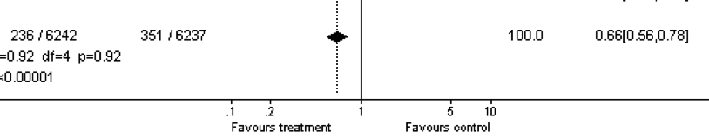

QUESTION
FIND
APPRAISE
SYNTHESISE
Effect size =
1 – 0.66 = 0.34
0.34 x 100 = 34%
There is a 34% reduced risk of mortality in the treatment compared to the control group
Notes:
1 = The overall effect is represented by the diamond at the bottom (labelled ‘Total’) and represents the combined or pooled ratio. The ends of the diamond represent the 95% CI. Here we can see that treatment reduces mortality by 34%

Slide 112
Heterogeneity
QUESTION
FIND
APPRAISE
SYNTHESISE
“The quality or state of being diverse in character or content”

Slide 113
Heterogeneity (diversity)
QUESTION
FIND
APPRAISE
SYNTHESISE
Clinical heterogeneity
Variability in the participants, interventions and/or outcomes studied
Methodological heterogeneity
Variability in study deign and risk of bias
Statistical heterogeneity
The observed intervention effects being more different from each other than we would expect due to random error (chance) alone

Slide 114
High heterogeneity
= appropriate to pool data?
QUESTION
FIND
APPRAISE
SYNTHESISE

Slide 115
QUESTION
FIND
APPRAISE
SYNTHESISE
Are the results similar across studies? 3 tests:
  ‘Eyeball’ test – do they look they same?
  Formal tests
    Proportion of variation not due to chance (I²)
      As a rule of thumb I2<25% means studies regarded as homogenous and I2>75% means heterogeneity is very high.
    Test of ‘Null hypothesis’ of no variation (p-value)
      Cochrane Chi-square: p<0.10 = heterogeneity
Notes:
Best done when there is a forest plot. In our knee study we don’t have this option. If we go back to example on sheet, the dotted vertical line running through the combined estimate crosses the horizontal lines of all the individual studies = studies are homogenous.
Formal statistical tests = cochrane chi squared test. If this is statistically significant there is definite heterogeneity. Significance set at 0.1 (rather than usual 0.05) as the chi-square test has low power to detect heterogeneity.
Can also use something called I-squared = more recently developed. Ranges between 0 and 100%, measures the variability between studies. As a rule of thumb I2<25% means studies regarded as homogenous and I2>75% means heterogeneity is very high.

Slide 116
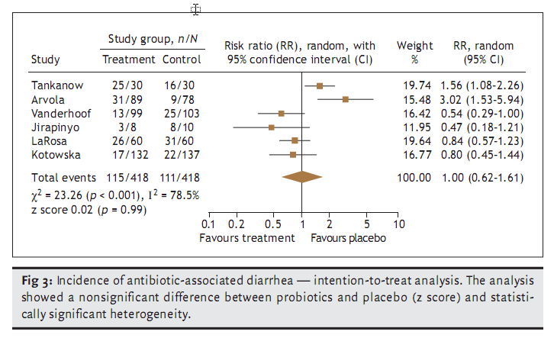
Are these trials different?
QUESTION
FIND
APPRAISE
SYNTHESISE
Notes:
Show of hands if you think there is heterogeneity present between these studies?

Slide 117
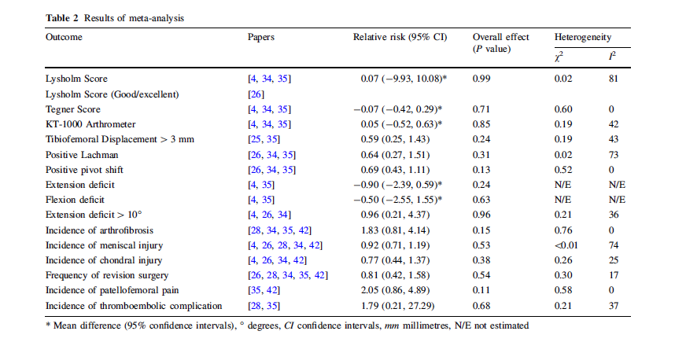
QUESTION
FIND
APPRAISE
SYNTHESISE
5. Were the results similar from study to study?
Notes:
1 min
So what do we think about the similarity of studies in our knee paper?
Indications are that there is high heterogeneity for 2 out of the 7 measures, none for 3 and some for remaining 1.
Do the authors discuss the heterogeneity? = small mention in results and a bit around studies of isokinetic strength, however, no discussion of scores in table 2.
Overall, results similar from study to study = yes and no.

Slide 118
QUESTION
FIND
APPRAISE
SYNTHESISE
Step 2 – What were the results?
Consider
  What these are (numerically if appropriate)
  How were the results presented/expressed (risk ratio, odds ratio, etc.)
  If you are clear about the review’s ‘bottom line’ results
Notes:
1 min them, 1 min feedback
Title, abstract or final paragraph of the introduction should state the question.
Our PICO:
P = patients with ACL injury = yes (initial injury suggests not chronic condition but no info on age)
I = Early ACL reconstruction = yes
C = Delayed reconstruction = yes
O = clinical and radiological = unclear
So overall we happy to say yes?
Tip = If cannot ascertain what the focused question is after reading these sections, search for another paper.

Slide 119
What are we interested in?
Notes:
2 min
Summary table: missing info on treatment and control (how many events, weight of studies?) = therefore weakness of paper.
The main things were interested in are the effect measure and the significant of the effect. In this case the effect measure is relative risk because we are mainly looking at dichotomous outcomes (yes/no) or frequencies (numbers of events/incidence). When we’re looking at continuous measures as outcomes we would assess the mean difference between the groups. An example is given here for first two outcome measures (Lysholm and Tegner scores).
Effect measures = Relative risk: “Are we all happy with relative risks”? More or less?” Okay, so RR is the probability of an event in one group divided by the probability of the event in another group.
A RR of 1 means no difference in risk/probability of an event between groups;
RR <1 = event is less likely to occur in treatment group than control (i.e. favours early surgery);
RR >1 = event is more likely to occur in treatment group (i.e. favours delayed surgery);
So, looking at an example using revision surgery, the relative risk of 0.81 suggests a more favourable outcome for the treatment group and suggests that the risk of revision surgery is 19% lower in the group who received early surgery. But…look at the significance for the effect. Can anyone tell me if it is statistically significant or not? Answer = not because it is greater than the cut-off of 0.05 so we would conclude that there is no difference between groups.
Recall what we said we were interested in:
Return to activity – did anyone find information on this? If you look carefully in the text of first paragraph on page 306 = Marcacci et al paper. Also, Lysholm and Tegnar scores give an indication of the level of PA an individual may return to = no difference.
Recurrent injury – we have three measures. Delaying surgery appears to decrease the risk of arthrofibrosis but again not significant. Risk of other injuries appears higher if surgery delayed but non-significant.
SO OVERALL – appears that delaying surgery will not affect any of the outcomes of concern to me.
“Can anyone think of another way in which these results could have been presented that might have made assessing them easier” = Forest plot. Give praise if someone says this then mention that there is example of a forest plot on their sheet. If no one answers, then say “one way is to use something called a forest plot.”
So our study did not use a forest plot. Any reasons why not?
one reason I can think of is because of the number of outcomes. Each one would require a forest plot = 16. This would most likely have been way beyond the editorial specifications of the journal although they could have put them as a data supplement online.
Authors don’t know how to do them…
Others = ????
So if you turn back to your appraisal sheet, there’s one more thing we need to look at = similarity of the included studies.

Slide 120
Our clinical question
Amongst adults with acute ACL injuries, does
early reconstructive surgery compared with
delayed reconstructive surgery lead to
favourable return to former activity and/or risk of recurrent knee injury?
Population
Intervention
Control
Outcome 1
Outcome 2

Slide 121
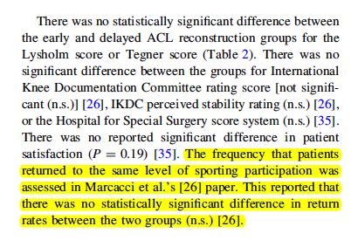
Return to former activity (page 306):

Slide 122
Risk of recurrent knee injury
Notes:
2 min
Summary table: missing info on treatment and control (how many events, weight of studies?) = therefore weakness of paper.
The main things were interested in are the effect measure and the significant of the effect. In this case the effect measure is relative risk because we are mainly looking at dichotomous outcomes (yes/no) or frequencies (numbers of events/incidence). When we’re looking at continuous measures as outcomes we would assess the mean difference between the groups. An example is given here for first two outcome measures (Lysholm and Tegner scores).
Effect measures = Relative risk: “Are we all happy with relative risks”? More or less?” Okay, so RR is the probability of an event in one group divided by the probability of the event in another group.
A RR of 1 means no difference in risk/probability of an event between groups;
RR <1 = event is less likely to occur in treatment group than control (i.e. favours early surgery);
RR >1 = event is more likely to occur in treatment group (i.e. favours delayed surgery);
So, looking at an example using revision surgery, the relative risk of 0.81 suggests a more favourable outcome for the treatment group and suggests that the risk of revision surgery is 19% lower in the group who received early surgery. But…look at the significance for the effect. Can anyone tell me if it is statistically significant or not? Answer = not because it is greater than the cut-off of 0.05 so we would conclude that there is no difference between groups.
Recall what we said we were interested in:
Return to activity – did anyone find information on this? If you look carefully in the text of first paragraph on page 306 = Marcacci et al paper. Also, Lysholm and Tegnar scores give an indication of the level of PA an individual may return to = no difference.
Recurrent injury – we have three measures. Delaying surgery appears to decrease the risk of arthrofibrosis but again not significant. Risk of other injuries appears higher if surgery delayed but non-significant.
SO OVERALL – appears that delaying surgery will not affect any of the outcomes of concern to me.
“Can anyone think of another way in which these results could have been presented that might have made assessing them easier” = Forest plot. Give praise if someone says this then mention that there is example of a forest plot on their sheet. If no one answers, then say “one way is to use something called a forest plot.”
So our study did not use a forest plot. Any reasons why not?
one reason I can think of is because of the number of outcomes. Each one would require a forest plot = 16. This would most likely have been way beyond the editorial specifications of the journal although they could have put them as a data supplement online.
Authors don’t know how to do them…
Others = ????

Slide 123
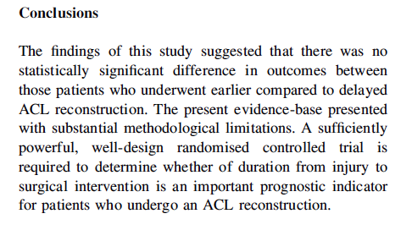
What’s the ‘bottom line’ of the review?
Notes:
Are we happy with the conclusions of the paper?
Are they based on the data they have provided in the paper? = yes

Slide 124
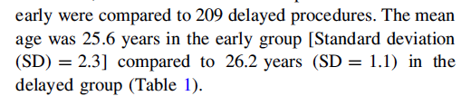
Can I apply these results to my case?
Is my patient so different to those in the study that the results cannot apply?
Notes:
Look back in results section on page 305 – mean age of approx. 26 years suggest very close to my age with acute injury, so results do apply.

Slide 125
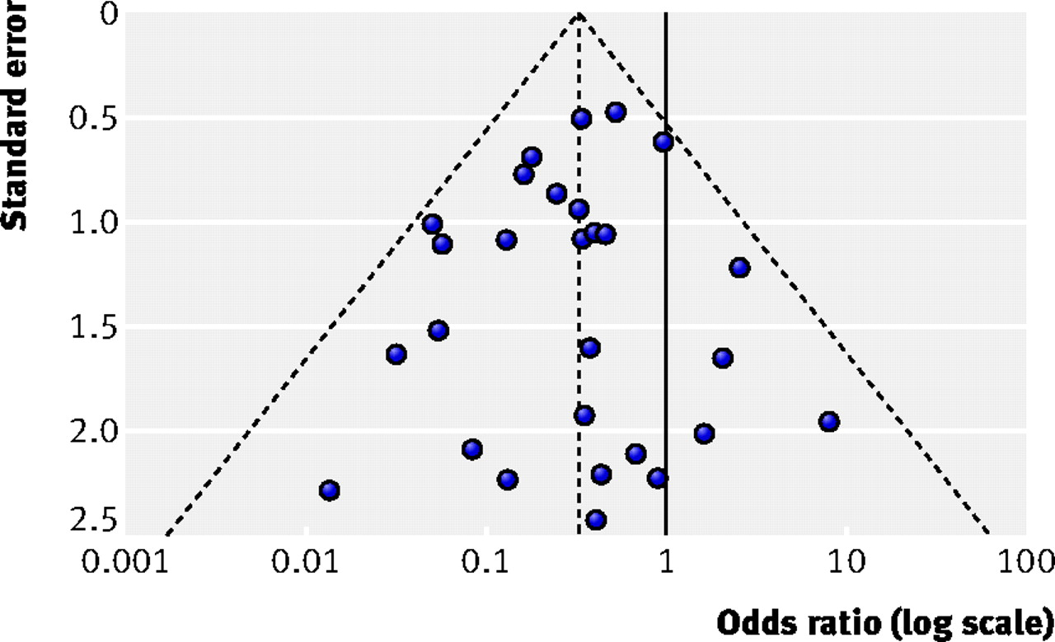

Funnel plots
Fig 1 Example of symmetrical funnel plot.
Jonathan A C Sterne et al. BMJ 2011;343:bmj.d4002
©2011 by British Medical Journal Publishing Group
Notes:
Fig 1 Example of symmetrical funnel plot. The outer dashed lines indicate the triangular region within which 95% of studies are expected to lie in the absence of both biases and heterogeneity (fixed effect summary log odds ratio±1.96×standard error of summary log odds ratio). The solid vertical line corresponds to no intervention effect
A funnel plot is a scatter plot of the effect estimates from individual studies against some measure of each study’s size or precision. The standard error of the effect estimate is often chosen as the measure of study size and plotted on the vertical axis8 with a reversed scale that places the larger, most powerful studies towards the top. The effect estimates from smaller studies should scatter more widely at the bottom, with the spread narrowing among larger studies.9 In the absence of bias and between study heterogeneity, the scatter will be due to sampling variation alone and the plot will resemble a symmetrical inverted funnel (fig 1⇓). A triangle centred on a fixed effect summary estimate and extending 1.96 standard errors either side will include about 95% of studies if no bias is present and the fixed effect assumption (that the true treatment effect is the same in each study) is valid. The appendix on bmj.com discusses choice of axis in funnel plots.

Slide 126
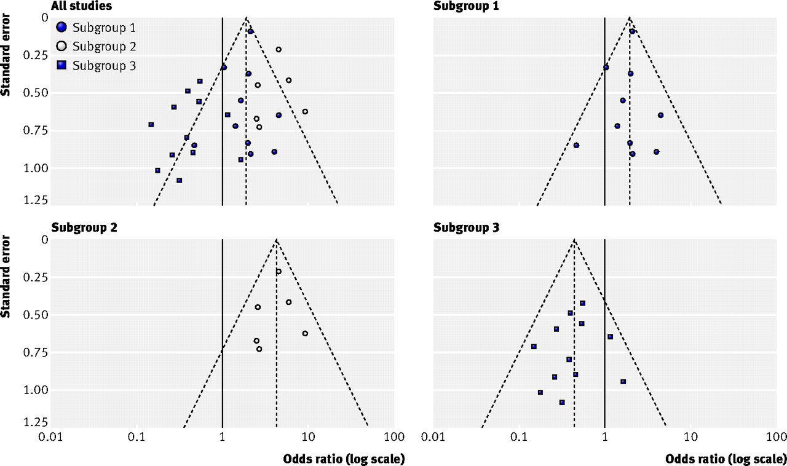
Fig 2 Illustration of funnel plot asymmetry due to heterogeneity, in the form of three distinct subgroups of studies.
Jonathan A C Sterne et al. BMJ 2011;343:bmj.d4002
©2011 by British Medical Journal Publishing Group
Notes:
Fig 2 Illustration of funnel plot asymmetry due to heterogeneity, in the form of three distinct subgroups of studies. Funnel plot including all studies (top left) shows clear asymmetry (P<0.001 from Egger test for funnel plot asymmetry). P values for each subgroup are all >0.49.

Slide 127

Evaluating Research about Diagnostic Tests

Slide 128
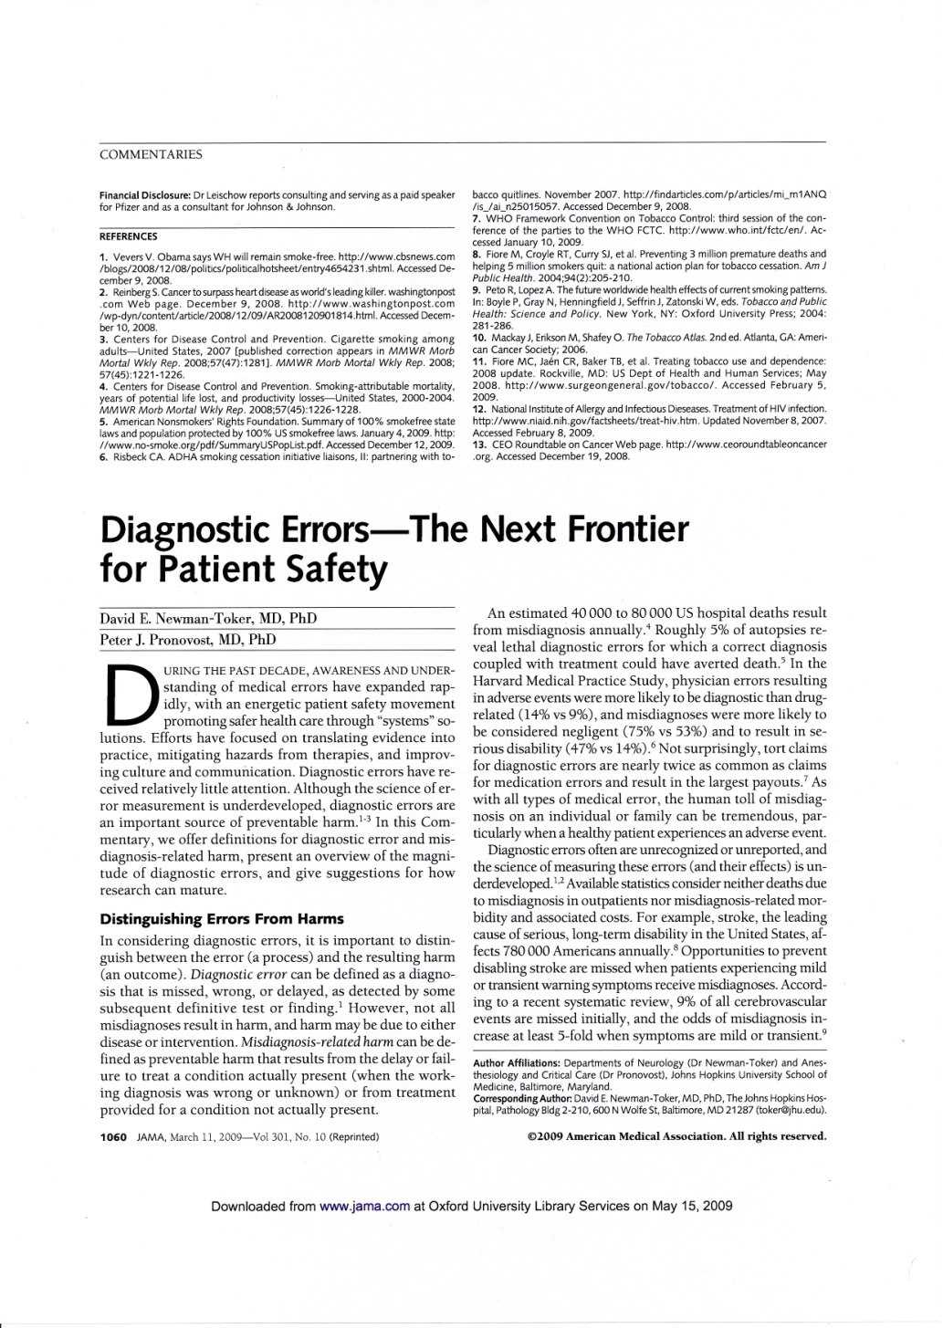
40,000-80,000 US hospital deaths from misdiagnosis per year
Diagnosis uses <5% of hospital costs, but influences 60% of decision making

Slide 129
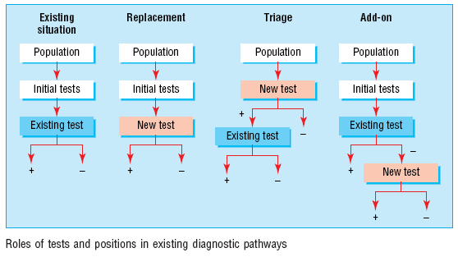
Roles of a new test
Replacement – new replaces old
  E.g., CT colonography for barium enema
Triage – new determines need for old
  E.g., B-natriuretic peptide for echocardiography
Add-on – new combined with old
  ECG and myocardial perfusion scan
Bossuyt et al BMJ 2006;332:1089–92

Slide 130
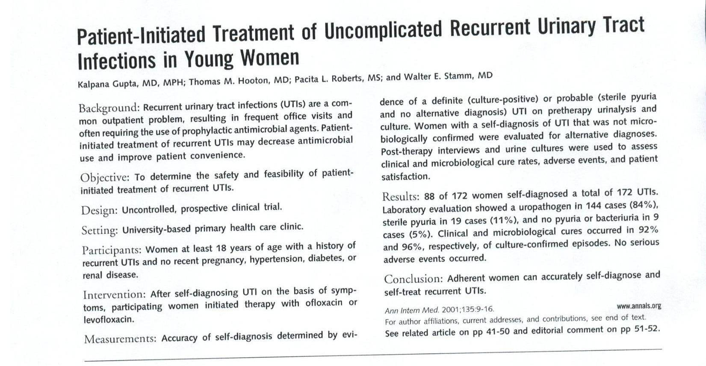
Read this abstract
Scan in UTI abstract

Slide 131
Series of patients
Index test
Reference (“gold”) standard
Compare the results of the index test with the reference standard, blinded

Slide 132
Reference standard
Scan in UTI abstract
Accuracy
Series of patients
Index test

Slide 133
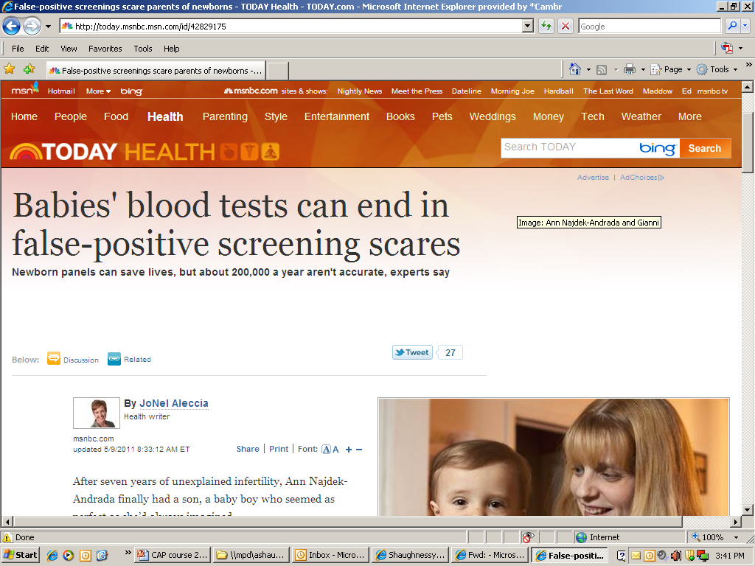
Why this is important
http://today.msnbc.msn.com/id/42829175

Slide 134
Appraisal of a cohort

Slide 135
Appraisal of a cohort
Did the study address a clearly focused issue?
Was the cohort / panel recruited in an acceptable way? (selection bias)
Was the cohort/ panel representative of a defined population?
Are objective and validated measurement methods used and were they similar in the different groups? (misclassification bias)
Was the follow up of cases/subjects long enough?
Could there be confounding?
Is the size of effect practically relevant?
Are the conclusions applicable?

Slide 136
Practice Guidelines

Slide 137
Effect on Patient-Oriented Outcomes
Symptoms
Functioning
Quality of Life
Lifespan
SORT
A
SORT
B
Effect on Disease Markers
Diabetes (microalbuminuria, GFR, photocoagulation rates)
Arthritis (ESR, x-rays)
Peptic Ulcer (endoscopic ulcers)
SORT
C
Relevance of Outcome
Effect on Risk Factors for Disease
Improvement in markers (blood pressure, HbA1C, cholesterol)
Uncontrolled Observations
&
Conjecture
Physiologic Research
Preliminary Clinical Research
Case reports
Observational studies
Highly Controlled Research
Randomized Controlled Trials
Systematic Reviews
Validity of Evidence
Notes:
This slide shows the inter-relationship between relevance and validity and how they both impact on the SORT taxonomy. Only valid POEMs can achieve an “A” recommendation.

Slide 138
Practice Guidelines
138
The Good,
The Not-So-Good
The Ugly

Slide 139
Where do practice guidelines come from?
Trust us, we’re the experts: Opinion-based/ consensus guidelines
  Whose opinion? Do they have a conflict of interest? What is their perspective?
Trust us, we have the evidence: “Evidence-based”
  How was the evidence used? Patient-oriented? Values?
Evidence-linked:
  Here is how we found the evidence, used the evidence
  Strength of recommendation noted

Slide 140
What is a Clinical Practice Guideline?
A clinical practice guideline is a systematically developed statement designed to help health care professionals make decisions about appropriate health care for specific clinical circumstances.

Slide 141
Scope and Purpose
Are the overall objectives of the guideline specifically described?
Is the clinical question(s) covered by the guideline specifically described?
Are the patients to whom the guideline is meant to apply specifically described?

Slide 142
Stakeholder Involvement
Does the guideline development group include individuals from all of the relevent professional groups?
Have the patients' views and preferences been sought?
Have the target users of the guideline been clearly defined?
Has the guideline been piloted among target users?

Slide 143
Rigour of Development
Were systematic methods used to search for evidence?
Is the criteria for selecting the evidence clearly described?
Were the methods used for formulating the recommendations clearly described?
Were the health benefits, side effects, and risks considered in formulating the recommendations?
Is there an explicit link between the recommendations and the supporting evidence?
Has the guideline been externally reviewed by experts prior to its publication?
Is a procedure for updating the guideline provided?

Slide 144
Clarity and Presentation
Are the recommendations specific and unambiguous?
Are different options for management of the condition clearly presented?
Are key recommendations clearly identifiable?
Is the guideline supported with tools for application?

Slide 145
Applicability
Have the potential organization barriers in applying the recommendation been discussed?
Have the potential cost implications of applying the recommendations been considered?
Does the guideline present key review criteria for monitoring and/or auditing purposes?

Slide 146
Editorial Independence
Is the guideline editorially independent from the funding body?
Have conflicts of interest of guideline development members been recorded?

Slide 147
Appraisal of Clinical Practice Guidelines

Slide 148
The AGREE
The AGREE (Appraisal of Guidelines for Research & Evaluation) Instrument is a tool that assesses the methodological rigour and transparency in which a guideline is developed and it is used internationally.
The purpose of the AGREE Instrument is to provide a framework for assessing the quality of clinical practice guidelines.

Slide 149


Slide 150
However, no paper is perfect and overzealous critiquing can lead to nihilism.
The primary aim of the appraisal process is to establish whether any shortcomings of the evidence are significant enough to lead to questioning the truthfulness of the conclusions of a research paper.
Fawkes, C., Ward, E., & Carnes, D. (2015). What evidence is good evidence? A masterclass in critical appraisal. International Journal of Osteopathic Medicine, 18(2), 116-129.

Slide 151
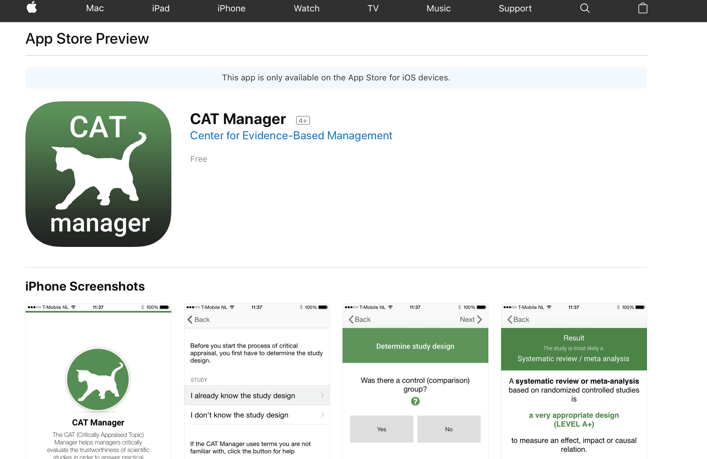

Slide 152
Understanding Health Research
Understanding Health Research is a tool designed to help people understand and review published health research to decide how dependable and relevant a piece of research is. The tool was developed by researchers at MRC/CSO Social and Public Health Sciences Unit, University of Glasgow, in collaboration with two other MRC Units and the London School of Hygiene and Tropical Medicine.
http://www.understandinghealthresearch.org/

Slide 153

https://ebm-tools.knowledgetranslation.net

Slide 154
In summary
Different types of question require different study designs.
Does the study address a clearly focused question?
Did the study use valid methods to address this question?
Are the valid results of this study important?
Are these valid, important results applicable to my patient or population?

Slide 155
References
Critical Appraisal tools and Work sheets http://www.cebm.net/critical-appraisal/
Jane M Young & Michael J Solomo. How to critically appraise an article. Nature Reviews Gastroenterology and Hepatology 6, 82-91 (February 2009) | doi:10.1038/ncpgasthep1331
What is a critical appraisal? http://www.medicine.ox.ac.uk/bandolier/painres/download/whatis/what_is_critical_appraisal.pdf
The BMJ - How to Read a Paper http://www.bmj.com/about-bmj/resources-readers/publications/how-read-paper
Evidently Cochrane http://www.evidentlycochrane.net/
CEBM http://www.cebm.net/

Slide 156
References
http://www.casp-uk.net/e-learning
http://www.casp-uk.net/checklists
http://clinicalevidence.bmj.com/x/set/static/ebm/toolbox/665061.html
Critical Appraisal tools and Work sheets http://www.cebm.net/critical-appraisal/
Jane M Young & Michael J Solomo. How to critically appraise an article. Nature Reviews Gastroenterology and Hepatology 6, 82-91 (February 2009) | doi:10.1038/ncpgasthep1331
What is a critical appraisal? http://www.medicine.ox.ac.uk/bandolier/painres/download/whatis/what_is_critical_appraisal.pdf
The BMJ - How to Read a Paper http://www.bmj.com/about-bmj/resources-readers/publications/how-read-paper
Evidently Cochrane http://www.evidentlycochrane.net/
CEBM http://www.cebm.net/

Slide 157


nalyousefi@ksu.edu.sa
All rights reserved

