Slide 1
Changes in bowel habit
Dr. Joud Almutairi.
Assistant consultant & demonstrator at FM department

Slide 2
By the end of session, Students will be able to:
Define constipation and diarrhea.
Discuss the definition, etiology and classification of irritable bowel syndrome (IBS)
Explain how to diagnose IBS
List the alarm symptoms and differential diagnosis
Provide a comprehensive management plan and follow up for patients with IBS
Recognize when to refer to specialist
Demonstrate history taking and physical examination for patients presented with history suggestive of IBS

Slide 3
Bowel Movements
Normal bowel movement is between three times a day to three times a week.
Problems arise when bowel movements frequency decreases or increases.

Slide 4
Bowel movement Disorders:
Diarrhea
Constipation
Passage of three or more loose or liquid stools per day (or more frequent passage than is normal for the individual).
Fewer than three bowel movements in a week, and stools are hard, dry, and small, making them painful and difficult to pass.

Slide 5
Irritable bowel syndrome

Slide 6
Irritable bowel syndrome (IBS):
Irritable bowel syndrome (IBS) is a functional gastrointestinal (GI) disorder characterized by chronic abdominal pain and altered bowel habits in the absence of a specific and unique organic pathology
People with IBS present most commonly with diarrhea predominant or constipation predominant.
One of the top 10 reasons for visits to primary care physicians.

Slide 7
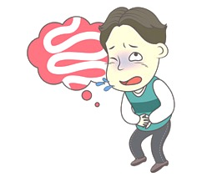
Etiology of IBS:
The causes of irritable bowel syndrome remain poorly defined.
● Possible etiologies for IBS include:
Stress and anxiety.
Visceral hypersensitivity.
Gastrointestinal infections.
Food sensitivity.
Psychological disorders.

Slide 8
Rome IV criteria for IBS:

Slide 9
Other supporting symptoms for diagnosing IBS:
Mucus in stool (Mucorrhea)
Abdominal bloating or subjective distention.
IBS can be associated with depression and anxiety.

Slide 10
Classification of IBS
IBS with constipation (IBS-C): hard or lumpy stools for ≥25% of bowel movements and loose (mushy) or watery stools for ≤25% of bowel movements.
IBS with diarrhoea (IBS-D): loose (mushy) or watery stools for ≥25% of bowel movements and hard or lumpy stool for ≤25% of bowel movements.
Mixed IBS (IBS-M): hard or lumpy stools for ≤25% of bowel movements and loose (mushy) or watery stools for ≤25% of bowel movements.
Unspecified IBS: insufficient abnormality of stool consistency to meet criteria for above subtypes.

Slide 11
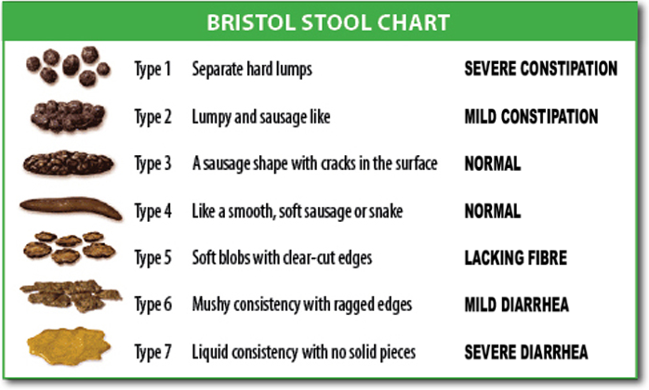

Slide 12
Diagnostic approach
Exclude alarm symptoms (red flags):
All people presenting with possible IBS symptoms should be assessed and clinically examined for red flag indicators and should be referred to secondary care for further investigation if any are present.
HX & PE.

Slide 13
Alarm features:
Age of onset after age 50 years
•GI bleeding (melena or hematochezia)
•Nocturnal diarrhea
•Progressive abdominal pain
•Unexplained weight loss
•Family history of IBD or colorectal cancer
•Laboratory abnormalities (iron deficiency anemia, elevated C-reactive protein or fecal calprotectin)

Slide 14
Diagnostic tests
No specific tests
In people who meet the IBS diagnostic criteria, the following tests should be undertaken
to exclude other diagnoses:
○ CBC
○ ESR
○ CRP
○ Endomysial antibodies [EMA] and anti-tissue transglutaminase [TTG]
Stool Studies

Slide 15
DDx:
Colorectal Cancer/ Carcinoid tumor.
Inflammatory bowel disease. (crohn’s disease & Ulcerative colitis)
Celiac disease/ Lactose intolerance
GI infection (Recent Antibiotic use)
Ischemic colitis
Thyroid dysfunction.

Slide 16
Management:
The goals of treatment are symptom relief and improved quality of life consists primarily of providing psychological support and recommending dietary measures.
Pharmacologic treatment is adjunctive and should be directed at symptoms.

Slide 17
Management:
Lifestyle advice:
○ Creating a relaxation time
○ Increase physical activity
○ Support group would be a good way to achieve this
● Dietary advice:
○ Regular timing meal.
○ High fluid intake (8 cups per day)
○ Restriction intake of caffeine, alcohol and soft drink.
○ Avoid high intake of fibers, starch and fruits (3 per day)

Slide 18
Pharmacological therapy:
Constipation-predominant IBS
Diarrhea-predominant IBS
Laxative should be considered in C-IBS.
Loperamide (antimotility) should be the first choice.
-Antispasmodic agents taken when required.
-Consider TCA as second-line treatment (Switch to SSRI if not effective).
-Cognitive behavioural therapy [CBT].
-Probiotics should be advised to take the product for at least 4 weeks while monitoring the
effect.

Slide 19
Refractory IBS:
Do not respond to pharmacological treatments after 12 months and Who develop a continuing symptom profile.

Slide 20
Indications for referral:
If there is :
Red flags.
Doubt about the diagnosis.
Refractory IBS.

Slide 21
References:
Uptodate
Medscape
AAFP

Slide 22
Thank you..

