Slide 1
Approach to adolescents health
Dr Aljohara Almeneessier
Female students
2022

Slide 2
By The end of session Students will be able to:
Define adolescence age according to World health organization.
Describe adolescence physiological and behavioral characteristics.
Determine adolescence health problems according to physical, psychological and social aspects based on best available evidence in the KSA.
Summarize the Comprehensive approach to common adolescent health problems in primary health care
Assess the Role of family, school and community in adolescent health care.

Slide 3
First, 15 minutes session will be allowed to students to ask and clarify any questions which are not understood or could not be answered during their pre-class preparation.
They are then followed by 60 minutes session where a tutor will ask questions from each student. The questions will be asked randomly to every student. If a question could not answer by a student will be asked by other students. The tutor will explain if the concept is not clear by the students.
The third and final session will be the clinical session, where the clinical scenario based on written or video presentations
Quiz 5 minutes

Slide 4

Adolescence:
Is the life stage between childhood and adulthood, encompasses the physical, cognitive, and emotional changes of puberty resulting in maturity. to reflect the complex biologic growth and social role transitions.

Slide 5
Sawyer SM , Azzopardi PS, Wickremarathne D, Patton GC The age of adolescence.
Lancet Child Adolesc Health. 2018; 2: 223-228

Slide 6
Adolescence is the transitional phase of growth and development between childhood and adulthood.
The World Health Organization (WHO) defines an adolescent as any person between ages 10 and 19.
This age range falls within WHO's definition of young people, which refers to individuals between ages 10 and 24

Slide 7
Quiz
5 minutes

Slide 8
Pubertal Development
1. Pubic hair (for males and females)
Tanner Stage | Appearance
1 | No hair
2 | Sparse, downy hair at base of symphysis pubis
3 | Sparse, coarse hair across symphysis pubis
4 | Adult hair quality, fills in pubic triangle, no spread to thighs
5 | Adult quality and distribution including spread to medial thighs

Slide 9
Pubertal Development
2. Female breast development

Slide 10
Pubertal Development
3. Male genital development
Stage | Comment (±2 Standard Deviations Around Mean Age)
1 | Prepubertal
2 | Enlargement of scrotum and testes; skin of scrotum reddens and changes in texture; little or no enlargement of penis; mean age 11.4 yr (9.5–13.8 yr)
3 | Enlargement of penis, first mainly in length; further growth of testes and scrotum; mean age 12.9 yr (10.8–14.9 yr)
4 | Increased size of penis with growth in breadth and development of glans; further enlargement of testes and scrotum and increased darkening of scrotal skin; mean age 13.8 yr (11.7–15.8 yr)
5 | Genitalia adult in size and shape; mean age 14.9 yr (13–17.3 yr)

Slide 11
Risky Health Behaviors Among Adolescent High School Students
Poor diet or low physical activity
Sexual activity
Substance misuse
Suicide
Unintentional injury
Violence victimization

Slide 12
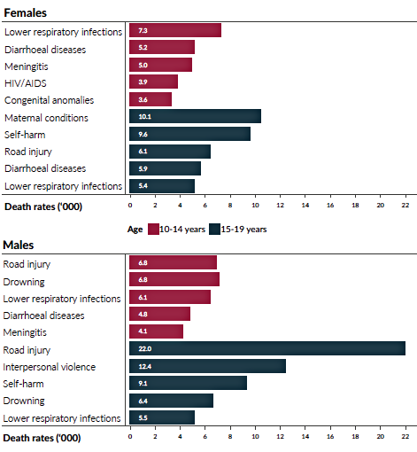
https://www.who.int/maternal_child_adolescent/topics/adolescence/framework-accelerated-action/en/

Slide 13
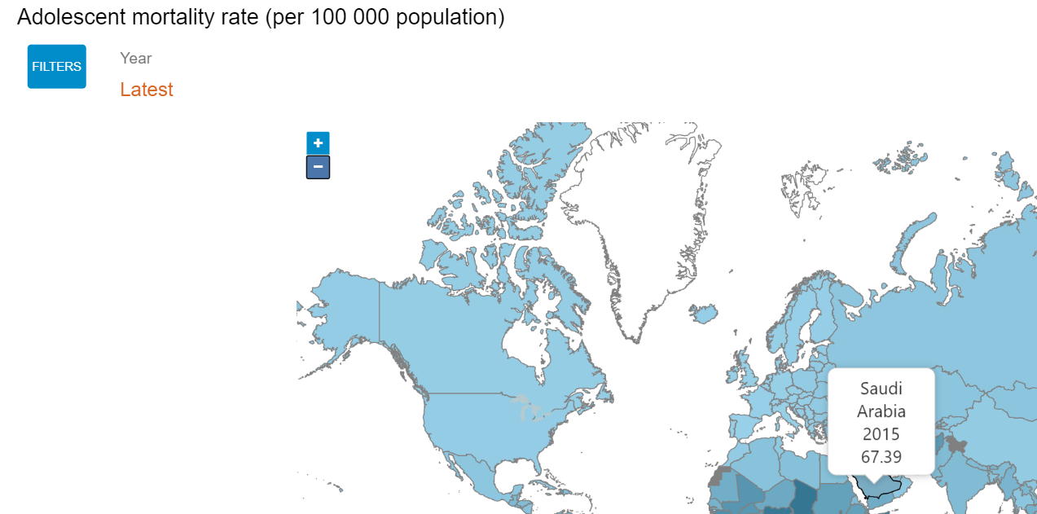

Slide 14
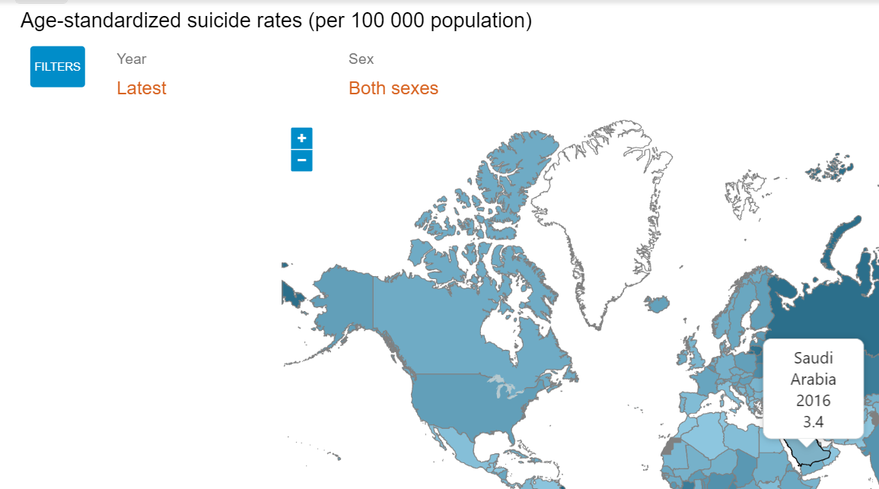

Slide 15
Objectives: To determine the incidence and pattern of injuries among children and adolescents <18 years old in Riyadh city and to identify associated factors.
Results: The study included 1650 children and adolescents. Of them, 22.2% reported having had injuries in the previous 12 months. The most common injuries were falls (40.4%), Road Traffic Accidents (RTA) (15%), food intoxication (8.8%). Males were more affected by injuries than females (26% vs. 18%). Males living near playgrounds or public gardens, playing in the street are independent risk factors for occurrence of both falls and RTA injuries.
Recommendations: school safety education and environmental modification should be applied in Riyadh.

Slide 16
Jeeluna جيلنا study database. Jeeluna was a cross-sectional, school-based, nationally representative study conducted in Saudi Arabia.
Participants included intermediate and secondary school students, aged 10–19 years from all 13 regions of the country.

Slide 17
The relationship of bullying and physical violence to mental health and academic performance: A cross-sectional study among adolescents in Kingdom of Saudi Arabia.AlBuhairan F, Abou Abbas O, El Sayed D, Badri M, Alshahri S, de Vries N.Int J Pediatr Adolesc Med. 2017 Jun;4(2):61-65. doi: 10.1016/j.ijpam.2016.12.005. Epub 2017 Feb 9.PMID: 30805503
Sleep deprivation: prevalence and associated factors among adolescents in Saudi Arabia.Nasim M, Saade M, AlBuhairan F.Sleep Med. 2019 Jan;53:165-171. doi: 10.1016/j.sleep.2018.08.031. Epub 2018 Oct 10.PMID: 30529632
Time for an Adolescent Health Surveillance System in Saudi Arabia: Findings From "Jeeluna".AlBuhairan FS, Tamim H, Al Dubayee M, AlDhukair S, Al Shehri S, Tamimi W, El Bcheraoui C, Magzoub ME, de Vries N, Al Alwan I.J Adolesc Health. 2015 Sep;57(3):263-9. doi: 10.1016/j.jadohealth.2015.06.009.PMID: 26299553

Slide 18
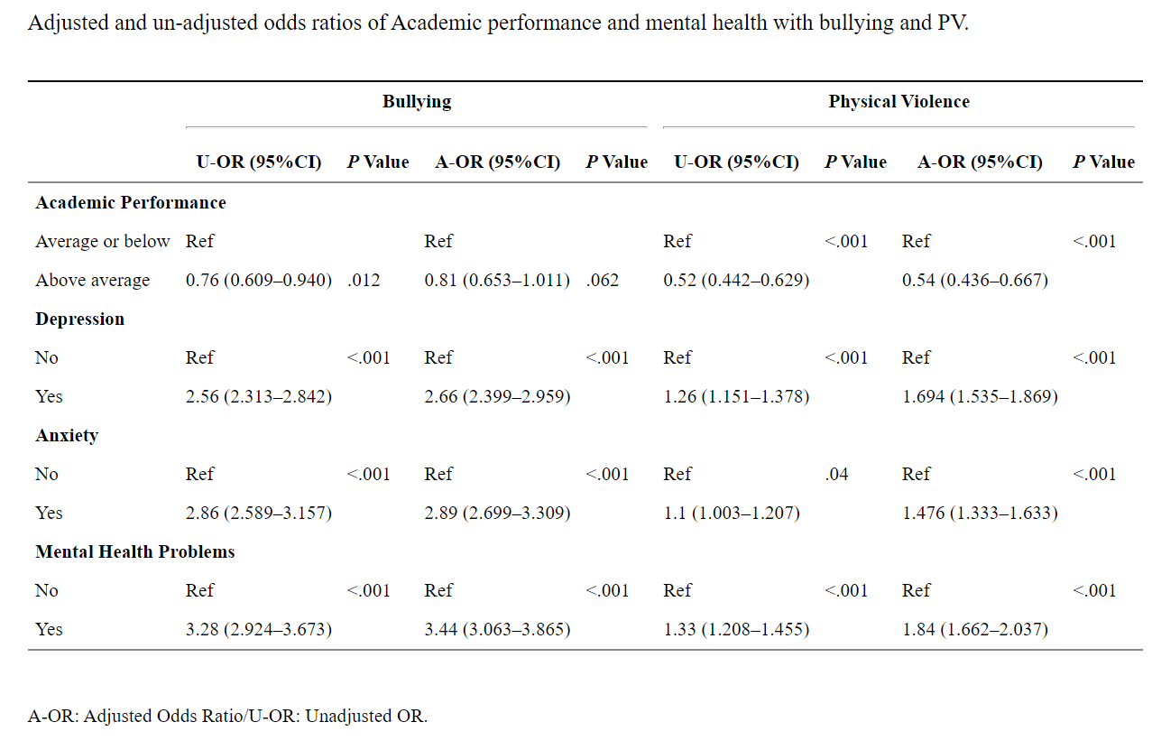
AlBuhairan, Fadia et al. “The relationship of bullying and physical violence to mental health and academic performance: A cross-sectional study among adolescents in Kingdom of Saudi Arabia.” International journal of pediatrics & adolescent medicine vol. 4,2 (2017): 61-65. doi:10.1016/j.ijpam.2016.12.005

Slide 19
Bullying
When adjusting for age and gender, results indicate that students who were bullied were 20% (OR: 0.81, 95% CI: 0.653 ,1.011%) less likely to have an academic performance that was at least average. Bullied students had a 2.66 (95% CI: 2.399 , 2.959) and a 2.89 (95% CI: 2.699 , 3.309) greater odds of suffering from depression and anxiety symptoms, respectively, compared to students who were not bullied. Likewise, bullied students had a 3.44 times higher risk of having mental health problems compared to non-bullied students (95% CI: 3.063 , 3.865).
AlBuhairan, Fadia et al. “The relationship of bullying and physical violence to mental health and academic performance: A cross-sectional study among adolescents in Kingdom of Saudi Arabia.” International journal of pediatrics & adolescent medicine vol. 4,2 (2017): 61-65. doi:10.1016/j.ijpam.2016.12.005

Slide 20
Physical Violence
For PV in the past year, after adjusting for age and gender, students who were involved in any PV were approximately 50% less likely to have ‘average’ or ‘above average’ academic performance compared to those who were not involved in any PV (95% CI 0.436, 0.667). Further, these students were significantly more likely to report experiencing depression (OR: 1.7; 95% CI 1.535,1.869), anxiety (OR: 1.48; 95% CI: 1.333,1.633), or mental health problems (OR: 1.84; 95% CI 1.662 ,2.037) compared to those who were not involved in any PV in the past year
AlBuhairan, Fadia et al. “The relationship of bullying and physical violence to mental health and academic performance: A cross-sectional study among adolescents in Kingdom of Saudi Arabia.” International journal of pediatrics & adolescent medicine vol. 4,2 (2017): 61-65. doi:10.1016/j.ijpam.2016.12.005

Slide 21
Time for an Adolescent Health Surveillance System in Saudi Arabia: Findings From "Jeeluna

Slide 22
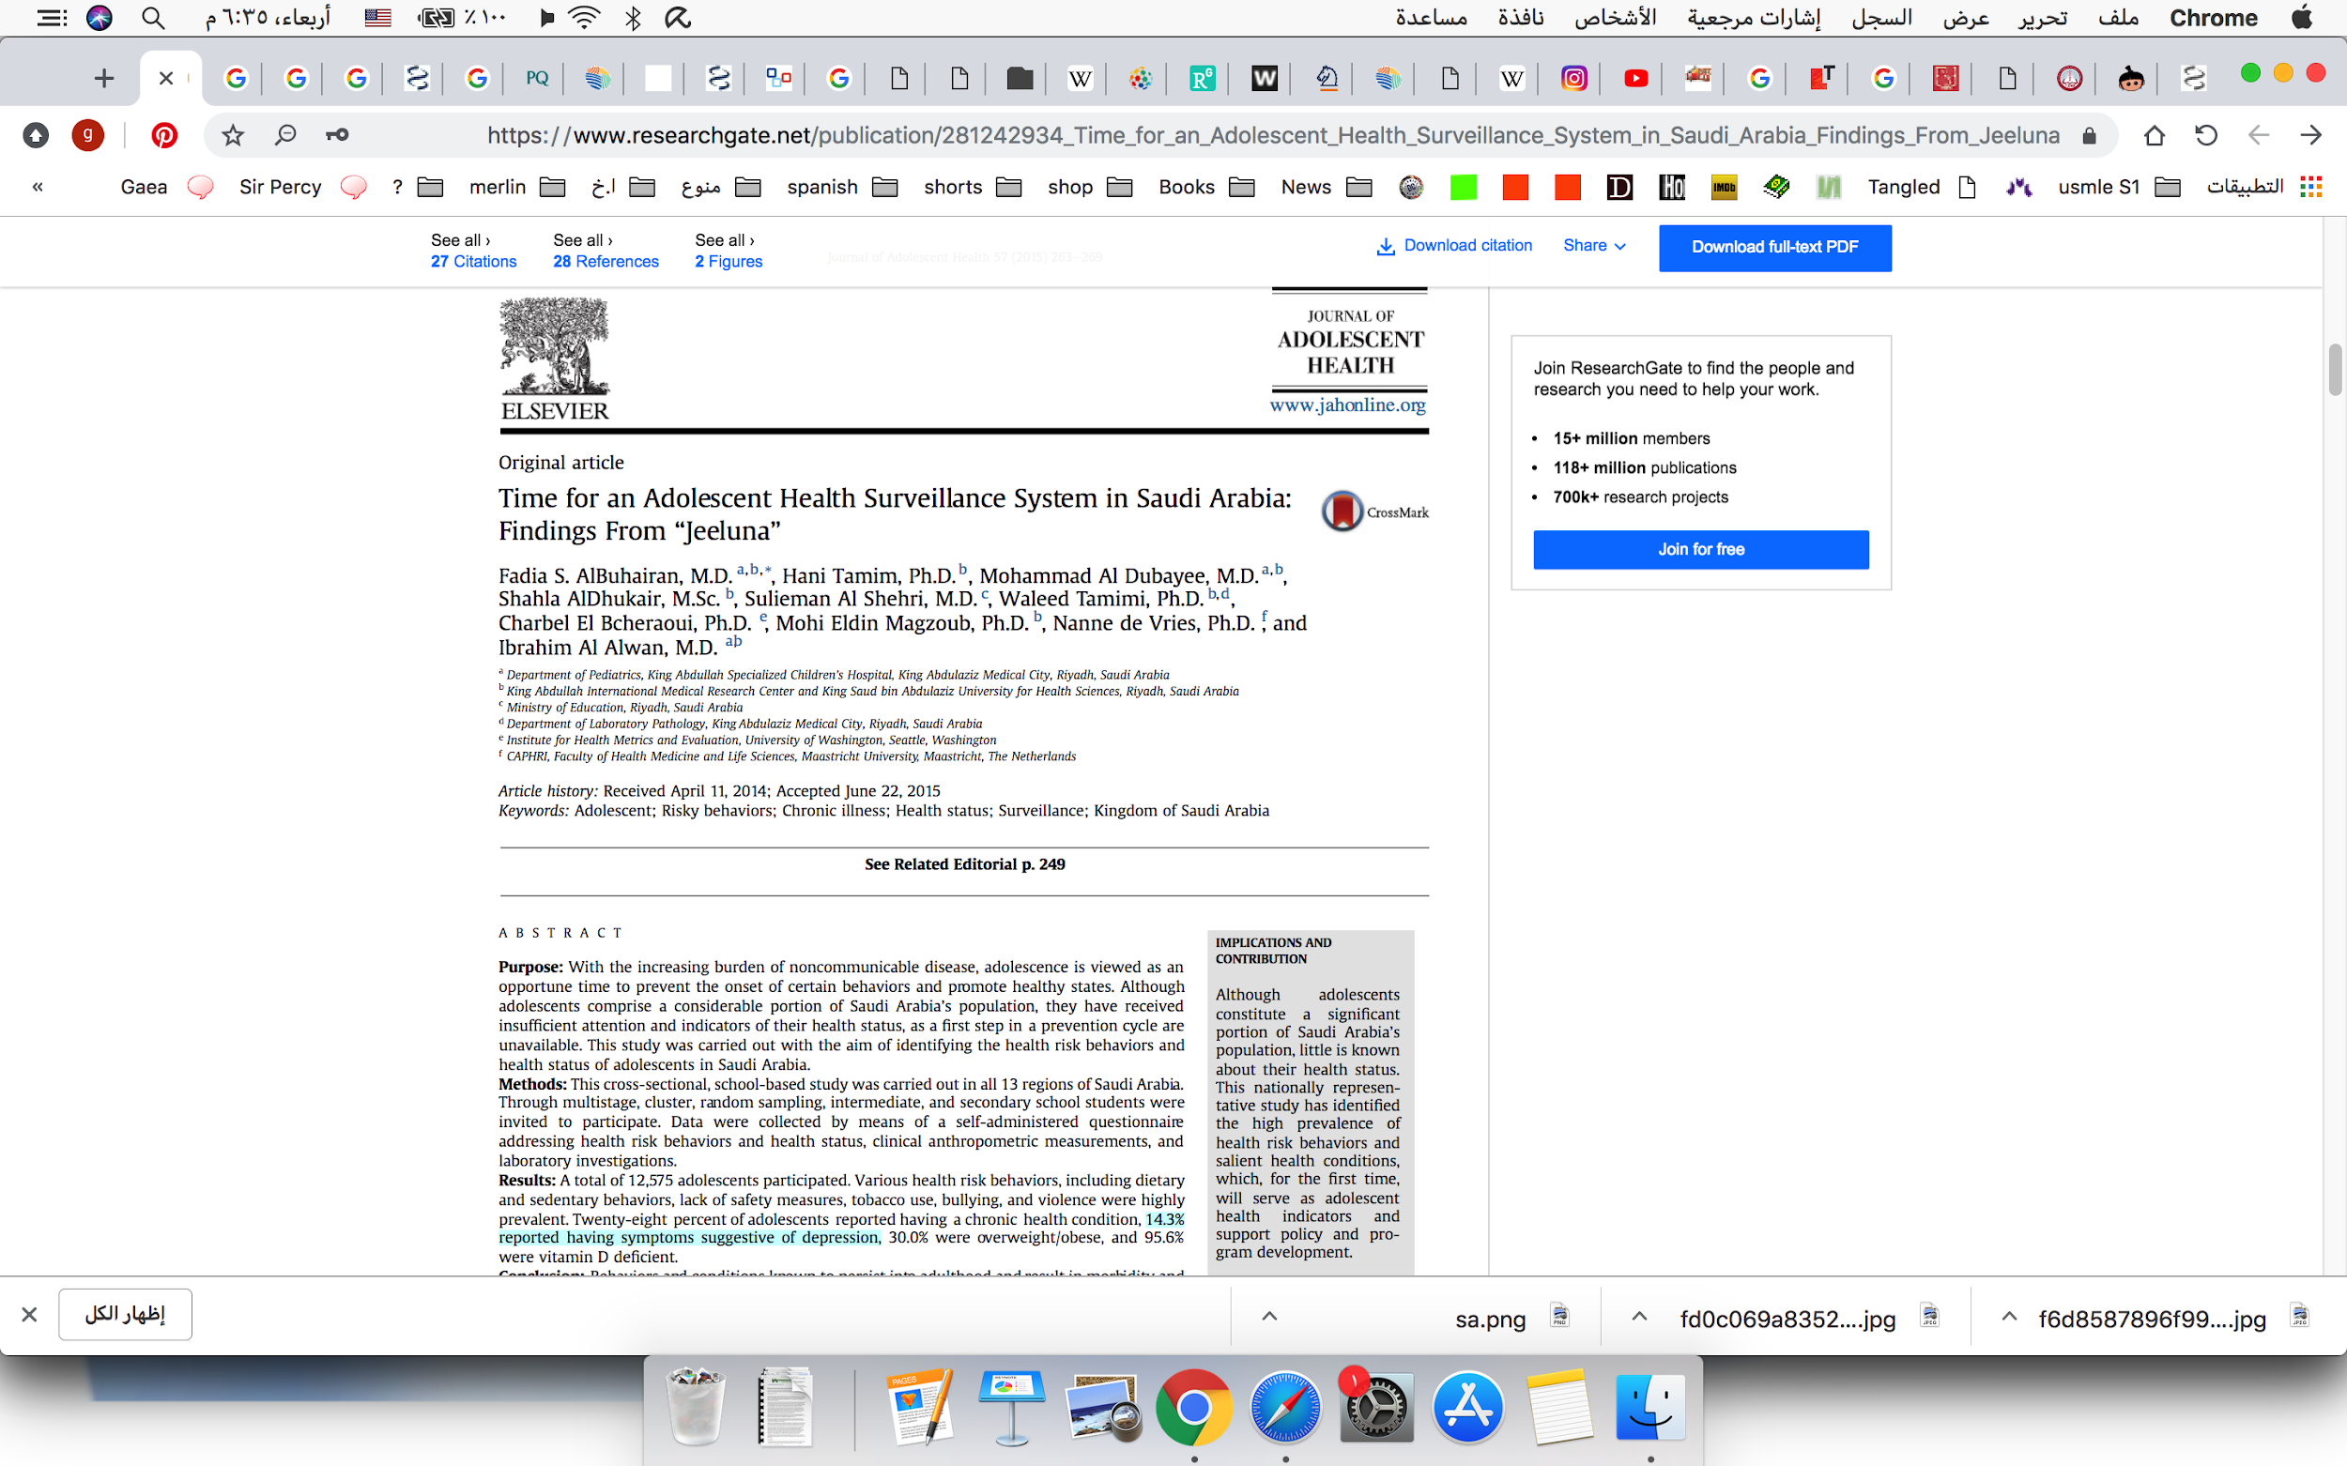
Time for an Adolescent Health Surveillance System in Saudi Arabia: Findings From "Jeeluna

Slide 23
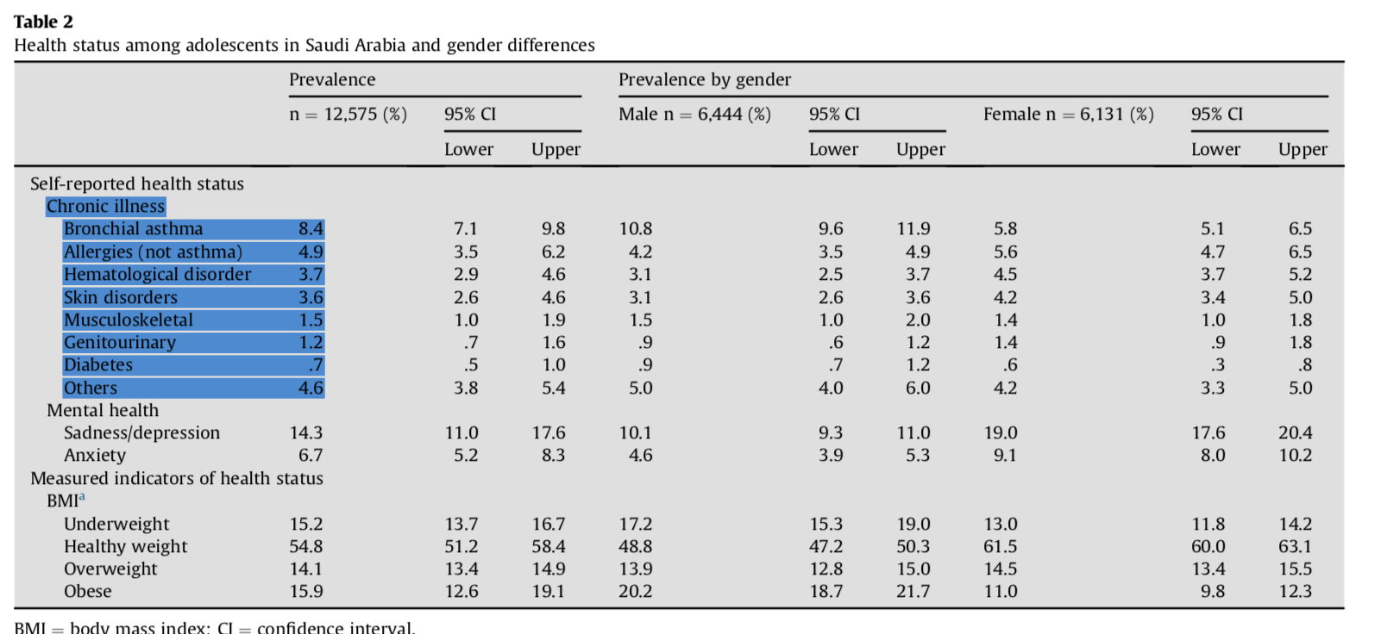
Time for an Adolescent Health Surveillance System in Saudi Arabia: Findings From "Jeeluna

Slide 24
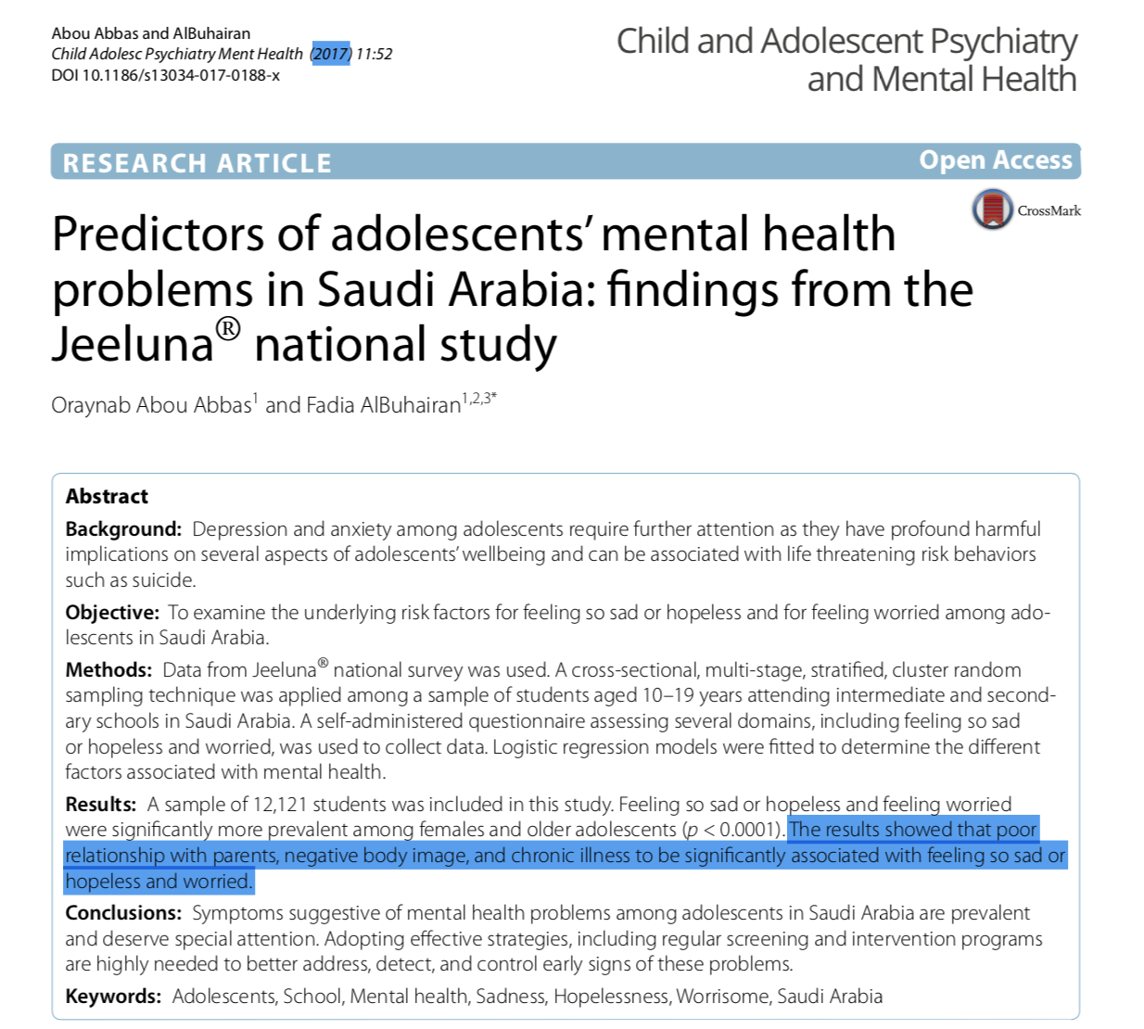

Slide 25
A Framework for Comprehensive Care
CONFIDENTIALITY
STRENGTH-BASED INTERVIEWING
SSHADESS (strengths, school, home, activities, drugs, emotions/eating, sexuality, safety)
HEEADSSS (home, education/employment, eating, activities, drugs, sexuality, suicide/depression, safety)

Slide 27

SOCIAL MEDIA
Traditional and social media, interactive video games, and other digital content can improve adolescents’ social support and access to diverse information but…
may negatively affect health (e.g., sleep, attention, learning, mood, weight, driving safety), compromise personal privacy, and reveal inaccurate content and unsafe contacts.

Slide 28
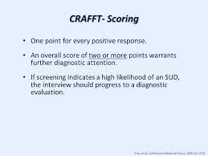
SUBSTANCE USE
The CRAFFT+N (car, relax, alone, forget, family/friends, trouble, nicotine) screening tool is sensitive for identifying problematic substance use.
(https://crafft.org/).
Energy drinks contain unregulated ingredients and stimulants, have no therapeutic benefit, and may cause toxicity; screening for use provides opportunities for education

Slide 29
OBESITY AND EATING DISORDERS
Eating disorders have high lifetime mortality because of disease complications and risk of suicide
MENTAL HEALTH
The U.S. Preventive Services Task Force recommends that clinicians screen adolescents starting at age 12 and adults for major depressive disorder when systems are in place to ensure accurate diagnosis, treatment, and follow-up.
PHQ-2* and PHQ-9† for Adolescents: Screening Instruments for Depression

Slide 30
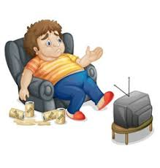
Clinical scenario

Slide 31
Case study
Nasser 12 years old
The consultation was initiated by the mother who is divorcee with 5 children, Nasser is the middle child with 2 brothers and 2 sisters
Mother concern was the bedwetting, started at age of 7, the time of family problems and divorce. The father moved to another town and he refused any medical attention to the bed wetting problem, reason all boys have this problem
Nasser 6th grade student, shy person, good relationship with siblings. Likes to play games. Missed a lot of classes (distance learning).
Physically BMI 32, other wise normal.
How will you approach this patient?

Slide 32
What is the Role of
  Family,
  School and
  Community
  in adolescent health care.

Slide 33
Healthy People 2010 Initiative

Slide 34
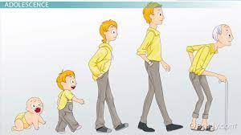
Thanks

