Slide 1
Enhancing consultation competencies and communication skills
By
Prof AlJoharah AlQuaiz

Slide 2
Flipped classroom
15 min session
Do you have any questions from the two lectures about Consultation and communication?

Slide 3
Questions will be asked during all the session
The questions will be asked randomly
If a question could not be answered
Then it will be directed to another student

Slide 4
final session
clinical sessions in the form of video presentations
Before and after videos
video analysis assessment showing the tasks of consultation by using videos and case scenarios
Video analysis and role play of verbal, nonverbal clues, cues, gestures and certain techniques that will facilitate communication between Dr and patient

Slide 5
consultation
Consultation and communication skills
Video –cough before and after
https://www.youtube.com/watch?v=tWFVT-fUafQ&feature=youtu.be
https://youtu.be/tWFVT-fUafQ
Before and after
https://youtu.be/-JSxDoNzy0g
https://youtu.be/-1Ba9juSMfM

Slide 6
Consultation video assessment
Consultation for video analysis Arabic
SOB
Use consultation assessment form

Slide 7
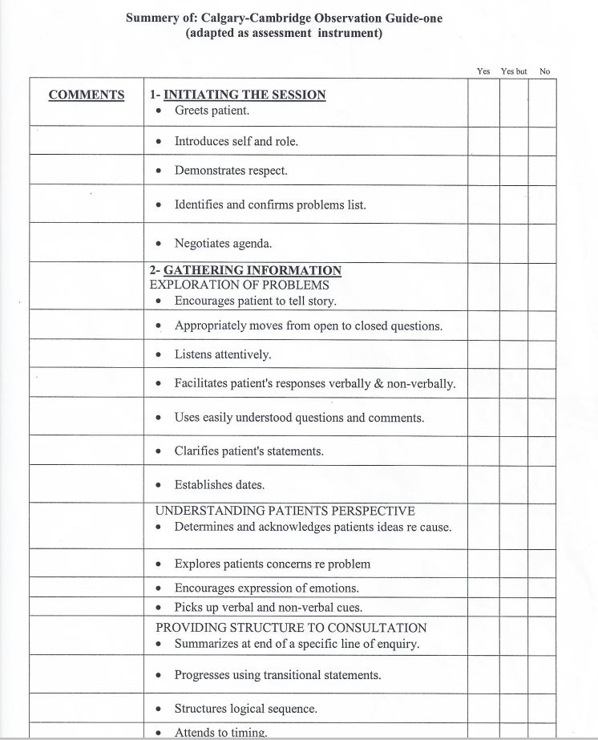
Consultation Assessment Instrument

Slide 8
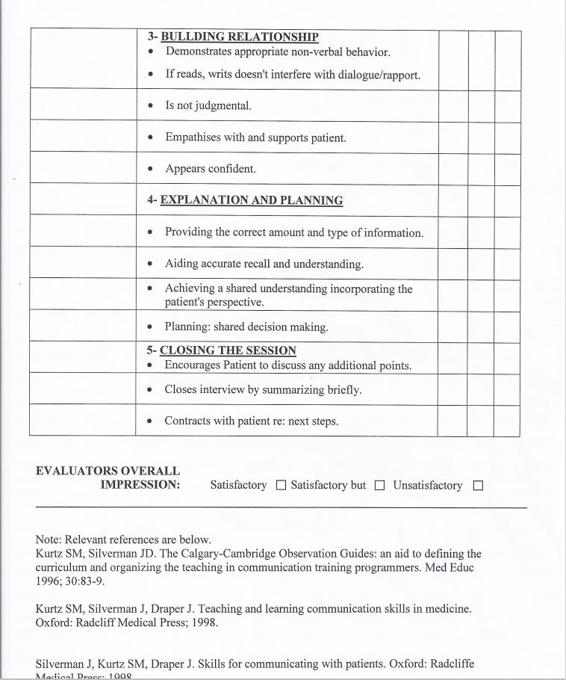
Continue

Slide 9
Consultation and communication skills
Depression
https://youtu.be/Cg4BbnkBavQ?list=PLpRE0Zu_k-By_X4lNa4WwYFC2MTbkDHok
https://www.youtube.com/watch?v=klfoD4cVkDY&list=PLpRE0Zu_kBy_X4lNa4WwYFC2MTbkDHok&index=3
Explaining and educating
https://www.youtube.com/watch?v=SSJFJpk0osU

Slide 10
Questions

