Slide 1
Smoking & Substance Abuse

Slide 2
By The end of session Students will be able to:
Describe the Epidemiology of smoking in Saudi Arabia
Recognize Risks of smoking (Morbidity and Mortality)
Appreciate the Effect of passive smoking on pregnancy, children…
Be able to help the smoker to quit with smoking cessation aids and overcoming nicotine withdrawal symptoms
Appreciate the Role of PHC physician in “smoking cessation clinic’
Discuss the smoking cessation medication, Nicotine preparations, Varenicline, Bupropion, …
Recognize Factors that lead to substance abuse
List types of substance abuse
Appreciate Method to approach subjects with substance abuse

Slide 3
-Describe the Epidemiology of smoking in Saudi Arabia

Slide 4
Epidemiology
Every year, more than 7000 of Saudi Arabia people are killed by tobacco-caused disease.
It is recognized by the World Health Organization as the second leading risk factor for death worldwide.
Despite its associated health risks, over 1.3 billion individuals smoke tobacco worldwide

Slide 5
Epidemiology
A latest study in Saudi Arabia among adults aged 18 years or older in 2018 showed that:
Prevalence of cigarette smoking is 21.4%
Gender | Categories | % percentage | Total
Male | Daily smoker | 26.29% | 32.5%
 | Nondaily smoker | 6.19%
Female | Daily smoker | 1.59% | 3.9%
 | Nondaily smoker | 2.34%

Slide 6
Recognize Risks of smoking
(Morbidity and Mortality)

Slide 7
What are the health risks of smoking?

Slide 8
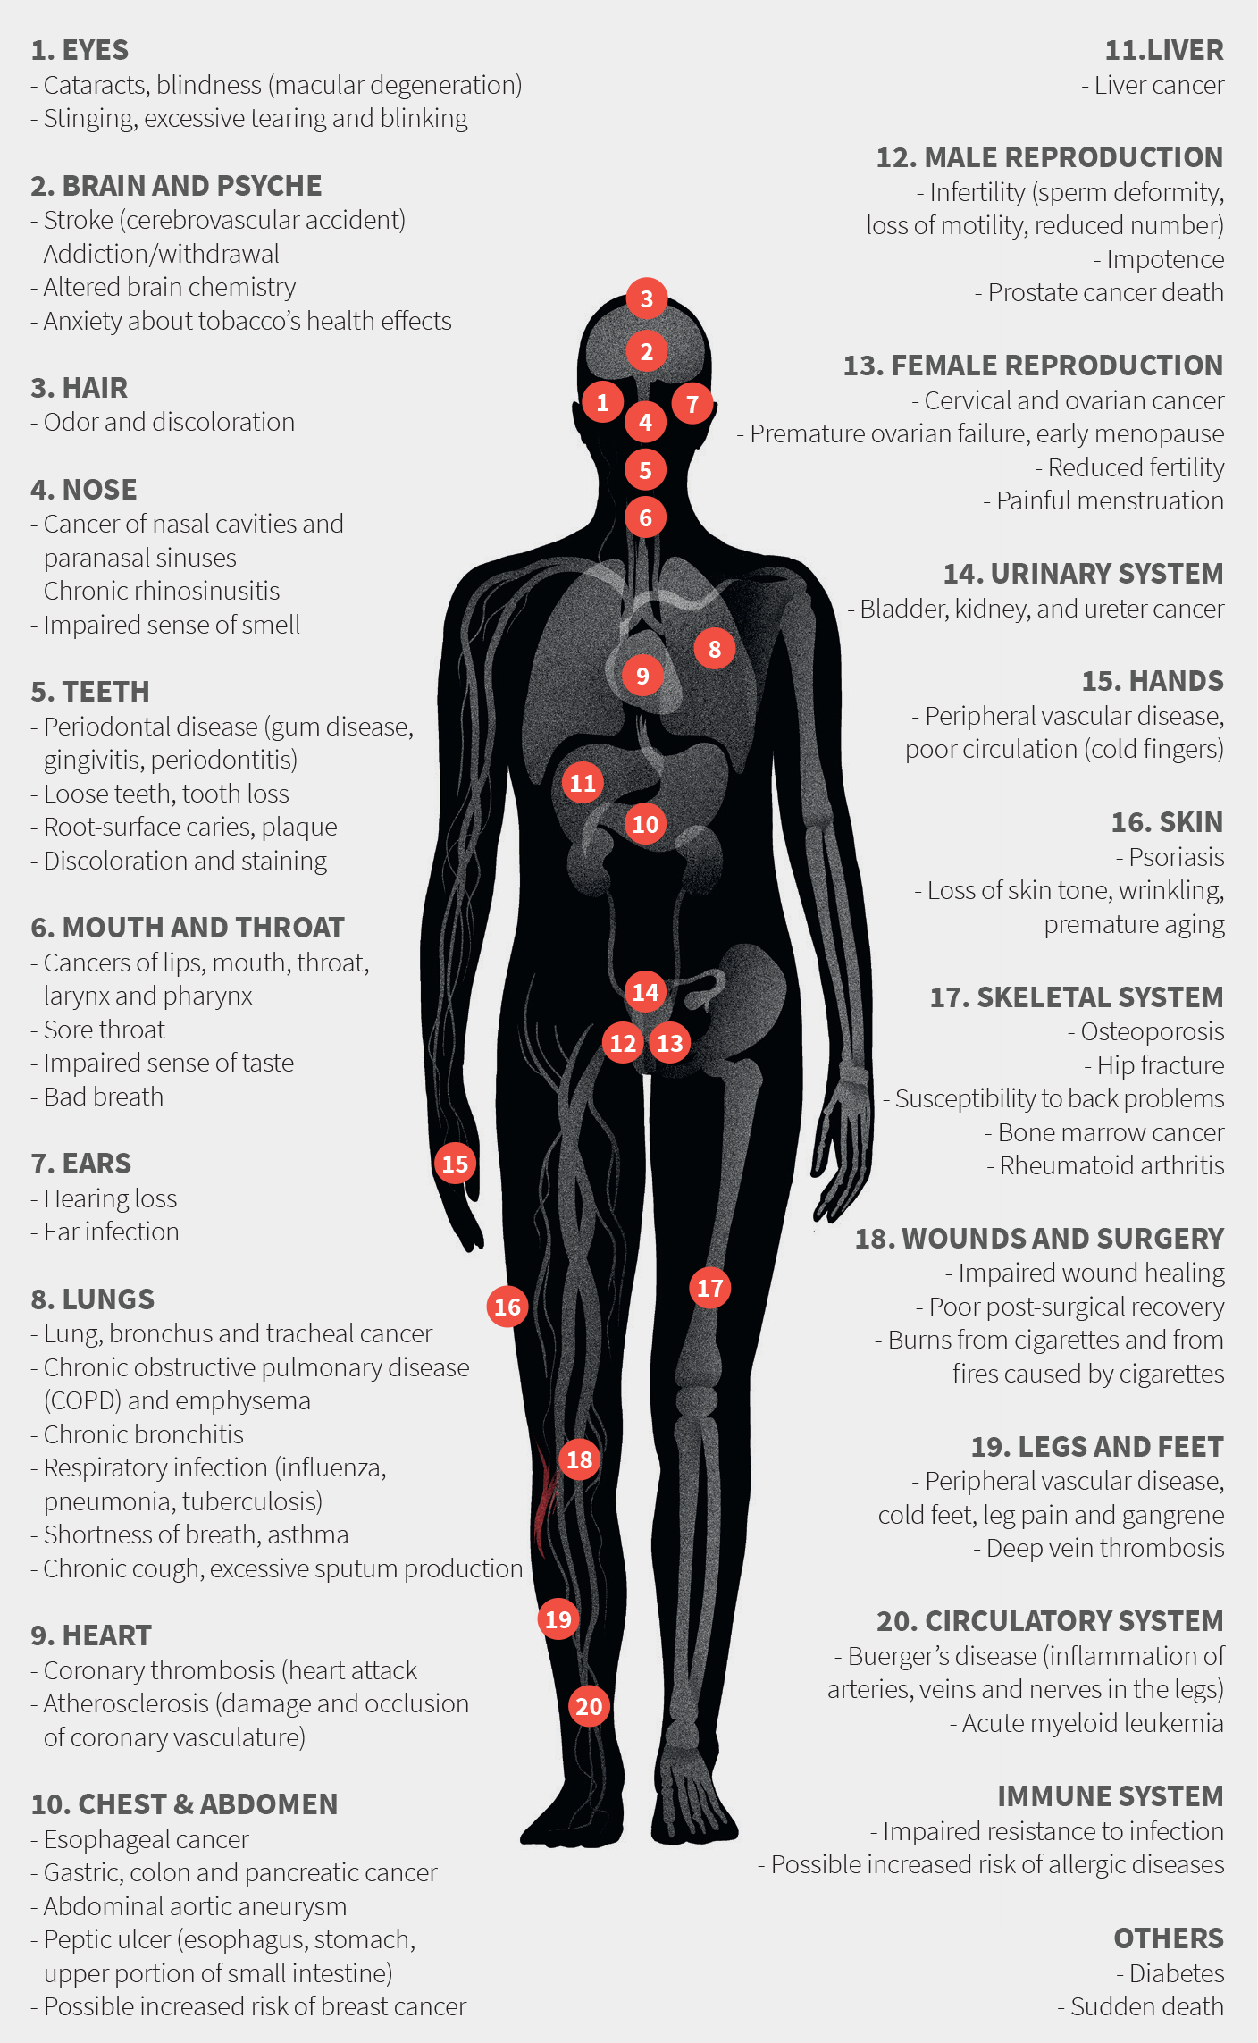
Risks of Smoking
Smoking harms nearly every organ in the body
Tobacco use is one of the most important preventable causes of premature death in the world. More than 6 million people per year die from tobacco use across the globe.

Slide 9
Morbidity
Smoking causes many diseases and reduces the health in general.
Even if you only smoke one cigarette a day it can have serious healthconsequences.

Slide 10
Smoking and Cancer
There are thousands of chemicals in cigarette smoke, including around 70 known cancer-causing chemicals called carcinogens.
causes cancer of the lung, mouth, throat, voice box, oesophagus, pancreas, bladder, kidney, liver, cervix, ureter, nose, nasal sinuses, stomach and bowel.
Smoking causes acute myeloid leukaemia and increases breast cancer risk.
Lung cancer is the leading cause of cancer death in both men and women, and is one of the hardest cancers to treat.

Slide 11
Smoking and Cardiovascular Problems
Smoking tobacco damages heart and blood vessels increasing risk of heart disease and stroke.
It's A major cause of coronary heart disease, which can lead to a heart attack.
Smoking causes high blood pressure, lowers ability to exercise, and makes blood more likely to clot.
decreases HDL (good) cholesterol levels in the blood.
Smoking is a major risk factor for peripheral arterial disease (PAD)

Slide 12
Smoking and Respiratory Problems
Chronic obstructive pulmonary disease (COPD) is one of the leading causes of death in the world.
mortality from this condition is increasing in most countries; globally, 45% of all deaths from COPD are attributed to tobacco use.
More women die from COPD than men.
Types of (COPD) that smoking can lead to:
Chronic bronchitis
Emphysema

Slide 13
- Appreciate the Effect of passive smoking on pregnancy, children…

Slide 14
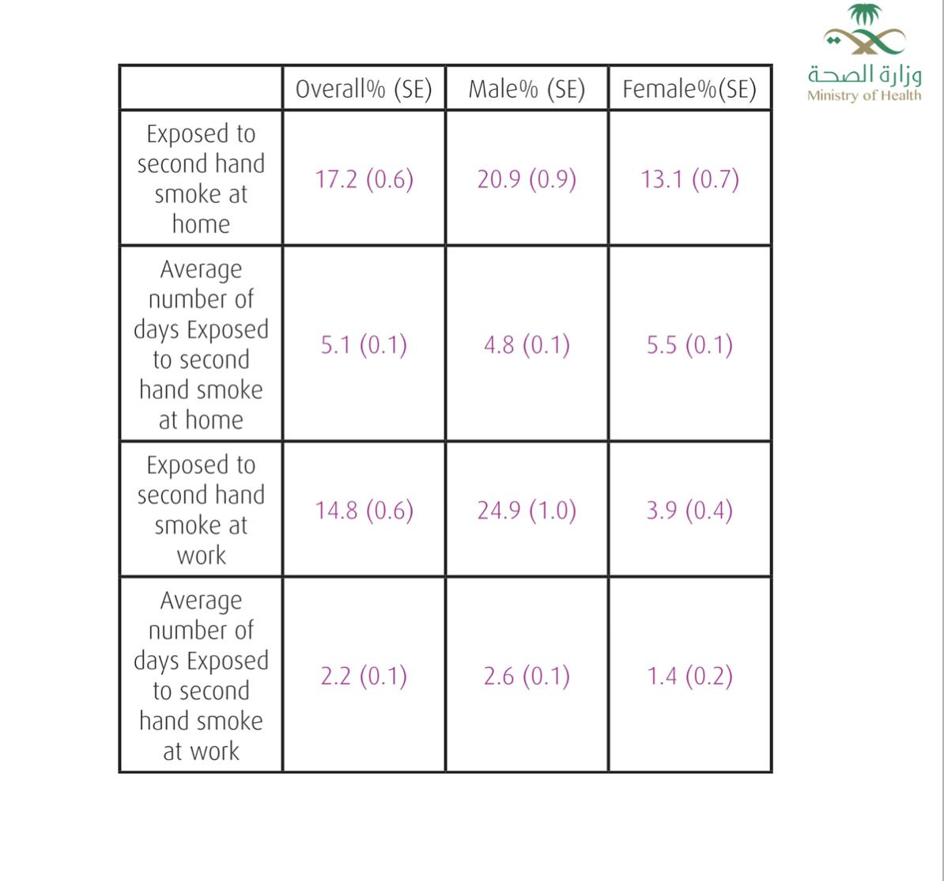
Passive Smoking
Inhaling Smoke that comes from burning tobacco products.
Exhaled smoke plus the “sidestream”.
It affects 17.2 % of Saudi people.

Slide 15
Passive smoking causes about 600 thousand deaths each year.
Results in several adverse health affects on respiratory and cardiac systems.
Individuals get exposed to unfiltered smoke. (4000 irritants).

Slide 16
Passive Smoking in Pregnancy
Low birth weight.
Poor lung function.
Ear infections .
Asthma.
Sudden infant death syndrome .
Abnormal or delayed growth and development .

Slide 17
Passive Smoking in children
The immune and respiratory systems are not completely developed yet.
Children exposed to smoke are at risk of respiratory diseases such as asthma and infections.
Meningitis and ear infections are also increased with passive smoking.
Particularly vulnerable in cars.

Slide 18
- Be able to help the smoker to quit with smoking cessation aids and overcoming nicotine withdrawal symptoms

Slide 19
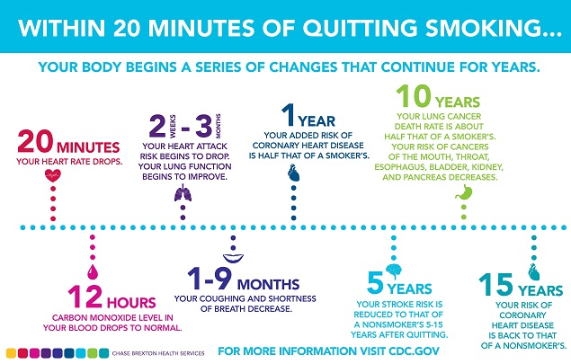
Smoking Cessation

Slide 20
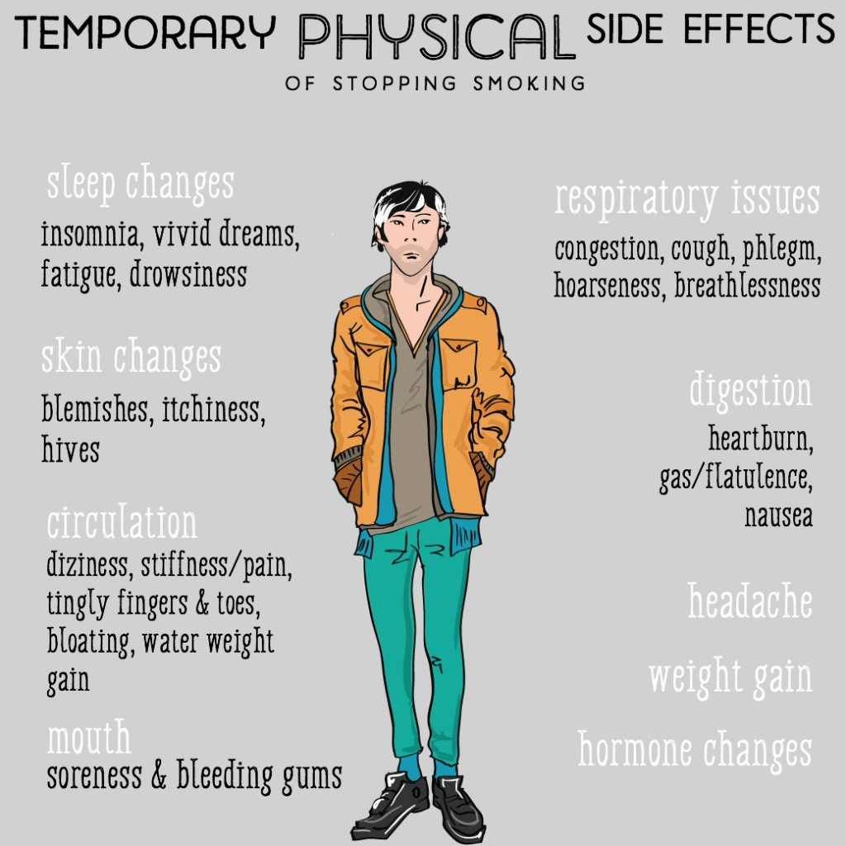

Slide 21
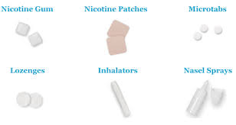
NRT (Nicotine Replacement Therapy)
NRT comes in variety of forms that used in different ways.

Slide 22
Nicotine Patch
Placed on the skin to supply the small controlled amount of nicotine to the body .
Helps reduce nicotine withdrawal symptoms and urges to smoke .
No need to talk to health care provider before using.
Side effects:
Nausea And vomiting
Headache
Increased blood pressure
Acne

Slide 23
Nicotine Gum
Chewed to release nicotine that gets absorbed through tissue inside the mouth.
Helps to reduce withdrawal symptoms.
No need to talk to a health care provider before using.
Side effects:
Nausea / vomiting
Mouth / tooth or jaw problems
Dizziness
Diarrhea
Weakness
Rash
Contraindicated in active temporomandibular joint disease.

Slide 24
Nicotine Lozenge
Looks like hard candy; placed in the mouth where it slowly dissolves, releasing nicotine.
Helps reduce nicotine withdrawal symptoms, available over the counter.
No need to talk to a health care provider before using.
Side effects:
● Increased blood pressure
● Nausea / vomiting
● Tachycardia
● Dizziness

Slide 25
Nicotine Inhaler
• Delivers a specific amount of nicotine to the user with each puff.
• Helps reduce nicotine withdrawal symptoms, available only from your doctor.
• Nicotine Inhaler works much more quickly than the nicotine gum.
Side effects:
●Mouth/throat irritation ●Nausea / vomiting
●Cough ●Headache ●Rhinitis ●Dyspepsia
Disadvantages:
It is more expensive than nicotine gum.

Slide 26
Nicotine Nasal spray
Pump bottle inserted into the nose and sprayed to deliver specific amount of nicotine.
Helps reduce nicotine withdrawal symptoms .
The medication gets rid of the symptoms faster than any medication.
Side effects:
Local irritation
Fatigue
Weight gain

Slide 28
- Discuss the smoking cessation medication, Nicotine preparations, Varenicline, Bupropion.

Slide 29
Smoking Cessation Medications
The severity of withdrawal symptoms that patients find distressing, and in some cases unacceptable, can be reduced by :
nicotine replacement therapy (NRT)
non- nicotine replacement therapy:
Varenicline
Buprobion

Slide 30
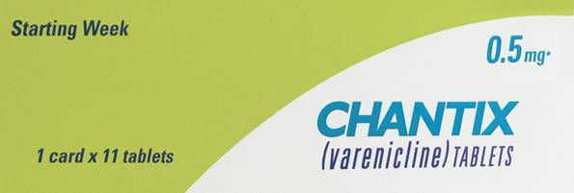
Varenicline
This medication is the first approved nicotinic receptor partial agonist.
The drug competitively inhibits the ability of nicotine to bind to and activate the alpha-4 beta-2 receptor.

Slide 31
Varenicline
Patients should be treated with varenicline for weeks.
Initiate regimen 1 week before quit smoking date
Days 1-3: 0.5mg PO qd (once daily )
Days 4-7:0.5mg PO BID (twice daily)
Day 8 to end of treatment: 1 mg PO BID
If quitting is successful after 12 weeks, continue another 12 weeks at 1 mg q12hr

Slide 32
Varenicline
side effects:
Neuropsychiatric Adverse Events including Suicidality
Seizures
Interaction with alcohol
Cardiovascular events
Serious skin reactions
contraindications
pregnancy/ breast feeding.
Age under 18.

Slide 33
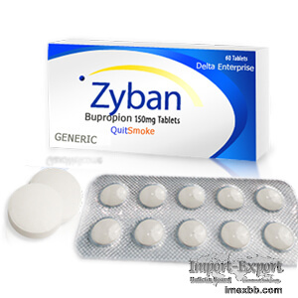
Bupropion
is a norepinephrine/dopamine-reuptake inhibitor (NDRI)
most commonly for the management of Major Depressive Disorder (MDD), Seasonal Affective Disorder (SAD), and for smoking cessation.

Slide 34
Bupropion
Exerts its pharmacological effects by weakly inhibiting the enzymes involved in the uptake of norepinephrine and dopamine from the synaptic cleft, therefore prolonging their duration of action.
bupropion has anti-craving and anti-withdrawal effects

Slide 35
Bupropion
Bupropion should be continued for 7 to 12 weeks
Initiate bupropion therapy 1 to 2 weeks before the patient's target smoking “quit day”
150 mg PO once daily for the first 3 days
150 mg PO twice daily for the remainder of the treatment period

Slide 36
Bupropion
Common bupropion side effects may include:
dry mouth, stuffy nose
sleep problems (insomnia)
tremors, sweating, feeling anxious or nervous
confusion, agitation

Slide 37
Bupropion
contraindications:
Epilepsy
Alcohol / benzodiazipines user
Active brain tumors.
Pregnancy/breast feeding
Age under 18

Slide 38
Dealing with Relapse
Most patients relapse within the first six to 12 months of a smoking cessation attempt. If a patient relapses, the physician needs to encourage the patient to try again.
It is useful to review the treatment plan to determine what did and did not work.
Behavioral therapy (98% success rate) and support in a group setting have been shown to improve quit rates. Individual counseling can also be effective.

Slide 39
- List types of substance abuse

Slide 40
Types of Substance Abuse
1- Alcohol:
A colourless volatile flammable liquid which is produced by the natural fermentation of sugars and is the intoxicating constituent of wine, beer, spirits, and other drinks. Side effects: Slurred speech, Drowsiness, Vomiting, Diarrhea, Upset stomach, Headaches, Breathing difficulties, Distorted vision and hearing, Impaired judgment, Decreased perception and coordination, Unconsciousness, Coma, Blackouts.
2- Central Nervous System Depressants:
Medications that slow brain activity, which makes them useful for treating anxiety and sleep problems. (Barbiturates, Benzodiazepines) Side effects: Drowsiness, slurred speech, poor concentration, confusion, dizziness, problems with movement and memory, lowered blood pressure, slowed breathing.

Slide 41
Types of Substance Abuse
3- Cocaine:
A powerfully addictive stimulant drug made from the leaves of the coca plant native to South America. Side effects: Narrowed blood vessels, enlarged pupils, increased body temperature, headache, abdominal pain and nausea, euphoria, increased energy, insomnia, restlessness, anxiety, violent behavior, panic attacks, paranoia, psychosis, heart attack, stroke, seizure, coma.
4- Heroin:
An opioid drug made from morphine, a natural substance extracted from seed pod of opium poppy plants. Side effects: Euphoria, dry mouth, itching, nausea, vomiting, analgesia, slowed breathing and heart rate.

Slide 42
Types of Substance Abuse
5- Marijuana (Cannabis):
Made from Cannabis sativa. The main psychoactive (mind-altering) chemical in marijuana is delta-9-tetrahydrocannabinol, or THC. Side effects: Enhanced sensory perception and euphoria followed by drowsiness/relaxation, slowed reaction time, problems with balance and coordination, increased heart rate, problems with memory, anxiety
6- Opioids:
Pain relievers with an origin similar to that of heroin. Opioids can cause euphoria and are often used nonmedically, leading to overdose deaths. Side effects: pain relief, drowsiness, nausea, constipation, euphoria, slowed breathing, death.

Slide 43
Types of Substance Abuse
7- Inhalants:
Solvents, aerosols, and gases found in household products such as spray paints, markers, glues, and cleaning fluids; also nitrites (e.g., amyl nitrite), which are prescription medications for chest pain. Side effects: Confusion, nausea, slurred speech, lack of coordination, euphoria, dizziness, lightheadedness, hallucinations/delusions, headaches, death from asphyxiation, suffocation, convulsions or seizures, coma, or choking.
8-Amphetamine :
Amphetamine is a central nervous system stimulant that affects chemicals in the brain and nerves that contribute to hyperactivity and impulse control. it is used to treat attention deficit hyperactivity disorder (ADHD). Side effects: Agitation , anxiety , bladder pain , bloody urin , delusion , false sense of well-being , mental depression, etc.

Slide 44
-Appreciate Method to approach subjects with substance abuse

Slide 45
Methods to Approach Substance Abuser
Substance misuse screening
Single-question screen:
“How many times in the past year have you used an illegal drug or used a prescription medication for nonmedical reasons?”

Slide 46
Methods to Approach Substance Abuser
Motivational interviewing The aim of motivational interviewing is to empower and motivate individuals to take responsibility and change their substance use behavior.
Stage 1: Understanding why they need to change
Stage2: Planning and making the changes
Stage 3: Maintaining the change

Slide 47
Methods to Approach Substance Abuser
For patients who are not committed to abstinence harm reduction strategies is an appropriate alternative.
Harm reduction strategies reduce the negative health consequences of substance use for example:
providing clean needles to persons who continue to inject drugs.
Avoid driving while intoxicated.

Slide 48
Methods to Approach Substance Abuser
Substance dependence is a chronic relapsing and remitting illness, Patients require chronic care approach that can include:
Pharmacotherapy
Referral to specialty treatment
Mutual help meetings
Ongoing counseling and care coordination.
Engage family members in the treatment plan as family support is important in the recovery process.

Slide 49
- Recognize Factors that lead to substance abuse

Slide 50
Factors Lead to Substance Abuse
Environment :
Peer pressure.
Stress ( Trauma , exposure to physical, sexual, or emotional abuse , …)
Low education level

Slide 51
Factors Lead to Substance Abuse
Illness :
Mental health disorder.
Previous usage for medical purpose
Early use → longer time of usage → more addiction
Taking a highly addictive drug

Slide 52
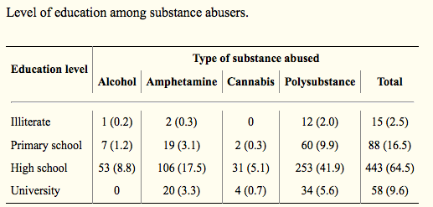
Studies in Saudi Arabia
1- brahim Y, Hussain SM, Alnasser S, Almohandes H, Sarhandi I. Patterns and sociodemographic characteristics of substance abuse in Al Qassim, Saudi Arabia:A retrospective study at a psychiatric rehabilitation center. Ann Saudi Med. 2018;38:319–25
In their study, possible risk factors for substance abuse were male sex, age of 20–40 years, availability of multiple drugs of abuse high school education ..

Slide 53
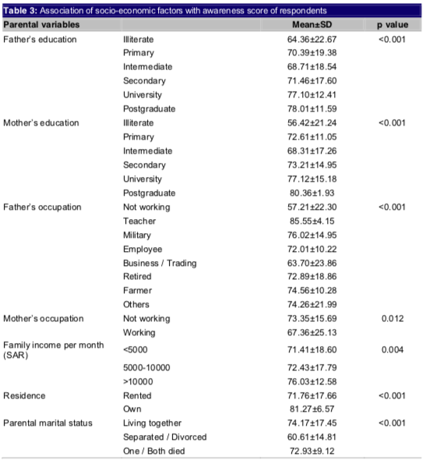
Studies in Saudi Arabia
2- Siddiqui A, Salim A. Awareness of substance use and its associated factors in young Saudi students. J Med Allied Sci [Internet] 2016;6(2):61. Available from: http://www.scopemed.org/fulltextpdf.php?mno=217010. [Google Scholar]

Slide 54
Role of PHC physician in “smoking cessation clinic “
Case :
55 year old male smoker known case of COPD and Diabetes .
He reported smoking 40 cigarettes/D for 30 years .
He had attempted to quit smoking more than 2 times
He had tried varenicline , nicotine patch and nicotine gum . but nothing worked

Slide 55
How will you approach this patient ?
What are the points to be included in taking history?
What clinical examination could be performed for such a case?
What are the investigations that could be requested at this stage for the patient?
What is the management plan for such a case, including preventive measures if applied?

Slide 56
References
https://www.cdc.gov/tobacco/data_statistics/fact_sheets/fast_facts/index.htm
https://tobaccoatlas.org/country/saudi-arabia/
https://tobaccoatlas.org/topic/health-effects/
https://www.cdc.gov/tobacco/data_statistics/fact_sheets/health_effects/effects_cig_smoking/
https://onlinelibrary.wiley.com/doi/pdf/10.1111/j.1520-037X.2007.05963.x
https://www.aafp.org/afp/2002/0315/p1107.html#sec-3
https://www.aafp.org/afp/2012/0315/p591.html
https://www.who.int/tobacco/quitting/summary_data/en/
https://www.guidelines.co.uk/smoking-cessation/nice-smoking-cessation-guideline/454141.article
Ibrahim Y, Hussain SM, Alnasser S, Almohandes H, Sarhandi I. Patterns and sociodemographic characteristics of substance abuse in Al Qassim, Saudi Arabia:A retrospective study at a psychiatric rehabilitation center. Ann Saudi Med. 2018;38:319–25 (https://www.ncbi.nlm.nih.gov/pmc/articles/PMC6180213/#b3-asm-5-319)
Siddiqui A, Salim A. Awareness of substance use and its associated factors in young Saudi students. J Med Allied Sci [Internet] 2016;6(2):61. Available from: http://www.scopemed.org/fulltextpdf.php?mno=217010.

