Slide 1
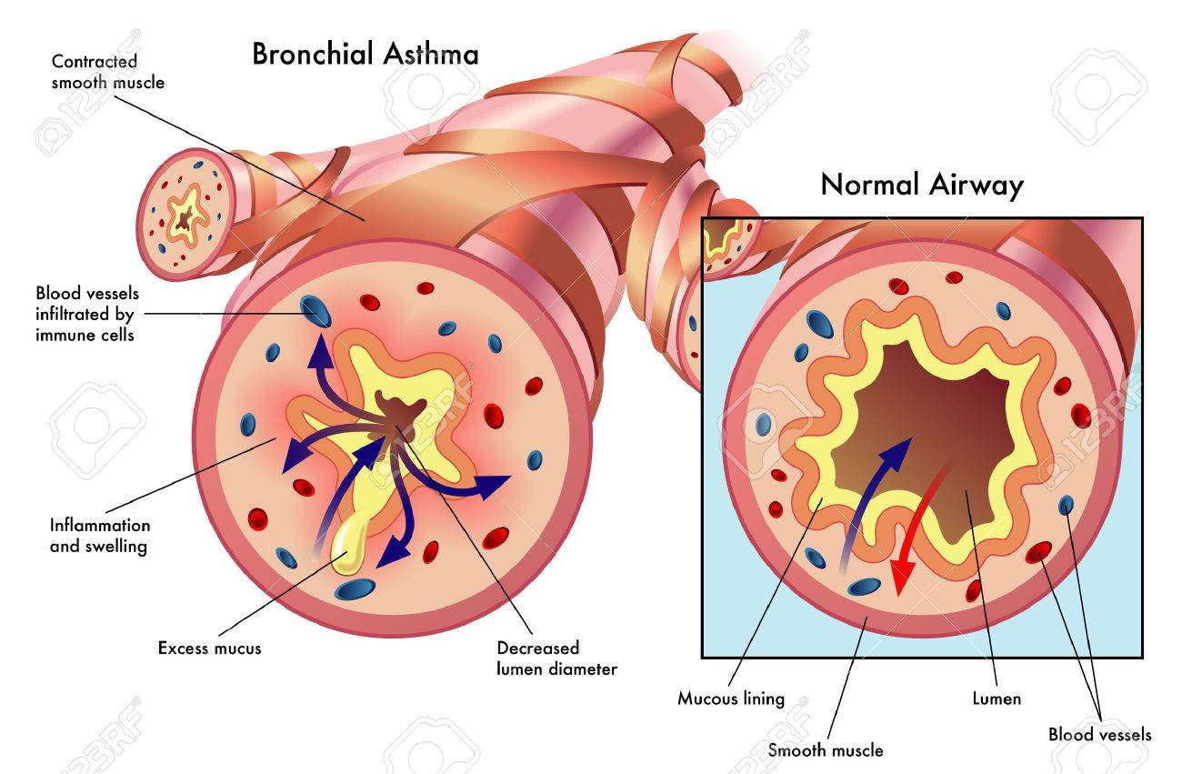
Bronchial Asthma
Team-Based Learning

Slide 2
Learning Objectives
By the end of this session, you should know:
What is Asthma? How common in KSA?
How to diagnose asthma in adults and children, according to the latest NICE (NG80) guidelines?
How to manage chronic asthma in adults and children in primary care?
How to identify patients at high risk of a life-threating asthma attack?
How to advise patients on the use of (different types of) inhalers?
Provide a comprehensive approach for the management of patients with asthma in family medicine.

Slide 3
What is Asthma?
Asthma is a common lung condition that causes occasional breathing difficulties.
It affects people of all ages and often starts in childhood, although it can also develop for the first time in adults.
There's currently no cure, but there are simple treatments that can help keep the symptoms under control, so it does not have a big impact on one’s life.

Slide 4
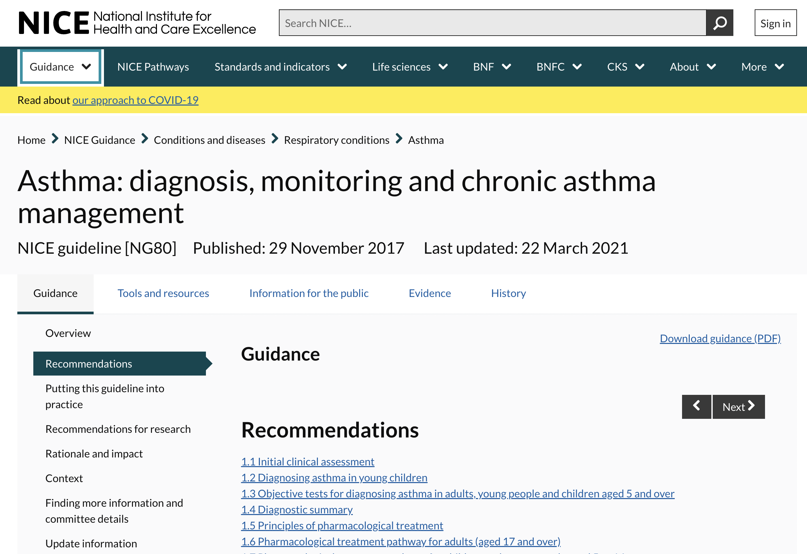

Slide 5
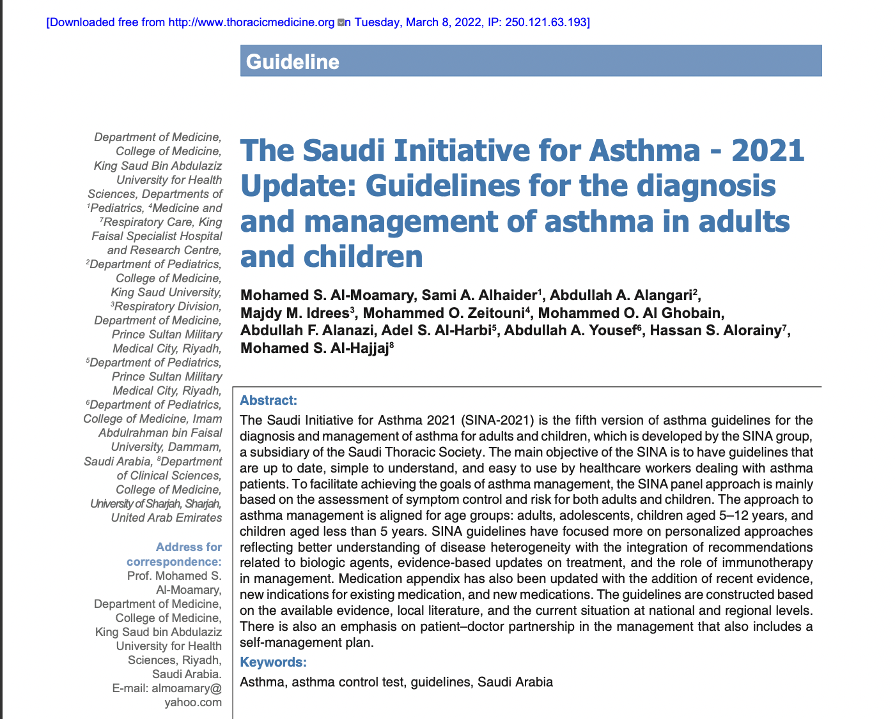

Slide 6
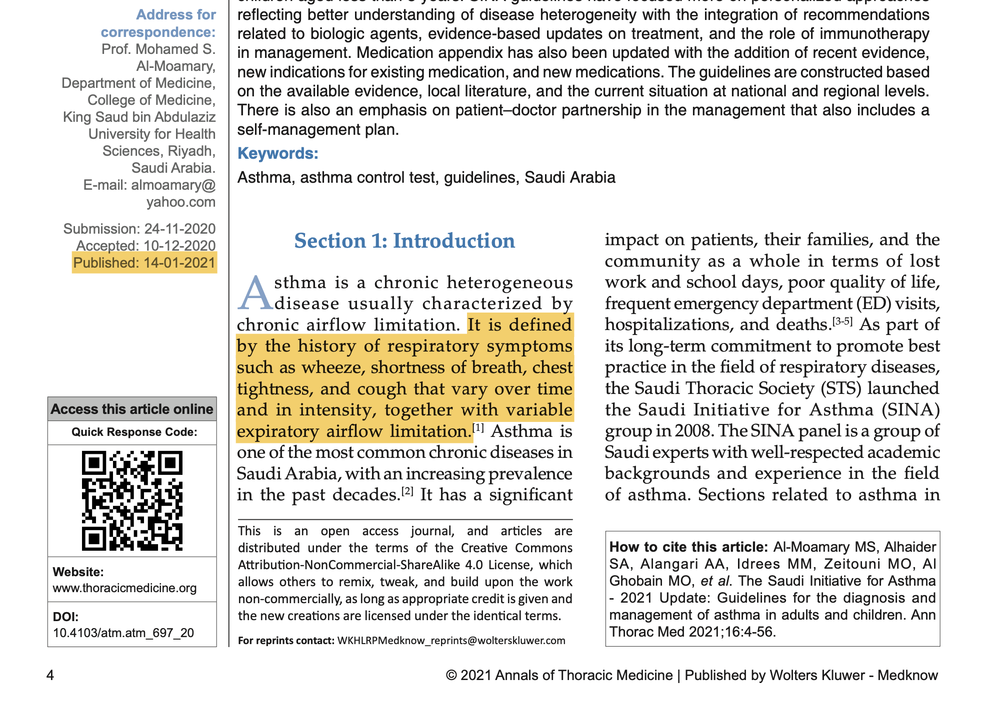

Slide 7
What Is Asthma? Saudi Initiative on Asthma (SINA)
Asthma is “defined by:
the history of respiratory symptoms such as wheeze, shortness of breath, chest tightness, and cough
that vary over time and in intensity
often with variable expiratory airflow limitation can be demonstrated.”
The Global Strategy for Asthma and Prevention 2020.

Slide 8
HOW COMMON IS ASTHMA IN KSA?

Slide 9
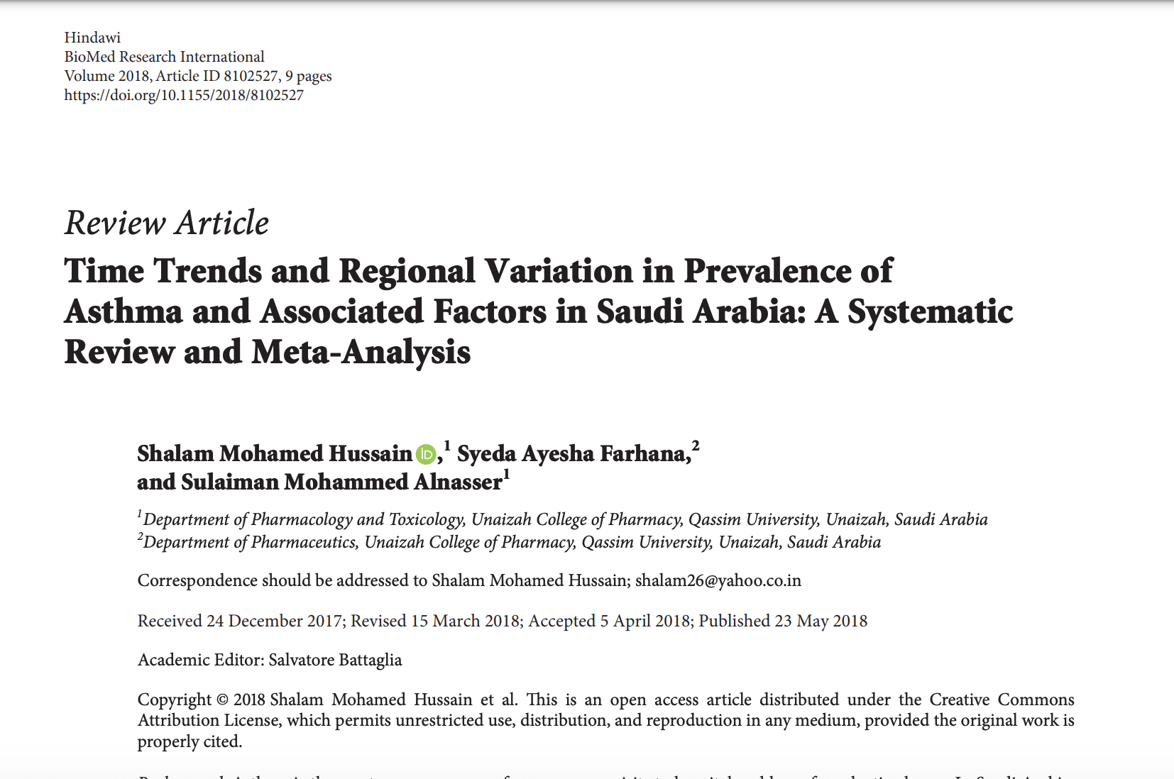

Slide 10
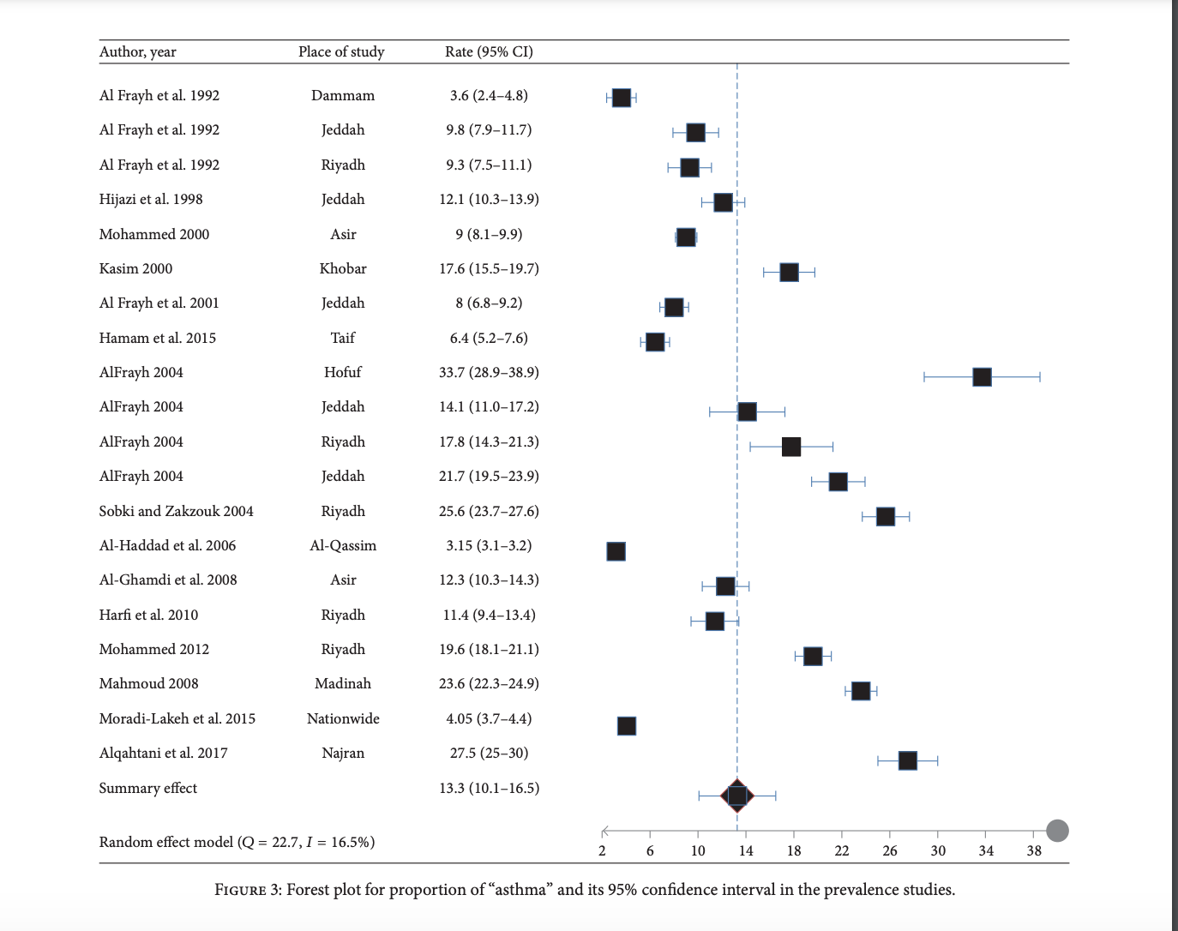

Slide 11
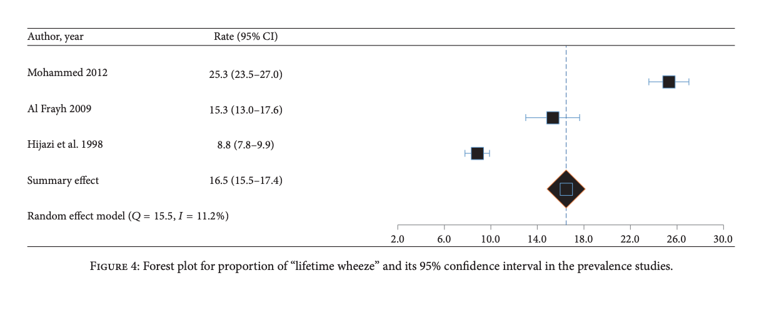

Slide 12
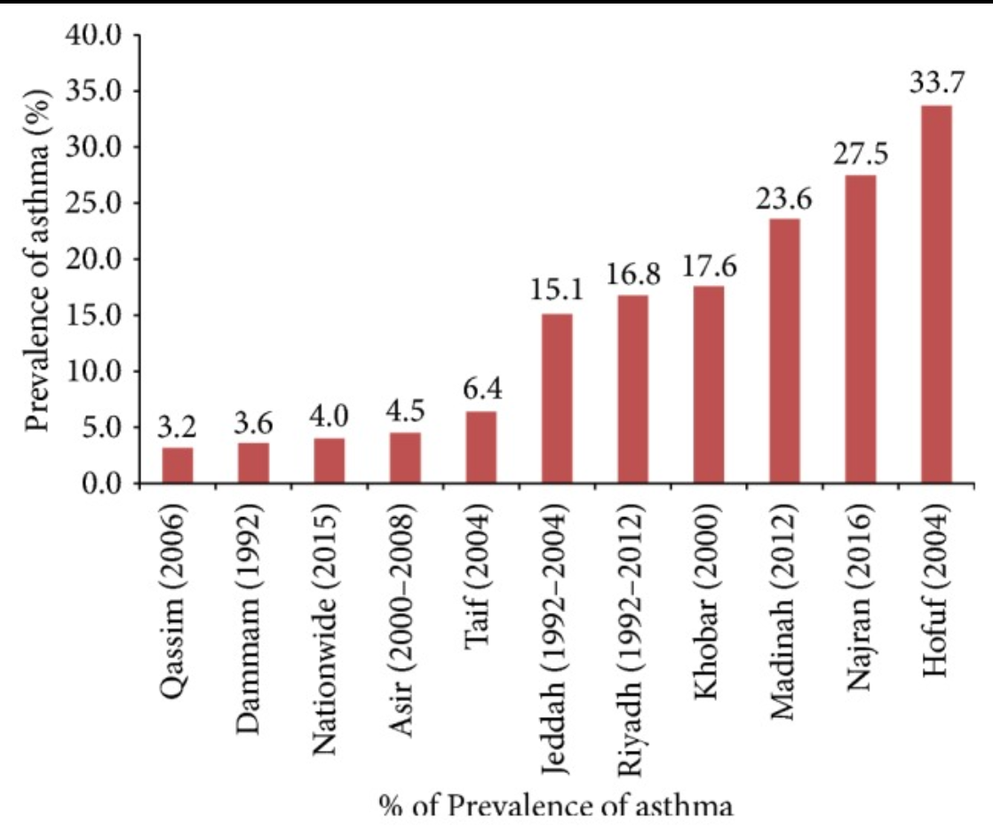

Slide 13
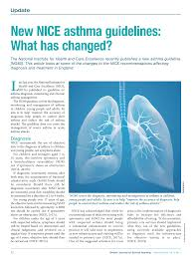
DIAGNOSIS OF ASTHMA IN CHILDREN AND ADULTS – NICE (NG80) GUIDELINES

Slide 14
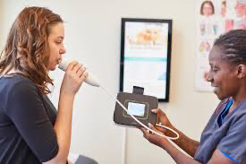
Forced Exhaling Nitric Oxide (FeNO)
https://youtu.be/c8e-vmZBWy8

Slide 15
Review Diagnosis Algorithm for adults (>17 yrs)
Algorithm C

Slide 16
Review Dx Algorithm for Older Children
Algorithm B

Slide 17
NICE Asthma Guidance on Diagnosis
OVERVIEW OF ASTHMA PATHWAYS
DIAGNOSTIC SUMMARY
https://pathways.nice.org.uk/pathways/asthma#path=view%3A/pathways/asthma/asthma-overview.xml&content=view-index
https://www.nice.org.uk/guidance/ng80/chapter/Recommendations#diagnostic-summary

Slide 18
Kareem
Kareem is a 22 year old fitness instructor who has come to see you following spirometry organised by your colleague. He seeks your advice about an ongoing cough that he hasn’t been able to shake off. He describes a non-productive cough which is most noticeable at night time and on waking.
He has also been aware of his breathing when fitness training, and has occasionally had to cut short his exercise due to a tight feeling in his chest.
He is usually very fit and well, troubled only by mild eczema. He has never smoked.

Slide 19
Kareem
On further questioning he says his mother and sister have asthma.
Respiratory examination today is normal, including normal observations. Spirometry five days ago, completed in the mid-afternoon, demonstrated no obstruction (normal).
Looking back at Kareem’s patient record, you note a peak flow taken two years ago which was significantly lower than his most recent value. At that time, your colleague also noted that Kareem had an audible wheeze.

Slide 20
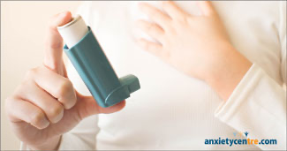
Sarah
Sarah, 35 years old, normally sees another family physician in your practice.
She is here today to get another salbutamol inhaler, as her current supply has run out.
Looking at her notes, she was first given a salbutamol inhaler five years ago when she reported wheeze on exertion.
Her notes say “?asthma”, but no firm diagnosis was recorded, and no reasoning for a diagnosis was recorded.

Slide 21
Sarah
She has no historical record of peak flow or FEV₁. She does not have hay fever or any other allergies, and neither does anyone in her family.
On examination her chest is clear with no audible wheeze.
She says her respiratory symptoms come on either just after she plays tennis or before she needs to give a presentation at work. She is also taking regular medication for anxiety.

Slide 22
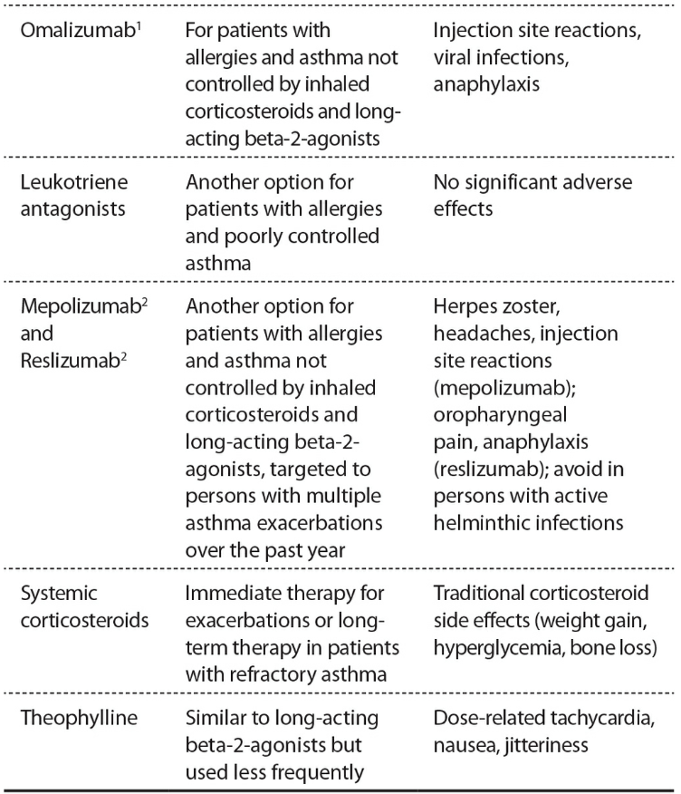
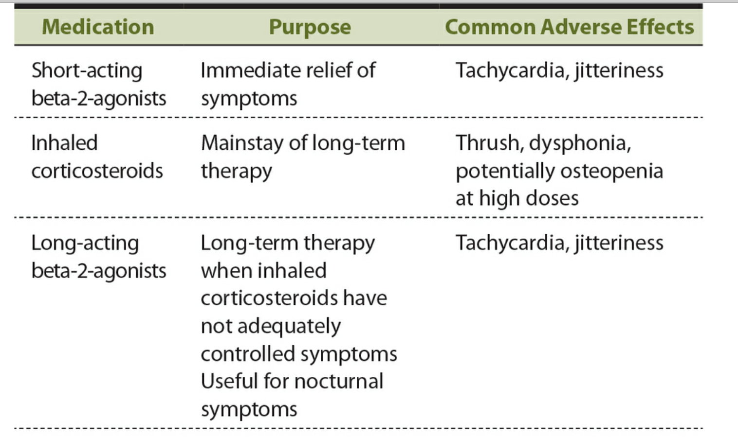
Pharmacotherapy of Asthma

Slide 23
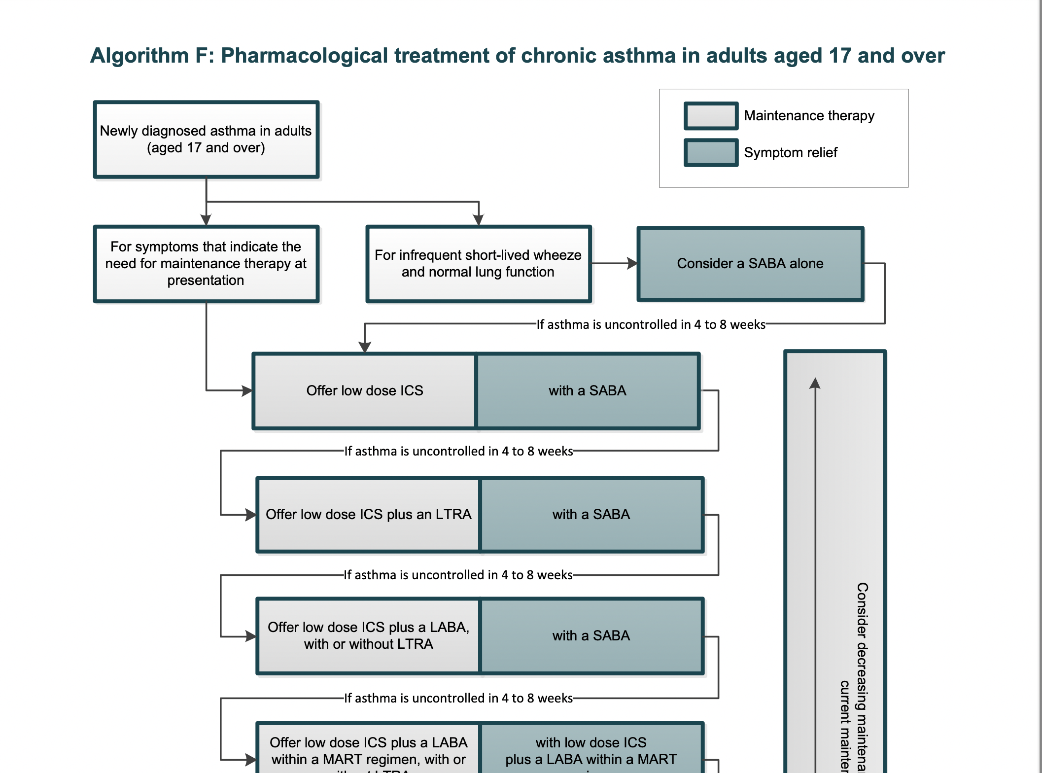
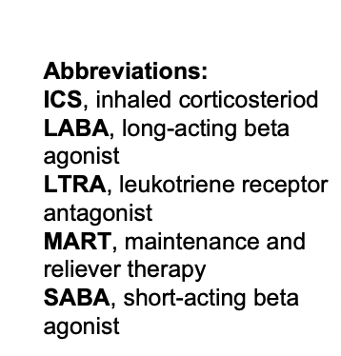

Slide 24
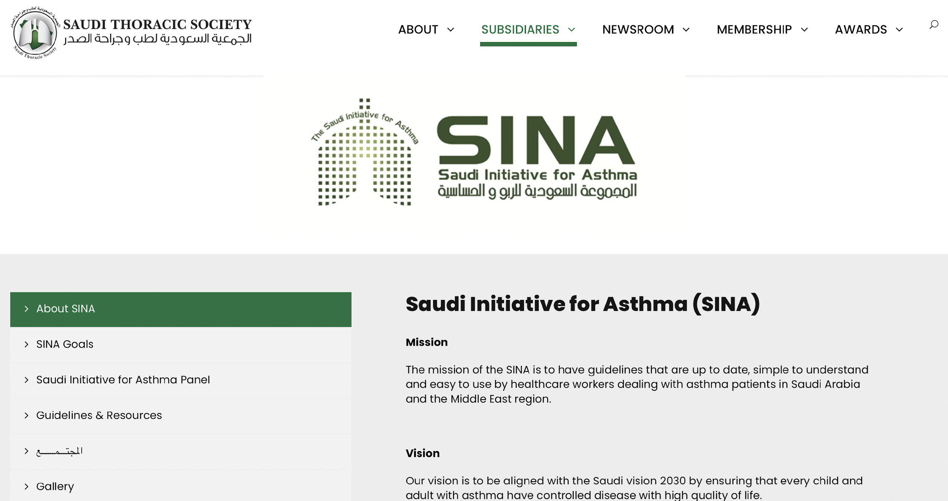

Slide 25
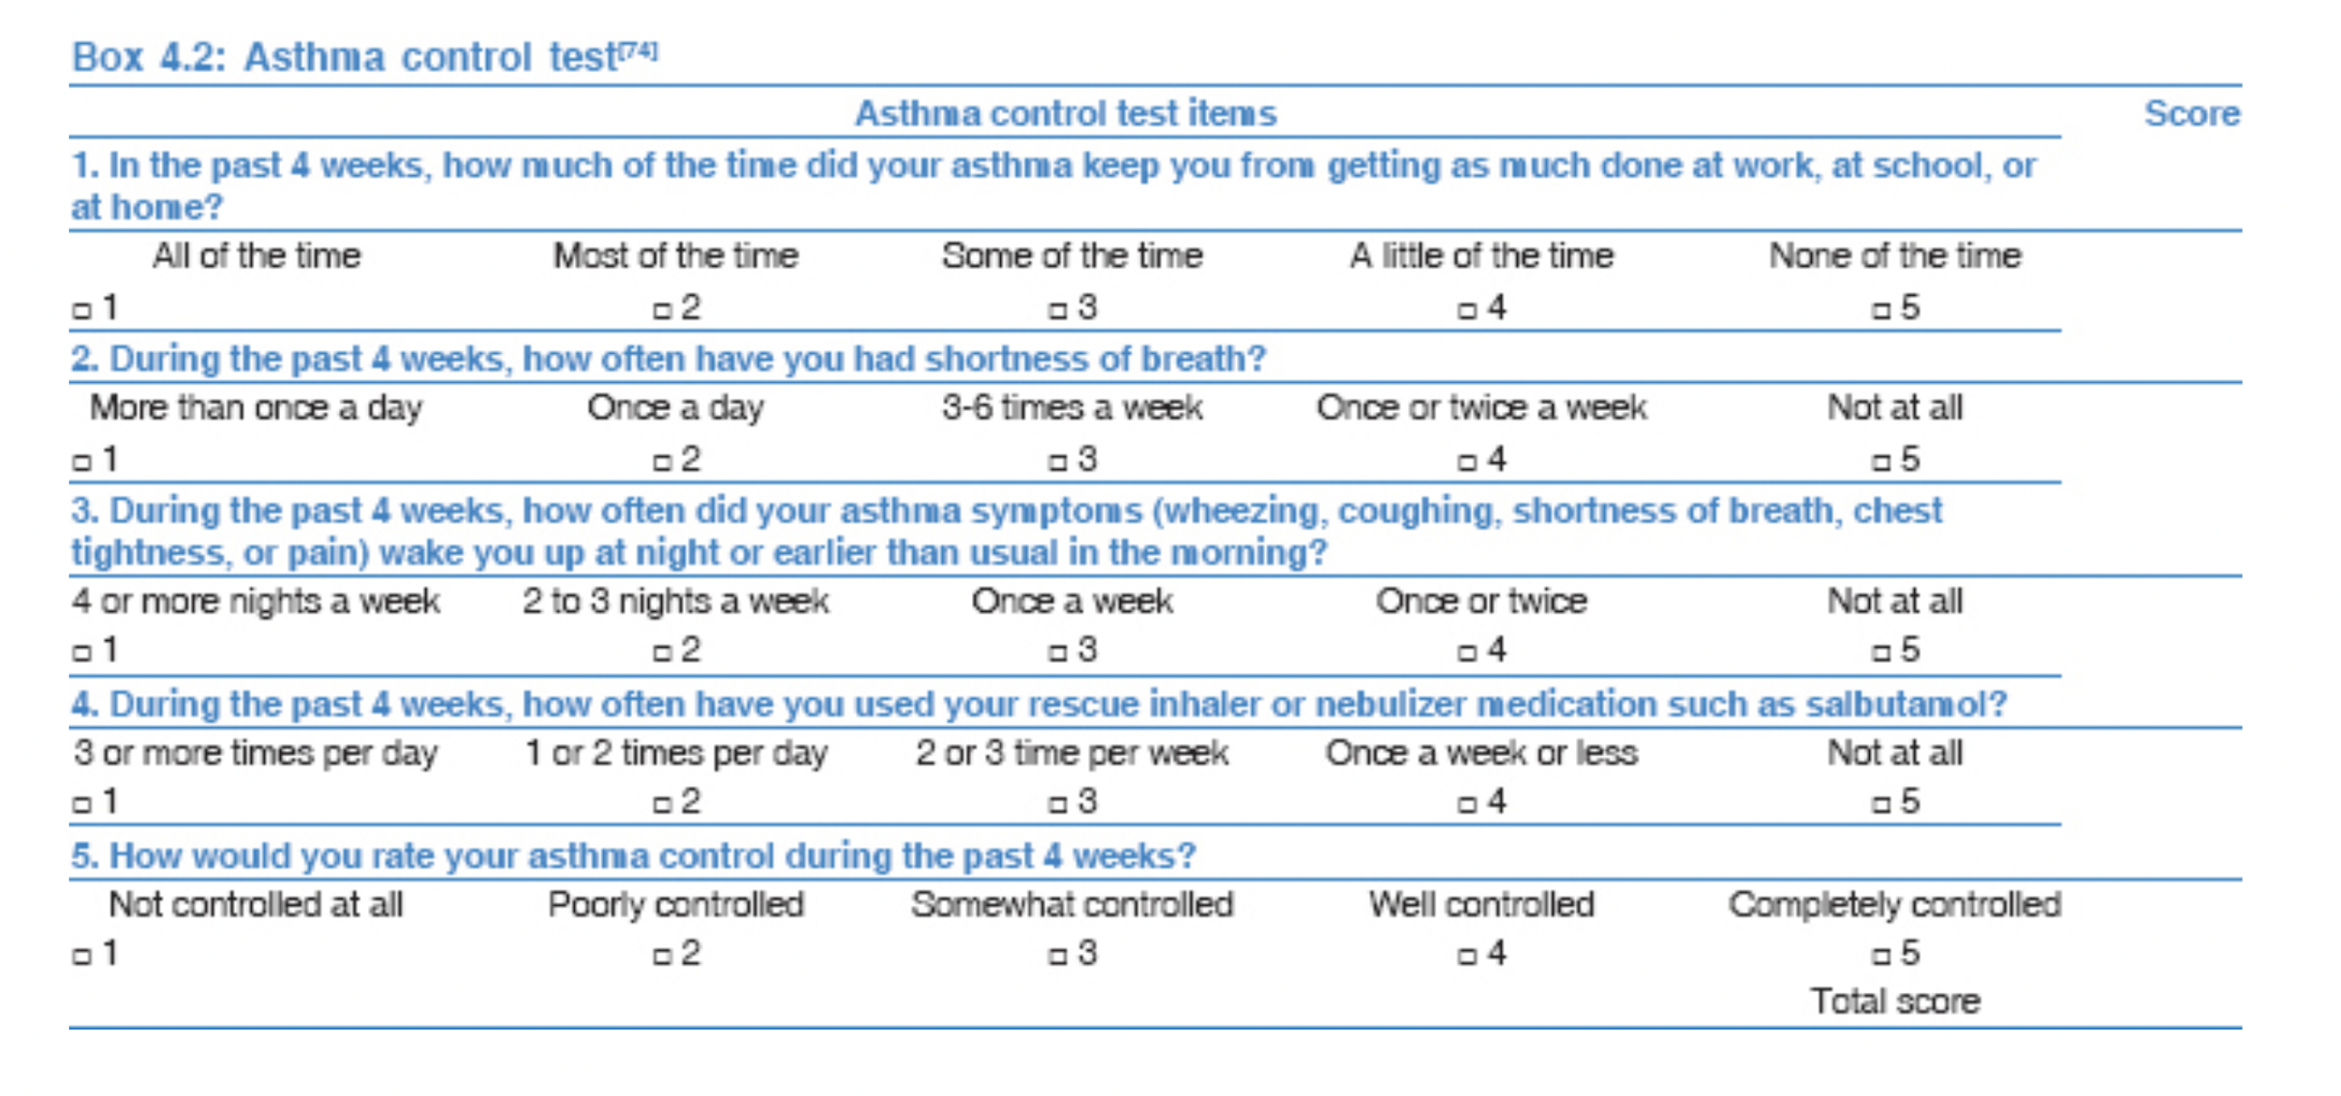

Slide 26
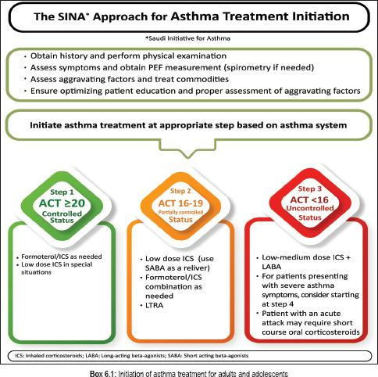

Slide 27
Red Flags in Asthma
How to identify patients who are at high risk of a life-threatening asthma attack?
Which asthma patients to refer?

Slide 28
Identified Features of Possible High risk of a Life-Threatening Asthma Attack include:
A retrospective analysis of series of deaths because of ~:
History of an asthma attack, particularly one treated in hospital.
Prescription of more than 12 short-acting beta-agonist inhalers (SABAs) per year.
The need to use a SABA regularly, especially more than once every four hours.
Prescription of insufficient preventer inhalers (such as inhaled corticosteroids (ICS)).
The need for 3 different asthma medications (in addition to a short-acting bronchodilator) to maintain control.
Concurrent mental health problems.

Slide 29
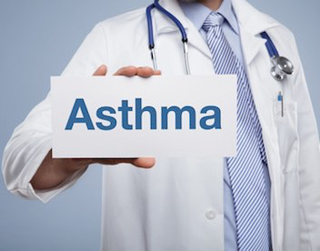
When to Refer to a Specialist?
Suspected occupational asthma
Poor response to treatment
Diagnostic uncertainty
If recommended tests, such as FeNO or bronchial challenge, are unavailable.

Slide 30
When to Refer to a Specialist?
Needed two courses of systemic corticosteroids in the past year.
Had two or more attendances at the emergency department for their asthma in the past year
A past admission to a high dependency unit for asthma
Poor symptom control despite correct inhaler technique and good adherence
Asthma with concurrent anaphylaxis or food allergy

Slide 31
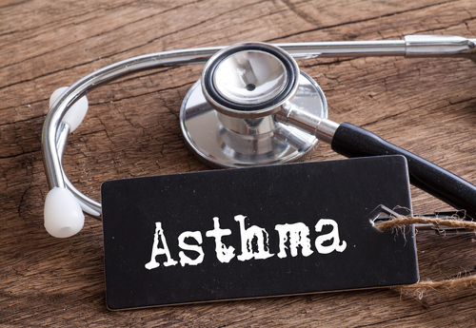
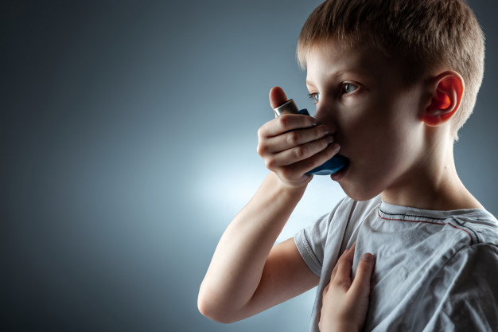
CAN ASTHMA BE MANAGED IN FAMILY MEDICINE?
Containing Asthma in Family Medicine
Notes:
If yes, what is his/her role?

Slide 32
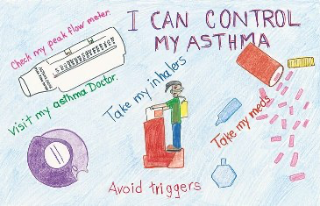
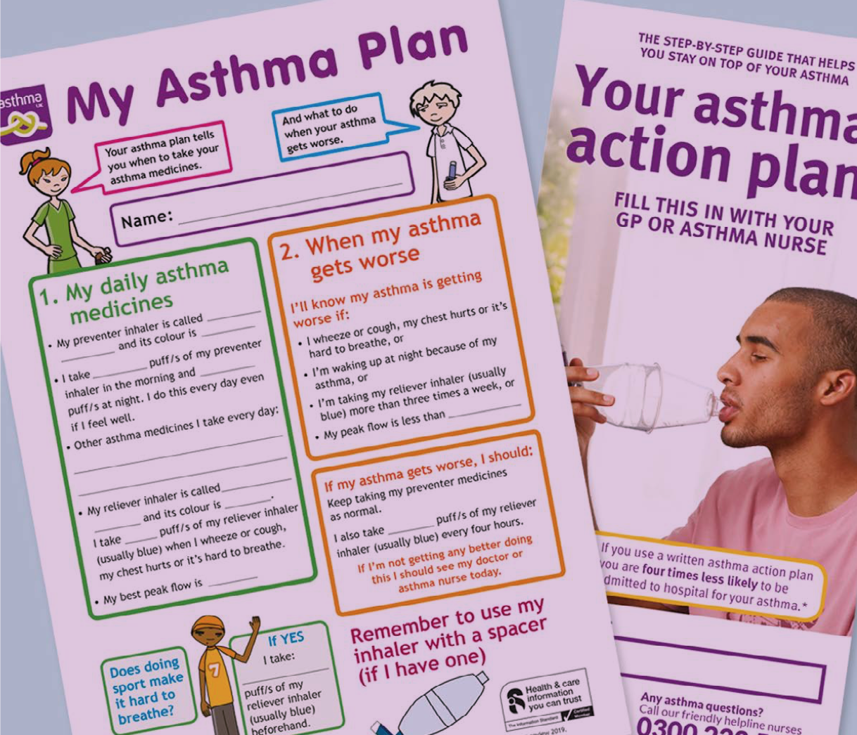
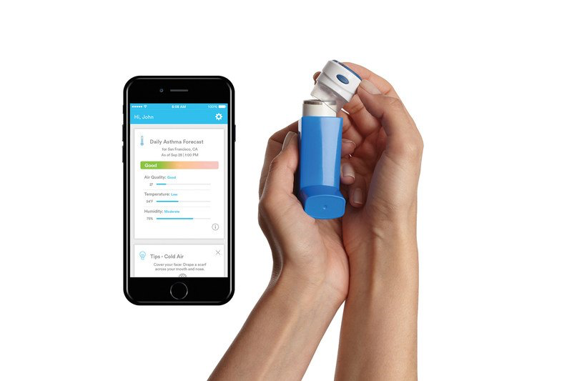
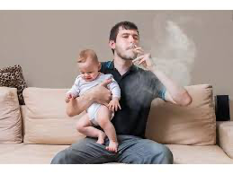
What Is The FP’s Role in Managing Asthma?

Slide 33
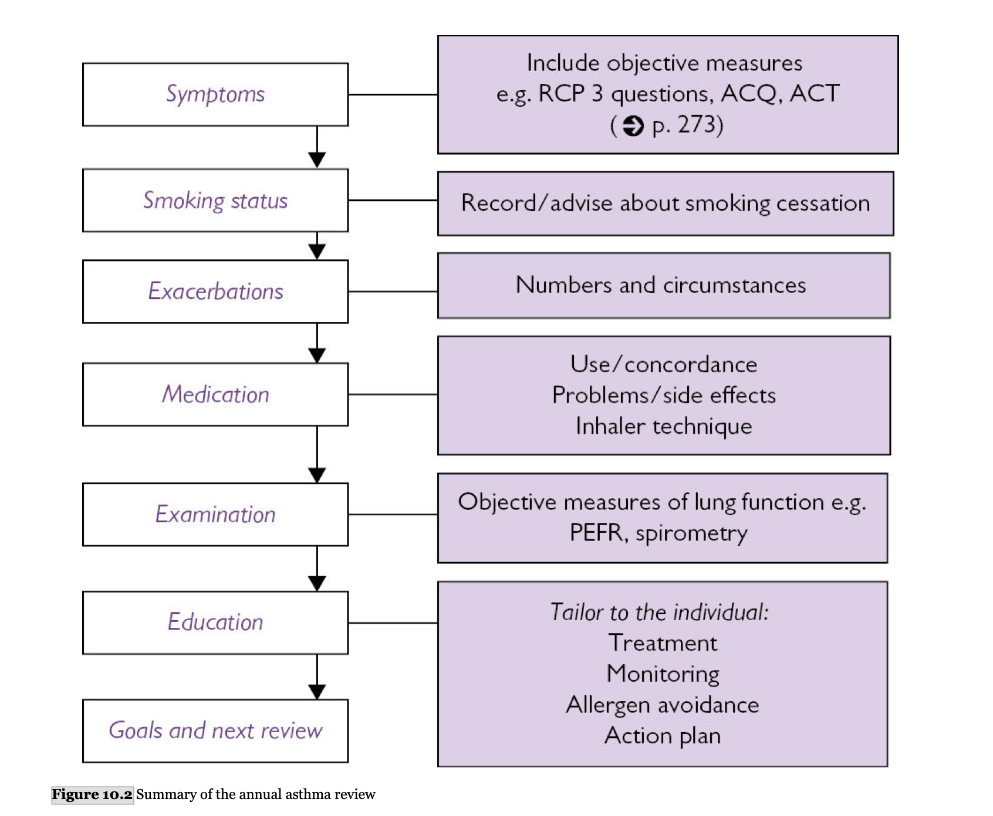
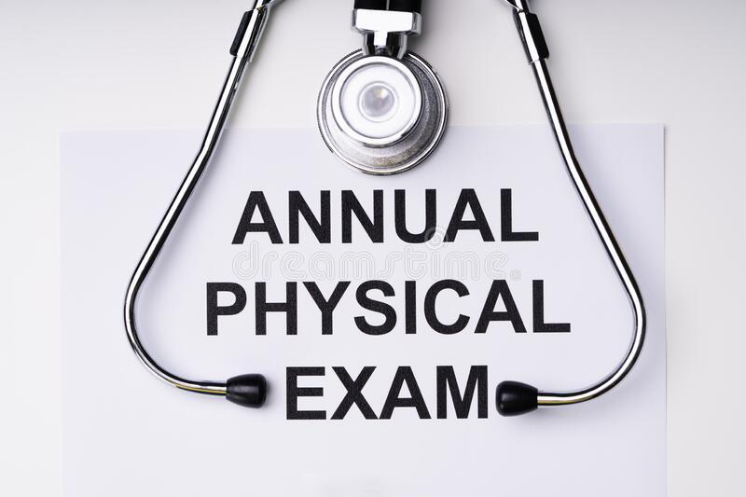
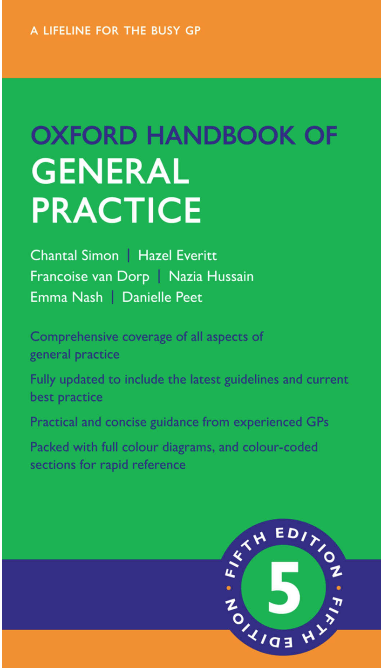
Notes:
RCP 3 questions Useful tool to identify patients with poor asthma control in general practice and monitor effect of changes of treatment. Morbidity categories correlate with lung function.
In the last month
• Have you had any difficulty sleeping because of your asthma symptoms (including cough)?
• Have you had your usual asthma symptoms during the day (cough, wheeze, chest tightness, or breathlessness)?
• Has your asthma interfered with your usual activities, e.g. housework, work/school, etc.?
NO to all questions = low morbidity 1 × YES answer = medium morbidity 2 or 3 × YES answer = high morbidity
Alternatives include the Asthma Control Questionnaire (ACQ) and Asthma Control Test (ACT)/Children’s Asthma Control Test. These questionnaires are not designed for use during an acute attack.
Simon, Chantal,Everitt, Hazel,van Dorp, Francoise,Hussain, Nazia,Nash, Emma,Peet, Danielle. Oxford Handbook of General Practice (Oxford Medical Handbooks) (p. 273). OUP Oxford. Kindle Edition.
Simon, Chantal,Everitt, Hazel,van Dorp, Francoise,Hussain, Nazia,Nash, Emma,Peet, Danielle. Oxford Handbook of General Practice (Oxford Medical Handbooks) (pp. 280-281). OUP Oxford. Kindle Edition. 5th edition 2021

Slide 34
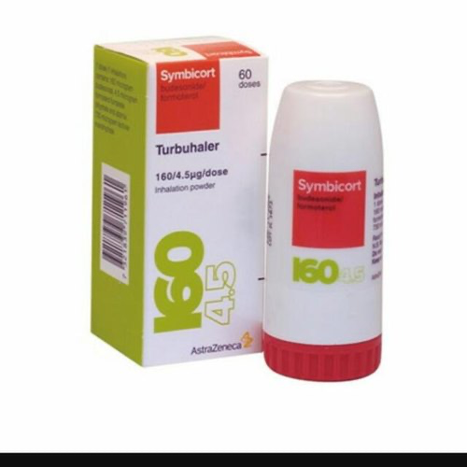
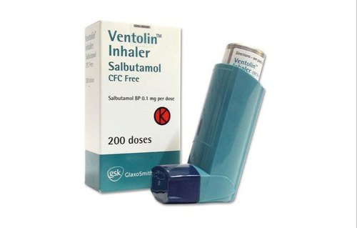
Observe and give advice on the person's inhaler technique:
at every consultation relating to an asthma attack
in all care settings when there is deterioration in asthma control
when the inhaler device is changed
at every annual review
if the person asks for it to be checked.
The Correct Use of Inhalers
https://www.nice.org.uk/guidance/ng80/resources

Slide 37
Thank you..

