Slide 1
Diabetes Mellitus
Dr Mohammed Batais
Associate Professor & Consultant , Family Medicine, Diabetes and Chronic Disease Management
King Saud University

Slide 2
Genetic predisposition
Insulin Resistance
(Hyperinsulinemia)
β Cell
Defect
IGT
Type 2 Diabetes
Usually 50% of β cells are functioning at time of diagnosis

Slide 4
Prevalence of DM in Saudi Arabia
A community-based study of 17232 subjects conducted between 1995 and 2000 in KSA.
The examining age group, 30-70 years of selected households during 5-year period
Mansour M. Al-Nozha et al,The prevalence of CAD among Saudis of both sexes, in rural as well as urban communities, as well as modifiable risk factors for CAD, Saudi Medical Journal 2004; Vol. 25 (9): 1165-1171

Slide 5
Prevalence of DM in Saudi Arabia
The overall prevalence of DM obtained from this study is 23.7% in KSA.
The prevalence in males and females were 26.2% and 21.5% respectively (p<0.00001).
A large number of diabetics 1116 (27.9%) were unaware of having DM.
Mansour M. Al-Nozha et al,The prevalence of CAD among Saudis of both sexes, in rural as well as urban communities, as well as modifiable risk factors for CAD. Saudi Medical Journal 2004; Vol. 25 (9): 1165-1171

Slide 6
CLASSIFICATION AND DIAGNOSIS OF DIABETES
Type 1 diabetes (due to autoimmune β-cell destruction, usually leading to absolute insulin deficiency)
Type 2 diabetes (due to a progressive loss of β-cell insulin secretion frequently on the background of insulin resistance)

Slide 7
CLASSIFICATION AND DIAGNOSIS OF DIABETES
Gestational diabetes mellitus (GDM) (diabetes diagnosed in the second or third trimester of pregnancy that was not clearly overt diabetes prior to gestation)
Specific types of diabetes due to other causes, e.g., monogenic diabetes syndromes (such as neonatal diabetes and maturity-onset diabetes of the young), diseases of the exocrine pancreas (such as cystic fibrosis and pancreatitis), and drug-or chemical-induced diabetes (such as with glucocorticoid use, in the treatment of HIV/AIDS, or after organ transplantation)

Slide 8
Diagnostic Tests for Diabetes

Slide 9
Diagnosis

Slide 10
Pre-diabetes

Slide 11
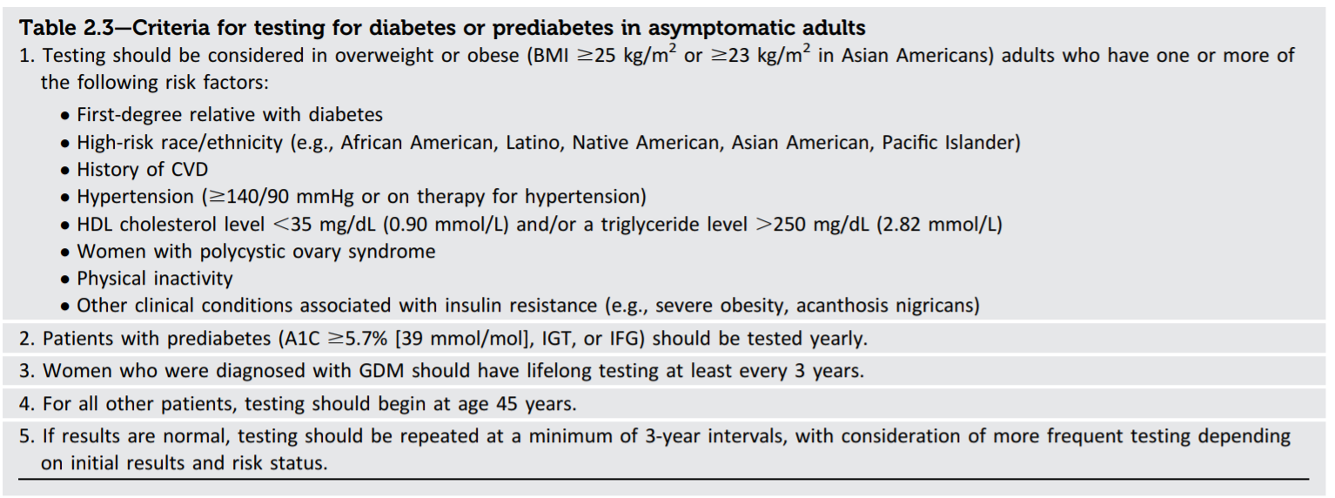
Screening for diabetes

Slide 12
PREVENTION OR DELAY OF TYPE 2 DIABETES

Slide 13
Recommendation
At least annual monitoring for the development of type 2 diabetes in those with prediabetes is suggested. E

Slide 14
1- Lifestyle Interventions
Recommendations
Refer patients with prediabetes to an intensive behavioral lifestyle intervention program modeled on the Diabetes Prevention Program to achieve and maintain 7% loss of initial body weight and increase moderate-intensity physical activity (such as brisk walking) to at least 150 min/week. A
Based on patient preference, technology-assisted diabetes prevention interventions may be effective in preventing type 2 diabetes and should be considered. B

Slide 15
2- Pharmacologic Interventions
Recommendation
Metformin therapy for prevention of type 2 diabetes should be considered in those with prediabetes, especially for those with BMI ≥35 kg/m2, those aged <60 years, and women with prior GDM. A

Slide 16
3- Prevention of Cardiovascular Disease
Recommendation
Prediabetes is associated with heightened cardiovascular risk; therefore, screening for and treatment of modifiable risk factors for cardiovascular disease is suggested. B

Slide 17
COMPREHENSIVE MEDICAL EVALUATION AND ASSESSMENT OF COMORBIDITIES

Slide 19
Comprehensive Medical Evaluation
Recommendations
A complete medical evaluation should be performed at the initial visit to: Confirm the diagnosis and classify diabetes. B
Evaluate for diabetes complications and potential comorbid conditions. B
Review previous treatment and risk factor control in patients with established diabetes. B
Begin patient engagement in the formulation of a care management plan. B
Develop a plan for continuing care. B

Slide 20
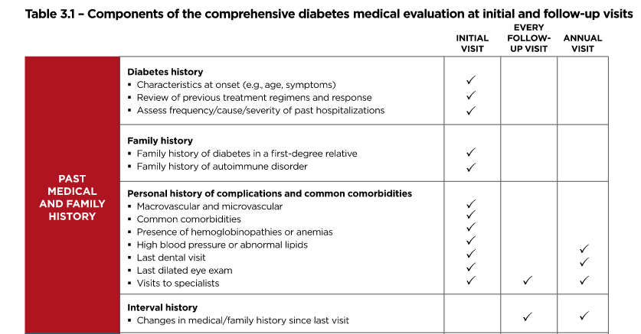

Slide 21
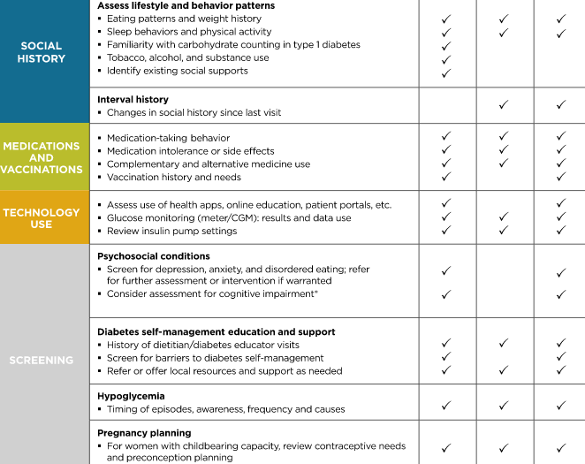

Slide 22
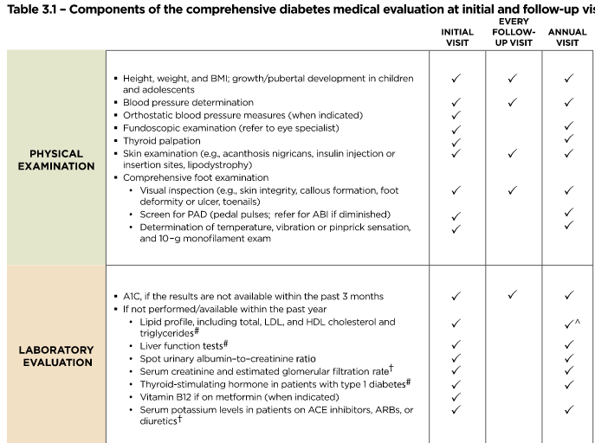

Slide 23
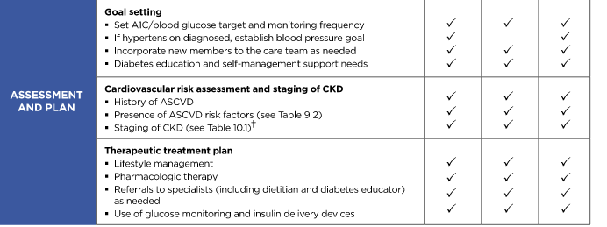

Slide 25
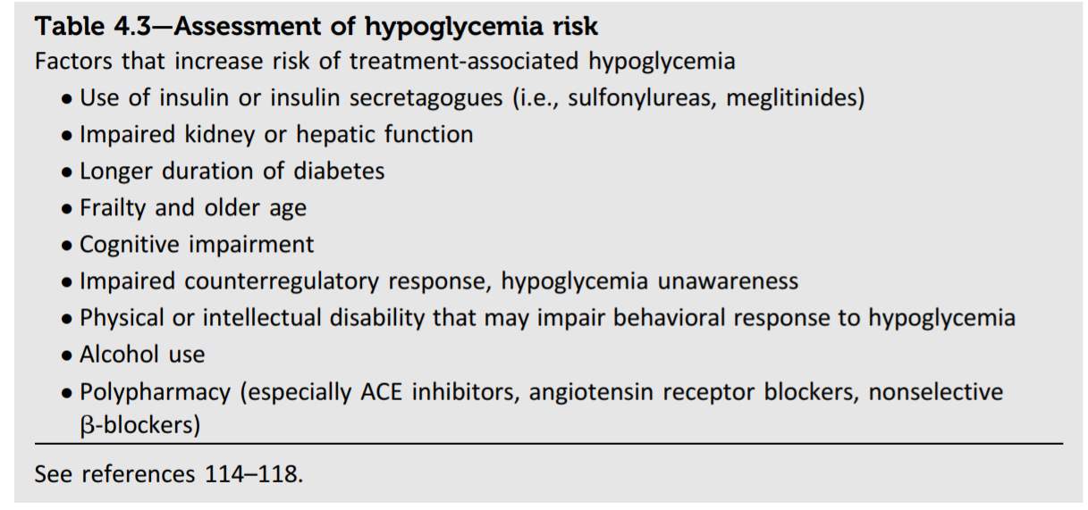

Slide 27
GLYCEMIC TARGETS

Slide 28
A1C Testing
Recommendations
Perform the A1C test at least two times a year in patients who are meeting treatment goals (and who have stable glycemic control). E
Perform the A1C test quarterly in patients whose therapy has changed or who are not meeting glycemic goals. E
Point-of-care testing for A1C provides the opportunity for more timely treatment changes. E

Slide 29
A1C Goals
Recommendations
A reasonable A1C goal for many nonpregnant adults is <7% (53 mmol/mol). A
Providers might reasonably suggest more stringent A1C goals (such as <6.5% [48 mmol/mol]) for selected individual patients if this can be achieved without significant hypoglycemia or other adverse effects of treatment (i.e., polypharmacy). Appropriate patients might include those with short duration of diabetes, type 2 diabetes treated with lifestyle or metformin only, long life expectancy, or no significant cardiovascular disease. C

Slide 30
Less stringent A1C goals (such as <8% [64 mmol/mol]) may be appropriate for patients with a history of level 3 hypoglycemia (altered mental and/or physical state requiring assistance), limited life expectancy, advanced microvascular or macrovascular complications, extensive comorbid conditions, or long-standing diabetes in whom the goal is difficult to achieve despite diabetes self-management education, appropriate glucose monitoring, and effective doses of multiple glucose-lowering agents including insulin. B
Reassess glycemic targets over time based on the criteria. E

Slide 32
Hypoglycemia
Level 1 hypoglycemia is defined as a measurable glucose concentration <70 mg/dL (3.9 mmol/L).
Level 2 hypoglycemia (defined as a blood glucose concentration <54 mg/dL [3.0 mmol/L]) is the threshold at which neuroglycopenic symptoms begin to occur and requires immediate action to resolve the hypoglycemic event.
Level 3 hypoglycemia is defined as a severe event characterized by altered mental and/or physical functioning that requires assistance from another person for recovery.

Slide 33
Recommendations
Individuals at risk for hypoglycemia should be asked about symptomatic and asymptomatic hypoglycemia at each encounter. C
Glucose (15–20 g) is the preferred treatment for the conscious individual with blood glucose <70 mg/dL (3.9 mmol/L), although any form of carbohydrate that contains glucose may be used. Fifteen minutes after treatment, if SMBG shows continued hypoglycemia, the treatment should be repeated. Once SMBG returns to normal, the individual should consume a meal or snack to prevent recurrence of hypoglycemia. E

Slide 34
Glucagon should be prescribed for all individuals at increased risk of level 2 hypoglycemia, defined as blood glucose <54 mg/dL (3.0 mmol/L), so it is available should it be needed. Caregivers, school personnel, or family members of these individuals should know where it is and when and how to administer it. Glucagon administration is not limited to health care professionals. E
Hypoglycemia unawareness or one or more episodes of level 3 hypoglycemia should trigger reevaluation of the treatment regimen. E

Slide 35
Insulin-treated patients with hypoglycemia unawareness or an episode of level 2 hypoglycemia should be advised to raise their glycemic targets to strictly avoid hypoglycemia for at least several weeks in order to partially reverse hypoglycemia unawareness and reduce risk of future episodes. A
Ongoing assessment of cognitive function is suggested with increased vigilance for hypoglycemia by the clinician, patient, and caregivers if low cognition or declining cognition is found. B

Slide 36
CARDIOVASCULAR DISEASE AND RISK MANAGEMENT

Slide 37
Hypertension/Blood Pressure Control
Recommendations for Screening and Diagnosis
Blood pressure should be measured at every routine clinical visit. Patients found to have elevated blood pressure (≥140/90 mmHg) should have blood pressure confirmed using multiple readings, including measurements on a separate day, to diagnose hypertension. B
All hypertensive patients with diabetes should monitor their blood pressure at home. B

Slide 38
Cardiovascular Disease
Recommendations for Screening
In asymptomatic patients, routine screening for coronary artery disease is not recommended as it does not improve outcomes as long as ASCVD risk factors are treated. A
Consider investigations for coronary artery disease in the presence of any of the following: atypical cardiac symptoms (e.g., unexplained dyspnea, chest discomfort); signs or symptoms of associated vascular disease including carotid bruits, transient ischemic attack, stroke, claudication, or peripheral arterial disease; or electrocardiogram abnormalities (e.g., Q waves). E

Slide 39
Recommendations: Antiplatelet Agents
Consider aspirin therapy (75–162 mg/day) C
As a primary prevention strategy in those with type 1 or type 2 diabetes at increased cardiovascular risk
Includes most men or women with diabetes age ≥50 years who have at least one additional major risk factor, including:
Family history of premature ASCVD
Hypertension
Smoking
Dyslipidemia
Albuminuria
American Diabetes Association Standards of Medical Care in Diabetes. Cardiovascular disease and risk management. Diabetes Care 2017; 40 (Suppl. 1): S75-S87
Notes:
Aspirin has been shown to be effective in reducing cardiovascular morbidity and mortality in high-risk patients with previous MI or stroke (secondary prevention). Its net benefit in primary prevention among patients with no previous cardiovascular events is more controversial, both for patients with and without diabetes.
Multiple recent well-conducted studies and meta-analyses reported a risk of heart disease and stroke that is equivalent if not higher in women compared to men with diabetes, including among non-elderly adults. Thus, the recommendations for using aspirin as primary prevention are now revised to include both men and women aged 50 years or older with diabetes and one or more major risk factors, to reflect these more recent findings.
Recommendations for the use of antiplatelet agents are summarized in three slides.
Consider aspirin therapy as a primary prevention strategy in those with type 1 and type 2 diabetes who are at increased cardiovascular risk. This includes most men or women with diabetes aged 50 years and up who have at least one additional major risk factor (such as family history of premature ASCVD, hypertension, smoking, dyslipidemia, or albuminuria) and are not at increased risk of bleeding.
[SLIDE}
39
References
American Diabetes Association. Standards of medical care in diabetes—2014. Diabetes Care 2014;37(suppl 1):S40–S41
Pignone M, Alberts MJ, Colwell JA, et al.; American Diabetes Association; American Heart Association; American College of Cardiology Foundation. Aspirin for primary prevention of cardiovascular events in people with diabetes: a position statement of the American Diabetes Association, a scientific statement of the American Heart Association, and an expert consensus document of the American College of Cardiology Foundation. Diabetes Care 2010;33:1395–1402

Slide 40
Recommendations: Antiplatelet Agents (2)
Aspirin is not recommended for ASCVD prevention for adults with DM at low ASCVD risk, since potential adverse effects from bleeding likely offset potential benefits. C
Low risk: such as in men or women with diabetes aged <50 years with no major additional ASCVD risk factors)
In patients with diabetes <50 years of age with multiple other risk factors (e.g., 10-year risk 5–10%), clinical judgment is required. E
American Diabetes Association Standards of Medical Care in Diabetes. Cardiovascular disease and risk management. Diabetes Care 2017; 40 (Suppl. 1): S75-S87
Notes:
Aspirin is not recommended for those at low risk of ASCVD (such as men and women with diabetes under age 50 years with no other major ASCVD risk factors; 10-year ASCVD risk under 5%) as the low benefit is likely to be outweighed by the risks of significant bleeding.
Clinical judgment should be used for those at intermediate risk such as younger patients with one or more risk factors or older patients with no risk factors until further research is available. Aspirin use in patients under the age of 21 years is contraindicated due to the associated risk of Reye syndrome.
[SLIDE]
40
Reference
American Diabetes Association. Standards of medical care in diabetes—2014. Diabetes Care 2014;37(suppl 1):S40–S41

Slide 41
Recommendations: Antiplatelet Agents (3)
Use aspirin therapy (75–162 mg/day) as secondary prevention in those with diabetes and history of ASCVD. A
For patients w/ ASCVD & aspirin allergy, clopidogrel (75 mg/day) should be used. B
Dual antiplatelet therapy is reasonable for up to a year after an acute coronary syndrome. B
American Diabetes Association Standards of Medical Care in Diabetes. Cardiovascular disease and risk management. Diabetes Care 2017; 40 (Suppl. 1): S75-S87
Notes:
Average daily dosages used in most clinical trials involving patients with diabetes ranged from 50 to 650 mg but were mostly in the range of 100 to 325 mg/day. There is little evidence to support any specific dose, but using the lowest possible dose may help reduce side effects
Use aspirin therapy (75–162 mg/day) as a secondary prevention strategy in those with diabetes and a history of ASCVD.
For patients with ASCVD and documented aspirin allergy, clopidogrel (75 mg/day) should be used.
Dual antiplatelet therapy is reasonable for up to a year after an acute coronary syndrome.
[SLIDE]
41
References
American Diabetes Association. Standards of medical care in diabetes—2014. Diabetes Care 2014;37(suppl 1):S40–S41
Vandvik PO, Lincoff AM, Gore JM, et al. Primary and secondary prevention of cardiovascular disease: Antithrombotic Therapy and Prevention of Thrombosis, 9th ed: American College of Chest Physicians Evidence-Based Clinical Practice Guidelines. Chest 2012;141:e637S–e668S

Slide 42
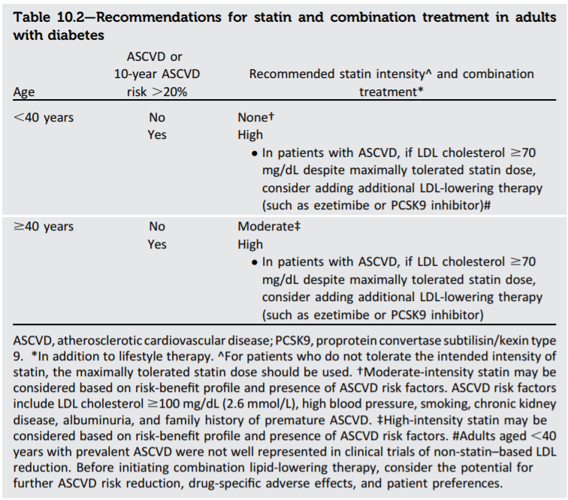
Lipid management in diabetic patients

Slide 43
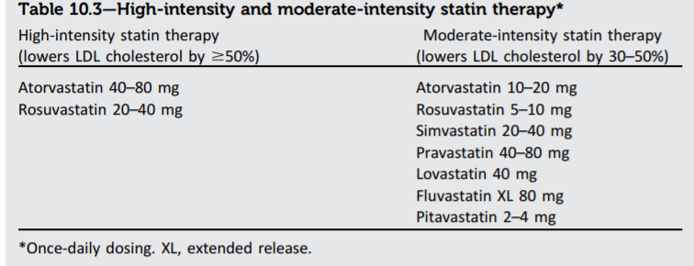

Slide 44
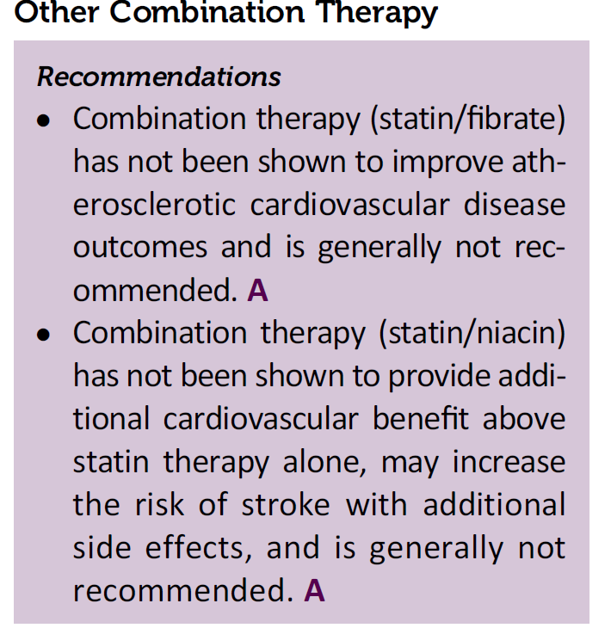

Slide 45
MICROVASCULAR COMPLICATIONS AND FOOT CARE

Slide 46
Chronic Kidney Disease
Recommendations for Screening
At least once a year, assess urinary albumin (e.g., spot urinary albumin-to-creatinine ratio) and eGFR in patients with type 1 diabetes with duration of ≥5 years, in all patients with type 2 diabetes, and in all patients with comorbid hypertension. B

Slide 47
Diabetic Retinopathy
Recommendations
Optimize glycemic control to reduce the risk or slow the progression of diabetic retinopathy. A
Optimize blood pressure and serum lipid control to reduce the risk or slow the progression of diabetic retinopathy. A

Slide 48
Screening
Adults with type 1 diabetes should have an initial dilated and comprehensive eye examination by an ophthalmologist or optometrist within 5 years after the onset of diabetes. B
Patients with type 2 diabetes should have an initial dilated and comprehensive eye examination by an ophthalmologist or optometrist at the time of the diabetes diagnosis. B
If there is no evidence of retinopathy for one or more annual eye exam and glycemia is well controlled, then exams every 1–2 years may be considered. If any level of diabetic retinopathy is present, subsequent dilated retinal examinations should be repeated at least annually by an ophthalmologist or optometrist. If retinopathy is progressing or sight-threatening, then examinations will be required more frequently. B

Slide 49
Telemedicine programs that use validated retinal photography with remote reading by an ophthalmologist or optometrist and timely referral for a comprehensive eye examination when indicated can be an appropriate screening strategy for diabetic retinopathy. B
Women with preexisting type 1 or type 2 diabetes who are planning pregnancy or who are pregnant should be counseled on the risk of development and/or progression of diabetic retinopathy. B
Eye examinations should occur before pregnancy or in the first trimester in patients with preexisting type 1 or type 2 diabetes, and then patients should be monitored every trimester and for 1-year postpartum as indicated by the degree of retinopathy. B

Slide 50
Neuropathy
Recommendations for Screening
All patients should be assessed for diabetic peripheral neuropathy starting at diagnosis of type 2 diabetes and 5 years after the diagnosis of type 1 diabetes and at least annually thereafter. B
Assessment for distal symmetric polyneuropathy should include a careful history and assessment of either temperature or pinprick sensation (small-fiber function) and vibration sensation using a 128-Hz tuning fork (for large-fiber function). All patients should have annual 10-g monofilament testing to identify feet at risk for ulceration and amputation. B
Symptoms and signs of autonomic neuropathy should be assessed in patients with microvascular complications. E

Slide 51
Foot Care
Recommendations
Perform a comprehensive foot evaluation at least annually to identify risk factors for ulcers and amputations. B
Patients with evidence of sensory loss or prior ulceration or amputation should have their feet inspected at every visit. C
Obtain a prior history of ulceration, amputation, Charcot foot, angioplasty or vascular surgery, cigarette smoking, retinopathy, and renal disease and assess current symptoms of neuropathy (pain, burning, numbness) and vascular disease (leg fatigue, claudication). B
The examination should include inspection of the skin, assessment of foot deformities, neurological assessment (10-g monofilament testing with at least one other assessment: pinprick, temperature, vibration), and vascular assessment including pulses in the legs and feet. B

Slide 52
Patients with symptoms of claudication or decreased or absent pedal pulses should be referred for ankle-brachial index and for further vascular assessment as appropriate. C
A multidisciplinary approach is recommended for individuals with foot ulcers and high-risk feet (e.g., dialysis patients and those with Charcot foot or prior ulcers or amputation). B
Refer patients who smoke or who have histories of prior lower-extremity complications, loss of protective sensation, structural abnormalities, or peripheral arterial disease to foot care specialists for ongoing preventive care and lifelong surveillance. C
Provide general preventive foot self-care education to all patients with diabetes. B
The use of specialized therapeutic footwear is recommended for high-risk patients with diabetes including those with severe neuropathy, foot deformities, or history of amputation. B

Slide 53
Diabetes management:
Oral hypoglycemic medication.
Steps for DM treatment.

Slide 54
Non Pharmological
Diet
Exercise
Pharmological
Oral Hypoglycemic
Insulin
Notes:
Diet therapy and exercise:
They are the cornerstone for the management of diabetes
Their effect appears within 1-4 weeks
If they did not control hyperglycemia within 3-6 month, start
anti-diabetic agent .

Slide 57
PHYSICAL ACTIVITY
Children and adolescents with type 1 or type 2 diabetes or prediabetes should engage in 60 min/day or more of moderate- or vigorous-intensity aerobic activity, with vigorous muscle-strengthening and bone-strengthening activities at least 3 days/week. C
Most adults with type 1 C and type 2 B diabetes should engage in 150 min or more of moderate-to-vigorous intensity aerobic activity per week, spread over at least 3 days/week, with no more than 2 consecutive days without activity. Shorter durations (minimum 75 min/week) of vigorous-intensity or interval training may be sufficient for younger and more physically fit individuals.
Adults with type 1 C and type 2 B diabetes should engage in 2–3 sessions/week of resistance exercise on nonconsecutive days.
All adults, and particularly those with type 2 diabetes, should decrease the amount of time spent in daily sedentary behavior. B Prolonged sitting should be interrupted every 30 min for blood glucose benefits, particularly in adults with type 2 diabetes. C
Flexibility training and balance training are recommended 2–3 times/week for older adults with diabetes. Yoga and tai chi may be included based on individual preferences to increase flexibility, muscular strength, and balance. C

Slide 58
Drug therapy of diabetes
Pharmaological
Oral Hypoglycemic agents
Insulin

Slide 59
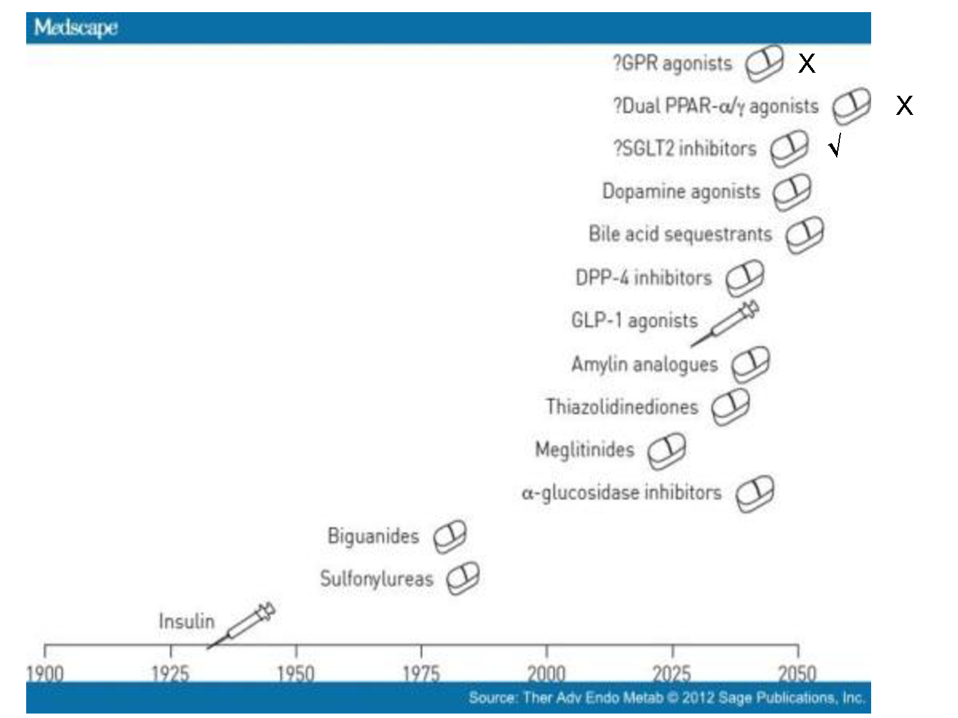

Slide 61
Type 2 DM Treatment Targets
↓glucose uptake
↑ lipolysis
Metformin Insulin TZDs
↑ glucose reabsorption
DPP-4i GLP-1 RA
Insulin Sulfonylureas
SGLT2i
↓insulin
β cell
Metformin Insulin TZDs
HYPERGLYCEMIA
α cell
↑ glucagon
DPP-4i GLP-1 RA
GLP-1 RA
Metformin DPP-4i GLP-1 RA TZDs
GLP-1 RA
↓ incretin effect
↑ glucose uptake
↑ hepatic glucose output
neurotransmitter dysfunction
DeFronzo RA. Diabetes. 2009;58(4):773-795

Slide 62
(OHA)
1-INSULIN-SENSITIZING AGENTS
reduce blood sugar by making the body’s tissues more sensitive to insulin.
Biguanides
Thiazolidinediones (TZD) / glitazone

Slide 63
Biguanides (Metformin)
PO | 500, 850, 1000 mg | Glucophage
PO | 500, 750 mg | Glucophage XR
DECREASE HGBA1C BY 1.0 to 2.0 %
The first line for oral treatment of type 2 diabetes
High efficacy with no hypoglycemia.
Notes:
1-a regular version which is taken at meal time, three times a day, and an extended release form
(marketed as ER or XR) which is taken once a day.
2-The ER version releases the drug more slowly and this usually eliminates the gastrointestinal problems.
3- the maximum dose of the ER is 2000 mg a day. That of the regular is 2550 mg/day
We begin with 500 mg once daily with the evening meal(HEAVY MEAL) and, if tolerated, add a second 500 mg dose with breakfast. The dose can be increased slowly (one tablet every one to two weeks) as necessary [27]. The usual effective dose is 1500 to 2000 mg/day per day

Slide 64
Biguanides (Metformin)
Disadvantages | Advantages
GI side effects | Weight neutral
Potential for vitamin B-12 def Lactic acidosis (rare) | No hypoglycemia
Discontinue during acute illness and before radiographic procedures requiring contrast | lipid-lowering activity
Contraindicated in Renal insufficiency (discontinue if eGFR < 30) | Decreased all-cause mortality and a decreased rate of (MI) in overweight and obese patients
Notes:
GI:metallic taste in the mouth, mild anorexia, nausea, abdominal discomfort, and soft bowel movements or diarrhea
lipid-lowering activity, :resulting in a decrease in serum triglyceride and free fatty acid concentrations, a small decrease in serum low-density-lipoprotein (LDL) cholesterol concentrations, and a very modest increase in serum high-density-lipoprotein (HDL) cholesterol concentrations
Observational data suggest that use of metformin decreases cancer incidence -a meta-analysis of randomized trials comparing metformin to a comparator (thiazolidinedione [TZD], sulfonylurea, dipeptidyl peptidase-IV [DPP-IV] inhibitor, or placebo) did not show a reduction in cancer incidence
requiring intravenous dye (may restart 48 hours after procedure if serum creatinine levels are unchanged
In a systematic review of 29 trials of metformin as monotherapy compared with other oral agents (sulfonylureas, thiazolidinediones [TZDs], meglitinides, glucosidase inhibitors), insulin, diet, or placebo, metformin resulted in decreased all-cause mortality and a decreased rate of myocardial infarction (MI) in overweight and obese patients with diabetes
reduces intestinal absorption of vitamin B12 in up to 30 percent of patients, and lowers serum vitamin B12 concentrations in 5 to 10 percent, but only rarely causes megaloblastic anemia
GFR 30 -60 DECRESE TO HALF DOSE

Slide 65
Thiazolidinediones (TZD)
Increase insulin sensitivity by acting on adipose, muscle, and liver to increase glucose utilization and decrease glucose production.
When used as monotherapy, they reduce hemoglobin (A1C) values by 1.5 %.
High efficacy with no hypoglycemia.
Show benefit in NASH
No dose adjustment

Slide 66
Thiazolidinediones (TZD)
Pioglitazone (Actos) 15, 30, 45 mg | Rosiglitazone(Avandia) 2, 4, 8 mg
Increase risk for bladder cancer | increased risk for cardiovascular event.(Progressive ischemia ,MI, HF) Increased LDL
OTHER ADVERSE EFFECT:
All thiazolidinediones cause weight gain
Fluid retention/heart failure (Peripheral edema occurs in 4 to 6 %)
FDA Black Box: CHF >> pioglitazone & rosiglitazone.
Decrease bone density and increase fracture risk, particularly in women
Not recommended in renal impairment due to fluid retention
Notes:
-activation of peroxisome proliferator-activated receptor (PPAR)-gamma in the central nervous system (WT GAIN)
The FDA currently recommends that patients receiving pioglitazone or rosiglitazone undergo baseline testing followed by periodic monitoring of liver function based upon clinical judgment.

Slide 67
2- Insulin Secretagogues
stimulate release of insulin from pancreatic beta cells
Sulfonylureas
Meglitinides

Slide 68
Sulfonylureas
Lower A1c by 1-2 %
High efficacy with risk of hypoglycemia.
Safe in CVD and renal impairment (except glyburide)

Slide 69
Sulfonylureas
2nd generation Sulfonylureas
Glipizide (minidab) | Glucotrol (OD or divided) Glucotrol XL (OD) | (2.5), 5, 10 mg (XL) | Up to 40 mg Up to 20 mg
Gliclazide | Diamcrone R (BID) /Glaze Diamcrone MR (OD) | 40,80 mg 30 , 60 mg | Up to 320 mg Up to120 mg
Glibenclamide (Glyburide) | Doanil Diatab | 2.5 , 5 mg | OD or BID Up to 10 mg
Notes:
1- 30 minutes before breakfast- Maximum single dose: 15 mg (2.5 for ir only)
2-Gliclazide is contraindicated in pregnancy
2-total daily dose may vary from 40-320mg. The dose should be adjusted according to the individual's response, commencing with 40-80mg daily and increasing until adequate control is achieved. A single dose should not exceed 160mg. When higher doses are required, gliclazide should be taken twice daily and according to the main meals of the day. (gliclazide)
2-from 30 to 120 mg taken orally in a single intake at breakfast time (mr) The interval between each dose increment should be at least 1 month except in patients whose blood glucose has not reduced after two weeks of treatment.
Dimacron r vs mr :( mr less risk of hypoglycemia – long acting od –low wt gain)
Switching from Diamicron 80 mg tablets to Diamicron 30 mg modified release 1 tablet of Diamicron 80 mg is comparable to 1 tablet of Diamicron 30 mg MR Tablets.
Dosing: Renal Impairment Mild to moderate impairment: Initial dosage adjustments are not required; adjust dose cautiously.
Severe impairment: Use is contraindicated.
Dosing: Hepatic Impairment Mild to moderate impairment: Initial dosage adjustments are not required; adjust dose cautiously.
Severe impairment: Use is contraindicated
given the relatively high incidence of hypoglycemia in patients taking glyburide or chlorpropamide, shorter acting drugs should be used, especially in older patients

Slide 70
3rd generation Sulfonylurea
Glimepiride | (Amaryl) | 1, 2, 4 mg | OD tablets Up to 8 mg
Side effects:
Hypoglycemia (most common)
Nausea, skin reactions (including photosensitivity)
Weight gain
Notes:
should be administered with breakfast or the first main meal(Glimepiride)

Slide 71
Meglitinides (Glinides)
0.5 before meal Max 4 mg before each meal | Repeglinide
120 mg immediately before each meal | Nateglinide
side effects:
Hypoglycemia & weight gain (less than sulfa )
Dosing frequency .
Repeglinide safe in pt. with decrease GFR or renal failure .
Notes:
*Meglitinides are pharmacologically distinct from sulfonylureas and may be used in patients who have an allergy to sulfonylurea medications.
(Repe)the dose should be skipped if the meal is missed.
There are no long-term studies of meglitinides to assess cardiovascular outcomes or mortality. Whether meglitinides are associated with poorer outcomes after a myocardial infarction is not known. However, since its mode of action is so similar to sulfonylureas, the same concern exists.

Slide 72
3- Incretin Based Therapy
DPP-4 inhibitors
GLP-1 receptor agonists

Slide 73
GLP-1 Effects in Humans
Understanding the Natural Role of Incretins
GLP-1 secreted upon the ingestion of food
Promotes satiety and
reduces appetite
DPP-4 inhibitor
DPP-4
enzyme
Alpha cells:
⬇Postprandial glucagon secretion
GLP-1 agonist
Inactive GLP-1
(GLP-1 t_{1/2} ~ 2 min)
Liver:
⬇Glucagon reduces
hepatic glucose output
Beta cells:
Enhances glucose-dependent insulin secretion
Adapted from Flint A, et al. J Clin Invest. 1998;101:515-520
Adapted from Larsson H, et al. Acta Physiol Scand. 1997;160:413-422 Adapted from Nauck MA, et al. Diabetologia. 1996;39:1546-1553 Adapted from Drucker DJ. Diabetes. 1998;47:159-169
Stomach:
Helps regulate gastric emptying

Slide 74
DPP-4 inhibitors
Reduce HbA1c between 0.6- 1.1%
Intermediate efficacy with no hypoglycemia
1-Sitagliptin | (Januvia) | 25, 50, 100 mg
2-Saxagliptin | (Onglyza) | 2.5, 5 mg
3-Vildagliptin | Galvas | 50 mg | OD –BID *
4-linagliptin | Tradjenta | 5 mg once daily
5-Alogliptin | Nesina, Kazano, | 25 mg once daily
Notes:
If DPP-4 inhibitors are going to be used in patients with chronic kidney disease (estimated glomerular filtration rate [eGFR] <30 mL/min), we prefer linagliptin because it is primarily eliminated via the enterohepatic system.
Cardiovascular effects — There are a growing number of trials evaluating the cardiovascular effects of DPP-4 inhibitors. Although these data are reassuring in that there does not appear to be an increased risk of adverse cardiovascular outcomes with short-term use of DPP-4 inhibitors used in combination with another oral agent, longer-term clinical trials are needed
Vildagliptin :it has not been approved by the US Food and Drug Administration (FDA). The usual dose is 50 mg twice daily when used as monotherapy, with metformin, or with a thiazolidinedione, and 50 mg once daily (in the morning) when used with a sulfonylurea

Slide 75
DPP-4 inhibitors
Require dose adjustment except Linagliptin
No effects on body weight or risk of hypoglycemia
Common SE :
Potential CV risk in saxagliptin and alogliptin.
Headache, nasopharyngitis, and upper respiratory tract infection
Joint pain, myalgias, muscle weakness, and muscle spasms.
Urticaria & angioedema
Acute pancreatitis

Slide 76
GLP-1 receptor agonists
BID Up to 10 BID once /week | 5 mcg subQ 2 mg subQ | EXENATIDE Extended-release:
Up to 1.8 mg OD | 0.6 mg subQ OD | LIRAGLUTIDE
Advantages :
High efficacy with no hypoglycemia
Weight reduction .
Decrease ASCVD in liraglutide > semaglutide > Exenatide ER
Side Effects:
GI side effect (nausea, vomiting, diarrhea )
Initiating / increasing dose >> Potential risk of AKI (liraglutide is safe)
FDA Black Box >> -cell hyperplasia/medullary thyroid tumors
Injectable >> injection site reaction.

Slide 78
Clinically Approved GLP-1 Receptor Agonists
SHORT-ACTING
LONG-ACTING
Exenatide extended
release QW
Exendin-4 derivatives (mimetics)
Exenatide BID
GLP1 analogs
Albiglutide QW
Liraglutide QD
Lixisenatide QD (EU approved)
Dulaglutide QW
Semaglutide QW

Slide 79
Considerations for incretin selection
Clinical variables | DPP-4 inhibitors | GLP1 RA
Glycemic effects
Effective A1C reduction | 0.5 – 1.0% above target | 1.0 – 1.5% above target
Fasting glucose reduction | 0 – 30 mg/dl | 20 – 70 mg/dl (long-acting > short-acting)
Post-prandial glucose reduction | < 60 mg/dl | 60 – 100 mg/dl (short-acting > long-acting)
Non-glycemic effects
Weight | neutral | 1– 4 kg decrease
Blood pressure | neutral | 0 - 3 mmHg decrease
Other
GI side effects | none | 5-20% nausea
Renal insufficiency | Linagliptin no dose adjustments | none indicated in severe renal insufficiency
Cost | $$ | $$$
Adapted from Nauck M. Diabetes, Obesity and Metabolism 2016; 18: 203–216

Slide 80
4- α Glucosidase Inhabitors
lowering (A1C) by only 0.4 to 0.9%
1-Acarbose: 50 and 100 mg TID
2-Miglitol
3-Voglibose
Slow absorption of glucose and reduce postprandial blood glucose concentration.
Side Effects: flatulence and diarrhea
Notes:
should be taken with the first bite of each meal.

Slide 81
5- SGLT-2 Inhibitors
Inhibit the reabsorption of glucose in the distal tubules of the kidney
Intermediate efficacy with no hypoglycemia
Dapagliflozin, Canagliflozin, Empagliflozin

Slide 82
Disadvantages | Advantages
FDA Black Box: risk of amputation (canagliflozin) | Weight loss
Risk of bone fracture (canagliflozin) | Good CV effect (empagliflozin and canagliflozin)
DKA risk (all agents, rare in T2DM) | lipid-lowering activity
Genitourinary infections | Delay progression of CKD (empagliflozin and canagliflozin)
Increase LDL cholestrol
Risk of volume depletion and hypotension

Slide 83
Adverse effects
Genitourinary tract
Hypotension
Acute kidney injury
Bone fracture
Diabetic ketoacidosis
Amputations

Slide 84
Insulin
Powerful agent
Necessary in 20-30%
Inexpensive
Weight gain
Hypoglycaemia
High level of patient fear

Slide 85
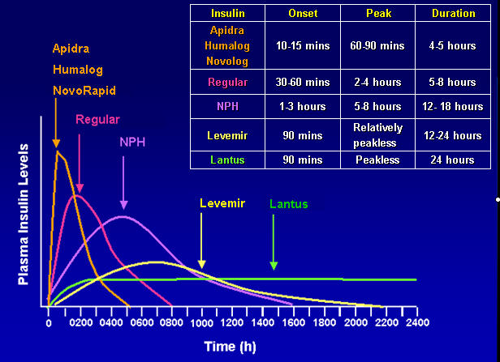

Slide 86
TREATMENT REGIMENS OF TYPE 1 DM
Conventional Insulin Therapy
Two injections of NPH and Regular Insulin
Mixed Insulin
Two injections of 70/30 or 60/40 or 50/50
Multiple Insulin Injections
1 or 2 injections of NPH plus 3 injections of Regular or Rapid Insulin.
One injection of Glargine or Detemir plus 3 injections of rapid insulin(Lispro /Aspart).

Slide 87
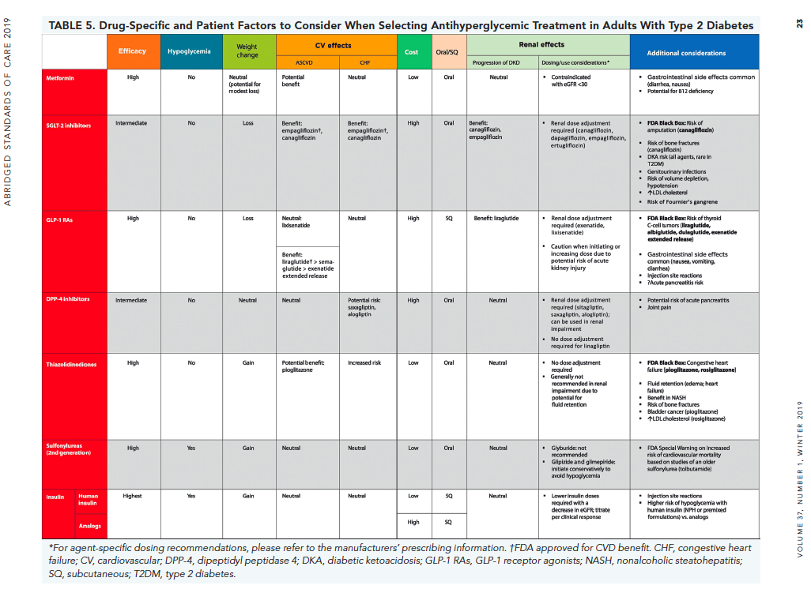

Slide 88
If you have DM pt on Metformin with HbA1c above target, What to do?
Establieshed ASCVD or CKD.
Without established ASCVD or CKD:
To minimize hypoglycemia
To promote weight loss or minimize weight gain
Cost is a major issue

Slide 91
Antihyperglycemic Agents and Renal Function
2018 Diabetes Canada CPG – Chapter 13. Pharmacologic Glycemic Management of Type 2 Diabetes
CKD Stage
5
4
3b
3a
1 or 2
eGFR (mL/min/1.73 m²):
<15
15–29
30–44
45-59
≥ 60
Alpha-glucosidase Inhibitors
Acarbose
30
Biguanides
Metformin
30
500-1000 mg daily
45
Alogliptin
6.25 mg daily
30
12.5 mg daily
60
DPP-4 Inhibitors
Linagliptin
15
Saxagliptin
15
2.5 mg daily
50
Sitagliptin
25 mg daily
30
50 mg daily
50
Dulaglutide
15
GLP-1 Receptor Agonists
Exenatide
30
50
Exenatide QW
30
50
Liraglutide
15
Lixisenatide
30
Gliclazide
30
60
Glimepiride
30
60
Insulin Secretagogues
Glyburide
60
Repaglinide
60
25
45
60
Canagliflozin*
45
100 mg daily
SGLT2 Inhibitors
Dapagliflozin
45
60
Empagliflozin
30
Pioglitazone
60
Thiazolidinediones
Rosiglitazone
Fluid retention
60
Insulins
30
Use alternative agent
Dose adjustment required
Caution
Do not initiate
Dose adjustment not required
* May be used for cardiorenal benefits in those with clinical CVD, A1C above target and eGFR >30 mL/min/1.73m²

Slide 92
Efficacy of Non-insulin Anti-diabetes Agents*
Drug A1c Reduction (%)
Metformin 1.5–2.0
Secretagogue (SFU/Glinide) 1.5–2.0
GLP1RA 1.0-1.5
TZD 1.0–1.5
SGLT2i¹ 0.8-1.5
DPP4i¹ 0.5–1.5
α−GI 0.5–1.0
Bromocriptine IR² 0.6-0.9
Amylin² 0.4-0.7
Colesevelam² 0.3-0.5
*Not head to head. Baselines and background therapies differ. Information derived from multiple studies.
¹http://resources.aace.com. ²Information taken from manufacturer PI.

Slide 93
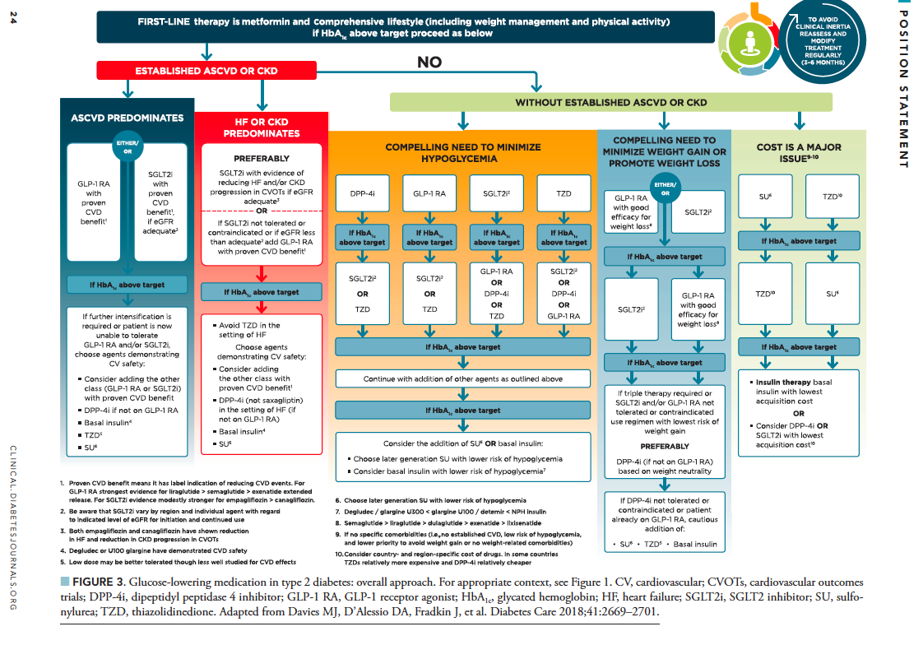

Slide 94
If HbA1c still above target despite dual/triple therapy, What to do?
Consider GLP-1 RA in most prior to insulin.
Consider insulin as first injectable if:
HbA1c very high > 11%
Symptoms or evidence of catabolism: Wt loss, polyurea, polydispsia which suggest insulin deficiency.
If type-1 diabetes is a possibility.
If already on GLP-1 RA or if GLP-1 RA not appropriate or Insulin preferred.

Slide 96
If HbA1c still above target despite adequately titrated basal insulin OR once basal insulin > .7 – 1.0 IU/kg OR FPG at target, What to do?
Add prandial insulin (one dose with the largest meal).
If HbA1c still above target:
Stepwise additional injections of prandial insulin (ex. two, then three additional injections).
If HbA1c still above target:
Proceed to full basal-bolus regimen.

Slide 98
Reference

Slide 99
Thank You

