Slide 1
Headache
Dr. Nada Alyousefi

Slide 2
Background
Headache is pain localized to any part of the head, behind the eyes or ears, or in the upper neck.
Among the most common medical complaints.
The most common neurological problems presented to FM and neurologists.
Lifetime prevalence of tension-type headache up to 80%.
Headache led to almost 4 million emergency room visits in the United States in 2014.
* (http://www.who.int/mediacentre/factsheets/fs277/en/), Dynamed

Slide 3
Guideline for primary care management of headache in adults. Canadian Family Physician
Worldwide prevalence of chronic daily headache about 3%-5%.
The estimated lifetime prevalence of headache is 66%:
46% to 78% for tension-type headache
14% to 16% for migraine
0.1% to 0.3% for cluster headache.
Most common primary headache disorders are tension-type headache, migraine and cluster headache.

Slide 4
Introduction
The International Headache Society classification and diagnostic criteria can help physicians differentiate primary headaches (e.g., tension, migraine, cluster) from secondary headaches (e.g., those caused by infection or vascular disease).
A thorough history and physical examination, and an understanding of the typical features of primary headaches, can reduce the need for neuroimaging, lumbar puncture, or other studies.
Red flag signs and symptoms include focal neurologic signs, papilledema, neck stiffness, an immunocompromised state, sudden onset of the worst headache in the patient’s life, personality changes, headache after trauma, and headache that is worse with exercise.
(Am Fam Physician. 2013;87(10):682-687. Copyright © 2013 American Academy of Family Physicians.)

Slide 5
Objectives
Headache types
Differential diagnosis
Red flags
Diagnostic approach
Management

Slide 6
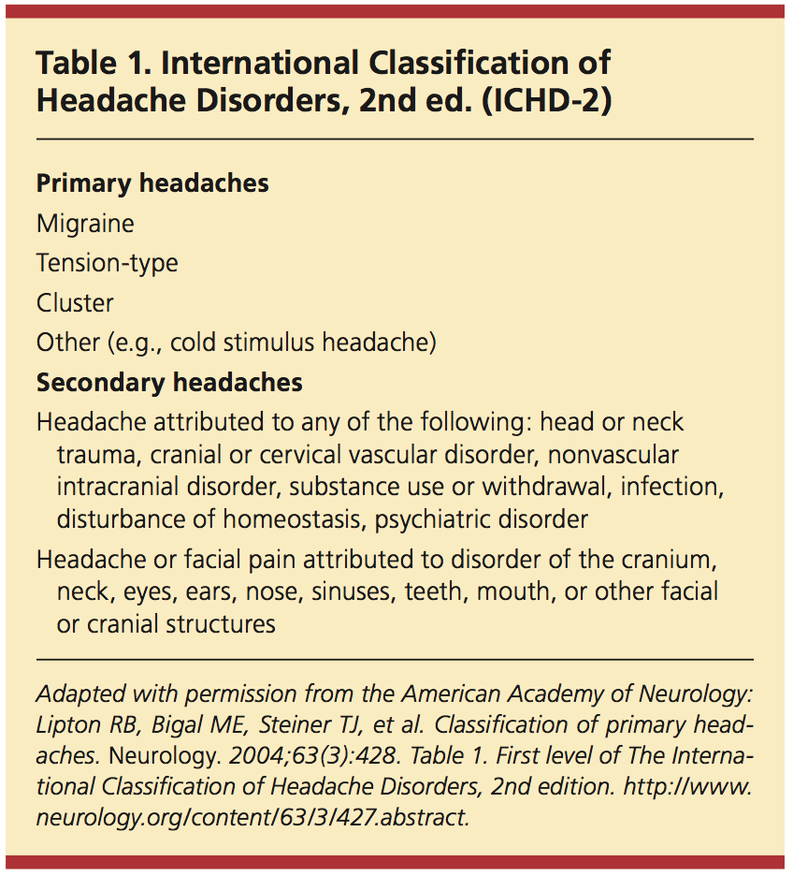

Slide 7
Update
https://www.ichd-3.org/classification-outline

Slide 8
Types of headaches
PRIMARY
SECONDARY
Migraine
Tension type
Cluster
Other trigeminal autonomic cephalalgias
Space-occupying mass
Vascular lesion
Infection
Metabolic disturbance
Systemic problem.

Slide 9
The 3 key outpatient situations in which headache presents differ in approach based on the likelihood of secondary headache and specific management issues:
In the outpatient office setting, most headaches are common primary headache s (such as migraine or tension-type headache) or the secondary headache disorder medication overuse headache.
In the emergency department (ED), the role of the provider is to exclude immediately life-threatening headache and to provide safe and effective treatment of acute symptoms.
Patients with headaches during pregnancy are a special population and require specific evaluation and management strategies.

Slide 10
Misconceptions
Acute or chronic sinusitis appears to be an uncommon cause of recurrent headaches, and many patients presenting with sinus headache turn out to have migraine.
Patients frequently attribute headaches to eye strain. Headaches are only rarely due to refractive error alone.
Hypertension can cause headaches: This is true in the case of hypertensive emergencies, it is probably not true for typical migraine or tension headaches.
Uptodate

Slide 11
Case scenario 1

Slide 12
A 37-year-old woman presents with a 12-year history of episodic headaches. She experiences these 4 times a week, typically beginning at the end of a working day. The pain is generalised and described as similar to wearing a tight band around her head. The headaches are bothersome, but not disabling, and she denies any nausea or vomiting. She is slightly sensitive to noise but has no photophobia. Pain during her attacks typically responds to ibuprofen. Examination reveals tenderness of her scalp and both trapezius muscles.

Slide 13
A 56-year-old man presents with a 25-year history of constant headache. The onset was insidious and he is certain that the only time he is headache-free is when he sleeps. He states the headache is generalised and his neck and shoulders are always 'tight'. He denies any associated autonomic symptoms including eye tearing, nasal congestion, light and sound sensitivity, nausea, or vomiting.

Slide 14
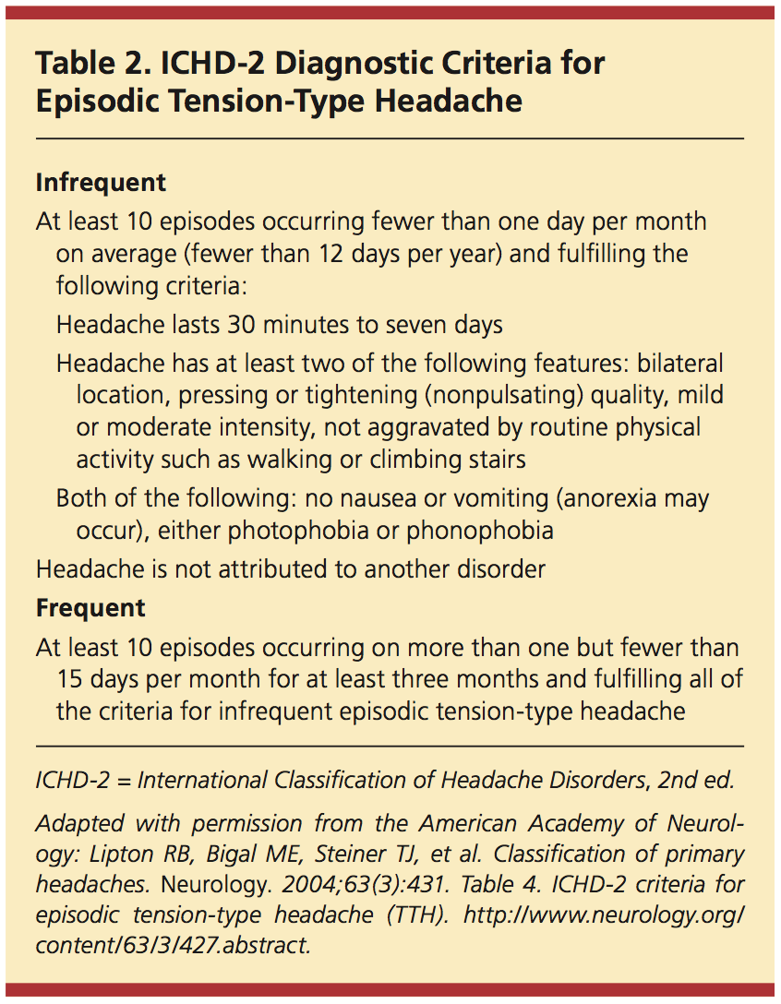

Slide 15
Medications for tension-type headache
Medication | Dose
Acute Ibuprofen Naproxen sodium Acetaminophen | 400 mg 500-550 mg 1000 mg
Prophylactic
First line amitriptyline nortriptyline | 10-100 mg/d 10-100 mg/d
Second line • mirtazapine • venlafaxine | 30 mg/d 150 mg/d

Slide 16
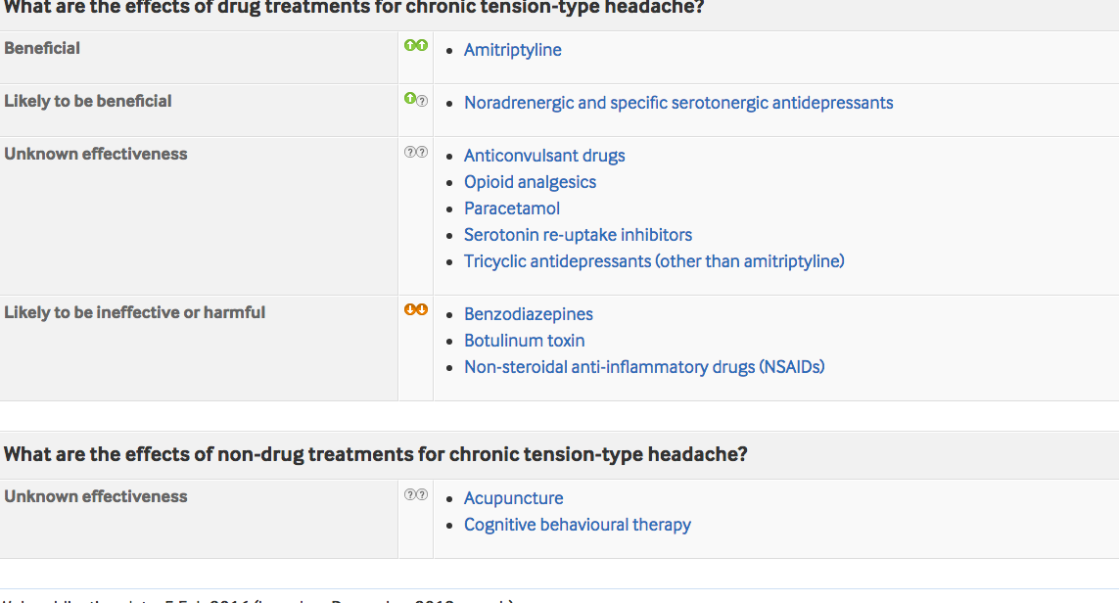
Aliya asks if there is anything that can be done to reduce the frequency of her migraine attacks.
Explain that prophylactic treatments prevent, rather than cure, a condition.
Depending on the person’s clinical needs and their preferences
offer prophylaxis with propranolol
consider treatment with amitriptyline

Slide 17
Case scenario 2

Slide 18
Ahmed is a 14-year-old boy. He attends your clinic accompanied by his mother. He presents with a two months history of headaches that he describes as “pulsating” and that make his head “very sore”.
He says that in the past two months, he has had 6 of these headaches. He also says that light hurts his eyes when he has the headaches. He does not feel nauseous or vomit during the headaches.

Slide 19
Mother tells you that when Ahmed has the headaches he is unable to go to school and that the headaches last from 2 to 4 hours. She gives Ahmed paracetamol and if that doesn’t work she also gives him ibuprofen. This combination of medication helps.

Slide 20
You diagnose migraine without aura.
How would you manage this?
Reassure them that a serious underlying cause is unlikely
Tell them that migraines are a well-recognised problem although what causes them is not known for certain
Explain the risk of medication overuse headache

Slide 21
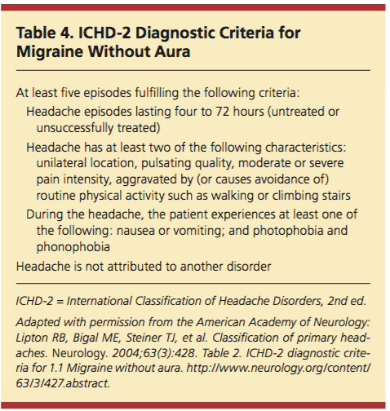

Slide 22
MIGRAINE HEADACHE PROPHYLAXIS. American Family Physician, 2019-01-01, Volume 99, Issue 1, Pages 17-24,

Slide 23
For acute management of migraine
Taking into account the person's preference, comorbidities and risk of adverse events:
Offer therapy:
First line: Simple analgesics ( Ibuprofen 400 mg, ASA 1000 mg, naproxen sodium 500-550 mg, acetaminophen 1000 mg )
Second line: Triptans

Slide 24
Uptodate
Mild to moderate attacks — not associated with vomiting - simple analgesics (NSAIDs, acetaminophen) or combination analgesics
Moderate to severe attacks — not associated with vomiting -oral migraine-specific agents are first-line, including oral triptans and the combination of sumatriptan-naproxen.
When complicated by vomiting , non oral migraine-specific medications including subcutaneous sumatriptan OR nasal sumatriptan, non oral antiemetic agents

Slide 25
Managing patients with migraine
Pay attention to lifestyle and specific migraine triggers.
Lifestyle factors to avoid include :
irregular or skipped meals, a stressful lifestyle, lack of exercise and obesity
Common triggers for headaches include menses, stress, exertion, sleep disturbance, odors, caffeine withdrawal, and dietary items such as cheese, wine, chocolate, monosodium glutamate (MSG), and hot dogs.
• Use acute pharmacologic therapy for individual attacks
• Use prophylactic pharmacologic therapy, when indicated.
• Evaluate and treat coexistent medical and psychiatric disorders
Guideline for primary care management of headache in adults. Canadian Family Physician

Slide 26
Acute Migraine Medication
First line | Ibuprofen 400 mg ASA 1000 mg naproxen sodium 500-550 mg acetaminophen 1000 mg
Second line | Triptans: oral sumatriptan 100 mg • Subcutaneous sumatriptan 6 mg if the patient is vomiting early in the attack. • Nasal spray: sumatriptan 20 mg if patient is nauseated Antiemetics: domperidone 10 mg or metoclopramide 10 mg for nausea
Third line | Naproxen sodium 500-550 mg in combination with a triptan
Fourth line | Fixed-dose combination analgesics (with codeine if necessary; not recommended for routine use

Slide 28
Prophylactic Medications
Prophylactic MEdications | Starting dose | Titration,* daily Dose increase | Target dose or therapeutic range
First line propranolol | 20 mg twice daily | 40 mg/wk | 40-120 mg twice daily
metoprolol | 50 mg twice daily | 50 mg/wk | 50-100 mg twice daily
amitriptyline | 10 mg at bedtime | 10 mg/wk | 10-100 mg at bedtime
Second line Topiramate candesartan gabapentin | 25 mg/d 8 mg/d 300mg/d | 25 mg/wk 8 mg/wk 300 mg every 3-7 d | 50 mg twice daily Few side effects; limited experience in prophylaxis Few drug interactions

Slide 30
Prophylactic medication
• Educate patients on the need to take the medication daily and according to the prescribed frequency and dosage
• Ensure that patients have realistic expectations, Explain that…
-Headache attacks will likely not be abolished completely
-A reduction in headache frequency of 50% is usually considered worthwhile and successful
-It might take 4-8 weeks for substantial benefit to occur
-If the prophylactic drug provides substantial benefit in the first 2 mo of therapy, this benefit might increase further over several additional months of therapy
• Evaluate the effectiveness of therapy using patient diaries

Slide 31
Prescribing prophylactic medication cont
• For most prophylactic drugs, initiate therapy with a low dose and increase the dosage gradually to minimize side effects
• Increase the dose until the drug proves effective, until dose limiting side effects occur, or until a target dose is reached
• Continue the prophylactic drug for at least 6-8 wk after dose titration is completed
• Because migraine attack tendency fluctuates over time, consider gradual discontinuation of the drug for many patients after 6 to 12 mo of successful prophylactic therapy

Slide 32
Case scenario 3

Slide 33
Aliya is a 28-year-old woman who was diagnosed with migraine with aura 6 months ago. She has, on average, 1 migraine attack per week, for which she takes an NSAID and an anti-emetic.
Because Aliya has migraine about 4 times per month, she is unlikely to develop medication overuse headache. You are therefore happy with her current treatment plan.
However, during an attack, she is unable to work or continue her normal daily activities. She also worries a lot about when the next attack is going to happen and their frequency causes her to take a lot of time off work.

Slide 34
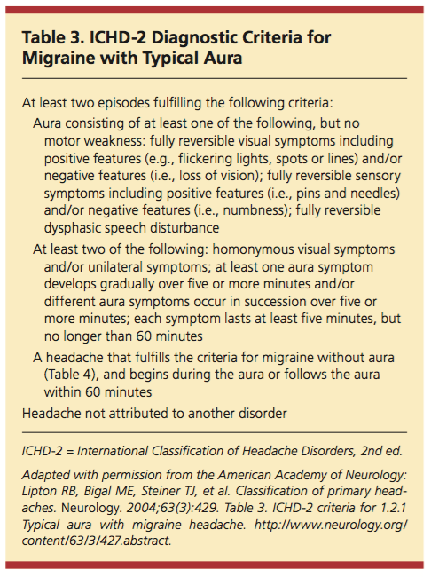
Aura
sensory, motor, or language symptoms.

Slide 35
You want to confirm that she is not a taking combined hormonal contraceptive for contraception purposes.
Why?
The World Health Organization, 2009 (medical eligibility criteria) recommends that the oral contraceptive pill should not be used in women with migraine with aura at any age.
There is an increased risk of ischaemic stroke in people with migraine with aura. This risk is increased in women using combined hormonal contraception.
Department of Reproductive Health WHO. Medical eligibility criteria for contraceptive use. 4th edition. World Health Organization; 2009
UK Medical Eligibility Criteria for contraception use. 2009

Slide 36
You suggest propranolol for migraine prophylaxis.
How would you assess the effectiveness of the propranolol?
Headache diary
b) When would you review the need to continue this prophylaxis?
It might take 4-8 wk for substantial benefit to occur
If the prophylactic drug provides substantial benefit in the first 2 mo of therapy, this benefit might increase further over several additional months of therapy
6-12 months after the start of prophylactic treatment.
Headaches in over 12s: diagnosis and management (2012 updated 2015)
Guideline for primary care management of headache in adults Canadian Family Physician

Slide 37
She wants to become pregnant in the future, but still needs migraine prophylaxis, what should you do?
Migraine without aura often improves during pregnancy. However, migraine with aura is more likely to continue throughout pregnancy.
Seek specialist advice if prophylactic treatment for migraine is needed during pregnancy.
Offer pregnant women paracetamol for the acute treatment of migraine.
Headaches in over 12s: diagnosis and management (2012 updated 2015)

Slide 38
Case scenario 4

Slide 39
Abdullah is a 31-year-old man. He has a history of severe headaches, which are the worst pain he has ever felt. When he gets these headaches, he has pain on 1 side of his head, around his eye and along the side of his face. He also experiences watery eye and nasal congestion, on the same side as the headache.
He experienced the headache for the first time 2 weeks ago. The CT scan done was normal and you have been asked to evaluate him.
He tells you that, since his first severe headache 2 weeks ago, he has experienced 6 more headaches. He says that on average his severe headaches last from 30 to 90 minutes.

Slide 41
What advice and support can you offer about his diagnosis?
Management primarily pharmacologic
Offer O2 or a subcutaneous or nasal triptan for the acute treatment.
What prophylaxis for cluster headache could you offer him?
Prophylactic medication: consider offering him verapamil.
Seek specialist advice before starting verapamil
Early specialist referral recommended
Guideline for primary care management of headache in adults, Canadian Family Physician

Slide 42
What medications would you not offer for the acute management of his cluster headache attacks?
You would not offer paracetamol, NSAIDS, oral triptans, ergots or opioids as there is no evidence to suggest that they would have any clinical benefit in the treatment of cluster headache.
NICE: https://www.nice.org.uk/donotdo/do-not-offer-paracetamol-nsaids-opioids-ergots-or-oral-triptans-for-the-acutetreatment-of-cluster-headache

Slide 43
General practice points for managing primary headache in adults

Slide 44
General practice points for managing primary headache in adults
Rule out secondary headache
Imaging is not recommended for the routine assessment of patients with headache with normal neurologic examination findings, and no red flags.
History and physical examination findings are usually sufficient to make a diagnosis
Migraine should be considered in patients with recurrent moderate or severe headaches and normal neurologic examination findings
Guideline for primary care management of headache in adults, Canadian Family Physician

Slide 46
General practice points cont….
Consider a diagnosis of migraine in patients with a previous diagnosis of recurring “sinus” headache.
Medication overuse is considered when patients with migraine or tension-type headache use combination analgesics,
Opioids, or triptans on ≥10 d/mo
or
Acetaminophen or NSAIDs on ≥15 d/mo
Comprehensive migraine therapy includes management of lifestyle factors and triggers, acute and prophylactic medications, and migraine self-management strategies

Slide 47
SNNOOP10
criteria may be helpful in identifying red flags suggestive of a secondary cause of headache
Systemic symptoms including fever - suggestive of infection or nonvascular intracranial disorder, carcinoid, or pheochromocytoma; orange flag for isolated headache
Neoplasm in history - suggestive of brain neoplasm or metastasis
Neurologic deficit - suggestive of headaches attributable to vascular or nonvascular intracranial disorders, brain abscess, or other infections
Onset of headache is sudden or abrupt - suggestive of subarachnoid hemorrhage and other headaches attributable to cranial or cervical vascular disorders
Older age (age > 50 years) - suggestive of giant cell arteritis or other headaches attributable to cranial or cervical vascular disorders, neoplasms, and other nonvascular intracranial disorders
Pattern change or recent onset of headache - suggestive of neoplasms and headaches attributable to vascular or nonvascular intracranial disorders
Positional headache - suggestive of intracranial hypertension or hypotension
Precipitated by sneezing, coughing, or exercise - suggestive of posterior fossa malformations or Chiari malformation
Papilledema - suggestive of intracranial hypertension, neoplasms, and other nonvascular intracranial disorders
Progressive headache and atypical presentations - suggestive of neoplasms and other nonvascular intracranial disorders
Pregnancy or puerperium - suggestive of headaches attributable to cranial or cervical vascular disorders, postdural puncture headache, hypertension-related disorders (such as preeclampsia), cerebral sinus thrombosis, hypothyroidism, anemia, or diabetes
Painful eye with autonomic features - suggestive of Tolosa-Hunt syndrome, ophthalmic causes, or pathology in posterior fossa, pituitary region, or cavernous sinus
Posttruamatic onset of headache - suggestive of acute and chronic posttaumatic headache, subdural hematoma, and other headaches attributable to vascular disorders
Pathology of immune system such as with HIV infection - suggestive of opportunistic infections
Painkiller overuse or use of new drug at onset of headache - suggestive of medication overuse headache or drug incompatibility

Slide 48
SNOOP(Red flag signs)
Systemic symptoms
Neurologic symptoms
Onset
Other associated conditions
Previous headache history
Fever, weight loss, cancer, pregnancy, immunocompromised state
Confusion, impaired alertness, papilledema, neurologic signs, meningismus, or seizures
Age >40 years or sudden, "thunderclap“
Head trauma, headache awakens from sleep, worse with Valsalva maneuvers, precipitated by cough, exertion
Headache progression or change in attack frequency, severity

Slide 49
In the outpatient office setting:
The history is targeted to defining common primary headache syndromes (migraine, tension-type headaches, cluster headache) and assessing for red flags suggesting potential secondary headache syndromes requiring further evaluation and referral.
Perform further evaluation if SNNOOP10 questions are positive, suggesting secondary causes of headache.
In patients with stable headaches and normal neurologic examination, diagnostic imaging is typically not required.
Perform magnetic resonance imaging (MRI) and consider magnetic resonance angiography (MRA) or venography (MRV) in patients with trigeminal autonomic cephalalgia, atypical headache with seizures, atypical headache with vomiting, focal neurological signs, or other red flags.

Slide 50
In the emergency room, evaluate for secondary causes of headache:
Ask about mode of onset of headache, exertion causing headache, focal neurologic symptoms, and concurrent medical illnesses.
Examine for meningismus, papilledema on fundoscopy, palpation of sinuses, temporomandibular joint, and carotid and temporal pulses.
Perform Emergency Department Diagnostic Testing if SNNOOP10 questions are positive and consider cerebrospinal fluid testing for meningitis or encephalitis.
Noncontrast computed tomography (CT) of head is the initial study of choice in most cases.

Slide 51
In the emergency room, evaluate for secondary causes of headache:
CT angiography (CTA) may be helpful to rule out dissection.
With new-onset headache, perform CT of head early to rule out subarachnoid hemorrhage as CT approaches 100% sensitivity for subarachnoid hemorrhage (SAH) within 6-12 hours of onset progressively declining over 5 days to 58%.
Consider lab testing including routine labs, sedimentation rate, and reactive protein in patients > 50 years old for giant cell arteritis (previously referred to as temporal arteritis).
Perform lumbar puncture to evaluate for red blood cells and xanthochromia if CT is negative for SAH but it is highly clinically suspected (for example with thunderclap headache or new worst headache).

Slide 52
In pregnant patients with a new onset of headache:
Sudden-onset severe headache, rapidly increasing headache frequency or severity, or neurologic deficits, diagnostic imaging should be considered early to rule out secondary causes of headache.
Evaluate risk considerations for fetus when choosing whether to perform CT and/or MRI of the head. MRI is preferred, but the use of gadolinium should be limited.
For acute stroke, perform workup as per usual acute stroke with caution as to risks of diagnostic testing for both mother and the fetus.

Slide 53
Characteristics of migraine, tension-type, and cluster headache syndromes
Symptom | Migraine | Tension-type | Cluster
Location | Adults: Unilateral in 60 to 70 percent, Children and adolescents: Bilateral in majority | Bilateral | Always unilateral, usually begins around the eye or temple
Characteristics | Gradual in onset, crescendo pattern; pulsating; moderate or severe intensity; aggravated by routine physical activity | Pressure or tightness which waxes and wanes | Pain begins quickly, reaches a crescendo within minutes; pain is deep, continuous, excruciating, and explosive in quality
Patient appearance | Patient prefers to rest in a dark, quiet room | Patient may remain active or may need to rest | Patient remains active
Duration | 4 to 72 hours | 30 minutes to 7 days | 15 minutes to 3 hours
Associated symptoms | Nausea, vomiting, photophobia, phonophobia; may have aura | None | Ipsilateral lacrimation, redness of the eye; stuffy nose; rhinorrhea; pallor; sweating; Horner syndrome;

Slide 54
Important elements in history : headache for the first time or those with a change in headache pattern
Explore the following important elements :
Headache onset (thunderclap, head or neck trauma)
previous attacks (progression of symptoms)
duration of attacks (4 hours, continuous)
days per month with headache
Pain location
Headache-associated symptoms
Relationship to precipitating factors (stress, posture etc)
Effect on work and family activities
Response to acute and preventive medications
Presence of coexistent conditions (depression, asthma, etc)

Slide 55
Approach to the physical examination
Screening neurologic examination
Neck examination
Blood pressure measurement
If indicated, a focused neurologic examination
If indicated by associated jaw complaints, an examination for temporo-mandibular disorders

Slide 56
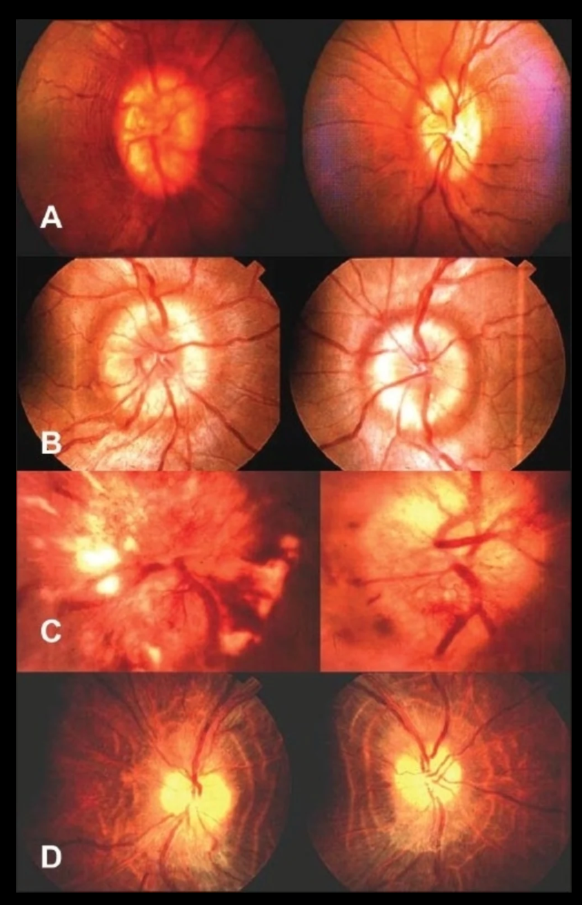
S. Ambika, Deepak Arjundas, Veena Noronha, and Anshuman. Clinical profile, evaluation, management and visual outcome of idiopathic intracranial hypertension in a neuro-ophthalmology clinic of a tertiary referral ophthalmic center in India. Ann Indian Acad Neurol. 2010 Jan-Mar; 13(1): 37-41.
Notes:
Fundus pictures showing (A) early papilledema (B) established papilledema (C) vintage papilledema and (D) atrophic papilledema

Slide 58
Red flags and other potential indicators of secondary headache

Slide 59
Red flags Emergent (address immediately)
• Thunderclap onset
• Fever and meningismus
• Papilledema with focal signs or reduced LOC
• Acute glaucoma
Urgent (address within hours to days)
• Temporal arteritis
• Papilledema (WITHOUT focal signs or reduced LOC)
• Relevant systemic illness
• Elderly patient: new headache with cognitive change
yes
Refer and investigate
Possible indicators of secondary headache
Unexplained focal signs
• Atypical headaches
• Unusual aura symptoms
• Onset after age 50 y
Aggravation by neck movement
Abnormal neck examination findings (cervicogenic headache)
• Jaw symptoms (consider temporomandibular joint disorder)
Guideline for primary care management of headache in adults, Canadian Family Physician

Slide 60
Medication overuse
Assess
• Ergots, triptans, combination analgesics, or codeine ≥10 d/mo
OR
• Acetaminophen or NSAIDs ≥15 d/mo
Manage
• Educate patient
• Consider prophylactic medication
• Provide an effective acute medication for severe attacks
• Gradual withdrawal of opioids if used
• Abrupt (or gradual) withdrawal of acetaminophen, NSAIDs, or triptans
Headache with ≥2 of
• Nausea
• Light sensitivity
• Interference with activities
migraine
NO
Headache with no nausea but ≥2 of
• Bilateral headache
• Non pulsating pain
• Mild to moderate pain
• Not worsened by activity
Tension type headache

Slide 65
Medication overuse headache (MOH)
Also called analgesic rebound headache
Consider a diagnosis in patients with headache on ≥15 d/mo
possible medication overuse; use of triptans, ergots, combination analgesics, or opioid-containing medications on ≥10 d/mo, or use of acetaminophen or NSAIDs on ≥15 d/mo
MOH appears to be highest with opioids containing combination analgesics, and aspirin/acetaminophen/caffeine combinations.
The risk with triptans is considered intermediate
The risk is lowest with NSAIDs

Slide 66
Diagnosis of medication-overuse headache
When medication-overuse headache is suspected, the patient should also be evaluated for the presence of the following:
psychiatric comorbidities
psychological and physical drug dependence
use of inappropriate coping strategies.

Slide 67
Coping strategies for headache
Rather than relying on medication as a main coping strategy, patients with suspected medication overuse might benefit from training in and development of more adaptive self-management strategies (eg, identification and management of controllable headache triggers, relaxation exercises, effective stress management skills, and activity pacing)
Headache diaries that record acute medication intake are important in the prevention and treatment of medication-overuse headache

Slide 68
Management of MOH- Patient education.
Acute medication overuse can increase headache frequency
When medication overuse is stopped, headache might worsen temporarily and other withdrawal symptoms might occur
Many patients will experience a long-term reduction in headache frequency after medication overuse is stopped
Prophylactic medications might become more effective

Slide 69
Strategy for cessation of medication overuse
Abrupt withdrawal should be advised for patients with suspected medication overuse headache (MOH) caused by simple analgesics (acetaminophen, NSAIDs) or triptans.
Gradual withdrawal should be advised for patients with suspected medication-overuse headache caused by opioids and opioid-containing analgesics.
Patient follow-up and support

Slide 70
Tips to Remember
A thorough history is the most important way to differentiate among the different causes of headache, which are many.
A useful mnemonic for the symptoms of migraine headache is POUND. P indicates a pulsatile quality of headache. O indicates 1-day duration (<4 hours suggests TTH). U indicates unilateral location. N indicates the presence of nausea or vomiting. D indicates a disabling intensity.
Medication-overuse headache should be strongly considered in patients who may be overusing narcotic or barbiturate-containing analgesics, which results in a refractory daily or near-daily headache.
The overuse of triptan drugs (more than 3 days a week, for 2 or more weeks) is now becoming a common cause of medication-overuse headache.

Slide 71
Tips to Remember
It is important to assess for alarm features that suggest headache due to a secondary, nonbenign cause.
There are serious causes of headache that exist and for which neuroimaging may be normal.
For migraine treatment, codeine, and other narcotics, has high potential for “rebound” headaches and opiate dependence and should generally be avoided.
It is important to note that triptans do not have a class effect; therefore, lack of efficacy or intolerance of side effects to 1 triptan does not predict a patient's response to other triptans.
Triptans are contraindicated in patients with CAD or uncontrolled hypertension.
Preventive migraine treatment should be considered in patients with frequent disabling migraine headaches (>2 per month), and may reduce frequency by one third to one half.

Slide 72
nalyousefi@ksu.edu.saحقوق الاستخدام محفوظة All rights reserved

