Slide 1
PREVENTION &SCREENING IN FAMILY PRACTICE Dr. Joud Almutairi. Demonstrator Dept. of Family & Community Medicine King Saud University

Slide 2
Objectives:
Definition of screening / prevention and its uses in family practice
To identify prevention types and targeted people for each type with examples.
To identify appropriate approaches for prevention and screening of common problems in primary care .
To explain pros and cons of screening .
To justify the rational for selection of a screening test with practical examples .
To explain the benefits of a good screening program .

Slide 3
Clinical Prevention, what is it?
It is the proactive clinical approach to maintain and improve health status of patients so that diseases can be avoided, diagnosed early and complications averted.

Slide 4
PREVENTION TYPES ?

Slide 5
Types of Preventions:
Researchers and health experts talk about three categories of prevention:
Primary .
Secondary .
Tertiary.
( What do they mean by these terms ? )

Slide 6
Primary prevention
Preventing illnesses before it happened
Examples: immunization .healthy lifestyle
Secondary prevention
Detecting diseases at early asymptomatic stage
Examples: screening (HTN), mammograms.
Tertiary prevention
Preventing complications of diseases.
Examples: rehabilitation.

Slide 7
Screening – an early disease detection OR secondary prevention:
The presumptive identification of unrecognized disease or defect by the application of tests, examinations, or other procedures which can be applied rapidly
Screening is applied to well persons who probably have a disease from those who probably do not
A screening is not intended to be diagnostic
Persons with positive or suspicious findings must be referred to their physicians for diagnosis and necessary treatment

Slide 8
Purpose of Screening:
Identifying unrecognized disease (early stage)
1
Identifying persons at increased risk for the presence of disease, who warrant further evaluation
2
Classifying people with respect to their likelihood of having a particular disease
3
Reducing morbidity and mortality from disease among persons being screened
4

Slide 9
What is Screening – recap
Application of certain procedures to populations by doctor initiative , with the aim of identifying asymptomatic disease or people at risk from it.
Screening is a form of secondary prevention i.e ; identifying pre-symptomatic disease (or risk factors) before significant damage is been done.

Slide 10
Requirements of a good screening Program (Wilsons criteria):
1. The condition must be ;
a) common.
b) important.
c) diagnosable by acceptable methods.
2. There must be a latent interval in which effective interventional treatment is possible .
Screening must be;
a) simple & cheap , case cost- effective.
b) continuous.
c) On a group agreed by policy to be high risk.

Slide 11
What is Family Physicians Role in Screening:
A family physicians is the one who provides an anticipatory care approach for precluding problems .
This specialty puts all efforts to offer all appropriate forms of prevention within the consultation and the organizational framework of primary care .

Slide 12
What are common conditions or
diseases ?
Where you can apply screening &
Preventive ?

Slide 13
Common Screening Conditions:
Hypertension Screening , detection and follow-up.
Cervical Cytology
Developmental surveillance.
Well woman & well man clinic.
Visiting elderly people at home.
Mammography .
Serum lipid estimation.
Screening psychiatric illness.
Prostate Cancer screening

Slide 14
Common Preventive Interventions:
Immunization /Vaccinations.
Postmenopausal hormonal Replacement .
Life style Counselling .
Advice on Smoking.
Weight –watching .
Keeping fit and aerobic programs

Slide 15
Common Cancers screening tests in Family Practice Clinic:
Cervical cytology .
Mammography.
Fecal occult blood.
Prostate Specific Antigen.

Slide 16
Some practical examples of prevention & Screening and how to approach

Slide 17
Prevention & screening in Elderly people
Preventive Measures
1. Falls Prevention like ;
Asses gait & balance training .
Home hazard intervention and follow-up.
Medication review /withdrawal (especially hypnotics , anti depressants).
Osteoporosis risks assessment .
Assessing auditory & visual impairments .

Slide 18
2. Mental health screening in older people .
Assessing for depression .
Assessing living conditions and Social isolation .
Assessing Medications causing depression like Beta – Blockers , statins , calcium channel blockers.
3. Life style advice .
4. Stroke prevention

Slide 19
Osteoporosis Screening & Prevention:
Why to screen ?
The BMD remains constant in women until menopause when it falls sharply for 5-10 years (estrogen withdrawal bone loss) , and more slowly there after (age –related bone loss)
Preventive Strategies:
Encouraging new bone formation .
Discouraging Bone Resorption
Achieving a high BMD .
BUT HOW

Slide 20
Osteoporosis –Prevention Strategies
Regular weight bearing exercises .
Avoidance of Smoking
A calcium rich diet .
Calcium & Vit D supplementation (those find deficient).
Measures at home to prevent falls.

Slide 21
SCREENING FOR BREAST CANCER:
From age 50-74 with mammography every 2 year . Recommendation B
From age 40 to 49 . Recommendation C
More than 75. Recommendation I

Slide 22
CERVICAL SCREENING:
The USPSTF recommends screening for cervical cancer in women ages 21 to 65 years with cytology (Pap smear) every 3 years. Grade : A Recommendation
• women ages 30 to 65 years who want to lengthen the screening interval, screening with a combination of cytology and human papillomavirus (HPV) testing every 5 years.
• The USPSTF recommends against routinely screening women older than age 65 for cervical cancer if they have had adequate recent screening with normal Pap smears and are not otherwise at high risk for cervical cancer (go to Clinical Considerations). Grade: D Recommendation.
• The USPSTF recommends against routine Pap smear screening in women who have had a total hysterectomy for benign disease. Grade: D Recommendation.

Slide 23
Human Pappiloma Virus Immunization & Future of Cervical Screening:
HPV Type 16 and 18 – the most carcinogenic of the pappiloma viruses.
They causes 70 % of cervical cancers worldwide.
Two vaccines types has been licensed for protection.
Advantages of Vaccines :
Offer high level of protection .
98% seropositivity at 4.5 years follow-up.
A significant reduction in the number of pre-cancerous changes in immunized individuals.
Vaccine also protects genital warts.

Slide 24
Screening for Colorectal Cancer:
The USPSTF recommends screening for colorectal cancer (CRC) using fecal occult blood testing, sigmoidoscopy, or colonoscopy, in adults, beginning at age 50 years and continuing until age 75 years. The risks and benefits of these screening methods vary. Grade: A Recommendation.
FOB (yearly)
COLONOSCOPY (every 10 year)
CT COLONOGRAPHY (every 5 years)
Flexible sigmoidoscopy (every 5 years)

Slide 25
SCREENING FOR PROSTATE CANCER:
75% of men with raised PSA had No prostate Cancer on Biopsy.
More than 50% of patients with raised PSA will become Normal when repeated 6 weeks later.
PSA is raised by UTI ,BPH , recent ejaculation ,vigorous exercise , prostatitis.
PSA cannot differentiate aggressive from Indolent cancer.
The USPSTF recommends against screening for prostate cancer in men age 75 years or older.
Men aged 55-69 the decision to undergo periodic PSA should be an individual one.

Slide 26
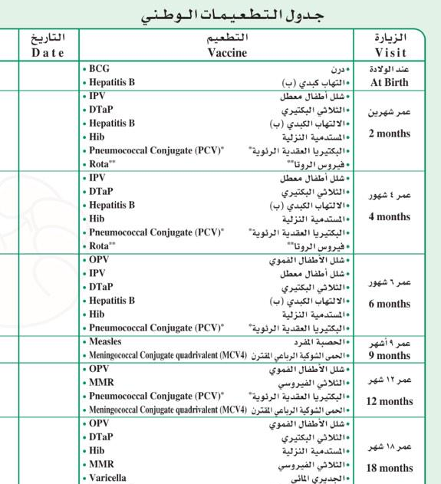
Vaccination

