Slide 1

Falls in the Elderly
Dr. Saad Mohammad Alsaad, MBBS, SBFM, ABFM, CFGM
Assistant Professor & Consultant Family medicine, Geriatrics
Department of Family and Community Medicine
College of medicine, King Saud University
FMD 421 course (4th year) 1442

Slide 3
Disclosure of no conflict of interest
I have no personal or financial interests to declare.
I have no financial support for the current presentation.

Slide 4
By the end of session students will be able to:
Define falls and the mechanism of falls (mechanical vs. nonmechanical)
Discuss the prevalence (local studies vs. international)
Explain falls risk factors (both intrinsic such as gait and extrinsic such as environmental hazards)
Recognize the tools for Osteoporosis screening and risk calculation
Discuss the consequence of falls such as hip fractures, lacerations, wounds, bleeding
Demonstrate the ability to identify falls and recurrent falls (Falls risk assessment) i.e. history and physical examination
Falls prevention and management in community dwelling elderly.

Slide 5
session outline:
Pre-session preparation
reading materials!
Readiness Assurance Test (RAT)
Pre-test (10 minutes)
Team based case discussion
Presenation to highlights important points and take home messages

Slide 6
Pre-test
Readiness assurance
10 min

Slide 7

What is a fall?
An unintentional event that results in a person
coming to rest on the ground, or another lower
level, not as a result of a major intrinsic event
such as stroke or epilepsy) or an overwhelming
hazard (such as being pushed).
Kellogg, 1987

Slide 8
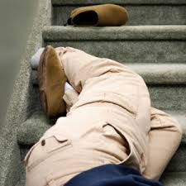
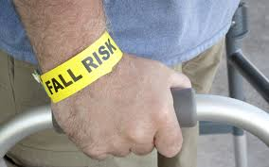
Falls
Community Dwelling
In the Hospital

Slide 9
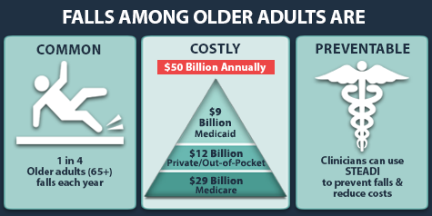
Prevalence
- 30 % of community-dwelling people over the age of 65 years fall each year.
-50 %for those 80 years and older .
Centers for Disease Control and Prevention, National Center for Injury Prevention and Control. Web–based Injury Statistics Query and Reporting System (WISQARS) [online]. Accessed August 15, 2013.

Slide 10
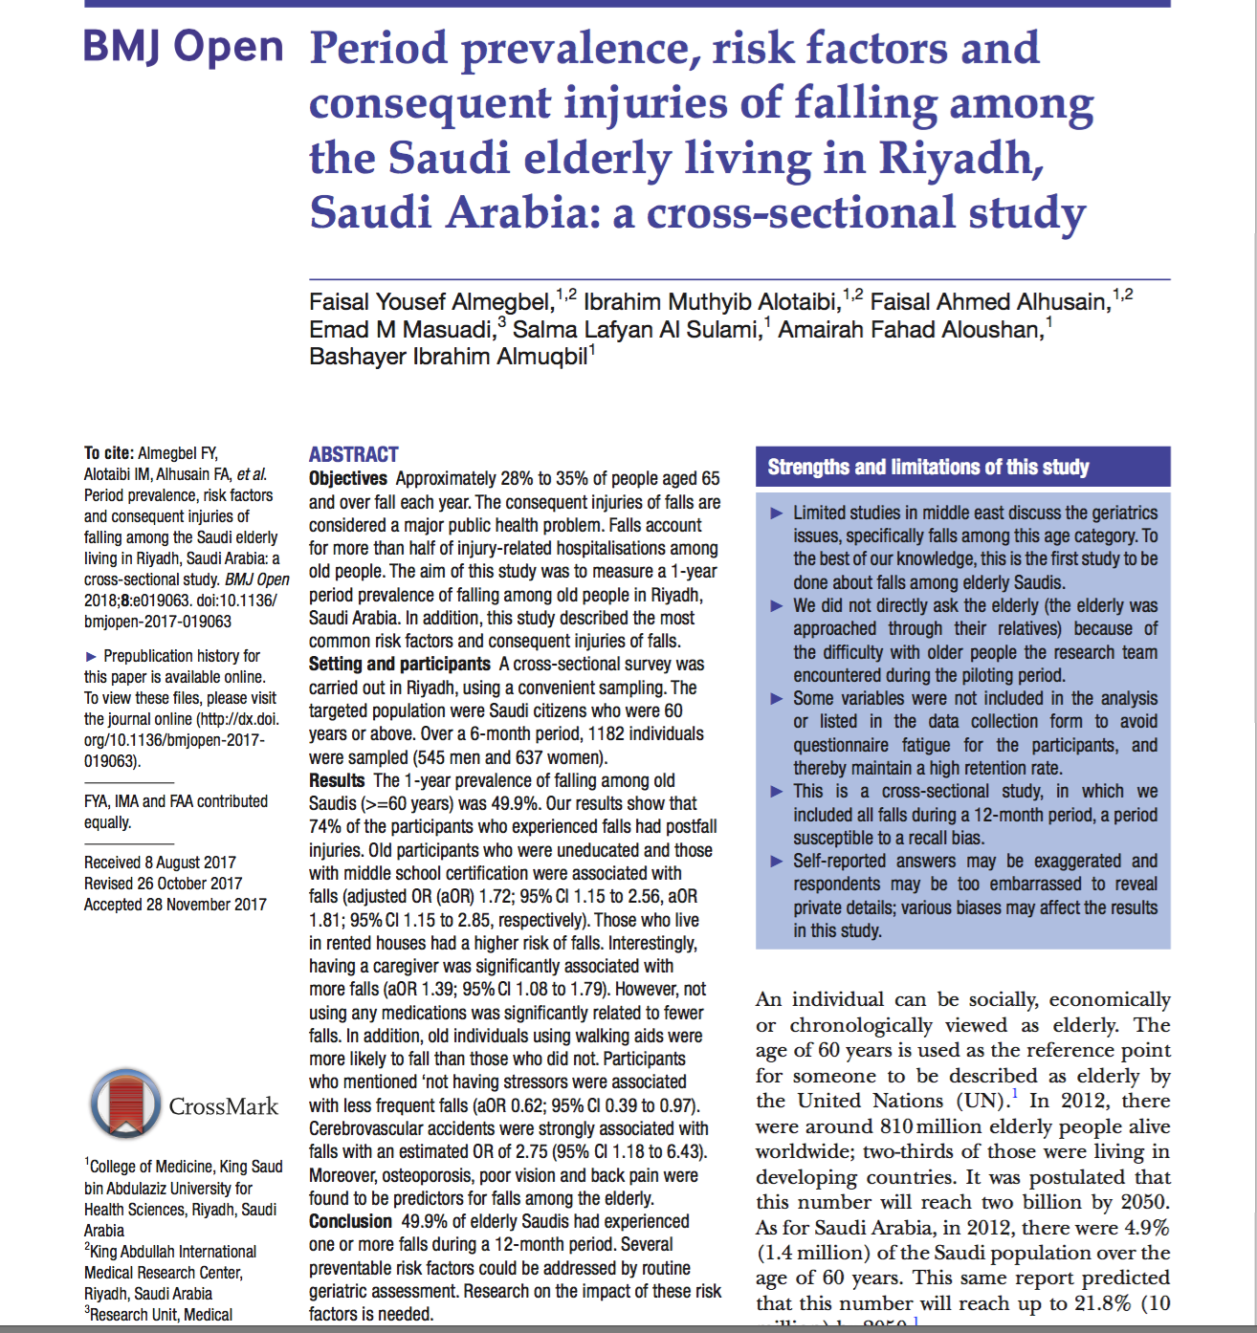
Prevalence in Saudi Arabia
The 1-year prevalence of falling among old Saudis (>=60 years) was 49.9%.
74% of the participants who experienced falls had post fall injuries.

Slide 11
Recurrent Falls
60 % of those with a history of a fall in the previous year will have a subsequent fall.
No1 risk factor of a fall is a previous fall.
Nevitt MC, Cummings SR, Hudes ESSOJ Gerontol. 1991;46(5):M164.

Slide 12
Gender
female > male.
Falls are more likely to result in injury in women.

Slide 13
When do falls occur?
Statistics show that most falls occur in the daytime when people are more active.
around 11am and between 4pm and 6pm.

Slide 14
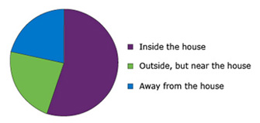
Where do they fall?

Slide 15

Consequences of falls
Significant morbidity and mortality may result from falls in older individuals.

Slide 16
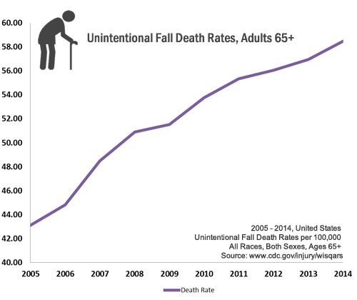
Notes:
As you can see that unintentional falls leads to increase death rates each year

Slide 17
Consequences of falls
Physical injury
Emotional trauma
Psychological problems
Social consequences
Financial impact

Slide 18
Consequences of falls
½ falls result in injury (10-15% in fractures).
¼ of all fallers limit their activities and lifestyle due to fear of falling.
Nevitt, MC et al. J Gerontol 1991; 46:M164.
Tinetti et al. J of Gerontol A bio Sci Med Sci .1998; 53: M 112.

Slide 19
Fall Severity Index
1. None means no injury or disability
2. Minor Injury means injuries, which are minor in nature. For example, abrasion, bruise, minor laceration and hematomas.
3-Major Injury means injuries that require medical or surgical intervention, increased hospital stays, or are disabling and/or disfiguring to a degree that the patient will have any degree of permanent lessened function or require surgical repair. For example, hip fracture, head trauma and arm fracture.
4-Death means fall related death.

Slide 20
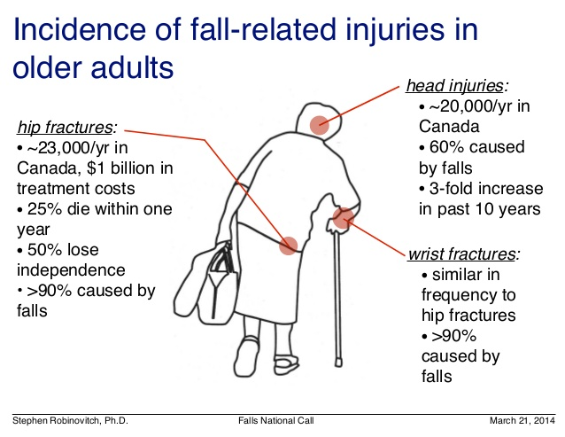
Notes:
60% of head injuries caused by falls
hip #.....

Slide 21
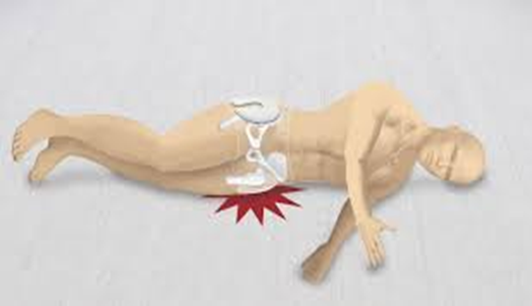
Hip #
1-2% of falls result in a fractured hip.
50% Of those who suffer fractured femurs will not fully recover.
25% will die within 12 months.

Slide 22
Hip #
‘’80 % of older women preferred death to a "bad" hip fracture that would result in nursing home admission ‘’.
Salkeld G,et al.BMJ.2000;320(7231):341.

Slide 23
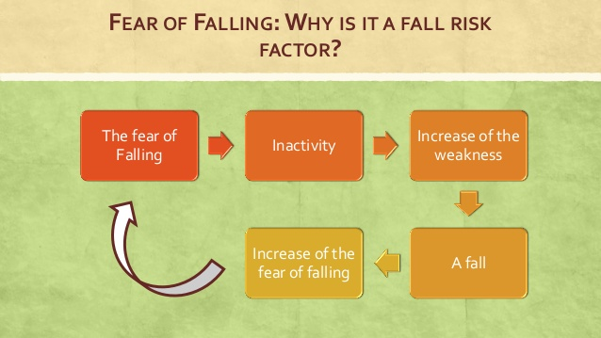

Slide 24
Costs of Fall
In US alone, the total cost of fall injuries for people 65 and older was $30 billion in 2012.
(The cost covered 2.4 millions ER visits for non fatal injuries and more than 722,000 hospitalizations.)

Slide 25

Indirect Cost
Quality of life.
Loss of independence.
Caregiving requirements.

Slide 26
Falls often go without clinical attention
WHY?

Slide 27
for a variety of reasons:
the patient never mentions falls.
there is no injury at the time of the fall.
the provider fails to ask the patient about a history of falls.
believes that falls are an inevitable part of the aging process.
treatment of injuries resulting from a fall does not include investigation of the cause of the fall.

Slide 28

Causes of Falls

Slide 29
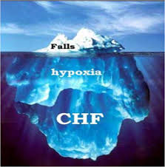
Causes Of Falls
A fall in a geriatric patient should be perceived as a symptom of a disease, to be investigated like any other serious symptom.

Slide 30
Theory of Why People Fall
Falls occur when:
Older adults who are predisposed because of accumulated effect of diseases / impairments (intrinsic)
Are exposed to precipitating challenges (extrinsic)

Slide 31
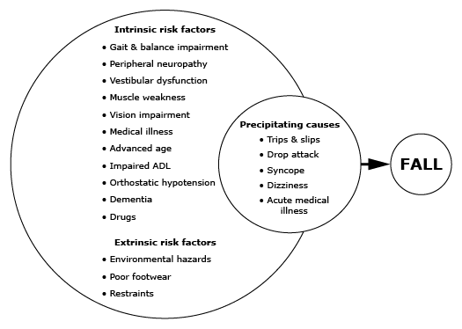

Slide 32
Falls
Physiological Changes with aging
Medication side effects
Environmental factors
Underlying illness

Slide 33
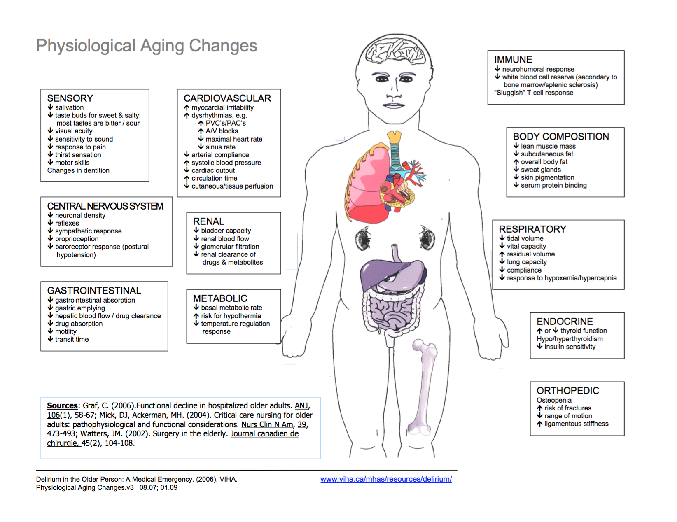

Slide 34
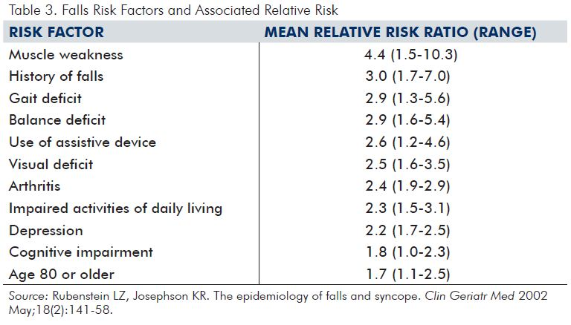

Slide 35
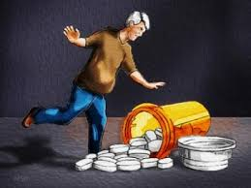
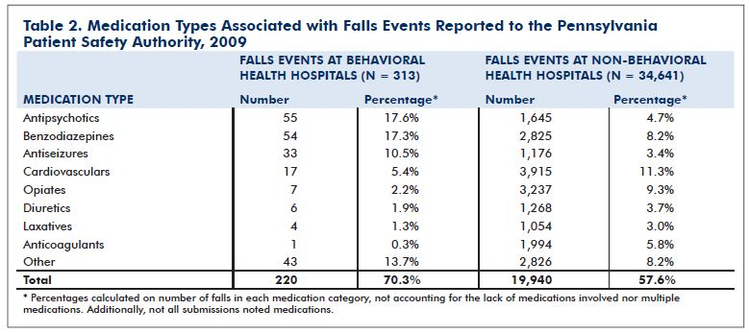

Slide 36

This study found that the three main factors that affect older persons’ likelihood of falling are:
1-number of medications taken per day.
2-sedentary lifestyle.
3- use of assistive devices.

Slide 37
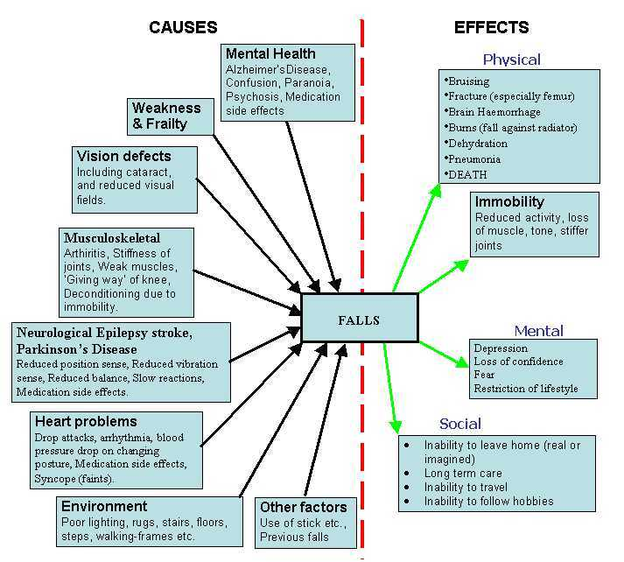

Slide 38
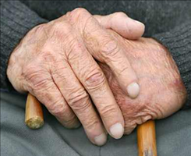
Case
Mrs.Fatmah is a 75year old lady was brought by her daughter. The daughter tells you her mother had a fall last week.
What questions do you want to ask about the fall?
Notes:
Pre during and after

Slide 39
History
Describe the fall
Ask questions to R/O syncope , pre fall symptoms .
Use systematic method to look into etiology of falls

Slide 40
Describe the fall
Accidental Fall occurs when a patient is oriented but rolls out of bed or trips / slips due to environmental risk factors, or an infant is dropped by a parent or caregiver.
Assisted Fall means that the patient was being assisted when the fall took place. While any fall is bad, assisted falls generally result in less injury than do unassisted falls.
Near Fall describes a sudden loss of balance that does not result in a fall or other injury. This can include a person who slips, stumbles or trips but who is able to regain balance; a near miss.
Unwitnessed Fall describes the event when a patient is found on the floor and neither the patient nor anyone else knows how he / she got there.

Slide 41
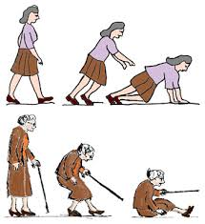
Mechanism of Falls

Slide 42
Case
lives alone in her 2 story house
Patient fell 2 days earlier while rushing to answer the phone as she was putting away the groceries.
Felt unsteady just prior to the fall as she tripped on kitchen mat. Was wearing shoes. Adequate lighting. Was able to get up right way. Uses no assistive walking devices at baseline
Reports new left arm pain immediately after the fall. Scattered bruising and swelling of Left forearm.

Slide 43
Hx
No Head trauma, LOC, syncope or presyncope, vertigo, visual changes, bowel or bladder incontinence, eating and drinking as usual, no medication changes.
Prior fall was 1 year ago while rushing down the stairs. No injury was incurred.
Had many near falls while running barefooted on waxed, wooden floors.

Slide 44
PMHx
DM
HTN
Atrial fibrillation.
Lt hip osteoarthritis
Depression
Insomnia
Insulin
Lisinopril+ Amlodipine.
Warfarin + digoxin
Tylenol regular+ Tylenol #3 PRN
Citalopram
Zolpedem Q HS

Slide 45
P/E
Check orthostatic
Perform a visual exam
Evaluate cognition ,NEUROLOGICAL EXAM.
Gait Assessment:
Motor + Balance + Coordination

Slide 46
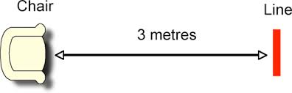
Timed up & Go test
(>12 Seconds)
Notes:
https://youtu.be/BA7Y_oLElGY

Slide 47
TUG
youtube
Notes:
https://youtu.be/BA7Y_oLElGY

Slide 49
functional reach test

Slide 50
Coordination Assessment:
Coordination Assessment:
Abnormal if:
Hesitant start
Broad-based gait
Path deviates
Heels do not clear toes of other foot
Extended arms

Slide 51
30-Second Chair Stand Test
link

Slide 52
4-Stage Balance Test
Notes:
https://youtu.be/3HvMLLIGY6c

Slide 53
P/E
Orthostatic: 135/70 88 sitting. Standing 120/65 100
Eye: +cataract. visual acuity: 20/40 L and 20/80 R. Corrected with bifocals
Gait:
-Motor: Bilateral Quad weakness+, decrease sensation in her feet.
TUG test :18 Sec
-Balance: semi tandem and tandem stances <10 sec, one leg stand< 10 secs
-Gait: Hesitant at start but walks with normal path, walks with extended arms, no wide based gait, no foot drop, heel clears toes of other foot. Slow turn with outstretched hands
Cognition: 1/3 on 3 item recall
Neuro: No Parkinsonian features or focal weakness

Slide 54
Case
What are the possible predisposing ‘intrinsic’ risk factors and ‘extrinsic’ precipitants of her fall?

Slide 55
Multi-factorial
Unmodifiable predisposing factors:
Age, female and prior history of falls
Modifiable predisposing and precipitating factors

Slide 56
Modifiable predisposing and precipitating factors
Mild weakness + moderate balance impairment
Has cataracts + refractive error +wears bifocals
Takes 4+ medications, including high risk meds Bp meds, digoxin, citalopram and zolpedem
Borderline orthostasis
?Cognitive impairment, depression
?Unsafe environment and behaviors
(kitchen matt, waxed floor. barefoot, rushing)

Slide 57
Case
What evidenced-based interventions can you recommend to prevent future falls for this patient?

Slide 59
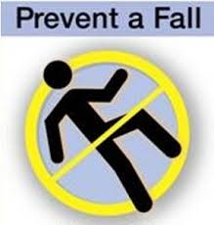
Multifactorial Assessment
With Targeted Intervention
Most commonly studied & consistently effective.
20+ trials showing 27% (2-37%) fall risk reduction for community dwelling older adults

Slide 60
USPSTF recommendation for prevention
Annual question about falls
exercise or physical therapy and vitamin D supplementation to prevent falls in community-dwelling adults aged 65 years or older who are at increased risk for falls.
Release Date: May 2012

Slide 61
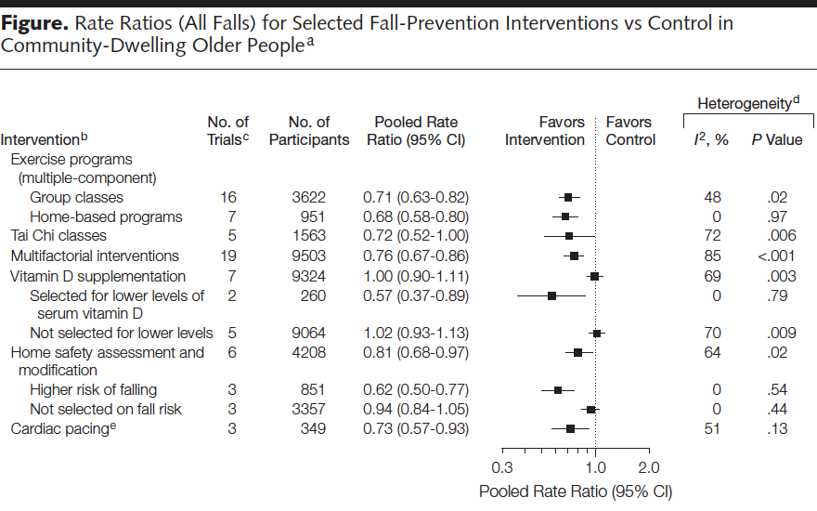
Falls Prevention

Slide 62
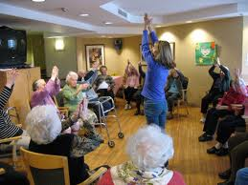
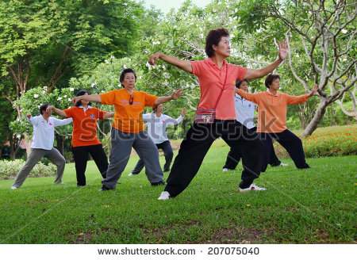
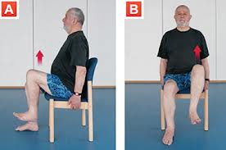
Exercise

Slide 63
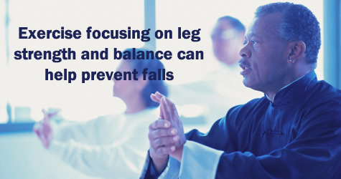

Slide 64
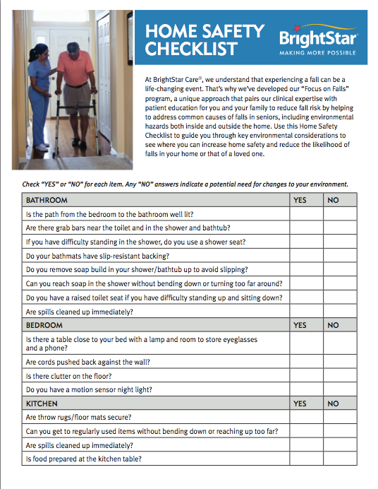

Slide 65
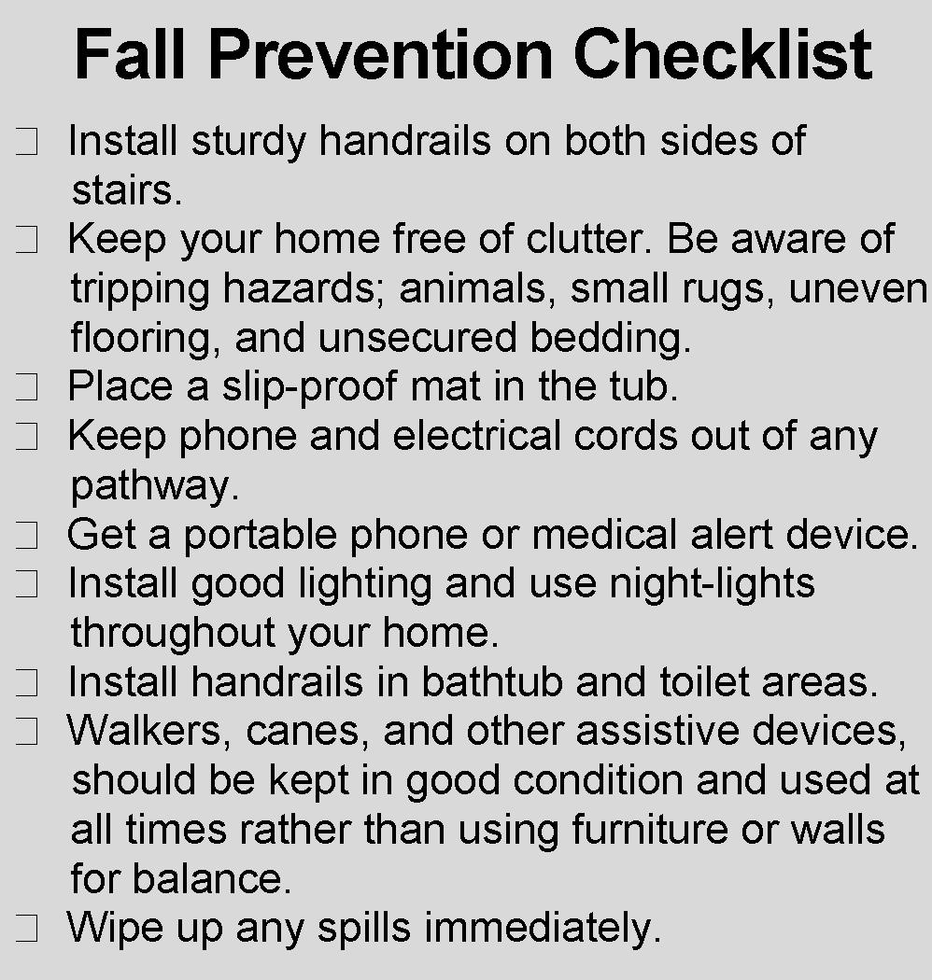

Slide 66
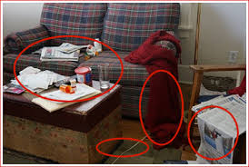
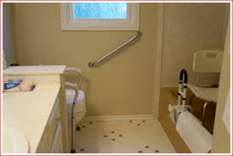

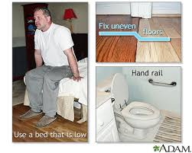
Home Safety

Slide 67
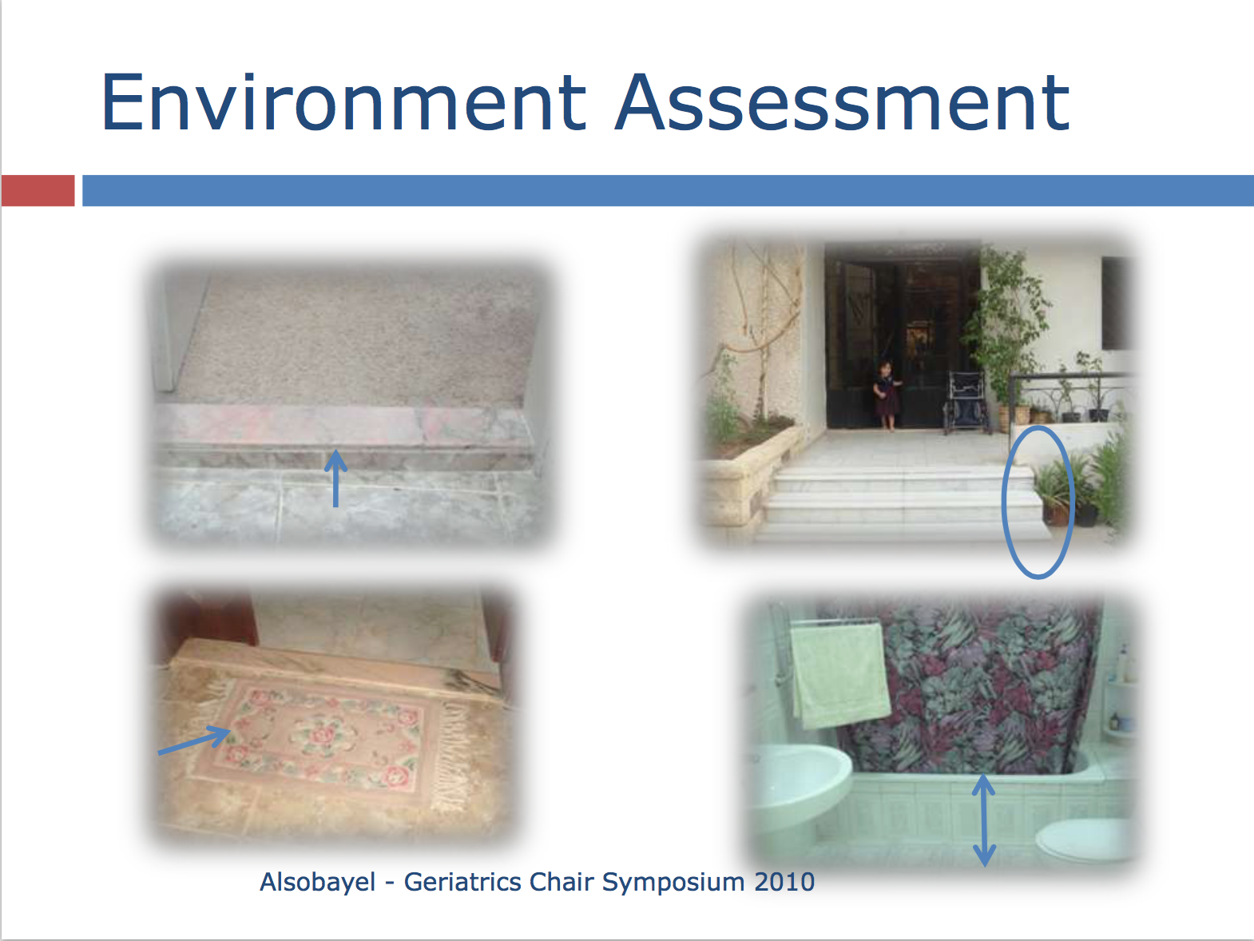

Slide 68
Vitamin D
Many older adults will need higher supplement levels (eg, at least 1000 IU daily) to achieve 25 hydroxyvitamin D levels sufficient for falls and fracture prevention.
The American Geriatrics Society

Slide 69
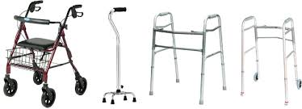
PREVENTING THE COMPLICATIONS OF FALLS
Assistive devices .

Slide 70
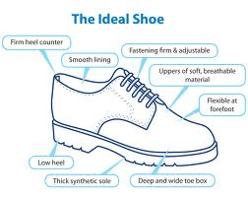

Slide 72
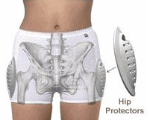
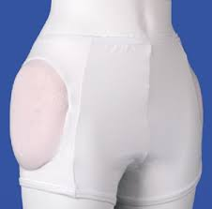
PREVENTING THE COMPLICATIONS OF FALLS
Hip protectors .
Effectiveness??
Compliance
Setting.

Slide 73
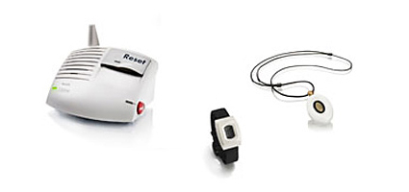
PREVENTING THE COMPLICATIONS OF FALLS
Time on floor .

Slide 74
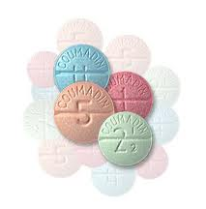
PREVENTING THE COMPLICATIONS OF FALLS
Anticoagulation

Slide 75


Slide 76

Summary
It is common in elderly.
The cause is always multifactorial.
The most important risk factor is a previous fall.
The prevention is Multifactorial Assessment
With Targeted Intervention.
We need to know the risk of falls in any patient in the hospital at all times.

Slide 77

Thank you

