Slide 1
Hypertension
Team based learning
Prof : Norah Alrowais
2022

Slide 2
EPIDEMIOLOGY OF HYPERTENSION IN SAUDI ARABIA

Slide 3
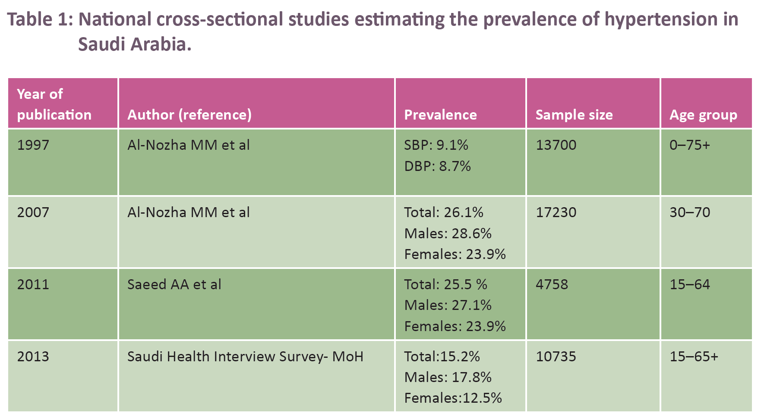

Slide 4
National Health Survey, 2013 had showed
Among all hypertensive individuals,
57.8%, undiagnosed
20.2%, treated uncontrolled
16.6%, treated controlled
and 5.4% untreated
,

Slide 5
Risk factors for HTN
Unhealthy diet
Physical inactivity
Obesity
Smoking
Family H/O
Age
Sex
race

Slide 6
HYPERTENSION PREVENTION
In view of the continuing epidemic of hypertension and its complications, efforts should be directed toward primary prevention through advocating a healthy life style and controlling other cardiovascular risk factors.

Slide 7
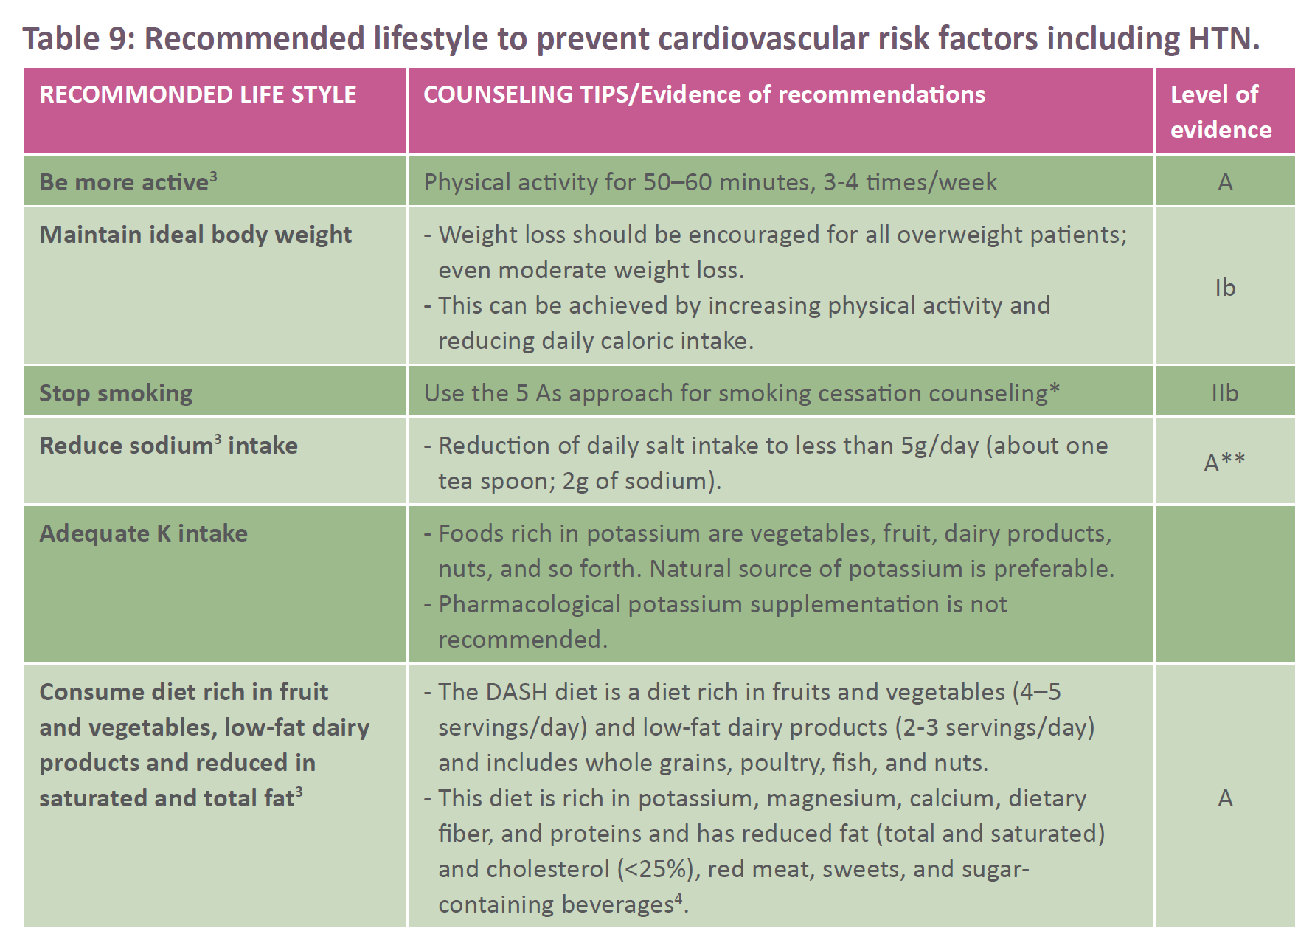

Slide 8
DEFINITION AND CLASSIFICATION OF HYPERTENSION

Slide 9
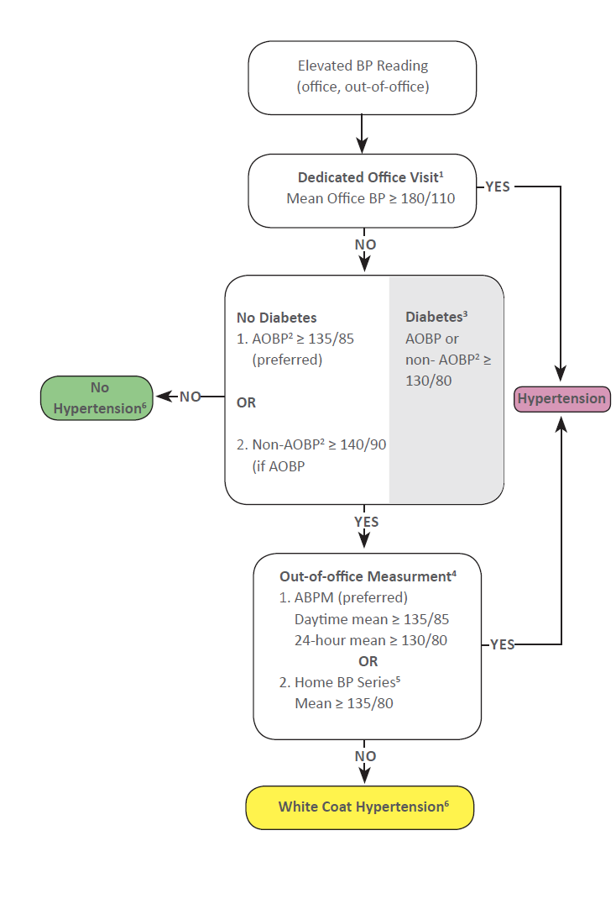

Slide 10
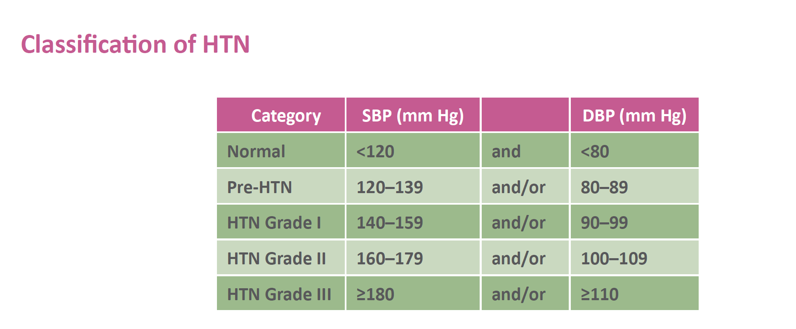

Slide 11
Isolated Systolic Hypertension:
Persistent high Office SBP ≥140 mm Hg and Office DPB <90 mm Hg.
White-coat hypertension (isolated office HTN, isolated clinic HTN):
• White coat HTN is defined as an elevated BP in the office at repeated visits, while it is normal out of the office, using either ABPM or HBPM.
• Prevalence of white-coat hypertension averages 13%.
• Target organ damage and cardiovascular events are less prevalent than those in sustained HTN. However, follow up is required.

Slide 12
Masked (isolated ambulatory) hypertension:
• Masked HTN is defined as normal BP in the office at repeated visits and elevated out of the office, either on ABPM or HBPM.
• Possible causes: anxiety, stress.
• Prevalence of masked hypertension averages about 13%.
• CV events are 2 times higher than those in true normotension.

Slide 13
CLINICAL EVALUATION

Slide 14
Clinical evaluation aims to:
• Establish the diagnosis of HTN
• Identify secondary HTN
• Detect additional RFs of CVDs
• Determine TOD
Clinical evaluation includes:
• History
• Physical examination
• BP measurement
• Basic investigations

Slide 15
History:
1. Presence of CV-RFs (DM, dyslipidemia, obesity, etc.) and other concomitant diseases
2. History or current symptoms suggestive of CVDs (CHD, MI, stroke, CHF, renal disease, and PAD)
3. Symptoms suggestive of secondary HTN
4. Lifestyle: smoking, physical inactivity, alcohol intake, sodium intake, and psychosocial
stress
5. Past experience with antihypertensive drugs
6. Medication history: oral contraceptives, NSAIDs, steroids, etc.
7. Family history of HTN and associated diseases (DM, dyslipidemia, CAD, stroke, or renal
disease).

Slide 16
Physical Examination:
Physical examination must be thorough enough to detect signs of comorbidity, organ damage, and secondary causes. It must include:
1. Weight, height, BMI, and waist circumference
2. Chest exam for rales
3. Abdominal exam for organomegaly and bruit
4. Central nervous system: motor or sensory defects
5. Cardiac: arrhythmia, murmur, rales, peripheral edema
6. Retina examination for hypertensive changes. However, a dilated fundoscopic examination by an ophthalmologist is recommended afterwards.
7. Vascular: absent arterial pulses, carotid bruit, radio-femoral delay

Slide 17
Signs suggesting secondary HTN
• Age of HTN diagnosis <20–30 or >55–60 years
• Family history of premature CV disease (<55 years)
• Early TOD

Slide 18
Basic Investigations:
1. Urinalysis (protein, glucose, blood, casts)
2. Blood chemistry: potassium, sodium, creatinine with e-GFR, fasting blood glucose, and serum uric acid
3. Complete fasting lipid profile
4. Hemoglobin and hematocrit
5. Electrocardiography (ECG)

Slide 19
Additional Optional Investigations, if needed:
1. TSH, Free T4
2. Chest X-ray
3. Abdominal sonography
4. Echocardiography

Slide 20
BLOOD PRESSURE MEASUREMENT

Slide 21
Methods of BPM:
Auscultatory
Oscillometric

Slide 22
Oscillometric
a. Automated arm sphygmomanometers: They are good alternative, for both office-based and home-based measurements. However, they must be validated and approved per the international standard test protocols, http://www.dableducational.org.
b. Automated wrist sphygmomanometers are widely used by patients, but they are less reliable. Minimal position changes can result in variable readings. Measurement of BP at the upper arm is preferred.
c. Automated unattended office sphygmomanometers is automated office BP (AOBP),
taken without patient-health provider interaction using a fully-automated device.

Slide 23
OUT-OF-OFFICE BLOOD PRESSURE MONITORING:
Proper Out-of-office BPM has a better prognostic value than Office Blood Pressure Monitoring (OBPM). It provides many BP measurements away from the medical environment.
It helps to rule out white coat hypertension (WCH) and identifies Masked HTN.
There are two forms of out-of-office BP monitoring

Slide 24
Home Blood Pressure Monitoring (HBPM):
• HBP may be used for both diagnosis and monitoring of BP.
• Home SBP values ≥135 mmHg or DBP values ≥85 mmHg should be considered as elevated.
• Home BPM should be based on duplicate measurements (one minute apart), morning and evening, for an initial 7-day period. First-day home BP values should not be considered.
• SHMS strongly supports the use of HBPM as adjunctive in hypertension follow-up. It is cost effective and improves adherence and control.

Slide 25
II. Ambulatory BP Monitoring (ABPM):
• It is performed by a validated automated device over a period of 24 hours.
• BP is measured at repeated intervals (every 15–30 mins while awake, and every 30–60 mins during sleep).
• The patient is instructed to engage in normal activities but to refrain from strenuous exercise and, at the time of cuff inflation, to stop moving and talking and keep the arm still with the cuff at heart level.
• At least 70% of BPs during daytime and nighttime periods should be satisfactory.

Slide 26
• ABPM is a more sensitive risk predictor of CV outcome than is office BPM.
• The incidence of CV events is higher in non-dippers.
• Normal average daytime BP is <135/85 mm Hg.
• Nocturnal BP is 10%–20% less than the average daytime BP (<120/75 mm Hg).
• A 24-hour average value of 130/80 mm Hg corresponds to a 140/90 mm Hg of office value.
• Possible reasons for the absence of dipping are: sleep disturbance, obstructive sleep apnea (OSA), CKD, and obesity.
• It is more expensive than self-monitoring.

Slide 27
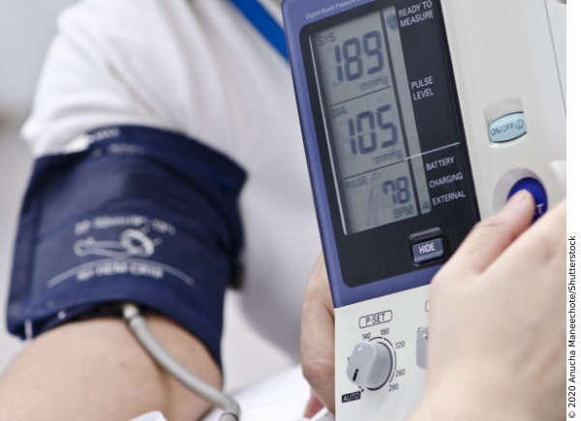
Automated office blood pressure (AOBP) is the preferred method of performing in-office BP measurement
Automated Office (unattended, AOBP)
Oscillometric (electronic)

Slide 29
GOALS OF TREATMENT
1. Reducing blood pressure to the target level
2. Controlling all other reversible cardiovascular risk factors, which include but not limited to:
• Diabetes,
• Smoking,
• Dyslipidemia,
• Obesity,
• Alcoholism,
• Physical inactivity,
• Stressful life style, and
• Unhealthy diet

Slide 30
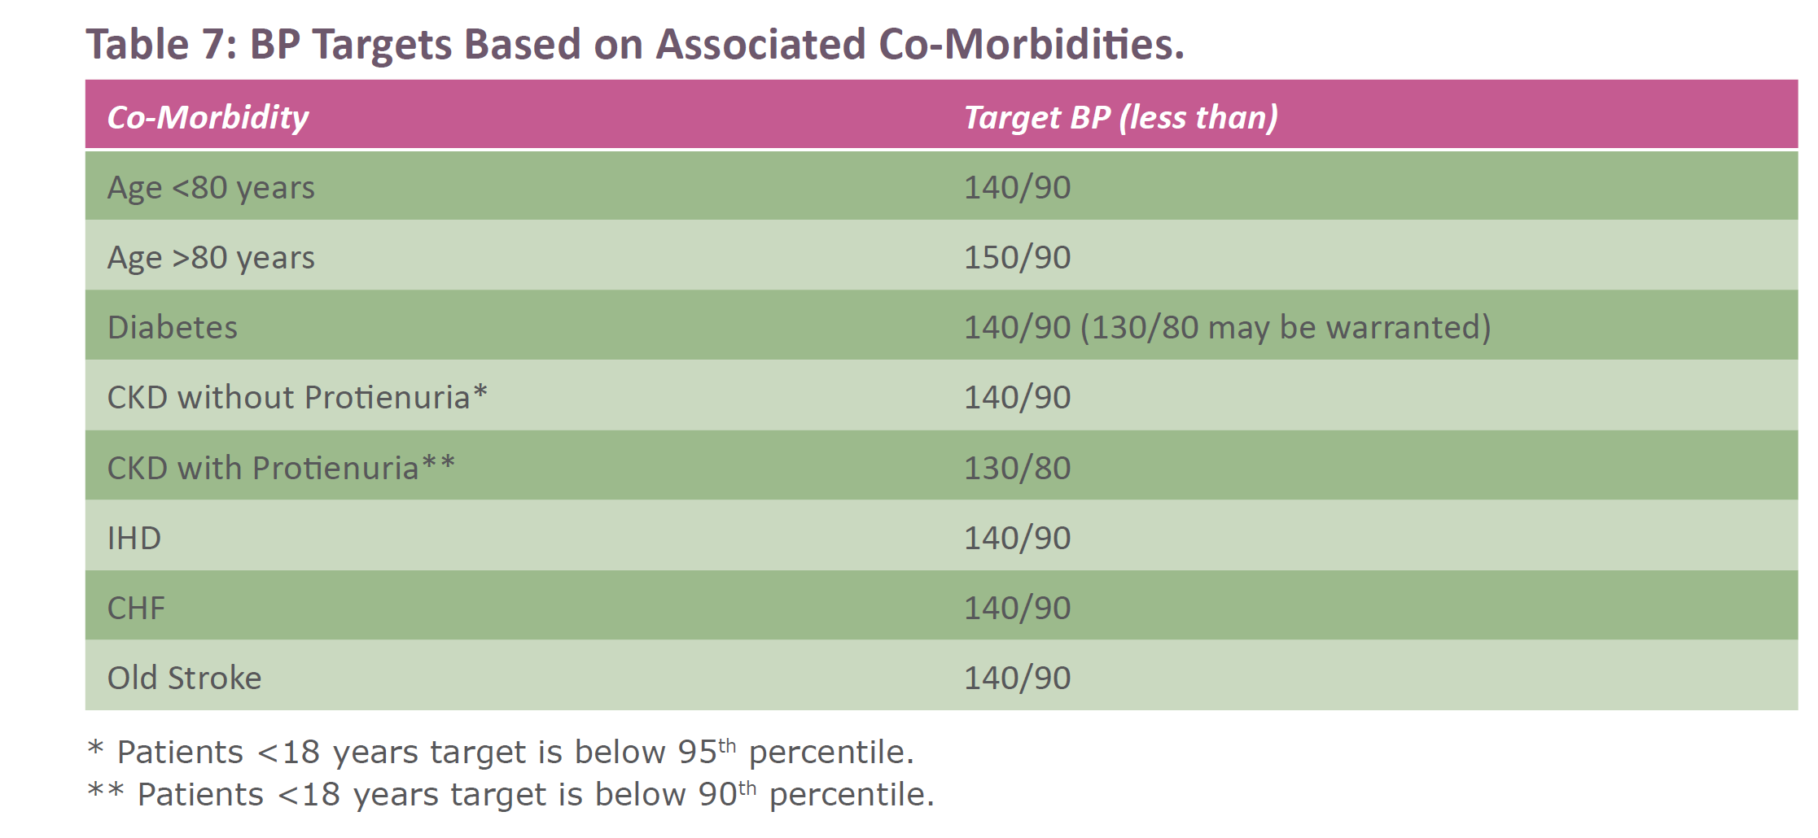

Slide 31
HYPERTENSION MANAGEMENT
Non-pharmacological approach
Pharmacological approach

Slide 33
Pharmacological approach

Slide 34
Current evidence from randomized controlled trials indicates that several classes of drugs, including low- dose thiazides (Level Ia), ACEI (Level Ia), long-acting dihydropyridine CCBs (Level Ia), and ARBs (Level Ia) will lower BP and reduce the complications of HTN.
Low-dose thiazide/thiazide-like agents are still considered among the first-line agents for the treatment of most patients with HTN. In addition, diuretics enhance the efficacy of other antihypertensive drugs and are affordable and widely available.
Beta blockers (BBs) are no longer recommended as first-line agents in patients over 60 years of age with uncomplicated HTN

Slide 35
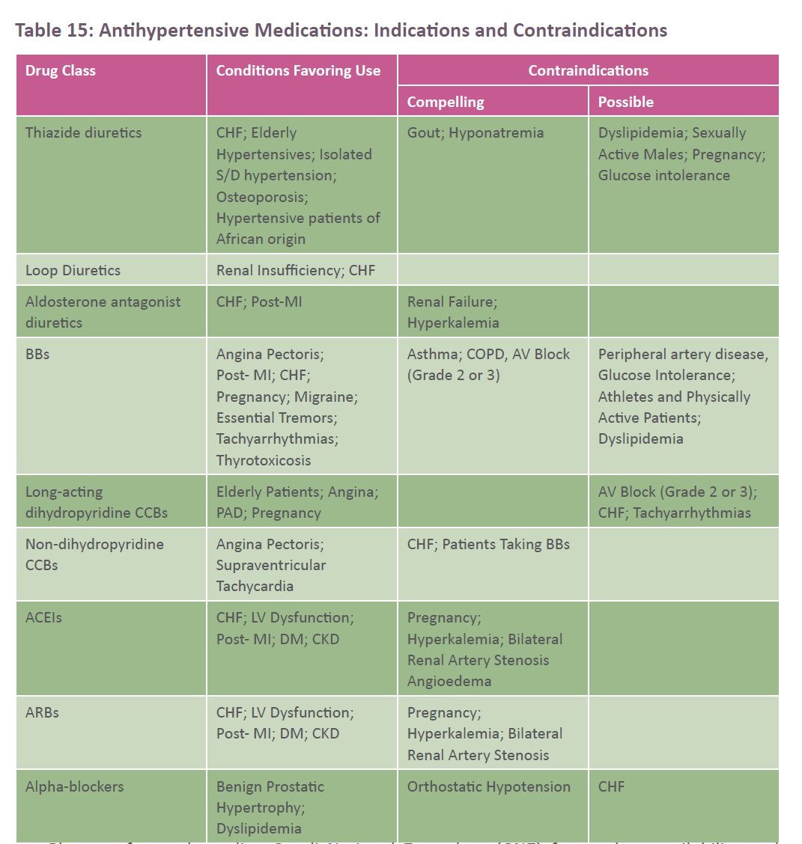

Slide 36
Hypertension without any compelling indications (Target BP <140/90 mm Hg):
Thiazide diuretics, ACEI, ARBS, or long-acting dihydropyridine CCBs are considered first-line antihypertensive agents.
Combination of first line agents (2-3 agents) should be considered if SBP ≥20 mm Hg or DBP ≥10 mm Hg above target or in patients at high CV-R.

Slide 37
Isolated systolic hypertension without other compelling indications (target BP for age <80 is <140/90 mm Hg; for age ≥80 the target systolic BP is <150 mm Hg):
Thiazide/thiazide-like diuretics, ARBs, or long-acting dihydropyridine CCBs.
Past stroke or TIA:
ACEI and a thiazide /thiazide-like diuretic combination.

Slide 38
Diabetes Mellitus (Target BP <140/90; however, <130/80 may be warranted)
a- Diabetes mellitus with microalbuminuria*, renal disease, cardiovascular disease, or additional cardiovascular risk factors:
ACE inhibitors or ARBs. Addition of long-acting dihydropyridine CCBs is preferred over thiazide/thiazide-like diuretics. A loop diuretic could be considered in hypertensive CKD patients with extracellular fluid overload.
b- Diabetes mellitus without microalbuminuria or other comorbidities: ACE inhibitors, ARBs, long-acting dihydropyridine CCBs or thiazide/thiazide-like diuretics. Combination of ACEI with CCB is preferred over combination with thiazide/thiazide-like diuretic.

Slide 39
Cardiovascular Disease (Target <140/90 mm Hg):
a- Coronary artery disease:
ACE inhibitors or ARBs; ßBs and LA-DHP-CCBs for patients with stable angina.
When combination therapy is being used for high risk patients, an ACE inhibitor with dihydropyridine CCB is preferred.
Avoid short-acting nifedipine.
Combination of an ACEI with an ARB is contraindicated.
Exercise caution when lowering SBP to target if DBP is ≤60 mm Hg.

Slide 40
Recent myocardial infarction:
ßBs and ACE inhibitors (ARBs if ACE inhibitor intolerant).
Long-acting CCBs if ßB contraindicated or not effective.
Non-dihydropyridine CCBs should not be used with concomitant heart failure.

Slide 41
Heart failure:
ACE inhibitors (ARBs if ACE inhibitor intolerant) and BBs.
Aldosterone antagonists may be added for patients with recent cardiovascular hospitalization, acute myocardial infarction, elevated Brain natriuretic peptide (BNP), or N-terminal pro BNP level or NYHA Class II to IV symptoms.
Second-line agents may include hydralazine/isosorbide dinitrate combination if ACE inhibitor and ARB contraindicated or not tolerated.
Thiazide/thiazide-like or loop diuretics are recommended as additive therapy.
Dihydropyridine CCB can also be used.

Slide 42
Target organ damage

Slide 45
Referral to specialist:
Referral to a specialist should be considered in the following situations:
1. Resistant HTN
2. Suspicion of secondary HTN
3. Sudden onset of HTN
4. HTN diagnosed at young age (30 years old)
5. Worsening of HTN
6. Malignant HTN

Slide 46
Thank You

