Slide 1
Infant and childhood Nutrition Aim :- To have a healthy well nourished child. Achieving normal growth. Avoidance of deficiency states. Good nutrition contribute to :- The prevention of acute and chronic illness. The development of physical and mental potential. The provision of reserve for stress. Individual nutritional requirement vary with genetic and metabolic differences. To provide a child with well balance diet which should contain :- Macro nutrient Protein, fat, CHO. Micro nutrient vitamins and minerals. Water. Cont….
1

Slide 2
- Proteins : Constitutes about 20% of adult body weight. Consist of amino acids. Twenty four amino acids were identified. Nine are essential. Proteins needed for tissue regeneration and growth. Ingested protein oligo peptide & amino acids. Hcl In alkaline medium of intestine Trypsin Oligo Peptides peptides Chemotropism Peptides Peptidase amino acids. Cont….
Pepsin
2

Slide 3
- Carbohydrates and fats. The main source of energy. Carbohydrates. Poly saccharide (starch). Poly saccharide amylase Disaccharide. Lactose Lactase glucose + galactose Disaccharide Sucrose Sucrase glucose + Fructose Maltase maltase 2 glucose Glucose and galactose are actively absorbed. Fructose is passively absorbed. Most of the absorbed sugar is converted to glycogen and stored in liver and muscles glycogen accounts for 15% of the weight of the liver and 3% of muscle weight. Cont….
3

Slide 4
Fats : Mainly triglycerides. 98% of natural fat. Triglyceride Lipase 3 fatty acids + glycerol. Fatty acids varying in length from 4-24 carbon atoms. Short chain fatty acid provides 5.3 kcal/gm. 1 gm of medium chain fatty acid 8.3 kcal. 1 gm of long chain fatty acid 9.3 kcal. Essential fatty acids. Linoleic, arachedonie and lino lenic acids. Unsaturated fatty acids are necessary for growth, skin and hair integrity. Cont….
4

Slide 5
Infant feeding : The most important period of life is the 1st year a normal child will achieved maximum growth. (growth velocity) (a normal child Triple his birth weight add 50% of birth length. Successful infant feeding requires cooperation between the mother and her child. Breast feeding should be initiated soon after birth. Feeding should be scheduled every 2-4 hours with increase amount of feeds and decrease frequency as the infant grows. Cont….
5

Slide 6
Energy requirement for growth : 1 week - month > 30 kcal / day 2nd month 25 kcal / day 2-3 months 16 kcal / day 3-6 months 10 kcal / day 12 months 05 kcal / day 18 months 02 kcal / day - Fluid : Water is essential for existence. It is second to oxygen. Water content of infant is higher than that of adult. Infant 70% - 75% of B.W. Adult 60% - 65% of B.W. 7% intravascular 18% in interstitial 45% in intracellular Cont….
6

Slide 7
- Daily consumption of fluid : In infant 10 - 15% of body weight. In adult 2 - 4 % of B. W. - Water requirements are related : Caloric consumption. In sensible water loss. Urine specific gravity. - Sources of fluid water : Fluid in take (majority). Oxidation of food Mixed diet 100 kcal 12 ml of H2O Almost all water intakes are lost in : Urine 40-50% of intake may in Diabetes mellihis. Diabetes insipiduis. Intrinsic real disease. Hypocalcaemia. Cont - - - .
7

Slide 8
- In insensible water loss 40 – 50% Increase loss from skin occurs in : Burns, severe dermatitis, fever. Phototherapy. Add 30 ml/kg Add 15 ml/kg for each additional light. Increase loss from lung respiratory distress. Fecal loss 3 – 10% in diarrhea. Losses in interstitial space. Due to disturbances in oncotic & hydrostatic pressure or lymphatic system. Daily fluid requirement 1/ Body surface area 1500 ml/day. 2/ Body Wt Wt Fluid 1-10 Kg 100 ml/kg / day 10-20 1000 ml + 50 ml/each kg above 10 > 20 1500 ml + 20 ml /each kg above 20 Cont- - - ….
8

Slide 9
- Fluid requirements in new born infant : First day 60 – 70 ml /kg/day 2nd day 75 – 80 ml /kg/day 3rd day 80 – 100 ml /kg/day 4th day 100 – 125 ml /kg/day Fluid requirements are increased in :- VL BW. Gaotroschisis. Omphalocele. Phototherapy. Cont….
9

Slide 10
- Calories : 1 calories = 1 k calories. A kilo calories :- The amount of heat needed to raise the temperature of 1kg of water from 14.5% c – 15.5 c. Daily calorie requirement. 100 – 120 kcal/kg/day. It decreases by 10 kcal/kg for each succeeding 3 years. Sources of energy :- Carbohydrates – 1 gm 4 kcal. 40-45% of total calorie requirement. Protein 1gm 4 kcal 10-15% of daily calories requirement . Fats. 35– 45% of daily calorie requirement. Cont….
10

Slide 11
- Expenditure of Energy :
Basal metabolism 50%
Physical activity 25%
Growth 12%
Fecal loss 8%.
T E F 5%
Recommended daily dietary allowance :-
Age | Energy | Protein | Vitamins
 |  |  | Vit A | Vit D | Vit E | Vit C
Infant Children | 110 | 2.2 | 1400 | 400 | 4 | 35
1-3 | 100 | 1.8 | 2000 | 400 | 7 | 40
4-6 | 90 | 1.5 | 2500 | 400 | 9 | 40
7-10 | 80 | 1.2 | 300 | 400 | 10 | 40
11-14
Male | 60 | 1.0 | 5000 | 400 | 12 | 40
Female | 50 | 1.0 | 4000 | 400 | 12 | 40 Cont….
11

Slide 12
Breast Feeding Human milk is the natural food for full term infants during the first few months of life. It provides all necessary nutrients till age of 6 months. Cont….
12

Slide 13
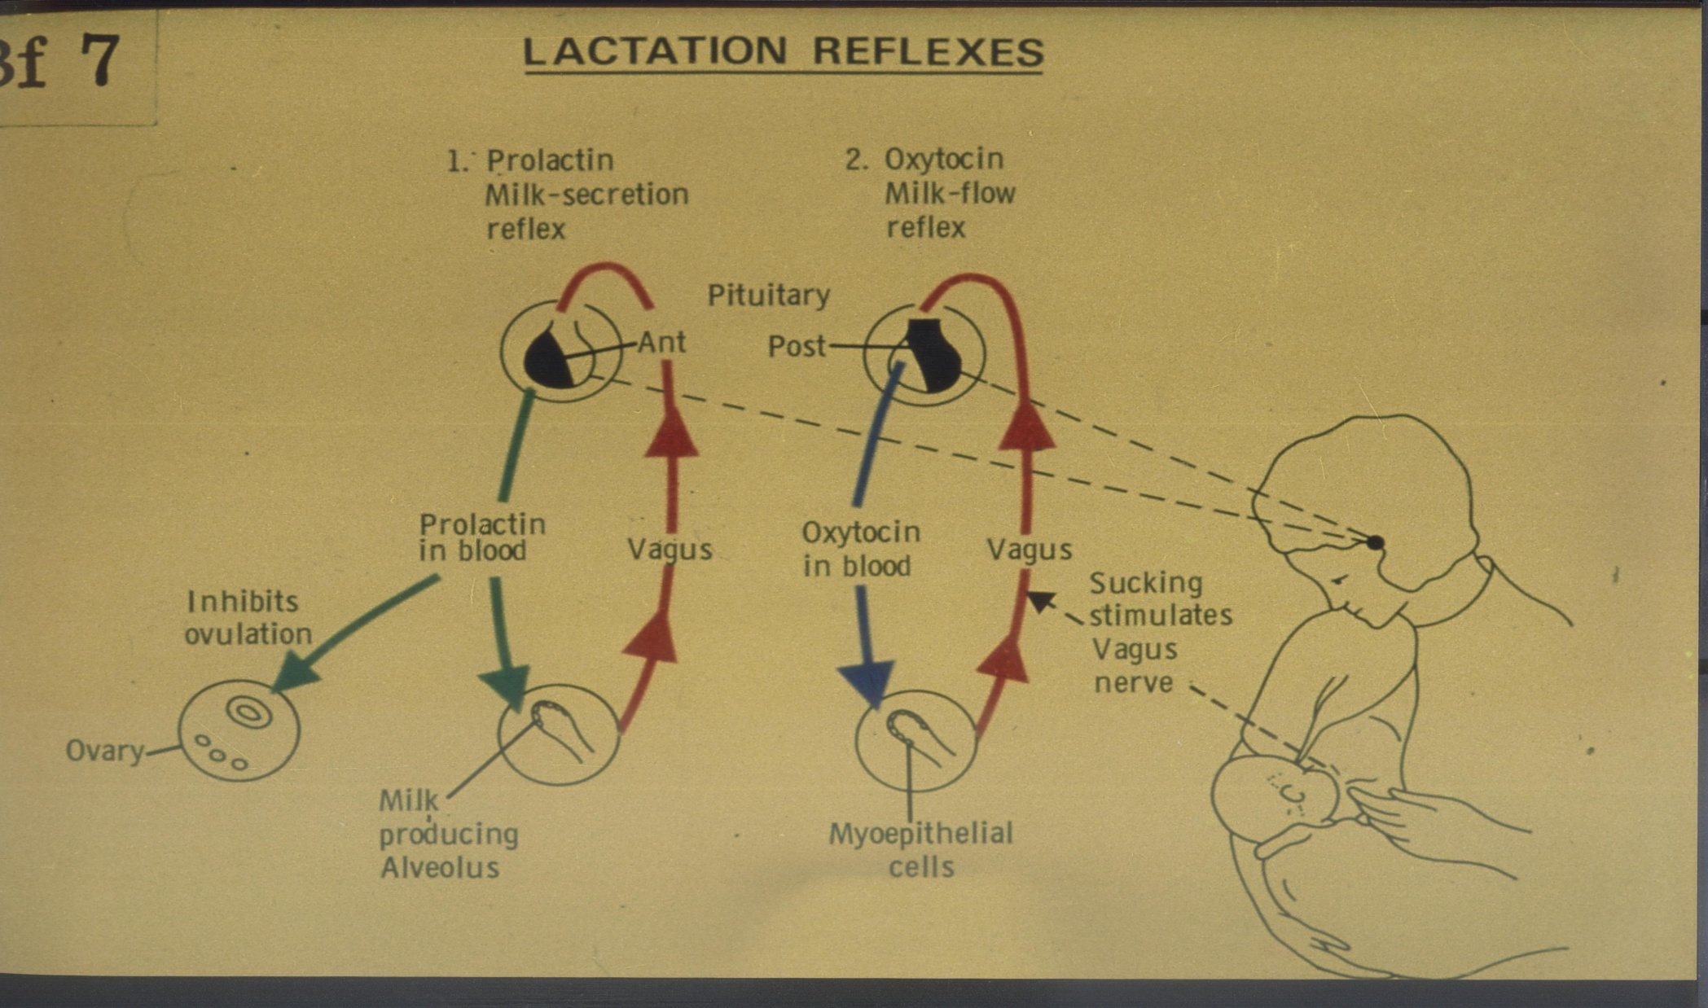
13

Slide 14
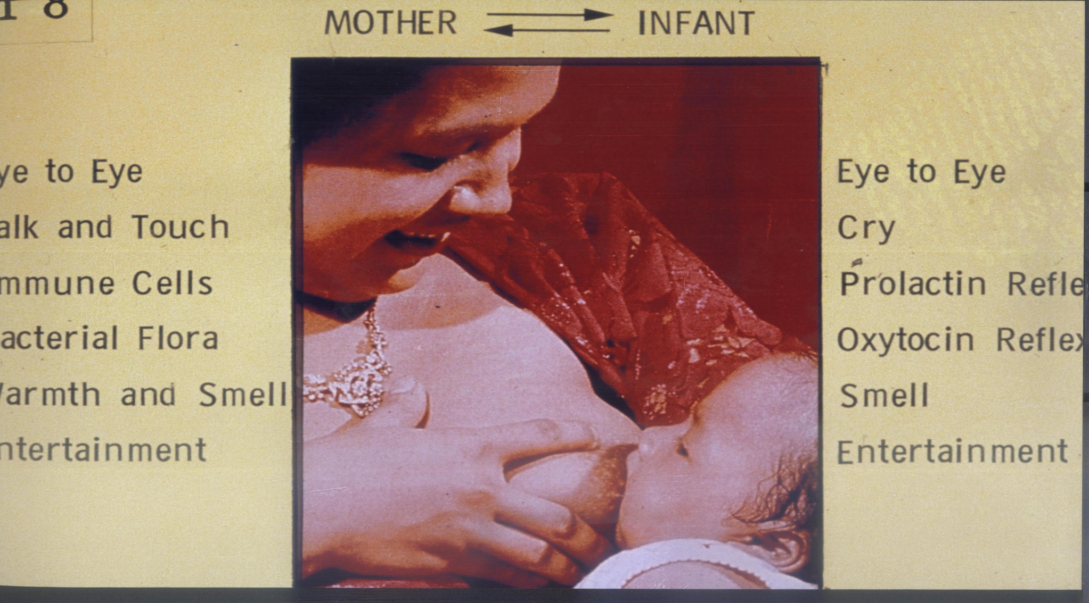
14

Slide 15
15

Slide 16
16

Slide 17
Approximate Composition of Human & Cow's Milk
Macronutrients.
Constituents Gm/100 gm | Human Milk | Cow's Milk
Water | 88% | 88%
Calories | 67% kcal/100ml | Same
Protein | 0.9 | 3.3
- Casein | 0.3 | 2.7
- Lactalbunin | 0.4 | 0.4
- Lacto globulin | 0.2 | 0.2
Fat | 3.8 | 3.8
- Poly unsaturated
Carbohydrate
- Lactose | 7.0 | 4.8 Cont….
17

Slide 18
Approximate Composition of Human & Cow's Milk
Micronutrient.
Menirals.
Constituents | Human Milk | Cow's Milk
Ca ++ mg/100 gm | 34 | 117
Po4 mg/100 gm | 15 | 92
Na+ mmal/L | 7 | 22
K + mmal/L | 13 | 35
Iron mg/L | 0.5 | 0.5
Cont….
18

Slide 19
Approximate Composition of Human & Cow's Milk
Micronutrient.
Vitamins.
Constituents | Human Milk | Cow's Milk
Vit A (1.4) | 1800 | 1025
Vit C (mg) | 43 | 11
Vit D (1.4) | 22 | 14
Vit E (mg) | 2 | 0.4
Vit K | 15 | 60
Cont….
19

Slide 20
Colostrums It is the secretion of breast during the later part of pregnancy and 1st 4days after delivery. It has a deep lemon yellow colour. It has an alkaline reaction. It has higher specific gravity than mature milk. Has more protein and mineral and less CHO and fat than mature milk. Cont….
20

Slide 21
Advantages of breast milk feeding Always ready available at proper temp and time. It is fresh and free of contamination. Contains bacterial and viral anti bodies. High concentration of secretary /gA. Contains macro phages and lysozymes. Contains lacto ferrin inhibit growth of Ecol. Contains growth promoting factors which enhances growth of non pathogenic flora. Cont….
21

Slide 22
Contra indications of breast feedings From the mother stand point - Absolute contra indication Septicemia, Nephritis. Profuse Hemorrhage. Eclampsia, typhoid fever. Severe neurosis, post partum psychosis Hiv. - Relative contra indication Fissuring and cracking of nipple. Mastitis. Acute infection in the mother. Cont….
22

Slide 23
Contra indications of breast feeding - From infant stand points. Metabolic diseases. PK.U ? Galacto sacmia. Digestive disorder. Primary lactose intolerance. Glucose – glactose malao or ption. Cont….
23

Slide 24
Milk formula feeding - Cow's milk is the main source for most formula - Commercial formulas are modified from a cow's milk in such away. Reduce protein concentration. Saturated facts are replaced with unsaturated fats Reduce mineral content. For lified with vitamins. Cont….
24

Slide 25
Milk substitute and hypoallergenic milk Used under certain circumstances Soya bean derived milk formula used in cow's milk protein allergy. Amino acids mixture preterm baby. Lactose free formula lactose intolerance. MCT to provide calories. Cont….
25

Slide 26
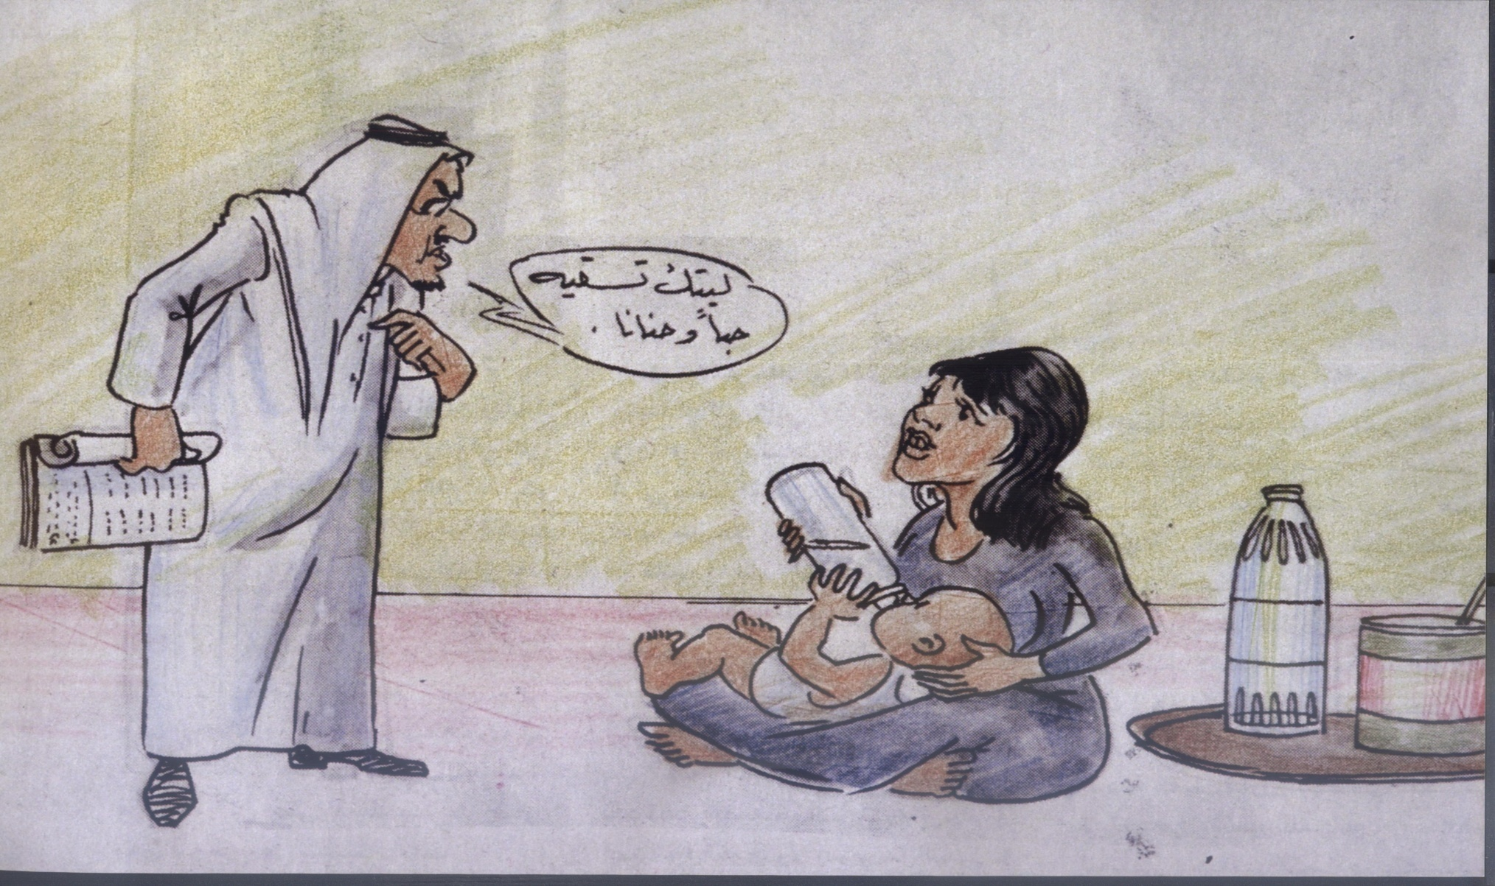
26

Slide 27
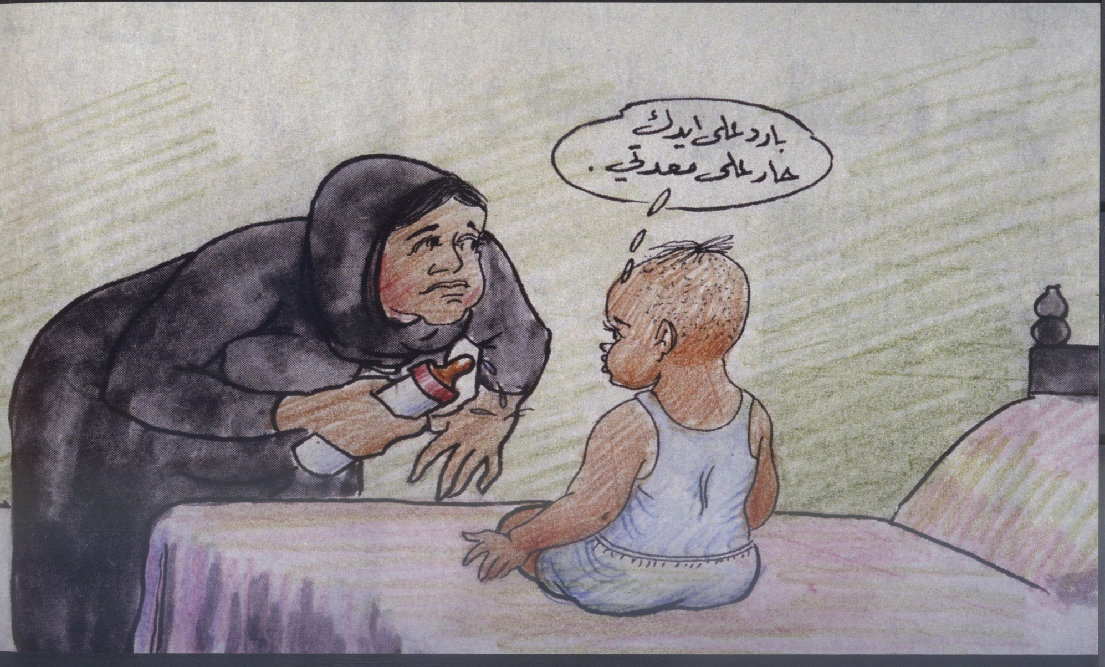
27

Slide 28
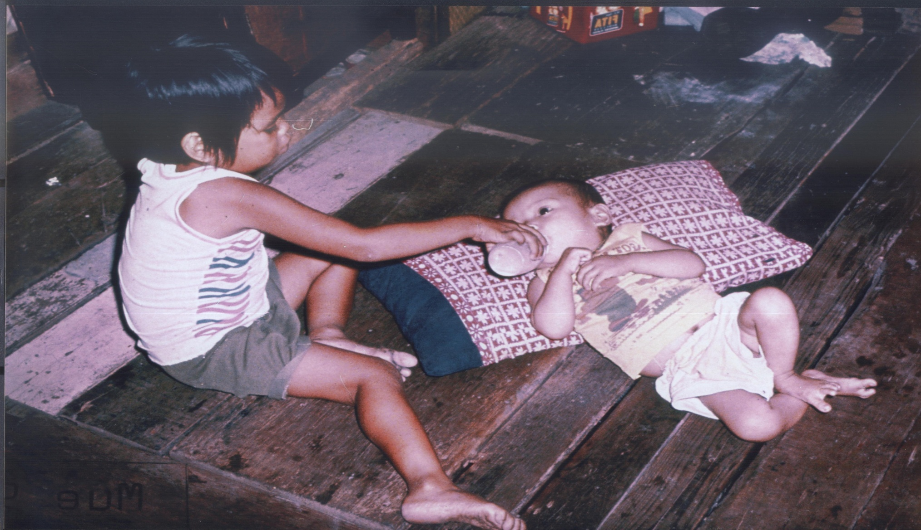
28

Slide 29
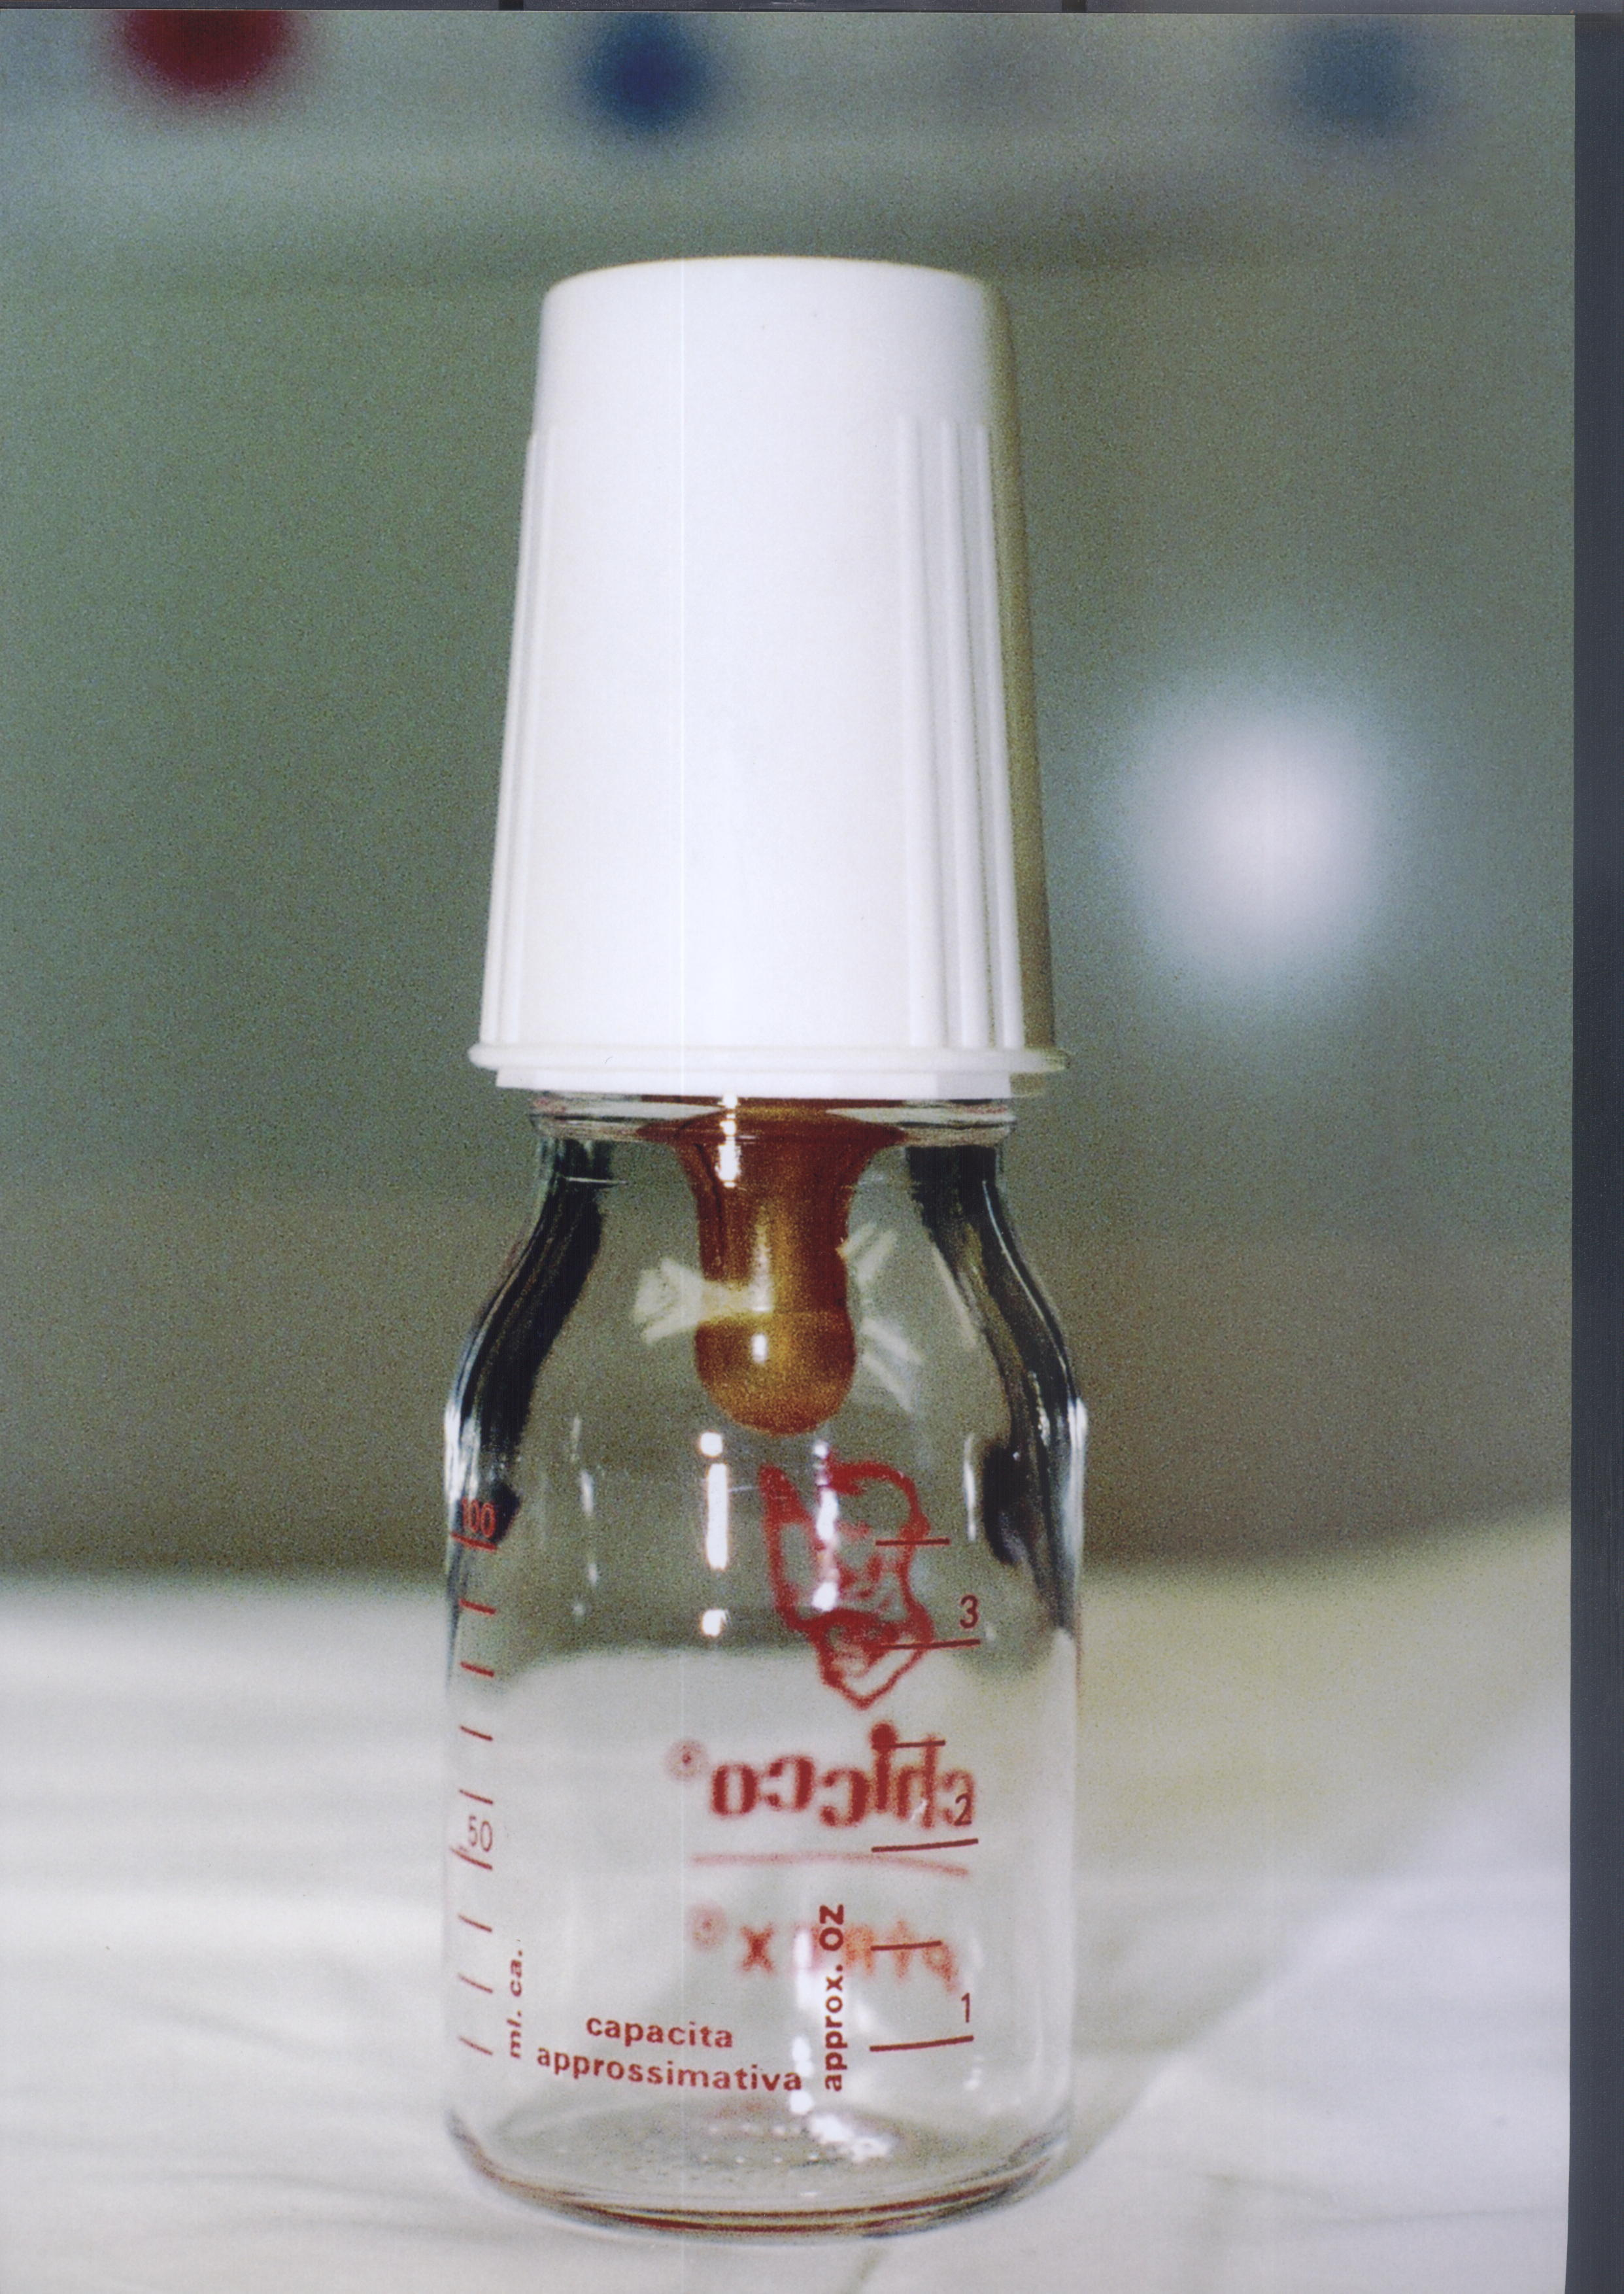
29

