Slide 1
Meningitis
`acute infection of the CNS
The clinical syndrom:
Bacterial meningitis
Viral minigitis
Encephalitis
Brain abscess

Slide 2
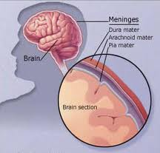
Meningitis:
Acute infection within the subarchanoid space.
Bacterial Meningitis:
Bacterial meningitis reflects
infection of the arachnoid
mater and the CSF in both
the subarachnoid space and the cerebral ventricles

Slide 3
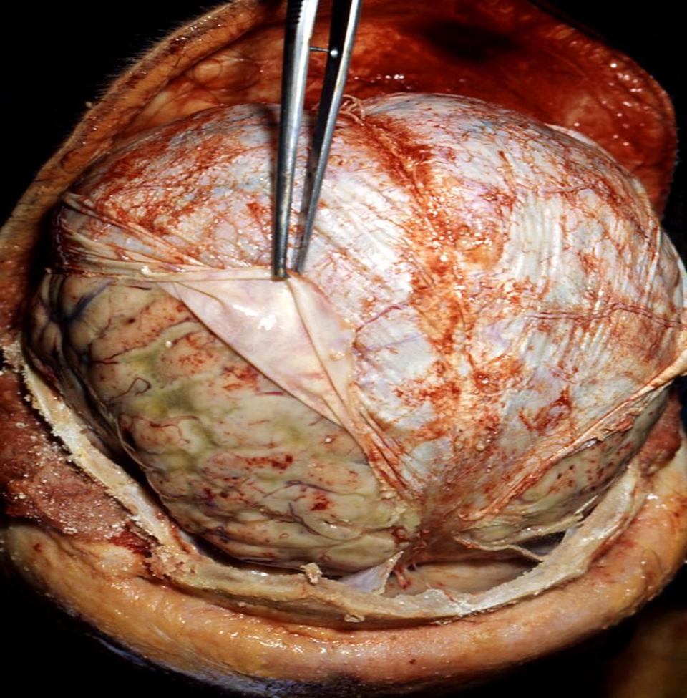

Slide 4
Bacterial meningitis is
Medical emergency
The mortality rate of untreated disease approaches 100 percent

Slide 5
Case scenario
26 yrs old female presented to private :
C/O :earache and eventually ended with
Ventilator dependent quadriplegia

Slide 6
March 13 :Ist visit to private doctor
C/O: earache
Dx : Otitis media
RX : Cipro
March 16: 2nd visit to another physician:
Headache , neck pain , fever and vomiting
DX :Gastroenteritis
RX: Phenergan

Slide 7
March 16 , 9pm : To Emergency deptc/o confusion and inability to follow commands
Exam:
Fever , stiff neck
DX: Meningitis VS Phenergan side effect
Action : CT-scan brain…CT-scan is normal----
CSF study : Result?
What do you think ? Normal or abnormal

Slide 8
  Cloudy ,
  Cells : WBC >6000 mainly polys.
  Gram stain : Gram positive dipplococci
  Action (2hrs from start ) :
  Cefitriaxone 2gm BID
  What happen

Slide 9
Patient deteriorated and connected to ventilator after developing quadriplegia.
Q:How do you assesss the management :
A) Well managed from the start
b) The first private doctor had done a mistake
c)The 2nd private physician is ignorant
d) The ER doctor has the job very well 100%
e) All are bad doctors ?

Slide 10
Clues to DX
Clues in the patient's clinical history ?
What are these ?
Symtoms :
Contacts
Travel
Surgery
Discharging ear
URTI

Slide 11
Symptoms of fever, altered mental status, headache, and nuchal rigidity
one or more of these findings are absent in many patients with bacterial meningitis

Slide 13
fever, neck stiffness, and altered mental status
Triad : 99 to 100 percent have at least one
Almost no patients have a normal temperature
Fever ..95 percent
Nuchal rigidity …88 percent
Mental status is altered in…78 percent

Slide 14
GENERAL PRINCIPLES OF THERAPY
Avoidance of delay
Effects of delay:
■In a prospective study of 156 patients with pneumococcal meningitis, a delay in antibiotic treatment of more than three hours after hospital admission was a strong and independent risk factor for mortality

Slide 15
Retrospective cohort study of 286 patients with community-acquired bacterial meningitis, early and adequate administration of antibiotic therapy in relation to the onset of overt signs of meningitis was independently associated with a favorable outcome, defined as mild or no disability

Slide 16
Causes of delay :
1. Atypical presentation : retrospective study of 119 adults with bacterial meningitis :
the most dramatic clinical predictor of death was the absence of fever at presentation
Lowering the threshold for initiation of therapy may be prudent, but there is no clear guideline

Slide 17
2. Delay due to imaging:
CT scan of the head to exclude an occult mass lesion that could lead to cerebral herniation during subsequent CSF removal .
Although commonly performed, a screening CT scan of the head is NOT necessary in the majority of patients

Slide 18
Retrospective study of 119 adults with bacterial meningitis noted above, withholding antibiotics until a CT scan and lumbar puncture were done was strongly associated with a delay of >6 h to the first dose of antibiotic

Slide 19
Case 1 Time :8:15am
14 years old boy who arrived recently from nigeria presented with history of URTI for the last 4 days ,when he was given antihistamine.
12 hours before arrival to ER he started to have :
Headache (mod severe) associated with vomiting.
What is next ?

Slide 20
Ask about : Photophobia , myalgia ,GIT symptomes, lethargy,
Contact with sick patient closely.
Previous vaccination
Any earache ,or ear discharge.
What is next

Slide 21
Examination :
Conscious state : OK
Temperature : 40
Ear , nose and throat exam
Skin examination :
Look for meningeal irritation…..How

Slide 22
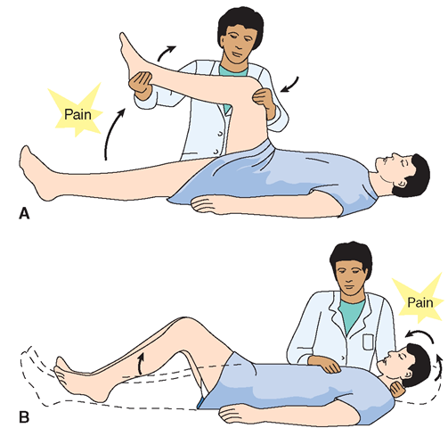
Nuchal rigidity
Pathognomonic
Sign for :meningeal
irritation
Kernig s sign : +
Brudzniski sign:+

Slide 23
Time :8:38am
The boy was resisting the flexion ?
Impression ?
Next ?
To Rule in or out the possibility of CNS infections?
What do you mean by CNS infection ?
How to answer the above mentiones TASK?

Slide 24
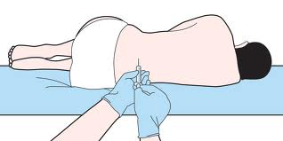
Time is 8:50am
Lumbar puncture to study the CSF :
What exactly you will do?
Appearance : Couldy
Cell count : Biochemistry:
Glucose & Protein
Gram stain :
Culture:

Slide 25
Causes :
Pneumococcal (The commonest in adult)
Haemophilus influenzae (uncommon in vaccinated
Meningococcal infection
Listeria monocytogens (neonate ,above 50 ,pregnant women)

Slide 26
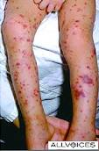
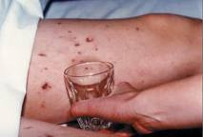
Skin exam:
Petechiae on the lower
limbs.
Very strong clue to the
diagnosis of
MENINGOCOCCAL infection
The likely diagnosis is :
Meningococcal meningitis

Slide 27
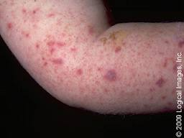
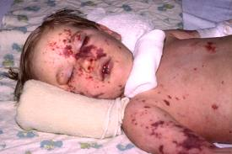
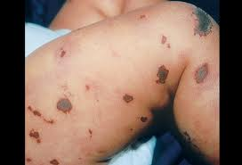
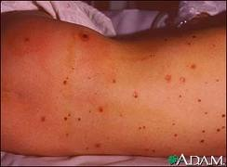
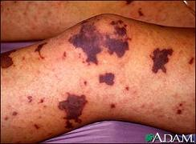
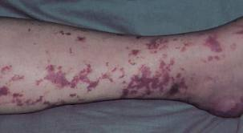

Slide 28
What is next time :9.14am
Start Antibiotics ?
Bacteriocidal
Parentral
Consider the epidemiology of the organism:
a. Aetiology
b. antibiotics Susceptibility (Global emergence andPrevalence ofPenicillin- Resistant Strain of Strep. pneumonia
What to give ?

Slide 29
1. supportive care : IVF
2. Antibiotics :blind therapy :
3.Isolation and prevention
Pencillin G 20-24 million unit/day q 4hrs
But ,we have to cover broadly until identification and drug Susceptibility.
D.O.C.:
Cefitriaxone 2gm 12hrly + vancomycin 1gr 12hrly

Slide 30
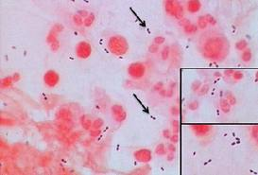
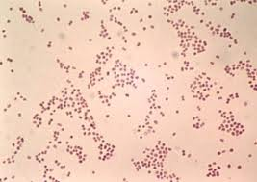
Cell count : WBC:4200 Ploy 89%
Biochemistry:Glucose 1.8mmol/l (ratio <0.4)
Protien : 120mg/dl (30—45 mg/dl)
Gram stain :
Culture:
Gram negative intracellular dipplococci.

Slide 31
Action : stop vancomycin
Isolation for one day.
Antibiotic for 7 days
Chemoprophylaxis: for
1. Index xase
2. close contacts : contacts with oropharyngeal secretion : wife , children who are sharing toys

Slide 32
prophylaxis
Candidates for chemoprophylaxis against meningococcal disease include the following:
All household contacts
Childcare or nursery school contacts during the 7 days before illness onset
Contacts directly exposed to index case secretions through kissing, sharing toothbrushes or eating utensils, or other markers of close social contact during the 7 days before illness onset
Persons who had mouth-to-mouth resuscitation or unprotected contact during endotracheal intubation in the 7 days before illness onset .
Contacts who frequently slept or ate in the same dwelling as the index patient during the 7 days before illness onset

Slide 33
prevention
Neisseria meningitidis | Rifampin | Adults | 600 mg PO q12h for 2 days
 | Ceftriaxone | >15 years | 250 mg IM once
 |  | =15 years | >125 mg IM once
 | Ciprofloxacin | =18 years | >500 mg PO once

Slide 34
is a gram-negative diplococcus that is carried in the nasopharynx of otherwise healthy individuals. It initiates invasion by penetrating the airway epithelial surface.
Most sporadic cases (95-97%) are caused by :
serogroups B, C, and Y, while.
while in epidemics :
The A and C strains are observed (< 3% of cases).

Slide 35
Vaccination:Neisseria meningitidis: Quadrivalent ( A, C, Y, W-135) meningococcal conjugate vaccine
Two doses of MCV4 are recommended for adolescents 11 through 18 years of age: the first dose at 11 or 12 years of age, with a booster dose at age 16.

Slide 36
recommended for high-risk groups: recommends the vaccine for:
First-year college students living in dormitories.
Laboratory personnel who are routinely exposed to meningococcal bacteria
military recruits.
Anyone traveling to, or living in, a part of the world where meningococcal disease is common, such as parts of Africa.
Anyone who has a damaged spleen, or whose spleen has been removed.
Anyone who has persistent complement component deficiency (an immune system disorder).
People who might have been exposed to meningitis during an outbreak.

Slide 37
Meningococcal conjugate vaccine (MCV4) is the preferred vaccine for people 55 years of age and younger.
•
Meningococcal polysaccharide vaccine (MPSV4) has been available since the 1970s. It is the only meningo-coccal vaccine licensed for people older than 55.
Both vaccines can prevent 4 types of meningococcal disease, including 2 of the 3 types most common.

Slide 38
Case 2 :
21 year old saudi man presented to TNT department c/o
Fever and ear discharge for 2 days .
Patient denied other smptomes
T: 38.2
DX .Otitis media
RX amoxacillin 500 mg TID for one wk
2days late patient condition got woarse?

Slide 39
Time 10.34 am
Started to have : severe Headache , and feeling unwell , and vomiting ,so presented again to ENT doctor?
What he should do ?

Slide 40
a. Consider amoxicillin resistant organism and change the antibiotic
b. Reassure him that antibiotics needs more time to produce effect
c. Refer him to ER department immediately and communicate with the physician in charge
d. Add another antibiotic for synergism
What do you think is happening ?

Slide 41
On arrival to ER : Time 11.12am
T: 39
Sick looking
Systemic examination are normal
Ear : dry and purluent discharge
What is next?
Look for sign of minigeal irritation.

Slide 42
CSF Analysis:
Turbid
Under pressure
Sent for full study
What is next?
Likely diagnosis

Slide 43
Menigitis complicating otitis media
Organism : Pnumococcal

Slide 44
Pneumococcal meningitis
The commonest cause in adult > 20 yrs
Account for 50%
Risk factors:1. pnumonia
2. acute sinusitis
3.otitis media
4. alcoholism
5. Diabetes , splenectomy ,
6. head trauma with basilar skull fracture
Mortality : 20% despite antibiotics therapy

Slide 45
Treatment:
Cefitriaxone or cefotaxime and Vancomycin
All isolates should be tested for pencillin and cefitriaxone sensitivity.
CSF result:
WBC: 1520 Polys :79%
Glucose is low , protein :145mg/dl
Gram stain :

Slide 46
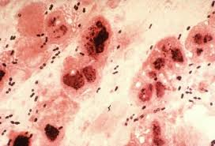
Gram positive intracellular
dipplococci
Dx :Streptococcal pnumonia
Antibiotic :cefitriaxone 2gmm BID for 14 days
Adjunctive therapy:
Dexamethazone Dexamethasone 4mg iv 6hrly for 5 days {1st dose should be before (20 min)or at start of AB. …later than 6 hrs : not useful
…… benefit ?

Slide 47
Prospective trial :
In adults, corticosteroids, given before or along with the first dose of antibiotics, reduce morbidity and mortality in patients with pneumococcal meningitis but not in others
hearing loss,
long-term neurologic sequelae, and
death

Slide 48
Case 3
34 year old pregnant women who presented to he GP c/o:
Fever ,backpain, arthralgia and myalgia
She gave History of taking food ouside :
Sandwish of hotdoge
Reassured and given analgesics
7 days late she presented with woarsening headache !........What is next ?

Slide 49
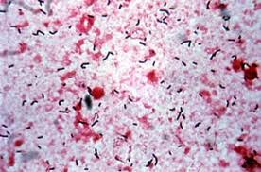
Neck stiffness : None
CSF:clear
Cell count: wbc :320 neut 74%
Glucose and protein :normal
Gram stain: gram positive bacilli
Diagnosis ?

Slide 50
Listeria monocytogens:
gram positive rods
Grow over a brosad temp range including frig
Follow ingestion of contaminated food, and enter through the GIT
Cause meningitis in:
1.Neonates
2.Elederly
3.Pregnant women

Slide 51
Treatment of choice:
Ampicillin 12g/day q 4h for 3 wks.

Slide 52
Case 4
13 year old boy brough by family to ER in confusional state
History of:
Fever for 1 wk
Headache for 3 days
And repeated seizure
DX?

Slide 53
Meningoencephalitis VS Meningitis
Clue :
1. altered conscious state
2. seizures.
Examination : hemiplegia
Action : CT-scan to rule out structural lesions
CSF: clear WBC: 120 90% Lympho
sugar and protein normal
Gram stain :negative…What is next

Slide 54
Indication for CT-SCAN:
1. suspicious history :
Immunocompromised state
History of previous central nervous system disease, or a seizure within the previous week Certain findings on neurologic examination A.Reduced level of consciousness,
B.focal motor or cranial abnormalities,
C. Papilledema

Slide 55
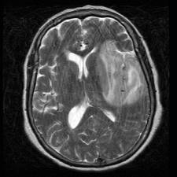
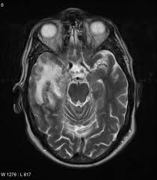
A) MRI Brain: high signal intensity lesions in
1. Orbitofrontal lobe
2. temporal lobe
B) EEG: Distenctive peridic pattern
Dx : Encephalitis due to HSV
Rx : ACYCLOVIR

Slide 56
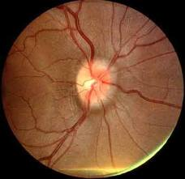
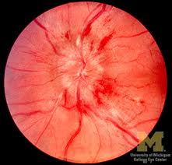
Case :
36 year old sudanese who presented with 2 wks history of :
Fever and headache
Clinical exam:
T:38.2 Exam of organs: normal
CNS: Cranial nerves : Papillodema
No Nuchal Rigidity
DDX:

Slide 57
1) SOL :space occupying lesions:
Brain abscess
Brain Tumor
Tuberculoma
2) Meningitis : Subacute or chronic
Tuberculosis VS Brucellosis

Slide 58
CSF:
WBC : 340 80 L
Sugar is below 40 % of the serum
Protein : 2gm /dl
Gram stain :negative
What to do next ?

Slide 59

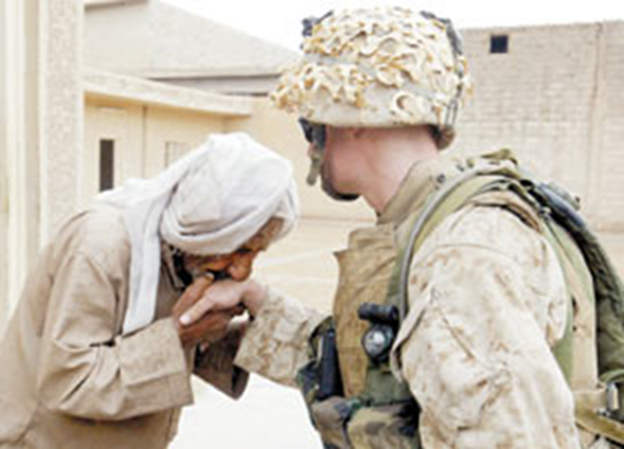

Slide 60
MALARIA
  Febrile illness caused by
  Plasmodium.
200 – 300,000,000 cases.
700,000---2.7,000,000 death/year
more in rural area..
more during rainy season
Human ---- -----→ Another
Mosquito

Slide 61
Transmission
BITE OF FEMALE ANOPHELES
BETWEEN DUSK AND DAWN
BLOOD TRANSFUSION
CONTAMINATED NEEDLES
CONGENITAL.

Slide 62
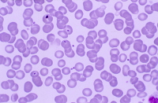
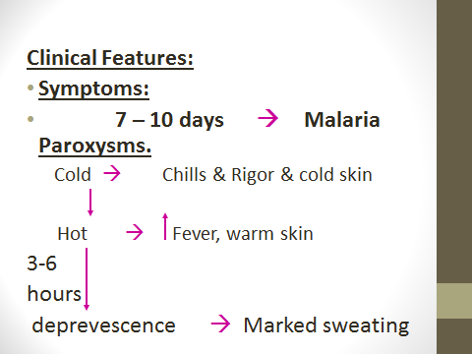
ETIOLOGY
Four species.
SYPMTOMS
Non-specific
Headache & fatigue & muscle pain
DX: → Viral infection..?
Between Paroxyms :
Patient is well !

Slide 63
SIGNS
Spleen Enlargement
Jaundice
Fever
Anemia

Slide 64
case
23 yrs old saudi who visited teshad presented with history of
Fever , myalgia , and headace
What you should do ?
When date of travel ………within one month of exposure
Use of prophylaxis
Examination :
T: 40
Spenomegaly
Jaundiced
What is next :? Lab

Slide 65
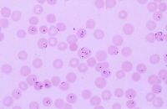
CBC : wbc : 11000 HB: 9gm platelets : 85
U/E normal
DIAGNOSIS
1. Index of suspicion Travel hist.
DDX
Next : malaria smear
Thin vs thick smear
Result : Malaria
Action:

Slide 66
treatment
Treatment should be guided by three main factors:
1) The infecting Plasmodium species
2) The clinical status of the patient
3) The drug susceptibility of the infecting parasites as determined by the geographic area where the infection was acquired and the previous use of antimalarial medicines

Slide 67
The infecting Plasmodium species:
Determination of the infecting Plasmodium species for treatment purposes is important for.
Firstly, P. falciparum infections can cause rapidly progressive severe illness or death while the other species, P. vivax, P. ovale, or P. malariae, are less likely to cause severe manifestations.
Secondly, P. vivax and P. ovale infections also require treatment for the hypnozoite forms that remain dormant in the liver and can cause a relapsing infection.
P. falciparum and P. vivax species have different drug resistance patterns in differing geographic regions. For P. falciparum

Slide 68
The clinical status of the patient:
uncomplicated or severe malaria. Patients diagnosed with uncomplicated malaria can be effectively treated with oral antimalarials.
patients who have one or more of the following clinical criteria 1.impaired consciousness/coma,
2. severe normocytic anemia [hemoglobin < 7],
3. renal failure, acute respiratory distress syndrome,
4. hypotension,
5. disseminated intravascular coagulation, spontaneous bleeding, acidosis, hemoglobinuria, jaundice, repeated generalized convulsions, and/or
6. parasitemia of ≥ 5%)
Are considered to have manifestations of more severe disease and should be treated aggressively with parenteral antimalarial therapy.

Slide 69
The drug susceptibility of the infecting parasites:
The geographic area where the infection was acquired provides information AND enables the treating clinician to choose an appropriate drug or drug combination and treatment course. In addition,
if a malaria infection occurred despite use of a medicine for chemoprophylaxis, that medicine should not be a part of the treatment regimen. If the diagnosis of malaria is suspected and cannot be confirmed, or if the diagnosis of malaria is confirmed but species determination is not possible, antimalarial treatment effective against chloroquine-resistant P. falciparum must be initiated immediately.

Slide 70
Treatment :
P falciparum malaria - Quinine-based therapy is with quinine (or quinidine) sulfate plus doxycycline or clindamycin alternative therapies are
artemether-lumefantrine,
atovaquone-proguanil,
mefloquine
P falciparum malaria with known chloroquine susceptibility (only a few areas in Central America) - Chloroquine
P vivax, P ovale malaria - Chloroquine plus primaquine
P malariae malaria - Chloroquine

Slide 71
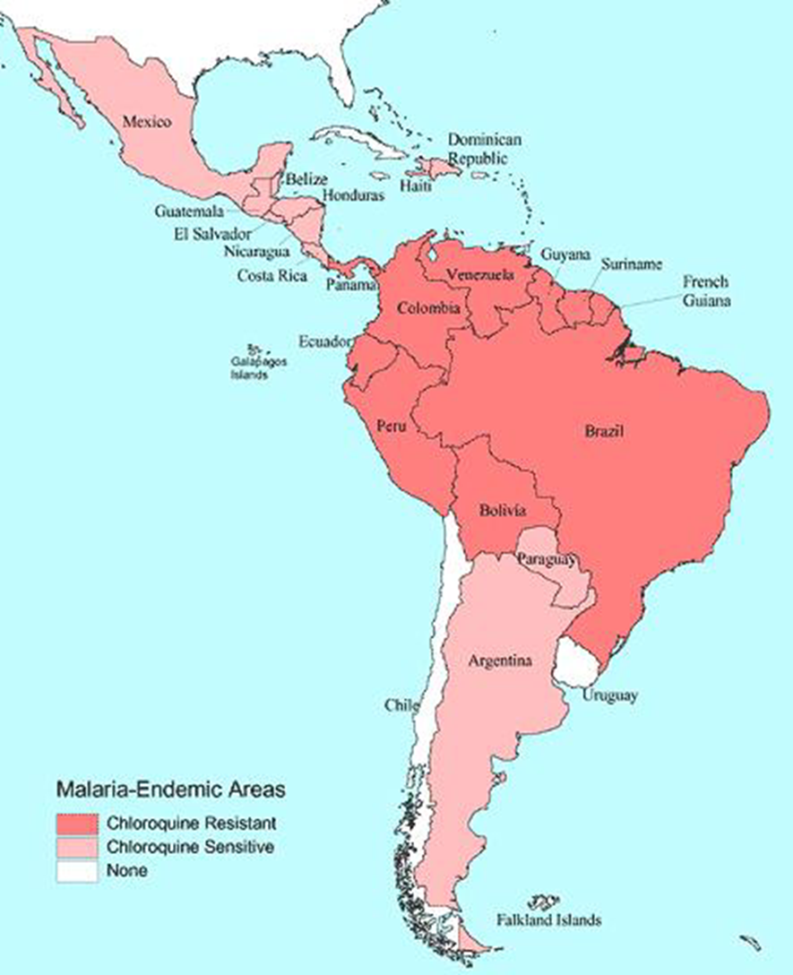
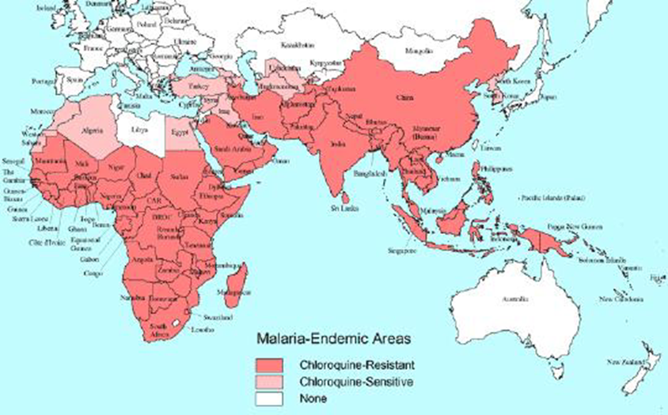

Slide 72
MEFLOQUINE : neuropsychiatric symptoms : mood changes .encephalopathy…transient
QUININE : Bitter taste , GIT upset , cinchonism ( nausea, vomiting , tinnitus , high tone deafness )
Doxycycline ..GIT upset, vaginal candidiasis..( use antifungal )

Slide 73
PREVENTION
Avoid mosquito
Wear long sleeved clothing
Sleep in well – screened rooms
Use mosquito netting
Use insect repellents (e.g. DEET)
Chemoprophylaxis..

Slide 74
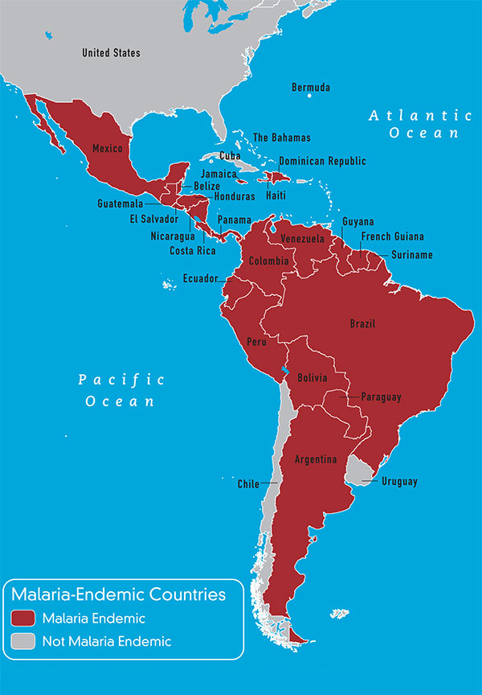
prophylaxis

Slide 75
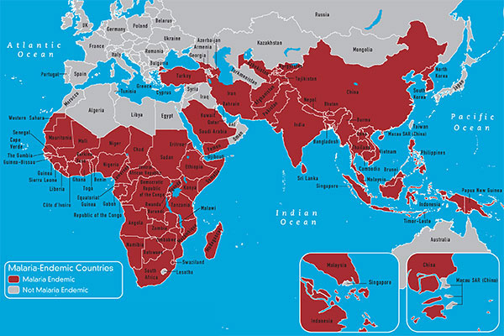

Slide 76
prevention
Chloroquine (only for special areas)
Doxycycline ( not for pregnant women)
Mefloquine
Primaquine ( for Vivax )

