Slide 1
How To Select Antibiotics For Some Common Infectious Diseases?
By
Prof. Abdulqader Alhaider
Department of Physiology and Pharmacology
College of Medicine
King Saud University
For Med 441
1433 H

Slide 3
Bacteria
Aerobic
Gram-Positive
Cocci
Streptococci: pneumococcus, Streptococcus viridans
Enterococcus: Strep D
Staphylococci: Staphelococcus aureus, Staphylococcus epidermidis
Rods (bacilli)
Corynebacterium
Listeria
Gram-Negative
Cocci
Moraxella
Neisseria (Neisseria meningitides, Neisseria gonorrhoeae)
Rods (bacilli)
Enterobacteriaceae (Escherichia coli, Klebsiella, Enterobacter, Citrobacter,
Proteus, Serratia, Salmonella, Shigella, Morganella, Providencai)
Pseudomonas
Helicobacter (Campylobacter)
Haemophilus (Coccobacilli morphology)
Legionella
Anaerobic
Gram-Positive Cocci
Peptococcus
Peptostreptococcus
Rods (bacilli)
Clostridia (Clostridium perfringens, Closteridium tetani)
Proprionibacterium acnes
Gram-Negative
Cocci
None
Rods (bacilli)
Bacteroides (Bacteroides fragilis, Bacteroides melaninogenicus)
Fusobacterium

Slide 4
Others
Fungi
Aspergillus, candida, coccidioides, cryptococcus, histoplasma, Mucor, tinea, trichophyton, torulopsis
Viruses
Influenza, hepatitis A, B, C, D, human immunodeficiency virus, rubella, herpes, cytomegalovirus, respiratory syncytial virus, Epstein-Barr virus
Chlamydiae
Chlamydia trachomatis
Chlamydia psittaci
Chlamydia pneumonia (TWAR)
LGV [(lymphogranuloma venereum) disease caused by Chlamydia trachomatis of immunotype L1-L3]
Rickettsia
Rocky Mountain Spotted Fever, Q fever
Ureaplasma
Mycoplasmas#
Mycoplasma pneumoniae, Mycoplasma hominis
Spinrochetes
Treponema pallidum, Borrelia burgdorferi (Lyme disease)
Mycobacteria
Mycobacterium tuberculosis
Mycobacterium avium intercellulare

Slide 5
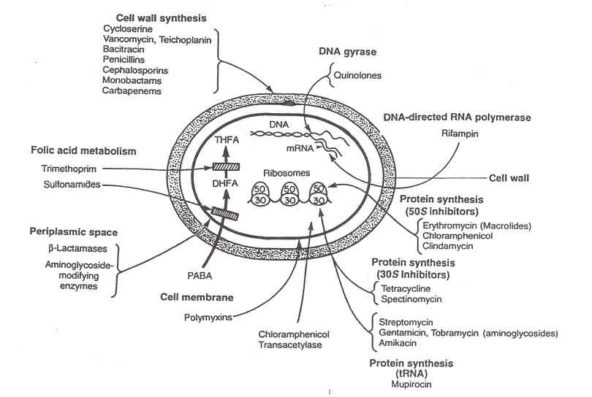
(e,g:Aztreonam)
e.g. Ciprofloxacin; Norfloxacine; moxifloxacin
e.g: Meropenem

Slide 6
Penicillin V is an acid-stable analogue of penicillin G.
Table 2: Development of Penicillins (Prof. Alhaider)
Category
Examples
Coverage
Narrow-spectrum
β – Lactamase resistant
( Antistaph. )
Penicillin G & V*
Oxacillin, cloxacillin, dicloxacillin, methicillin, Flucloxacilline
-Gram-positive cocci (Strep and enterococi; Lesteria).
-Staphylococous aureus, Streptococcus (weak)
Not for gram-negative bacili; However,?
Intermediate-spectrum
( Broad-spectrum )
β – Lactamase resistant
Ampicillin, amoxicillin
Amoxicillin + clavulanic acid (Augmentin^{R})
-Streptococcus, enterococi;Escherichia coli, Haemopheilus influenzae (70-80%),
-E. coli, Enterobactor, Proteus, H.lnfluenze; Klebsiella
Bacteroides Fragilis, S. aureus,
Extended-spectrum
(Antipsydomonus)
β – Lactamase resistant
Piperacillin, Ticarcillin
(Tazocin^{R}= Pipercillin +Tazopactam)
-Most gram positive cocci & bacilli
H. Influenzae (90-100%), gram-
negative bacilli including
Pseudomonas and B. fragilis
-Same coverage as ticarcillin plus
greater coverage of gram-
negative bacilli and S. aureus.

Slide 7
Cephalosporins:
First, Second and Third Generations differ in:
1- Antistaph: Only first and second are effective.
2. Antistrep: all (very important)
2- Gram negative Coverage:
First Gen. almost similar to Amoxicillin
Second Gen. similar to Augmentin
Third pass BBB and cover most gr –.
Which one of the 3rd that covers p.aur.?.
3- All cephalosporins have no effect on enterococci (Strep D) and
listeria monocytogenes. So What?
Antianerobes: Clindamycin and Metronidazole (FlagylR)
What are the differences between Clindamycin and Maclolides like
Clarithromycin?.

Slide 8
What are the Big Weapons for Rx of Infection?
Simply they are ultra-broad spectrum
Meropenum (Good Penetration All over the body)
Tazocin

Slide 9
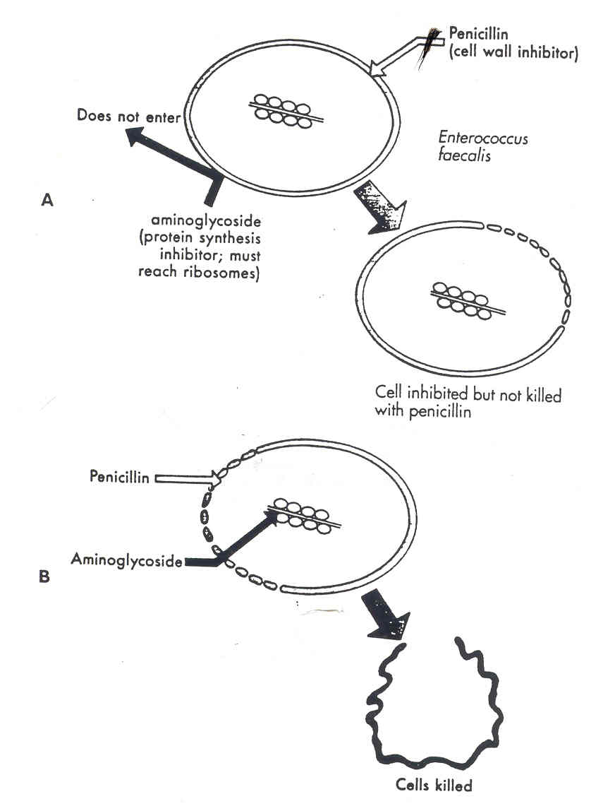

Slide 10
Table 3: Microorganisms & treatment of pneumonia (Prof. Alhaider)
Type of Pneumonia | Suspected Organisms | Antibiotic(s)
Community-acquired | S.Pneumoniae H. Influenzae Mycoplasma Pneumoniae | Cefuroxime or Clarithromycin Cefuroxime Clarithromycin Which one should we select? Why some Drs use Moxifloxacine?
Hospital-acquired | E. Coli Klebsiella spp. Proteus | Cefriaxone ± Maclorides
 | Pseudomonas Aeruginosa | Ceftazedime or Antipseudomonal
 | Entcrococci Staph. Aureus | Ampicillin Flucloxacillin or Vancomycin
Aspiration (Anaerobic P) | Bacteroids F Peptostreptcoccus + Coliforms | Clindamycin + Ceftriaxone
Typical | S. Pneumoniae H.Influenzae Klebsiella | Cefuroxime (outpatient) Or Ceftriaxone (Inpatient)
Atypical | Mycoplasma Pneumoniae Legionella Pneumophila Chlamydia | Clarithromycin

Slide 11
Table 4: Meningitis: Types, causing organisms and treatment ( Prof. Alhaider )
Type | Microorganisms | Antibiotics
Neonatal | S. Pneumoniae Enterocci + Staph. Epidermis E. Cole Klebsiella Proteus | Cefriaxone(DOC), Penicillin G Vancomycin Ceftriaxone
Blind Therapy for Neonatal | Cefotaxime+ Vancomycin Why not ceftraixone?
Child-hood | Pneumococci N. Meningitides H. Influenzae | Penicillin or Ceftriazone (DOC) Ceftriazone
Adult & Elderly Blind Therapy | S. Pneumoniae N. Meningitidis (70.80%) S. Aureus S. Epidermis (Rare) Ceftriaxone +/- Vancomycin | Penicillin or Ceftriazone (DOC) Oxicillin Or Vancomycin
 | H. Influenzae (Rare) E. Coli Klebsiella Pseudomonas Acroginosa | Ceftazidime + Gentamycin
Prophylaxis: Adult: Ciprofluoxacine 500mg single day
Pediatrics: Rifampacin 10mg/kg iD/2 days

Slide 12
Table 5: Types of organisms and antibiotics of choice for UTI (Prof. Alhaider)
Type | Suspected Organism | Drug of Choice
a) Community acquired | 1. E. Coli (-) 80% proteus SP (-) Kliebsella - | Many drugs can be used Why? (Nitrofurantoin; Ciprofluxacin; Norfloxacin or Co-trimoxazole (Bactrim) or cephalosporines
 | 2. Staphylococcus (+) Saprofietica (Honeymoon cystitis) 3. Enterococeus faecelus (+) | Cloxacillin; flucloxacillin or Cefuroxime Ampicilin
b) Hospital-acquired | E. Coli But drug Proteius Resistance Kliebsella | Ceftriazone or Based on C & S.
 | Pseudomonas (-) Acinitobacter (-) Enterobacter (-) | I.V Gentamycin + Ceftazedine Oral Norfluoxacin Ciprofloxacin

Slide 13
Endocarditis (Remember Staph)
a. Native valve
b. Prosthetic valve
Brucellosis
a. Uncomplicated (Doxicyclin 100 mg P.O. BID/6 weeks) + Streptomycin (i.m.)/3 weeks. What shall we do if bones are involved?
WHO recommendation? Rifampicin +Dox
b. Complicated
i. CNS
ii. Pregnancy (Dox & Strep are contra)
Upper Respiratory Tract Infections
a. Pharyngitis; Laryngitis and tonsillitis
b. Otitis media (Why Augmentin is commonly used in pediatrics?).

Slide 14
4. Sepsis: Tip: Remember three things:
a. Source of infection and RX accordingly
b. Drug combination should always be considered.
c. Almost all drugs should be given parentally.
5. Cellulites and wound Infection:
6. Septic Arthritis:
7. Osteomyelitis: (start with i.v + prolonged Rx)
8. Diabetic foot infection
9. Spontaneous infective peritonitis
10. Salmonella typhe:

Slide 15
Clinical Uses of Aminoglycosides:
Endocarditis together with antistaph
For enterococus in sepsis to augment the action of penicillin or ampicillin.
As antipsydomonal (neutropenic patients)
together with ceftazidime
Clinical Indications of Ciprofloxacin
(weak antistrep, no action at aneaerobes or staph but very potent at gm –ve).
Ostoemylitis in DM together with clindamycin
For TB if patient could not tolerate the
traditional drugs.
UTI (pyelonephritis).
Salmonella typhe.

