Slide 1
Common Childhood Infectious Diseases
DR. FAHAD AL ZAMIL
Associate Professor & Consultant
Pediatric Infectious Diseases
King Khalid University Hospital
King Saud University, Riyadh
Skimmia Japonica Rubella

Slide 2
Measles
RNA Virus
Incubation Period: 8 – 12 days
Clinical Features
Complications
Treatment
Isolation & Infectivity: 2 days before till 5 days after rash
Vaccine

Slide 3
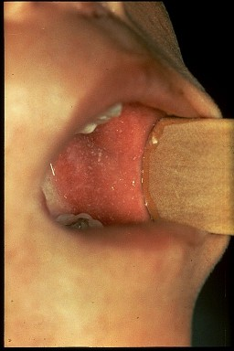
Measles (cont.)
Koplik’s spots

Slide 4
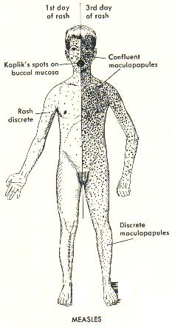
Measles (Cont.)

Slide 5
Measles vs. Scarlet fever

Slide 6
Mumps
RNA Virus
Incubation Period: 14 – 21 days
Clinical Features
Complications
Treatment
Isolation & Infectivity: 9 days after onset of parotid swelling
Vaccine

Slide 7
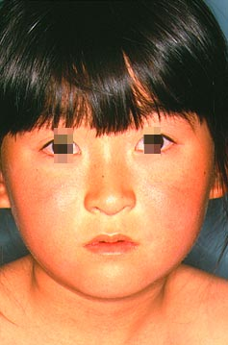
Rubella
RNA Virus
Incubation Period: 14 – 21 days
Clinical Features
Complications
Treatment
Isolation & Infectivity: 7 days from onset of rash
Congenital Rubella: until 1 year of age
Vaccine

Slide 8
Rubella (Cont.)

Slide 9
Rubella, Smallpox, Chickenpox

Slide 10
Congenital Rubella Syndrome

Slide 11
Chicken Pox (Varicella)
DNA Virus
Incubation Period: 10 – 21 days
Clinical Features
Complications
Treatment
Isolation & Infectivity: 2 days before rash till all skin lesions have crusted (6th day of rash)
Vaccine

Slide 12
Cont. Chicken Pox

Slide 13
Cont. Chicken Pox

Slide 14
Diphtheria
Corynebacterium diphtheriae
Incubation Period: 2 – 7 days
Clinical Features
Complications
Treatment
Isolation & Infectivity: up to 6 weeks, but with treatment communicable for fewer than 4 days
Vaccine

Slide 15
Diphtheria (Cont.)

Slide 16
Pertusis (Whooping Cough)
Bordetella Pertusis
Incubation Period: 7 – 14 days
Clinical Features
Complications
Treatment
Isolation & Infectivity: up to 6 weeks, but with treatment => 5 days after starting therapy
Vaccine

Slide 17
Whooping Cough
Video: Whooping Cough: Child
Video: Whooping Cough: Infant

Slide 18
Tetanus
Clostridium tetani
Incubation Period: 2 days to months, most within 14 days
Clinical Features
Complications
Treatment
Isolation: no person to person transmission
Vaccines

Slide 19
Haemophilus influenzae type b (Hib)
Clinical Features
Complications
Treatment
Isolation & Infectivity: droplet precautions for 24 hours after starting antimicrobial therapy
Vaccine
Cerebrospinal fluid culture positive for Hib (Gram stain)

Slide 20
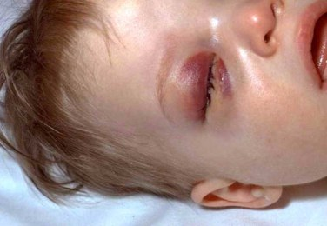
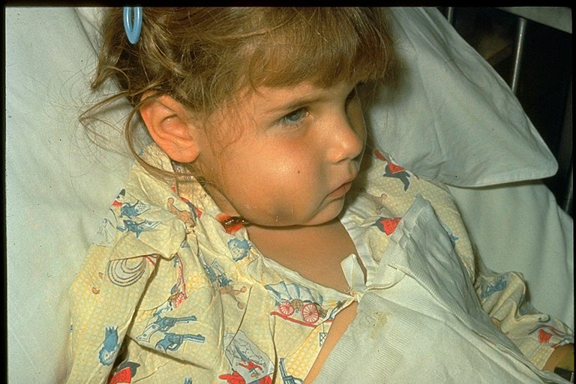
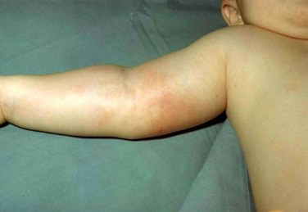
Hib (Cont.)

Slide 21
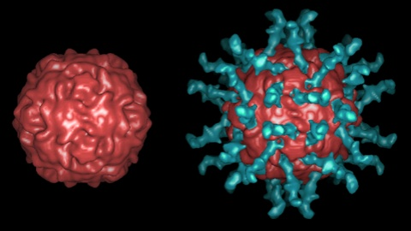
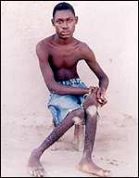
Poliovirus
Incubation Period: 7 – 21 days
Clinical Features
Complications
Treatment
Isolation & Infectivity: several weeks
Vaccines:

Slide 22
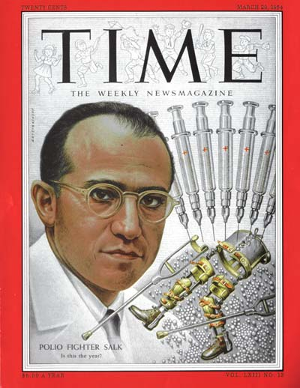
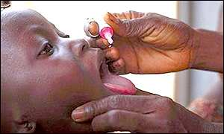
Polio Vaccines
IPV
OPV

Slide 23
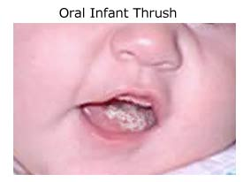
Thrush
Candida Albicans
Clinical Features
Complications
Treatment

Slide 24
Croup
Parainfluenza
Incubation Period: 2 – 6 days
Clinical Features
Complications
Treatment
Isolation & Infectivity: contact precaution in hospital, infective up to 3 weeks
Video: A Child with Croup

Slide 25
Bronchiolitis
Respiratory Syncytial Virus
Incubation Period: 2 – 8 days
Clinical Features
Complications
Treatment
Isolation & Infectivity: 3 – 8 days (up to 4 weeks in infants)

Slide 26
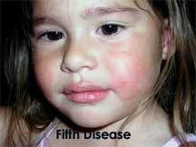
Erythema Infectiosum (Fifth Disease)
Parvovirus B19
Incubation Period: 4 – 21 days
Clinical Features
Complications
Treatment
Isolation & Infectivity: droplet precautions for 7 days

Slide 27
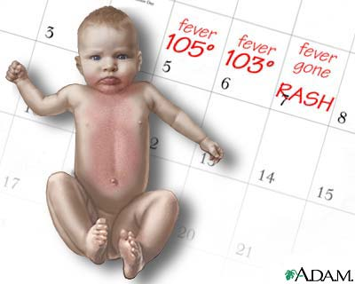
Roseola (Sixth Disease)
HHV-6
Incubation Period: 9 – 10 days
Clinical Features
Complications
Treatment

Slide 28
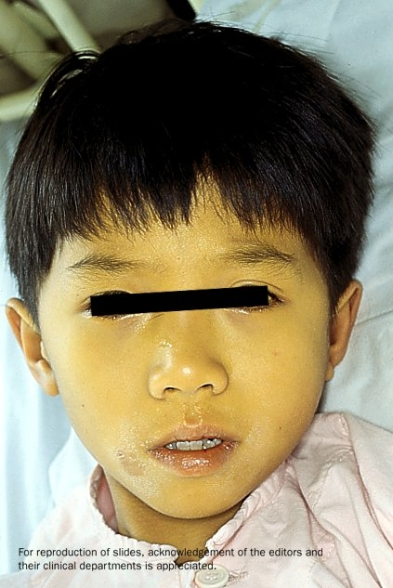
Viral Hepatitis

Slide 29
Feature | Hepatitis A | Hepatitis B | Hepatitis C | Hepatitis D | Hepatitis E
Virus | HAV | HBV | HCV | HDV | HEV
Genome | RNA | DNA | RNA | RNA | RNA
Incubation | 15-50 days | 45-160 days | 7-9 weeks | 2-8 weeks | 15-60 days
Onset | Acute | Insidious | Insidious | Acute | Acute
Transmission | Oral | Parenteral Perinatal | Parenteral | Parenteral | Oral
Sequelae: Fulminant liver failure Carrier Chronic hepatitis | Rare No No | Uncommon Yes Yes | Uncommon Yes Yes | Yes Yes Yes | Yes No No
Mortality | 0.1-0.2 % | 0.5-2 % | 1-2 % | 2-20 % | 1-2 %

Slide 30
Infectious Mononucleosis
Epstein-Barr Virus
Incubation Period: 30 – 50 days
Clinical Features
Complications
Treatment
Isolation & Infectivity: patients with recent infection should not donate blood

Slide 31
Further Reading

