Slide 1
Congenital Heart Disease
Mohammed Alghamdi, MD, FRCPC (peds), FRCPC (card), FAAP, FACC
Assistant Professor and Consultant
Pediatric Cardiology, Cardiac Science
King Fahad Cardiac Centre
King Saud University

Slide 2
INTRODUCTION
CHD ~ 0.8% of live births.
Major CHD:
Ventricular Septal Defect: 30-35%
Atrial Septal Defect: 6-8 %
Patent Ductus Ateriosus: 6-8 %
Coarctation of Aorta: 5-7 %
Tetralogy of Fallot: 5-7 %
Pulmonary valve stenosis: 5-7 %
Aortic valve stenosis: 4-7 %
D-Transposition of great arteries: 3-5 %

Slide 3
Congenital Heart Disease
Etiology: Mostly unknown
Sometimes: associated with chromosomal abnormalities or other genetic disorders.
Trisomy 21: AVSD
Trisomy 18: VSD
Trismoy 13: PDA, VSD, ASD
DiGeorge Syndrome: Arch, Conotruncal abnormalities
Turner syndrome: Coarctation of Aorta
Williams Syndrome: Supra-aortic stenosis, PA stenosis
Noonan Syndrome: Dysplastic pulmonary valve

Slide 4
Classification of CHD
Divided into 2 major groups:
Cyanotic heart diseases.
Acyanotic heart diseases.
Subdivided further according to:
Physical Finding
Chest X-ray finding
ECG finding
Diagnosis is confirmed by:
Echo, Cardiac CT/MRI or Cardiac Catheterization.

Slide 5
Classification of CHD
Cyanotic Heart Disease
Acyanotic Heart Disease
Decreased pulmonary flow:
Tetralogy of Fallot
Tricuspid atresia
Other univentricular heart with pulmonary stenosis.
Increased pulmonary flow:
Transposition of great arteries
Total anomalous pulmonary venous return.
Left – Right shunt lesions:
Ventricular septal defect
Atrial Septal Defect
Atrio-ventricular Septal Defect
Patent Ductus Arteriosus
Obstructive lesions:
Aortic stenosis
Pulmonary valve stenosis
Coarctation of Aorta

Slide 6
Acyanotic Heart Disease Left – to- Right Shunt lesions

Slide 7
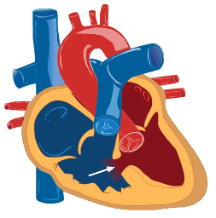
VSD

Slide 8
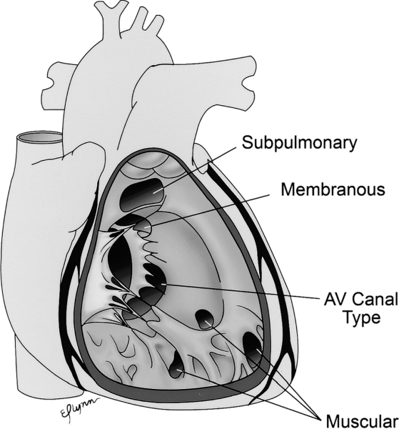
VSD
Most common form of CHD
30-35 % of CHD
Divided into:
Defect in membarnous septum (70% of all VSDs)
Peri-membranous VSD
Defect in muscular septum (30% of all VSDs)
Inlet VSD
Trabecular (muscular) VSD
Outlet VSD

Slide 9
VSD
Pathophsiology:
L-R shunt toward pulmonary circulation.
Increased Qp:Qs ratio
Increased cardiac output to the pulmonary circulation (Qp)
Reduced of cardiac output to the systemic circulation (Qs)
L-R shunt at ventricular level level:
Dilated LA and LV
Enlarged pulmonary arteries.

Slide 10
VSD
Clinical Features:
Small (restrictive) VSD: Asymptomatic
Moderate to large (unrestrictive) VSD:
No symptom during neonatal period
due to high pulmonary vascular resistance
Symptoms of CHF started ~ 2/12 of age
diaphoresis, poor feeding, and failure to thrive.
shortness of breath, recurrent chest infection.
exercise intolerance.

Slide 11
VSD
Clinical Features:
Physical Examination:
Tachypnia
Tachycardia
Active precordium
Murmur:
Pan-systolic (holosystolic) murmur at left sternal border
Thrill (palpable murmur): suggests small VSD
Large VSD: mid-diasolic murmur at apex
Hepatomegaly

Slide 12
VSD
Diagnosis:
Chest X-ray:
Increased pulmonary vascular marking
+/- cardiomegally
ECG:
Small VSD: Normal
Mod VSD: LA enlargment , LV hypertrophy
Large VSD: Biventricular hypertrophy.
ECHO:
Confirm Diagnosis
Cardiac Cath: not required for Dx

Slide 13
VSD
Treatment:
Medical Rx:
Anti-congestive therapy:
diuretics
digoxin.
+/- after load reducing agents
Nutritional support.
Surgical closure:
Symptomatic infants who fail medical management.
Between 3-12 months of age
Children with significant left to right shunting and ven- tricular dilatation.
Before 2 years of age
Notes:
Other indication for surgical VSD closure is Small VSD with complication:
Aortic valve prolapse
Right ventricular tract obstruction

Slide 14
VSD
Prognosis:
If left untreated beyond first 1-2 years of age:
Pulmonary vascular obstructive disease
Eisenmenger’s syndrome
Sign and symptom of CHF will disappear
Patient will become cyanotic
R-L shunt across VSD

Slide 15
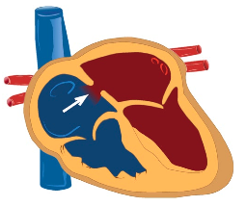
ASD

Slide 16
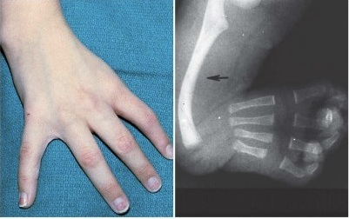
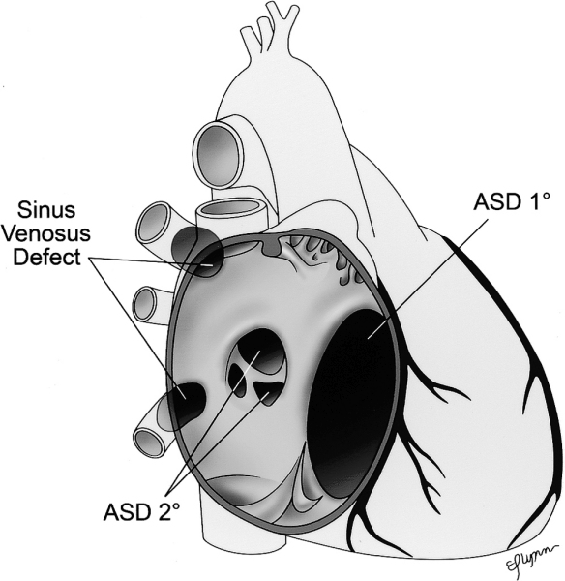
ASD
Isolated ASDs : 5-7 % of CHD
Majority of cases are sporadic
Seen Holt-Orman Syndrome
Types:
ASD secundom
ASD primum (type of AVSD)
Sinus Venosus ASD

Slide 17
ASD
Pathophsiology:
L-R shunt toward pulmonary circulation.
Increased Qp:Qs ratio
Increased cardiac output to the pulmonary circulation (Qp)
Reduced of cardiac output to the systemic circulation (Qs)
L-R shunt at atrial level:
Dilated RA, RV and pulmonary arteries.

Slide 18
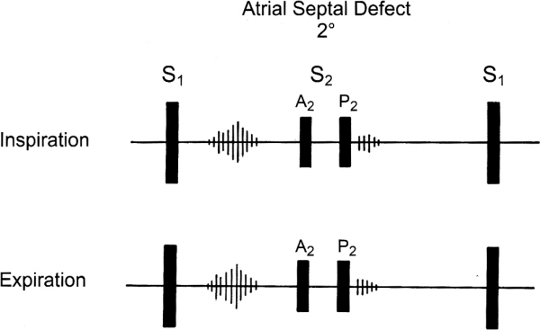
ASD
Clinical Features:
Usually asymptomatic
Symptoms include:
Shortness of breath
Fatigability
Rare: congestive heart failure, failure to thrive
Physical examination:
Active precordium
Widely fixed splitted second heart sound
Ejection systolic murmur at left upper sternal border
If large: mid-diastolic murmur at left lower sternal border

Slide 19
ASD
Diagnosis:
Chest X-ray:
Increased pulmonary vascular marking
+/- cardiomegally
ECG:
Evidence of RA and RV enlargement.
ECHO:
Confirm Diagnosis
Cardiac Cath: not required for Dx

Slide 20
ASD
Treatment:
Medical Rx:
Diuretics might help in large defect with excessive pulmonary flow:
Surgical or Device (cath) closure ~ 4-6 age of life.

Slide 21
ASD
Prognosis:
Complication might occur If left untreated to adult life:
Pulmonary vascular obstructive disease.
Atrial arrhythmias.
Paradoxical embolization (rare).

Slide 22
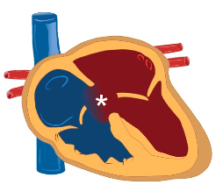
AVSD

Slide 23
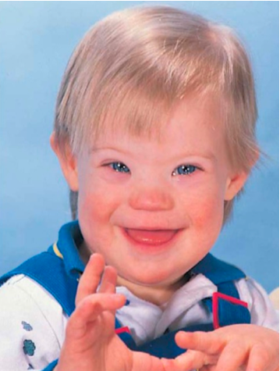
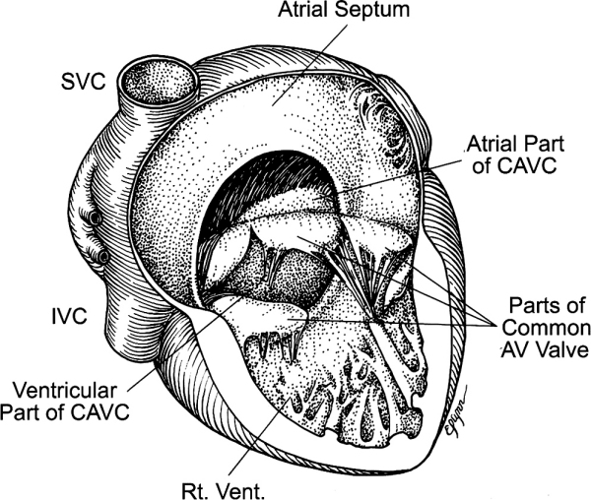
AVSD
Involved a defect closure of embryologic endocardial cushion tissue.
Incidence: 4 % of all CHD
Associated with Down Syndrome (50%)
Divided into:
Complete AVSD
Consist of (ASD primum, inlet VSD, and common AV valve)
Could be balanced or unbalanced AVSD
Partial AVSD
ASD primum
No VSD
Notes:
Balanced AVSD
AV valve orifice is committed equally to both ventricles, i.e. sits equally over both ventricles.
Unbalanced AVSD
AV valve orifice is favoring one ventricle over the other, there will be discrepancy in the size of AV valves and ventricles.

Slide 24
AVSD
Pathophsiology:
Similar to VSD and ASD
left to right shunt across the atrial level
Left to right shunt at and ventricular level
In addition: AV valve regurgitation
Significant L-R shunting:
Pulmonary over-circulation
Increase Qp:Qs ratio.

Slide 25
AVSD
Clinical Features:
Usually asymptomatic at neonatal period
Due to high pulmonary vascular resistance
Baby may have slightly lower oxygen saturation
Symptoms of CHF started at few months of age
Diaphoresis
Poor feeding
Failure to thrive.
Shortness of breath
Recurrent chest infection.
Exercise intolerance.

Slide 26
AVSD
Clinical Features:
Physical Examination:
Feature of Down Syndrome
Tachypnia
Tachycardia
Active precordium
Murmur:
Pan-systolic (holosystolic) murmur
Hepatomegaly

Slide 27
AVSD
Diagnosis:
Chest X-ray:
Increased pulmonary vascular marking
Cardiomegaly
ECG:
Left Axis deviation with RVH is very suggestive of AVSD
ECHO:
Confirm Diagnosis
Cardiac Cath: not required for Dx

Slide 28
AVSD
Treatment:
Medical Rx:
Anti-congestive therapy:
Nutritional support.
Surgical closure for complete VSD:
Usually done before 6 months of age to ovoid develoment of Eisenmenger’s syndrome.
Balanced AVSD: Biventricular repair
Unbalanced AVSD: may need single ventricular repair
Notes:
Other indication for surgical VSD closure is Small VSD with complication:
Aortic valve prolapse
Right ventricular tract obstruction

Slide 29
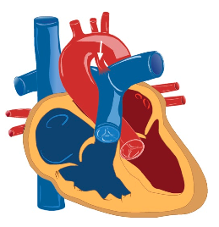
PDA

Slide 30
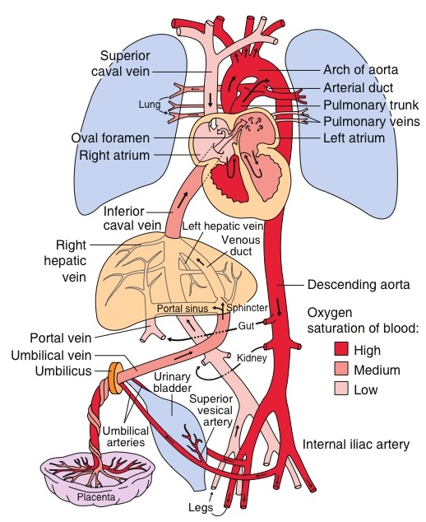
PDA

Slide 31
PDA
Ductus Arteriosus:
vascular tube connecting the left pulmonary artery to descending aorta
DA is an important structure in fetal circulation
After birth: DA mostly closed by the second or third day of life and is fully sealed by 2–3 weeks of life.
Incidence: 6-8 % of CHD
Most common form of CHD in premature baby
Frequently seen in T21 and congenital Rubella syndrome
Notes:
The ductus arteriosus remains patent in utero due to low oxygen tension in the blood and a high level of circulating prostaglandins.
With the baby’s first few breaths, the oxygen tension rises. Simultaneously, there is a drop in the prostaglandin level due to metabolism in the infant’s lungs and elimination of the placental source
Closure of the ductus is initiated by smooth muscle contraction a few hours after birth. This is followed by enfolding of the endothelium, subintimal disruption and proliferation. The lumen is thus obliterated and the closed ductus is transformed into a fibrous ligament known as the ligamentum arteriosum
Failure of the ductus arteriosus to close results in maintenance of patency and therefore a channel for blood to shunt from the aorta to the pulmonary circulation

Slide 32
PDA
Pathophsiology:
L-R shunt toward pulmonary circulation.
Increased Qp:Qs ratio
Increased cardiac output to the pulmonary circulation (Qp)
Reduced of cardiac output to the systemic circulation (Qs)
L-R shunt at great arteries level:
Dilated LA and LV

Slide 33
PDA
Clinical Features:
Small PDA: Asymptomatic
Moderate to large (unrestrictive) VSD:
Symptoms of CHF
Diaphoresis
Poor feeding
Failure to thrive.
Shortness of breath
Recurrent chest infection.
Exercise intolerance.

Slide 34
PDA
Clinical Features:
Physical Examination:
Tachypnia
Tachycardia
Widened pulse pressure
Active precordium
Murmur:
Continuous (machinery murmur) at left infraclavicular region
Large PDA: mid-diasolic murmur at apex.
PDA in neonate: ejection systolic murmur.
Hepatomegaly

Slide 35
PDA
Diagnosis:
Chest X-ray:
Increased pulmonary vascular marking
+/- cardiomegally
ECG:
Small PDA: Normal
Mod PDA: LA enlargment , LV hypertrophy
Large PDA: Biventricular hypertrophy.
ECHO:
Confirm Diagnosis
Cardiac Cath: not required for Dx

Slide 36
PDA
Treatment:
Premature Babies:
Aggressive mechanical Ventilation due to pulmonary edema
on prostaglandins Antagonizing agents
Indomethacin and ibuprofen
Mature Babies:
Small PDA:
Conservative Rx
Anti-congestive therapy if symptomatic
PDA closure:
Transcatheter occlusion: Rx of choice
usually performed around 6–12 months of age
Surgical PDA ligation if can’t done in cath lab

Slide 37
PDA
Prognosis:
If left untreated beyond infancy:
Pulmonary vascular obstructive disease
Eisenmenger’s syndrome
Sign and symptom of CHF will disappear
Patient will become cyanotic
R-L shunt across VSD

Slide 38
Acyanotic Heart Disease obstructive lesion

Slide 39
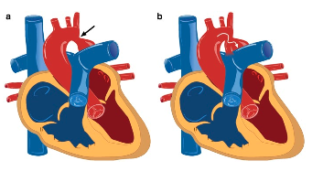
Coarctation of Aorta (CoA)

Slide 40
Coarctation of Aorta (CoA)
CoA: narrowing of the aortic arch such that it causes obstruction to blood flow.
Discrete
Diffuse (arch hypoplasia)
Can be mild to severe
Could lead to arch interruption
Incidence: 5-7 % of all CHD
Associated with Turner syndrome in female
Arch interruption: associated with DiGeorge syndrome

Slide 41
Coarctation of Aorta (CoA)
Pathophysiology:
Critical CoA
Spontaneous closure of PDA leads t
Obstruction of blood flow in distal arch
Hypotension and Shock
Acute increase of LV afterlaod
LV dysfunction
Milder obstruction:
Gradually collateral vessels develop connecting proximal aorta with distal arch.

Slide 42
Coarctation of Aorta (CoA)
Clinical Features:
Mild CoA:
Asymptomatic
Chronic hypertension
Headache
Fatigue
Stroke secondary to rupture of cerebral aneurysm
Critical CoA:
Presented around 7-10 days of life
Circulatory collapse and shock

Slide 43
Coarctation of Aorta (CoA)
Clinical Features:
Physical Examination:
Differential cyanosis (severe CoA in newborn)
Signs of cardiac shock
Reduced or absent femoral pulses
Brachio- femoral delay
4 limb BP: Lower BP in lower limb compare to upper
Murmur:
Typically: ejection systolic murmur at the back
Continues murmur with well develop collateral.

Slide 44
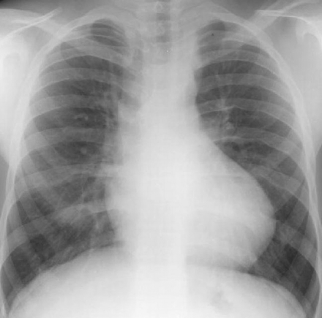
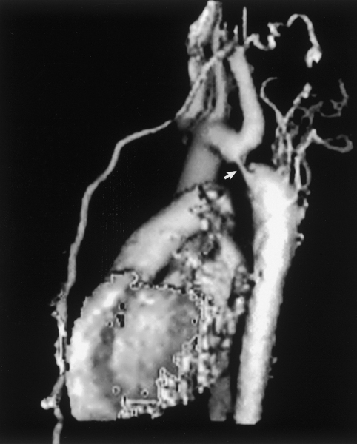
Coarctation of Aorta (CoA)
Diagnosis:
Chest X-ray:
Severe CoA:
Increased pulmonary vascular marking
cardiomegally
Delayed Dx:
Cardiomegaly,
prominent aortic knob
Rib notching
Due to development of collateral vessels
Rarely seen before age of 10 years
ECG:
Neonate : RV hypertrophy
Older children: LV hypertrophy.
ECHO:
Usually will establish the diagnosis
May need Cardiac CT /MRI or Cardiac Cath

Slide 45
Coarctation of Aorta (CoA)
Treatment:
Critical CoA
Type of Duct dependent lesion
Prostaglandin E2 to keep PDA open
Rx is surgical:
Trans-catheter balloon angioplasty with stent placement is usually reserve for recurrent CoA.

Slide 46
Coarctation of Aorta (CoA)
Prognosis:
If left untreated beyond infancy:
Pulmonary vascular obstructive disease
Eisenmenger’s syndrome
Sign and symptom of CHF will disappear
Patient will become cyanotic
R-L shunt across VSD

Slide 47
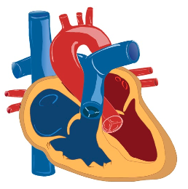
Pulmonary Valve Stenosis

Slide 48
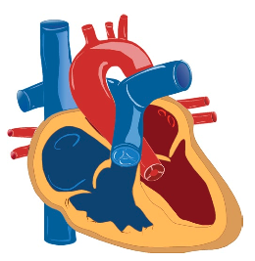
Aortic Valve Stenosis

Slide 49
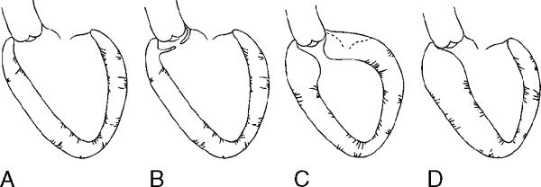
Sub-Aortic Stenosis

Slide 50
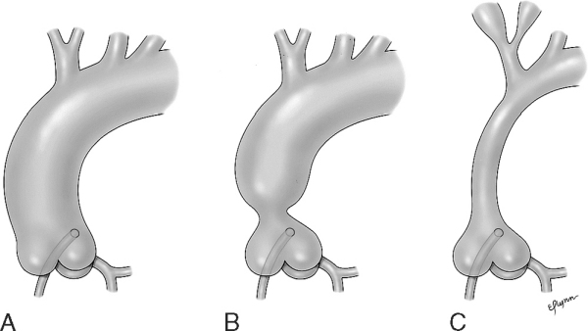
Supra-Valve Aortic Stenosis

Slide 51
Cyanotic Heart Disease

Slide 52
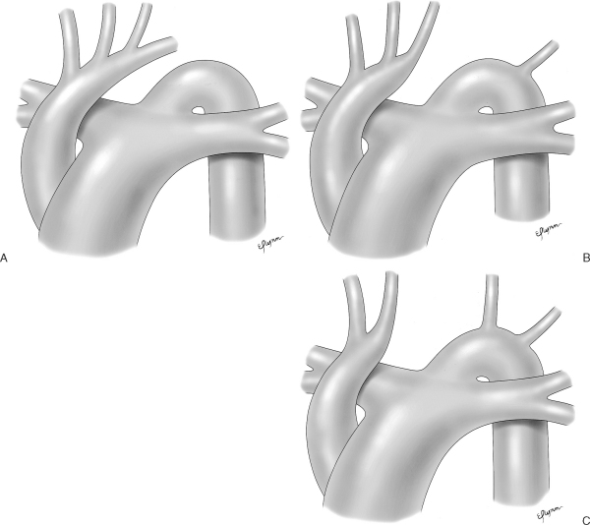
Interrupted Aortic arch

Slide 53
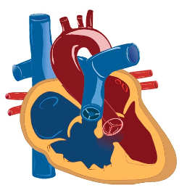
Tetralogy of Fallot

Slide 54
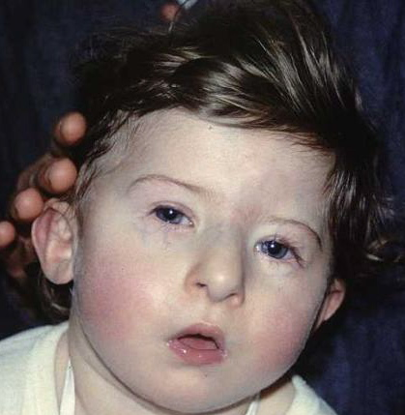
Tetralogy of Fallot
Most common cyanotic CHD
Incidence: 5-7 % of all CHD
Can be associated with
DiGeorge Syndrome

Slide 55
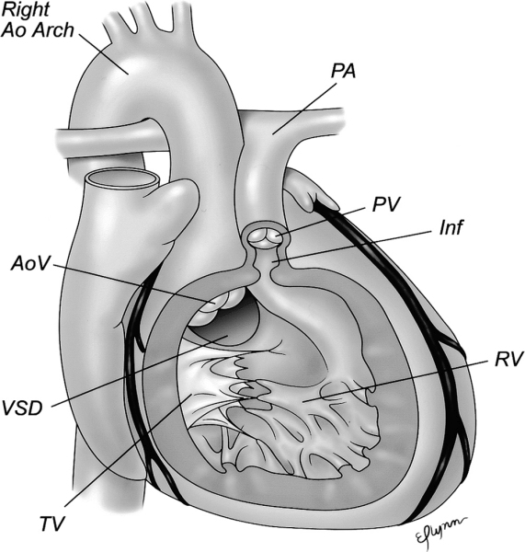
Tetralogy of Fallot
Basic pathology:
Anterior displacement of outlet septum (Infandibular septum)
Four basic components
Large VSD
Pulmonary stenosis (PS)
Overriding aorta
RV hypertrophy

Slide 56
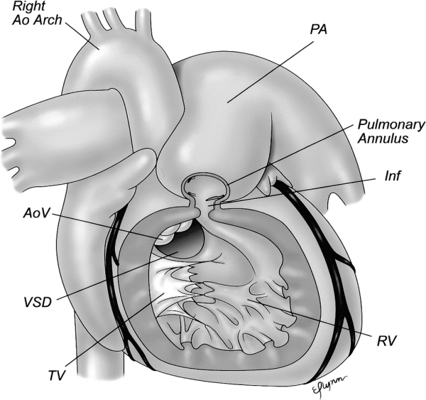
Tetralogy of Fallot

Slide 57
Tetralogy of Fallot
Clinical Features:
Depend on the severity of PS
Most newborn:
Asymptomatic
Ejection systolic murmur on routine discharge exam.
Initially have mild cyanosis which progress with time.
Might present with hypercyanotic spells “tet spells” if delayed intervention.
Newborn with severe PS or pulmonary atresia
Severe cyanosis when PDA close “Duct dependent lesions”
Need IV prostaglandin E2

Slide 58
Tetralogy of Fallot
Tet Spells:
Usually occur around 9-12 months of age
Episodes of acute and severe cyanosis
RX:
Medical emergency
Reduced anxiety “Keep child in his mother lab”
Knee-to-chest position
Give oxygen
If these intervention is not effective
Sedation with morphine
IV fluid
Beta Blocker
Phenylephrine
Might require emergency surgical intervention.

Slide 59
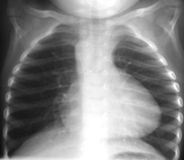
Tetralogy of Fallot
Diagnosis:
Chest X-ray: Classically show “boot-shaped heart”
ECG: RVH
Diagnosis is confirmed mainly by ECHO
Cardiac CATH: Mostly not required
Treatment:
TOF Surgical repair
VSD patch closure
RV outflow enlargement

Slide 60
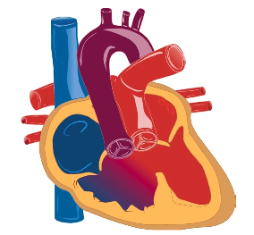
Double Outlet Right Ventricle

Slide 61
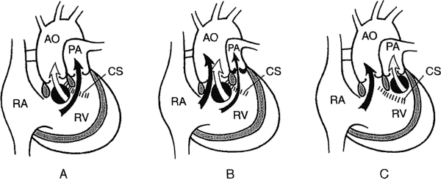
Double Outlet Right Ventricle

Slide 62
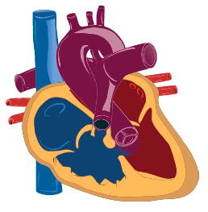
Pulmonary Atresia with Ventricular Septal Defect

Slide 63
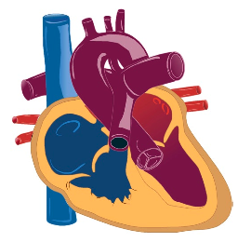
Pulmonary Atresia with Intact Ventricular Septum

Slide 64
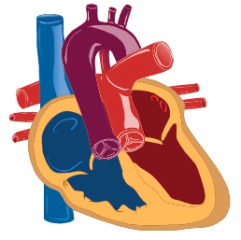
Transposition of the Great Arteries

Slide 65
Transposition of the Great Arteries
Aorta and pulmonary artery are connected to the wrong ventricle (transposed).
Most common cyanotic CHD presented with cyanosis at birth.
Incidence: 3-5 % of all CHD
More common in male
Higher incidence in infant of diabetic mother

Slide 66
Transposition of the Great Arteries
Pathophysiology:
In Normal heart:
Pulmonary and systemic circulations are in series with one another.
In D-TGA:
Pulmonary and systemic circulations are in parallel with one another
Pulmonary artery arise from LV
Aorta arise from RV

Slide 67
Transposition of the Great Arteries
Pathophysiology:
Mixing of oxygenated and deoxygenated blood can occur at three levels:
Atrial level via ASD/PFO (most important)
Great arteries level via PDA
Ventricular level via VSD (if present)

Slide 68
Transposition of the Great Arteries
Well tolerated during fetal life like other CHD
After birth:
Severely Cyanosis
“reverse differential cyanosis”
No signs of respiratory distress
Single second heart sound
Typically: no murmur
Hyper-oxic test: fail

Slide 69
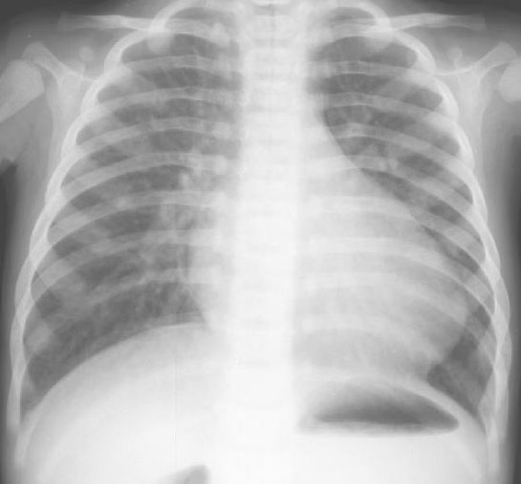
Transposition of the Great Arteries
Diagnosis:
Chest X-ray:
“egg on a string” appearance
Increase pulmonary vascular marking.
ECG:
Typically normal
ECHO:
procedure of choice to establish diagnosis
Cardiac Cath:
might be needed to define coronary arteries anatomy.

Slide 70
Transposition of the Great Arteries
Treatment:
Supportive:
Prostaglandin E2 (to keep PDA open)
Balloon atrial septostomy (to establish good mixing)
Definite intervention:
arterial switch operation (ASO)
Switch of great arteries
Moving coronaries to what is called “neo-aorta”
Atrial switch operation (not used anymore)
Mustard and Senning procedures

Slide 71
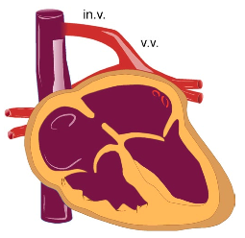
Total Anomalous Pulmonary Venous Return

Slide 72
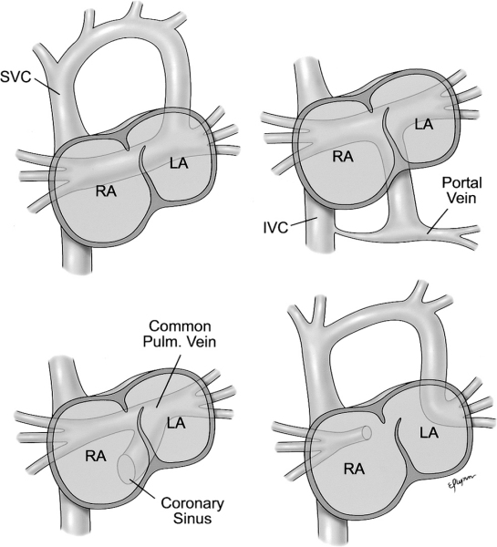
Total Anomalous Pulmonary Venous Return
All 4 pulmonary veins returns anomalously to the right atrium instead of the left atrium.
Can be:
Supracardiac (50%)
Cardiac (25%)
Infracardiac (20%)
Mixed (5%)
Can be:
Obstructed TAPVR
Non-obstructed TAPVR

Slide 73
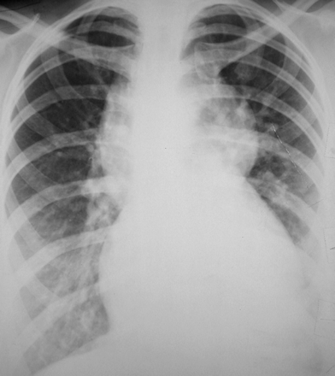
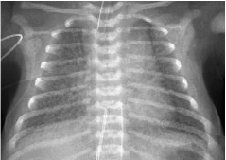
Total Anomalous Pulmonary Venous Return
Clinical Feature:
Cyanosis at birth
Severities depend degree of obstruction
Diagnosis:
Chest X-ray:
Increased pulmonary vascualr markings
“Figure of eight” in obstructed supracardiac TAPVR
ECG: RVH
ECHO: Confirm Dx
Cardiac CT/MRI: may be need to define venous anatomy

Slide 74
Total Anomalous Pulmonary Venous Return
Treatment
TAPVR is the only cyanotic CHD which can get worse with Prostaglandin E2 infusion.
Surgical repair is the only available option
Emergency surgical repair is requires with obstructed TAPVR

Slide 75
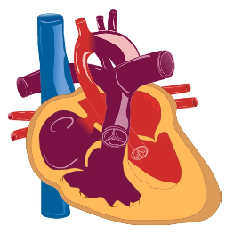
Hypoplastic Left Heart Syndrome

Slide 76
Hypoplastic Left Heart Syndrome
HLHS: one of the most severe form of CHD
High morbidity and mortality
Incidence: 1-2 % of all CHD
Involved obstruction at multiple level of left heart structures.
Mitral stenosis to mitral atresia
Variable degree of LV hypoplasia
Aortic stenosis to aortic atresia
Variable degree of ascending aorta hypoplasia

Slide 77
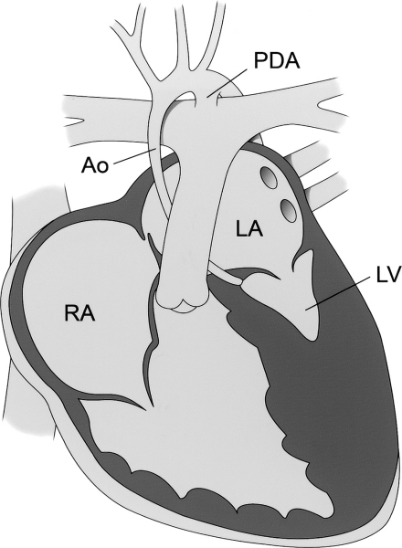
Hypoplastic Left Heart Syndrome
Pathophysiology:
Typically no adequate forward flow across the aortic valve through the ascending aorta.
Relies exclusively on PDA flow in a retrograde fashion through ascending aorta and coronary arteries.
Essential to have atrial communication (ASD/PFO) to shunt blood from left atrium to right atrium.

Slide 78
Hypoplastic Left Heart Syndrome
Clinical Features:
At birth: Cyanosis at birth
At 2-4 week of life: Respiratory distress , lethargy, poor pulses/perfusion and other signs of shock
When PDA is closed.

Slide 79
Hypoplastic Left Heart Syndrome
Diagnosis:
Chest X-ray :
non-specific
ECG:
RVH
Decrease LV forces
ECHO:
Gold standard diagnostic tool
Cardiac Cath:
not needed for Dx.

Slide 80
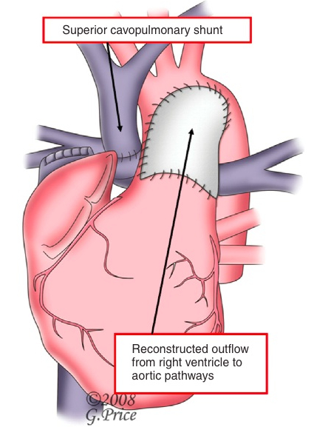
Hypoplastic Left Heart Syndrome
Treatment:
Start PGE2
Stabilization in high cardiac centre
Options for treatment:
Companionate care
Norwood staged Repair:
Norwood stage I
After birth: arch reconstruction and systemic-pulmonary shunt
Norwood stage II
3-6 month: Glenn procedure (connecting SVC directly to PA)
Norwood stage III
2 years: Fontan procedure (Connecting IVC directly to PA)
Cardiac transplantation

Slide 81
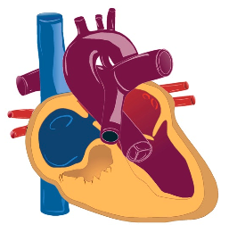
Tricuspid Atresia

Slide 82
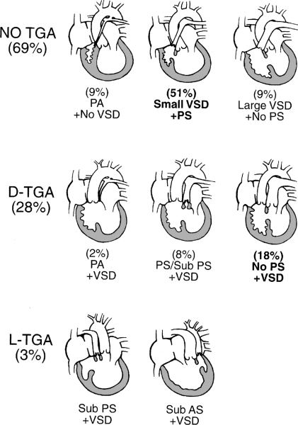
Tricuspid Atresia

Slide 83
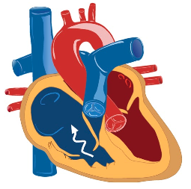
Ebstein’s Anomaly

Slide 84
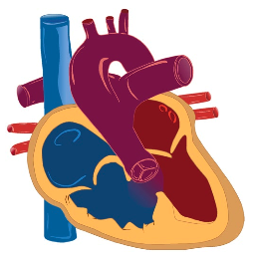
Truncus Arteriosus

Slide 85
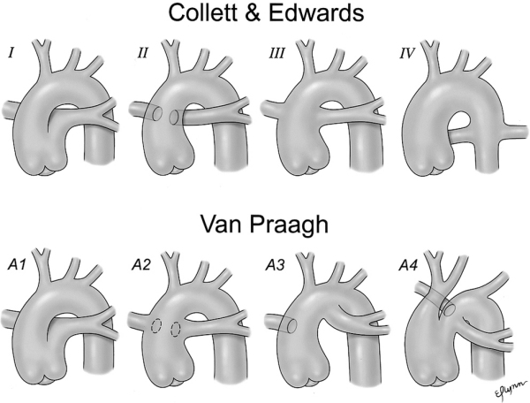
Truncus Arteriosus

Slide 86
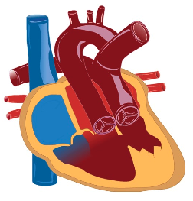
Single Ventricle

Slide 87
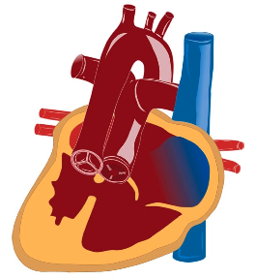
Complex Cyanotic Congenital Heart Disease: The Heterotaxy Syndromes

Slide 88
END

