Slide 1
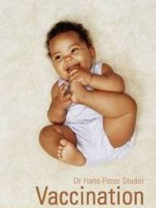
IMMUNIZATION IN CHILDREN
FAHAD AL ZAMIL
Professor & Consultant
Pediatric Infectious Diseases
Head Of Infectious Diseases Unit
King Khalid University Hospital
King Saud University, Riyadh
Keeps Kids Healthy!

Slide 2
Historical Milestones
1000 years ago: Chinese inhaled dried crusts from smallpox pustules
1721: “variolation” was introduced from Turkey to Britain by Lady Montagu
1796: Edward Jenner: 1st scientific attempt of immunization (cowpox)
19th Century: Anthrax 1881, Rabies 1885, Diphtheria antitoxin 1891, Plague 1895, Cholera 1896, Typhoid 1898
Early 20th Century: BCG 1921, Diphtheria toxoid 1923, Pertusis 1926, Tetanus 1927, Yellow fever 1937, Influenza 1941
Post World War II: Polio, MMR, Pneumococcal, Meningococcal, HiB, Hepatitis B, Hepatitis A
1980: Eradication of Smallpox
What’s New in the 21st Century??

Slide 3
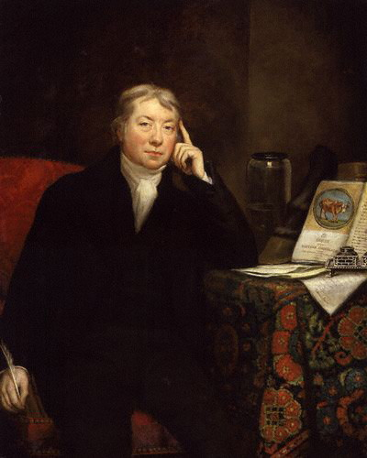
Edward Jenner
Edward Anthony Jenner (17 May 1749 – 26 January 1823) was an English scientist who studied his natural surroundings in Berkeley, Gloucestershire. Jenner is widely credited as the pioneer of smallpox vaccine,^{[1]} and is sometimes referred to as the "Father of Immunology"; his works have been said to have "saved more lives than the work of any other man".^{[2][3][4]}

Slide 4
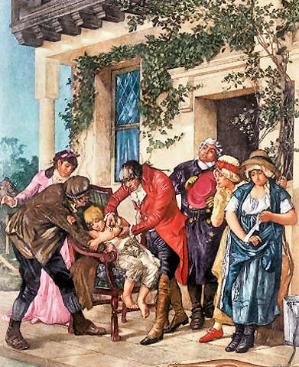
James Phipps
James Phipps (1788-1853), as an eight year old boy, and the son of Edward Jenner's gardener, was the first person given the cowpox vaccine by Edward Jenner. Phipps was often used as an living proof that Jenner's vaccine worked.
Phipps was exposed to the smallpox virus multiple times over the next twenty years, but successfully resisted infection, proving the efficacy of Jenner's vaccination.
Edward Jenner Vaccinating 8 year old James Phipps on 14 May 1796

Slide 5
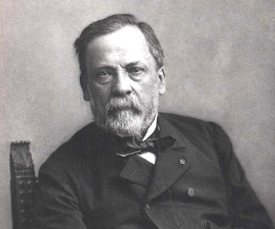
Louis Pasteur 27 December, 1822 – 28 September, 1895
The great revolution in the vaccination science occurred thanks to the genius French chemist and microbiologist Louis Pasteur who developed an attenuated vaccines to prevent cholera, anthrax and rabies.
Louis Pasteur was the first person to use the terms Vaccine and attenuated.
His body lies beneath the Institute Pasteur in France

Slide 6
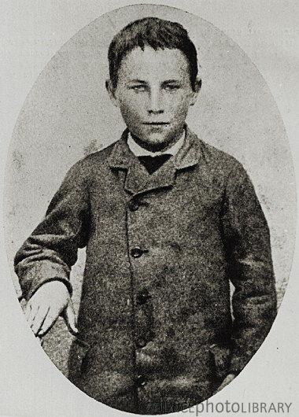
Joseph Meister
Joseph Meister (21 February 1876 - 16 June 1940) was the first person to be inoculated against rabies by Louis Pasteur, and the first person to be successfully treated for the infection.
In 1885, nine-year-old Meister was bitten by a rabid dog after provoking it by poking it with a stick. Pasteur decided to treat the boy with a rabies virus grown in rabbits and weakened by drying, a treatment he had earlier tried on dogs. The treatment was successful and the boy did not develop rabies.

Slide 7
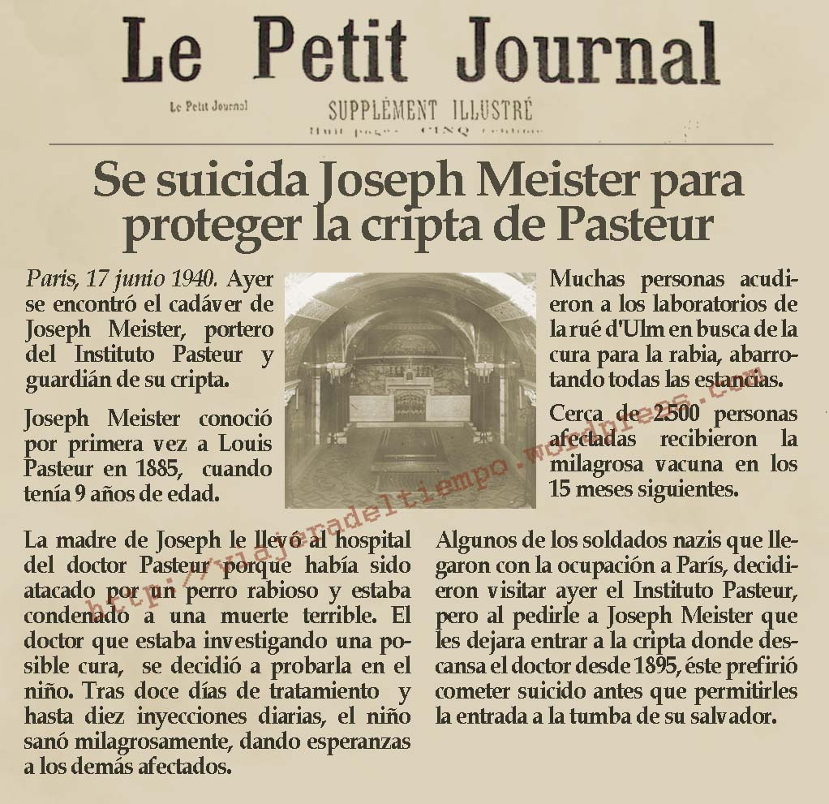
Article from the French newspaper “Le Petit Journal” regarding Joseph Meister’s reported suicide during the German occupation of Paris during World War 1. During the German occupation of Paris, Meister committed suicide by shooting himself with his World War I service revolver rather than allow German soldiers enter Pasteur’s crypt(secret burial place or tomb).

Slide 8
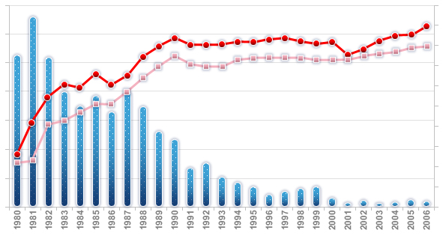
POLIOMYELITIS Global Epidemiology
The global decline in reported poliomyelitis incidence in the 1980s is consistent with the overall increases in immunization coverage
Poliomyelitis global annual reported incidence and third-dose polio vaccine coverage 1980-2006
70000
60000
50000
40000
30000
20000
10000
0
100
90
80
70
60
50
40
30
20
10
0
Number of cases
immunization coverge (%)
Number of cases
Official Coverage
WHO/UNICEF estimated coverage
WHO estimates for 2007: 1278 reported cases worldwide
[1] WHO. Vaccine preventable diseases monitoring system Global Summary 2007. WHO. Immunization Vaccines and Biologicals. Global and regional summary. Accessed Feb 2008. Available from: http://whqlibdoc.who.int/hq/2007/WHO_IVB_2007_eng.pdf
[2] WHO Global Polio Eradication Initiative Wild poliovirus weekly update. Accessed February 2008. Available from: http://www.polioeradication.org/casecount.asp
[3] WHO. Global Polio Eradication Initiative Strategic Plan 2004-2008. 2003
Notes:
Poliomyelitis: epidemiology
In 1988 the polio eradication initiative was launched.
As outlined by the Global Polio Eradication Initiative strategic Plan 2004-2008 the key steps of the eradication initiative are 1) the interruption of poliovirus transmission (2004-2005) 2) the achievement of the global certification (2006-2008) and 3) the preparation of global OPV cessation
By the end of the year 2007 only four countries remained endemic: India (844 cases); Pakistan (32 cases); Afghanistan (17 cases); Nigeria (282 cases)
[PEDIACEL™ Diseases epidemiology]

Slide 9
Polio Incidence, KSA 1980 – 2007

Slide 10
Measles Outbreak KSA, January – February 2007
736 Cases by Age
18%
22%
11%
18%
31%
< 1 yrs
1-4 yrs
5-14 yrs
15-19 yrs
> 20 yrs

Slide 11
Varicella-related hospitalization rates among persons aged <50 years, by year and age group United States, 1994-2002
Rate / 100,000
JAMA 2005;294:797-802

Slide 12
Summary of the studies on anti-HAV IgG prevalence in Saudi Arabia (1986-2006)
Percent anti-HAV (IgG) | Age Group (years) | No. of Subjects | Area (Region) | Year | Reference No.
76.5 | 1-15 | 1015 | Western | 1986 | Ramia et.al
79 | 6-18 | 5876 | Eastern | 1987 | Fathalla et.al
92 | 1-10 | 2582 | All Regions | 1989 | El-Hazmi
52.4 | 1-10 | 4375 | All Regions | 1989 | Al-Rashed
50.5 | 1-12 | 4575 | All Regions | 1989 | Al-Faleh et.al.
24.7 | 1-12 | 243 | Central (Riyadh) | 1995 | Arif M et.al.
30.2 | 1-15 | 592 | Central (Riyadh) | 1996 | Khalil et.al.
24.9 | 1-12 | 5355 | All Regions | 1997 | Al-Faleh
28.9 | All (mostly children) | 2399 | Central (Riyadh) | 2005 | Al Muneef

Slide 13
Cycle of Antibiotic Resistance
Prevalence of
Prevalence of
resistant strains
resistant strains
Use of
Use of
antibiotics
antibiotics
Prevalence of:
Prevalence of:
•
Serious disease
•
Serious disease
•
Difficult
-
to
-
treat disease
•
Difficult
-
to
-
treat disease

Slide 14
Meningitis in Saudi Children under 5 Years of Age
Etiology | # of Cases (%) | Incidence/100,000
H. influenzae type B | 58 (28) | 17
N. meningitides | 37 (18) | 11
S. pneumoniae | 23 (11) | 7
Other bacteria | 23 (11) | 7
Aseptic | 67 (32) | 19
Total | 208 (100) | 61
Y Al Mazrou et. al. J trop pediatr 2004; 50(3): 131-6

Slide 15
Causes of 4.1 million deaths in under-five (out of 10.5 million total deaths) in 2002
34%
Available New Vaccines
Source: World Health Report 2004
27%

Slide 16
Four-month-old female with gangrene of hands and lower extremities due to meningococcemia

Slide 17
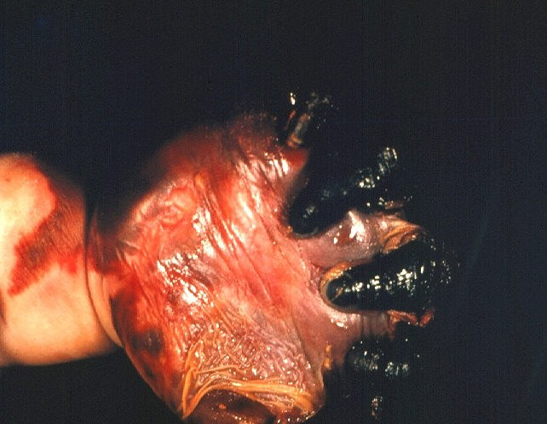
Four-month-old female with gangrene of hand due to meningococcemia

Slide 18
Reported Cases of Meningococcal Disease Saudi Arabia, 1970 – 2008
Source: Kingdom of Saudi Arabia, Ministry of Health, February 2009
Notes:
Key Points

Slide 19
Meningococcal Cases by Region, Saudi Arabia, 1999 - 2003
Notes:
The majority of incidence change from the hajj areas to the others areas due to the fact of oro-pharengeal carriage of the pathogen

Slide 20
Meningococcal Cases by Age Group, Saudi Arabia, 1999 - 2003

Slide 21
Meningococcal Disease by Serogroup* Saudi Arabia, 1994 – 2008
* Cases for whom a serogroup
was identified and reported
Source: Kingdom of Saudi Arabia, Ministry of Health, February 2009
Notes:
Key Points

Slide 23
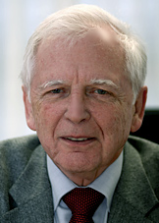
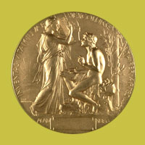
The Nobel Prize in Physiology for Medicine 2008 Harald Zur Haussen
"for his discovery of human papilloma viruses causing cervical cancer"
October 6th 2008

Slide 24
IMMUNITY & IMMUNIZATION
II. Immunizations:
A. Types:
● Active
● Passive

Slide 25
IMMUNITY & IMMUNIZATION
Active:
● Immunizing antigens
● Site, route and dose
● Scheduling
● Simultaneous administration of vaccines

Slide 26
IMMUNITY & IMMUNIZATION
Immunization in special clinical circumstances:
● Preterm
● Pregnancy
● Immunodeficient
● Asplenic children

Slide 27
IMMUNITY & IMMUNIZATION
● History and family seizures
● Children with chronic diseases
● Foreign travel

Slide 28
IMMUNITY & IMMUNIZATION
● Lapsed immunizations and unknown immunization status.
● Reimmunization
● Interference with immunoglobulin
● Vaccine safety and contraindications
● Immunization after exposure to disease.

Slide 29
Revised Basic Vaccination Schedule Activated in January 1st, 2009
اللقاح | Vaccine | Age
الدرن ، الالتهاب الكبدي (ب) | BCG, HepB | At birth
شلل الاطفال المحلل ( الثلاثي البكتيري،الالتهاب الكبدي ب، المستديمة النزلية) | IPV (DTP, HepB, Hib, PCV) | 2 months
شلل الأطفال الفموي (الثلاثي البكتيري، الالتهاب الكبدي ب، المستديمة النزلية) | OPV (DTP, HepB, Hib, PCV) | 4 months
شلل الاطفال الفموي | OPV (DTP, HepB, Hib, PCV) | 6 months
الحصبة المفرد | Measles (Mono) | 9 months
شلل الاطفال الفموي، الثلاثي الفيروسي، الجديري المائي | OPV, MMR, Varicella, PCV | 12 months
شلل الاطفال الفموي (الثلاثي البكتيري،المستديمة النزلية) ، الالتهاب الكبدي(أ) | OPV (DTP, Hib), HepA | 18 months
الالتهاب الكبدي(أ) | HepA | 24 months
شلل الأطفال، الثلاثي البكتيري، الثلاثي الفيروسي، الجديري المائي | OPV, DTP, MMR, Varicella | 4 – 6 Years

Slide 30
VACCINES AVAILABLE FOR ACTIVE IMMUNIZATION
Route | Type | Vaccine
Intradermal (Preferred) or subcutaneous | Live bacteria | BCG
Subcutaneous intramuscular or intradermal | Inactivated bacteria | Cholera
Intramuscular | Toxoids and inactivated bacteria | DTP

Slide 31
VACCINES AVAILABLE FOR ACTIVE IMMUNIZATION (cont)
Route | Type | Vaccine
Subcutaneous | Live virus | Rubella
Intramuscular | Toxoids | Tetanus & TD, DT
Subcutaneous (Boosters may be intradermal) | Inactivated bacteria | Typhoid
Subcutaneous | Live virus | Yellow fever

Slide 32
VACCINES AVAILABLE FOR ACTIVE IMMUNIZATION (cont)
Route | Type | Vaccine
Subcutaneous | Live viruses | MMR
Subcutaneous | Live virus | Mumps
Oral | Live virus | OPV
Intramuscular | Inactivated bacteria | Plague
Intramuscular or subcutaneous | Polysaccharide | Pneumococcal
Intramuscular | Inactivated virus | Rabies

Slide 33
VACCINES AVAILABLE FOR ACTIVE IMMUNIZATION (cont)
Route | Type | Vaccine
Intramuscular | Inactivated viral antigen | Hep. B
Subcutaneous intramuscular | Polysaccharide | Haemop. B
Intramuscular (Preferred) or subcutaneous | Inactivated virus | Influenza
Subcutaneous | Inactivated virus | IPV
Subcutaneous | Live virus | Measles
Subcutaneous | Polysaccharide | Meningococcal

Slide 34
Immunization
Misconceptions concerning vaccine contraindications
Mild acute illness with low-grade fever or mild diarrhea illness in an otherwise well child.
Current antimicrobial therapy or the convalescent phase of illness.

Slide 35
Immunization
Recent infection to an infectious disease
Breast feeding
A history of non-specific allergies or relatives with allergies

Slide 36
Immunization
Reaction to a previous DTP dose that involved only soreness, redness, or swelling in the immediate vicinity of the vaccination site or temperature less than 105F (40.5 C).
Prematurity
Pregnancy of mother or other household contact.

Slide 37
Immunization
Family history of Sudden Infant Death Syndrome in children considered for DTP vaccination.
Family history of an adverse event, unrelated to immunosuppression, after vaccination.
Malnutrition

Slide 38
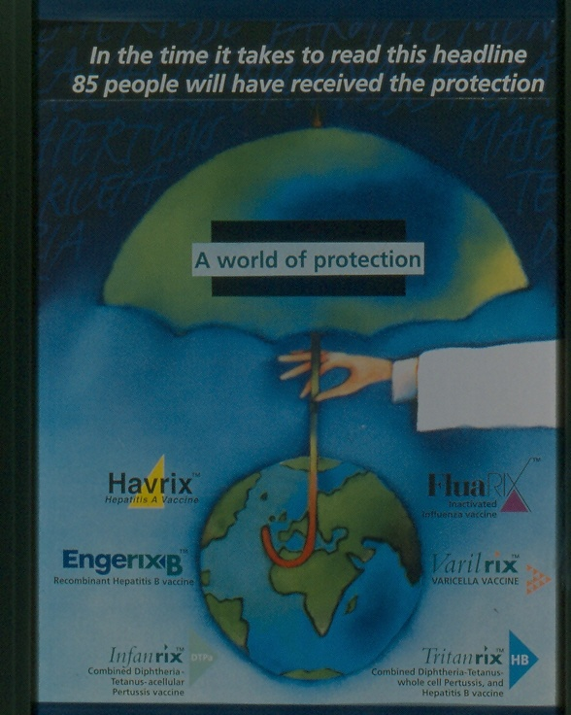

Slide 41
IMMUNIZATION
Questions to be answered:
Q. Is it possible to immunize a child with neurological disorder?
Q. Is it possible to immunized a child during a minor illness?
Q. My child is having eczema and evidence of atopy. Can he be immunized?

Slide 42
IMMUNIZATION
Questions to be answered:
Q. Is it possible to administer multiple vaccines simultaneously?
Q. Does the lapse in the immunization schedule require re-institution of the entire series?
Q. If a child immunization status is unknown – what to do?

Slide 43
IMMUNIZATION
Questions to be answered:
Q. Is it possible to give vaccines during immunosuppressive therapy?
Q. Is it possible to immunize a child who recently received immune globulins?
Q. When to immunize a child born prematurely?
Q. My child is allergic to egg, can he be immunized?

Slide 44
Further Reading
http://www.vaccineinformation.org
Red Book 2009 (28th Edition) Report of the Committee on Infectious diseases
Immunization – Childhood and Travel Health 3rd Edition

