Slide 1
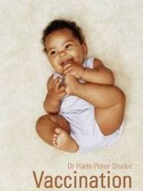
IMMUNITY AND IMMUNIZATION
d
Dr Elham Essa
.Assistant Professor & Consultant
Paediatric Infectious Diseases
King Khalid University Hospital
King Saud University, Riyadh
Keeps Kids Healthy!

Slide 2
Immunization.
- is the process by which an individual's immune system becomes fortified against an agent (known as the immunogen).

Slide 3
Immunization.
The adaptive immune system:
When this system is exposed to molecules that are foreign to the body , it will orchestrate an immune response, and it will also develop the ability to quickly respond to a subsequent encounter (through immunological memory).

Slide 4
Immunization.
The most important elements of the immune system that are improved by immunization are the B cells (and the antibodies they produce) and T cells. Memory B cell and memory T cells are responsible for a swift response to a second encounter with a foreign molecule.

Slide 5
Vaccines.
Immunization is done through various techniques, most commonly vaccination. Vaccination against microorganisms that cause diseases can prepare the body's immune system, thus helping to fight or prevent an infection.

Slide 6
The immunization result in:
Anti toxin
Anti invasive
Neutralizing activity
Other types of protective humoral or cellular response in the recipient.

Slide 7
IMMUNITY & IMMUNIZATION
II. Immunizations:
A. Types:
● Active
● Passive

Slide 8
Active Immunization:
Administration of all or part of a microorganism or a modified product of that microorganism i.e. a toxoid, a purified antigen, or an antigen produced by genetic engineering→to evoke an immunologic response(produce Antibody) mimicking that of the natural infection but that usually present little or no risk to the recipient. (Ag containing prepration).

Slide 9
what are the advantages of a live attenuated vaccine?
-they act like the natural infection with regard to their effect on the immune response -Immunity develops slowly.
-stimulates longer lasting antibody production -used for long term prophylaxis. -induce antibody production and resistance at the portal of entry for the natural virus

Slide 10
Active Immunization
Types
Live attenuated
Virus Measles, mumps, rubella
Bacteria BCG
Killed
Virus Hepatitis B
Bacteria
Whole Pertussis
Toxoid Tetanus
Polysaccharide Meningoccocal

Slide 11
what is the advantage of using an inactivated vaccine?
no chance of it reverting back to virulent form

Slide 12
Why we need booster doses?
Inactivated and sub-unit(influenza) preparation are incapable of replicating in the host, these vaccines must contain a sufficient antigenic mass to stimulate the desired response maintenance of long-lasting immunity
with inactivated viral or bacterial vaccines often requires periodic administration of booster doses.

Slide 13
what is the advantage of using an carrier protein or adjuvant?
-Enhance APC receptors and cytokine release -carrier protein recruit helper T cells and induce IgG antibody responses -conjugate bacterial vaccines

Slide 14
what is a toxoid?
a toxin produced by a bacterial organism that is inactivated by formalin
Eleminated toxicity without eleminating immunogenicity.

Slide 15
Passive immunization
is when antibodies are introduced directly into the body to give passive immunization.
Produce immunity quickly.
Used for short term prophylaxis and therapeutically.
Temporary effect.

Slide 16
Human Immune Serum Globulin
Specific
IM Hepatitis B (HBIG)
Rabies (RIG)
Tetanus (TIG)
Varicella (VZIG)
IV CMV (CMV-IG)
RSV (RSV-IG)

Slide 17
Passive Immunization (Cont)
SPECIFIC EQUINE ANTIBODIES (IM)
BOTULISM ANTITOXIN
DIPHTERIA ANTITOXIN
TETANUS ANTITOXIN
SNAKE & SPIDER ANTI-VENOM
MONOCLONAL ANTIBODIES (IV)
ANTI-ENDOTOXIN ANTIBODIES

Slide 18
Bacillus Calmette‑Guerin Vaccine (BCG).
INDICATIONS
All tuberculin negative infants
Intradermal route
PRECAUTIONS & CONTRAINDICATIONS(CI):
Give only to PPD negative children
CI in persons with immunodeficiencies
CI during pregnancy

Slide 19
Diphtheria, Tetanus & Pertussis (DTP)
PREPARATIONS
< 7 years : DTP, DT, DTaP (acellular pertussis vaccine)
> 7 years : Td, TdaP
(Td:adult tetanus toxoid full dose and diphtheria toxoid reduced dose)
ADMINISTRATION
IM

Slide 20
Diphtheria, Tetanus & Pertussis (DTP)
CONTRAINDICATIONS (CI)
Encephalopathy within 7 days
Progressive or unstable neurological disorders
Anaphylactic reaction to a previous dose
PRECAUTIONS
severe systemic reactions such as
Temp > 40.5⁰C
persistent inconsolable crying > 3 hours
Collapse episodes
Convulsions

Slide 21
Measles, Mumps & Rubella (MMR)
PREPARATIONS:
MEASLES.
MMR.
ADMINISTRATION:
SC.
INDICATIONS:
Primary immunization at 1 & 6 years

Slide 22
Pneumococcal vaccine
PREPARATIONS:
Purified capsular polysaccharide of 23 serotypes of Streptococcus pneumoniae
13 valent conjugated vaccine
ADMINISTRATION:
IM / SC
3 dose/booster

Slide 23
Pneumococcal vaccine
INDICATIONS:
Primary vaccination (conjugate vaccine)
children 2 yr. or older with
Anatomical or functional asplenia
Sickle cell disease
Nephrotic syndrome
Immunosuppression

Slide 24
Meningococcal vaccine
PREPARATIONS:
monovalent (A or C)
bivalent (A & C)
quadrivalent (A,C,Y & W‑135)
quadrivalent conjugate quadrivalent
ADMINISTRATION:
SC
Given at age of 9&12 months

Slide 25
Meningococcal Prophylaxis
INDICATIONS:
Control of outbreaks
Children with complement deficiencies or a splenia
SIDE EFFECTS:
local erythema and discomfort
transient fever

Slide 26
VACCINES AVAILABLE FOR ACTIVE IMMUNIZATION
Route | Type | Vaccine
Intradermal (Preferred) or subcutaneous | Live bacteria | BCG
Subcutaneous intramuscular or intradermal | Inactivated bacteria | Cholera
Intramuscular | Toxoids and inactivated bacteria | DTP

Slide 27
VACCINES AVAILABLE FOR ACTIVE IMMUNIZATION (cont)
Route | Type | Vaccine
Subcutaneous | Live virus | Rubella
Intramuscular | Toxoids | Tetanus & TD, DT
Subcutaneous (Boosters may be intradermal) | Inactivated bacteria | Typhoid
Subcutaneous | Live virus | Yellow fever

Slide 28
VACCINES AVAILABLE FOR ACTIVE IMMUNIZATION (cont)
Route | Type | Vaccine
Subcutaneous | Live viruses | MMR
Subcutaneous | Live virus | Mumps
Oral | Live virus | OPV
Intramuscular | Inactivated bacteria | Plague
Intramuscular or subcutaneous | Polysaccharide | Pneumococcal
Intramuscular | Inactivated virus | Rabies

Slide 29
VACCINES AVAILABLE FOR ACTIVE IMMUNIZATION (cont)
Route | Type | Vaccine
Intramuscular | Inactivated viral antigen | Hep. B
Subcutaneous intramuscular | Polysaccharide | Haemop. B
Intramuscular (Preferred) or subcutaneous | Inactivated virus | Influenza
Subcutaneous | Inactivated virus | IPV
Subcutaneous | Live virus | Measles
Subcutaneous | Polysaccharide | Meningococcal

Slide 30
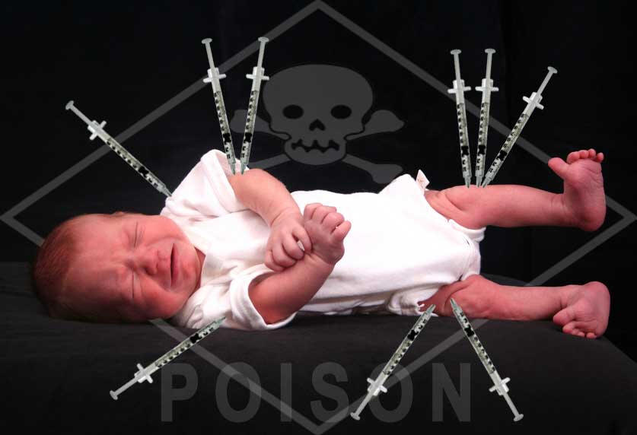

Slide 31
ROUTINE ACTIVE IMMUNIZATION FOR INFANTS & CHILDREN
Vaccine | Age
BCG, HBV 1st | At birth
DPT + HiB + OPV 1st, HBV 2nd | 2 months
DPT + HiB + OPV 2nd | 4 months
DPT + HiB + OPV 3rd, HBV 3rd | 6 months
MMR 1st | 12 months
DPT + HiB + OPV 1st booster | 18 months
DPT + OPV 2nd booster, MMR 2nd | 4 – 6 years
Td (Repeated every 10 yrs.) | 14 – 16 years

Slide 32
Revised Basic Vaccination Schedule
اللقاح | Vaccine | Age
الدرن ، الالتهاب الكبدي (ب) | BCG, HepB | At birth
شلل الاطفال المحلل ( الثلاثي البكتيري،الالتهاب +الكبدي ب، المستديمة النزلية) | IPV (DTaP, HepB, Hib)+PCV+rota | 2 months
شلل الأطفال المحلل(الثلاثي البكتيري، الالتهاب الكبدي ب، المستديمة النزلية) | IPV (DTaP, HepB, Hib)+PCV+rota | 4 months
شلل الاطفال الفموي | OPV (DTaP, HepB, Hib)+PCV | 6 months
الحصبة المفرد | Measles (Mono)+meningococcal conjugate quadrivalent | 9 months
شلل الاطفال الفموي، الثلاثي الفيروسي، الجديري المائي | OPV, MMR, +PCV+meningococcal conjugate quadrivalent | 12 months
شلل الاطفال الفموي (الثلاثي البكتيري،المستديمة النزلية) ، الالتهاب الكبدي(أ) | OPV (DTaP, Hib),MMR, Varicella+ HepA | 18 months
الالتهاب الكبدي(أ) | HepA | 24 months
شلل الأطفال، الثلاثي البكتيري، الثلاثي الفيروسي، الجديري المائي | OPV, DTaP, MMR, Varicella | 4 – 6 Years

Slide 35
Catch up schedule < 7 yr.
First visit :Dtab,Hib,HBV,MMR,PCV
Interval after first visit
1 mo :DTaP,IPV,HBV,Var.PCV
2 mo:DTaP,Hib,IPV.PCV
>8 mo:DTaP,HBV,IPV.PCV

Slide 36
Catch up schedule > 7 yr.
Comments | Recommended Vaccine (s)
Before giving BCG, Tuberculin, skin testing is recommended if feasible. | BCG, Td, OPV | 1st visit
 |  | Interval after 1st visit
 | MMR | 1 month
 | Td, OPV | 2 months
 | Td, OPV | 8 – 14 months
Repeat every 10 yrs. throughout life | Td | 10 years

Slide 37
Catch up immunization schedule for aged 4 m through 6 yrs who start late or who are more than one month behind.
 | Dose 4 to dose 5 | Dose 3 to dose 4 | Dose 2 To dose 3 | Interval Dose 1 to dose 2 | minimum.aage for dose 1 | vaccine
 |  |  | 8 weeks | 4 weeks | Birth | hepatitis
 | 6 m if the 4 th dose given <4 yrs | 6 months | 4 weeks | 4 weeks | 6 weeks | Diphtheria , tetanus , pertussis ,
 |  | 8 w if 3 doses<12m | 4 w if <12m 8 w if >12m 0 if @ 15m | 4 w if age <12m 8 w if >12m 0 if @ 15m | 6 weeks | HIB
 |  | 8 if 3 doses @<12 m | 4 if <12m 8 if@12m 0 if @24m | 4w if <12m 8w if @ or >12m 0 if @24 m | 6 weeks | pneumococcal

Slide 38
Catch up immunization schedule for aged 4 m through 6 yrs who start late or who are more than one month behind.
 |  | Dose 3-4 | Dose 2-3 | Dose 1-2 | Minimum age for dose 1 | Vaccine
 |  | 4 w | 4 w | 4 w | 6 w | Inactiva Polio
 |  |  |  | 4 w | 12 m | MMR
 |  |  |  | 3 m | 12 m | Varicella
 |  |  |  | 6 m | 12 m | Hepatitis A

Slide 39
Catch up immunization schedule for aged 6 yrs through 18 years.
 | Dose 4 to dose 5 | Dose 3 to dose 4 | Dose 2 To dose 3 | Interval Dose 1 to dose 2 | minimum.age for dose 1 | vaccine
 |  |  | 8 weeks | 4 weeks | Birth | Hepatitis B
 |  | 6 months if 1st dose <12 m.of age | 4 weeks if 1st dose <12m. 6 months if 1st dose @12 m or >. | 4 weeks | 7 yrs | Tetanus,Diphtheria /Tetanus Diphtheria , pertussis (Td),(Tdap)
 |  | 4 w | 4 w | 4 w | 6 weeks | Inactivated Poliovirus
 |  |  |  | 3 m if <13yrs | 12 m | Varicella
 |  |  |  | 6 m | 12 m | Hepatitis A
 |  |  |  | 4w | 12m | Measles ,Mumps,Rubella.

Slide 40
Complications &contraindications. -Swelling,discomfort at the injection site and mild fever. -If there is family hx of f.convulsion ,advise on fever prevention should be given.

Slide 41
-Complications &contraindications Live vaccine should not be given to children with impaired immune responsivness(except in children with HIV infection in whom MMR vaccine can be given).
.

Slide 42
- Complications &contraindications -Moderate or severe illness with or without fever -Anaphylactic reaction to vaccine or vaccine constituent -Live attenuated vaccines -Pregnant women -Immunocompromised / Immunosuppressed children -within 3-11 months of immunoglobulin administration

Slide 43
- Complications &contraindications The only contraindication to pertussis vaccination if the child has experienced a sever local or general reaction to a preceding dose. -If there is an evolving neurological problem,immunisation should be deferred until the condition is stable.

Slide 44
Immunization Of Special Groups
IMMUNOCOMPROMISED HOSTS
Avoid MMR, measles (may be used in HIV)
Avoid OPV; use IPV for these children and their household contacts(gastrointestinal excretions of po vaccine).
PRETERM INFANTS
Treat as term babies
Avoid OPV in hospital
Influenza vaccine in BPD
may delay HBV if <2 kg & mother is HBsAG negative

Slide 45
What is the benefit of the Live attenuated polio oral vaccine? is it still used today?
-provides local and systemic immunity - It is discontinued in the U.S becuse of the risk of developing paralytic poliomyelitis in those immunecompromised. It is still used in other parts of the world

Slide 46
Influenza Virus
Nature of vaccine:
Killed vaccine(injection).
Live attenuated(intranasal)
Preparations:
whole and “split virus” vaccines.
“split virus” vaccines are recommended for children 6 months and older.
composition of the vaccine is changed annually.

Slide 47
Influenza vaccine.
Indications:
Sickle cell anemia.
Chronic salicylate therapy.
Diabetes mellitus.
Chronic renal disease.
Chronic metabolic disease.
immunosuppressive conditions: cancer, HIV etc.
Hospital personnel with significant patient contact.

Slide 48
Immunization & Immunity
Misconceptions concerning vaccine contraindications
Mild acute illness with low-grade fever or mild diarrhea illness in an otherwise well child.
Current antimicrobial therapy or the convalescent phase of illness.

Slide 50
Further Reading
http://www.vaccineinformation.org

