Slide 1
Congenital Heart Disease
Mohammed Alghamdi, MD, FRCPC (peds), FRCPC (card), FAAP, FACC
Assistant Professor and Consultant
Pediatric Cardiology, Cardiac Science
King Fahad Cardiac Centre
King Saud University

Slide 2
INTRODUCTION
Is the most common congenital anomalies in children. CHD ~ 0.8% (1/100) of live births.
Major CHD:
Ventricular Septal Defect: 30-35% *most common.
Atrial Septal Defect: 6-8 % (ASD is often mistaken for PDA)
Patent Ductus Ateriosus: 6-8 %. It is not that common, but it is the most common in premature children.
Coarctation of Aorta: 5-7 %
Tetralogy of Fallot: 5-7 % it’s the commonest cyanotic heart disease.
Pulmonary valve stenosis: 5-7 % more common than aortic valve stenosis.
Aortic valve stenosis: 4-7 %
D-Transposition of great arteries: 3-5 % most common cause of severe cyanosis in newborn (at birth).

Slide 3
Congenital Heart Disease
Etiology: Mostly unknown
Sometimes: associated with chromosomal abnormalities or other genetic disorders. 50% of Down syndrome have CHD.
Trisomy 21: AVSD
Trisomy 18: VSD
Trismoy 13: PDA, VSD, ASD
DiGeorge Syndrome: Arch, Conotruncal abnormalities
Turner syndrome: Coarctation of Aorta
Williams Syndrome: Supra-aortic stenosis, PA stenosis
Noonan Syndrome: Dysplastic pulmonary valve

Slide 4
Classification of CHD
Divided into 2 major groups:
Cyanotic heart diseases.
Acyanotic heart diseases, which is more common. The two main ones are left to right shunt (VSD, ASD, PDA (septal defect at the level of great vessel), AVSD), and obstructive lesions (aortic stenosis, Coarctation of aorta)
Subdivided further according to:
Physical Finding
Chest X-ray finding
ECG finding
Diagnosis is confirmed by:
Echo in 95-98%, and in ≤ 5% require other modalities such as Cardiac CT/MRI or Cardiac Catheterization.

Slide 5
Classification of CHD
Cyanotic Heart Disease
Acyanotic Heart Disease
Decreased pulmonary flow (more common than increased flow): there will be right to left shunt and blue blood will go to the systemic circulation
Tetralogy of Fallot
Tricuspid atresia
Other univentricular heart with pulmonary stenosis.
Increased pulmonary flow:
Transposition of great arteries
Total anomalous pulmonary venous return.
Left – Right shunt lesions:
Ventricular septal defect
Atrial Septal Defect
Atrio-ventricular Septal Defect
Patent Ductus Arteriosus
Obstructive lesions:
Aortic stenosis
Pulmonary valve stenosis
Coarctation of Aorta

Slide 6
Acyanotic Heart Disease Left – to- Right Shunt lesions

Slide 7
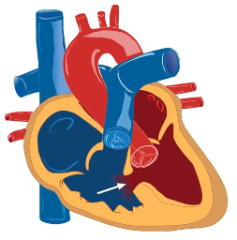
VSD
LA is left and posterior.
RV anterior and behind the sternum.

Slide 8
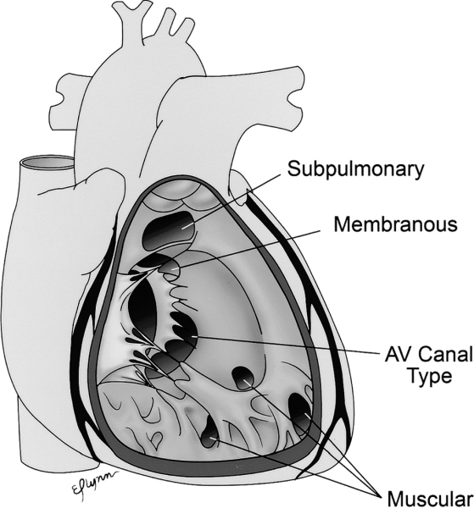
VSD
Most common form of CHD
30-35 % of CHD
Divided into:
Defect in membarnous septum (MV, TV, PA, Aorta)
(70% of all VSDs)
Peri-membranous VSD
Defect in muscular septum (30% of all VSDs)
Inlet VSD
Trabecular (muscular) VSD
Outlet VSD

Slide 9
VSD
Pathophysiology:
L-R shunt (high pressure LV to low pressure RV) toward pulmonary circulation.
Blood shunts during the whole of systole and not diastole.
Increased Qp:Qs ratio
Increased cardiac output to the pulmonary circulation (Qp)
Reduced of cardiac output to the systemic circulation (Qs)
L-R shunt at ventricular level:
Dilated LA and LV
Enlarged pulmonary arteries (hypertrophied and dilated).

Slide 10
Ductus arteriosis (lung to aorta) closure is the transition from fetal to post natal life. It functionally closes at birth, but anatomically after a few weeks of life.
Foramen ovale closes physiologically due to increase in left atrial pressure.
After birth, the lung resistance decrease due to decreased pulmonary artery pressure.
Only 10% of the blood goes to the lung in fetal life. The blood goes for perfusion and not oxygenation.
At birth the pulmonary resistance is high so there will be little Lft to Rt shunt. As the lungs grow in size, the pulmonary resistance drop around 2, 3 months the murmur and symptoms (because symptoms are related to lung congestion) will develop.

Slide 11
VSD
Clinical Features:
Small (restrictive) VSD: Asymptomatic but they have a high murmur.
Moderate to large (unrestrictive) VSD:
No symptom during neonatal period
due to high pulmonary vascular resistance
Symptoms of CHF started ~ 2/12 of age
Tetrad of HF: cardiomegaly, hepatomegaly, tachycardia, and tachypena.
diaphoresis, poor feeding (has to stop breathing to take breaths), and failure to thrive (not gaining weight and looks thin).
shortness of breath, recurrent chest infection.
exercise intolerance.
Larger VSD present symptoms later than small VSD.

Slide 12
VSD
Clinical Features:
Physical Examination:
If you examine the patient by placing
your hand on the heart, you will find a very
active heart and maybe a displaced heart beat.
Tachypnia
Tachycardia
Active precordium
Murmur:
Pan-systolic (holosystolic) murmur at left sternal border (the murmur is only heard during systole because of the high pressure difference between the two ventricles, in diastole the pressure equalizes between the two chambers).
Murmur had nothing to do with valve closure or heart sounds
Thrill (palpable murmur): suggests small VSD
Large VSD (6mm): mid-diasolic murmur at apex with soft pansystolic or no murmur which signifies a large defect. This is due to the concept of overload on the left atrium mimicking mitral valve stenosis. Larger blood volume in the left atrium is pushed through a normal sized valve, therefore gushing of the blood producing the murmur (As if the valve is stenosed).
The smaller the hole the earlier the symptoms and the greater the murmur.

Slide 13
VSD
Diagnosis:
Chest X-ray:
Increased pulmonary vascular marking i.e. congested lung
+/- cardiomegally
ECG:
Small/mild VSD: Normal
Mod VSD: LA enlargement , LV hypertrophy
Large VSD: Biventricular hypertrophy.
Dilated and hypertrophied LV, LA, PA but not RV except on ECG and not echo. Explanation: the blood will not stay long in the right ventricle and will go to pulmonary artery therefore LV, LA and pulmonary artery are enlarged. While in large VSD the RV will also be affected (both dilated and hypertrophied).
ECHO:
Confirm Diagnosis
Cardiac Cath: not required for Dx

Slide 14
VSD
Treatment:
Medical Rx:
Anti-congestive therapy:
Diuretics (lasix) is the main stay of treatment because it decrease lung congestion and give catopril along with it (potassium sparing diuretics).
Digoxin it is not imp because the problem is energy wasting( because the heart is going into a vicious circle- the lung is filled with blood and the heart is failing to pump any extra blood) and not muscular problem.
+/- after load reducing agents e.g. captopril to decrease the systemic circulation so blood can be pushed to the aorta instead of the RV (Lft_RT shunt).
Nutritional support is very important, because they need to grow and prepare for surgery.
Do not restrict fluids, give more fluids with more diuretics.
140kcal/kg/day (normal 100 kcal/kg/day) through NG tube because feeding is a process and may exhaust the baby. Nowadays, we can do surgery earlier (tx of choice).
Do not delay surgery because lung will move from reversible to irreversible increase in pressure in which you can’t repair the VSD and the condition is known as Eisenmenger’s syndrome.
Surgical closure: the treatment of choice.
Symptomatic infants who fail medical management.
Between 3-12 months of age try to repair before 6 months specially if large.
Children with significantly large left to right shunting and ventricular dilatation.
Before 2 years of age.
Other indication for surgical VSD closure is Small VSD with complication:
Aortic valve prolapse.
Right ventricular tract obstruction.
Notes:
Other indication for surgical VSD closure is Small VSD with complication:
Aortic valve prolapse
Right ventricular tract obstruction

Slide 15
VSD
Prognosis:
If left untreated beyond first 1-2 years of age:
Pulmonary vascular obstructive disease
Eisenmenger’s syndrome
Obstructive lung disease leading to pulmonary artery hypertension, which then leads to a certain point where it becomes irreversible. Patient becomes cyanotic due to high pressure (left to right shunt), leading to right to left shunt and HF symptoms fading due to elevated pulmonary resistance.
Sign and symptom of CHF will disappear due to increased vascular resistance.
Patient will become cyanotic
R-L shunt across VSD

Slide 16
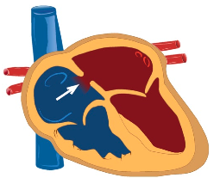
ASD

Slide 17
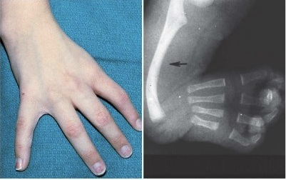
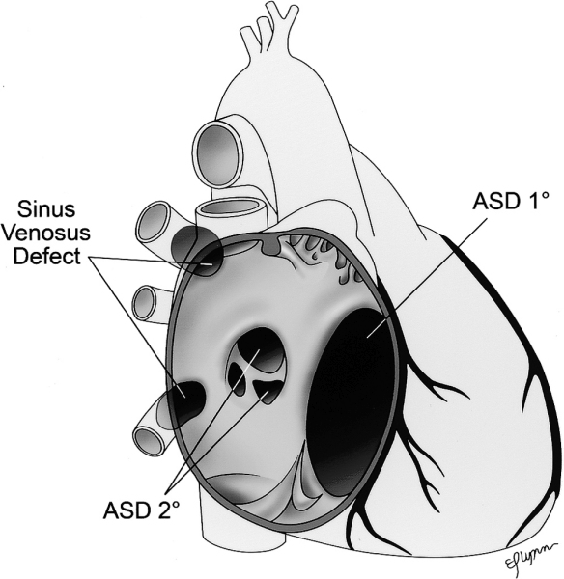
ASD
Isolated ASDs : 5-7 % of CHD
Majority of cases are sporadic
Seen with Holt-Orman Syndrome
Types:
ASD secundom
ASD primum (type of AVSD)
Sinus Venosus ASD

Slide 18
ASD
Pathophsiology:
L-R shunt toward pulmonary circulation.
Increased Qp:Qs ratio
Increased cardiac output to the pulmonary circulation (Qp)
Reduced of cardiac output to the systemic circulation (Qs)
L-R shunt at atrial level:
Dilated RA, RV and pulmonary arteries.
Pressure difference is not high; therefore, the shunt pressure (mmHg) difference is not.

Slide 19
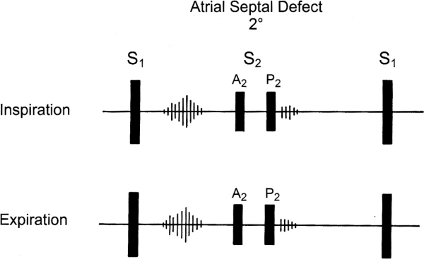
ASD
Clinical Features:
Usually asymptomatic (even no murmur) because of low pressure difference between the two atria even if it was large.
Symptoms if they present late as the RA enlarges when Afib occurs will occur 20-40 years.
include:
Shortness of breath
Fatigability
Rare: congestive heart failure, failure to thrive
Eisenmenger’s syndrome will appear late in life (around 40 years) unlike in VSD where it appears around the second or third year.
Physical examination:
Active precordium because of the proximity of the RV to the chest wall.
Widely fixed splitted second heart sound
Ejection systolic murmur at left upper sternal border due to increased flow across the pulmonary valve (as if its pulmonary stenosis) and not due to the shut across the ASD.
If large: mid-diastolic murmur (same concept as VSD and mitral stenosis but here tricuspid stenosis) at left lower sternal border.

Slide 20
Splitting Murmur
In normal physiology:
- During inspiration the intra-thoracic pressure is negative and this will suck the blood to the right ventricle increasing the venous return to the right side, therefore the right side cardiac output needs longer time to be pumped from the heart leading to a delay in the closure of the pulmonary valve and also because the right ventricular activity is weaker than that of the left which will further delay the closure of the pulmonary component of the second heart sound. This will make the splitting more evident during inspiration.
- During expiration: the intra-thoracic pressure becomes positive and the lungs are compressed decreasing the right venous return and increasing the left venous return so the aortic valve closure will be nearer to that of the pulmonary valve, therefore splitting will be less evident.

Slide 21
In ASD:
There will be wide (because there is increased blood in the right side because of the shunt) and fixed i.e. in both inspiration and expiration(because during expiration there will be increase in the left venous return that will be shunted to the right side which will further delay the pulmonary closure) splitting.

Slide 22
ASD
Diagnosis:
Chest X-ray:
Increased pulmonary vascular marking
+/- cardiomegally
ECG:
Evidence of RA and RV enlargement.
ECHO:
Confirm Diagnosis
Cardiac Cath: not required for Dx but might be used for treatment.

Slide 23
ASD
Treatment:
Medical Rx:
Diuretics might help in large defect with excessive pulmonary flow:
Surgical or Device (cath) closure ~ 4-6 age of life, which is done to prevent complication and not the defect.

Slide 24
ASD
Prognosis:
Complications might occur If left untreated to adult life. Heart conduction is in the right atrium; therefore, when it enlarges conduction is disrupted and forms:
Pulmonary vascular obstructive disease.
Atrial arrhythmias.
Paradoxical embolization (rare).
Eisenmenger’s syndrome: occurs at the age of 1-2 in VSD and around 30 years in ASD.

Slide 25
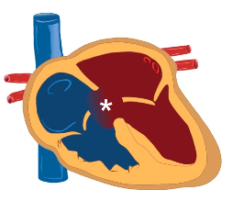
AVSD

Slide 26
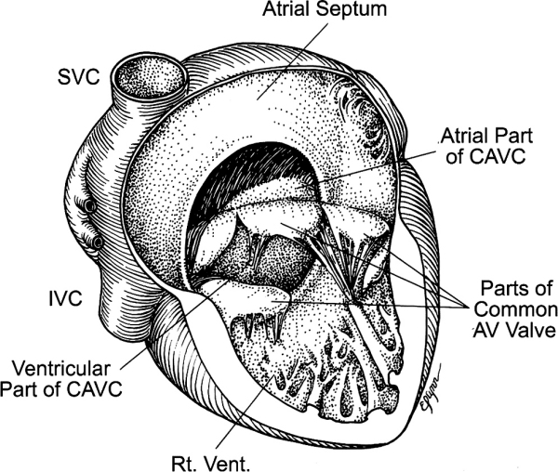
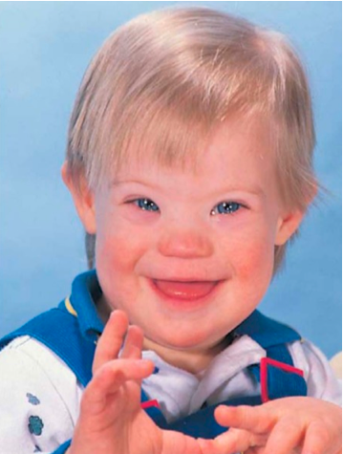
AVSD
Involves a defective closure of embryologic endocardial cushion tissue.
Incidence: 4 % of all CHD
%0% of patients with down have CHD, and 50% of patients with AVSD are down syndrome patients
Divided into:
Complete AVSD
Consist of (ASD primum, inlet VSD, and common AV valve)
Could be balanced or unbalanced AVSD
Balanced AVSD
AV valve orifice is committed equally to both ventricles, i.e. sits equally over both ventricles.
Unbalanced AVSD
AV valve orifice is favoring one ventricle over the other, there will be discrepancy in the size of AV valves and ventricles , one ventricle is hypoplastic
Partial AVSD
ASD primum
No VSD
Notes:
Balanced AVSD
AV valve orifice is committed equally to both ventricles, i.e. sits equally over both ventricles.
Unbalanced AVSD
AV valve orifice is favoring one ventricle over the other, there will be discrepancy in the size of AV valves and ventricles.

Slide 27
AVSD
Pathophsiology:
Similar to VSD and ASD
left to right shunt across the atrial level
Left to right shunt across the ventricular level
In addition: AV valve regurgitation
Left to right shut at three levels, but the valve is competent.
Significant L-R shunting:
Pulmonary over-circulation
Increase Qp:Qs ratio.

Slide 28
AVSD
Clinical Features:
Usually asymptomatic at neonatal period
Due to high pulmonary vascular resistance
Baby may have slightly lower oxygen saturation. It is an acynatoic heart disease but can be found with cyanosis at birth (common presentation).
Symptoms of CHF started at few months of age
Diaphoresis
Poor feeding
Failure to thrive.
Shortness of breath
Recurrent chest infection.
Exercise intolerance.

Slide 29
AVSD
Clinical Features:
Physical Examination: ( same symptoms as VSD )
Feature of Down Syndrome
Tachypnea
Tachycardia
Active precordium
Murmur:
Pan-systolic (holosystolic) murmur which is not due to valves. There is no diastolic murmur because they have a common valve ( instead of tricuspid and mitral valve ).
Hepatomegaly

Slide 30
AVSD
Diagnosis:
Chest X-ray ( as VSD )
Increased pulmonary vascular marking (lung congestion)
Cardiomegaly
ECG:
Left Axis deviation (AV node is displaced to the posterior part of heart) with RVH is very suggestive of AVSD
ECHO:
Confirm Diagnosis
Cardiac Cath: not required for Dx

Slide 31
AVSD
Treatment:
Medical Rx:
Anti-congestive therapy:
Important to prevent infection because it is common cause of death.
Nutritional support.
Surgical closure for complete VSD:
Close the ASD, VSD and make a common valve, but wait for proper heart size.
Usually done before 6 months of age to ovoid development of Eisenmenger’s syndrome. They develop Eisenmenger syndrome before VSD specially patients with Down syndrome.
Balanced AVSD: Biventricular repair ( you close both holes with a patch and divide the heart into 4 chambers )
Unbalanced AVSD: may need single ventricular repair
Notes:
Other indication for surgical VSD closure is Small VSD with complication:
Aortic valve prolapse
Right ventricular tract obstruction

Slide 32
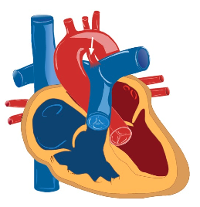
PDA

Slide 33
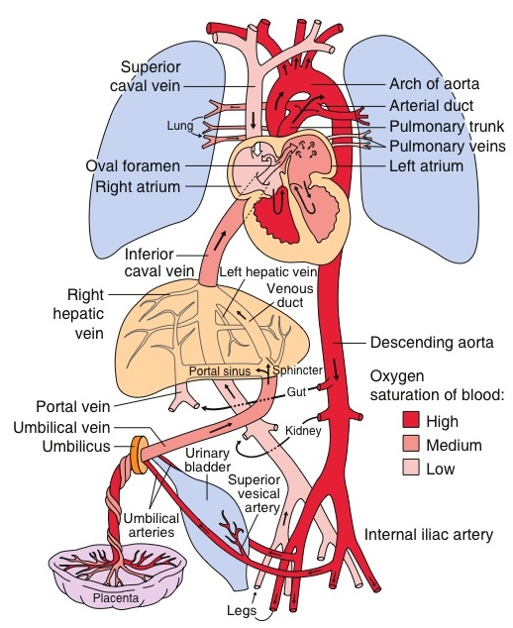
PDA

Slide 34
PDA
Ductus Arteriosus:
vascular tube connecting the left pulmonary artery to descending aorta
DA is an important structure in fetal circulation
After birth: DA mostly closed by the second or third day of life and is fully sealed by 2–3 weeks of life.
Incidence: 6-8 % of CHD
Most common form of CHD in premature baby
Frequently seen in T21 and congenital Rubella syndrome
Notes:
The ductus arteriosus remains patent in utero due to low oxygen tension in the blood and a high level of circulating prostaglandins.
With the baby’s first few breaths, the oxygen tension rises. Simultaneously, there is a drop in the prostaglandin level due to metabolism in the infant’s lungs and elimination of the placental source
Closure of the ductus is initiated by smooth muscle contraction a few hours after birth. This is followed by enfolding of the endothelium, subintimal disruption and proliferation. The lumen is thus obliterated and the closed ductus is transformed into a fibrous ligament known as the ligamentum arteriosum
Failure of the ductus arteriosus to close results in maintenance of patency and therefore a channel for blood to shunt from the aorta to the pulmonary circulation

Slide 35
PDA
Pathophsiology:
L-R shunt toward pulmonary circulation.
Increased Qp:Qs ratio
Increased cardiac output to the pulmonary circulation (Qp)
Reduced of cardiac output to the systemic circulation (Qs)
L-R shunt at great arteries level:
Dilated LA and LV
The ductus arteriosus remains patent in utero due to low oxygen tension in the blood and a high level of circulating prostaglandins.
With the baby’s first few breaths, the oxygen tension rises. Simultaneously, there is a drop in the prostaglandin level due to metabolism in the infant’s lungs and elimination of the placental source
Closure of the ductus is initiated by smooth muscle contraction a few hours after birth. This is followed by enfolding of the endothelium, subintimal disruption and proliferation. The lumen is thus obliterated and the closed ductus is transformed into a fibrous ligament known as the ligamentum arteriosum
Failure of the ductus arteriosus to close results in maintenance of patency ;therefore, a channel for blood to shunt from the aorta to the pulmonary circulation.

Slide 36
PDA
Clinical Features:
Small PDA: Asymptomatic (0.1mm)
Moderate to large (unrestrictive) PAD (3mm) (In the septal defects we consider it large if it was 6mm.)
Symptoms of CHF
Diaphoresis
Poor feeding
Failure to thrive.
Shortness of breath
Recurrent chest infection.
Exercise intolerance.

Slide 37
PDA
Clinical Features:
Physical Examination:
Tachypnia
Tachycardia
Widened pulse pressure
Active precordium
Murmur:
The shunt is throughout the cardiac cycle this is because pressure in the aorta is high in both systole and diastole (due to the elastic recoil of the aorta) whereas it is low during diastole in right ventricle.
Continuous (machinery murmur) at left infra-clavicular region because pressure is elevated throughout.
Large PDA: mid-diasolic murmur at apex.
PDA in neonate: ejection systolic murmur.
Hepatomegaly
Diastolic pressure is important to profuse the gut and coronary therefore they can present with necrotizing entercolitis.

Slide 38
PDA
Diagnosis:
Chest X-ray:
Increased pulmonary vascular marking
+/- cardiomegaly
ECG:
Small PDA: Normal
Mod PDA: LA enlargement , LV hypertrophy
Large PDA: Biventricular hypertrophy.
ECHO:
Confirm Diagnosis
Cardiac Cath: not required for Dx

Slide 39
PDA
Treatment:
Premature Babies:
Aggressive mechanical Ventilation due to pulmonary edema
On prostaglandins Antagonizing agents
Indomethacin and ibuprofen
NSAID (doesn’t work in mature babies)
Mature Babies:
Small PDA:
Conservative Rx
Anti-congestive therapy if symptomatic
PDA closure:
Transcatheter occlusion: Rx of choice
usually performed around 6–12 months of age or more than 10 Kg.
Surgical PDA ligation if can’t be done in cath lab
If symptoms are severe enough and can’t wait for 6 months to insert the device.
3 to 4 year old.

Slide 40
PDA
Prognosis:
If left untreated beyond infancy:
Pulmonary vascular obstructive disease
Eisenmenger’s syndrome
Sign and symptom of CHF will disappear
Patient will become cyanotic
R-L shunt across VSD

Slide 41
Acyanotic Heart Disease obstructive lesion

Slide 42
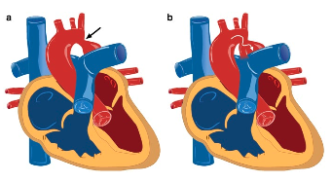
Coarctation of Aorta (CoA)

Slide 43
Coarctation of Aorta (CoA)
CoA: narrowing of the aortic arch such that it causes obstruction to blood flow.
Discrete
Diffuse (arch hypoplasia)
Can be mild to severe
Could lead to arch interruption
Incidence: 5-7 % of all CHD
Associated with Turner syndrome in female
Arch interruption: associated with DiGeorge syndrome
Post-ductal is 90%, pre-ductal is 10%, and 99% of pre-ductal will benefit form prostaglandins.

Slide 44
Coarctation of Aorta (CoA)
Pathophysiology:
Critical CoA
Spontaneous closure of PDA leads to
Obstruction of blood flow in distal arch
Hypotension and Shock
Acute increase of LV afterlaod
LV dysfunction
Milder obstruction:
Gradually collateral vessels develop connecting proximal aorta with distal arch.

Slide 45
Normal in utero because of the presence of ductus arteriosis. After birth, they become symptomatic due to the closure of DA and the patient can present with shock.
Because the CoA is not flexible, some present with stroke (aneurysm) due to elevated blood supply to the brain, and its decreased blood supply to the peripheral circulation.
If mild disease, presents later in life due to the formation of collaterals, and if severe/critical presents early in life with shock and severe LV failure.
Rule out CoA in middle aged patients presenting with HTN..
Preductal oxygen saturation ( to the upper part of the body ) is higher than the postductal saturation ( to the lower limbs) causing differential diagnosis ( upper body is pink while the lower part of body is blue )
Once you see an infant with differential cyanosis must consult a cardiologist to start PG to keep PDA open
If a baby presents at 7-10 days with shock and absent femoral pulses think of CoA.

Slide 46
Coarctation of Aorta (CoA)
Clinical Features:
Mild CoA:
Asymptomatic
Chronic hypertension
Headache
Fatigue
Stroke secondary to rupture of cerebral aneurysm in adults.
Critical CoA:
Presented around 7-10 days of life
Circulatory collapse and shock

Slide 47
Coarctation of Aorta (CoA)
Clinical Features:
Physical Examination:
Differential cyanosis (severe CoA in newborn)
Signs of cardiac shock
Reduced or absent femoral pulses
Brachio- femoral delay
4 limb BP should be done simultaneously : Lower BP in lower limb compare to upper, normally lower limbs have higher pressure than upper limbs due to gravity effect , more distant from the heart and increase in muscular wall thickness in LL vessels
Murmur:
Typically: ejection systolic murmur at the back
Continues murmur with well develop collateral.

Slide 48
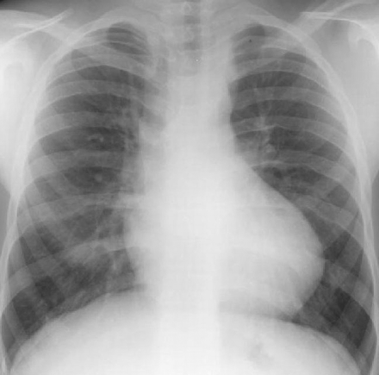
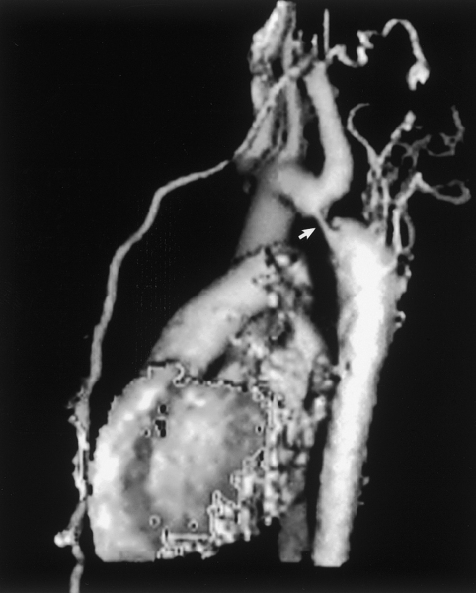
Coarctation of Aorta (CoA)
Diagnosis:
Chest X-ray:
Severe CoA:
Increased pulmonary vascular marking
cardiomegally
Delayed Dx:
Cardiomegaly,
prominent aortic knob due to engorgement of intervertebral vessels
Rib notching
Due to development of collateral vessels
Rarely seen before age of 10 years
ECG:
Neonate : RV hypertrophy
Older children: LV hypertrophy.
ECHO:
Usually will establish the diagnosis but limited outside the heart at arch level, may use CT or MRI.
May need Cardiac CT /MRI or Cardiac Cath

Slide 49
Coarctation of Aorta (CoA)
Treatment:
Critical CoA
Type of Duct dependent lesion
Prostaglandin E2 to keep PDA open to create a L-R shunt to decrease the load on left ventricle
Rx is surgical:
Trans-catheter balloon angioplasty with stent placement is usually reserved for recurrent CoA.

Slide 50
Coarctation of Aorta (CoA)
Prognosis:
If left untreated beyond infancy:
Pulmonary vascular obstructive disease
Eisenmenger’s syndrome
Sign and symptom of CHF will disappear
Patient will become cyanotic
R-L shunt across VSD

Slide 51
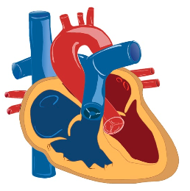
Pulmonary Valve Stenosis

Slide 52
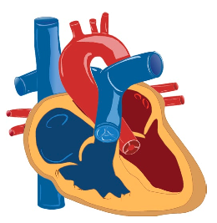
Aortic Valve Stenosis

Slide 53
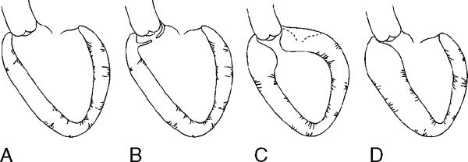
Sub-Aortic Stenosis

Slide 54
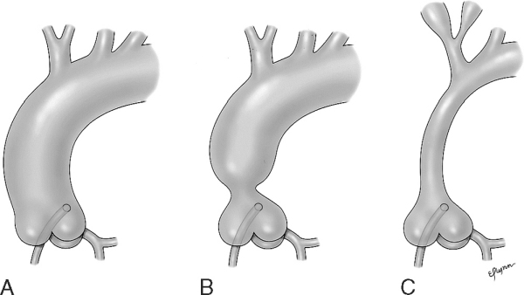
Supra-Valve Aortic Stenosis

Slide 55
Cyanotic Heart Disease
Causes of cyanotic heart disease are:
5Ts: tricuspid atresia, TGA, TOF, TAPVR and truncus arteriosus.
H: Hypoplastic left heart syndrome.
E: Ebstein’s anomaly.
Mixing of oxygenated and deoxygenated blood with obstruction of flow to the pulmonary circulation.

Slide 56
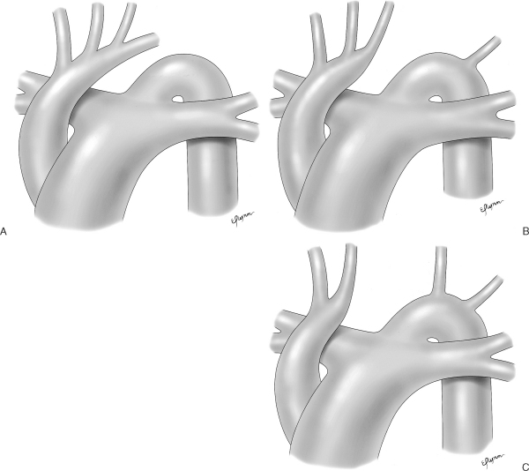
Interrupted Aortic arch

Slide 57
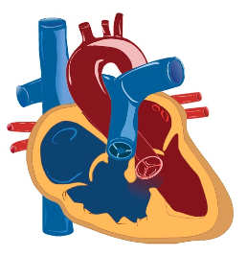
Tetralogy of Fallot

Slide 58
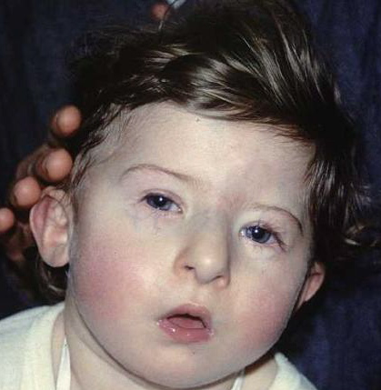
Tetralogy of Fallot
Most common cyanotic CHD
Incidence: 5-7 % of all CHD
Can be associated with
DiGeorge Syndrome
Suspect TOF in a cyanotic baby with systolic murmur and digeorge syndrome.

Slide 59
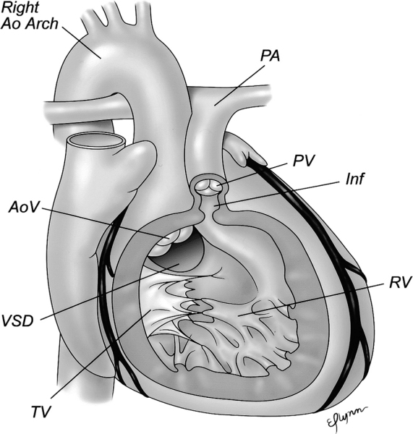
Tetralogy of Fallot
Basic pathology:
Anterior displacement of outlet septum (Infandibular septum)
Conus septal deviation
Four basic components
Large VSD
Pulmonary stenosis (PS)
Overriding aorta
RV hypertrophy

Slide 60
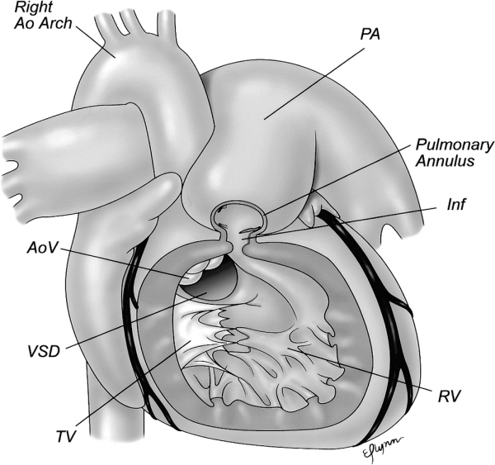
Tetralogy of Fallot

Slide 61
Tetralogy of Fallot
Clinical Features:
Depend on the severity of PS
Most newborn:
Asymptomatic
Ejection systolic murmur on routine discharge exam due to the pulmonary stenosis (the VSD does not produce a murmur at birth)
Initially have mild cyanosis which progress with time.
Might present with hypercyanotic spells “tet spells” if delayed intervention.
Newborn with severe PS or pulmonary atresia
Severe cyanosis when PDA close “Duct dependent lesions”
Need IV prostaglandin E2 to keep lungs perfused through PDA ( unlike in CoA the use PG is to keep the duct open to create a L-R shunt)
Note : the deoxygenated blood in the right ventricle does not go through the pulmonary arteries due to the pulmonary stenosis, instead it passes through VSD into the left ventricle and to the systemic circulation leading to cyanosis.

Slide 62
Tetralogy of Fallot
Tet Spells:
Usually occur around 9-12 months of age, rarely seen because of early detection and the use of beta blockers.
Sudden drop in oxygen saturation leading to episodes of acute and severe cyanosis
It is a viscous cycle occurring under stress as in fever, infection, delayed treatment or dehydration that leads to acidosis . The acidosis causes more muscular spasm increasing the severity of pulmonary stenosis leading to more cyanosis that will further increase the acidosis and so on.
Management:
The main stay of treatment is aimed at
Decreasing the pulmonary vascular resistance.
Systemic vascular resistance.
Increase venous return.
Medical emergency:
Reduced anxiety and stress that might precipitate tet spells “Keep child in his mother lap”.
Knee-to-chest position to increase VR to the right side increasing the systemic resistance.
Give oxygen
If these interventions are not effective
Sedation with morphine and O2 : decrease the pulmonary resistance by causing vasodilatation.
IV fluid: to increase VR.
Beta Blocker : better filling of the heart and main treatment of tet spells by slowing the HR. must consider surgery at this point because the child might die in a month and the condition will be exacerbated by infection or ischemia.
Phenylephrine : to increase the aortic systemic resistance.
Might require emergency surgical intervention (once there is tet spells surgical treatment is required)

Slide 63
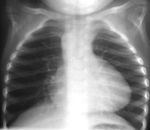
Tetralogy of Fallot
Diagnosis:
Chest X-ray:
Classically show “boot-shaped heart” but not enlarged, because of RVH that pushes the apex upward, or a right arch resulting is a narrowed mediastinum
Oligemic lung: decreased vasculature.
ECG: RVH
Diagnosis is confirmed mainly by ECHO
Cardiac CATH: Mostly not required
Treatment:
Principle of Tx :
1- increase venous return 2- decrease pulmonary resistance 3- increase systemic resistance
TOF Surgical repair by 6-9 months
VSD patch closure
RV outflow enlargement

Slide 64
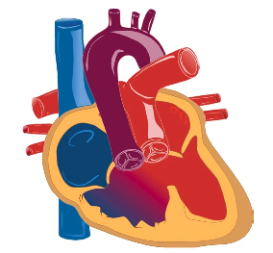
Double Outlet Right Ventricle

Slide 65
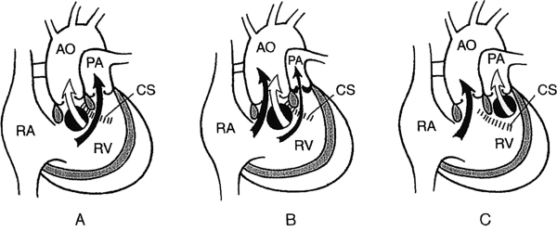
Double Outlet Right Ventricle

Slide 66
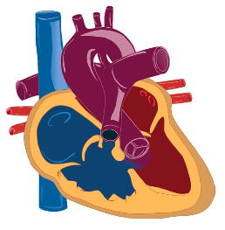
Pulmonary Atresia with Ventricular Septal Defect

Slide 67
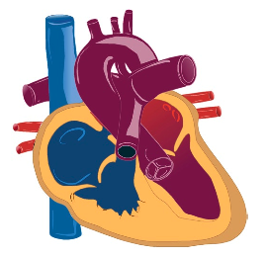
Pulmonary Atresia with Intact Ventricular Septum

Slide 68
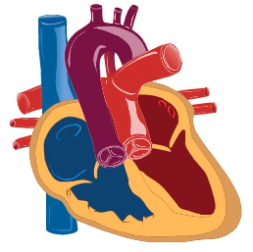
Transposition of the Great Arteries

Slide 69
Transposition of the Great Arteries
Aorta and pulmonary artery are connected to the wrong ventricle (transposed).
Most common cyanotic CHD presenting with cyanosis at birth.
Incidence: 3-5 % of all CHD
More common in male
Higher incidence in infant of diabetic mother

Slide 70
Transposition of the Great Arteries
Pathophysiology:
In Normal heart:
Pulmonary and systemic circulations are in series (crossed) with one another.
In D-TGA:
Pulmonary and systemic circulations are in parallel (and separate) with one another
Pulmonary artery arise from LV carrying oxygenated red blood
Aorta arise from RV carrying de-oxygenated blue blood
Therefore, if there was no L-R (for mixing of blood) shunt the baby will be severely cyanotic.

Slide 71
Transposition of the Great Arteries
Pathophysiology:
Mixing of oxygenated and deoxygenated blood can occur at three levels:
Atrial level via ASD/PFO patent foramen ovale (most important)
Great arteries level via PDA
Ventricular level via VSD (if present)

Slide 72
Transposition of the Great Arteries
Well tolerated during fetal life like other CHD
After birth:
Severely Cyanotic:
“reverse differential cyanosis”: its seen when the TGA is associated with both PDA and pulmonary HTN. Because the increase in the pulmonary pressure creates a L-R shunt through the PDA to the Aorta resulting blue arms and red legs.
No signs of respiratory distress
Single second heart sound
Typically: no murmur (most cyanotic heart diseases come with a defected s₂ and not as a murmur)
Hyperoxic test: fail
Note: its seen in big male infants who are deeply cyanotic but without respiratory distress.

Slide 73
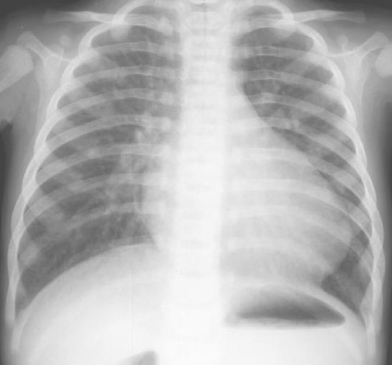
Transposition of the Great Arteries
Diagnosis:
Chest X-ray: normal or
“egg on a string” appearance because of a narrow aorta.
Increase pulmonary vascular marking.
ECG:
Typically normal
ECHO:
procedure of choice to establish diagnosis
Cardiac Cath:
might be needed to define coronary arteries anatomy.

Slide 74
Transposition of the Great Arteries
Treatment:
Supportive:
The systemic circulation in TGA is de-oxygenated while the pulmonary circulation will be carrying oxygenated blood, therefore we must create a septal defect at any level so that mixed blood can reach the systemic circulation instead of purely de-oxygenated blood.
Prostaglandin E2 (to keep PDA open) its not efficient alone.
Balloon atrial septostomy (the best way to establish good mixing). It’s better than creating a VSD, because in VSD the mixing will only occur during systole where there is pressure difference, while in ASD the pressure is nearly equal all the time; therefore, better shunting.
Definite intervention:
arterial switch operation (ASO)
Switch of great arteries
Moving coronaries to what is called “neo-aorta”
Atrial switch operation (not used anymore)
Mustard and Senning procedures

Slide 75
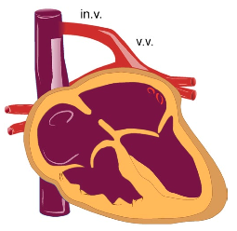
Total Anomalous Pulmonary Venous Return

Slide 76
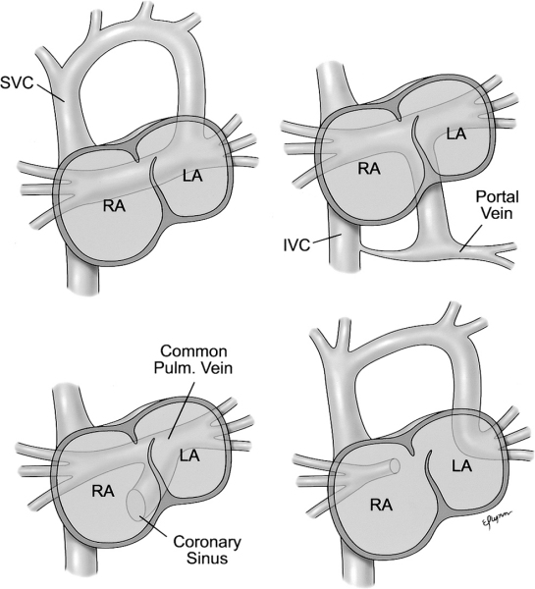
Total Anomalous Pulmonary Venous Return
All 4 pulmonary veins returns anomalously to the right atrium instead of the left atrium. There is only one pathway of circulation, from the pulmonary veins to:
SVC in Supra-cardiac (50%) most common type.
RA-RV intra-cardiac (25%)
IVC in Infra-cardiac (20%)
Mixed (5%)
The Oxygenated blood coming from the lung will mix with the deoxygenated blood in the RV which will drop the saturation to 85%. The oxygen saturation can reach 90-95% but never reach 100%, must do echo to confirm.
Can be:
Obstructed TAPVR: pulmonary venous flow obstruction resulting in lesser O₂ saturation and reflux pulmonary vasoconstriction leading to pulmonary hypertension therefore giving PG here will be a killer because PDA is already congested.
Non-obstructed TAPVR: will present with tachypnea and low saturation. They can present later on with bronchiolitis.

Slide 77
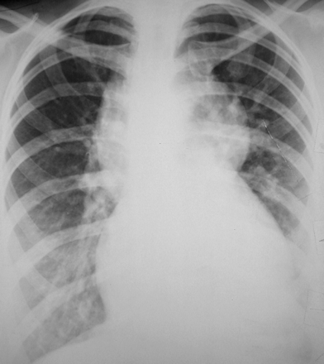
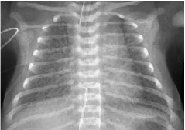
Total Anomalous Pulmonary Venous Return
Clinical Feature:
Cyanosis at birth
Severities depend degree of obstruction
Diagnosis:
Chest X-ray:
Increased pulmonary vascular markings
“Figure of eight” in obstructed supracardiac TAPVR or snow man appearance because the heart is receiving less blood and the veins of the neck are congested.
Small heart and congested lung.
ECG: RVH
ECHO: Confirm Dx
Cardiac CT/MRI: may be need to define venous anatomy

Slide 78
Total Anomalous Pulmonary Venous Return
Treatment
TAPVR is the only cyanotic CHD which can get worse with Prostaglandin E2 infusion.
Surgical repair is the only available option
Emergency surgical repair is required with obstructed TAPVR

Slide 79
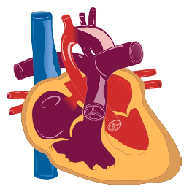
Hypoplastic Left Heart Syndrome

Slide 80
Hypoplastic Left Heart Syndrome
HLHS: one of the most severe form of CHD
High morbidity and mortality
Incidence: 1-2 % of all CHD
Involved obstruction at multiple level of left heart structures.
Mitral stenosis to mitral atresia
Variable degree of LV hypoplasia
Aortic stenosis to aortic atresia
Variable degree of ascending aorta hypoplasia

Slide 81
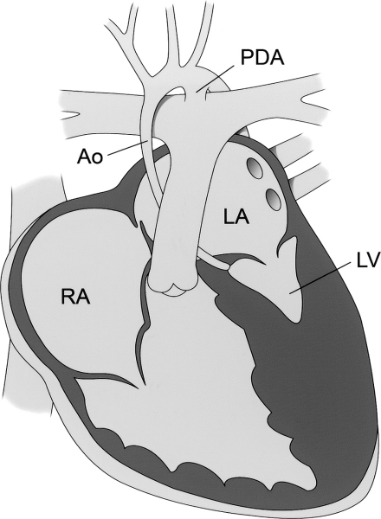
Hypoplastic Left Heart Syndrome
Pathophysiology:
Typically no adequate forward flow across the aortic valve through the ascending aorta.
Relies exclusively on PDA flow in a retrograde fashion through ascending aorta and coronary arteries.
Hypoplastic left ventricle and ascending aorta while the descending distal aorta is normal because it relies on the shifting of the blood retrograde-ly through PDA (from pulmonary to systemic circulation via descending aorta).
Essential to have atrial communication (ASD/PFO) to shunt blood from left atrium to right atrium.

Slide 82
Hypoplastic Left Heart Syndrome
Clinical Features:
At birth: Cyanosis at birth
At 2-4 week of life: Respiratory distress , lethargy, poor pulses/perfusion and other signs of shock
When PDA is closed.
Diagnosis:
Chest X-ray :
non-specific
ECG:
RVH
Decrease LV forces
ECHO:
Gold standard diagnostic tool
Cardiac Cath:
not needed for Dx.

Slide 83
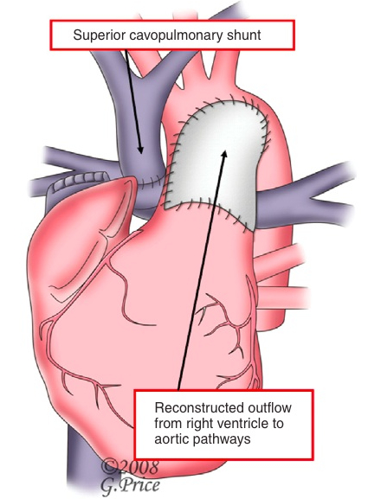
Hypoplastic Left Heart Syndrome
Treatment:
Start PGE2
Stabilization in high cardiac centre
Options for treatment:
Companionate care
Norwood staged Repair:
Norwood stage I
After birth: arch reconstruction and systemic-pulmonary shunt
Norwood stage II
3-6 month: Glenn procedure (connecting SVC directly to PA)
Norwood stage III
2 years: Fontan procedure (Connecting IVC directly to PA)
Cardiac transplantation

Slide 84
Tricuspid Atresia
In tricuspid atresia, there will be no flow to the RV and no blood will be going to the pulmonary arteries resulting in pulmonary atresia.
In tricuspid atresia, the presence of VSD will determine the survival and degree of stenosis.
If there was no VSD, the baby will die if the PDA was not maintained.
If VSD was there, the baby will survive with cyanosis.
In small VSD there will be small RV and higher degree of stenosis because of severe pulmonary stenosis, while in large VSD the RV will be large with lesser degree of stenosis.

Slide 85
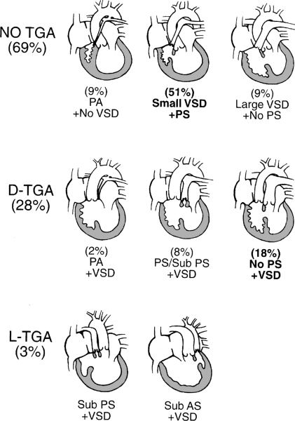
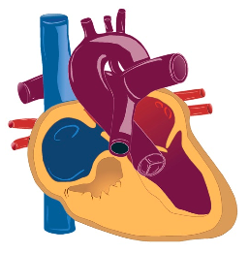
Tricuspid Atresia

Slide 86
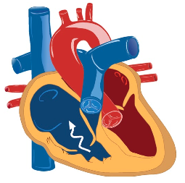
Ebstein’s Anomaly
The tricuspid valve or hinge point is displaced causing the right atrium to enlarge.
The right ventricle is very weak and small so it will not be able to generate pressure to overcome pulmonary resistance; therefore, the RV can’t pump the blood to the pulmonary circulation but once it’s repaired, they become better.
50% of the neonates are born with other anomalies such as ASD or patent foramen vale that help in the mixing of blood.

Slide 87
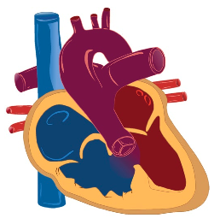
Truncus Arteriosus
In Truncus Arteriosus, the pulmonary artery and the aorta originate from the same trunk, so deoxygenated and oxygenated blood will always mix together.
Patients will have a boot shaped heart as in TOF but without lung congestion or cardiomegaly.
They will have unrestricted flow to the lungs leading to congestive heart failure, cyanosis, narrow mediastinum.

Slide 88
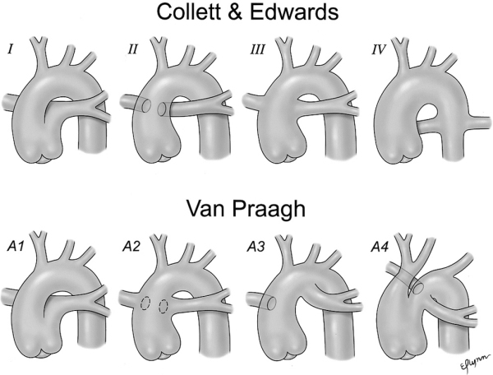
Truncus Arteriosus

Slide 89
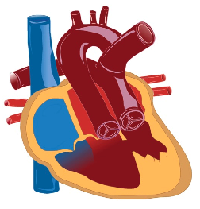
Single Ventricle

Slide 90
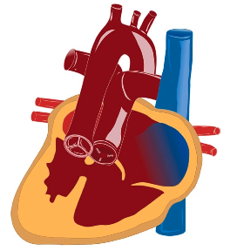
Complex Cyanotic Congenital Heart Disease: The Heterotaxy Syndromes

