Slide 1
Burns, & Burn Management
Dr. Abdullah Kattan, MBBS, FRCS( C )
Consultant Plastic Surgeon
Division of Plastic Surgery
Department of Surgery - KKUH

Slide 2
Definition
Thermal, chemical or electrical injury sufficient enough to cause tissue disruption, denaturation, or even death
Carry a risk of permanent :
Disfigurement
Impairment of function

Slide 3
Epidemiology
Males>Females
2 peaks at :
0 - 5yrs
25 - 35yrs
80% of burns are less than 20%TBSA
Pediatrics
Scald Burns >80%
Account for 45% of Hospital Admission
33% due to child abuse
Elderly :
Impaired mobility, poor coordination, decrease awareness to pain
Abuse/neglect
Factors that  mortality :
Age greater than 60
Greater than 40% TBSA
Inhalation injury
Alcohol is a common contributing factor

Slide 4
Types of Burns
Scalds (hot liquids) → most common type in children
Flame (thermal) → most common in adults
Electrical
Chemical
Frictional
Flash
Contact

Slide 5
Pathophysiology
Increased fluid loss from the surface
Normally 15ml/m² increase to 200 ml/m²
In deep burns, the dermis is converted to coagulum called ESCHAR
Inflammatory response ranges from
Capillary dilatation in sunburn
Damaged capillaries and increase permeability and interstitial edema

Slide 6
Pathophysiology
2cm increase in leg diameter represent 2L of increase in fluid
Destruction of epidermis removes the protective bacterial barrier → Contamination → Sepsis → Death

Slide 7
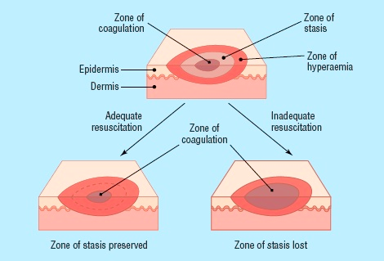
Pathophysiology
Zone of coagulations
Zone of stasis
Zone of hyperemia

Slide 8
General Effect Of Burns
Depends on the burn size
The bigger the burn the more the physiological changes :
Water loss
Salt loss
Protein loss
Increased catabolism
Edema due to fall in circulating plasma
Damage to RBCs : Immediate or delayed
Increase Hct
Hypovolumic Shock
Increased Metabolic Rate 7000 Kcal expended daily
Daily Wt loss of 0.5kg

Slide 9
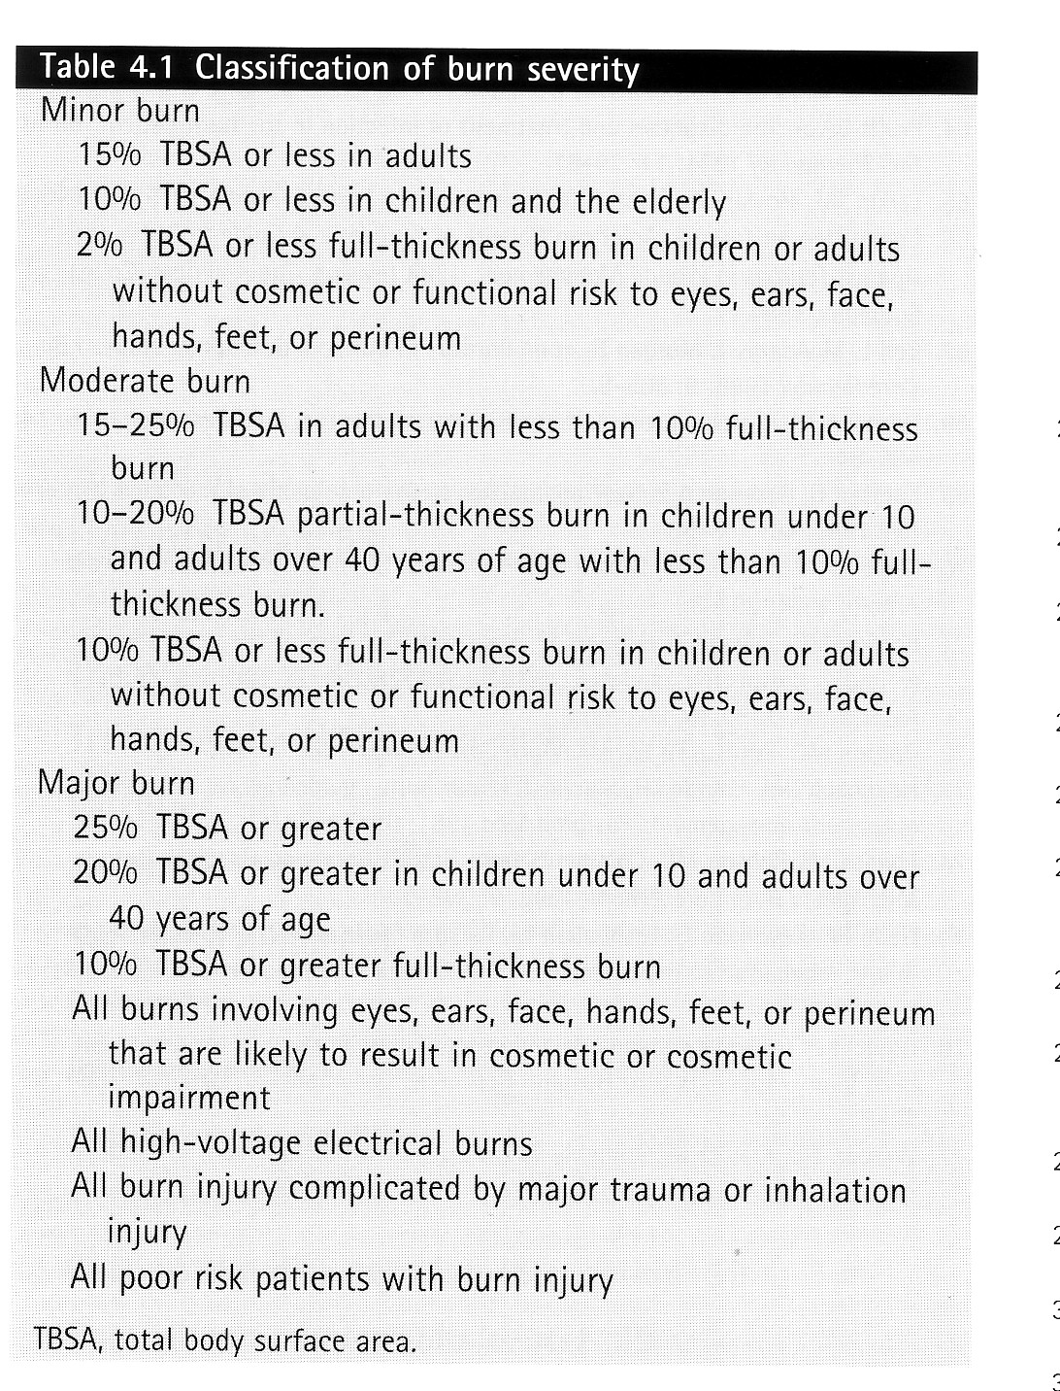

Slide 10
Mortality
In the early post burn period:
Inadequate hydration
Respiratory issue (inhalation or infection)
In the late post burn period:
Wound sepsis
Delayed healing,
Increased energy expendature

Slide 11
Burn Classification
By Types
By TBSA
By degree / thickness

Slide 12
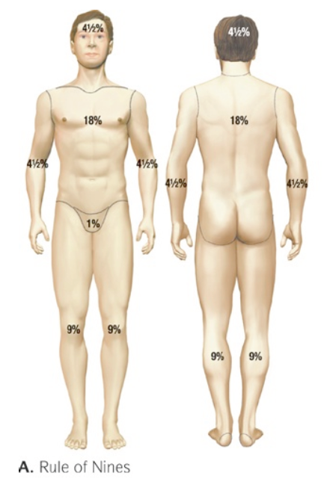
Burn Classification By Total Body Surface Area (TBSA)
Wallace rule of 9s:

Slide 13
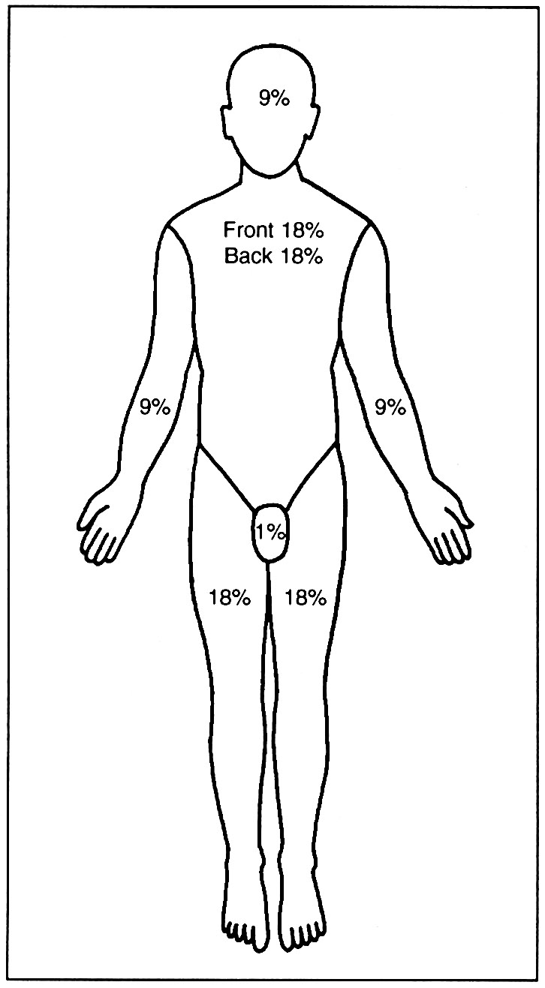
Burn Classification By TBSA
The Role of Palm
Pts palm is equal to 1%
Good for scattered burns

Slide 14
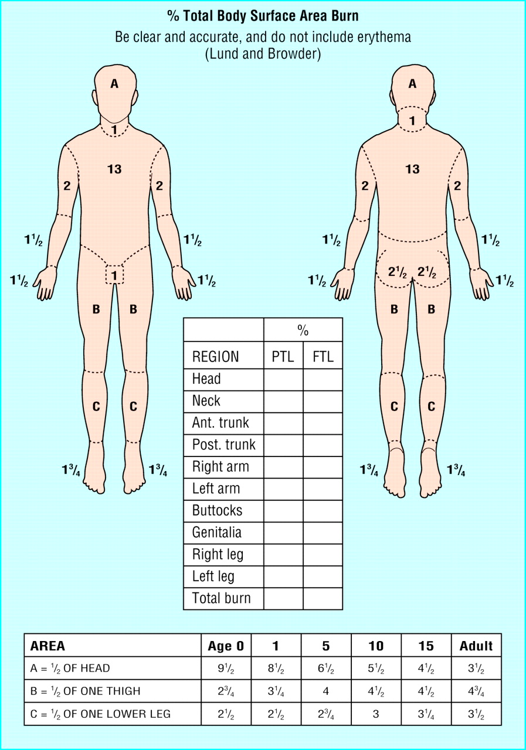
Burn Classification By TBSA
Lund Browder Chart

Slide 15
Burn Classification By Degree / Thickness
Old:
1st degree
2nd degree
3rd degree
4th degree
New:
Superficial (1st degree)
Superficial partial thickness (2nd degree)
Deep partial thickness (2nd degree)
Full thickness

Slide 16
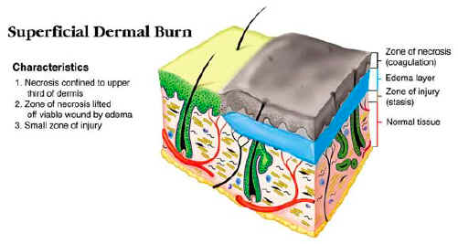
Superficial (1st Degree)
Damage to the epidermis only
No Need for admission
Heal with in 5 – 7 days
No scarring
Needs ONLY analgesia

Slide 17
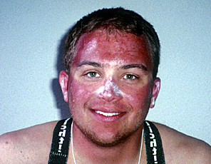

Slide 18
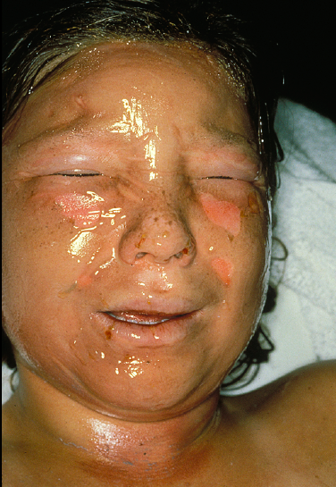

Slide 19
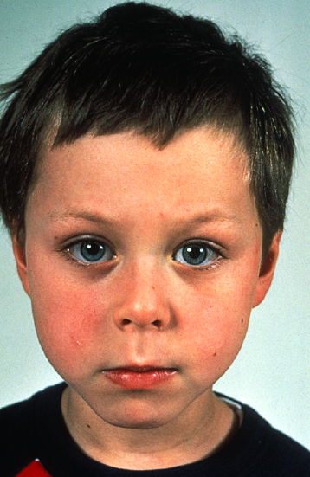

Slide 20
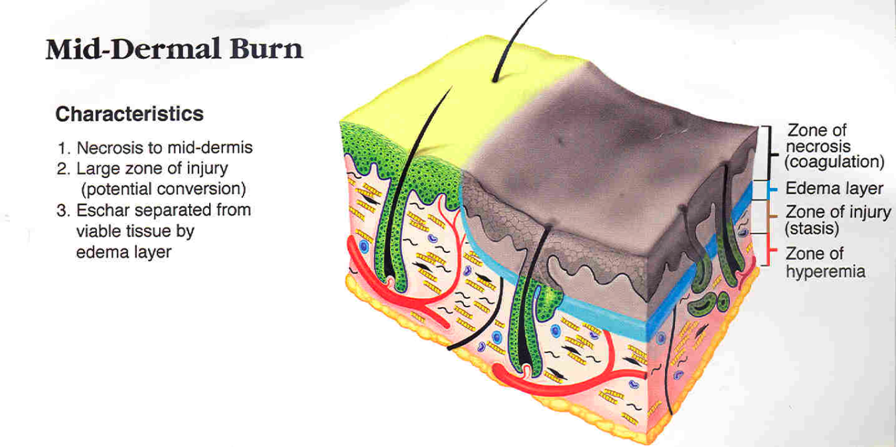
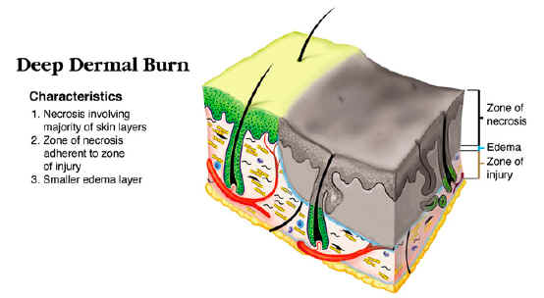
Partial Thickness (2nd Degree)
Superficial Partial thickness
Epidermis and upper dermis
Pink, painful, swollen
Fluid loss
BLISTER
Heal with-in 2 weeks
From epidermal appendages
DAILY DRESSING
Minimal scarring
Deep partial thickness
Epidermis and most of the dermis
Treat like 3rd degree burn
Less or not painful
Rarely Blister
Prolonged inflammatory phase cause scarring
Leave an ugly hypertrophic scar
NEEDS DEBRIDEMENT & SKIN GRAFT

Slide 23
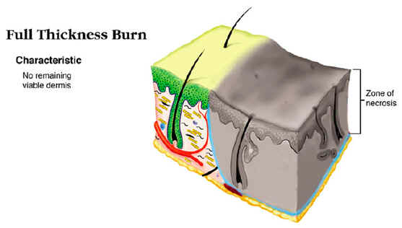
Full Thickness (3rd Degree Burns )
Epidermis and total dermis including the epidermal appendages
Destroyed tissue undergoes coagulative necrosis
Not painful
No Blister
Marble or leathery like appearance
THROMBOSED VEINS
Cause significant Scarring due inward growing and movement of the cells
NEEDS DEBRIDEMENT & SKIN GRAFT

Slide 24
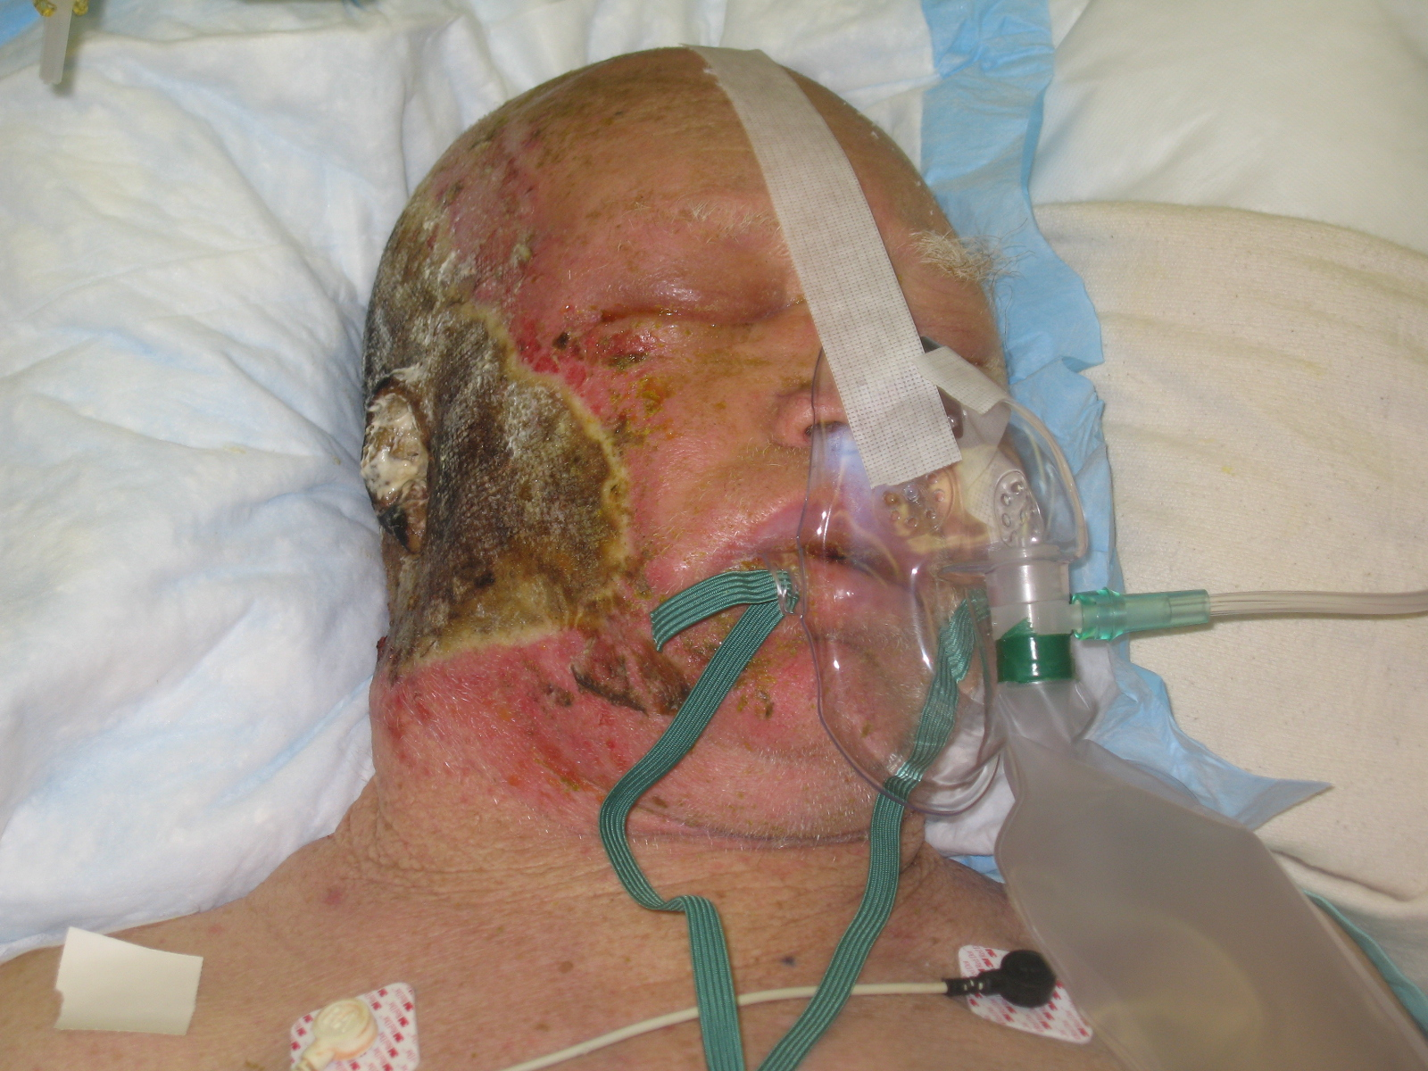

Slide 25
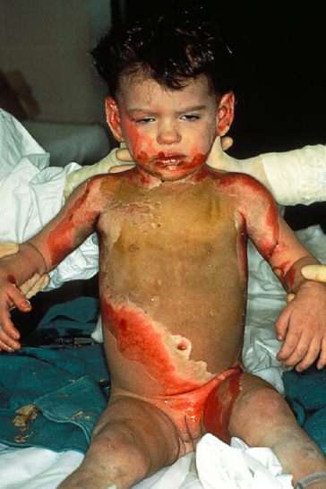

Slide 26
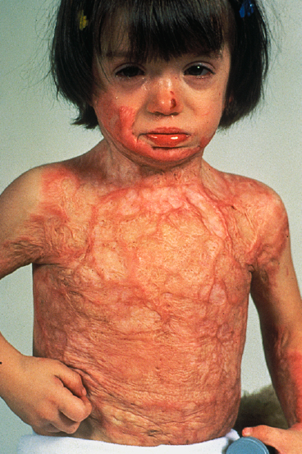

Slide 27
Full Thickness (4th Degree)
Injury extends to the underlying structures
Muscle, Fascia, Bone
Charring of the tissue

Slide 29
Determination of Burn Depth
Mechanism
Scald : Short Vs. Long
Flame, Chemical , Electrical
Appearance
Erythema, Blister, Eschar, thrombosed veins
Sensation
Time to healing

Slide 30
Prognosis
Age, and General condition
Extent of the Burn
The TBSA the smaller the burn the better the prognosis, and vise versa
Depth of the Burn
Superficial burns heal with in 2 – 3 weeks
The deeper the burn the higher the risk of infection
Site of the Burn
Due to appearance and functional impairment
Inhalation Injury

Slide 31
Burn Management
First Aid
Stop the burning process
Victim should stay flat to avoid inhalation of smoke and fumes
Remove all burned clothes
Apply cold water Vs. Hypothermia
Chemical Burns
Copious irrigation
Electrical Burns
Switch off the current, or by pushing the victim away from the current source with a non-conducting object

Slide 32
Burn Management
Avoid Wound Contamination
Burn must be covered with clean sheet
Avoid using house hold items
It might convert partial injury to a full thickness one

Slide 33
Burn Management
ABCs - Life preservation
History:
Agent of injury
Medical co-morbidities
Physical exam:
Inhalational component?
Estimation of depth
Estimation of TBSA of burn
Determination: Severity of injury and triage/transfer
Irrigation and debridement of wounds

Slide 34
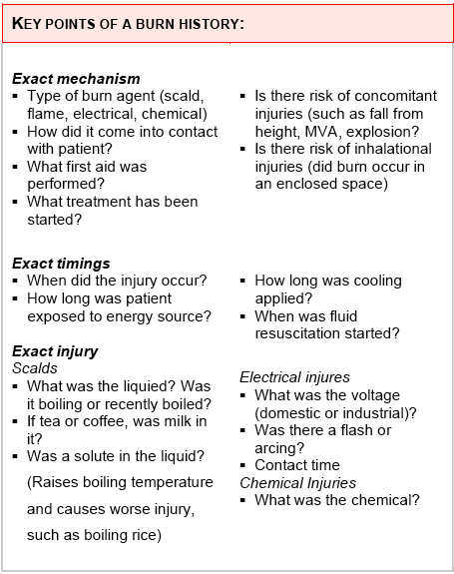
History

Slide 35
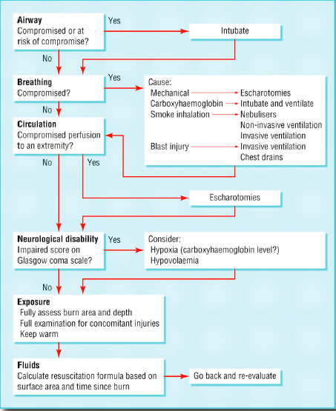

Slide 36
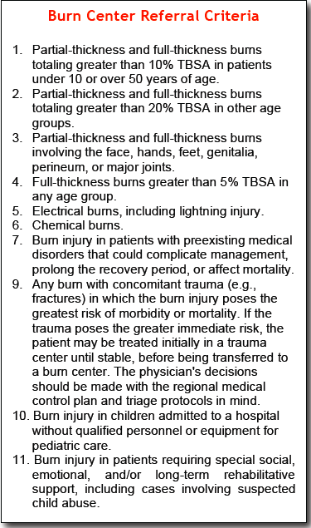
Transfer Criteria

Slide 37
Inhalation Injuries
The mechanisms of inhalation injury can be divided into three broad areas
Inhalation of products of combustion
Carbon monoxide inhalation
Direct thermal injury to the upper aero-digestive tract
Suspect inhalation injury if:
Flame burn in a closed space
Singed (burned) nasal hair
Facial or oropharyngeal burns
Expectoration of carbonaceous (blackish) sputum
Signs of upper respiratory obstruction—such as crowing, dyspnoea, cough, stridor, or air hunger

Slide 39
Inhalation Injury / CO
Odourless, tasteless gas
Impairs tissue oxygenation by preferentially binding to Hgb
Affinity 240 times that of oxygen
shifts the Hb dissociation curve to the left decreasing O2 delivery
Signs include:
Headache
cherry red lips
arrhythmias
acidosis
seizures
LOC

Slide 40
Inhalation Injury Carbon Monoxide
Co Level | Symptoms
0 - 5 | Normal Value
15 - 20 | Headache, Confusion
20 – 40 | Disorientation, Fatigue, Nausea< Visual Changes
40 – 60 | Hallucinations, Coma< Shock
60 or above | Mortality >50%

Slide 41
Inhalation Injury Carbon Monoxide
Treatment
100 % O2 +/- intubation and ventilation
t1/2 of CO is 5 to 6 hours on R/A
45 min on 100% O2
27 min HBO @ 3 atm
Indications for HBO therapy
Coma
LOC
ischemic ECG changes
focal neurological deficits
+/- CO Hb >40%

Slide 42
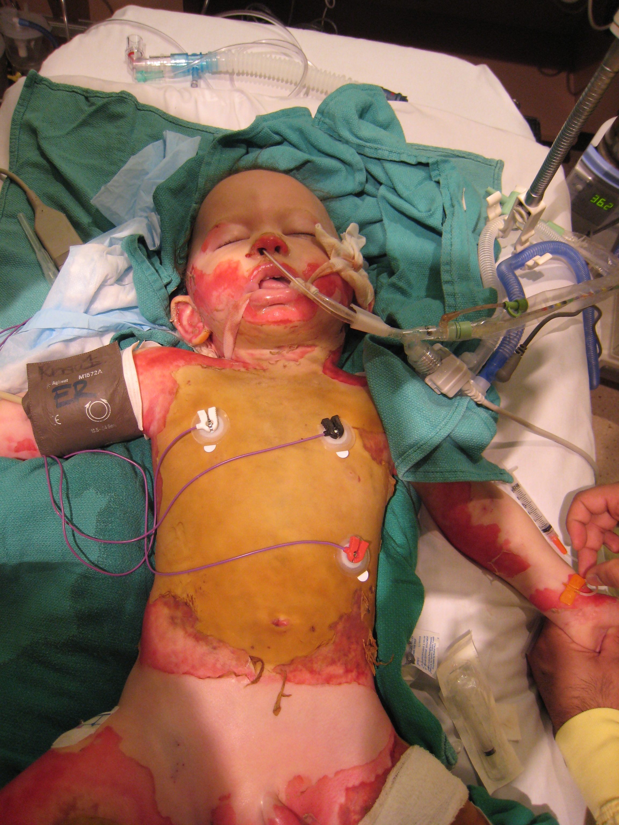

Slide 43
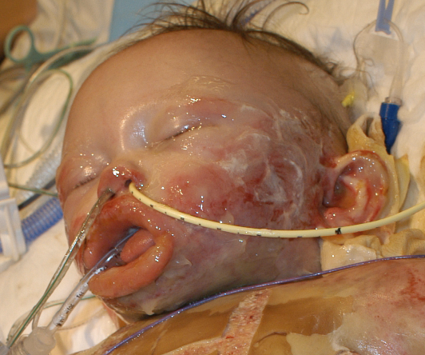

Slide 44
Burn Management
Non – Surgical
Tetanus Vaccine
Fluid
Nutrition
Physiotherapy
Dressing
Surgical
Escharotomy
Debridement
Grafting

Slide 45
Non-Surgical Burn Management Fluid Resuscitations
Burns over 15% TBSA in Adults or 10% in Children
Require IVF administrations
Through a peripheral Vein
Or Internal Jugular or subclavian vein line if peripheral line is not possible
Withdraw blood for CBC, Electrolytes, CO level
Foley catheter

Slide 46
Non-Surgical Burn Management Fluid Resuscitations
Crystalloid Vs. Colloid

Slide 47
Non-Surgical Burn Management Fluid Resuscitations
Parkland Fromula
Wt in Kg X TBSA % X 4cc
1st ½ in the 1st 8 hrs and 2nd ½ in the next 16 hrs
Use R/L
Only for 2nd degree burns or deeper
Modified Brooke
Wt in Kg X TBSA % X 2cc
Hypertonic Saline
250-300meq
Decrease the fluid requirement
Require regular Na monitoring

Slide 48
Non-Surgical Burn Management Fluid Resuscitations
Children will need the maintinance IVF add to there fluid resuscitations
100ml / kg / 24hr 1st 10 kg
50ml / kg / 24hr 2nd 10kg
20ml / kg / 24hr 3rd on kg
To avoid Hypoglycemia
Use D5% ½ NS fluid

Slide 49
Non-Surgical Burn Management Fluid Resuscitations
Colloid Replacement formula
0.5ml/kg/%of burn
Blood transfusion
After 24hrs
Mainly needed in pts with full thickness burn
Regular Hb, Hct monitoring is mandatory

Slide 50
Non-Surgical Burn Management Fluid Resuscitations
Adequate fluid resuscitation is monitored by :
Urine Output
0.5 – 1 ml/kg/hr for Adult
1 ml/kg/hr for Children
In cases of electrical burns more urine is needed to protect the kidney
2 – 3ml/kg/hr
Inhalational injury patients also need extra fluids

Slide 51
Non-Surgical Burn Management Nutrition
Due to increased energy expenditure following sever burn
High caloric protein diet once the pt can take orally or via NGT
Daily requirement is 20kcal/kg + 70kcal/kg/%of burn ( 1g/kg + 3g/kg/%of burn of protein )
Vitamines Supplement
Vit C
Zinc
Multi-Vitamines

Slide 52
Non-Surgical Burn Management Physiotherapy
Splints to prevent contractures
Range of motion exercises to prevent stiffness

Slide 53
Non-Surgical Burn Management Dressing
Local wound management
Cover burn regularly to avoid infection which is the main threat to life once the 1st 24hrs have passed
Initial cleansing and debridement
Cleanse wound with antiseptic & saline
Blister are punctured
No role for IV or Oral Abx
Do not forget tetanus

Slide 54
Non-Surgical Burn Management Dressing
Destruction of the epidermis removes the normal barrier to infection
Full thickness burn impairs the normal response to infection
The organism colonize the burn wound
Staphylocooci the most common
Pseudomonos remains troublesome in most burn units

Slide 55
Non-Surgical Burn Management Dressing
Flamazine ( Silver sulphadiazine ) the most common burn dressing used
Must be applied daily
S/E neutropenia
Can not be used in infants under 6/12 of age
Open Vs. Closed dressing
Fucidine or bacitracine ointment
To prevent super-infection of the burn wound from the colonized organisms

Slide 57
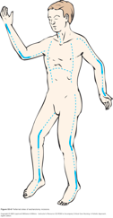
Surgical Burn Management Escharotomy
Mid – Axial incision in the eschar only of full thickness burn
To relieve the tourniquet effect of the circumferential full thickness burns on :
Extremity
Trunk if
Breathing was an issue
Increase intra-abdominal pressure
Due to interstitial fluids accumulation

Slide 58
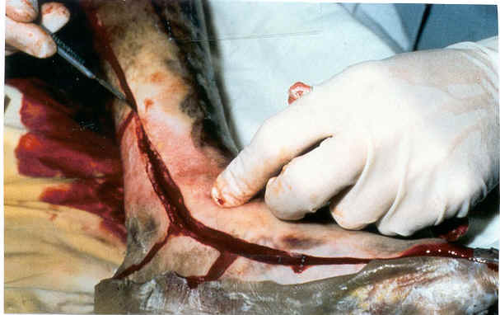

Slide 59
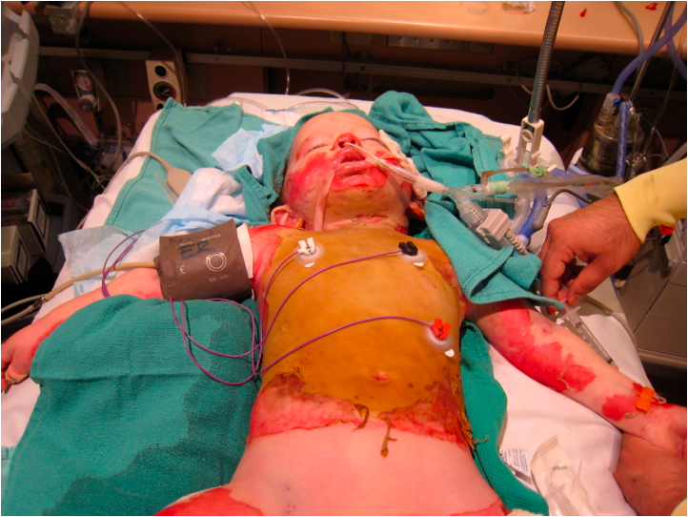
Surgical Burn Management Escharotomy

Slide 60
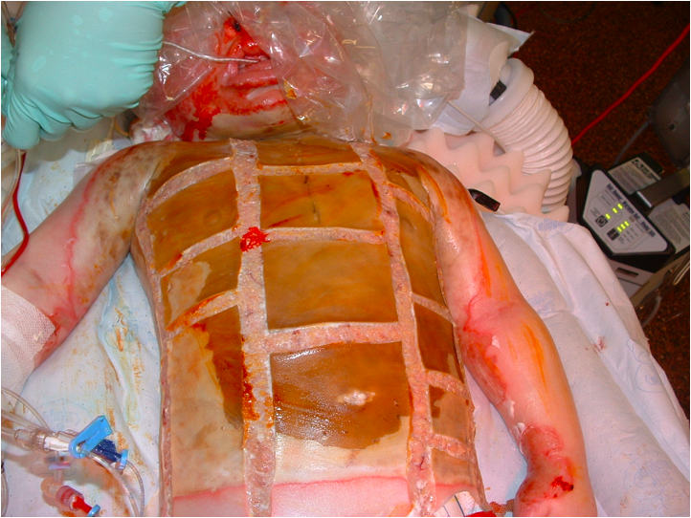

Slide 61
Skin Grafts
Split Thickness (STSG) | Full Thickness (FTSG)
Epidermis + part of the dermis | Epidermis and entire dermis
Donor sites: Thighs - Back - Abdomen - Scalp - any part of the body | Donor sites: - Post auricular - supraclavicular - Groin - forearm
Advantages: Donor heals spontaneously Large donor area, can be reused Higher chance of take in less ideal conditions | Advantages: Less contraction Grows with the patient Secrets oil and sweat Better donor site scar and less pain More stable/durable
Disadvantages: More contraction More fragile Loss growth potential Donor site more painful | Disadvantage: Donor site must be closed Less donor areas Needs clean wound bed May grow hair

Slide 62
Surgical Burn Management Debridement, and Skin Graft

Slide 63
Surgical Burn Management Debridement, and Skin Graft

Slide 64
Surgical Burn Management Debridement, and Skin Graft

Slide 65
Surgical Burn Management Debridement, and Skin Graft

Slide 67
Surgical Burn Management Debridement, and Skin Graft

Slide 68
Surgical Burn Management Debridement, and Skin Graft

Slide 69
Surgical Burn Management Debridement, and Skin Graft

Slide 70
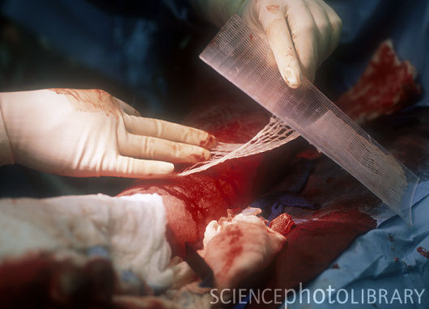

Slide 72
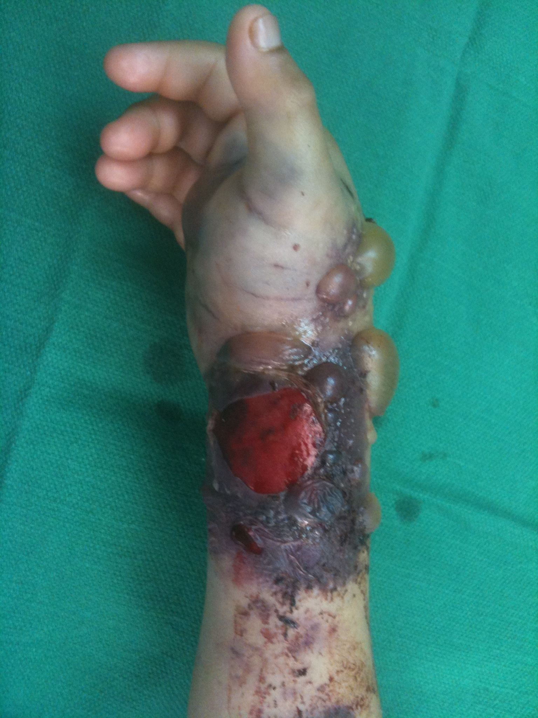
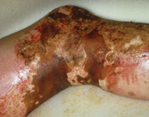
Escharotomy Vs. Fasciotomy

Slide 73
Surgical Burn Management Escharotomy

Slide 74
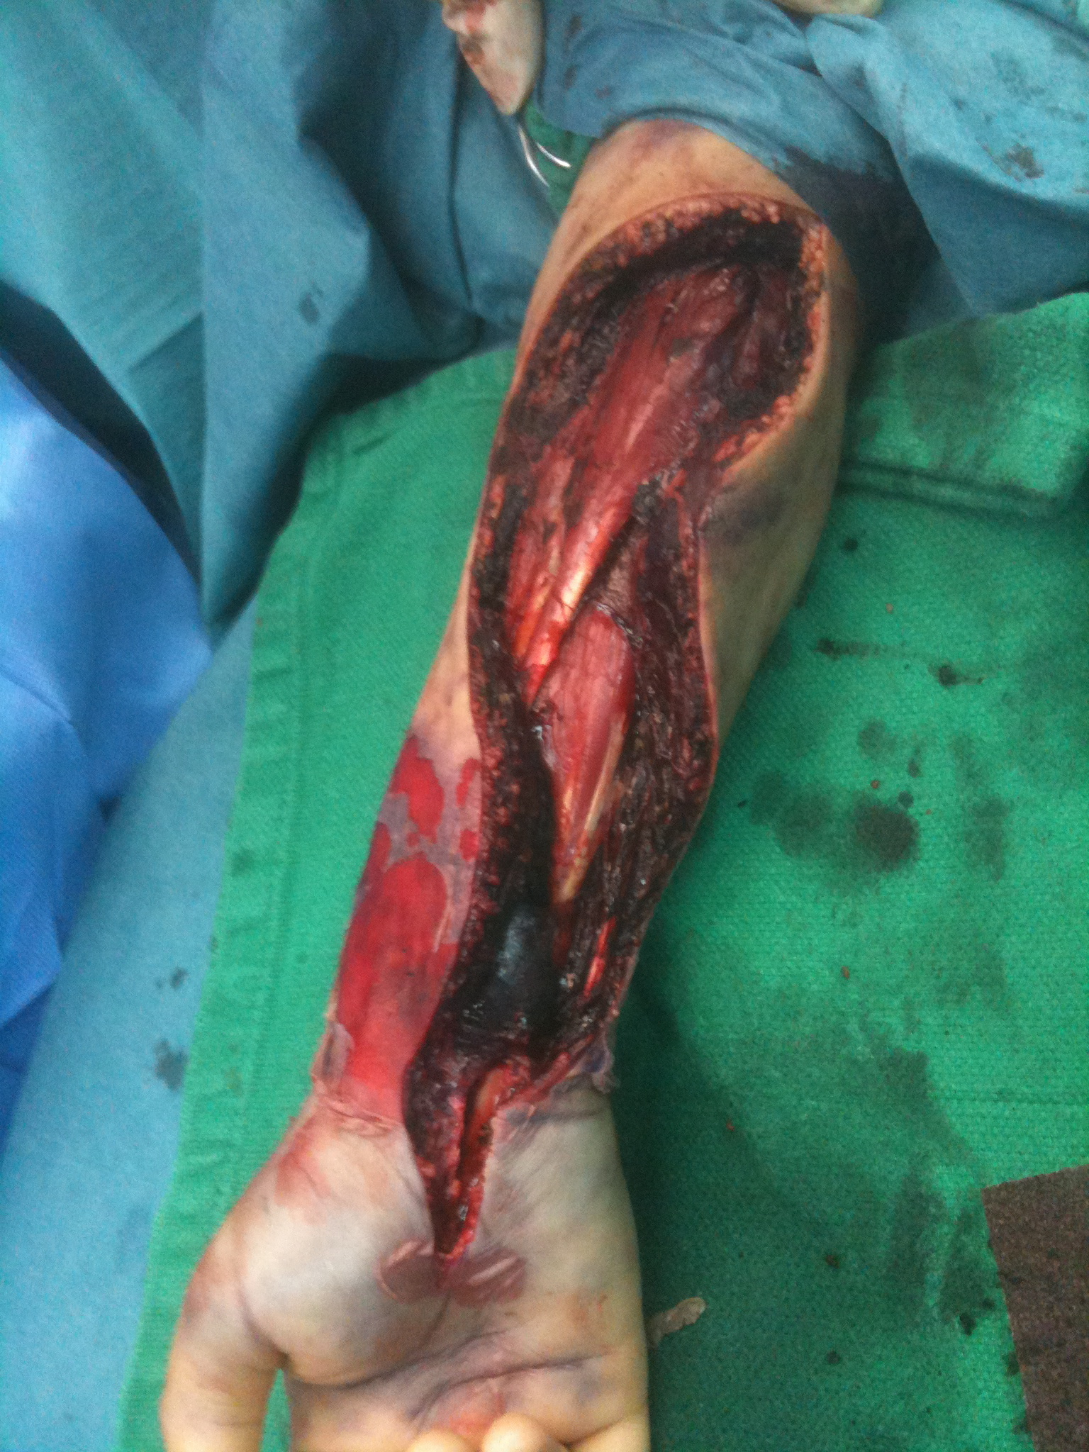
Surgical Burn Management Fasciotomy

Slide 75
Chemical Burn
ATLS
Remove the etiology
Including cloth
Irrigation
Ensure no Inhalation, GI involvment, Occular Involvment
Antidote if available
Burn Treatment
Acid Vs. Alkali

Slide 76
Electrical Burn
High Voltage Vs. Low Voltage
ATLS
Management
IVF add 30% to TBSA
Cardiac
Kidney
Air/Way
Fasciotomy
Burn Management

Slide 77
Questions ?

Slide 83
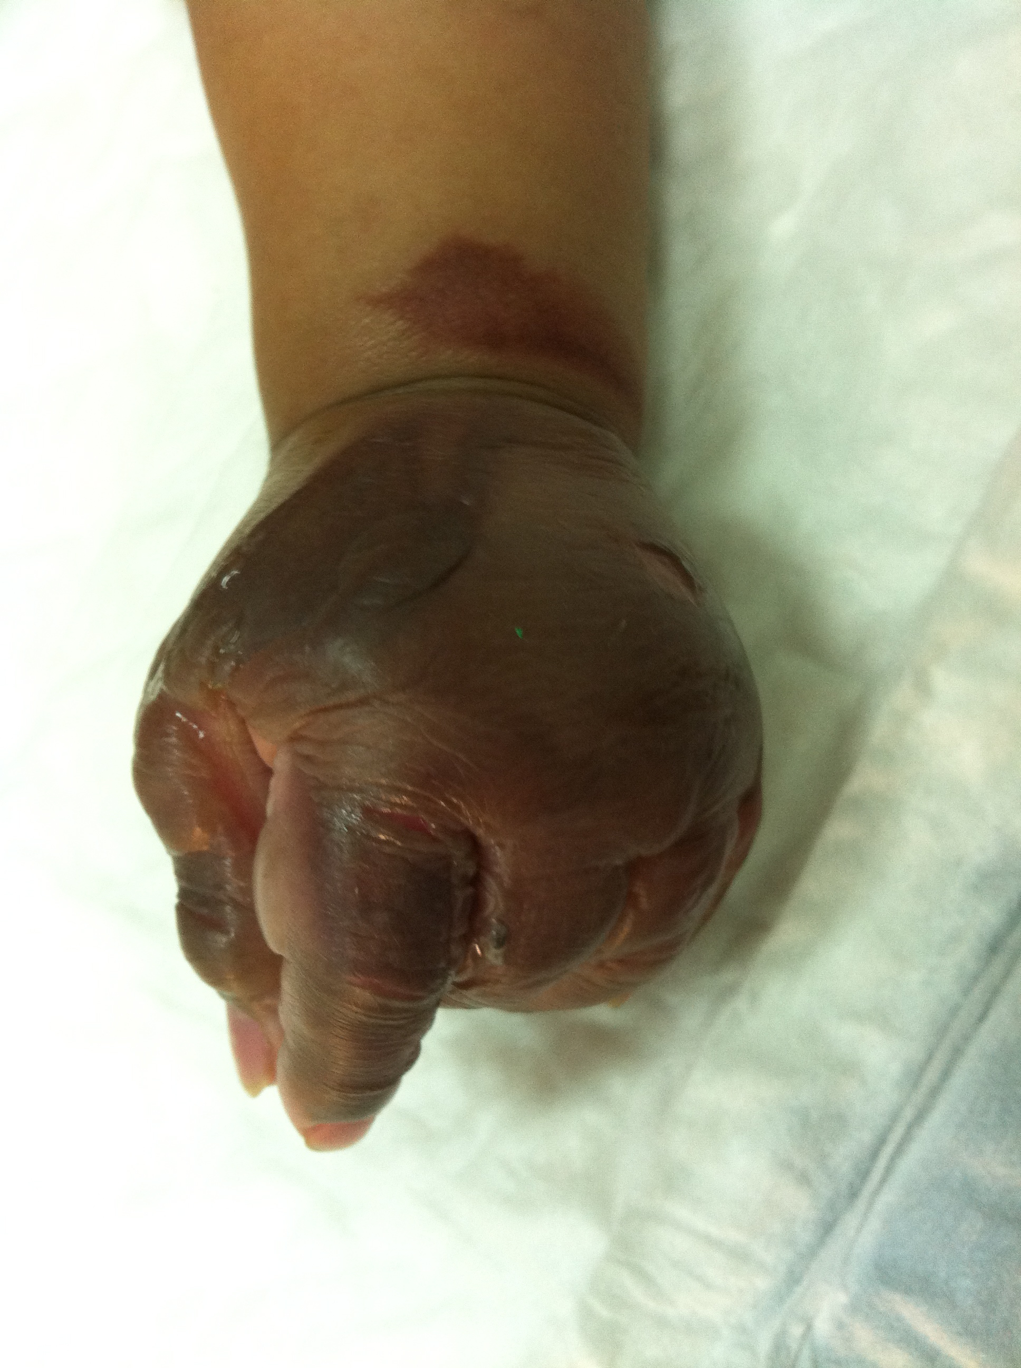

Slide 84
