Slide 1
Burns, & Burn Management
Dr. Abdullah Kattan, MBBS, FRCS( C )
Consultant Plastic Surgeon
Division of Plastic Surgery
Department of Surgery - KKUH

Slide 2
Definition
Thermal, chemical or electrical injury sufficient enough to cause tissue disruption, denaturation, or even death
Carry a risk of permanent :
Disfigurement
Impairment of function

Slide 3
Epidemiology
Males>Females
2 peaks at :
0 - 5yrs
25 - 35yrs
80% of burns are less than 20%TBSA
Pediatrics
Scald Burns >80% by hot water. Superficial burn.
Account for 45%-60% of Hospital Admission
33% due to child abuse. Don’t miss it. Therefore any kid with a burn you have to rule out child abuse.
Elderly :
Impaired mobility, poor coordination, decrease awareness to pain
Abuse/neglect
Factors that  mortality :
Age greater than 60
Greater than 40% TBSA
Inhalation injury
Note: the older the patient and the greater the TBSA the higher the mortality. If all the above three are present the mortality rate is 95%. Calculate the mortality rate.
Alcohol is a common contributing factor

Slide 4
Types of Burns
Scalds (hot liquids) → most common type in children
Flame (thermal) → most common in adults
Electrical
Chemical
Frictional
Flash
Contact

Slide 5
Pathophysiology
Increased fluid loss from the surface
Normally 15ml/m² increase to 200 ml/m²
In deep burns, the dermis is converted to coagulum called ESCHAR
Inflammatory response ranges from
Capillary dilatation in sunburn
Damaged capillaries and increase permeability and interstitial edema
Note: the deeper the burn the more fluid loss, and the lower the immunity therefore higher risk of infection and the more capillary destruction. Edema will result from capillary destruction.

Slide 6
Pathophysiology
2cm increase in leg diameter represent 2L of increase in fluid. Which might predispose to compartment syndrome.
Destruction of epidermis removes the protective bacterial barrier → Contamination → Sepsis → Death.
Note: the most common cause of death in burn patient in the first 24 hrs is dehydration if the patient is not adequately resuscitated. While the most common after 24 hrs up to 7 days is infection.

Slide 7
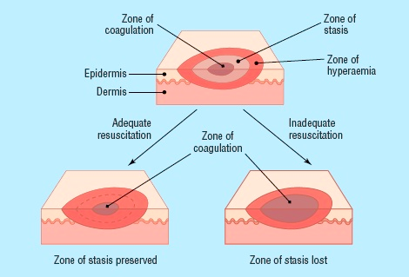
Pathophysiology
Zone of coagulations: maximum contact area it = 3rd degree burn treated surgically.
Zone of stasis: 2nd degree burn. It might progress to 3rd degree burn (surgically treated) or regress to hyperemic (conservative) therefore you have to observe to decide how to treat according to progression (hardest to treat because you have to wait and see)
Zone of hyperemia: furthest contact area, 1st degree burn treated by anelgesia, hydration and protection.

Slide 8
General Effect Of Burns
Depends on the burn size
The bigger the burn the more the physiological changes :
Water loss
Salt loss
Protein loss
Increased catabolism
Edema due to fall in circulating plasma
Damage to RBCs : Immediate or delayed
Increase Hct
Hypovolumic Shock
Increased Metabolic Rate 7000-8000 Kcal expended daily
Daily Wt loss of 0.5kg
Note: the normal Kcal required is 1800-2200 kcal/day. The amount of weight loss in burned patient depends on the extension of the burn.

Slide 9
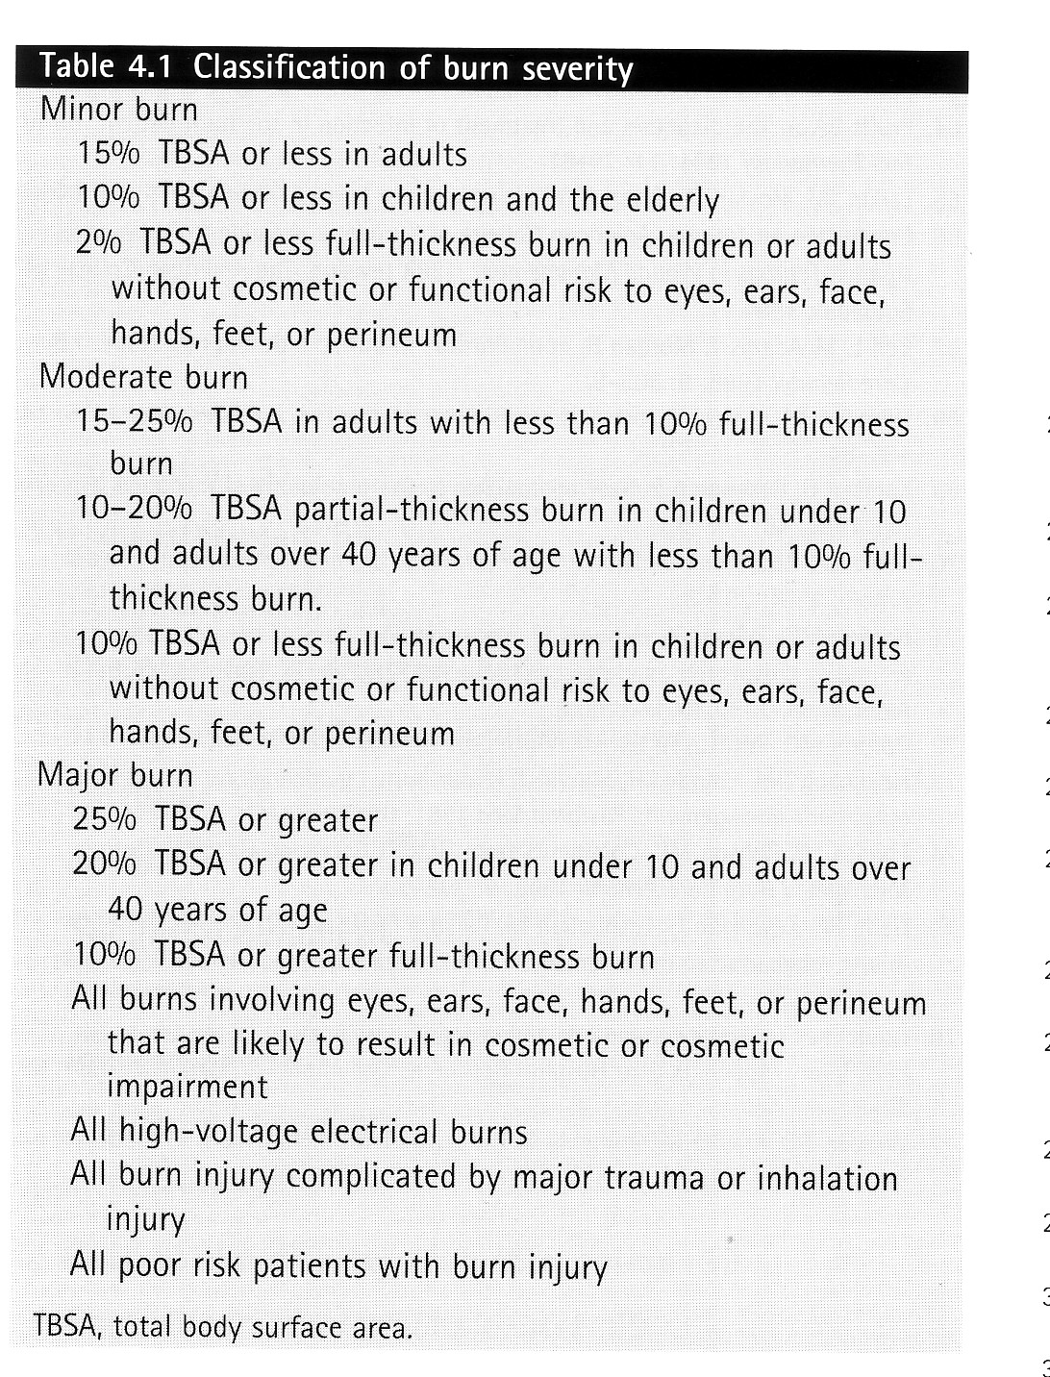

Slide 10
Mortality
In the early post burn period:
Inadequate hydration
Respiratory issue (inhalation or infection)
In the late post burn period:
Wound sepsis
Delayed healing,
Increased energy expendature

Slide 11
Burn Classification
By Types
By TBSA
By degree / thickness

Slide 12
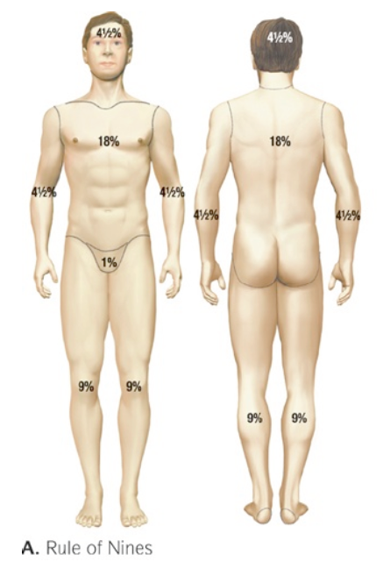
Burn Classification By Total Body Surface Area (TBSA)
Wallace rule of 9s:

Slide 13
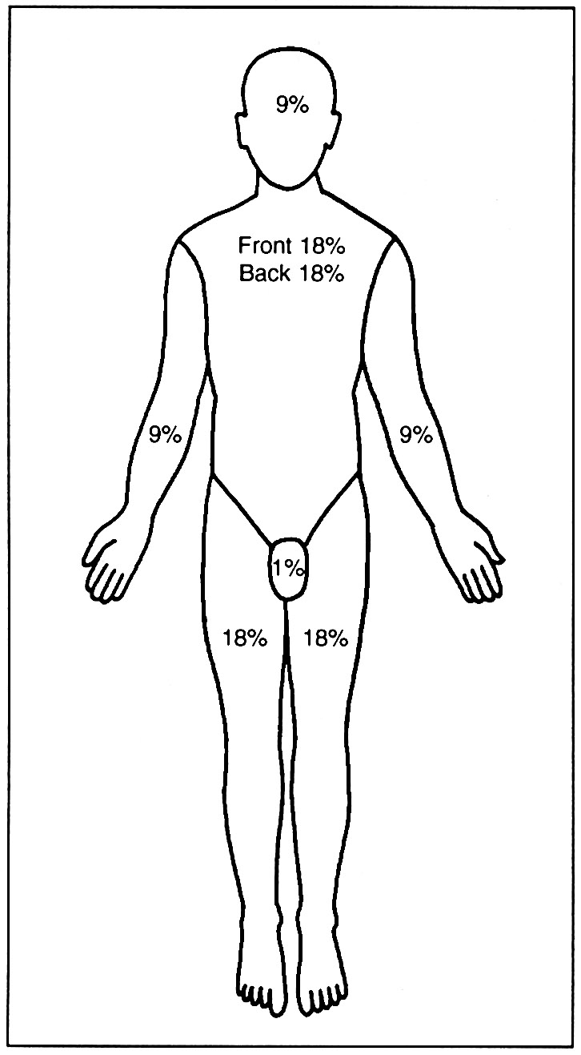
Burn Classification By TBSA
The Role of Palm
Pts palm is equal to 1%
Good for scattered burns
Note: used in children, but children have a different chart. Lund browder chart)

Slide 14
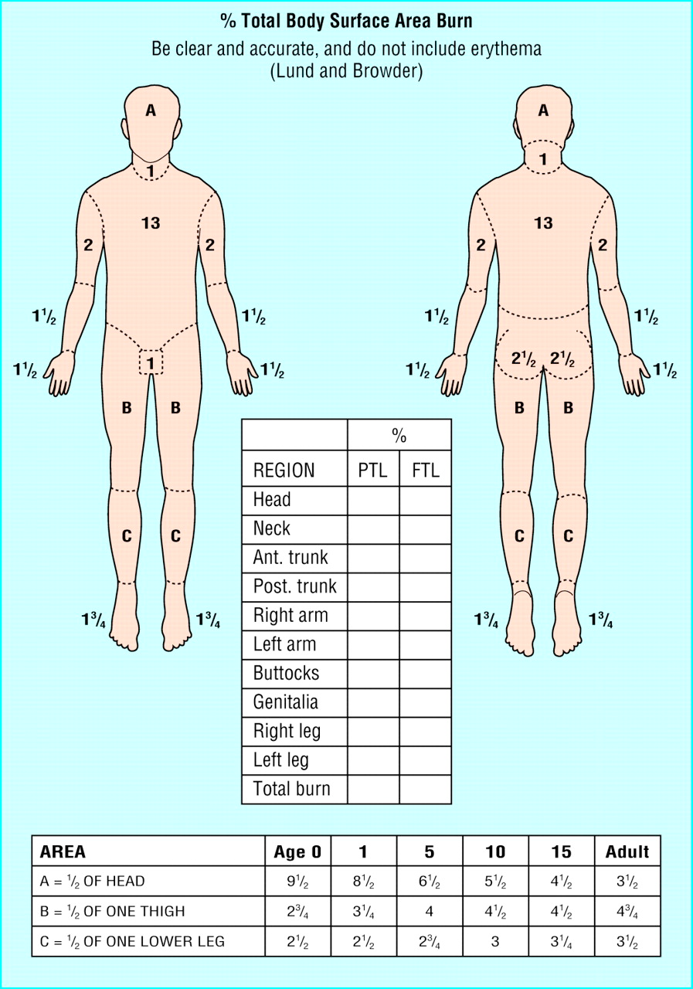
Burn Classification By TBSA
Lund Browder Chart

Slide 15
Burn Classification By Degree / Thickness
Old:
1st degree
2nd degree
3rd degree
4th degree
New:
Superficial (1st degree)
Superficial partial thickness (2nd degree)
Deep partial thickness (2nd degree)
Full thickness

Slide 16
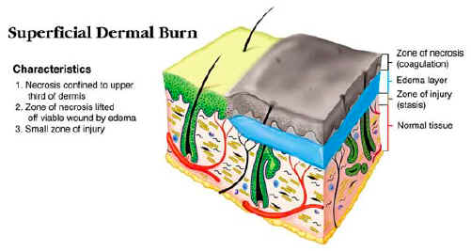
Superficial (1st Degree)
Damage to the epidermis only
No Need for admission
Heal with in 5 – 7 days
No scarring
Needs ONLY analgesia

Slide 17
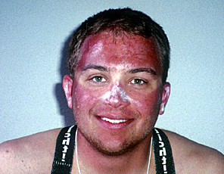
Characteristics of superficial burns: hyperemia, pain. Treatment: no admission, give analgesia and send home and tell them to stay away from sun.

Slide 18
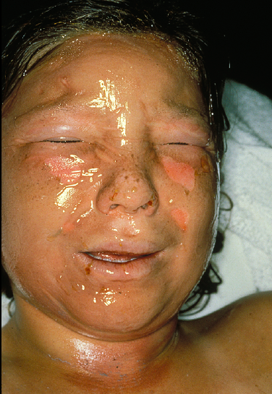

Slide 19
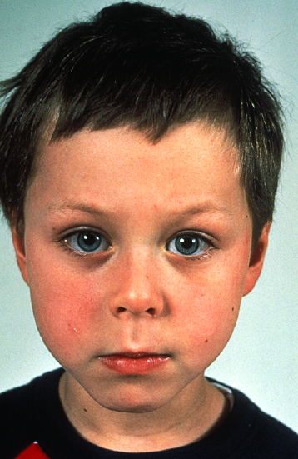

Slide 20
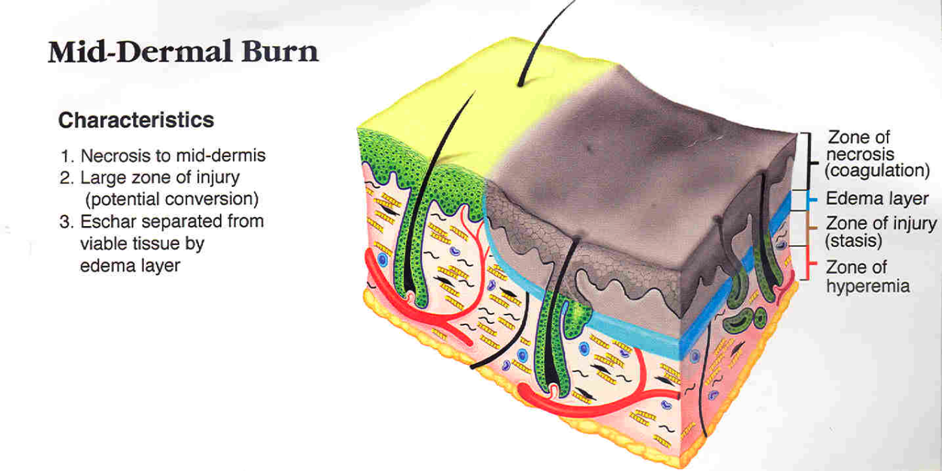
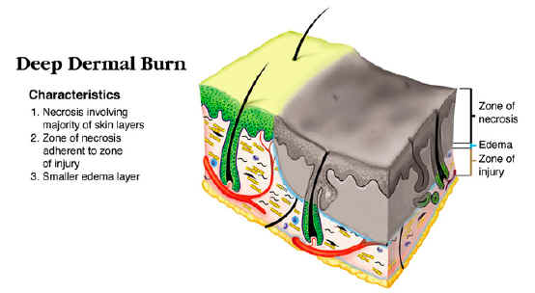
Partial Thickness (2nd Degree)
Superficial Partial thickness
Epidermis and upper dermis
Pink (redness that blanches with pressure, very painful (severe pain), swollen
Fluid loss. wet
BLISTER
Heal with-in 2 weeks good healing process. You admit the patient.
From epidermal appendages
DAILY DRESSING
Minimal scarring
If it stayed more than 20 days (2-3 weeks) without healing you treat it surgically (any burn of any degree).
Deep partial thickness
Epidermis and most of the dermis
Treat like 3rd degree burn
Less or not painful, less fluid loss and less edema and swelling
Rarely Blister
Purple in color non-blanching with no capillary refill.
Prolonged inflammatory phase cause scarring
Leave an ugly hypertrophic scar
NEEDS DEBRIDEMENT & SKIN GRAFT
May convert to full thickness therefore treat it as full thickness.

Slide 23
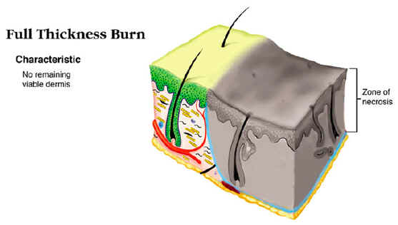
Full Thickness (3rd Degree Burns )
Epidermis and total dermis including the epidermal appendages
Destroyed tissue undergoes coagulative necrosis
Not painful
No Blister, dry.
Marble (white with black streaks due to thrombosed vessels) or leathery like appearance
THROMBOSED VEINS
Cause significant Scarring due inward growing and movement of the cells
NEEDS DEBRIDEMENT & SKIN GRAFT, it will never heal alone.

Slide 24
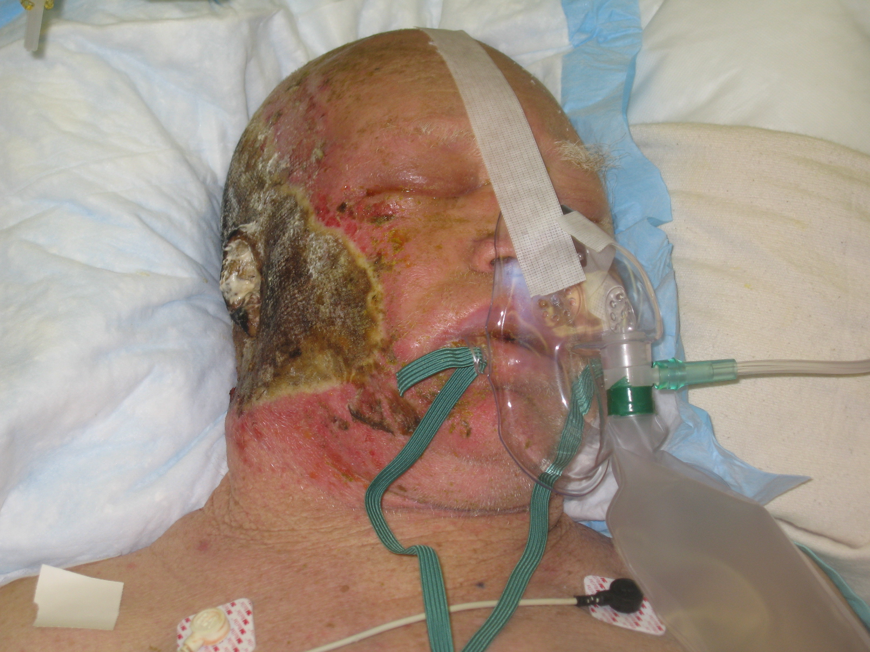

Slide 25
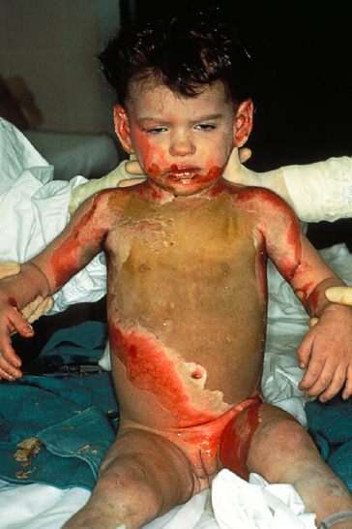

Slide 26
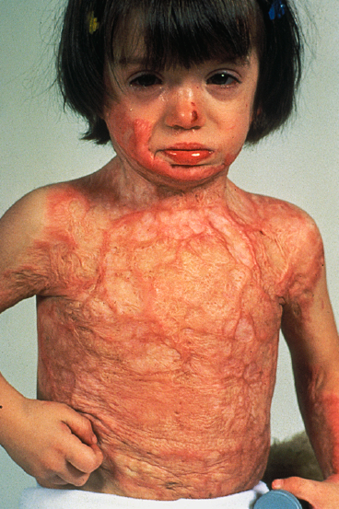

Slide 27
Full Thickness (4th Degree)
Injury extends to the underlying structures
Muscle, Fascia, Bone and fat.
Charring of the tissue
Seen in electrical burns: they come with muscle tetany and cant let go of what they’re holding therefore you have to push them away from the electricity.
Treated as third degree burns.

Slide 29
Determination of Burn Depth
Mechanism
Scald : Short Vs. Long
Flame, Chemical , Electrical
Appearance
Erythema, Blister, Eschar, thrombosed veins
Sensation
Time to healing

Slide 30
Prognosis
Age, and General condition
Extent of the Burn
The TBSA the smaller the burn the better the prognosis, and vise versa
Depth of the Burn
Superficial burns heal with in 2 – 3 weeks
The deeper the burn the higher the risk of infection
Site of the Burn
Due to appearance and functional impairment e.g. burn in the abdomen has better prognosis than in the hand or around the eyes.
Inhalation Injury, any respiratory problem will have a poor prognosis.

Slide 31
Burn Management
First Aid
Stop the burning process
Victim should stay flat to avoid inhalation of smoke and fumes (remove the patient away from the fire)
Remove all burned clothes
Apply cold water Vs. Hypothermia never apply anything that can cause contamination not even toothpaste.
Chemical Burns
Copious irrigation after removing the patients clothes (very imp)
Electrical Burns
Switch off the current, or by pushing the victim away from the current source with a non-conducting object as a wooden chair.

Slide 32
Burn Management
Avoid Wound Contamination
Burn must be covered with clean sheet
Avoid using house hold items
It might convert partial injury to a full thickness one

Slide 33
Burn Management
ABCs - Life preservation
History:
Agent of injury
Medical co-morbidities
Physical exam:
Inhalational component? You have to always rule it out
Estimation of depth
Estimation of TBSA of burn
The degree of the burn can be assessed with the aid of the chart.
Determination: Severity of injury and triage/transfer
Irrigation and debridement of wounds

Slide 34
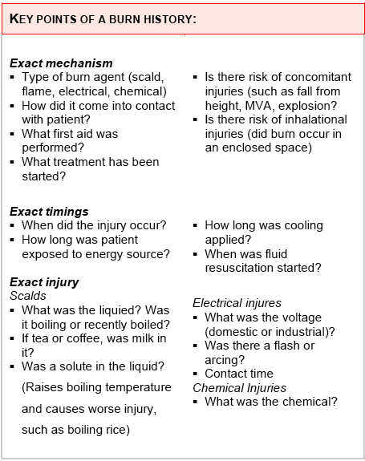
History

Slide 35
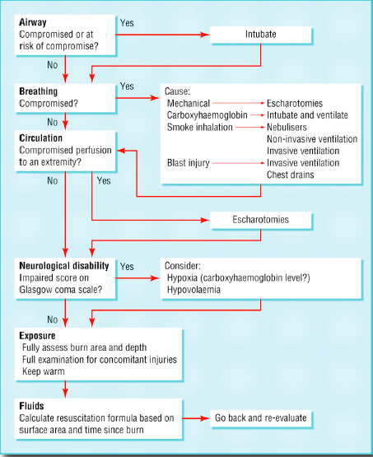

Slide 36
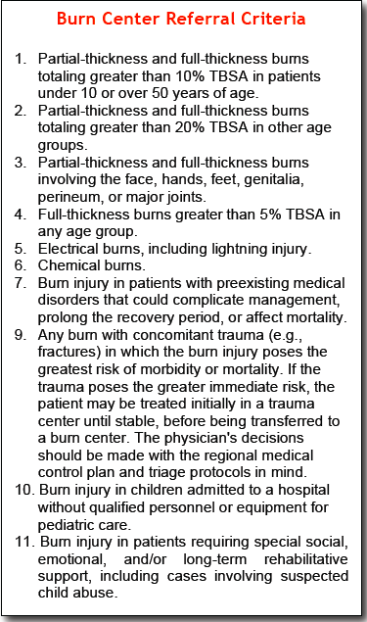
Transfer Criteria
Plus any inhalational burn or circumferential 3rd degree burns because we worry about the development of compartment syndrome because the eschar is not expandable.

Slide 37
Inhalation Injuries
The mechanisms of inhalation injury can be divided into three broad areas
Inhalation of products of combustion
Carbon monoxide inhalation
Direct thermal injury to the upper aero-digestive tract (mechanical)
Suspect inhalation injury if:
Flame burn in a closed space
Singed (burned) nasal hair
Facial or oropharyngeal burns
Expectoration of carbonaceous (blackish) sputum
Signs of upper respiratory obstruction—such as crowing, dyspnoea, cough, stridor, or air hunger
Hoarseness of the voice because of vocal cord involvement or any mucosal or tongue involvement.
Cyanosis.

Slide 38
Treatment of inhalational injury
Must intubate immediately and not only I.V fluid replacement because the airway edema will progress which will lead to airway obstruction requiring tracheo-stomy which cannot always be done and the patient might die.
Therefore false unnecessary intubation is better than not intubating at all.

Slide 40
Inhalation Injury / CO
Odourless, tasteless gas
Impairs tissue oxygenation by preferentially binding to Hgb
Affinity 240 times that of oxygen
shifts the Hb dissociation curve to the left decreasing O2 delivery
When you ask for ABG you have to request for CO levels.
Signs include:
Headache
cherry red lips
arrhythmias
acidosis
seizures
LOC

Slide 41
Inhalation Injury Carbon Monoxide
Co Level | Symptoms
0 - 5 | Normal Value
15 - 20 | Headache, Confusion
20 – 40 | Disorientation, Fatigue, Nausea< Visual Changes (red tongue and blue extremities)
40 – 60 | Hallucinations, Coma< Shock
60 or above | Mortality >50%

Slide 42
Inhalation Injury Carbon Monoxide
Treatment
100 % O2 by nasal cannula, face mask or re-breathing mask +/- intubation and ventilation
t1/2 of CO is 5 to 6 hours on R/A
45 min on 100% O2
27 min HBO (hyperbaric oxygenation) @ 3 atm
Indications for HBO therapy
Coma
LOC
ischemic ECG changes
focal neurological deficits
+/- CO Hb >40%

Slide 43
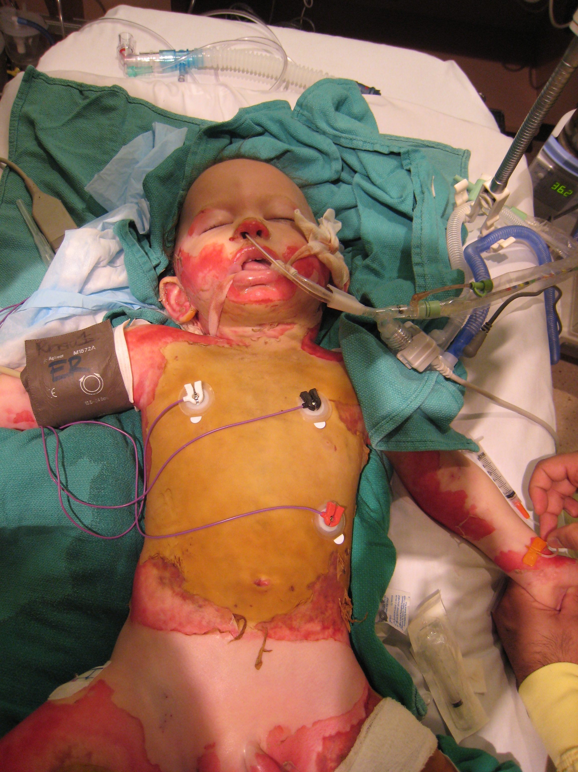

Slide 44
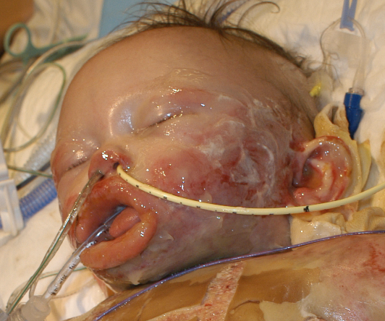

Slide 45
Burn Management
Non – Surgical
Tetanus Vaccine
Fluid
Nutrition
Physiotherapy
Dressing
Surgical (Note: for any 3rd degree, deep 2nd degree or any superficial 2nd degree that didn’t heal within 3 weeks)
Escharotomy
Debridement
Grafting

Slide 46
Non-Surgical Burn Management Fluid Resuscitations
Burns over 15% TBSA in Adults or 10% in Children of second or third degree if less than that no need. In 1st degree if if the whole body is involved no fluid resuscitation or admission.
Require IVF administrations
Through a peripheral Vein
Or Internal Jugular or subclavian vein line if peripheral line is not possible
Withdraw blood for CBC, Electrolytes, CO level
Foley catheter

Slide 47
Non-Surgical Burn Management Fluid Resuscitations
Crystalloid Vs. Colloid

Slide 48
Non-Surgical Burn Management Fluid Resuscitations
Parkland Fromula
Wt in Kg X TBSA % X 4cc
Very important Note: any facial burn indicates inhalational injury you add 25% to the TBSA because there is internal burns, in electrical 30%)
1st ½ in the 1st 8 hrs (from the onset of burn and not the presentation to the ER) and 2nd ½ in the next 16 hrs
Use R/L (because it’s the most physiological therefore more balance)
Only for 2nd degree burns or deeper
Modified Brooke
Wt in Kg X TBSA % X 2cc
Hypertonic Saline
250-300meq.
Decrease the fluid requirement.
Require regular Na monitoring.

Slide 49
Non-Surgical Burn Management Fluid Resuscitations
Children will need the maintinance IVF add to there fluid resuscitations
100ml / kg / 24hr 1st 10 kg
50ml / kg / 24hr 2nd 10kg
20ml / kg / 24hr 3rd on kg
To avoid Hypoglycemia that might lead to coma.
Use D5% ½ NS fluid ( he said in class RL)
Note: in children, in addition to the parkland formula you have to add maintenance fluid (as mentioned above) to prevent hypoglycemia because unlike adults they don’t have glucose stores, you must check the glucose levels every 6 hours.

Slide 50
Non-Surgical Burn Management Fluid Resuscitations
Colloid Replacement formula
0.5ml/kg/%of burn
Note: its better to avoid colloids in burn patients because it will enter the interstium and suck more fluid from the vessels which increases hypotension, therefore it should be avoided at least in the 1st 24-48 hrs.
Blood transfusion
After 24hrs ( avoid in the 1st 24 hours )
Mainly needed in pts with full thickness burn
Regular Hb, Hct monitoring is mandatory

Slide 51
Non-Surgical Burn Management Fluid Resuscitations
Adequate fluid resuscitation is monitored by :
Urine Output
0.5 – 1 ml/kg/hr for Adult
1 ml/kg/hr for Children
In cases of electrical burns more urine is needed to protect the kidney (due to myoglobin -muscle breakdown- in the tubes leading to ATN)
2 – 3ml/kg/hr
Inhalational injury patients also need extra fluids
Note: because of large fluid loss in both electrical and inhalational burns you have to give fluid bolous.
Note: if the patient has renal impairment you measure the response by taking the patient to the ICU and check the central venous pressure.

Slide 52
Non-Surgical Burn Management Nutrition
Due to increased energy expenditure following sever burn
High caloric protein diet once the pt can take orally or via NGT
Daily requirement is 20kcal/kg + 70kcal/kg/%of burn ( 1g/kg + 3g/kg/%of burn of protein )
Note: burned patients must be fed immediately by TPN or NG tube to prevent the conversion of columnar epithelial cells to cuboidal which leads to atrophy and bacterial translocation and sepsis.
Vitamines Supplement for all burned patienst coz it improves wound healing
Vit C
Zinc
Multi-Vitamines

Slide 53
Non-Surgical Burn Management Physiotherapy
Splints to prevent contractures , must put the splint in resting position to ensure that all ligaments are stretched. Resting position: the wrist is extended MCP are flexed and IPJ are extended.
Range of motion exercises to prevent stiffness
Note :Physiotherapy is imp to prevent bed sores and to prevent muscle wasting and loss of joint functions.

Slide 54
Non-Surgical Burn Management Dressing
Local wound management
Cover burn regularly to avoid infection which is the main threat to life once the 1st 24hrs have passed
Initial cleansing and debridement
Cleanse wound with antiseptic & saline
Blister are punctured (Note: some schools say do not touch them but I prefer to pop them because they contain PG which causes vasoconstriction and impair wound healing therefore you pop to remove the PG.)
No role for IV or Oral Abx
Do not forget tetanus

Slide 55
Non-Surgical Burn Management Dressing
Destruction of the epidermis removes the normal barrier to infection
Full thickness burn impairs the normal response to infection
The organism colonize the burn wound
Staphylocooci the most common
Pseudomonos remains troublesome in most burn units

Slide 56
Non-Surgical Burn Management Dressing
Flamazine ( Silver sulphadiazine ) the most common burn dressing used
Must be applied daily
S/E neutropenia
Can not be used in infants under 6/12 of age
Note: after applying it you need to wrap it, therefore if facial burn you cant wrap so you use fucidin instead. Flamizine is a broad spectrum AB.
Open Vs. Closed dressing
Fucidine or bacitracine ointment
To prevent super-infection of the burn wound from the colonized organisms

Slide 58
Note: Circumferential burn
3rd degree circumferential burn may lead to compartment syndrome.
The most important symptoms of compartment is pain and when the patient is intubated they cant complain and this might lead to missed diagnosis and lose their limbs.
To prevent this you do escharatomy to release the tight tissue by mid-axial incision (the incision is usually painless because the nerves are already damaged).
Chest burns might reduce chest expansion leading to hypoxia therefore even in 3rd degree chest burn we do escharatomy.

Slide 59
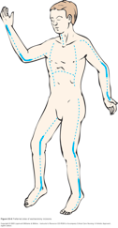
Surgical Burn Management Escharotomy
Mid – Axial (Note: cause its on the side therefore no risk of flexion contractures) incision in the eschar only of full thickness burn
To relieve the tourniquet effect of the circumferential full thickness burns on :
Extremity
Trunk if
Breathing was an issue
Increase intra-abdominal pressure
Due to interstitial fluids accumulation

Slide 60
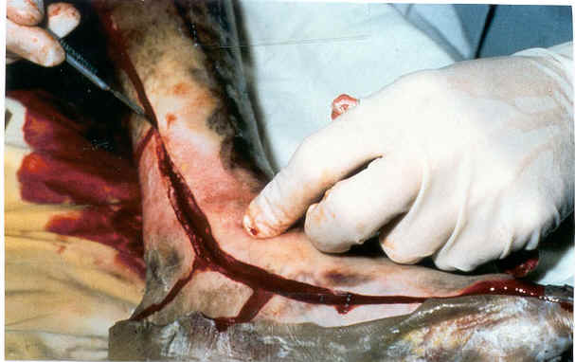

Slide 61
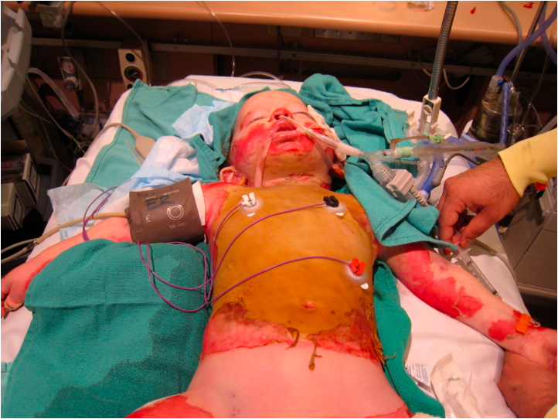
Surgical Burn Management Escharotomy

Slide 62
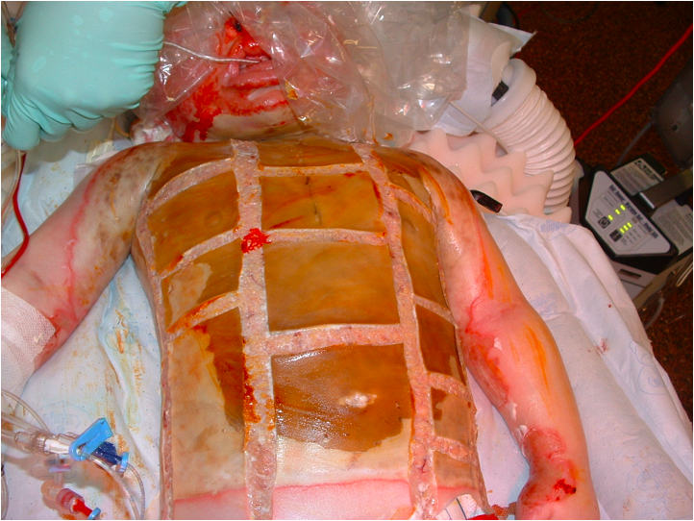

Slide 63
Skin Grafts
Split Thickness (STSG) | Full Thickness (FTSG)
Epidermis + part of the dermis | Epidermis and entire dermis
Donor sites: Thighs - Back - Abdomen - Scalp - any part of the body | Donor sites: - Post auricular - supraclavicular - Groin - forearm
Advantages: Donor heals spontaneously Large donor area, can be reused Higher chance of take in less ideal conditions | Advantages: Less contraction Grows with the patient Secrets oil and sweat Better donor site scar and less pain More stable/durable
Disadvantages: More contraction More fragile Loss growth potential Donor site more painful | Disadvantage: Donor site must be closed Less donor areas Needs clean wound bed May grow hair

Slide 64
Surgical Burn Management Debridement, and Skin Graft

Slide 65
Note: surgical debridement
In face burns you cant debride because the face is so vascular and you can not put a tourniquet around it, and instead do unmeshed grafts. (facial grafts should be unmeshed).
When you debride, you do conjunctional incision which means you keep cutting thin slices of the necrotic burned skin by a machine called dermatome until you reach to a point of healthy bleeding tissue (this zone is well vascularized) then you know that you got rid of all burned layers and then you start grafting but make sure you put it in the right position (not flipped).
When taking the graft from the donor site make sure you don’t take full thickness because you need to keep the appendages ( basalis layer ) for healing.
Skin from cadavers or other donor will be rejected within 7 days except if from the monozygotic twins.
You can mesh more than 3 cm of skin if you want to mesh more than 3 cm you repeat grafting after 2 weeks

Slide 66
Surgical Burn Management Debridement, and Skin Graft

Slide 67
Surgical Burn Management Debridement, and Skin Graft

Slide 68
Surgical Burn Management Debridement, and Skin Graft

Slide 70
Surgical Burn Management Debridement, and Skin Graft

Slide 71
Surgical Burn Management Debridement, and Skin Graft

Slide 72
Surgical Burn Management Debridement, and Skin Graft

Slide 73
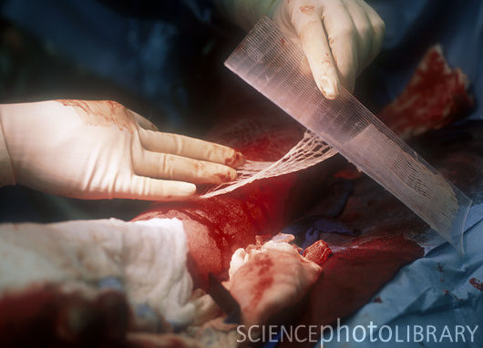

Slide 75
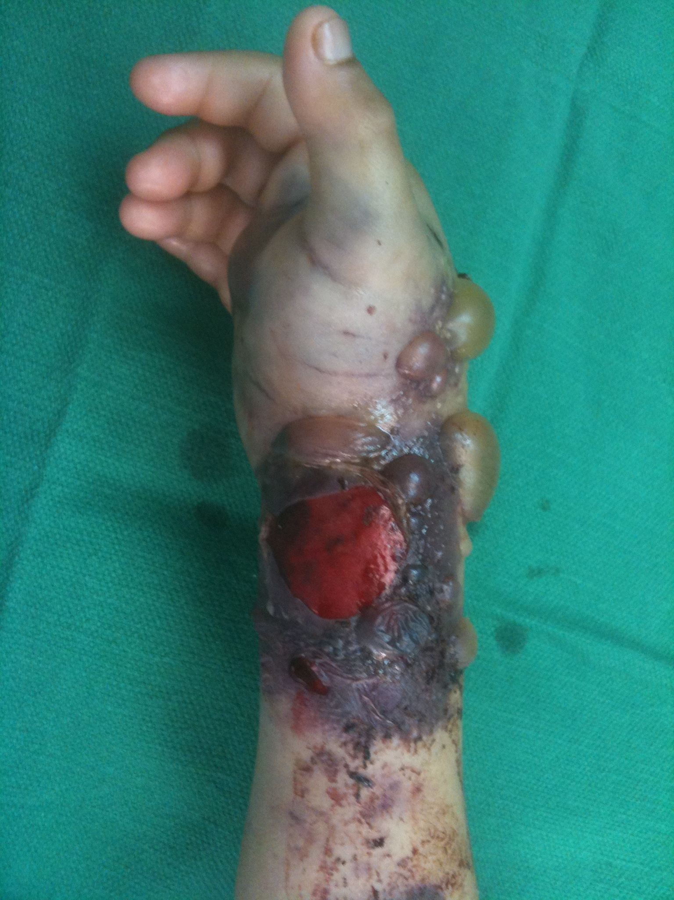
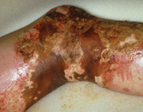
Escharotomy Vs. Fasciotomy Note: if compartment syndrome is due to burn then you do escharatomy if due to any other cause you do faciotomy.

Slide 76
Surgical Burn Management Escharotomy

Slide 77
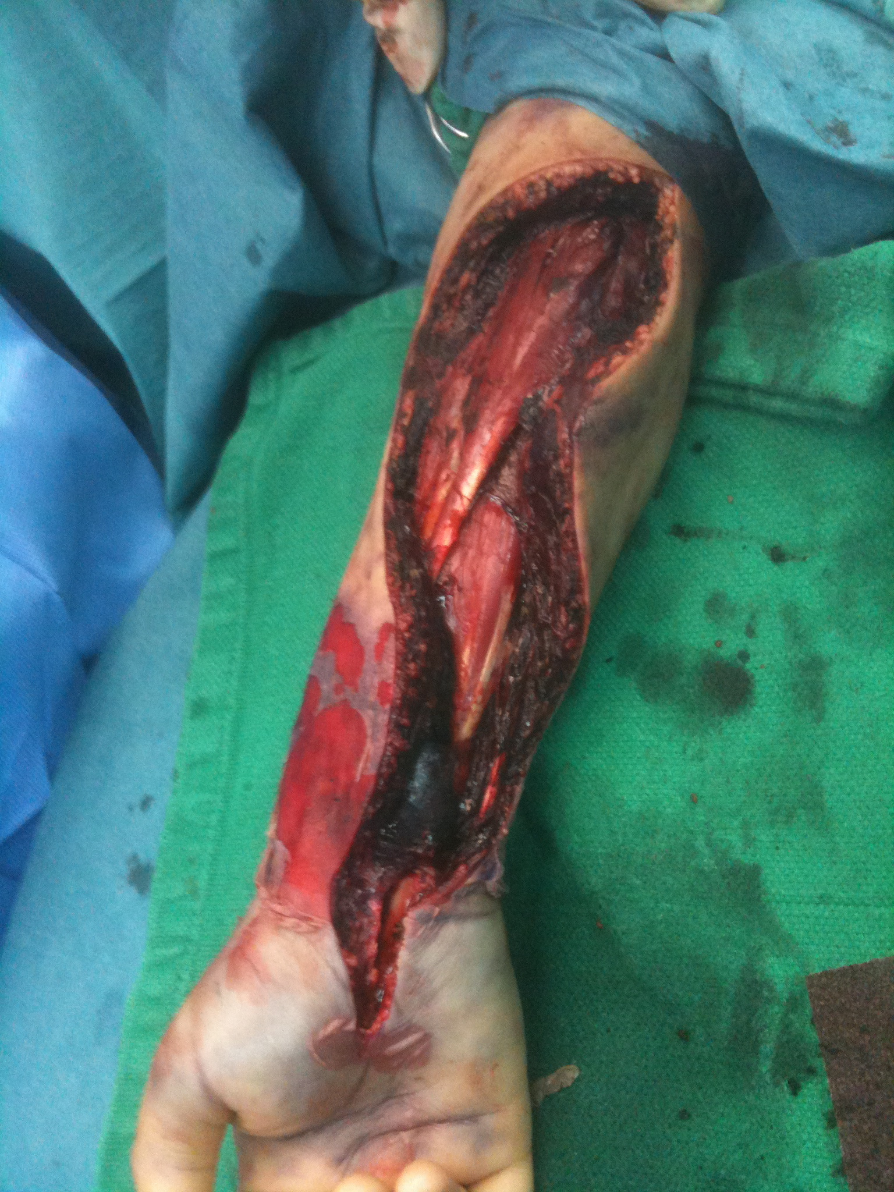
Surgical Burn Management Fasciotomy

Slide 78
Chemical Burn
ATLS
Remove the etiology
Including cloth
Irrigation for at least 30 min
Ensure no Inhalation, GI involvment, Occular Involvment , if esophageal or ocular involvement must refer to GI or ophthalmologist.
Antidote if available , if you know the substance ask for antidote
Burn Treatment (after doing the previous steps treat like any other burn)
Acid Vs. Alkali (alkali more corrosive because it doesn’t get buffered).

Slide 79
Electrical Burn
High Voltage (more than 1000) Vs. Low Voltage (less than 1000).
ATLS
Must keep on mind heart , kidney , compartment complocations so admit patient to CCU for cardiac monitoring cause might die from arrythmias, and must monitor kidney function and myoglobin
Management
IVF add 30% to TBSA
Cardiac
Kidney
Air/Way
Fasciotomy in case of compartment syndrome ( suspect it if patient complaains of pain or decrease in sensation)
Must do a full body Ex to find the exit point
Burn Management

Slide 80
Questions ?

Slide 86
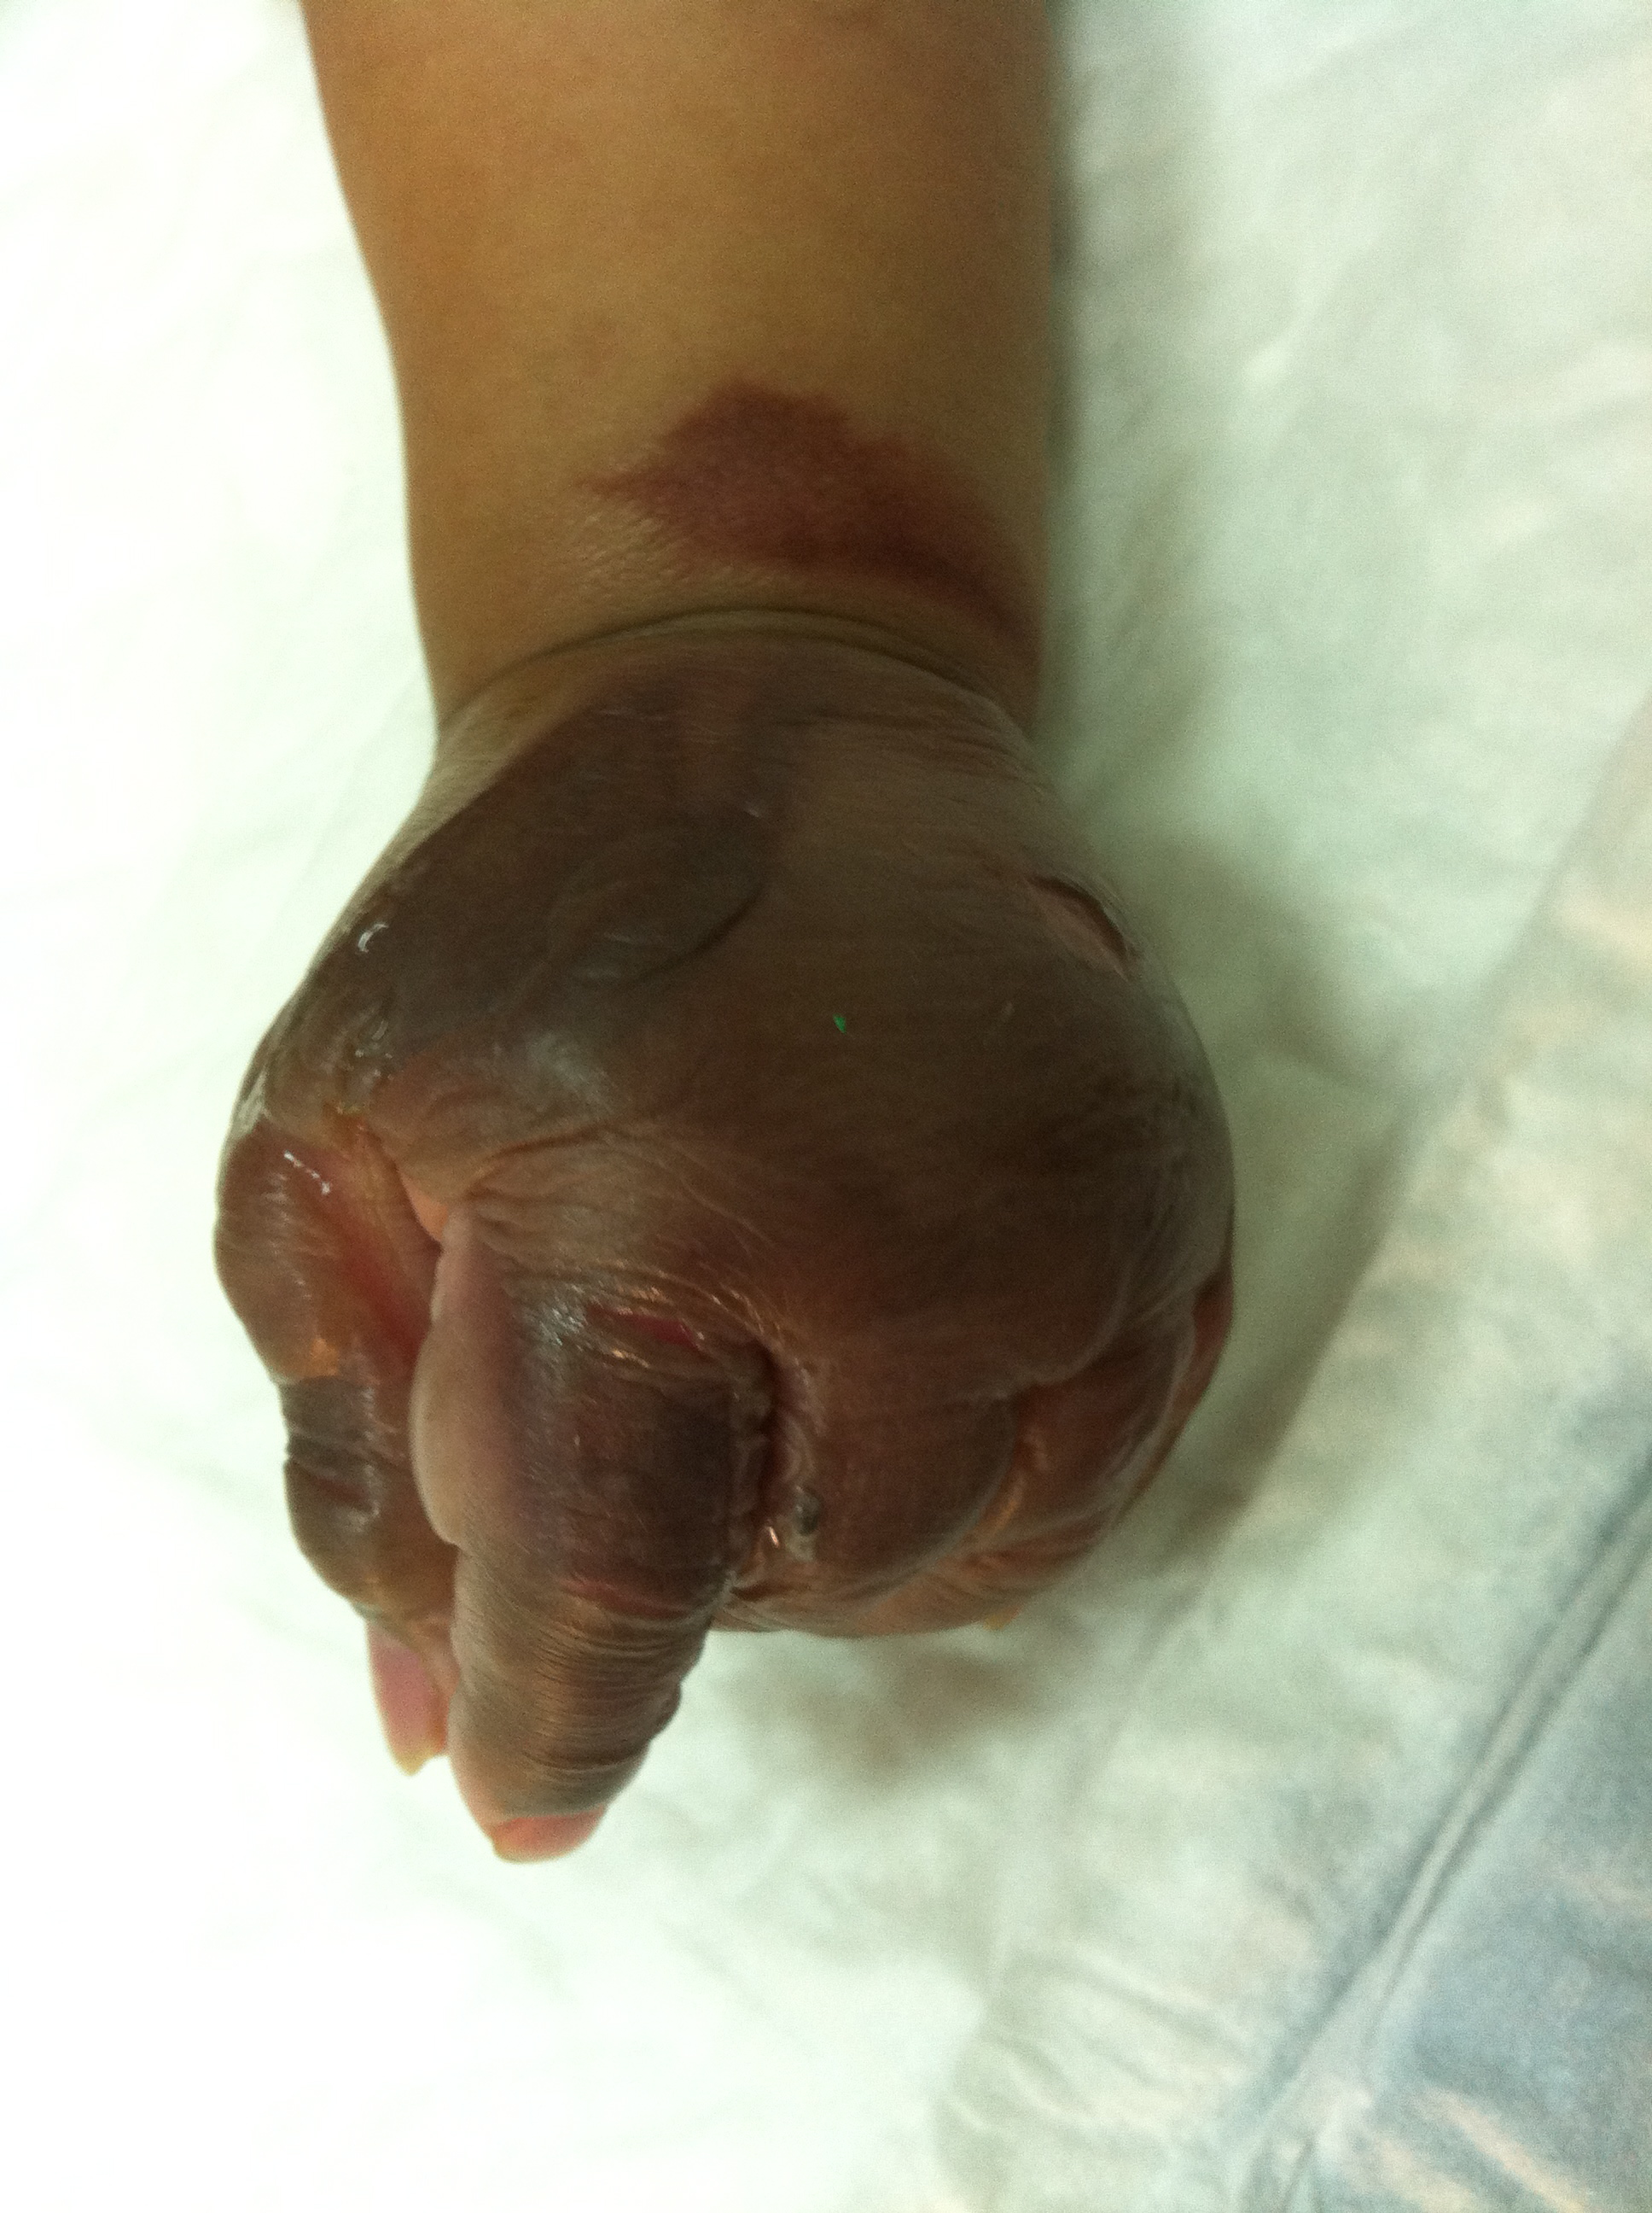

Slide 87
