Slide 1
Surgical Infections
Dr.Mohd AlAkeely

Slide 2
Introduction
* Defined as an infection which requires surgical
Treatment or as a complication of surgical treatment . Hospital aquired infection might be related to the surgery itself (or any invasive intervention) or remote from it.
*It accounts for one-third of surgical pts.
* Important complication of any invasive procedures.

Slide 3
Any breach in the skin or mucosa will introduce infection if one of these factors is found with it
For an infection to develop , four factors :
1- adequate dose of the microorganism.
2- virulence of the organism.
3- susceptible host as DM, HTN, renal impairment or jaundiced patient. Or local effect as low blood supply, hypoxia, hypothermia these are commonly seen in shocked patients. These factors are more resistant to phagocytosis.
4- suitable environment.
The capsulated organism cant be identified by the body’s immunity, that’s why they need opsinisation in the spleen, therefore in spleenectomy we give pre-op vaccination to cover these organism, in children we have to give long term peniciilin.

Slide 4
The virulence
Is the ability of bacteria to produce toxins and resist phagocytosis.
There are two types of toxins:
1- exotoxins.
2- endotoxins.

Slide 5
Endotoxins:
Lipopolysaccharides
Part of gram –ve bacterial wall and released after destruction of bacteria
Do not have specific effects for each type of bacteria they will all respond in the same way.
It causes gram –ve shock (septicemea- because its antigenic)

Slide 6
Exotoxins :
* Soluble proteins
*Released from intact bacteria (gram +ve & -ve)
* Have specific effects for each type of bacteria
*their effects are local and remote from the site of release ( they go to certain areas )

Slide 7
Host resistance:
Intact skin & mucous membrane .
Good inflammatory response .
Intact acquired immunity
Note: synergistic groups of microorganisms augment each other action and if one is resistant to penicillin the other will also be resistant increasing the pathogenesis.
Strept is sensitive to penicillin but staph is resistant to it so if the patient is infected with both and was given penicillin the staph will inhibit the penicillin action increasing the virulence of strep.

Slide 8
Diagnosis of infection
Clinical features:
*Local features of inflammation (may not be present). Heat reddness pain swelling and loss of function.
*Systemic symptoms . Tachycardia, hypotension, fever.
Investigations :
*CBC ,ESR, CRP. They are all non-specific they will only tell you if there was an infection or inflammation.
*Sample for gram stain(for superficial infection, deep seated infection are investigated by radiology or serology) & culture .they are specific.
*Others.

Slide 9
Principles of treatment
Debridement of wounds (necrotic tissue).
Drainage of pus.
Removal of the source and foreign bodies ,Eg:appendicectomy and cholecystectomy.
Supportive measures .
Carbuncle , adenitis , necrotizing fascitis , gas gangrene are difficult to recognize

Slide 10
Common community acquired surgical infections
1- cellulitis:
. Spreading infection of skin & subcutaneous tissue.
very common .
Caused by streptococcus (mainly ) & staph.
The area affected becomes red ,hot ,indurated
,tender and painful.

Slide 11
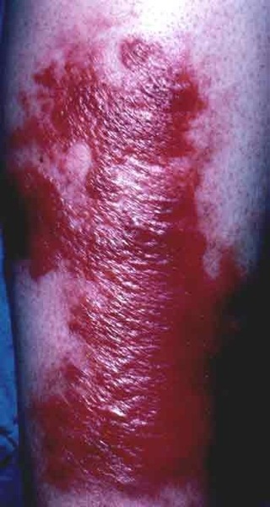

Slide 12
Treatment:
Penicillins (because most commonly caused by strept) (or erythromycin). If small area you give oral AB but if large they need I.V but nevet topical.
Rest & elevation of the affected limb (because it most commonly affects the limbs).
If treatment was delayed it might progress to abscess which has to be drained.

Slide 13
2- lymphangitis:
*Inflammation of lymphatic pathway caused by
hemolytic streptococci (usually secondary to cellulitis)
*Appears as red streaks might have blisters on extremities
*treatment :antibiotics, rest and elevation.
Note: Erysipelas: it only affects the skin unlike cellulitis, its margins are regular and raised and is commonly seen in elderly patients.

Slide 14
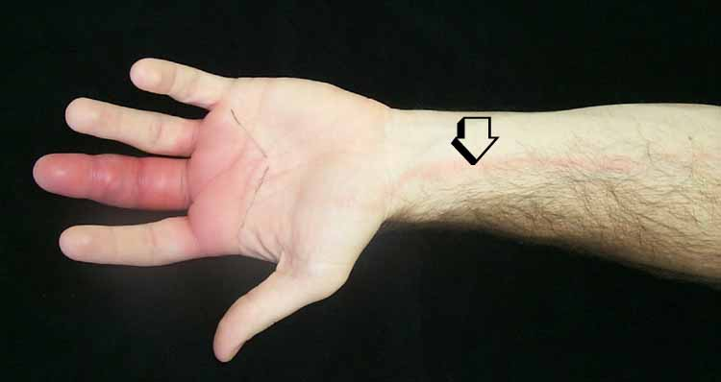

Slide 15
3- Necrotizing fascitis:
Necrosis of skin , fascia and subcutaneous tissue underlying the skin. But it doesn’t go deep to the muscles, its progressive, very painful skip lesions.
Its noon blanching erythema unlike cellulitis because its deep infection
Polymicrobial commonly anaerobic strept and other anaerobes.
Common sites are abdominal wall ,perineum and limbs.`
Usually follows abdominal surgery or trauma.
Diabetics an I.V drug users are more susceptible .

Slide 16
Cont.
Starts as cellulitis & systemic toxicity (sometimes will be disoriented confused even if the local signs of inflammation were minimal)
Characterized by non-blanching erythema , with blisters and frank necrosis of the skin.
No definitive margins ( may require multiple surgeries)
Extensive surgical debridement (nearly everyday becaise of newly growing infective tissue) of the affected area ,in combination with high dose penicillines and clindamycin is the appropriate Rx.
Because it’s a deep infection reaching to the subcutaneous tissue this will result in edema and pressure and ischemia.

Slide 17
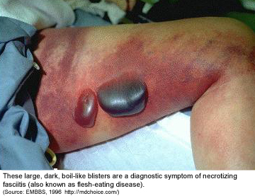

Slide 18
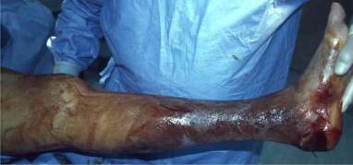

Slide 19
4- gas gangrene : rare nowadays
Caused by cl. Perfringens (mainly)& cl. Septicum
Commonly enter the body through wounds contaminated with soil
Produce exotoxins .
it is characterized by progressive rapidly spreading edema . The more the edema the more the ischemia the more the ischemia the better the environment for infection by anerobes.

Slide 20
Cont.
Rapid myonecrosis it results in swelling ,seropurulent discharge,crepitus in subcutaneous tissues , gas production and foul smelling wounds.
Other findings: ill looking pt ,profound toxemia,tachycardia and in X-ray appearance of gas under skin and in muscles
Some microrganism might produce gas on a pre-existting infection as anaerobic strept in diabetic gangrene which is different than gas gangrene produced by clostridium that causes toximia.

Slide 21
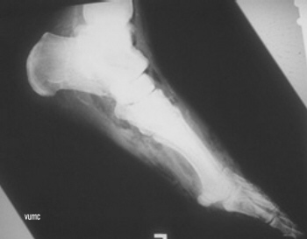

Slide 22
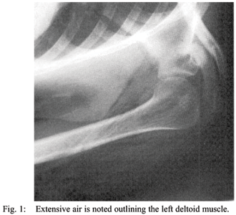

Slide 23
Treatment :
wound debridement ,drainage and exposure
Antibiotics (penicillins ,clindamycin and
metronidazole)
*antibiotics are not effective without aggressive debridement.

Slide 24
Cont Rx
Putting the pt in a hyperbaric oxygen chamber
The last solution is amputation.

Slide 25
5- Tetanus : rarely seen now due to vaccination.
* Caused by cl.tetani as complication of wound contamination .
* Usually the wound is healed when the symptoms start to appear. It appears 2 3 weeks after the onset of the wound because the incubation period is 1-3 weeks.
* Cl .tetani produces a neurotoxin (more important than the organism itsel, it causes muscle spasm) that stimulate the nerves and produce muscle spasm.

Slide 26
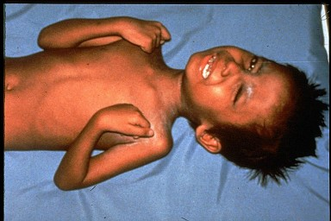

Slide 27
Cont.
The first manifestations include trismus (lockjaw) , neck and back stiffness.
Other manifestations include risus sardonicus (an anxious look with mouth drawn up), progressive dysphasia and difficult respiration and reflex convulsions along with intense tonic contractions of body muscles .

Slide 28
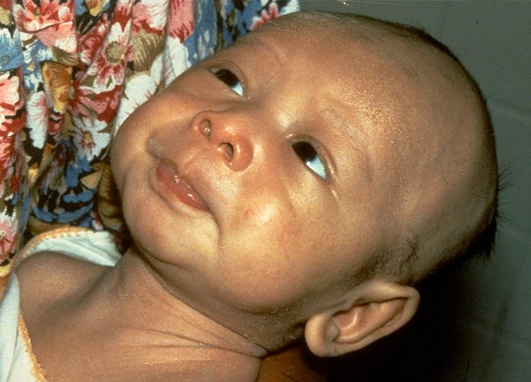

Slide 29
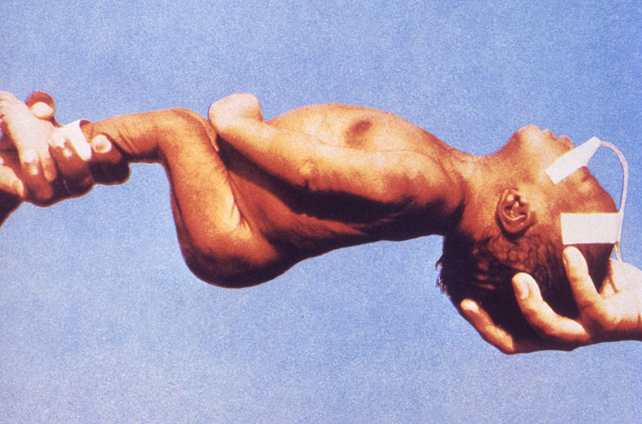

Slide 30
Cont.
May result in death if not treated early due to exhaustion ,aspiration or asphyxiation and respiratory arrest
Prevention is more important than treatment.
.

Slide 31
Treatment & prophylaxis
Rx include wound debridement ,penicillin ,muscle relaxants ,ventilation and nutrition
Prophylaxis :
Wound care & antibiotics
Vaccination by tetanus immunoglobulin in high risk pts ( passive immunization )
Commence active immunization (T toxoid)

Slide 32
Cont.
In previously immunized pt, if the booster was:
> 5 years , the pt needs anther booster.
< 5 years , no treatment .
Any trauma patient look into his of vaccination and follow the above.
If highly susceptible give both passive (IG) and active (toxoid).

Slide 33
Pseudo-membranous colitis
Caused by clostridium difficile,
It affects peaple that are hospitalized and taking antibiotics, it causes diarrhea
Diagnosed by detecting toxins in the stool or serology, colonoscopy will show you pseudo-membranes
Treatment is by stopping the offending antibiotics and give metronidazole if they didn’t respond give vancomycin.

Slide 34
staphylococci
Normal flora of the skin
The most common cause of wound infection in surgical practice . Surgical site infection.
Can cause endocarditis .
It also can cause :
Abscesses ,furuncle (boil) ,carbuncles.
* Antibiotics effective against staph : penicillin (mostly resistant to it), cephalospoin (1st gen) and vancomycin (for MRSA).

Slide 35
Abscess :
Inflammatory exudates localized pus collection
Treated by drainage & antibiotics (only if surrounded by cellulitis or if it was in a deep seated cavity as brain) .
Furuncle :
Inflammation of hair follicles or sweat glands treated by drainage & usually antibiotics .
Carbuncle :
a large extension of furuncle with multiple more than one hair follicle) discharge openings and its surrounded by cellulitis .
Common in diabetics , usually on the back and the neck ,treated by drainage & antibiotics- wide incision and removal of dead tissue and skin graft.
Hidrandenitis suppurativa:
sebaceous and sweat gland infection, treated by incision and drainage if extensive do extensive excision and skin graft.
If it was simple give tetracycline e.g. doxyxycline and drain it
if it was extensive and reaching the axilla you have to do debridement an excision to remove the glands

Slide 36
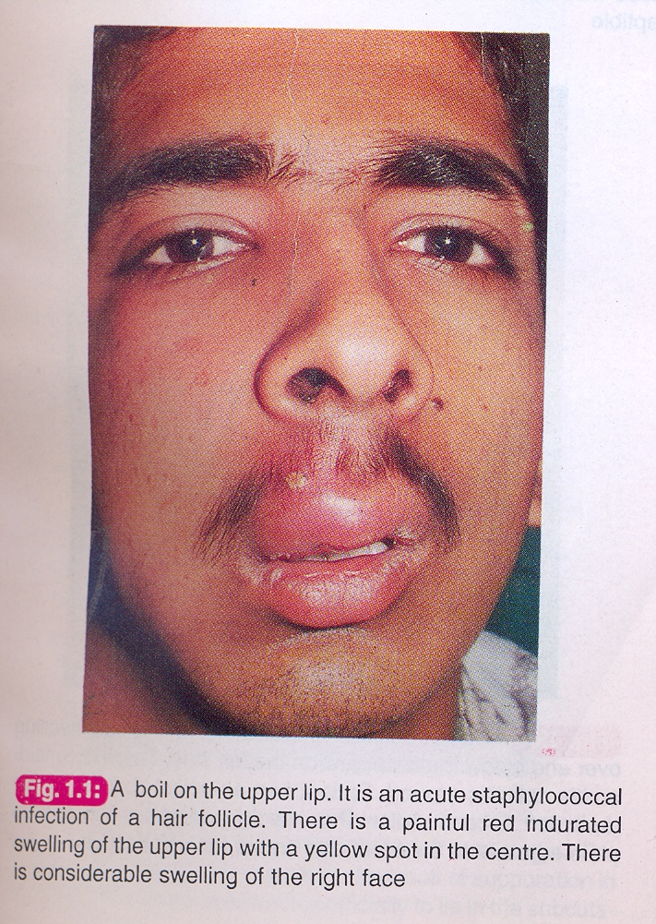

Slide 37
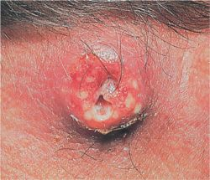

Slide 39
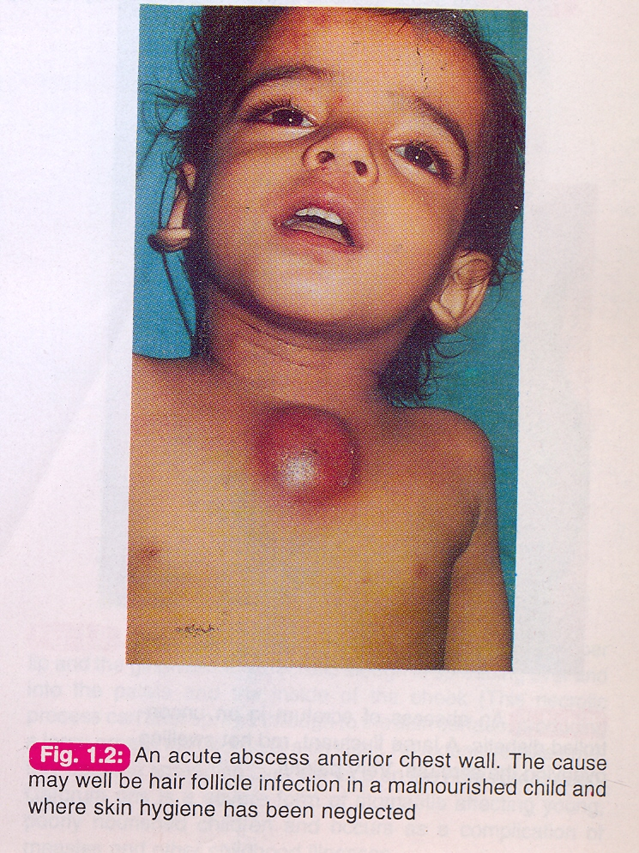

Slide 40
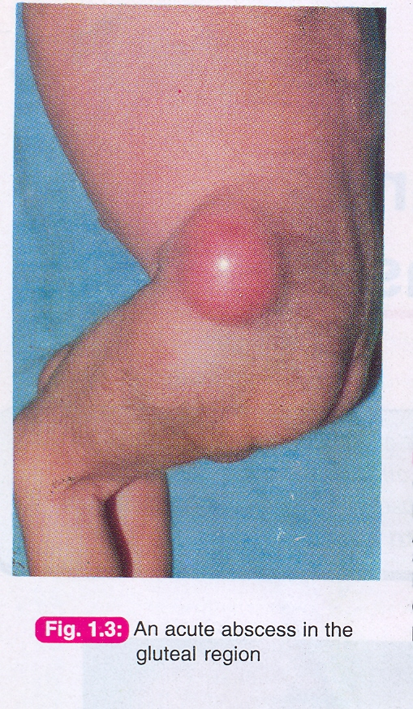

Slide 41
Paraonychia: infection of the nail bed, even if 1 mm its very painful, it contains pus, related by small incision and drainage. (by nail cutting)
Perianal abscess is related to hair follicles ad caused by staph.

Slide 42
Pseudomonas
Aerobic opportunistic bacteria that cause skin infections , but also can cause lethal infections
It enter the body through minor skin abrasions ,ventilator tubes , urinary catheter ,I.V. lines etc…so endemic in ICU
Treatment : aminoglycosides ,piperacillin ,ceftazidime.

Slide 43
Intraabdominal abscess
Important complication of G.I. & biliary surgery. E.g. post op appendictomy or perforated appendix or post op any lapratomy.
Clinical feature : abdominal pain(72 hrs after surgery) tenderness fever & leukocytosis and tachycardia.
Investigation : X-ray ,ultrasound less sensitive than CT (the most useful ) because gas might obscure the vision.
Treatment :drainage (surgical vs radiological ) & broad antibiotics if large drain under ct guidance if small and multiple give anibiotics

Slide 44
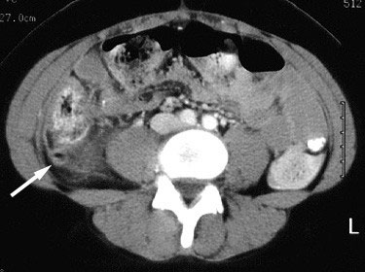

Slide 45
Classification of wounds
Clean wound: surgery done through clean tissue plains , no need for prophylaxis except for high risk groups . Eg: thyroid , breast , hernia surgeries, lymph node, lipomas less than 3 % get infection .
Clean\ contaminated : surgery with suspesion of infection . Eg: cholecystectomy , urinary tract surgery , etc…(entering body cavities) any surgery in the biliary tree or urinary tract but bile and secretions are originally sterile and clear but can be contaminated.
prophylaxis is advisable .

Slide 46
Cont .
3- Contaminated : surgery where microorganism are definitely present . eg: bowel surgery . 15% will get infection. Therapeutic AB is advisable .
4- Dirty : surgery through well established infection e.g: abscess surgery or as in perforated bowel and appendix . the use of antibiotic is considered to be of therapeutic nature. Risk of infection is 40%.

Slide 47
Most surgical site infection come within 30 days after operation or if implant or prosthesis or mesh then they come within 1 year so even after one year it is still considered as surgical site infection.
Usually pain goes away after 72 hours of the surgery if it didn’t think of superficial infections.

Slide 48
Preventive measures
Antibiotics are chosen according to the most likely causative agent.
Preop showering doesn’t decrease the risk of new infections it only washes out any pre-existing organism
Don’t leave hematomas in the wounds and don’t put tight sutures in any wound because this will decrease the blood supply and decrease healing.
Hypothermia increases the risk of infection.
Don’t open the wound every day unless there is an indication and don’t open it before 72 hours but you have to open the wound and inspect it properly before discharge.
When there is a wound infection you open the wound and keep it open.

Slide 49
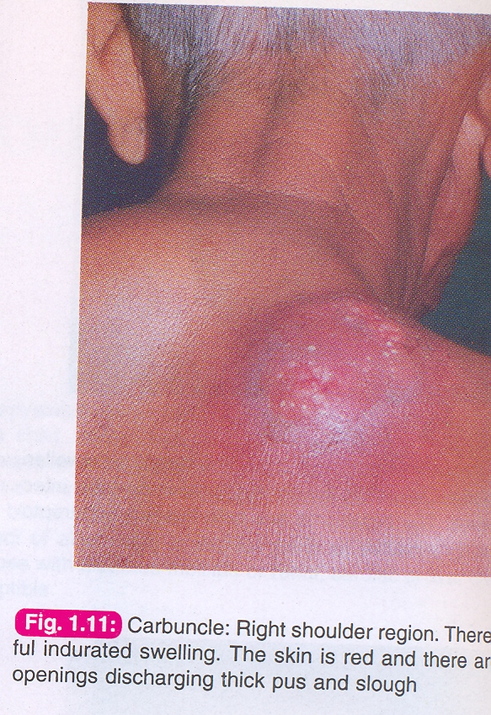

Slide 50
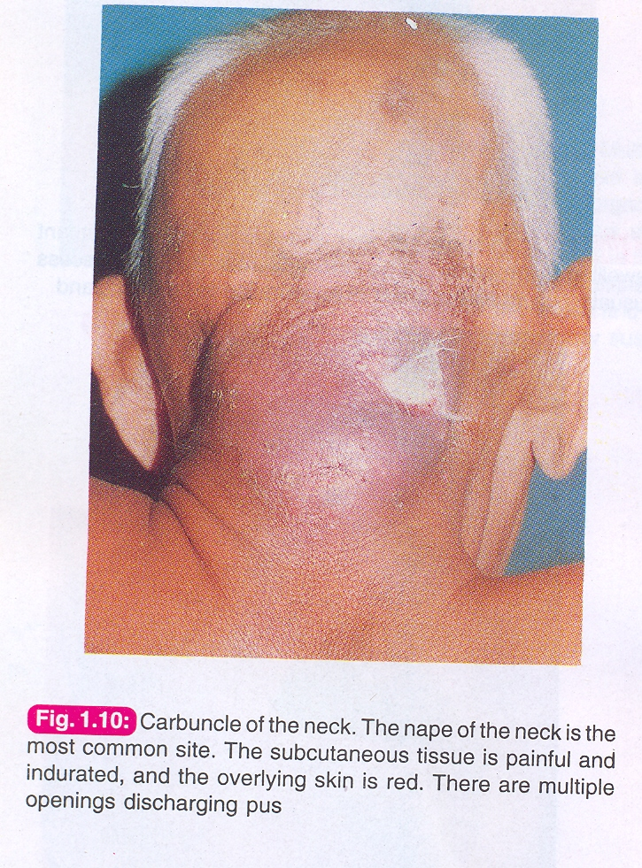

Slide 51
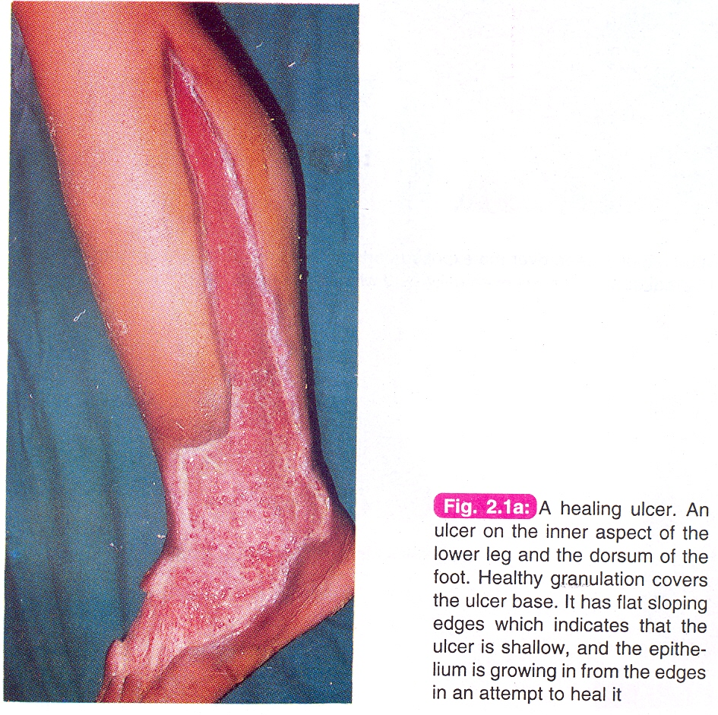

Slide 52
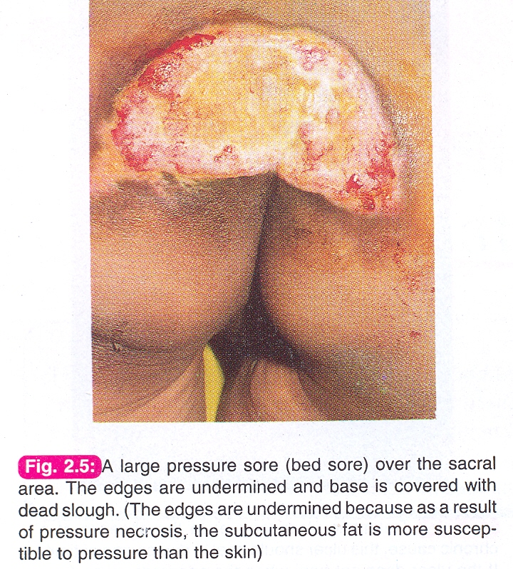

Slide 53
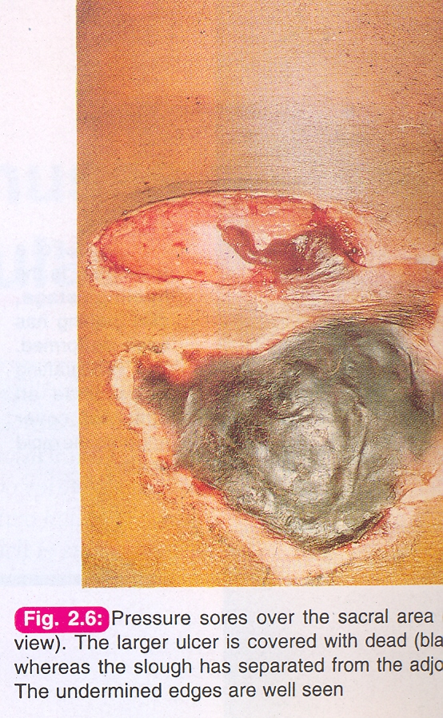

Slide 54
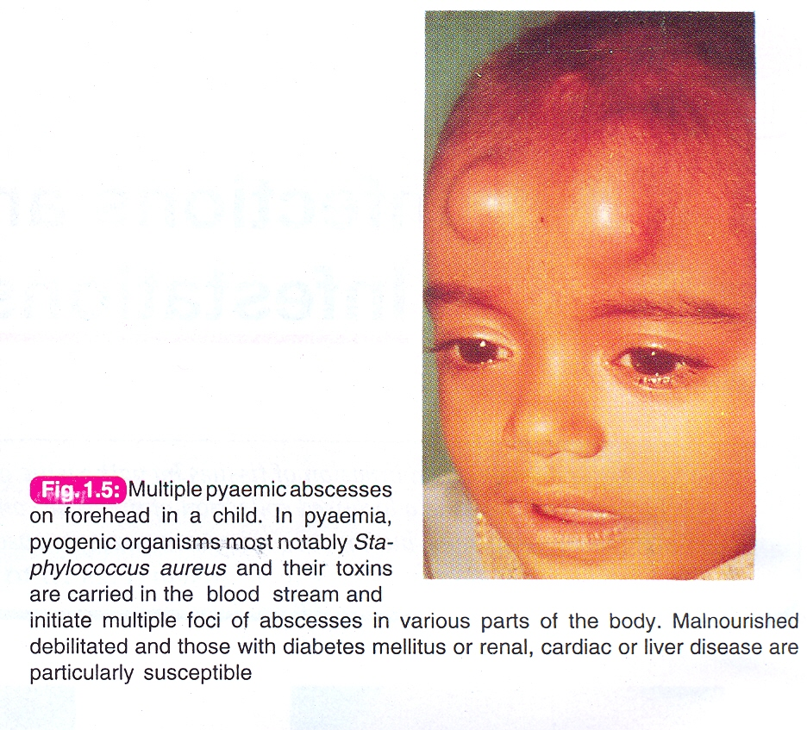

Slide 55
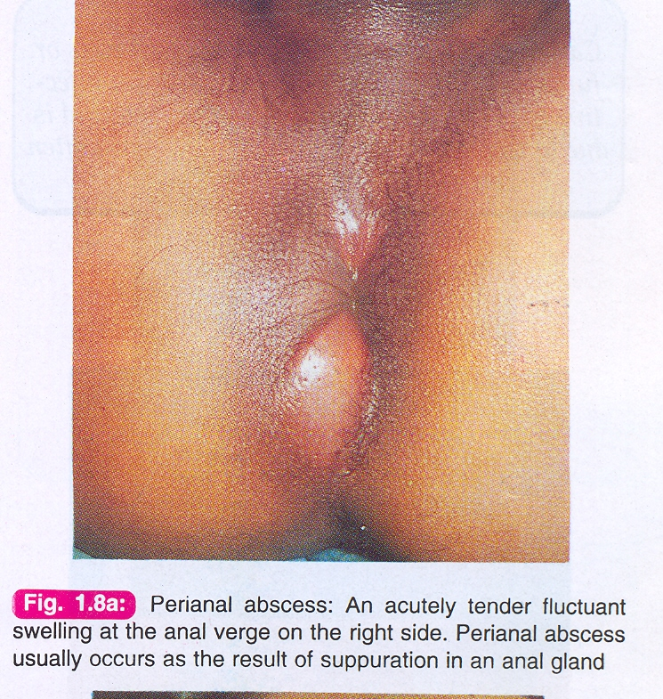

Slide 56
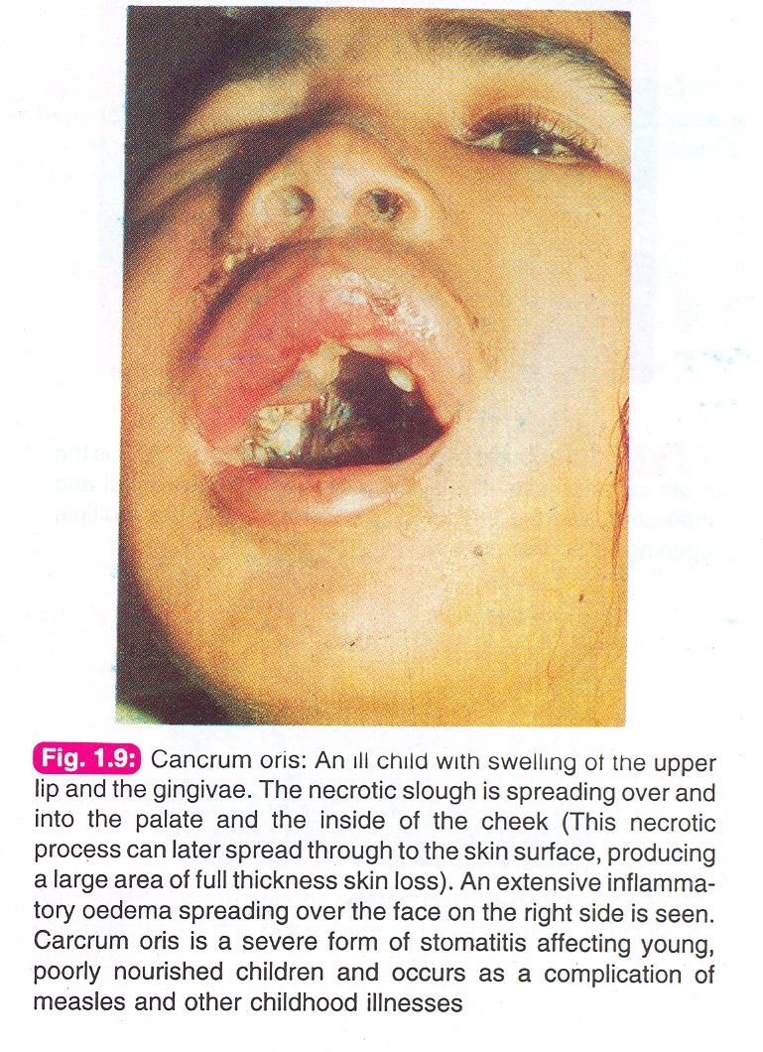

Slide 57
ANTIBIOTICS
Chemotherapeutic agents directed towards micrro-oganisms. They are either synthetic or semi-synthetic.

Slide 58
Penicillin has a wide safety margin you can give up to 6000 mg a day . Inhibits cell-wall synthesis. hyper sensitivity is the main side effect but luckily it is a rare event .therefore skin sensitivity test is a must before therapy you put a small amount of it on the skin and check if there was any reaction before giving it as I.V.
The first natural discovered antibiotic.

Slide 59
Gentamycine is the main aminoglycoside.It inhibits ribosome synthesis . Effective in Gram-ve bacteria eg; psudomonas and E.coli .side effects includes ; ototoxicity and nephrotoxicity. It has a narrow safety margin.
Gentamycin and penicillin is bacterocidal

Slide 60
Tetracycline is a wide spectrum bacteriostatic antibiotic (gram+ve & gram-ve ).It alters the ribosome synthesis in bacteria. Main side effects includes, teeth discoloration and risk
of super infection.
Its bacteriostatic.
Its contraindicated in pregnancy and early childhood.

Slide 61
Amphotericin B is an anti fungal which acts by impairing DNA synthesis. It is a hepatotoxic and nephrotoxic in high doses .Like gentamycine, this antibiotic should always be givin with frequent pre and post dose serum level asessment.

Slide 62
Prophylactic antibiotic
Antibiotic which is given to patients before surgery or invasive procedure in order to prevent infection . A high serum level of the antibiotic is essential just before starting the procedure. It is usually given intravenously or one hour intramuscularly before the surgery. Antibiotic selection depends on common bacteria in the operative site. If it’s a dental procedure give it orally 3 hours before the procedure.

Slide 63
It is usually given in CLEAN CONTAMENATED PROCEDURES
Sterilization is complete eradication of the organism and its spores.
Disinfectants(inanimate objects) ad antiseptic (used in humans)
are for killing the microorganism only. For e.g. soup if used to wash your hands it becomes antiseptic but if on the floor its disinfectant.
Gamma radiation is used in industries to kill the DNA it’s a method of sterilization.
Ethylene oxide is a temporary sterilization used in the OR if the instrument fell on the floor cant be used on the hand.
Gas gultaraldehyde is used to spray the room before OR as a disinfectant.

Slide 64
Thank you

