Slide 1
Management of head injury
By : waleed alhoshan
saleh aljabri
wael almajed

Slide 2
epidemiology
Head injury is a leading cause of morbidity and mortality and it is the most common cause of death among all patient suffering of traumatic injury.
Motor vehicle accident are the most frequent cause of traumatic brain injury peaking in 15-24
Childe abuse is a common cause of head injury in very young infants
Falls is the most common source of head injury in patient above 80

Slide 3
Pathophysiology
Head injuries include both injuries to the brain and those to other parts of the head, such as the scalp and the skull.
Brain injury is divided into primary and secondary
Primary: occurs at the time of brain injury or immediate there after eg:(skull fracture ,laceration of the brain , hemorrhage in or around the brain)
Secondary: denotes the brain response to injury eg:(cellular ischemic injury and cerebral edema )

Slide 4
Primary brain injury
Primary brain injury could be caused by penetrating or blunt trauma .
The brain is much more sensitive to diffuse angular application of force than focal linear one.

Slide 5
Secondary brain injury
They occur from subcellular to macroscopic level
Tissue ischemia due to the fact that Cerebral blood flow drop concededly in the early face after traumatic brain injury.
Cerebral edema occur do to cytotoxic and vasogenic mechanism and acts as an additional mass which increase intracranial pressure .

Slide 6
Clinical assessment
The basic management is divided into:
initial resuscitation(a,b,c,d,e)
primary neurologic survey(glasgow coma scale+ pupils+gross motor)
search for lesions that require immediate surgical management
identification and management of cerebral edema and increased intra cranial pressure.

Slide 7
All patient with sever brain injury may require intubation purely on the basis of a reduced ability to protect the airway and maintain ventilation.
Restoring and maintaining adequate blood pressure is important
data base research demonstrate that a single episode of hypotension following brain injury doubles the risk of dying compared to patients who never had an episode.

Slide 8
Primary neurological survey

Slide 9
Glasgow coma scale

Slide 10
The score range from 3-15.
A score between 3-8 indicate severe brain injury .
A score between 9-12 indicate moderate brain injury.
A score between 13-15 indicate mild closed head injury.

Slide 11
In addition to determining the GCS the primary neurological survey include an assessment of the pupil and gross motor function .
The mass of hematoma may produce uncle herniation with unilateral pupillary dilatation and contralateral hemiparesis and these indicate a life threatening intra cranial hemorrhage is present.

Slide 12
Sign and symptoms
Presentation varies according to the injury. A patient may present with or without neurologic deficit.
Common symptoms of head injury include: coma, confusion, drowsiness, personality change, seizures, nausea and vomiting, headache and a lucid interval, during which a patient appears conscious only to deteriorate later.
When we have a scull fracture :
leaking cerebrospinal fluid and is strongly indicative of basilar skull fracture.
an eye that cannot move or is deviated to one side.
wounds or bruises on the scalp or face.
Basilar skull fractures, those that occur at the base of the skull, are associated with Battle's sign, a subcutaneous bleed over the mastoid hemotympanum, and cerebrospinal fluid rhinorrhea and otorrhea.

Slide 13
Diagnostic imaging
All patient with moderate and sever brain injury should have a CT scan of the head . Also with mild with risk factor such as the use of anticoagulants.
Plain scull X ray is not advised as substitute for CT.
MRI maybe useful in assessing cervical and intracranial vasculature and helpful in accurate prognostication of injury outcome

Slide 15
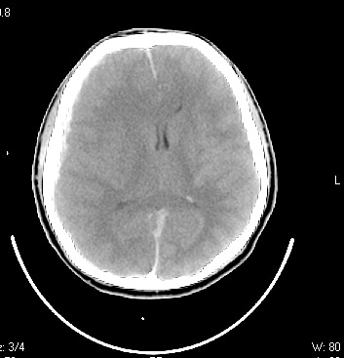

Slide 16
Conventional angiography ,CT scan ,and MRA are potential consideration in case of cervical intra cranial vascular injury
Conventional angiography is the gold standard and offers endovascular treatment.
After the head CT scan the clinical and radiographic information should be synthesized to formulate a plan either to operate or evaluate for intra cranial hypertension or to observe clinically for worsening of neurological status

Slide 17
Clinical injury pattern and herniation syndrome
Immediate recognition and treatment of these syndromes is essential for patient survival.
Subfalcine herniation occur when part of the cerebrum is forced from one side to an other under the falx cerebri.
There is a general correlation between the degree of Medline shift , the depression in the level of consciousness and the severity of the injury.

Slide 19
Uncal herniation
Occur when the uncus of the temporal lobe is shifted medially
It can compress the oculomotor resulting in los of it’s parasympathetic function
With more sever or prolonged compression the extra oculor muscle function is also lost leading to an eye that is deviated anteriorly and laterally.
if the uncus is forced further medially it compress the cerebral peduncle producing counter lateral hemiparesis

Slide 20
Tonsillar herniation
Occur when the intra cranial content particular the content of the posterior fossa are forced out of the foramen magnum
The tonsils of the cerebellum are pushed downward and compress the medulla oblongata leading to respiratory depression and death

Slide 22
The cushing triad
Bradycardia
Hypertension
Respiratory irregularity
Intubation and mechanical ventilation often obscure the respiratory part of the triad

Slide 23
Specific injuries & surgical management
Skull fracture
They are usually categorized into open or closed depressed or non depressed and basilar or convexity varieties
Depressed fracture can tear the Dura or lacerate the cortex of the brain and they are usually considered for operative repair
Skull fractures that are not depressed usually do not require repair
Basilar skull fractures can damage the the vasculature and crainial nerves and can lead to a CSF leak and meningitis
Clinically one may suspect a basilar skull fracture in the presence of battle sign or raccoon eyes

Slide 24
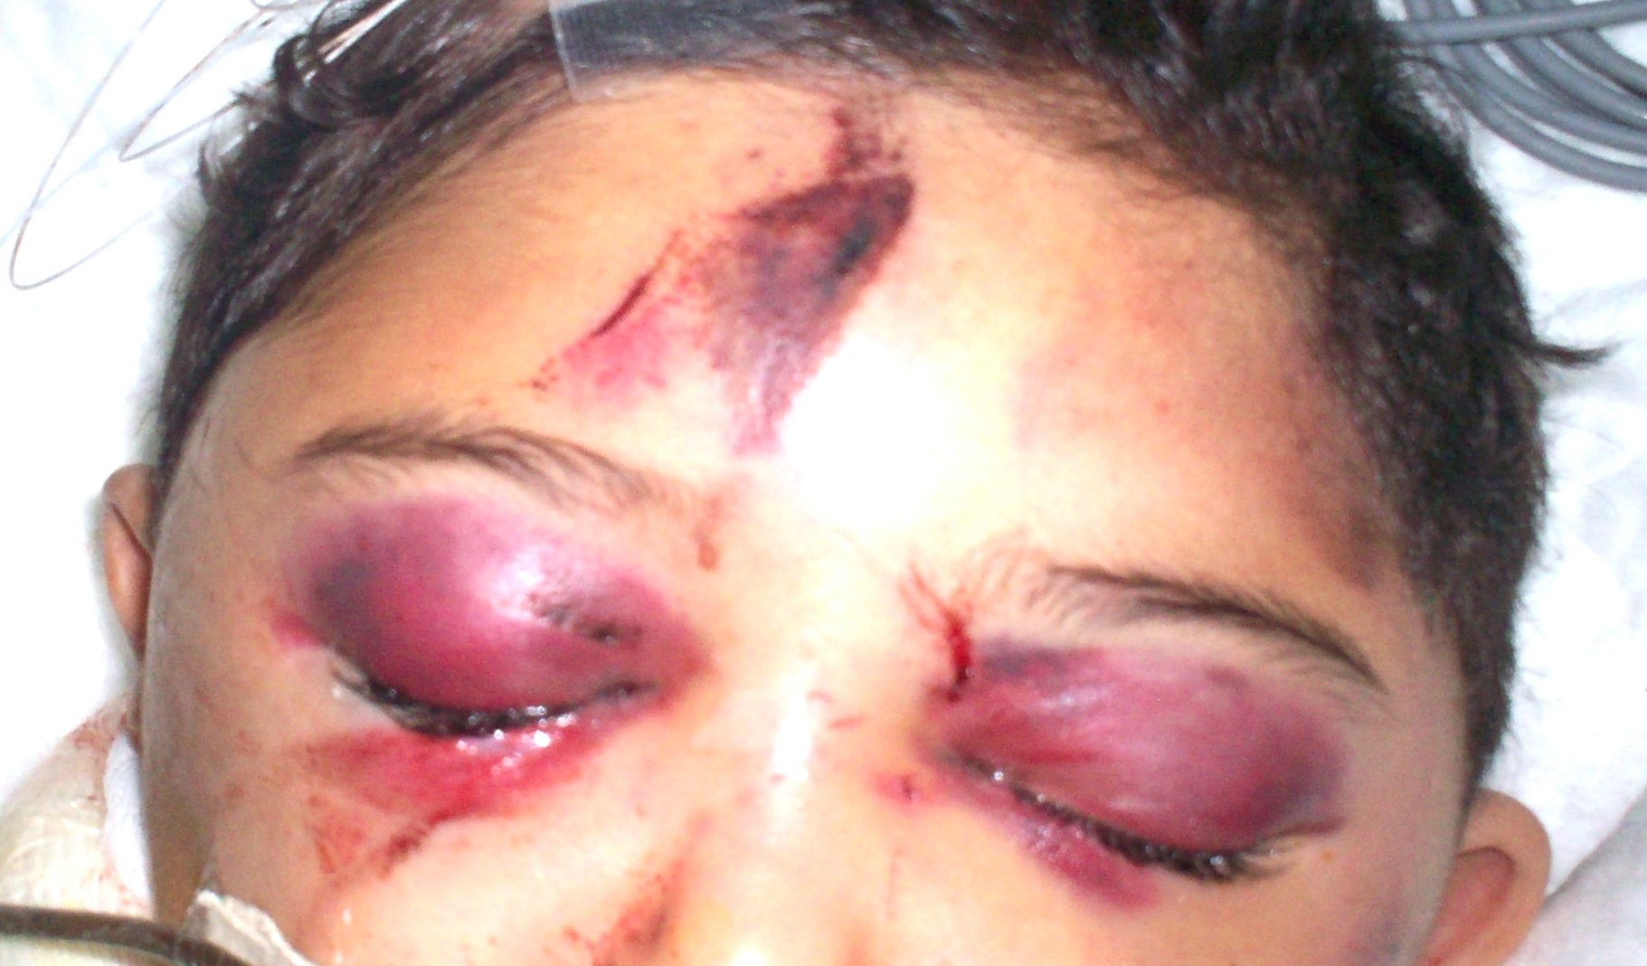

Slide 25
Epidural hematoma
The bleeding occures on the outside of the dura and collects in and expands the potential epidural space between the dura and the bone
The classic example is laceration of the middle meningeal artery by the temporal bone
The hematoma can compress the adjacent brain to the point of serious injury and death
venous epidural hematoma are less likely to produce life threatening compression
Distinguishing between the two types is location (temporal vs non temporal) ,size (small vs large) ,and the rate of exchange (slow vs fast)

Slide 26
The classic presentation of a tamporal epidural hematoma is a patient suffering from a blow of the temple and a brief loss of consciousness . This is fallowed by a lucid interval during which the patient appears to be neurologically well
during this time either the epidural hematoma expands slowly enough for the compensatory mechanism of the brain to maintain consciousness or the hemorrhage stops temporarily
Subsequently either due to rebleeding or exhaustion of the compensatory mechanisms a rapid decline in the level of consciousness and associated with other element of uncal herniation

Slide 28
Epidural hematoma has a lens shaped appearance and limited by the suture lines
CT image is also helpful in assessing the impact of the hematoma on the brain such as the degree of the midline shift or compression of the nearby structures
Management of epidual hematoma is determined by lesion size ,location and time from injury to diagnosis
Generally, an epidural hematoma more than 1cm in depth is considered for surgical management
When the diagnosis has been delayed, it is considered safe to observe patients with epidural hematoma of modest size (1cm) since the bulk of the hematoma expansion occures within the first 24-36 houres

Slide 29
In contrast , a 1cm thick temporal epidural hematoma in a patient only 30 minutes out from injury should be strongly considered for emergent surgical removal of the hematoma

Slide 30
Acute subdural hematoma
The blood collects between the dura and the arachnoid membrane , in the potential subdural space
The force required to shear vessels in this fashion can occur with a focal blow to the head but is more common with diffuse ,rotational force applications to the brain ,as often occur in motor vehicle accidents
Most patients present with a significantly depressed level of consciousness and may have other finding related to the compressive mass of the hematoma

Slide 32
It has more of a crescent shape and there is no barrier to it’s spreading over the hemispheric surface of the brain
Associated intracerebral hemorrhage and edema is often evident beneath the acute subdural hematoma
Management of the acute subdural hematoma involves emergent operative removal by craniotomy for lesions more than 1cm thick
Acute brain swelling during the surgical procedure must be expected
Bleeding source usually difficult to stop and often best managed with gentle packing of hemostatic materials rather than aggressive exploration

Slide 33
Medical management of elevated intracrainial pressure and the underlying brain injury is an essential part of patient care
Outcomes are often poor with mortality of 50%-90%. Survivors often have significant disabilities
In elderly the subdural hematoma can present several months after injury due to the space caused by brain atrophy and they are labeled as chronic subdural hematoma and outcomes post surgery are much better than acute subdural hematoma

Slide 34
Penetrating brain injury
Usually produce a focal injury pattern specific to the site of penetration
Gunshot wound that pass through the ventricular system are most often fatal
Management of less severe penetrating injury revolves around manging the potential infection ,complication of injury and repairing the breach of the skull

Slide 36
Diffuse brain injury diagnosis not typically requiring immediate surgical management
Concussion
Is an immediate and transient loss of consciousness or normal mentation after head trauma often associated with period of amnesia
The severity of concussion appears to be proportional to the duration of amnesia particularly the anterograde amnesia
Who gets CT ?

Slide 37
Validated clinical decision rules stress that all patient presenting with GSC of less than 15 , those that are vomiting , and those older than 60 to 65 are at high enough risk to warrant CT scan
Other factors warranting CT scan are sever headache, intoxication , persistent anterograde amnesia , a seizure with the injury , evidence of trauma to bone or soft tissue above the clavicle and severe mechanism of injury such as ejection injury

Slide 38
Management for isolated concussion in the ER includes a period of observation for at least 2 hours
Long term outcome are generally good however 25% of patients report an increased incidence of headache and memory difficulties even several months later
post concussive syndrome include depression, anxiety, memory loss , headache , emotional lability , insomnia
Treatment is reassurance

Slide 39
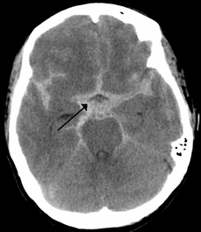
Subarchnoid hemorrage
is bleeding into the subarachnoid space—the area between the arachnoid membrane and the pia mater surrounding the brain
Trauma is most common fallowed by cerebral aneurism

Slide 40
Diffuse axonal injury
Occurs when the axons become sheared off between the boundary between gray and white matter during rapid brain acceleration or deceleration
Management is primarily medical

Slide 41
Medical management after traumatic brain injury
Seizure management
Homeostasis
Management of increased intracranial pressure by (venous drainage , CSF drainage, sedation, osmotic agent and diuretics, hyperventilation ,barbiturate, hypothermia , surgical decompression

Slide 42
Thank you

