Slide 1
LATERAL NECK MASSES Prof. Alam
Presented By:
Hazem Aljumah
Mohammed Aljulifi

Slide 2
Objectives:
Anatomy & lymphatic drainage of the neck
How to approach a patient with a neck mass.
Differential diagnosis of a neck mass.
Examples of common lateral neck masses.

Slide 3
Anatomy of the neck:-
The most important landmark: Sternocleidomastoid muscle.
It divides the neck into anterior & posterior triangles.
the anatomy of the neck helps us in the differentiates of each region by knowing contents of the region.

Slide 4
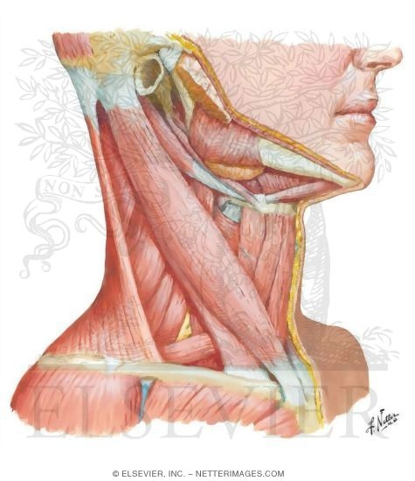
Anatomy of The Neck

Slide 5
Anatomy of The Neck
The Anterior Triangle:
Superiorly : the border of the mandible.
Medially : The Midline.
Laterally : Ant. Border of the SCM
Subdivide into :
Submental triangle : formed by the anterior belly of the digastric, hyoid, and midline .
Submandibular /digastric triangle : formed by the mandible, posterior belly of the digastric, and anterior belly of the digastric .
Carotid triangle : formed by the superior belly of the omohyoid, SCM, and posterior belly of the digastric ( mostly vascular tumors)
Muscular triangle : formed by the midline, superior belly of the omohyoid, and SCM . ( has no significant structures > no swellings )

Slide 6
Anatomy of The Neck

Slide 7
Anatomy of The Neck
The Posterior Triangle :
Inferiorly : The Clavicle.
Anteriorly : Post. Border of the SCM .
Posteriorly : Ant. Border of the Trapezius.
Subdivided into ( divided by the inf. Omohyiod muscle ) :
Occipital triangle : SCM medial , Ant. Border of the Trapezius lateral , Inf omohyoid inferiorly.
Supraclavicular triangle : clavicle inf. , SCM medial , Inf. Omohyoid superiorly.

Slide 8
Lymph Nodes of the Neck

Slide 9
Lymph Nodes of the Neck
Level I submental, submandibular
Level II upper jugular
Level III middle jugular
Level IV lower jugular
Level V posterior jugular
Level VI paratracheal, perithyroidal

Slide 10
Lymph Drainage
Level I (Submandibular / Submental)
Drains the lip, oral cavity & submandibular gland.
Level II (Upper jugular)
Drains the nasopharynx, oropharynx, parotid, & the supraglottic larynx.
Level III (Mid jugular), IV (lower juglar)
Drains the oropharynx, thyroid
Level V (post. Cervical)
Drains nasopharynx, thyroid
Level VI (paratracheal)
Drains cervical oesophagus and thyroid

Slide 11
History
Age
Pediatric(0-15):90% benign
Young adult(16-40):as pediatric
Elderly(>40):consider malignant until proven otherwise.
Notes:
In the paediatric age group (0 – 15), a neck lump is likely to be inflammatory followed by congenital lumps and neoplastic lesions. Patients in the age group between 16-40 years are again more likely to have inflammatory lesions followed by congenital and neoplastic lesions. In patients over 40 years of age, a neck lump is to be considered malignant until proven otherwise.

Slide 12
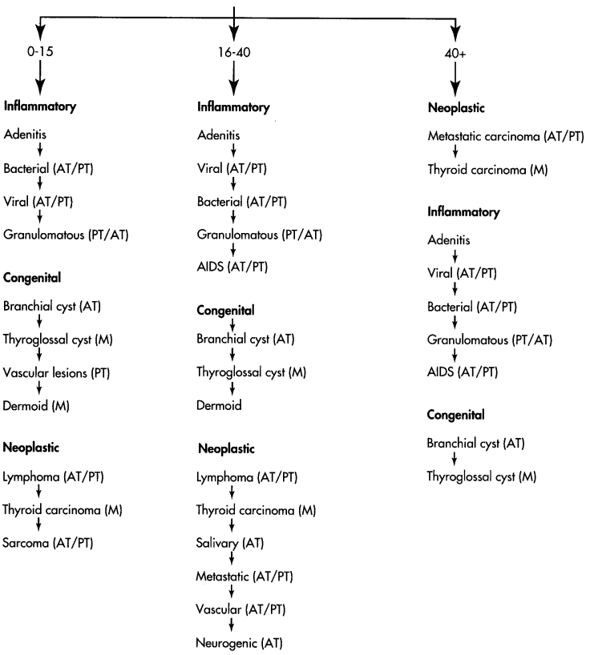

Slide 13
History (continued)
Swelling:
Duration
Location
How was it noticed
Size
Shape
Skin changes, discharge
Painful or not
Other swellings in the body
Notes:
Duration:
7 days: inflammatory
7 months: neoplastic
7 years: congenital
Location: congenital lesions are consistent in position, metastatic points to primary lesion
How was it noticed
Size: is it progressive or regressive
Shape
Skin changes, discharge
Painful or not
Other swellings in the body
===============
1) Onset: The nature of onset is vital to establish the pathology of the lump. A rapid onset painful swelling suggests an inflammatory condition on the other hand a slowly Progressive lump, which is not painful, suggests a neoplastic lesion. Inflammatory swellings in the neck are commonly associated with infections in the ear, nose, throat and scalp.
2) Duration: Inflammatory lumps settle once the primary source of infection is treated. A neck lump which is persistent (> 6 weeks) with or without associated symptoms needs referral to an ENT surgeon.

Slide 14
History (continued)
Associated Symptoms:
Dysphagia, odynophagia
Breathing difficulties
Hoarseness of voice or dysphonia
Otalgia, nasal discharge
Constitutional: fever, night sweats, wt loss, anorexia
If supraclavicular LN: ask pulmonary, GIT, GU symptoms
Oral or skin lesion
Notes:
) Associated Symptoms: It is vital to gather information from the patient that would suggest a primary head and neck malignancy causing a metastatic lymph node enlargement. The symptoms and their associations are: a) Dysphonia (cancer of the larynx) b) Dysphagia (cancer of the pharynx and oesophagus) c) Dyspnoea (lung cancer) d) Weight loss (cachexia)

Slide 15
Risk factors
Tobacco, alcohol
Exposure to radiation
Previous Hx of cancer
Family Hx of head & neck CA
URTI or dental problem
Hx TB or contact with sick pt
Notes:
Social History: Occupational exposure to asbestos, nickel and wood dust are associated with an increased risk of head and neck cancers. Smoking is the single most important risk factor for cancers of the upper aerodigestive tract and a detailed history regarding the same should be sought. Alcohol consumption is also a known risk factor for cancers of the head and neck.

Slide 16
Examination
Scalp & face Ex for skin cancer
Ear: external auditory canal and tympanic membrane
Nasal Ex.
Mucosal surface of oral cavity & oropharynx
Motor & sensory Ex of the face

Slide 17
Examination (continued)
Neck:
1. Swelling
2. Ex of other LN
3. Thyroid gland Ex.
Respiratory & abdominal Ex.
Notes:
Neck: 1. Swelling: site, size, shape, surface, consistency, mobility, skin
changes, tenderness, fluctuation, pulsatility, bruit, movement with swallowing or tongue protrusion

Slide 18
Investigations
Laboratory test:
CBC with ESR
Serology: monospot, toxoplasma, HIV, PPD
Thyroid function test
ANA

Slide 19
Investigations (continued)
Imaging:
Chest x-ray
CT
MRI
US
Radionuclear scan
FNA
Excisional biopsy

Slide 20
CT scan
Distinguish cystic from solid masses
Extent of lesion
Vascularity (with contrast)
Detection of unknown primary (metastatic) lesion
Pathological LN node (lucent, >1.5cm, loss of normal shape)
Avoid contrast in thyroid lesions
Notes:
Contrast in thyroid will delay and confuse the treatment with radio iodine therapy

Slide 21
MRI
Similar information as CT
Better for upper neck & skull base
Useful in defining deeply invasive tumors of tongue, pharynx and larynx
Vascular delineation with infusion

Slide 22
Ultra sound
Less important now with FNAB
Solid versus cystic masses
Congenital cysts from solid nodes/tumors
Noninvasive (pediatric)

Slide 23
Radio nuclear Scan
Salivary & thyroid masses
Location –glandular versus extra-glandular
Functional information

Slide 24
Fine needle aspiration (FNA)
Standard of diagnosis
Indications:
Any neck mass that is not an obvious abscess
Persistence after a 2 week course of antibiotics
Small gauge needle:
Reduces bleeding
Seeding of tumor –not a concern
Can be used to Dx carcinoma without illuminating the primary source, inadequate to define lymphoma
Contraindications - vascular ?carotid body tumor

Slide 25
Panendoscopy
FNAB positive with no primary on repeat exam
FNAB equivocal/negative in high risk patient
Directed Biopsy
All suspicious mucosal lesions
Areas of concern on CT/MRI
None observed – random biopsy of nasopharynx, tonsil (ipsilateral tonsillectomy for jugulodigastric nodes), base of tongue

Slide 26
Open excisional biopsy
Only if complete workup negative
Occurs in ~5% of patients
Be prepared for a complete neck dissection.
Frozen section results (complete node excision):
Inflammatory or granulomatous –culture
Lymphoma or adenocarcinoma –close wound

Slide 27
Differential Diagnosis

Slide 28
80s simple rule for solitary neck mass
If benign tumors of the thyroid gland are excluded, nearly 80% of neck mass in adults are malignant.
80% are metastatic
80% arise from primary sites above the clavicle.
80% are metastatic SCC.
Notes:
80% benign in children

Slide 30
Midline Neck Masses
EXAMPLES:
1. Dermoid cyst.
2. Thyroglossal Duct Cyst.

Slide 31
Lateral Neck Masses

Slide 32
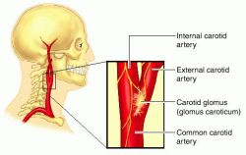
Carotid body tumor
What is the carotid body?
is a small cluster of chemoreceptors and supporting cells located near the fork (bifurcation) of the carotid artery (which runs along both sides of the throat).

Slide 33
Carotid body tumor
- Also called as Paragangliomas (chemodectomas) tumors arising from chemoreceptor tissue.
- Carotid body tumor is the most common of the head and neck paragangliomas
- Could be benign(most common) or malignant

Slide 34
Carotid body tumor
Presentation:
Rare in children, common in 4th/ 5th decade (common in 50s).. In areas with high altitude
It usually presents as a painless neck mass
larger tumors may cause dysphagia, airway obstruction, and cranial nerve palsies, usually of the vagus nerve and hypoglossal nerve

Slide 35
Carotid body tumor
Features:
Approximately 3% are bilateral. This tumor increases to 26% in patients with a familial tendency for paragangliomas
Usually it compressible mass.
Mobile medial/lateral not superior/inferior
The mass may be pulsatile & may have a bruit.

Slide 36
Carotid body tumor
Diagnosis:
confirmed by angiogram or CT
angiography shows tumor blush at the carotid bifurcation
FNA or biopsy are contraindicated
Nowadays mostly by CTA(CT angio)

Slide 37
Carotid body tumor
Treatment:
- By surgical excision. But large tumors may require carotid bypass.
- Irradiation or close observation in the elderly.
- Surgical resection for small tumors in young patients
Hypotensive anesthesia
Preoperative measurement of catecholamines

Slide 38
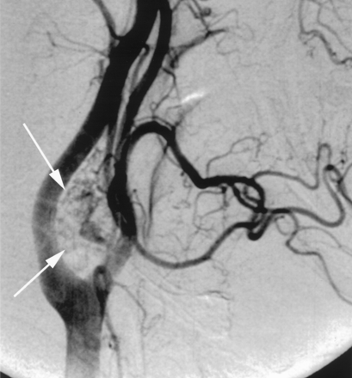
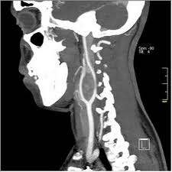
Carotid Body Tumor

Slide 39
Lymphadenopathy
Causes:
They are best recalled with the use of the mnemonic MINT

Slide 40
Lymphadenopathy
M: Malformations include sickle cell anemia and other congenital hemolytic anemias , the reticuloendothelioses like Gaucher disease
I: Inflammatory: the largest group of lymphadenopathies
Viral illnesses: infectious mononucleosis, German measles, chickenpox, & viral upper respiratory illnesses
Rickettsial disease: typhus & rocky mountain spotted fever

Slide 41
Lymphadenopathy
Bacterial diseases: Acute Bacterial lymphadenitis, typhoid, plague, tuberculosis , meningococcemia, & brucellosis
Spirochetes: syphilis & borrelia vincentii.
Parasites: malaria, filariasis, & trypanosomiasis
Fungi: histoplasmosis, coccidioidomycosis, & blastomycosis
Common after upper respiratory tract infection

Slide 42
Lymphadenopathy
N:Neoplasms like leukemias , lymphomas & metastasis from H&N
T:Toxic disorders like Dilantin toxicity may mimic Hodgkin disease and drug allergies from sulfonamides, hydralazine, & iodides
In addition to disorders like SLE, sarcoidosis

Slide 43
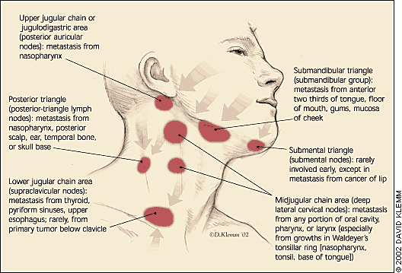

Slide 44
Lymphadenopathy
Investigations
CT , MRI & US for evaluation of mass & staging
FNA is sensitive & specific
Management: according to cause
Inflammatory: by Abx.
Neoplastic:
If metastasis, surgical excision of lymph node
If leukemia or lymphoma: radiotherapy or chemotherapy

Slide 45
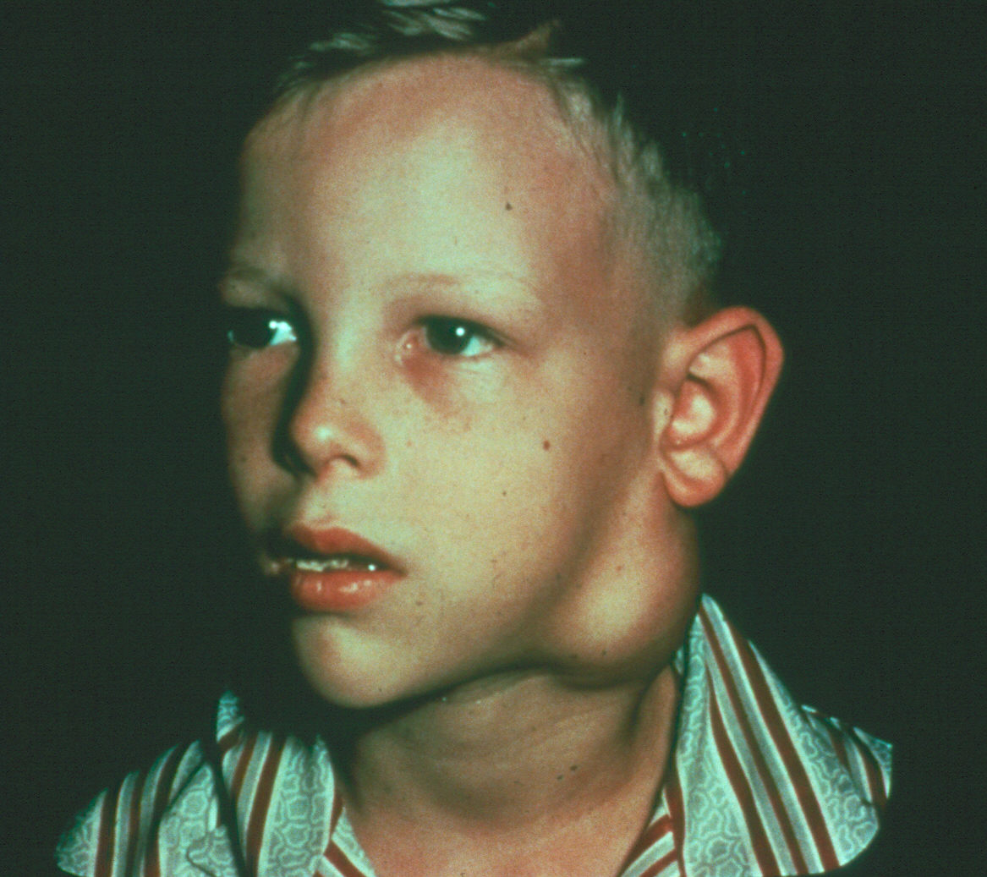
Lymphoma

Slide 46
Branchial Cleft Cysts
Definition:
A branchial cyst is a cavity- a congenital remnant from embryologic development.

Slide 47
Branchial Cleft Cysts
- It is present at birth usually on one side of the neck
located just in front of the sternocleidomastoid muscle.
- The commonest cause: incomplete disappearance of site of fusion between the 2nd & the 5th pharyngeal pouch
- may not present clinically until later in life, usually by early adulthood

Slide 48
Branchial Cleft Cysts
- The most common congenital masses in the lateral neck
- include cysts(most commonly), sinuses, & fistulae, may present anywhere along the SCM muscle
-The most common is the 2nd
- Usually appears adulthood

Slide 49
Branchial Cleft Cysts
2nd cleft most common (95%) –Identified along the anterior border of the upper third of the SCM muscle & adjacent to the muscle. tract medial to CNXII between internal and external carotids.
1st cleft less common – in the region of the parotid gland, ear or high sternocleidomastoid. close association with facial nerve possible
3rd and 4th clefts rarely reported

Slide 50
Branchial Cleft Cysts
History
A branchial cyst commonly presents as a solitary, painless mass in the neck of a child or a young adult.
A history of intermittent swelling and tenderness of the lesion during upper respiratory tract infection may exist. Discharge may be reported if the lesion is associated with a sinus tract.
In some instances, branchial cleft cyst patients may present with locally compressive symptoms.
A family history of branchial cleft cysts may be present

Slide 51
Branchial Cleft Cysts
Presentation:
palpable neck mass, slowly growing
Usually unilateral. Bilateral in 2-3 %
Present in older children or young adults often following URTI
If gets infected it’ll become enlarged & tender. Spontaneous discharge (e.g. following URTI)
Mass effect such as respiratory compromise.

Slide 52
Branchial Cleft Cysts
P/E:
Most common: Soft, smooth, fluctuant & painless mass underlying SCM
Usually transilluminates
It involves an epithelial tract along the lateral neck.
Skin erythema and tenderness if infected
Complications?
-severe infection & abscess formation.
-malignant transformation of the edges(rare).

Slide 53
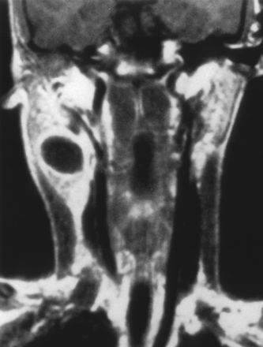
Branchial Cleft Cysts
Investigations :
FNA. Aspirate appears as a straw-colored fluid & with feature cholesterol crystals. And also may be helpful to distinguish branchial cleft cysts from malignant neck masses
US helps to delineate the cystic nature of these lesions.
CT with contrast shows a cystic and enhancing mass in the neck.
MRI allows for finer resolution during preoperative planning.

Slide 54
Branchial Cleft Cysts
Treatment
Antibiotics are required to treat infections or abscesses related to branchial cleft cysts.
Surgical excision, including the tract.
May necessitate a total parotidectomy (1st cleft).
Percutanous sclerotherapy has been reported to be an effective alternative to surgical excision of branchial cleft cysts by some groups.

Slide 55
Salivary glands
Parotid Gland: (80% of salivary gland tumors)
80% are benign
Mixed tumors (pleomorphic): most common benign tumors
Papillary adenocytoma (warthin’s tumor): 2nd most common benign tumor
Malignant:
Accounts for 20% of all parotid tumors.
Mucoepidermoid carcinoma is the most common
The 2nd most common is malignant mixed tumor
Investigations:
FNA (87%) ACCURATE
CT
MRI
US
Management:
Benign lesions: superficial parotidectomy
Complete excision may be required
Malignant lesions are treated by total parotidectomy, & facial nerve should be sacrificed if involved.

Slide 56
Salivary glands
Submandibular gland:
Accounts for 10% of salivary gland tumors.
50% are malignant , the most common is adenoid cystic carcinoma, treated by excision of the gland, neck dissection if nodal involvement with postoperative radiation
Sublingual:
Less than 1% of all salivary tumors.
90% are malignant
Treatment: excision of the gland, neck dissection if nodal involvement with postoperative radiation

Slide 57
Salivary Gland Tumors
Enlarging mass anterior/inferior to ear or at the mandible angle is suspect
Benign
Asymptomatic except for mass
Malignant
Rapid growth, skin fixation, cranial nerve palsies
Lymphadenopathy- advanced malignancy

Slide 58
Salivary Gland Tumors
Diagnostic tests
FNAB
CT/MRI – deep lobe tumors, intra vs. extra-parotid
Be prepared for total parotidectomy with possible facial nerve injury.

Slide 59
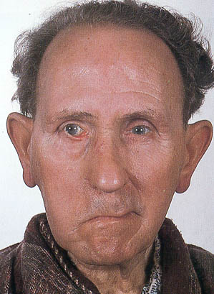
Salivary Gland Tumors

Slide 60
Cystic hygroma
Definition:
Congenital macrocystic malformations of the lymphatic vessels in H & N
May occur anywhere but most commonly in the posterior triangle
Most CHs are multicystic, in approximately 10% of cases, a unilocular cyst is found
Causes:
Isolated or in association with other birth defects as part of syndromes
Environmental (alcohol abuse during pregnancy, viral infections)
Genetic- Turner syndrome (majority)
Unknown

Slide 61
Cystic hygroma
Presentation:
- May be present at birth and almost always appears by the age of 2
- They are slowly growing, large, soft masses
- Sudden increase in size- infection or bleeding
- May regress but rarely disappear
- Sleep apnea syndrome (rare)
- Airway compromise
- Feeding difficulties, failure to thrive

Slide 62
Cystic hygroma
P/E:
Soft, compressible, painless mass with ill defined borders.
Usually transilluminates
Investigations:
Plain radiogragh
US
CT
MRI
Lymphoscientigraphy
Management:
Observation ( if asymptomatic)
Surgical excision
Sclerotherapy

Slide 63
Lipoma
A lipoma is a benign tumor composed of adipose tissue. It is the most common form of soft tissue tumor
Soft, movable, ill-defined mass and generally painless.
Usually >35 years of age. but can also be found in children.
Asymptomatic
Clinical diagnosis – confirmed by excision
Usually, treatment of a lipoma is not necessary, unless the tumor becomes painful or restricts movement.

Slide 64
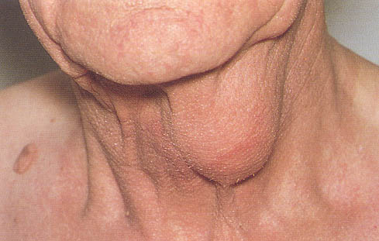
Lipoma

Slide 65
Thank You

