Slide 1
Hernia
Prepared by:
Abdullah Al Saleh
Mohammad Al mazroa
Khalid Al Qahtani
Supervised by:
Dr. Fahad Bamehriz

Slide 2
Objectives :
Definition of hernia
Surgical anatomy
Common types and presentation
Complications of hernia
Surgical treatment

Slide 3
Objectives :
Definition of hernia
Surgical anatomy
Common types and presentation
Complications of hernia
Surgical treatment

Slide 4
Definition:
Hernia is the physical displacement of tissue from one compartment into another due a pressure gradient across the opening between the chambers.
Abdominal wall hernia: protrusion of all or part of any intra abdominal structure through any congenital, acquired or iatrogenic defect.

Slide 5
Objectives :
Definition of hernia
Surgical anatomy
Common types and presentation
Complications of hernia
Surgical treatment

Slide 6
Objectives :
Defenition of hernia
Surgical anatomy
Common types and presentation
Complications of hernia
Surgical treatment

Slide 7
Surgical anatomy
Layers of abdominal wall:
1)skin
2)Subcutaneous Tissue:
( Superficial Camper’s fascia, Deep Scarpa’s fascia)
3) External Oblique
Rectus sheath
inguinal ligament
external spermatic fascia
external or superficial inguinal ring
4) Internal Oblique
Rectus sheath
Cremaster muscle
5) Transversus abdominus
Rectus sheath
Internal or deep inguinal ring
6) Transversalis Fascia
Internal spermatic fascia
7) Peritoneum

Slide 8
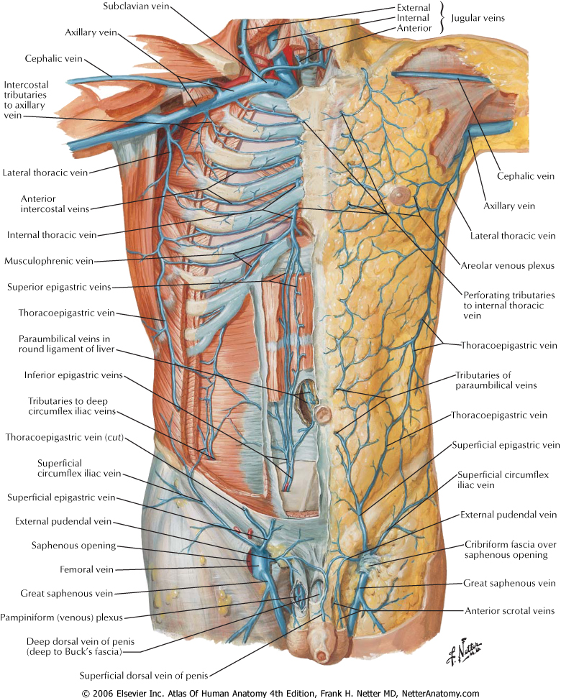

Slide 9
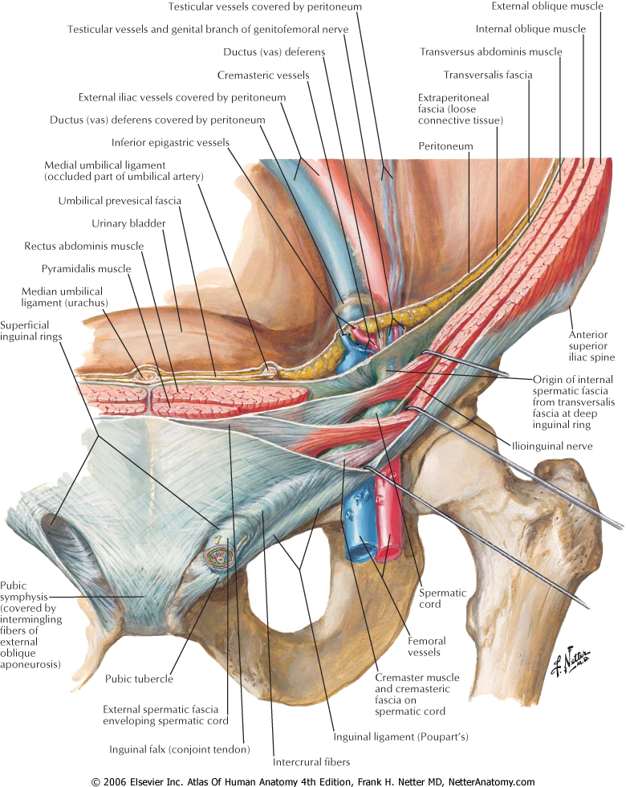

Slide 10
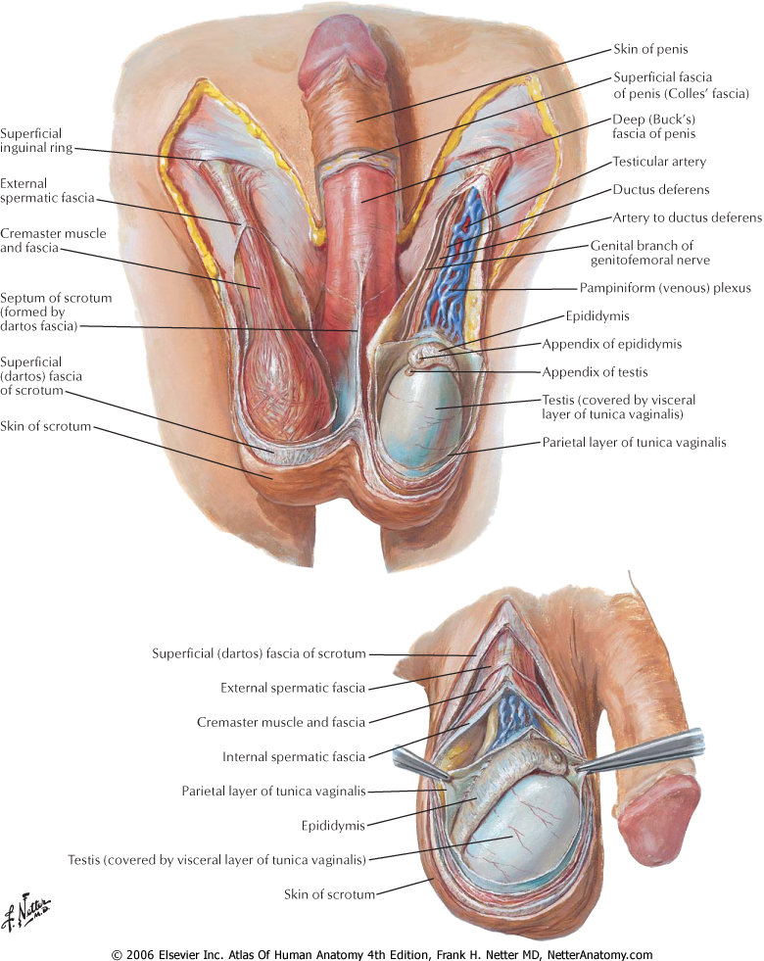

Slide 11
Cont…
Inguinal canal:
4cm long
From the deep ring to superficial ring
Above the inguinal ligament
Walls:
Anterior: aponeurosis of external oblique
Posterior wall: fascia transversalis
Inferior wall (floor): inguinal ligament
Superior wall ( roof) : lower fibers of internal oblique and transversus abdominis
Content:
Spermatic cord in male
Round ligament in the uterus in females

Slide 12
Cont…
Inguinal Triangle ( Hesselbach's triangle)
It is defined by the following structures:
Lateral margin of the rectus sheath (medially)
Inferior epigastric vessels (laterally)
Inguinal ligament (inferiorly)

Slide 13
Objectives :
Definition of hernia
Surgical anatomy
Common types and presentation
Complications of hernia
Surgical treatment

Slide 14
Objectives :
Definition of hernia
Surgical anatomy
Common types and presentation
Complications of hernia
Surgical treatment

Slide 15
Types:
There are many types of hernias like:
Inguinal Hernia
Femoral Hernia
Obturator Hernia
Umbilical Hernia
Incisional Hernia
Spigelian Hernia
Epigastric Hernia
Lumbar Hernia
Others…..

Slide 16
Inguinal Hernia
1) Indirect Inguinal Hernia:
Most common hernia in both sexes.
Congenital in origin
It occurs when bowels, omentum or any other intra abdominal organ protrudes through the deep ring within a patent processus vaginalis.

Slide 17
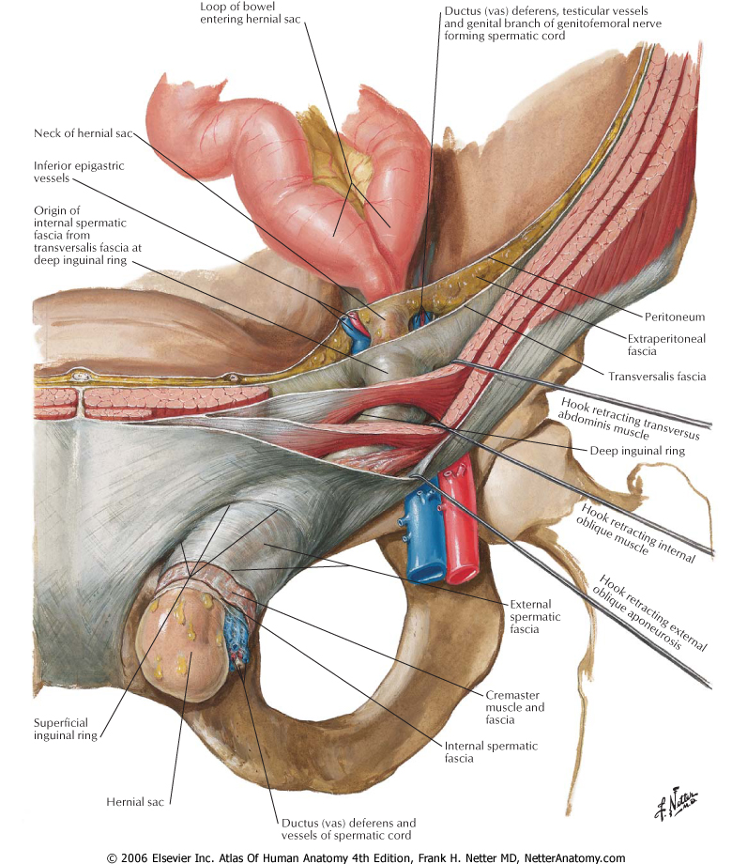

Slide 18
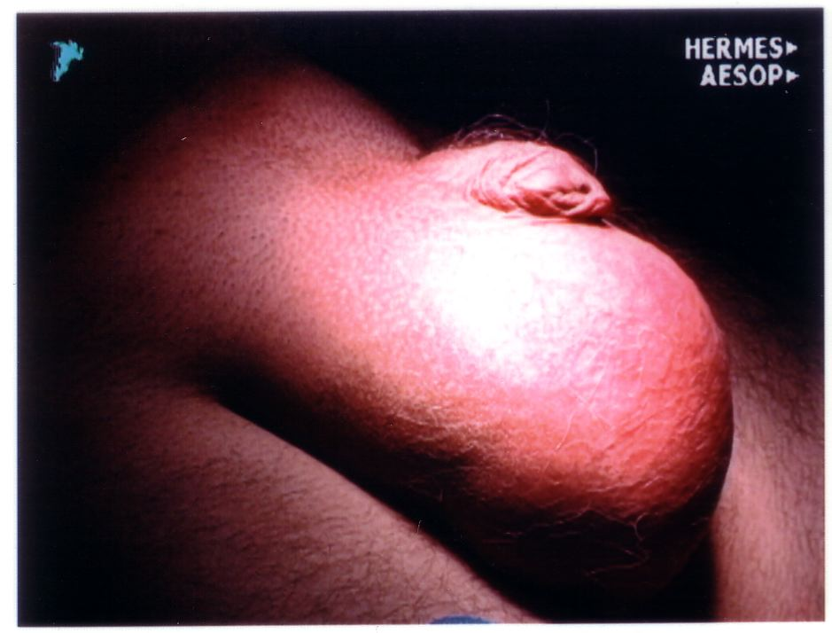

Slide 19
Cont….
History:
Patient may present with a swelling, pain ,or symptoms of complication.
Take history of the swelling (when was it noticed, how did the patient notice it?, disappearance,……)
If there is pain take history of the pain , and review GI symptoms.
Risk factors (lifting heavy object, chronic cough, constipation, previous surgery, trauma, family history…)

Slide 20
Cont….
Examination:
Standing position.
Inspection: Site, Shape, uni or bilateral.
Measure the size
inspect the skin overlying it.
inspect for peristalsis.
make the patient cough and inspect for increase in size

Slide 21
Palpation:
Change in temperature.
Tenderness.
Can you get above the swelling?
Palpate the pubic tubercule and locate the site of the swelling.
Palpate the testis.
What is the consistency?
Ask the patient to cough and feel for enlargement.
Is it reducible?
Deep ring occlusion test.

Slide 22
Percussion:
Resonant (indicate bowel)
Auscultation :
Bowel sounds?
General examination for causes…( Respiratory, GI,…)
Don’t forget to examine the other site!

Slide 23
Inguinal Hernia
2) Direct inguinal hernia:
In the (Hesselbach's triangle)
Doesn’t extend through the scrotum
Acquired lesion ( more common in older men)

Slide 24
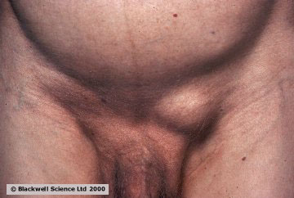

Slide 25
Cont…
Differential Diagnosis of inguinal hernia:
Femoral hernia.
Hydrocele of the cord.
Un-descended testis.
Lipoma of the cord.

Slide 26
Incisional Hernia
Can develop through any incision.
Deep wound infection is the most common cause of this hernia.
Obesity and number of prior operations may play a role.
What is the difference between incisional hernia and recurrent hernia?

Slide 27
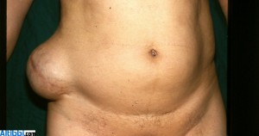

Slide 28
Epigastric Hernia
Congenital or acquired weakness of the midline linea alba
It is more common in men.
20 % are multiple.

Slide 29
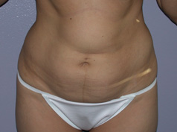

Slide 30
  Spigelian hernia
Herniation through semi lunar line.
Seen in Obese patients.
Common to have a narrow neck.

Slide 31


Slide 32
Others…
Littre’s hernia:
A groin hernia that contains Meckel’s diverticulum is called Littre’s hernia.
Richter’s hernia:
Only a portion of the bowl incarcerate or strangulate.
Symptoms of bowel obstruction is absent!

Slide 33
Cont….
Sliding hernia:
when a portion of the wall of the protruding sac is made of some intra abdominal organ…

Slide 34
Umbilical hernia
It’s hernia through the umbilical ring.
it contains mostly bowel in neonates or omentum in adults.
Among adults, it is three times more common in women than in men; among children, the ratio is roughly equal.

Slide 35

Congenital
Common in children but usually closes by the age of 2 years, < 5% persist.

Slide 36
Acquired
In adults, associated with ↑ intra-abdominal pressure e.g.
obesity, heavy lifting, a long history of coughing, or multiple pregnancies.
**Through a defect adjacent to umbilicus and NOT through the umbilcal scar itself termed “ PARA-UMBILICAL”

Slide 37
Presentation:
*Ahernia is present at the site of the umbilicus (commonly called a navel, or belly button) in the newborn; although sometimes quite large, these hernias tend to resolve without any treatment by around the age of 2-3 years.
*Obstruction and strangulation of the hernia is rare because the underlying defect in the abdominal wall is larger than in an inguinal hernia

Slide 38
FEMORAL HERNIA
Femoral hernias occur just below the inguinal ligament, when abdominal contents pass through a naturally occurring weakness called the femoral canal.
Femoral hernias are a relatively uncommon type, accounting for only 3% of all hernias. While femoral hernias can occur in both males and females, but almost all of them develop in women because of the wider bone structure of the female pelvis.
It has a narrow neck, 30%-40% of them get incarcerated or strangulated .
Risk factors:
female, prior pregnancy, prior inguinal hernia repair.

Slide 39
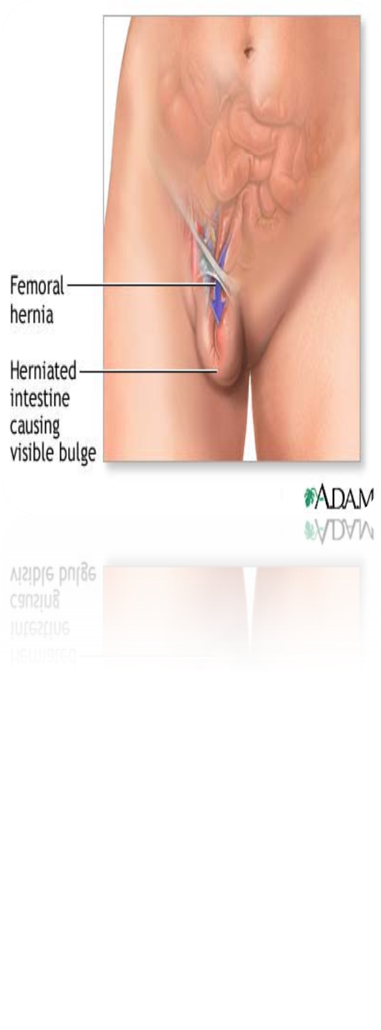
FEMORAL canal anatomy:
  Ant: inguinal ligament.
  Post: cooper’s ligament.
  Med: lacunar ligament.
  Lat: femoral vein

Slide 40
obturator hernia
An obturator hernia is a rare type of abdominal wall hernia in which abdominal content protrudes through the obturator foramen.
it is much more common in women than in men, especially multiparous and older women who have recently lost a lot of weight.

Slide 41
presentation
Usual presentation is small bowel obstruction of unknown cause.
May compress the obturator nerve and cause pain or paresthesia in the medial thigh
DX:
The diagnosis is often made intraoperatively after presenting with bowel obstruction
C.T scan
The Howship-Romberg sign is suggestive of an obturator hernia, exacerbated by thigh extension, medial rotation and abduction.

Slide 42
Lumbar Hernia
  In the lumbar region, in the form of a broad bulging hernia, that are not vulnerable to incarceration.
Petit’s hernia: in the inferior lumbar triangle.
Grynfeltt’s Hernia: in the superior lumbar triangle and is less common than Petit’s.

Slide 43
Objectives :
Defenition of hernia
Surgical anatomy
Common types and presentation
Complications of hernia
Surgical treatment

Slide 44
Objectives :
Defenition of hernia
Surgical anatomy
Common types and presentation
Complications of hernia
Surgical treatment

Slide 45
Complication
Strangulation
Obstruction
Incarceration

Slide 46
Reducible:
hernial contents can be pushed back into their usual anatomical site in the abdomen.
Incarcerated:
(imprisoned) hernial contents can NOT be pushed back = irreducible.
Strangulated:
(choked) the tissue contained in the hernia is ischemic and necrosed due to to compromise of its blood supply.
Obstructing:
the hernia contains a loop of bowel that is kinked and obstructs the GI tract.
Obstruction is Independent to strangulation.

Slide 47
Incarceration
In case of incarcerated hernia:
  Cannot be reduced (either spontaneously or manually) .
  Painful enlargement of a previous hernia.
  Nausea, vomiting, and symptoms of bowel obstruction (possible).
An incarcerated hernia could be strangulated, obstructed or both or NONE
Every strangulated or obstructed should be incarcerated
  Reduce it by analgesia, squeeze it by 2 hands to relief edema

Slide 48
Strangulation
In case of strangulated hernia:.
  Symptoms of an incarcerated hernia present combined with a toxic appearance.
  Strangulation is probable if pain and tenderness of an incarcerated hernia persist after reduction.

Slide 49
Con’t
For strangulated hernias, start broad-spectrum antibiotics. Antibiotics are administered routinely if ischemic bowel is suspected.
Correction of volume status and electrolyte abnormalities.
If the pt have strangulated hernia take him to the OR

Slide 50
Obstruction
If the pt have obstruction treat him conservatively NPO for 24 hrs
If it did not get relived take him to the OR

Slide 51
Cont…
Direct hernia have wide neck SO it has less complication than the indirect, because indirect have narrow neck.
Femoral hernia is characterized by a narrow neck.

Slide 52
Objectives :
Defenition of hernia
Surgical anatomy
Common types and presentation
Complications of hernia
Surgical treatment

Slide 53
Objectives :
Defenition of hernia
Surgical anatomy
Common types and presentation
Complications of hernia
Surgical treatment

Slide 54
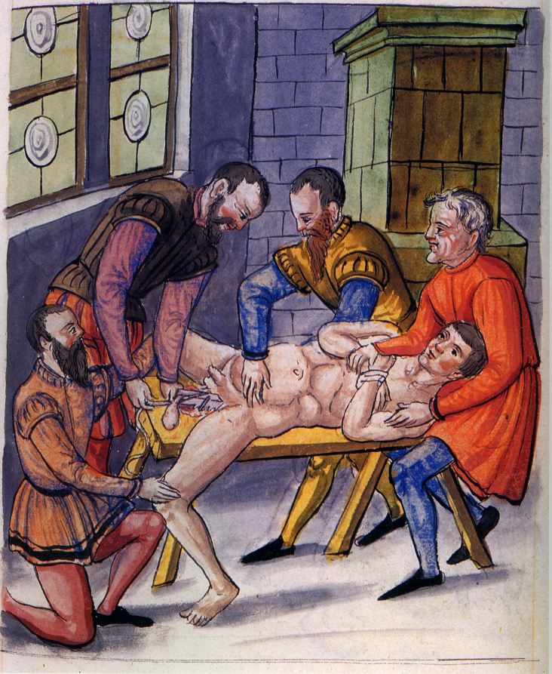
Surgical treatment

Slide 55
ALL patients with hernia should be treated surgically.
Types of treatment:
Herniorrhaphy:
treat it by human tissue u don’t need to interfere with the hernia.
Hernioplasty :
usually using foreign body to repair the hernia.
Herniotomy:
this is only for the children b/c there are growing .

Slide 56
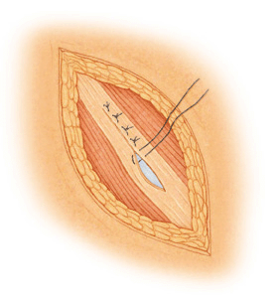
Surgical treatment
1.Herniorraphy: apposition and suturing of the edges of the defect. Tension repair(sutures)
Bassini
McVay
Shouldice

Slide 57
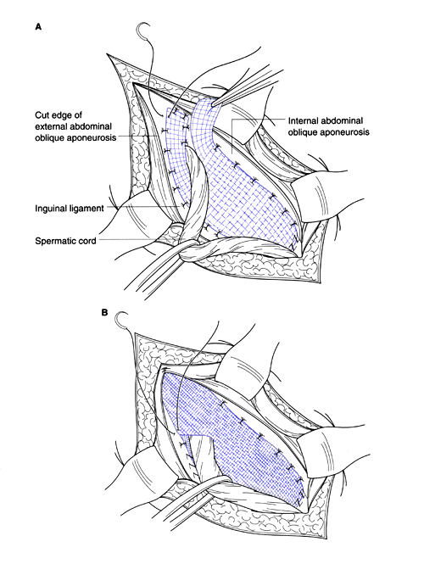
Surgical treatment
2. Hernioplasty: reinforced repair of the posterior inguinal canal wall with heterogeneous (like steel or prolene mesh) material (tension free)
Lichtenstein
Plug & patch

Slide 58
Surgical treatment
3.Herniotomy: An operation in which the hernia sac is removed without any repair of the inguinal canal (used for congenital hernia; indirect inguinal hernia).

Slide 59
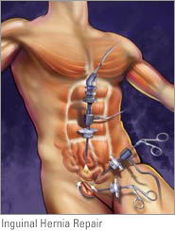
Surgical treatment
Laparoscopic repair, e.g. TAPP (transabdominal preperitoneal), TEP (total extra peritoneal)

Slide 60
Indications for laparoscopic repair
Bilateral hernias.
Recurring hernias.
Need to resume full activity as soon as possible.
Nowadays laproscopic more than Open.

Slide 61
THANK YOU

