Slide 1
Right Lower Quadrant pain & Masses
Presented By:
Aeed Saad
Mohmmad Hassan
Abdulrahman AlGhamdi
Supervised By:
Dr. Ahmad Zubaidi

Slide 2
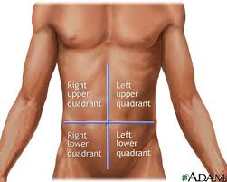
Anatomy
The RLQ extends from the median plane to the right of the patient, and from the umbilical plane to the right inguinal ligament.

Slide 3
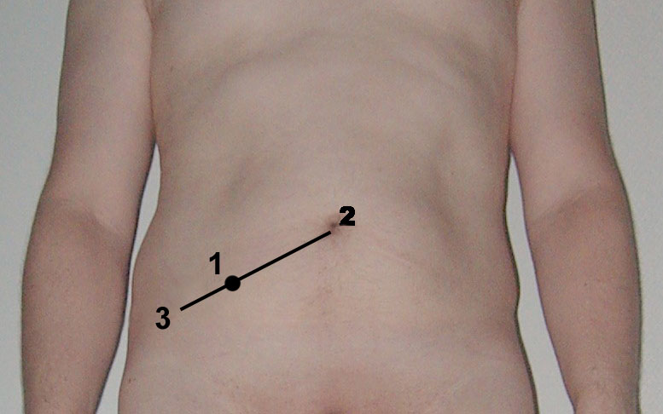
RLQ Anatomy
Impotant organs of the RLQ:
Cecum
Appendix
Ascending Colon
Right ovary and Fallopian tube
Right ureter
Mcburney’s point

Slide 4
Approach to RLQ pain History
The most common presenting symptom is pain.
Pain:
Site – nature – radiation – onset - frequency – aggravating and relieving factors – severity – associated symptoms
Nausea, vomiting, and anorexia.
Bowel habits:
diarrhea – constipations – flatus - change in stool color
Urinary symptoms.
Gynecological symptoms.

Slide 5
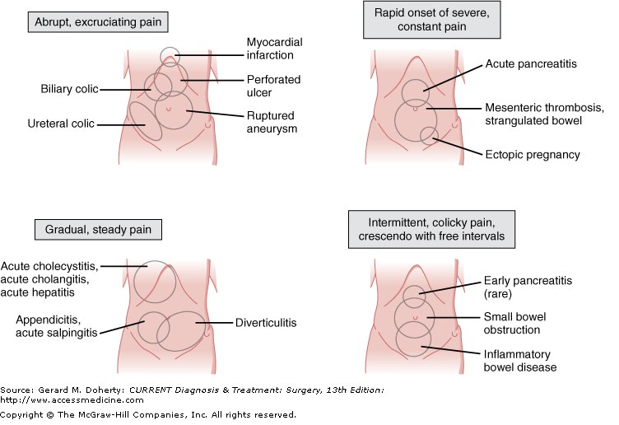

Slide 6
Approach to RLQ pain Examination
General Examination
Vital sign
Local Examination
Inspection
Palpation
Percussion
Auscultation

Slide 7
Approach to RLQ pain Investigation
Lab tests:
CBC
Arterial blood gases
U&E
LFT
Urine dip stick
Radiological invest.:
abdominal x-ray
Ultrasound
CT scan
MRI
laprotomy

Slide 8
Differential Diagnosis of RLQ pain & masses
Appendicitis
Crohn’s disease
Meckel’s Diverticulum
Gyne dis. (ectopic pregnancy, PID, Ovarian torsion)
malignancy
Appendicular mass
Appendicular abscess
Tuberculosis
Psoas abscess
Urological differntial
others

Slide 9
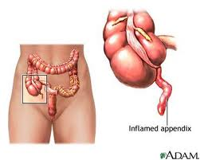
Appendicitis

Slide 10
Appendicitis
Epidemiology:
Appendicitis is one of the more common surgical emergencies, and it is one of the most common causes of abdominal pain.
Appendicitis occurs in 7% of the US population, with an incidence of 1.1 cases per 1000 people per year.
Risk of perforation:
➔ 25% in first 24 hrs.
➔ 50% by 36 hrs.
➔ 75% by 48 hrs.

Slide 11
Appendicitis
Etiology:
Obstruction of the appendiceal lumen :
Lymphoid hyperplasia secondary to inflammatory bowel disease (IBD) or infections (more common during childhood and in young adults).
Fecal stasis and fecaliths (more common in elderly patients).
Parasites (especially in Eastern countries).
Foreign bodies and neoplasms.

Slide 12
Appendicitis
Pathophysiology :
Obstriction >> continuous secretion of fluids and mucus from the mucosa and the stagnation of this material >> bacterial infection >> recruitment of white blood cells >> inflammation and pus formation .
Persistent obstruction >> Increase intralumenal pressure >> venous outflow obstruction >> appendiceal wall ischemia >> thrombosis of the appendicular artery and veins >> perforation and gangrene .

Slide 13
Appendicitis
Clinical features:
The most common symptom of appendicitis is abdominal pain.
Typically, pain begins as periumbilical or epigastric migrating to the right lower quadrant (RLQ) of the abdomen.
Later, a worsening progressive pain along with vomiting, nausea , and anorexia are described by the patient.
Irritative voiding symptoms and hematuria or pyuria .

Slide 14
Appendicitis
Physical Examination
Rebound tenderness in RLQ.

Slide 15
Cont.
Examination :
Investigations:
Low grade fever.
Guarding, rebound tenderness.
Signs:
Dunphy’s sign
Rovsing sign
Obturator sign
Psoas sign
Lab tests:
Leukucytosis
Mild Pyuria (not severe>UTI)
Radiology:
X-ray: may show calcified fecalith
US: help rule out other pathologies.
CT: Golden standard.

Slide 16
Cont.
Treatment:
Preoperative IV fluids and antibiotics
In nonperforated:
Prompt appendectomy, 24 hours of antibiotics, discharge on next day.
In perforated:
IV fluid resuscitation, prompt appendectomy, drain the pus with 3-7 postoperative antibiotics.
In appendiceal abcess:
Percutaneous drainage and antibiotic adminstration, and elective appendectomy 6 weeks later

Slide 17
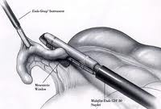
Cont.
If normal appendix is found upon exploration you should remove it anyway. (ex: in crohn’s)
Appendicitis and pregnancy:
If appendicitis develops in a pregnant woman, an appendectomy is usually performed and should not harm the fetus. The risk of fetal death in the perioperative period after an appendectomy for early acute appendicitis is 3% to 5%. The risk of fetal death is 20% in perforated appendicitis.

Slide 18
Crohn’s disease

Slide 19
Crohn’s disease
Crohn's disease is an inflammatory disease of the intestines that may affect any part of the gastrointestinal tract from mouth to anus, causing a wide variety of symptoms.

Slide 20
Crohn’s disease
Pathology
**Macroscopically:
Crohn's disease produces a cobblestone appearance,these can extend through all coats of the bowel wall.
**Microscopically:
- may show mucosal inflammation, characterized by focal infiltration of neutrophils, a type of inflammatory cell, into the epithelium. And non-caseating granulomas in 50% of cases

Slide 21
Clinical features:
* Inflammatory:
Fever.
Malaise.
Abdominal and Diarrhea usually the initial symptoms. (usually the diarrhea without blood).
Weight loss
Children and adolescents may have failure to thrive or have retarded growth.
Rectal bleeding is rare except in Chron's colitis.

Slide 22
*Fistulizing features:
Para-enteric abscess formation often with a tender abdominal mass
Fistula formation(ileocolic, ileoileal,ileocutaneous)
Rarely free perforation with features of peritonitis.

Slide 23
*Stenosing features:
1- Colicky abdominal pain.
2- Weight loss due to poor food intake(food fear)
3- Palpable or visible distended small bowel loops.

Slide 24
*Extraintestinal manifestations of crohn's disease:
Clubbing & Erythema nodosum
Pyoderma gangrenosum
Oral ulcers
Erythema nodosum
Iritis
Large joint arthritis
Seronegative spondyloarthropathy(sacroiliitis, ankylosing spondylitis)
Sclerosing cholangitis
Renal stones

Slide 25
Investigations:
Lab :
*Blood: CBC,ESR,CRP,U&E,LFT,Blood culture.
- Serum iron,B12,Red cell folate if anemia.
*Laboratory Findings
- Luekocytosis and increased sedimentation rate occur during the acute inflammatory phase.
- Hypochromic, microcytic anemia due to chronic blood loss.
- Occult blood in stool due to intestinal mucosal bleeding
- Decreased serum albumin and total protein due to loss of protein from the intestinal mucosa and to impaired dietary intake.
- Increased alkaline phosphatase, serum glutamic-oxaloacetic transminase (SGOT) (AST {aspartate aminotransferase}) or bilirubin due to associated liver disease.
- Increased urine oxalate and calcium oxalate renalcalculi due to increased colonic absorption of dietary oxalate

Slide 26
Radiology:
The standard diagnostic investigation is barium follow- through(or small bowel enema).
Double-contrast barium enema may be useful in assessing the extent of disease /delineate fistula formation.
Active disease produces radiological evidence of thickening, luminal narrowing and separation of loops, and is often associated with ulceration, spike-like fissures and a cobblestone appearance

Slide 27
Endoscopy
- A colonoscopy is the best test for diagnosing Crohn’s disease since it allows straight visualization of the colon and the terminal ileum, recognizing the pattern of the disease participation

Slide 28
*Complications of Chron’s Disease:
Anal fistula/ abscess
Stricture
Perforation
Toxic megacolon
Obstruction

Slide 29
Treatment
Surgical Management:
Surgery does not cure Crohn's disease, but corrects an immediate problem that cannot be resolved using medication.
Almost 75% of patients with crohn's disease require surgery at some stage.
Surgery may have a role in the acute management of abscess or perforation, and in the chronic situation.
Stricturoplasty
Radical surgery is CONTRAINDICATED.
Proctocolectomy and ileostomy.

Slide 30
INDICATIONS FOR SURGERY IN CROHN'S DISEASE:
Emergency
Fulminant colitis or acute small bowel relapse unresponsive to medical management
Acute bowel obstruction.
Life threatening haemorrhage.
Abcess or free perforation.
Perianal abscess.

Slide 31
Elective
Chronic subacute obstruction due to fibrotic strictures, adhesions or refractory disease.
Symptomatic disease unresponsive to or poorly controlled by medical management.
Chronic relapsing disease on discontinuation of medical management and steroid dependency.
Complications of medical management (e.g.osteoporosis).
Concerns about long-term Immunosuppression, risk of malignancy and viral/atypical infections.

Slide 32
Perianal sepsis and fistula
Enterocutaneous fistula
Onset of malignancy, including colorectal adenocarcinoma and small bowel lymphoma.

Slide 33
Meckle’s Diverticulum

Slide 34
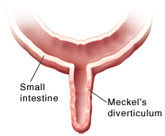
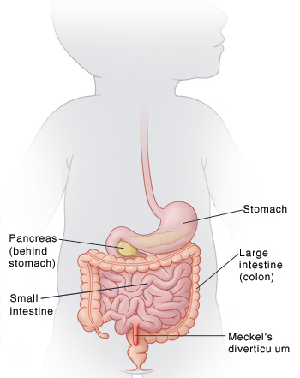
Meckle’s Diverticulum
A remnant of the vitellintestinal duct of the embryo
The most common congenital abnormality of the gastrointestinal tract.
The diverticulum is around 5 cm long .
Arises from the antimesenteric border of the ileum some 50 cm from the ileocaecal valve.
It is a true diverticulum.
Usually symptomless, but may present with rectal bleeding or have the same clinical picture as appendicitis.

Slide 35
Cont.
Complications: small bowel volvulus, intussusception and perforation.
Treatment: asymptomatic adults surgery is not indicated. Wedge resection of divericulum in symptomatic patients or under 18 yrs of age
Asymptomatic diverticula found incidentally at laparotomy should be left alone, unless the neck is narrow or nodularity suggests that the diverticulum contains abnormal mucosa
Rule of 2:occurs in 2% of population, 2% symptomatic, 2 feet away from the ileocecal valve, 2 inches in length, 2 types of mucosa(gastric and pancreatic), 2 times more common in male and 2 presentations bleeding and obstruction.
Diagnosis: made by the aid of 99m technetium scan.

Slide 36
Gynecological
Differential

Slide 37
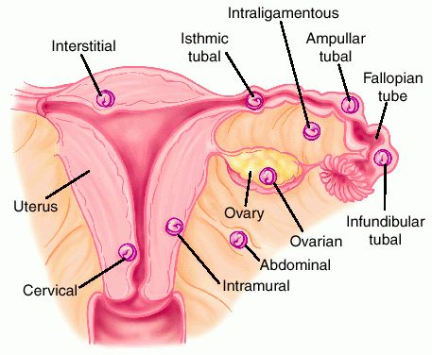
Ectopic Pregnancy
a complication of pregnancy, in which the pregnancy implants outside the uterine cavity. Most commonly the fallopian tube.

Slide 38
Symptoms
Investigations
Pain in the lower abdomen.
Vaginal bleeding, usually mild.
Pregnancy test→ positive
Urinary B-HCG test→ fast
blood B-HCG→ accurate
Ultrasound→ show a gestational sac in the ectopic location

Slide 39
Treatment
Medical→ Methotrexate
Surgical :
If hemorrhage has already occurred, surgical intervention may be necessary. However, whether to pursue surgical intervention is an often difficult decision in a stable patient with minimal evidence of blood clot on ultrasound.
Surgeons use laparoscopy or laparotomy to gain access to the pelvis and can either incise the affected Fallopian and remove only the pregnancy (salpingostomy) or remove the affected tube with the pregnancy (salpingectomy).

Slide 40
Complications
Rupture→ internal bleeding→shock
Infertility in 10-15% of women

Slide 41
Pelvic Inflammatory Disease

Slide 42
PID
It is acute salpingitis in one or both of the fallopian tubes, but it is often associated with infection of the surrounding tissue. Commonly in married women (15-45yrs)
The most common organism is gonococcus and streptcoccus

Slide 43
Symptoms
Purulent, yellow white vaginal discharge.
Lower abdominal pain
History of irregular menses and dymenorrhea.
Fever
Sweating and rigors

Slide 44
Examination
Flushed and feverish looking
Tenderness and guarding
Percussion and auscultation usually normal.
Vaginal examination, discharge
Bimanual palpation will cause pain and a mass will be present if there is an abscess

Slide 45
Investugations:
Treatment:
CBC → leucocytosis
Blood culture
Swab of vaginal discharge and send for culture
Antibiotic therapy → cefotoxin(2 g IV q 6hrs) and doxycycline (100 mg PO or IV q 12 hrs)

Slide 46
Ovarian Torsion

Slide 47
Changes in normal ovaries to congenital and developmental abnormalities or even a disease that affects the tube or ovary.
Normal ovaries that experience spasms or changes in the blood vessels in the mesosalpinx can become twisted.
Developmental abnormalities of the fallopian tube such as extremely longer-than-normal tubes.
Diseases such as ovarian cysts or fibromas.
Tumor of the ovary or tubes.
Trauma

Slide 48
Symptoms
Examination
fever, tenderness, unilateral adenxal mass may be palpable upon pelvic exam.
Investigations:
B-HCG (-ve)
Ultrasound
Diagnostic Laproscopy
Sudden onset of severe lower abdominal pain, may radiate to the back
N & V
60% in the right side

Slide 49
Management:
The key to successful treatment is early diagnosis to prevent infarction of the ovary
Surgical:
Salpingo-oophorectomy
untwist the pedicle
perform cystectomy if the cause is ovarian cyst.
stabilize the ovary

Slide 50
Malignancy

Slide 51
Tumor of the Appendix
Benign Tumor of the appendix
Carcinoid tumors:
Around 80% of all appendiceal tumors.
Treatment:
Appendicectomy: Sufficient for most appendiceal carcinoid tumors.
Right Hemicolectomy:
(1)Tumor is larger than 2 cm.
(2)Involves the cecum.
(3)Lymph nodes are affected.

Slide 52
Adenocarcinoma
An uncommon but highly malignant neoplasm.
The clinical presentation may mimic acute appendicitis or appendix mass.
Treatment:
Right hemicolectomy is the treatment of choice.
Often affects younger patients.
May be associated with hereditary non-polyposis colorectal cancer(HNPCC)

Slide 53
Cystadenoma
Mucin-secreting cystadenoma is important because, if ruptured, it may lead to pseudomyxoma peritonei.

Slide 54
Other DDx :
Renal stone
pyelonephritis
urinary retention
Pancreatitis
Mesenteric lymphadenitis
Gastroenteritis
Constipation
Cholecystitis
diverticulitis

Slide 55
THANK U

