Slide 1
Jaundice
Mohammed Al- Rajeh & Shreef Al- Qahtani .

Slide 2
Anatomy of Biliary Tract

Slide 4
Conditions of the gallbladder & billiary tree
Colelithiasis :
Stones in the gallbladder ( 85% cholesterol, 15% pigmented).
Male : Female ratio (1:2 ).
INCIDENCE: 10%
Signs & Symptoms :
Asymptomatic
RUQ pain, tend to worse after eating ± nausea vomiting , biliary colic, resolves over few hours.

Slide 5
risk factors :
Family history.
Genetic factors. Native Americans and Hispanics.
Obesity.
Excess alcohol consumption
Oral contraceptives.
High fat, low fiber diet.
Rapid weight loss.
Hemolytic disorders (sickle cell anemia, hereditary spherocytosis).
Liver cirrhosis.
Diabetes.
Female gender.
Inflammatory bowel disease such as crohns.

Slide 6
DIAGNOSIS
Incidental
Abdominal films pick up to 15%
US. (procedure of choice) ;classic findings ?
TREATMENT
Asymptomatic ; does not require cholecystectomy
Symptomatic requires cholecystectomy .
Medical treatment : ursodeoxycholic acid.

Slide 7
Cholelithiasis. Ultrasound image obtained with a 4-MHz transducer demonstrates a stone in the gallbladder neck with typical acoustic shadow.

Slide 8
Complications
Infection or Rupture
obstructive jaundice.
Gall bladder cancer.
Small bowel obstruction .( gallstone ileus)
PROGNOSIS:
Most have no symptoms.
For those who do, the disorder is curable with surgery. About 10 to 15% of people with gall bladder stones will have associated choledocolithiasis .Also, after cholecystectomy, stones may recur in the bile duct.

Slide 9
Acute Cholecystitis
Inflammation of the gallbladder wall, due to obstruction of cystic duct by gallstone.
Sings & Symptoms :
RUQ tenderness, nausea, vomiting, anorexia, fever.
Murphy’s sign vs sonographic Murphy’s sign.
Mass (in 1/3 of patients) .

Slide 10
Labs :
Leukocytosis.
↑ ALP, LFTs, Amylase & total bilirubin.
Ultrasound : findings ?
HIDA scan.
Treatment :
NPO.
IV fluids , Antibiotics, analgesia.
Cholecystectomy.

Slide 11
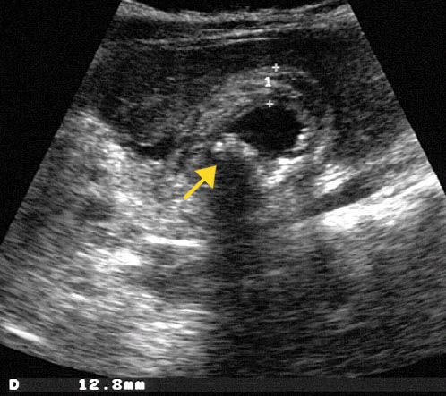

Slide 12
Choledocholithiasis
Stones in the CBD.
Signs & symptoms :
Epigastric or RUQ pain, jaundice (Charcot’s triad).
Diagnosis :
Labs : ↑ ALP, LFTs, Amylase & total bilirubin.
ERCP : gold standard
Treatment
ERCP: with sphincterotomy
If ERCP fails; CBD can be opened surgically.

Slide 13
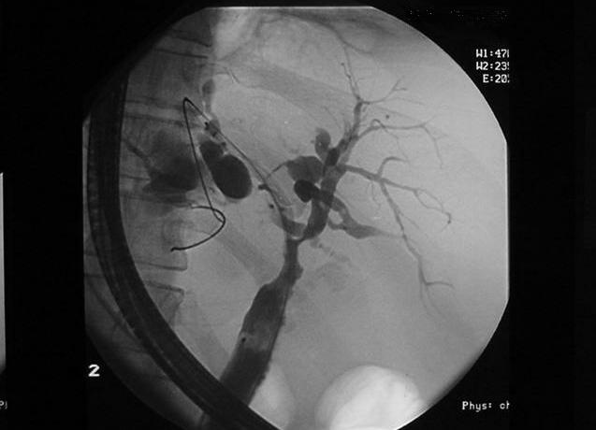
ERCP , shows a dilated irregular common bile duct with multiple irregular filling defects.

Slide 14
Carcinoma of the pancreas

Slide 15
Adenocarcinoma ( 2/3 occurs in the head).
Risk Factors :
Male gender, old age .
Tobacco use .
Diabetes .
Alcohol .
Chronic pancreatitis.

Slide 16
Signs & Symptoms:
Wt. loss
Jaundice (due to obstruction)
Epigastric pain (worsen in supine position & relived by lining forward, radiates to back).
Diagnosis:
↑ CEA (carcino-emberyonic antigen) or CA19-9 .
Ct scan (study of choice).
PTC and ERCP

Slide 17
Treatment :
Head : Whipple procedure .
(Most are not resectable at the time of Dx).
Body/ Tail : Distal “near-total” panceatectomy.
If unresectable : Palliative therapy.
Postop. Chemotherapy: contraversial.

Slide 18
Chiledocal cysts
Cystic dilatations of the extrahepatic biliary tree, intrahepatic biliary or both.
Congenital .
More frequent in females (4:1 female:male ratio).
Late teens or early 20s.
Pain, jaundice, upper abdominal mass (classic triad).
20% risk of cancer if not removed.
Typical scenario :
22 years old female, RUQ pain, jaundice
Imaging studies: ( US, ERCP, MRCP
Extra hepatic ductal dilation w/o any cause of obstruction.

Slide 19
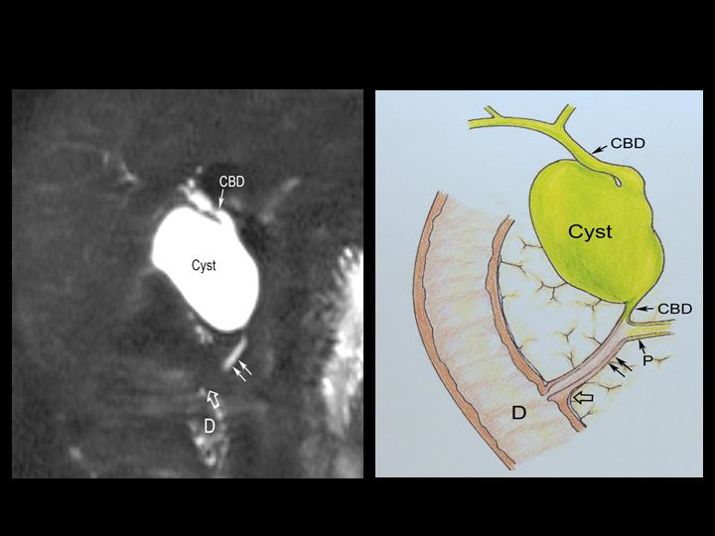

Slide 20
Initial step should be to rule out metastatic disease.
Treatment : Surgical Excision.
- Cyst excision and cholecystectomy.
- Bile duct is reconstructed: hepaticojejunostomy, hepaticoduodenostomy .
* Most commonly used technique:
Roux-en-Y hepaticojejunostomy.

