Slide 1
Presentation and management of skin lesions

Slide 2
General points in presentation
Skin tumors are the most common body tumors .
Most skin lesions presented by patients are benign; however, some concern has caused the patient to make an inquiry, and a correct diagnosis is important.

Slide 3
Presentation
Benign
Malignant
Premalignant

Slide 4
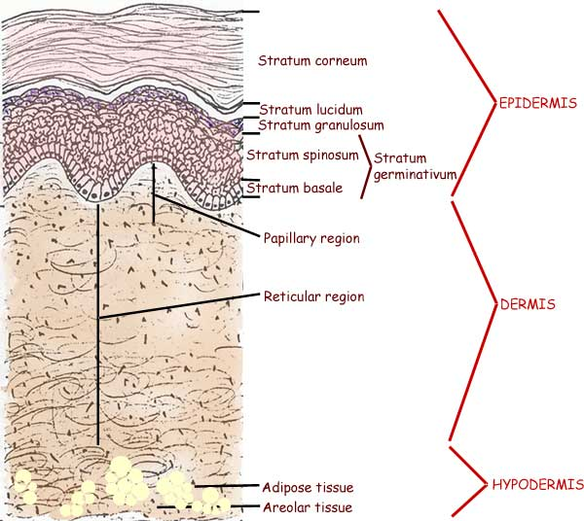
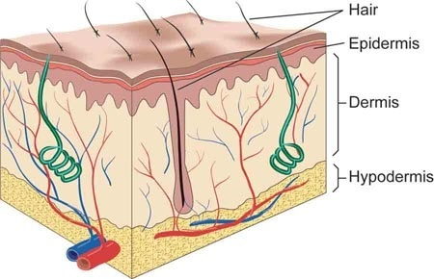

Slide 5
Morphology
Cysts
Ulcers
Histology
Epidermis
Dermis
Lumps
Macule
Pigmented lesions
Subcutaneous
Skin appendages
Vascular
Melanotic

Slide 6
General points in the management of skin lesions
Simple excision for straight forward clinically diagnosed ones e.g. skin tag
Excision biopsy to exclude malignancy
Incisional one for unhealed ulcer or to exclude malignancy or vasculitis
Wide excision with or without grafting
Others like radiotherapy , curettage , freezing & etc.

Slide 7
Lesions derived from EPIDERMIS
Benign :
Skin tags, (papillomas).
Warts.
Seborrhoeic (senile) keratosis.
Kerato-acanthoma.
Premalignant :
Solar keratosis.
Bowen’s disease.
Erythroplasia of Queyrat.
Malignant :
SCC, BCC

Slide 8
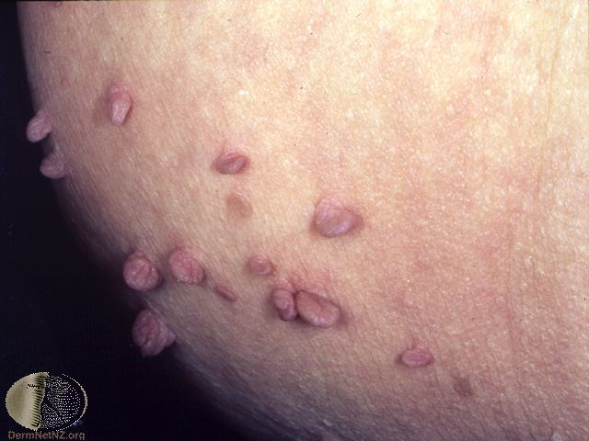
Skin tags
Small benign polypoid lesions consist of loose connective tissue covered by normal excessively pigmented keratinized epithelium. Common in adults, occur on any part of the body particularly the trunk, neck, axillae and groins.
We treat it by cautery or excision under local anesthesia, or by tying a fine thread around the stalk.

Slide 9
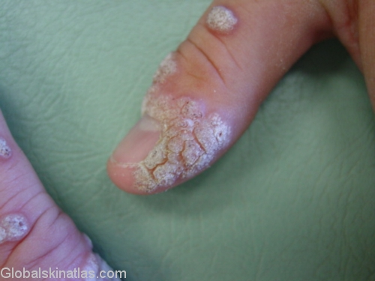
Warts
Small, papovavirus induced epidermal tumors. Irregular thickening of the epidermis, excessive keratinisation, exaggerated dermal papillae. Common wart (verruca vulgaris), common on fingers. Juvenile wart (verruca plana juvenilis), multiple lesions common in face less keratotic in children. Plantar warts (verruca plantaris), on the foot sole. Condylomata accuminata, genital large warts.
Treatment by keratolytic applications (salicylic acid) , Cryosurgery (liquid nitrogen application)
IF UNSUCCESSFUL; Electrocautery with or without curettage .

Slide 10
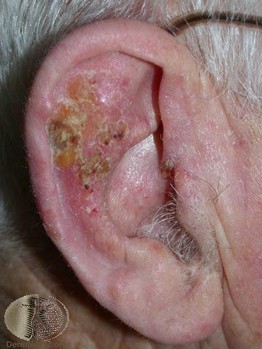
Solar keratosis
Flat well demarcated brown scaly or crusty lesion with an erythematous base. Common in middle aged and elderly. Common on face neck arms and hands(sun exposed parts)
It is premalignant condition which predispose to SCC.

Slide 11
Treatment is by :
Isolated lesion >>> excised.
Multiple keratosis >>> excision biopsy curettage or cryocautery of suspicious lesion.
Minimize ultraviolet rays exposure. Regularly examination for SCC, BCC and melanoma
Multiple lesions can be treated with topical 5-fluorouracil (5-FU). Occasionally, a relatively depigmented spot may remain after topical treatment.

Slide 12
Bowen’s Disease
Intraepidermal squamous , Carcinoma in situ . Scaly, crusted, erythematous plaques occurs in 4th to the 6th decade it may be associated with other skin and internal malignancies.
Squamous cell carcinoma from Bowen disease tends to be more aggressive. Bowen’s disease Is called Erythroplasia of Queyrat if occurring on the penis glans.

Slide 13
BCC
Basal cell carcinoma is the most common human malignancy. Although this lesion can be significantly invasive and locally destructive, distant metastases are uncommon. Most of these lesions are located on the face ‘is above the line drawn from the angle of the mouth to the lobe of the ear ‘ and scalp, with the nose, cheek, and periorbital regions the most common sites. Basal cell carcinoma rarely is found on the lip or hand .
There are different types of it nodular is the most common one .
The differential is seborrhoeic keratoses or M. melanoma .

Slide 14
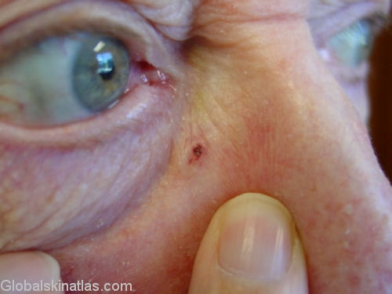
Small lesions >>> radiotherapy, cryotherapy or curettage.
Isolated or suspicious lesions >>> excision biopsy.
Large destructive lesion >>> reconstructive plastic surgery and skin grafting.
The cure rates for this treatment modality reportedly are 90-98%. Recurrence rates of 50% are reported for tumors wider than 3 cm.

Slide 15
SCC
Squamous cell carcinoma (SCC) is currently the second most common type of nonmelanoma skin cancer. Unlike most BCCs, SCCs of the skin are associated with a risk of metastasis. Occur in SSE of the mouth, tongue, esophagus, anal canal, glans penis or uterine cervix. Metaplastic epithelium in bronchus or bladder.
Typical SCC manifests as a painless skin lesion on a sun-exposed region of the body & diagnosed by biopsy and must extend to the level of the mid dermis in order to establish the level of invasion. Depending on the lesion, the physician may elect to obtain additional studies to exclude metastasis .

Slide 16
Staging:
Stage 0 - Tis/N0/M0
Stage I - T1/N0/M0
Stage II - T2/N0/M0
Stage III - T3/N0/M0, T1/N1/M0, T2/N1/M0, or T3/N1/M0
Stage IV - T4/N0, N1/M0, any T/N2, N3/M0, any T/any N/M1
No topical treatment is available for treatment of SCC; topical treatments are for actinic keratoses. Local radiotherapy, or excision with a margin of normal tissue. Infiltrated lymph node by radiotherapy or block dissection & patient reviewed annually for 5 years after successful Tx.

Slide 17
Lesions derived from DERMIS
Benign
Pyogenic granuloma .
Fibrous histocytoma .
Keloid.
Malignant
Secondary deposits.
Kaposi sarcoma.

Slide 18
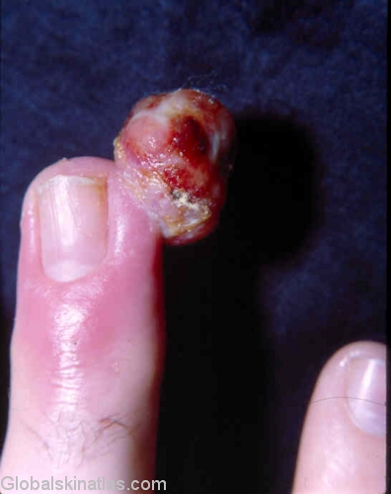
Pyogenic granuloma
Common inflammatory lesion of skin following penetration of skin, eg, splinter or thorn. Common in hand and feet. Solitary reddish blue fleshy nodules may be polypoid. The surface may be ulcerated and confusing with amelanotic malignant melanoma.
Treatment is by Should be excised and the base curetted.

Slide 19
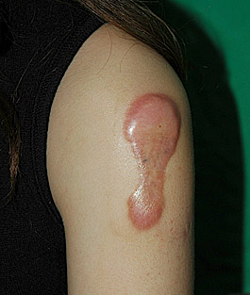
Keloid
Formed by excessive collagen deposition in the dermis during wound healing. Elevated nodular lesion covered by normal epidermis. More common in chest and neck. More in black young patients .
Treatment is by intralesional steroids , silicon gel .
Surgical excision but it’s associated with a 50-100% recurrence rate . In extreme cases, excision and local radiotherapy. Other modalities such as interferon, laser surgery, and intralesional bleomycin have also been tried with variable but not significantly convincing results.

Slide 20
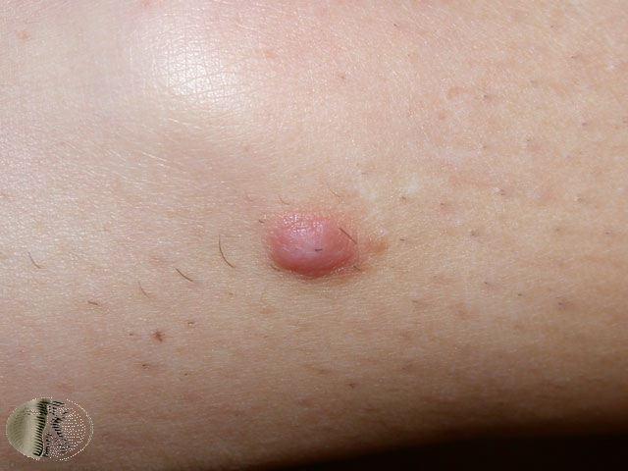
Fibrous histiocytoma
Also known as dermatofibromas firm will circumscribed nodules painless deep reddish-brown in colour. Clinically important because they may be mistaken for MM.
Treatment by excision.

Slide 21
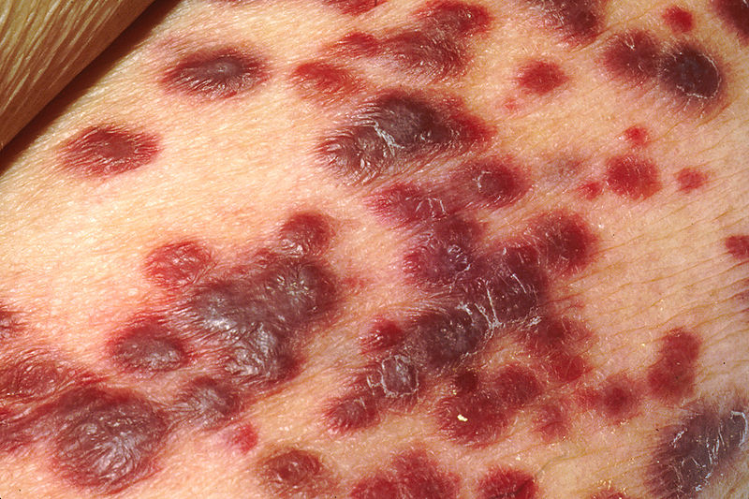
Kaposi sarcoma
Most frequent presentation of AIDS patient. Multiple blueish-red to brown nodules or plaques all of which are primary tumors. Commonly occurs on the limbs.
Treatment by excision biopsy, cytotoxic therapy or radiotherapy .

Slide 22
Metastatic carcinoma of the skin
Cutaneous metastases from carcinoma are relatively uncommon in clinical practice, but they are very important to recognize. Cutaneous metastasis may herald the diagnosis of internal malignancy. The breast, stomach, lung, uterus, large intestine, and kidneys are the most frequent organs to produce cutaneous metastases .

Slide 23
Lesions derived from HYPODERMIS
Benign :
Lipoma.
Neurofibroma.
Schwannoma.
Malignant :
Liposarcoma.
Sarcoma.

Slide 24
Lipoma
Lipomas are the most common benign subcutaneous tissue tumor it’s a soft rubbery masses that can sometimes be well-circumscribed and other times have indistinct palpable borders or lobuolated . Most often seen in the trunk and limbs , Solitary lesions are the most common, but multiple lesions can there . They are noncompressible and do not transluminate making them easily distinguishable from a fluid-filled cyst.occur, with higher frequency in young males. The overlying skin is normal.
Treatment is by excision , Small asymptomatic lipomas require no treatment & in certain cases, liposuction has been used to remove large lipomas in anatomically sensitive locations.

Slide 25
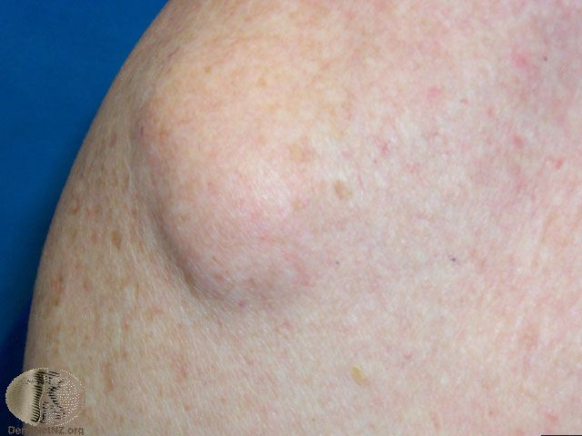

Slide 26
Neurofibroma
The most common of the peripheral nerve tumors is the benign neurofibroma, derived from an admixture of Schwann cells and perineural fibroblast proliferations. Multiple lesions are seen in persons with von Recklinghausen neurofibromatosis. May be present as solitary or pedunculated lesions. Patients may report cutaneous discoloration or disfigurement or more serious physical symptoms (eg, pain caused by neurofibromas, pathologic fractures, hypertensive headaches due to pheochromocytoma).The autosomal dominant inherited syndrome is called neurofibromatosis (Café-au-lait spots). The biopsy will confirm the diagnosis . Occasionally malignant change to neurofibrosarcoma .
Treatment, Solitary neurofibroma not associated with a syndrome is surgically excised with minimal risk of recurrence with careful excision to preserve the affected nerve, this required operating microscope.

Slide 28
Sarcoma
A soft tissue sarcoma is a form of sarcoma, a cancer, that develops in connective tissue, though the term is sometimes applied to elements of the soft tissue that are not currently considered connective tissue & it’s not associated with any known risk factors or identifiable etiology . Usually do not cause symptoms till it grow up .The biopsy will confirm the diagnosis .
Surgery is the most common treatment for soft tissue sarcomas. If possible, the doctor will remove the cancer and a safe margin of the healthy tissue around it. It is important to obtain a margin free of tumor to decrease the likelihood of local recurrence + Radio and chemotherapy .

Slide 29
Liposarcoma
Liposarcoma is a malignancy of fat cells it is the most common soft tissue sarcoma. Liposarcoma normally appears as a slowly enlarging, painless, nonulcerated submucosal mass in a middle-aged person, but some lesions grow rapidly and become ulcerated early & occur in deep soft tissues of both the limbs and the retroperitoneum . Metastases are common, especially in poorly differentiated liposarcomas. The lungs and the liver are the most common sites of metastasis.
Wide and deep surgical excision, along with local radiation and/or chemotherapy, may be necessary for high-grade lesions.

Slide 30
Melanotic Lesions
Benign:
Intradermal nevus.
Blue nevus.
Compound nevus.
Juvenile nevus.
Junctional nevus .
Malignant:
Malignant melanoma

Slide 31
Nevi
Benign melanotic lesions in general:
due to normal no of melanocyte in their normal position with excess melanin production >>>>freckle or ephelis .
due to increase in the no of melanocyte in their normal position with normal melanin production >>lentigo .
due to increase no of melanocytes in abnormal cluster producing normal or excess melanin>>>mole or pigmented navus .
Nevi Either congenital or acquired .
Both acquired and congenital melanocytic nevi hold some risk for the development of melanoma. Congenital melanocytic nevi hold the greater risk .

Slide 32
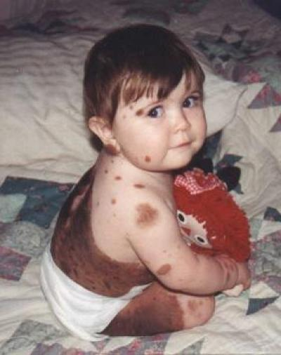
Congenital nevi
Occurs early in life it may also occur in adolescent & have high risk of developing malignant melanoma . Usually asymptomatic presented as congenital abnormality but it raise cosmetic concern to the parents , located anywhere on the body .
Etiology: one possible cause is a mutation due to external stimuli
Rx: depend on (size , location , age of the patient, effect on cosmoses ,and potential for malignant transformation. Large nevi treated by surgical excision and need tissue expander , graft and flaps .
Curettage performed during neonatal period . Laser due to it entrance to deeper tissue but it`s use still controversial .

Slide 33
Acquired nevi
Classified according to the microscopic appearance:
intradermal nevus :cluster of melanocyte accumulate in the dermis .
compound nevus: cluster of melanocyte accumulate in the dermis and epidermis .
junctional nevus: melanocyte rest at the junction between the dermis and epidermis
blue nevus: melanocyte lie deep in the dermis or subcutaneous tissue.
Acquired melanocytic nevi are considered benign neoplasm's
Risk factor:
ultraviolet irradiation, genetic factors , after blistering events, severe sunburns , It is asymptomatic . Whenever a lesion has become symptomatic (e.g., itchy, painful, irritated, or bleeding) is considered an important indicator of potential malignant change .

Slide 34
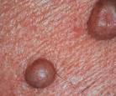
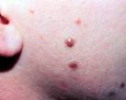
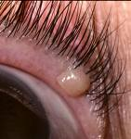
Rx:
Medical treatment : is typically ineffective and inappropriate for the management of a benign neoplasm such as a melanocytic nevus .
Surgical rx: shave excision, Punch excision for small lesions, Large lesions may require complete excision with sutured closure, simple conservative excisional biopsy with a sutured closure for lesion with suspected melanoma and send for pathologist.

Slide 35
Malignant Melanoma
A malignancy of pigment-producing cells (melanocytes) located predominantly in the skin, but also found in the eyes, ears, GI tract, leptomeninges, and oral and genital mucous membranes, it causes the greatest number of skin cancer–related deaths worldwide . Primary cutaneous melanoma may develop in precursor melanocytic nevi 60% of cases are believed to arise de novo (ie, not from a preexisting pigmented lesion).
Risk factor: ultraviolet radiation causing,fair complexion, excessive childhood sun exposure and blistering childhood sunburns, an increased number of common and dysplastic moles, a family history of melanoma, the presence of a changing mole or evolving lesion on the skin, and, , older age.
Symptoms that suggest malignancy: Asymmetry , Color variegation, reddish, or blue discoloration , a diameter greater than 6 mm .

Slide 36
Classification:
Superficial; spreading melanoma .
Nodular melanoma .
Lentigo melanoma .
Acral lentiginous .
Amlenotic .
Desmoplastic .
Staging by clark :
1st stage :Epidermis .
2nd stage:Papillary dermis .
3rd stage Junctional of paplliary and reticual dermis .
4th stage :Extend to reticular dermis .
5th stage : extend to sbcutanous.
Rx: Surgical excision with free margin and send for histology to confirm And do breslow thickness>>you may need further surgery . Involved lymph node should be removed .
Radiotherapy for palliation diagnosis .
Chemotherapy with little value.

Slide 37
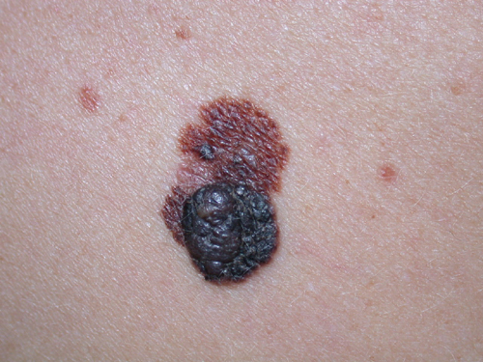

Slide 38
Lesions derived from SKIN APPENDAGES
Benign :
Furuncle.
Carbuncle.
Hidradenitis suppurativa.
Sebaceous cyst.
Dermoid cyst.
Pilonidal sinus.
Malignant :
Sebaceous carcinoma.
Sweat gland carcinoma

Slide 39
Furuncle
Is a staphylococcus abscess which develop in hair follicle in the dermis . 1st it produce pus (furncle) and then central core of necrotic tissue (boils) , could be single or multiple( furunculosis) . Occure in any part of the body but commony in the head ,neck, axilla, and grion , It may occure in healthy individual but commonly in immunocompromised,elderly, diabetic and obese patient.
Dangerous area in the face between the orbit and at the angle of the mouth which may associated with cavernous sinus thrombosis.
Multiple boils with surrounding cellulitis in diabetic where septicemia is a risk.

Slide 40
Carbuncles
A carbuncle is a cluster of boils that often occurs on the back of the neck, shoulders or thighs. Carbuncles cause a deeper in the dermis and subcutaneous tissue and more sever. Which open into skin surface through sinuses .
Risk factors for both :bacterial colonization of skin or nose, diabetes, humid climates, immunocompromised patient

Slide 41
Symptoms: painful pink- red bump that is rapidly increasing in size that develop yellow tip which finally rupture and drain .
Complication : sepsis, MRSA .
Diagnosis : clinically and culture of the discharge
Rx: drainage and may be encouraged with magnesium sulphate paste and compresses to allow it to point and drain spontaneously if single lesion
oral and topical antibiotics. These can include , flucloxacillin clindamycin, dicloxacillin, Incision and drainage are occasionally necessary if large and Abx irresponsive .

Slide 42
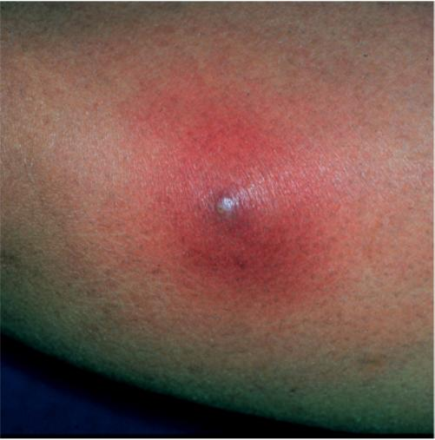
Furuncle

Slide 43
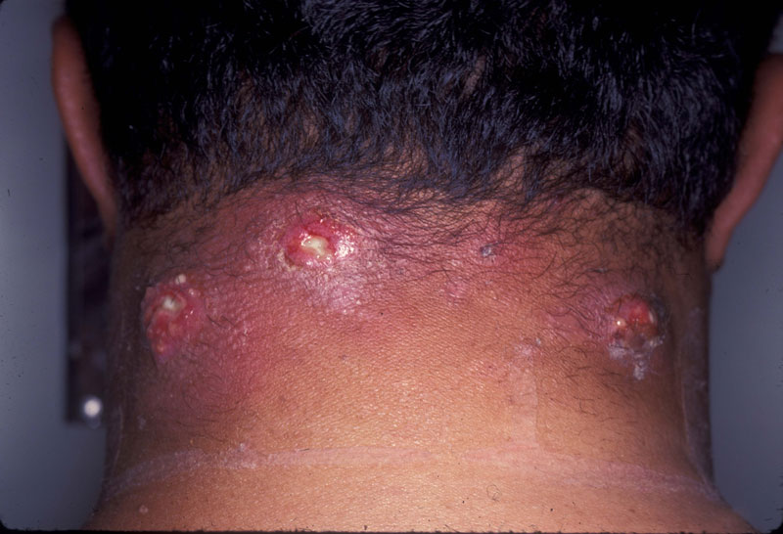
Carbuncle

Slide 44
Hidradenitis suppurativa
It is an infection of apocrine sweat gland , seen in the axilla and groin which enlarge and discharge pus .
Symptoms: One or more red, tender bumps (lesions) that fill often enlarge, break and drain pus . The drainage may have an unpleasant odor. Itching, burning and excessive sweating may accompany the bumps .
Risk factors: gender (female) ,age (puberty) ,genetic .
Complication: Sinus tracts or tunnels that connect and form a network under the skin, Scars and skin changes, Restricted movement, Cellulitis.

Slide 45
Diagnosis: hx , physical exam, culture of discharge .
Rx: Abx initially , if there is abscess incised and drain . In advance cases wide incision and grafting >> in perianal area diverting clostomy prior to skin grafting .

Slide 46
Sebaceous cyst (epidermis cyst)
Formed when the mouth of sebaceous gland is blocked and the gland is enlarged by it`s own secretion, occur in the scalp, face , neck . It need treatment when it cause cosmetic concern or rupture or become infected.
Symptom: small bumps that is slow-growing and often painless, soft and spherical .
When it infected it gives the following feature: A thick, yellow material draining from the cyst that may have a foul odor , redness, swelling and tenderness around the cyst .
Causes: Damage to a hair follicle, A ruptured sebaceous gland, Developmental defect , Heredity(Gardner's syndrome, basal cell nevus syndrome)
Complication: Inflammation, Rupture, Infection, Genital discomfort .
Diagnosis : clinically .
Rx: total excision under local anesthesia .

Slide 47
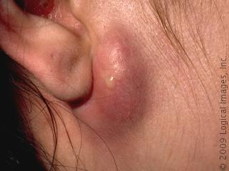

Slide 48
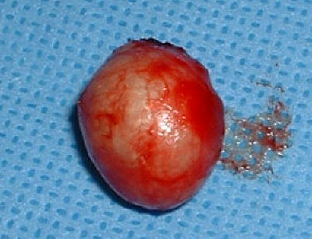
Sebaceous cyst after excision

Slide 49
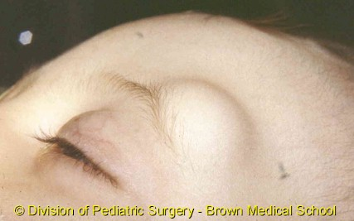
A dermoid cyst
Is a saclike growth that is contains structures such as hair, fluid, teeth, or skin glands that can be found on or in the skin, usually occur on the face, inside the skull, on the lower back, and in the ovaries.
could be :
Congenital, developed in intrauterine life
Acquired, traumatic forcibly implanted into dermis
Symptoms: cosmetic disfigurement , mechanical disability ,it become tender and painful if it acquired at the site of trauma.
Rx: surgical excision

Slide 50
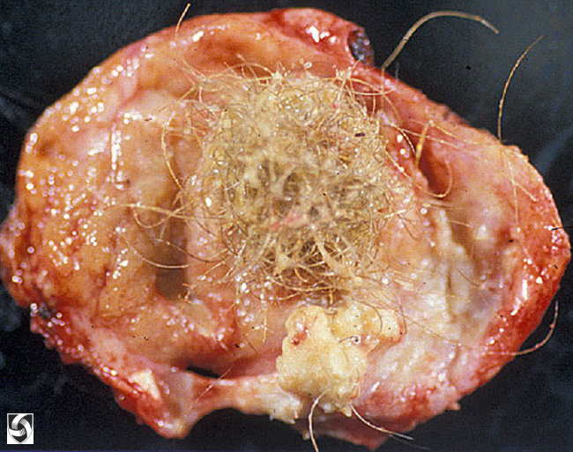
dermoid cyst after excision

Slide 51
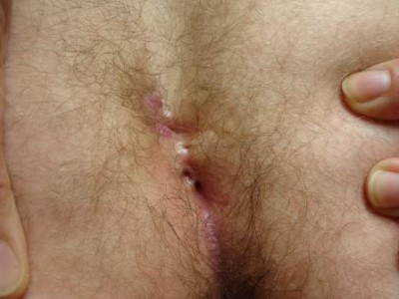
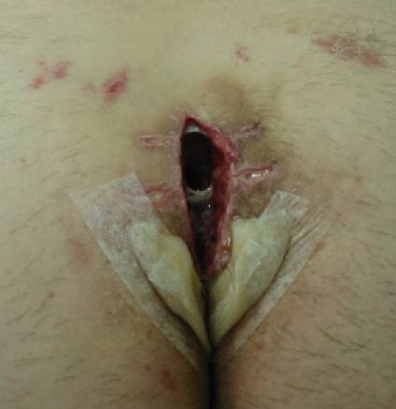
Pilonidal sinus
It is formed by penetration of hairs into skin and subcutaneous tissue, infection lead to pilonidal abscess. It is filled by hair and granulation tissue affect men more frequently than women .
Common site :sacrococcygeal area occasionally umbilicus, axilla and nipple.
Symptom: pain and discharge
Causes: Excessive sitting , Trauma, congenital pilonidal dimple, Excessive sweating
Rx: antibiotic therapy, hot compresses and application of depilatory creams. In sever cases surgical excision and Post-surgical wound packing replaced twice daily for 4 to 8 weeks .

Slide 52
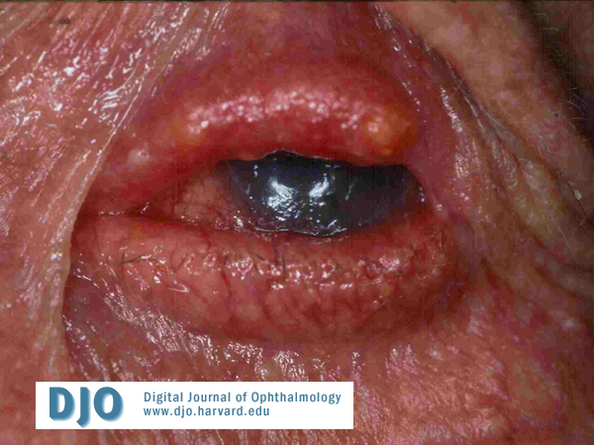
Sebaceous carcinoma
Sebaceous gland carcinoma is an aggressive, uncommon, arise from sebaceous glands in the skin , arise anywhere on the body where these glands exist, including the genitalia but commonly in the periocular region. This tumor exhibits an aggressive clinical course, with a significant tendency for both local recurrence and distant metastasis not easily diagnosed . Women affected more than men . Sebaceous gland carcinoma has a varied clinical presentation that often results in delayed diagnosis.
The most common presentation is a firm, slowly enlarging nodule of the upper eyelid, often mistaken for a chalazion. Patients are not uncommonly treated for many months for recurrent chalazia before a biopsy is performed. Extraocular sebaceous gland carcinoma represents 25 % of reported tumors .
Causes: ultraviolet radiation , human papillomavirus (HPV), chalazia, Genetic factors .
Diagnosis: biopsy confirmed the diagnosis .
Rx: topical chemotherapy, and radiotherapy , local resection, cryotherapy .

Slide 53
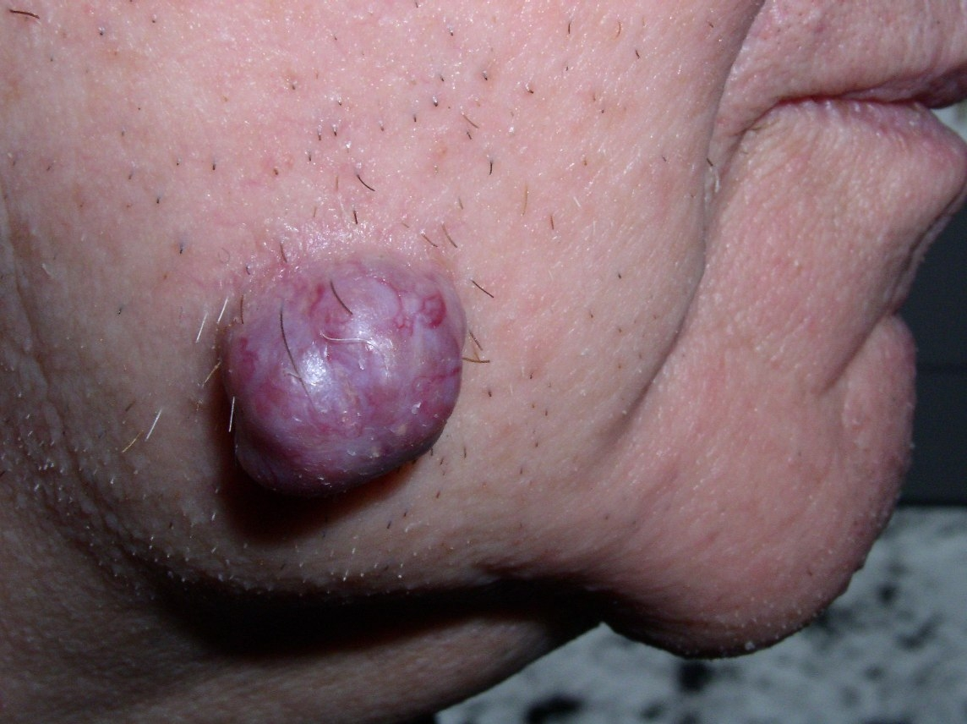
Sweat gland carcinoma
Rare group of tumors with potential for local destruction and metastasis, High recurrence rates following surgical excision .
Symptoms: single, asymptomatic, nondescript cutaneous lesion, grow either slowly over years or rapidly, with disseminated disease, patients may complain of symptoms related to organ specific metastases .
Causes: u v r , immunosuppression
Rx: radiation , chemotherapy, surgery.

Slide 54
Thank you !!

