Slide 1
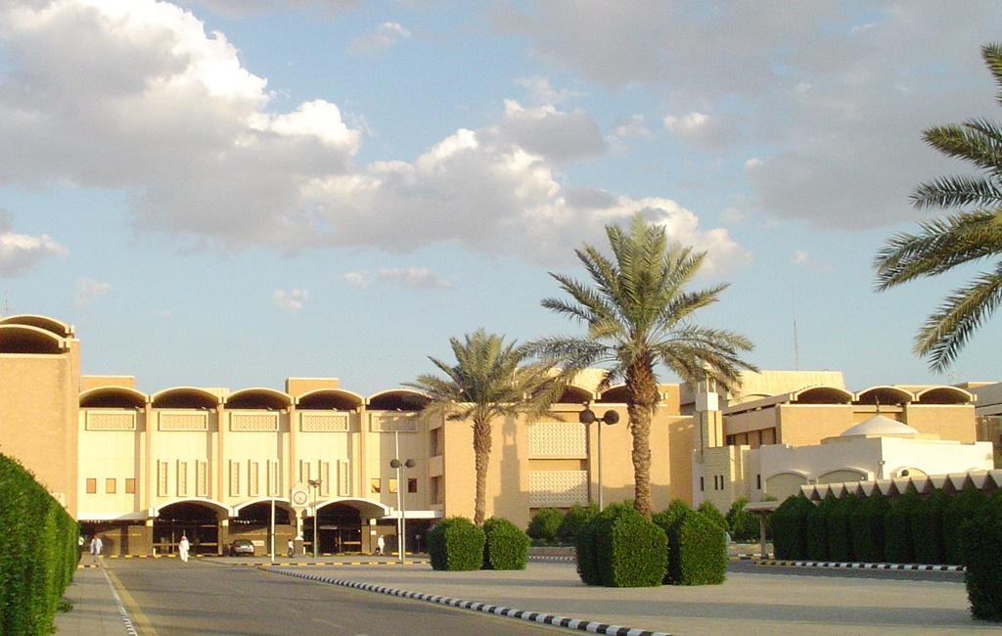
Alveolar Recruitment in Acute Lung Injury/ARDS
MANAGEMENT OF CRITICAL PATIENT IN ICU
Amir B. Channa FFARCS,DA(ENG)
Department of Anesthesia & Intensive Care
King Khalid University Hospital
Riyadh

Slide 2
Critically ill patient
Unstable conditions in whom small changes in organ function may lead to a serious deterioration in overall body function with irrevesible organ damage and death.
Monitoring: early to provide optimal treatment and restore a more stable physiologic condition to prevent organ damage and death
10/19/2011
Patient Care in the ICU
2
Notes:
2

Slide 3
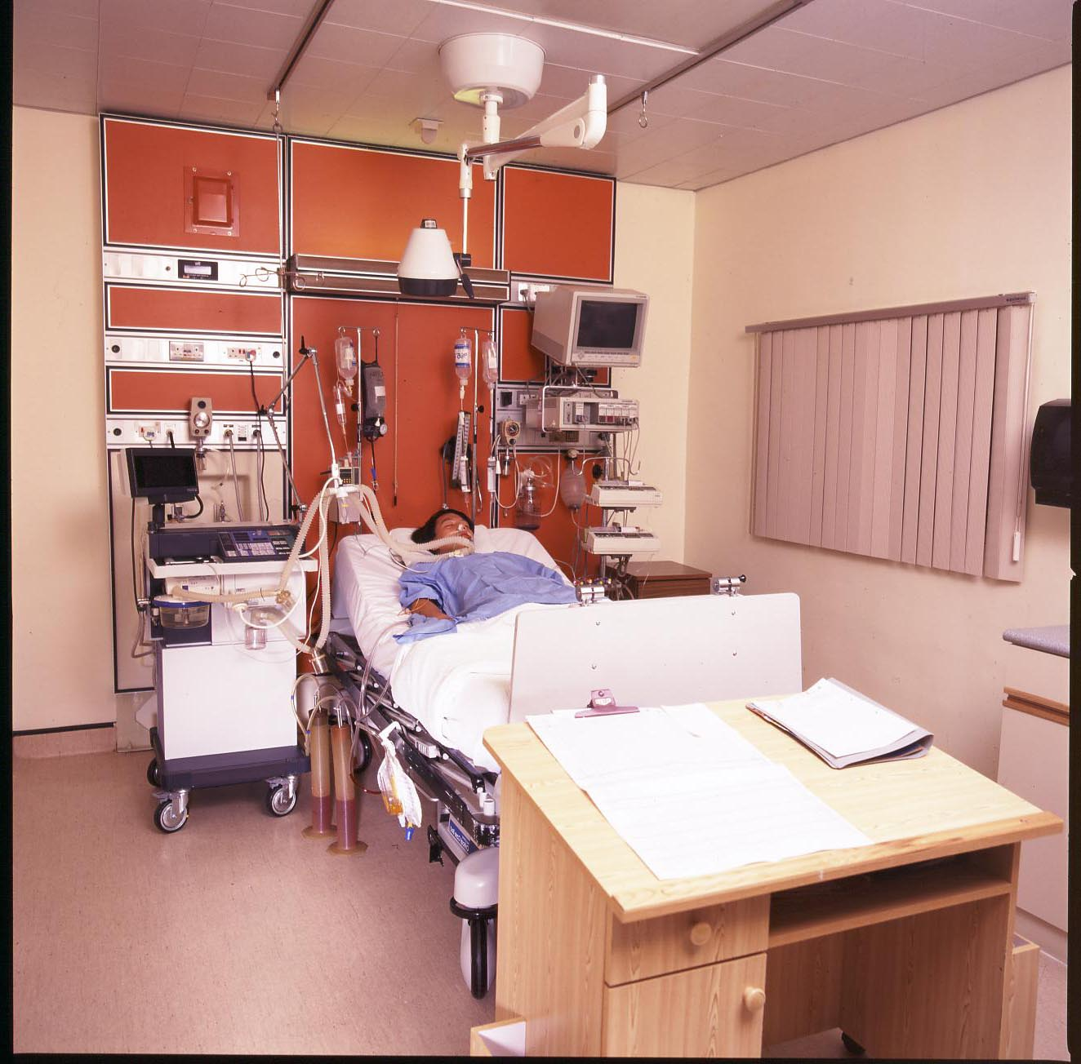
    Intensive Care Unit (ICU)
  Specially staffed
      and equipped
      hospital ward
  Highly trained and Dedicated staff to
      management of
      patients with
      life-
      threatening illness,
      injuries and
      complicatios

Slide 4
Who is the Critical Patient?
Trauma (poly trauma)
Post-operative (Major)
Neurotrauma
Cancer Surgery
Septic
Pancreattitis
Seizures
Acute coronary sydromes
Severe Gastroenteritis
Heart failure
Hemorrhage
Immune-mediated disease.
Renal failure
Liver failure
Resp. failure
Hemopoetic failure
And the list goes on on… …….

Slide 5
Volume
Perfusion
Multi Organ Failure
Micro-
circulation
Tissue
Hypoxia
Inflammation
Severe infections

Slide 6
Critical Care of
MORIBUND Patient
:
“Care of the problem with which the patient has been admitted & save the other organs or systems from any further insult or deterioration.”
Notes:
6

Slide 7
TYPE, SIZE AND SITE OF AN ICU
Medical ICU
CCU
Surgical ICU
Burns ICU
Pediatric ICU
Neonatal ICUs
Multidisciplinary ICU

Slide 9

The Care Process is a Systematic Five Step Process
Assessment
Diagnosis
Planning
Implementation
Evaluation

Slide 10
CRAE PLAN 1.Holistic Approach
2.Challenges
General care
CNS
Respiration
CVS
Renal
Hemopoetic system care
Renal replacement therapy
Infections etc (MRSA & MRO)
Sepsis care,

Slide 11
Holistic Approach
GIT (Stress ulcer - Severe Bleeding etc.)
Nutritional care: fluid & electrolyte status maintenance
Psychological
Locomotor system
Skin care (Bed sores)
Prevention of nosocomial infection
Patients are/may become immunocompromised
Iatrogenic problems & Complications
Drug Interactions
In case of death or demise sympathy with kin or kith

Slide 12
Patient Care in the ICU
Assess current status, interval history, and examination
Review vital signs for interval period (since last review)
Review medication record,
including continuous infusions: Duration and dose.
Change in dose or frequency
based on changes in renal, hepatic or other pharmacokinetic function. Changes in route of administration.
Potential drug interactions

Slide 13
Patient Care in the ICU
Correlate changes with vital signs with medication administration and other changes by use of chronologic charting
Review,AGAIN &AGAIN if indicated:
  Respiratory therapy flow chart
  Hemodynamics records
  Laboratory flow sheets
  Other continuous monitoring

Slide 14
Patient Care in the ICU
Integrate nursing, Pharmacist respiratory therapists patient,s family,
Social worker and other observations.
Review all problems, including adding, updating, consolidating or removing problems as indicated
Periodically, review supportive care:
Intravenous fluids
    Nutritional status and support
    Prophylactic treatment and support
    Duration of catheters and other
    invasive devices
Review the risk and benefits of the stay in intensive care.

Slide 15
General ICU Care
Nosocomial infections, especially line-and catheter related.
Stress gastritis
Deep venous thrombosis and pulmonary embolism
Decubitus ulcers
Psychosocial needs and adjustments.
Toxicity of drugs (renal, pulmonary, hepatic, CNS)
Development of antibiotic-resistant organisms.

Slide 16
General ICU Care
Complications of diagnostic tests
Correct placement of catheters and tubes
Need for vitamins (thiamine, C, K) glutamine etc.
adrenal insufficiency,
fungal sepsis,
myocardial infarction,
pneumothorax,
volume overload or volume depletion,
decreased renal function with normal serum ceratinine,
errors in drug administration or charting,

Slide 17
FAST HUG APPROACH
F - Feeding
A - Analgesia
S - Sedation
T - Thrombo prophylaxis
H - Head elevation (30 degree UP)
U - Ulcer prophylaxis
G - Glycemic control
BUNDLE CONCEPT OF TREATMENTS

Slide 18
Factors influencing outcome from a critical illness
Patient factors
- Pervious health status
- Physiological reserves
- Biological age
- Co morbidities
Disease factors
- Type of disease
- Severity of disease
Treatment factors
- Treatment available?
- Timing if therapy
- Suitability of therapy
- Response to treatment

Slide 19
Types of Data Used in Patient monitoring in different ICU’s

Slide 20
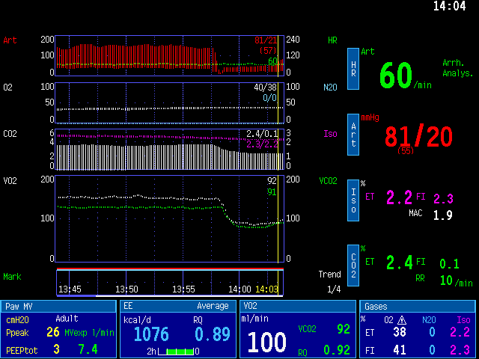
Typical display. Perceptible output?

Slide 22
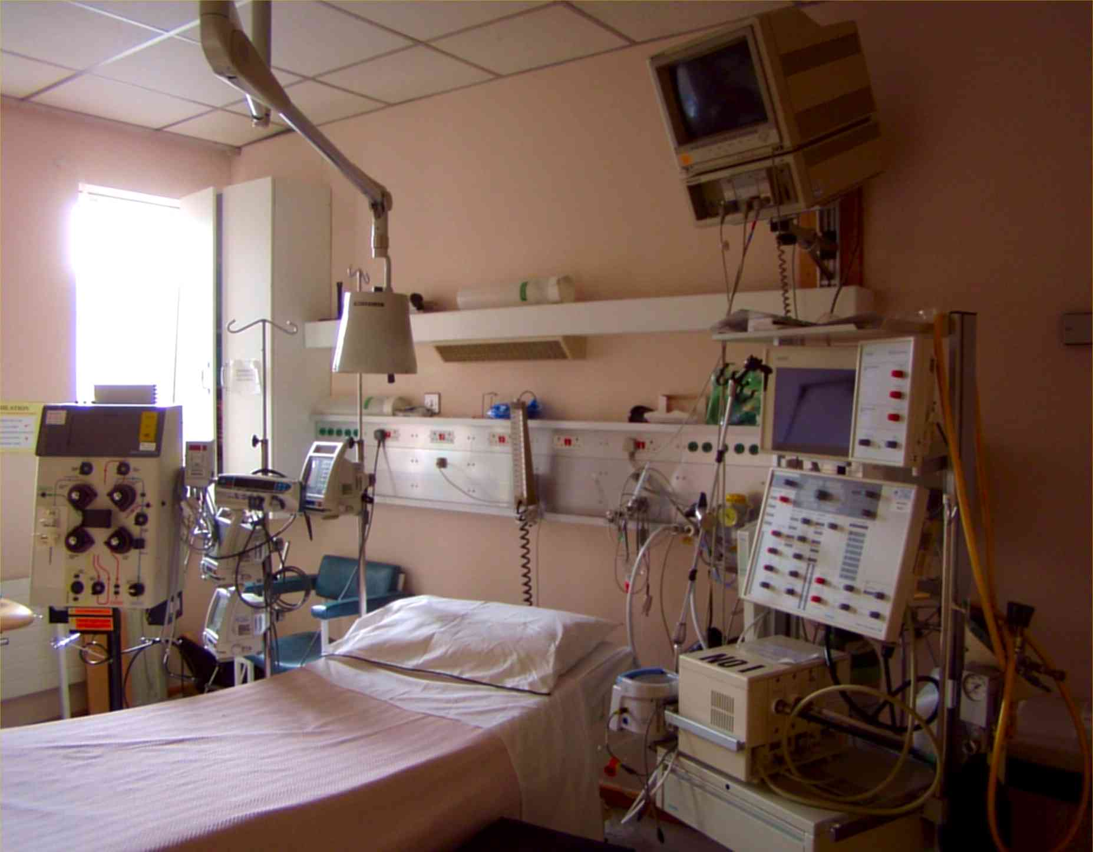
Concept Development
Physiological Monitoring
CRRT
Ventilation
Infusion Devices
Notes:
The movement from device centred to information centred ICU was reflected in the way that bed design changed with the expansion of the carevue system.
As I said earlier older ICU bedspaces are quite cramped as they weren’t designed to accommodate the amount of equipment that is currently required. In this image we tried to setup a typical older ICU bed as it would have been arranged. The equipment is spread around the bed.

Slide 23
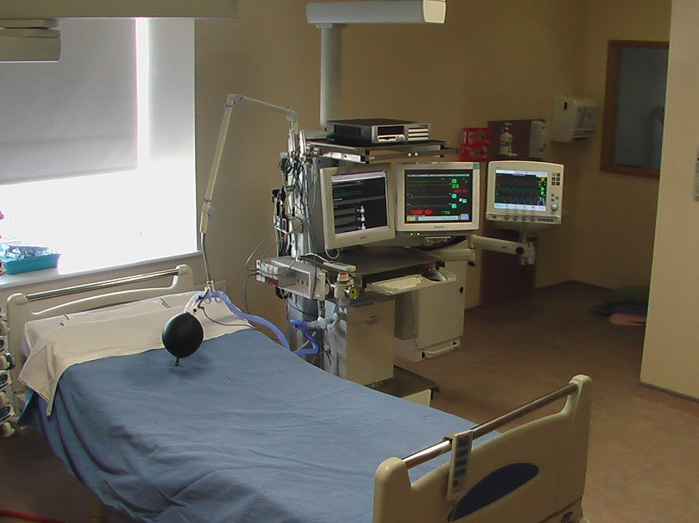
Practical Issues 1.Placing Technology
Notes:
1. In the new design the nurse is positioned right by the patients head, making observation easier.

Slide 25
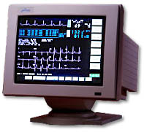
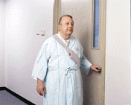
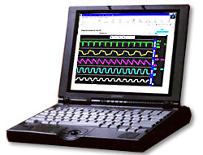
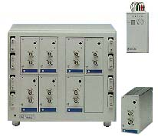
ICU
Bed
Bed
Bed
Bed
Nurse station
Telemetry
WEB
connection

Slide 26
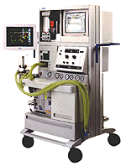
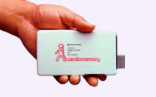
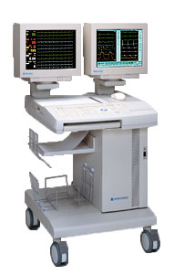
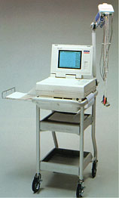
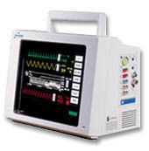
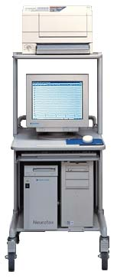
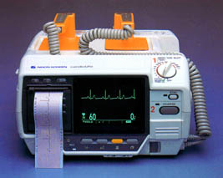
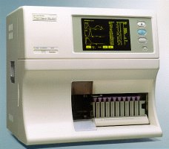
Some instruments in mind

Slide 27
Scoring systems for ICU & surgical patients
General scores SAPS II and predicted mortality APACHE II and predicted mortality APACHE III SOFA (Sequential Organ Failure Assessment) MODS (Multiple Organ Dysfunction Score) ODIN (Organ Dysfunctions and / or INfection) MPM (Mortality Probability Model) on admission 24 hours 48 hours MPM Over Time (admission-24 h-48 h) MPM II (Mortality Probability Model) on admission 24 h, 48 h, 72 h LODS (Logistic Organ Dysfunction System) TRIOS (Three days Recalibrated ICU Outcome Score) RIYADH scoring system MEES (Mainz Emergency Evaluation System) PGH – MPM Philippines | General scores PRISM (Pediatric RISk of Mortality) DORA (Dynamic Objective Risk Assessment) PELOD (Pediatric Logistic Organ Dysfunction) PIM II (Paediatric Index of Mortality II) PIM (Paediatric Index of Mortality)

Slide 28
Scoring systems for ICU & surgical patients
Specialized and Surgical Intensive Care - Preoperative evaluation EUROSCORE (cardiac surgery) ONTARIO (cardiac surgery) Parsonnet score (cardiac surgery) System 97 score (cardiac surgery) QMMI score (coronary surgery) Early mortality risk in redocoronary artery surgery MPM for cancer patients POSSUM (Physiologic and Operative Severity Score for the enUmeration of Mortality and Morbidity) (surgery, any) Portsmouth POSSUM (surgery, any) IRISS score : graft failure after lung transplantation Glasgow Coma Score | Specialized : Neonatal, Surgical, Meningococcal septic shock CRIB II (Clinical Risk Index for Babies) CRIB (Clinical Risk Index for Babies) SNAP (Score for Neonatal Acute Physiology) SNAP-PE (SNAP Perinatal Extension) SNAP II and SNAPPE II MSSS (Meningococcal Septic Shock Score) GMSPS (Glasgow Meningococcal Septicaemia Prognostic Score) Rotterdam Score (meningococcal septic shock) Children's Coma Score (Raimondi) Paediatric Coma Scale (Simpson & Reilly)

Slide 29
Scoring systems for ICU & surgical patients
Trauma scores ISS (Injury Severity Score), RTS (Revised Trauma Score), TRISS (Trauma Injury Severity Score) ASCOT (A Severity Characterization Of Trauma) 24 h - ICU Trauma Score | Pediatric Trauma Scores Pediatric Trauma Score

Slide 30
TABLE 1: Scoring systems for ICU & surgical patients
Therapeutic intervention, nursing ICU scores TISS (Therapeutic Intervention Scoring System) TISS-28 : simplified TISS | Pediatrics : therapeutic intervention, nursing ICU scores NTISS : Neonatal Therapeutic Intervention Scoring System

Slide 31
The APACHE II scoring system
Variable Maximum points
Temperature 4 Mean arterial pressure 4 Heart rate 4 Respiratory rate 4 Oxygenation 4 Arterial pH 4 Sodium 4 Potassium 4 Creatinine 8 Haematocrit 4 White cell count 4 Glasgow coma scale 12 Acute physiology score 16 Age 6 Chronic health evaluation 5 APACHE II score 71

Slide 32
Scoring of Various Acute physiological Variables
A APACHE II
+ 4 + 3 + 2 + 1 0 0 + 1 + 2 + 3 + 4
Temperature ≥41 39-40.9 38.5-38.9 36-38.4 34-35.9 32-33.9 30-31.9 ≤29.9
MAP ≥160 130-159 110-129 70-109 50-69 ≤49
HR ≥180 140-179 110-139 70-109 55-69 40-54 ≤39
RR ≥50 35-49 25-34 12-24 10-11 6-9 ≤5
Oxygenation1 ≥500 350-499 200-349 < 200
PaO2> 70 61-70 55-60 < 55
pH ≥7.7 7.6-7.69 7.5-7.59 7.33-7.49 7.25-7.32 7.15-7.24 < 7.15
Na+ ≥180 160-179 155-159 150-154 130-149 120-129 111-119 ≤110
K+ ≥7 6.6-6.9 5.5-5.9 3.5-5.4 3-3.4 2.5-2.9 <2.5
Creat ≥
Hct ≥60 50-59.9 46-49.9 30-45.9 20-29.9 < 20
WCC ≥40 20-39.9 15-19.9 3-14.9 1-2.9 < 1
15-GCS
1 FIO2 > 0.5 record δA-aO2 FIO2< 0.5 record PAO2

Slide 33
Sepsis: Defining a Disease Continuum
Infection/
Trauma
SIRS
Sepsis
Severe Sepsis
A clinical response arising from a nonspecific insult, including ≥ 2 of the following:
  Temperature ≥38ºC or ≤36ºC
  HR ≥90 beats/min
  Respirations ≥20/min
  WBC count ≥12,000/mm³ or
  ≤4,000/mm³ or >10% immature neutrophils
SIRS with a presumed or confirmed infectious process
SIRS = Systemic Inflammatory Response Syndrome
Adapted from: Bone RC, et al. Chest 1992;101:1644
Opal SM, et al. Crit Care Med 2000;28:S81
10/19/2011
Patient Care in the ICU
33
Notes:
33

Slide 34
Sepsis: Defining a Disease Continuum
Infection/
Trauma
SIRS
Sepsis
Severe Sepsis
Sepsis with ≥1 sign of organ failure
  Cardiovascular (refractory hypotension)
  Renal
  Respiratory
  Hepatic
  Hematologic
  CNS
  Metabolic acidosis
Shock
Bone et al. Chest 1992;101:1644; Wheeler and Bernard. N Engl J Med 1999;340:207
10/19/2011
Patient Care in the ICU
34
Notes:
34

Slide 35
Relationship Of Infection, SIRS, Sepsis Severe Sepsis and Septic Shock
SEPSIS
PANCREATITIS
SEVERE
SEPSIS
INFECTION
SIRS
BURNS
SEPTIC
SHOCK
TRAUMA
OTHER
10/19/2011
Patient Care in the ICU
35
Bone et al. Chest 1992;101:1644
Notes:
35
This conceptual framework shows the interrelationships between infection, non-infectious disorders, SIRS, sepsis and severe sepsis. Components of the process not discussed on the following slides include:
Infection: a microbial phenomenon characterized by an inflammatory response to the presence of microorganisms or the invasion of normally sterile host tissue by those organisms
Bacteremia: the presence of viable bacteria in the bloodstream
Septic shock: sepsis-induced hypotension despite adequate fluid resuscitation along with the presence of perfusion abnormalities that may include, but are not limited to, lactic acidosis, oliguria or an acute alteration in mental status
Multiple organ dysfunction syndrome (MODS): presence of altered organ function in an acutely ill patient such that homeostasis cannot be maintained without intervention
Bone RC, Balk RA, Cerra FB, et al. Definitions for sepsis and organ failure and guidelines for the use of innovative therapies in sepsis. Chest 1992;101:1644-55.
Opal SM, Thijs L, Cavaillon JM, et al. Relationships between coagulation and inflammatory processes. Crit Care Med 2000;28:S81-2.

Slide 36
Question #1
Which of the following is necessary in the definition of shock?
(a) Hypotension
(b) Tissue hypoxia
(c) Use of pressors
(d) Multiple organ dysfunction

Slide 37
Question #3
Which can cause low preload?
(a) High PEEP
(b) Tension pneumothorax
(c) Third spacing
(d) Positive pressure ventilation
(e) All of the above

Slide 38
Question #4
Which is not typical of sepsis?
(a) Low SVR
(b) High cardiac output
(c) Low oxygen delivery
(d) Low wedge pressure

Slide 39
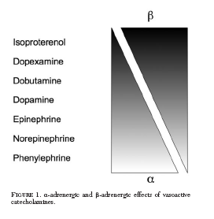

Slide 40

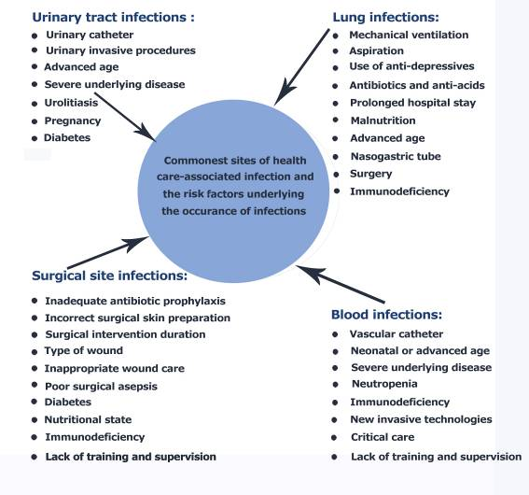
Most frequent sites of infection and their risk factors
34%
13%
Urinary catheter
Mechanical ventilation
Urinary invasive procedures
Aspiration
Nasogastric tube
LACK OF HAND HYGIENE
17%
14%
Inadequate A/B prophylaxis
Vascular catheter
Incorrect surgical skin preparation
Neonatal age
Inappropriate wound care
Critical care

Slide 41
Ventilator Bundle
Head of Bed elevation
Daily sedation vacation
Daily trial of spontaneous breathing when appropriate
DVT prophylaxis
PUD prophylaxis
ALI Screen New January 2005

Slide 42
Central Line Bundle Elements
Hand hygiene
Maximal barrier precautions
Chlorhexidine skin antisepsis
Optimal catheter site selection, with subclavian vein as the preferred site for non-tunneled catheters in adults
Daily review of line necessity with prompt removal of unnecessary lines
Notes:
The central line bundle is a package of interventions that reduce the risk of the harm associated with having a central line placed and used. The risk of bloodstream infection is reduced by ensuring hand hygiene amongst staff, always using maximal barrier precautions at the time of placement, cleansing sites with chlorhexidine rather than other antiseptics, selecting the appropriate site, and reviewing daily for early removal.

Slide 44
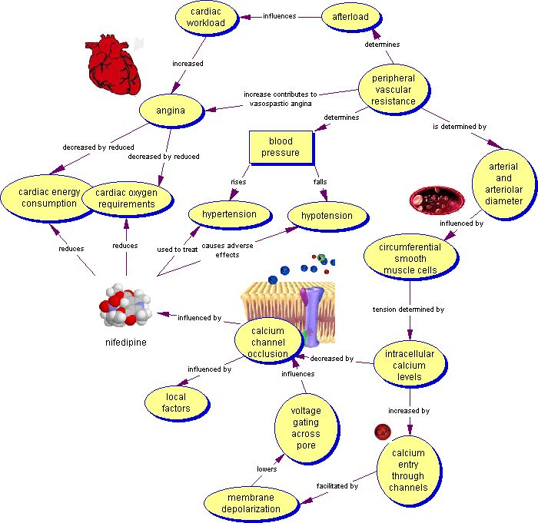

Slide 45
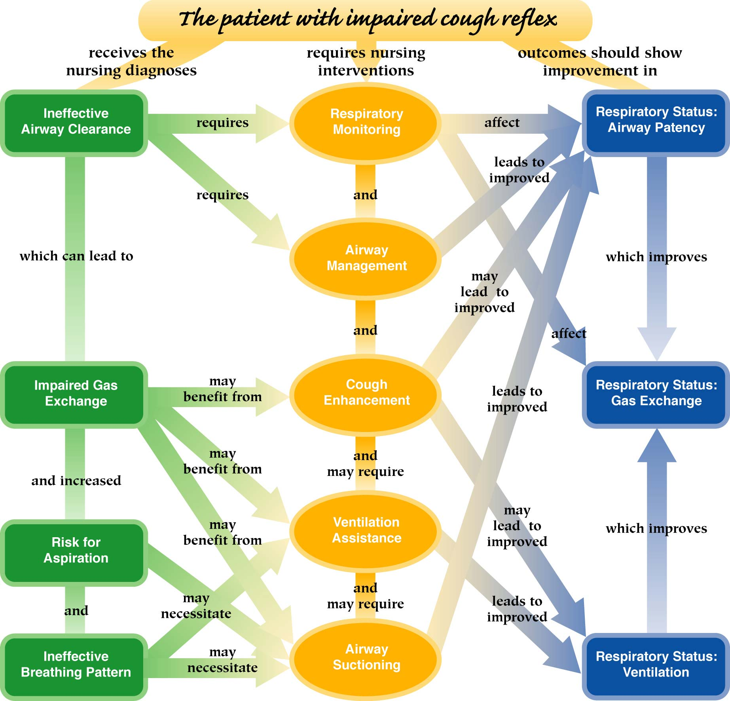

Slide 46
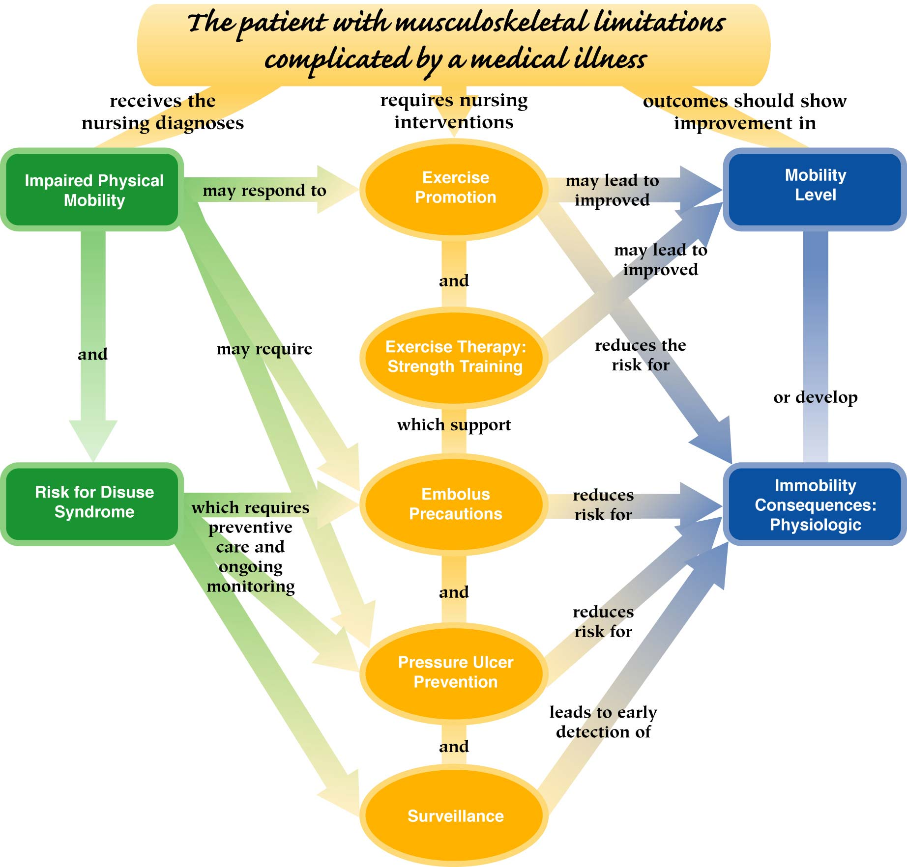

Slide 47
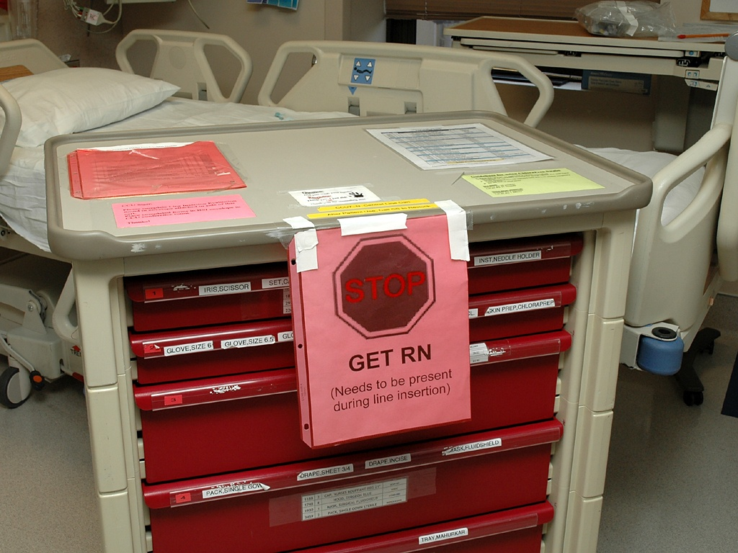

Slide 48
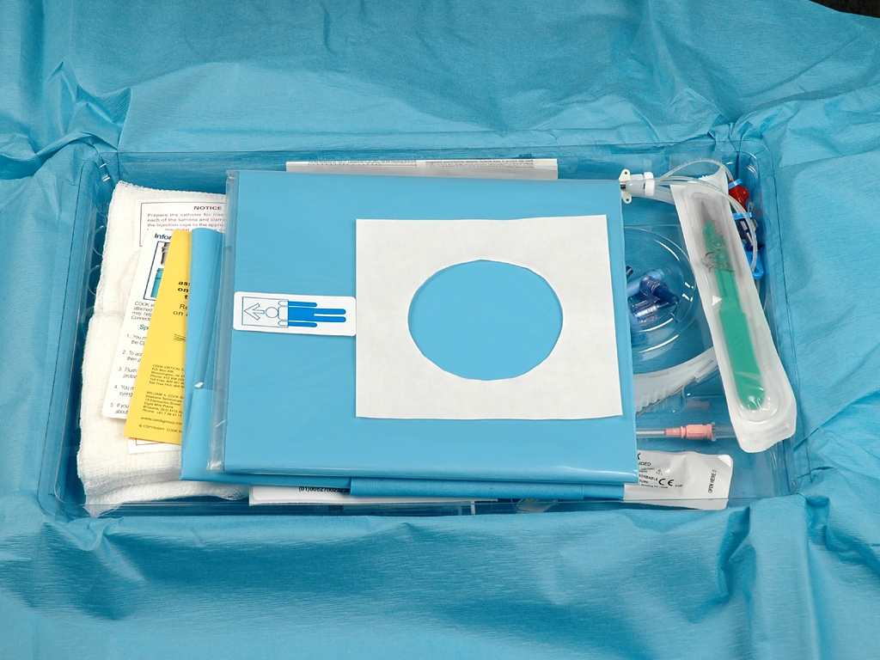

Slide 49
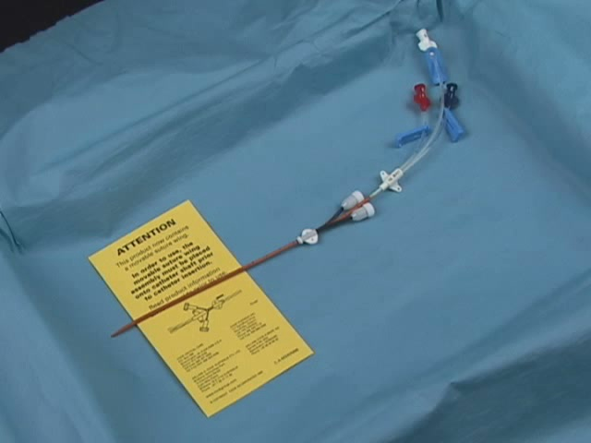

Slide 50
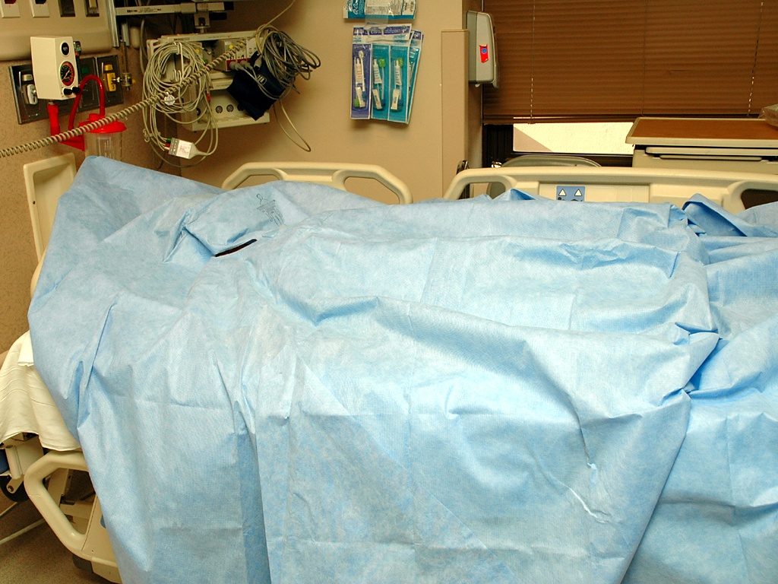

Slide 51
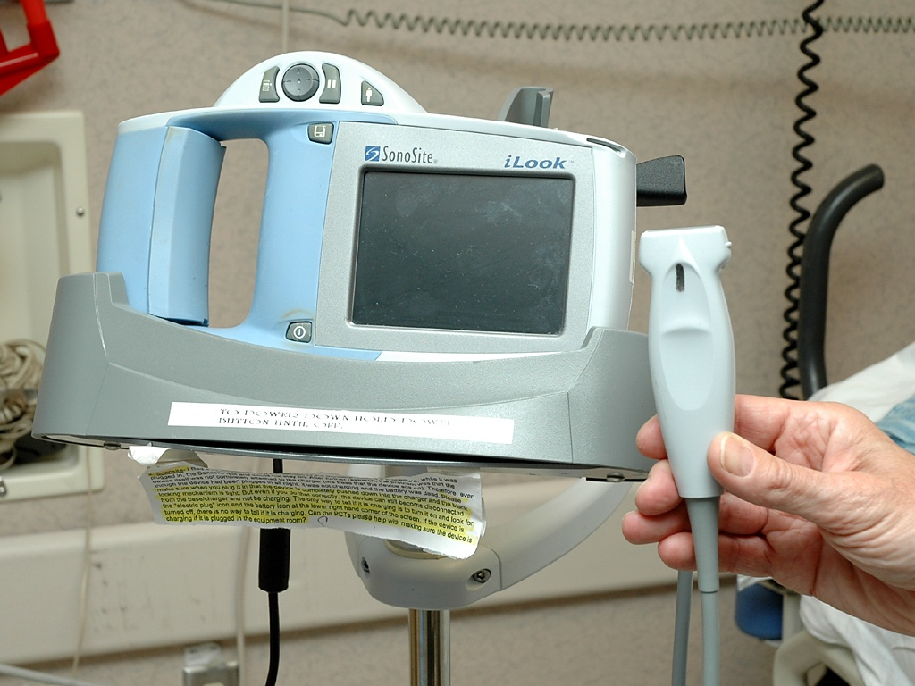

Slide 52
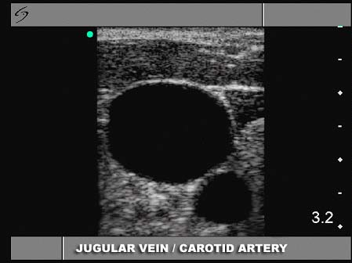

Slide 53
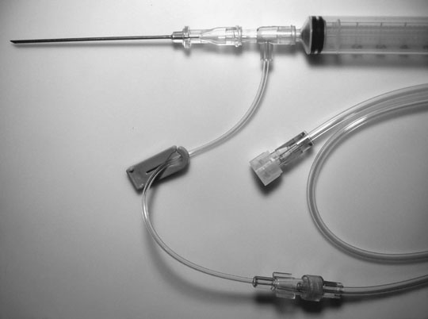
Jobes DR, Schwartz AJ, Stephenson LW, et al.
Safer jugular vein cannulation: Recognition of arterial puncture and preferential
use of the external jugular route. Anesthesiology 59:353-355, 1983.

Slide 54
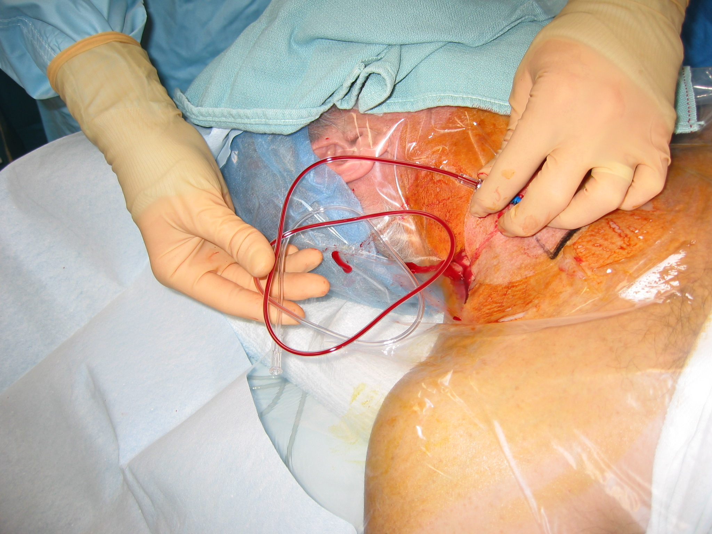

Slide 55
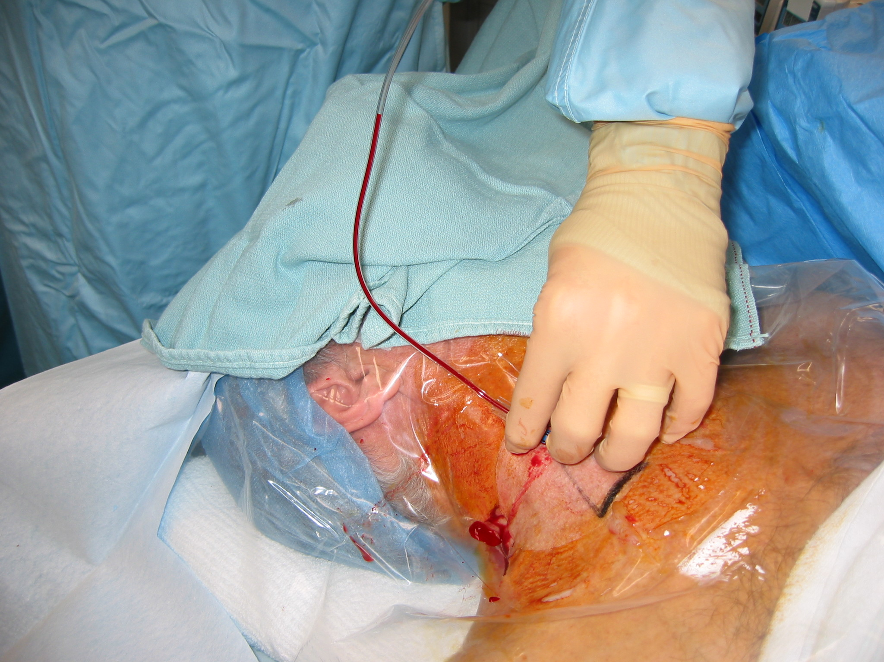

Slide 56
If you are admitted to our ICU we will:
Use proper hand hygiene
Identify and treat your ALI/ARDS with low volume ventilation
Use our “Vent Bundle” to prevent needless VAP and mechanical complications
”

Slide 57
If you are admitted to our ICU we will:
Tightly control your glucose
Promptly identify and treat your sepsis with the “Sepsis Bundle” with
Early Goal Directed Therapy
Assess your need for supplemental steroids if you have septic shock
Prevent all avoidable skin breakdown

Slide 58
Therapies that make a difference
Mortality Reduction
Limit tidal volume in ALI/ARDS
Elevate HOB,
Daily SBT,
Daily sedation/analgesia holiday,
DVT prophylaxis,
SU prophylaxis,
Ventilator Bundle to prevent VAP
Maximum barrier protection to reduce device related blood stream infections
Intensive Insulin Therapy in Critically Ill Patients
SBT=Spont..breathing trial.
9%
?
?
10%

Slide 59
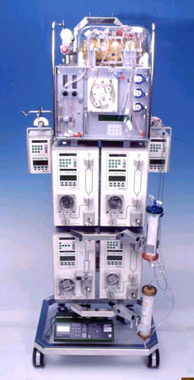
Modular Organ Support
Respiratory
Renal
Hepatic
Cardiac
Others…

Slide 60

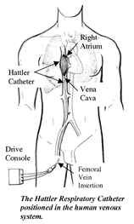

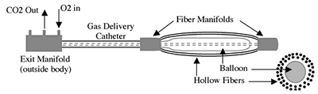

Hattler Respiratory Support Catheter
Cylindrical bundle of microporous hollow fiber membranes
O₂ and CO₂ exchange
Expected Launch worldwide 2006

Slide 61
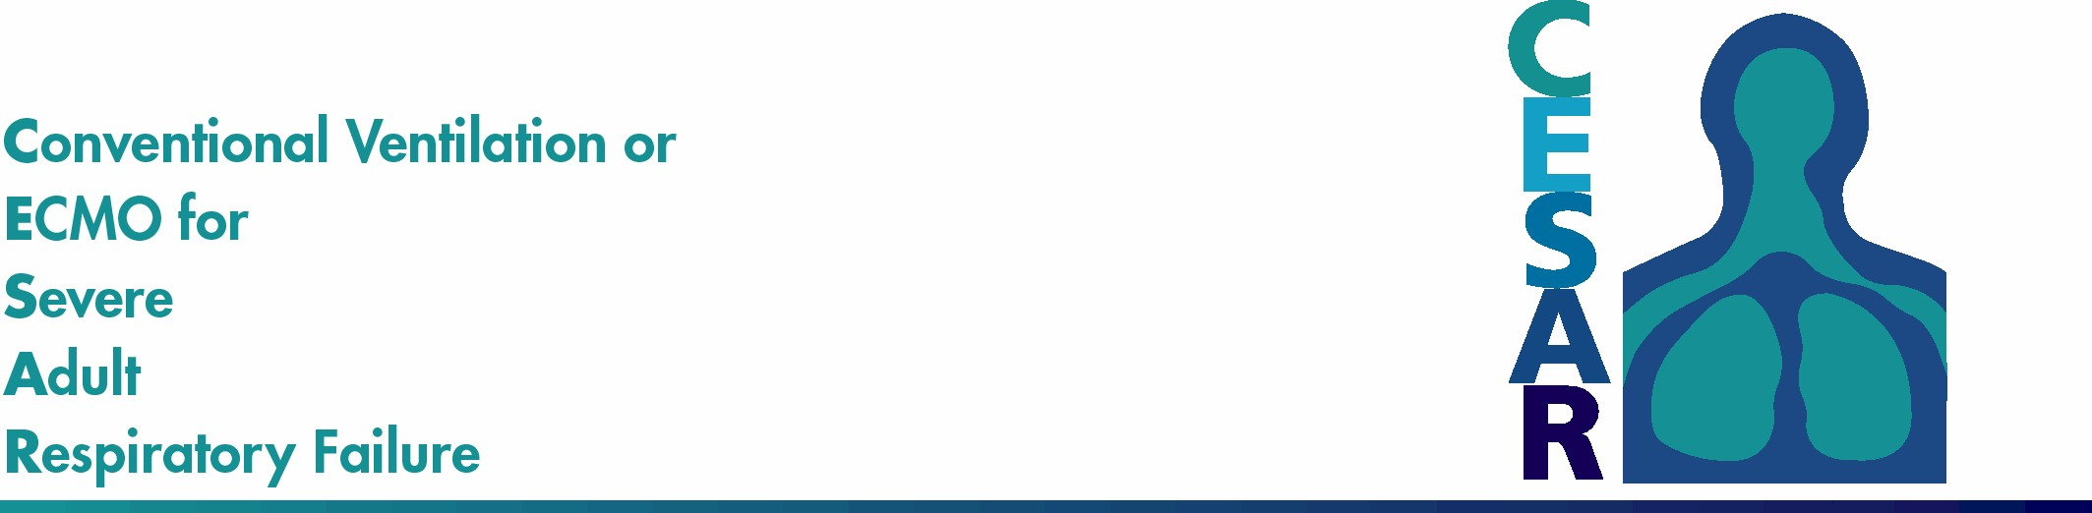
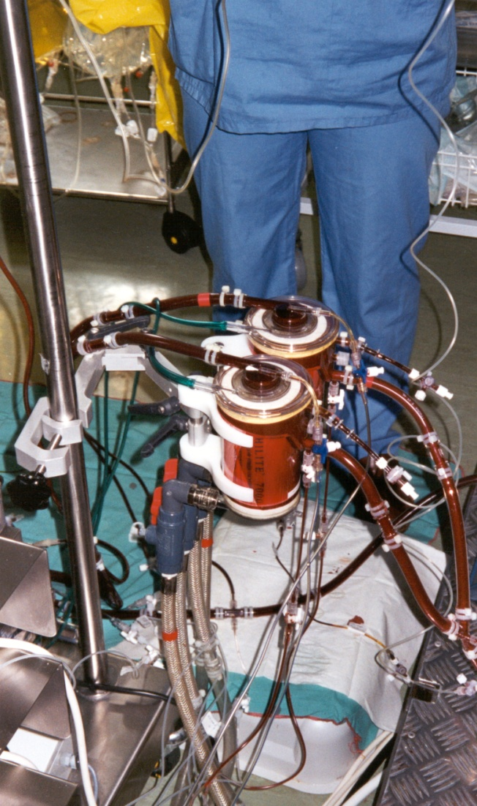
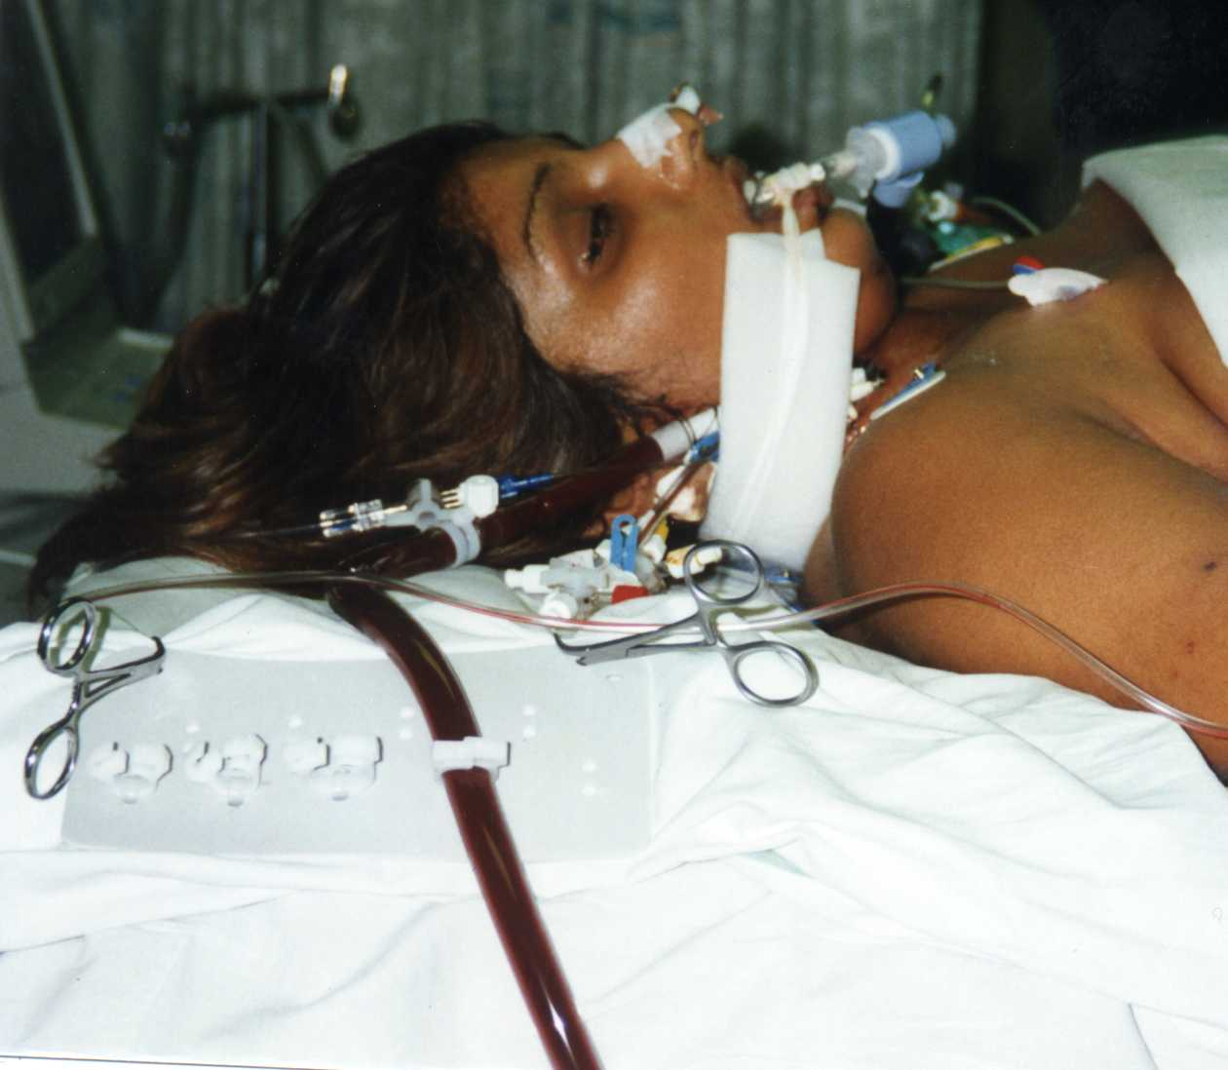

Slide 62
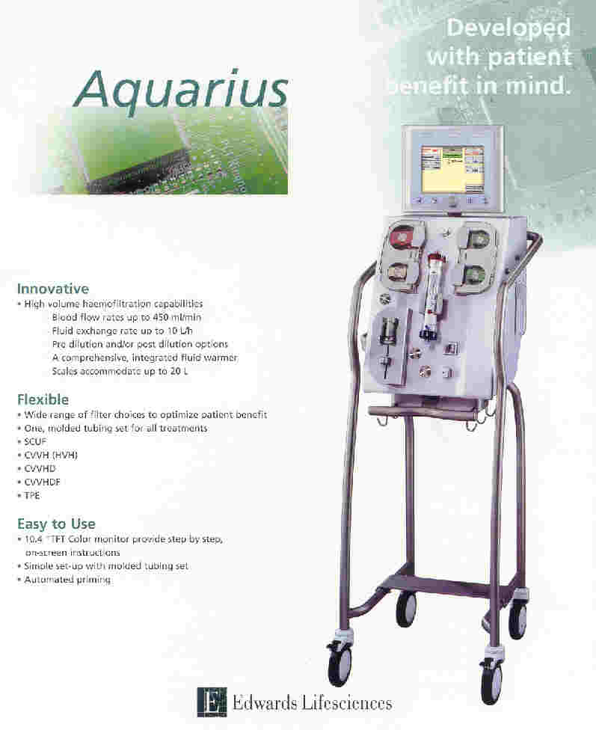
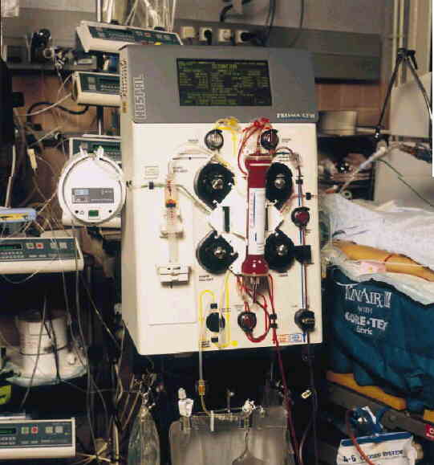
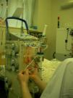
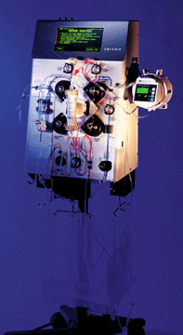
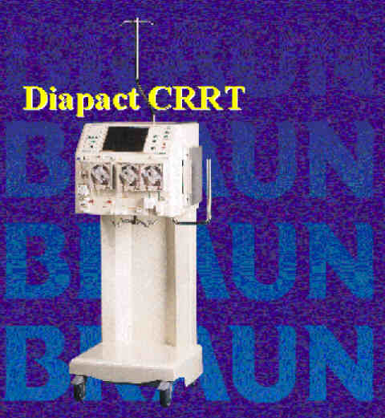
Renal Support Systems - CRRT

Slide 63
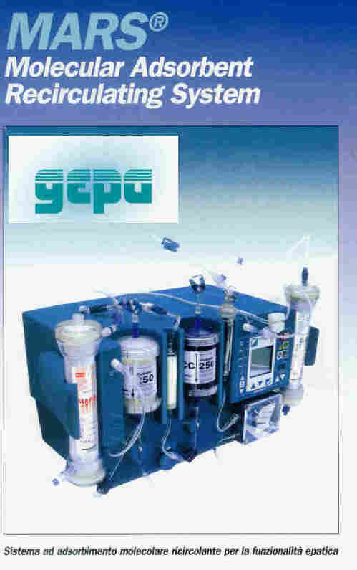
Hepatic Support Systems
Methods of liver support:
  Extracorporeal whole organ perfusion (historical)
  Bioartificial livers
  Extracorporeal liver-assist devices, including charcoal column hemoperfusion and plasmapheresis
  Hepatocyte transplantation
  Hepatic transplantation

Slide 64
Hepatic Support Systems
Modular Extracorporeal Liver Support (MELS) system
CellModule bioreactor for temporary liver support
Hollow-fiber bioreactor cartridge loaded with hepatocytes
Hollow fibers act as an immunoisolation barrier and as an artificial capillary network
Currently Phase I Trial
McGowan Institute for Regenerative Medicine, University of Pittsburgh
      Sauer IM, Gerlach JC et al. Primary human liver cells as source for modular extracorporeal liver support- a preliminary report. Int J Artif Organ 25:1001-5, 2002

Slide 65
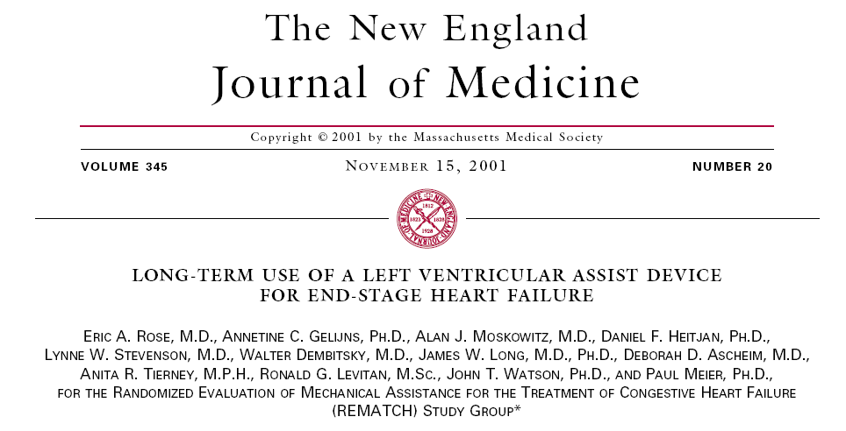
Cardiac Support Devices
N Engl J Med 2001 November;345(20):1435-1443

Slide 66
HeartMate Device – REMATCH Trial
LVAD vs. Medical Mgmt
N=129, randomized
NYHA class IV CHF
1998-2001
48% reduction in risk of death from any cause with LVAD, RR 0.52 (95% CI 0.34-0.78, p=0.001)
LVAD is acceptable therapy in pts not candidates for cardiac transplantation.

Slide 67
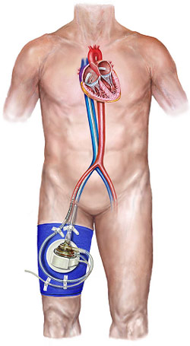
Tandem Heart
May be inserted in Cardiac Cath lab with percutaneous cannulae
Centrifugal pump
Very small, priming volume of only 7ml
Inflow cannula placed through atrial septum from RA into LA
Short-term device
More support than IABP
Cardiac Assist Inc., Pittsburgh, PA

Slide 68
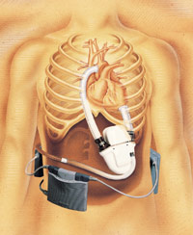
WorldHeart – Novacor LVAS
Commercially available for bridge to cardiac transplantation in the US, Europe, Canada and parts of Asia.
A clinical trial is currently underway in the US and Canada to evaluate the long-term use as an alternative to medical therapy in non-transplant-eligible patients who are inotrope dependent.
In Europe, the device is already available without restriction for use by HF patients.
To demonstrate its high level of confidence in the durability and reliability of Novacor LVAS, WorldHeart has announced a 3-yr warranty for all implanted components.
Over 100 recipients have been supported by the Novacor LVAS for more than 1 year, with some recipients supported for more than 4 years.
Notes:
WorldHeart - Novacor LVAS (WorldHeart Corp., Ottawa, Canada) The three external components, weighing just over 7 lbs (3.3 kg) together, may be carried on a belt or in a shoulder bag. The controller electronics are worn outside the body, powered by primary and reserve battery packs. A single percutaneous lead connects the controller to the implanted pump. This design allows patients with the Novacor LVAS a high degree of mobility. Many even return to work full-time.The Novacor LVAS, made by World Heart Corporation, is

Slide 69
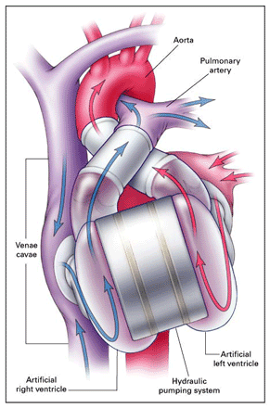
Totally implanted Artificial Heart
AbioCor
Artificial Heart
Replaces RV & LV
For biventricular cardiac failure
Requires removal of the native heart

Slide 70
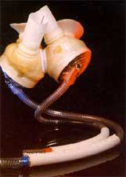
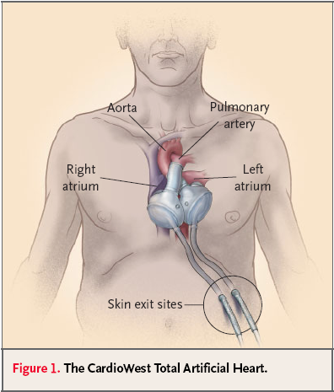
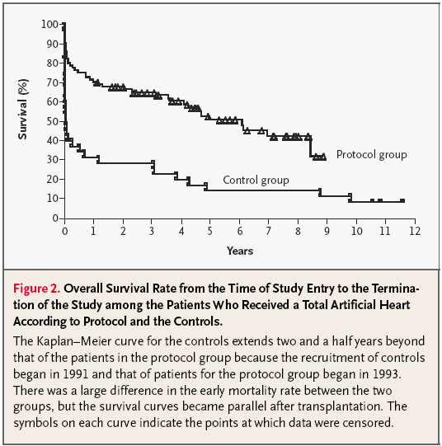
Jarvik-7
CardioWest TAH
1 year survival
70 vs. 3
1-year survival
70 vs. 31%
Copeland GJ et al. N Engl J Med 2004;351:859-67.

Slide 71

Thoratec IVAD System
Currently in clinical trials, is an implanted version of the external.
Only implantable biventricular assist device, which does not require removal of the native heart.
Very similar to the external system with exception of a titanium outer housing (allowing a smaller external dimension), and a transducer which measures pump emptying. The blood contacting components have not changed from the external version.
May improve a patient's quality of life, especially when discharged from the hospital, by reducing the external components a patient must deal with.

Slide 72

E
C
L
S
xtra
orporeal
ife
upport

Slide 73
THANK YOU.

