Slide 1
Central Abdominal Pain and masses
Supervised by :
DR. HAMED AL QAHTANI

Slide 2
Objectives
Approach a patient with central abdominal pain and mass
Differential diagnosis of central abdominal pain and mass
Appendicitis
Small Bowel Obstruction
Mesenteric Ischemia

Slide 3
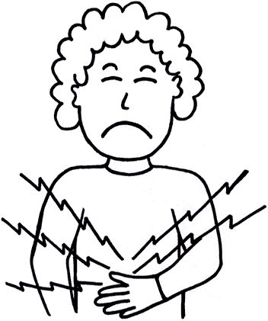
Abdominal pain is frequently a benign complaint, but it can also indicate serious acute pathology. It is very commonly due to Irritable bowel syndrome, however, other possible pathologies should be taken in consideration.

Slide 4
The history is the most important clue to the source of abdominal pain.
Starting from the outer surface to the inner surface of the abdomen, the pain could be : cutaneous, musculoskeletal, vascular, neurological or organic.

Slide 5

Central Abdominal Pain
Referred to midgut structures , which begin from second part of duodenum to splenic flexure

Slide 6
Generally, abdominal pain can be categorized by its underlying mechanism:
-Visceral
-Parietal
-Referred
- Radiating
Notes:
In addition, pain should be characterized according to location, chronology, severity, aggravating and alleviating factors, and associated symptoms.

Slide 7
Visceral pain is
usually dull and aching in character, although it can be colicky, poorly localized.
It arises from distention or spasm of a hollow organ such as the discomfort experienced early in intestinal obstruction or cholecystitis.
Parietal pain is
sharp and very well localized.
It arises from peritoneal irritation such as the pain of acute appendicitis with spread of inflammation to the parietal peritoneum.

Slide 8
Referred pain is aching and perceived to be near the surface of the body.
Radiating pain: is at site of pathology and other site

Slide 9
What are the possible DDx of central abdominal pain?

Slide 10
History
Age, gender.
Pain analysis:
location,
radiation, nature of the pain,
duration, onset, mode, aggrevating and relieving factors, associated symptoms.
Associated syptoms:
nausea, vomitting,
dyspepsia, constipation, diarrhea, change in stool color, change in urine color,
abdomenal distention, fever, loss of weight, loss of appetite.

Slide 11
Cont. History
Past history:
- Medical: Diabetes, hypertention, hyperlipidemia, history of previous similar complaint, co-existing medical diseases.
- Surgical: abdomenal procedures.
- Drugs: eg. steriods, PPI’s, paracetamol.
- Allergies.

Slide 12
Cont. History
Social history: Alcohol, diet and socioeconomical status, pain in relation to psychological factros and stress.
Family history.
Systemic review.

Slide 13
Examination
General:
- Appearance: jaundice, pallor, body mass, hydration, bruises, respiratory or
cardiac distress, patient looking in pain
discomfort, IV fluids.
- Vital signs.

Slide 14
Cont. Examination
Abdomen:
- Inspection: abdominal distention, symmetry, visible pulsations, hernia, scars.
- Palpation: superficial (rigidity, rebound tenderness, masses). Deep (Murphy’s sign, masses, organomegaly)
- Percussion: tenderness, dullness/ tympany.
- Auscultation: bruit, bowels sounds.
- PR examination.

Slide 15
Investigation
Labs:
- CBC
- Serum U&E
- LFT
- Amylase
- Lipase
- Blood glucose level

Slide 16
Cont. Investigation
Imaging:
- Abdominal Xray (air-fluid levels, distended bowel, stones).
- X-ray with contrast (follow-through).
- CT with contrast.

Slide 17
Interventional investigations:
- Endoscopy.
- Laproscopy

Slide 18
Causes of Central abdominal pain:
Gastroenteritis.
Peptic Ulcer Disease.
Pancreatitis.
Appendicitis.
Abdomenal Aortic Aneurism.
Mesenteric Ischemia.
Small Bowel Obstruction.
Intussusception.

Slide 19
Small Bowel Obstruction

Slide 20
Definition
Interruption of the passage of intestinal contents.

Slide 21
Small Bowel Obstruction
Clinical features
Colicky central abdominal pain
Vomiting - early in high obstruction
Abdominal distension - extent depends on level of obstruction
Absolute constipation - late feature of small bowel obstruction
Dehydration associated with tachycardia, hypotension and oliguria
Features of peritonitis indicate strangulation or perforation

Slide 22
Small Bowel Obstruction
Investigation
Supine abdominal X-ray shows dilated small bowel
May be normal
Valvulae coniventes differentiate small from large intestine
Erect abdominal film is very important to show the presence of air fluid level to differentiate if there is true obstruction or adynamic ileus
Contrast studies(water soluble gastograffin not barium) & CT. are very helpful

Slide 23
Small Bowel Obstruction
Pathophysiology
Hypercontractility--hypocontractility
Massive third space losses
  oliguria, hypotension, hemoconcentration
Electrolyte depletion
bowel distension--increased intraluminal pressure--impedement in venous return--arterial insufficiency

Slide 24
Site?
Small Bowel vs. Large Bowel
Scenario
  prior operations(SBO), Δ in bowel habits(LBO)
Clinical picture
  scars, masses/ hernias(SBO), amount of distension(more distension more distal the obstruction usually )/ vomiting(more w/ SBO)
Radiological studies
  gas in colon(LBO), mass(according to its site)
(Almost) always operate on LBO, often treat SBO non-operatively
Notes:
SBO: small bowel obstruction
LBO: Large bowel obstruction

Slide 25
Etiology?
Outside the wall
Inside the wall
Inside the lumen

Slide 26
Lesions Extrinsic to Intestinal Wall
Adhesions (most common cause )(usually postoperative)
Hernia (2nd most common)
  External (e.g., inguinal, femoral, umbilical, or ventral hernias)
  Internal (e.g., congenital defects such as paraduodenal, and diaphragmatic hernias or postoperative secondary to mesenteric defects)
Neoplastic
  Carcinomatosis, extraintestinal neoplasm
Intra-abdominal abscess/ diverticulitis
Volvulus (small bowel )

Slide 27
Lesions Intrinsic to Intestinal Wall
Congenital
  Malrotation
  Duplications/cysts
Traumatic
  Hematoma
  Ischemic stricture
Infections
  Tuberculosis
  Actinomycosis
  Diverticulitis
Neoplastic
  Primary neoplasms
  Metastatic neoplasms
Inflammatory
  Crohn's disease
Miscellaneous
  Intussusception
  Endometriosis
  Radiation enteropathy/stricture

Slide 28
Intraluminal Lesions
Gallstone
Enterolith
Foreign body

Slide 29
Is there strangulation?
4 Cardinal Signs:
fever
tachycardia
localized abdominal tenderness
leukocytosis

Slide 30
Management of SBO
(Principles)
Admission
NPO
Fluid resuscitation
Electrolyte, acid-base correction
Close monitoring
  Foley +/- central line
NGT decompression
? Surgery

Slide 31
Resuscitation
Massive third space losses as fluid and electrolytes accumulate in bowel wall and lumen
Depend on site and duration
  proximal- vomiting early, with dehydration, hypochloremia, alkalosis
  distal- more distension, vomiting late, dehydration profound, fewer electrolyte abnormalities
Requirements = deficit + maintenance + ongoing loses

Slide 32
TO OPERATE OR NOT TO OPERATE
The rule in SBO is to manage the pt conservatively w/ observation & give the pt time up to 48 hrs then reevaluate if still obstructed.

Slide 33
Indications for surgery
  Peritoneal findings.
  Rapidly progressing abdominal pain or distension.
  Visceral perforation..(evident by increase amylase level)
  Irreducible hernia
  Development of:
- Fever.
- Diminished urine output.
- Metabolic acidosis.

Slide 34
Paralytic ileus
Functional obstruction most commonly seen after abdominal surgery, or w/ hypokalemia & sepsis
Small bowel is distended throughout its length
Absorption of fluid, electrolytes and nutrients is impaired..
Abdominal distension is often apparent
Pain is often not a prominent feature
Auscultation will reveal absence of bowel sounds
Water soluble contrast study may be helpful to differentiate if in doubt is it mechanical or functional obstruction
Notes:
Significant amounts of fluid may be lost from the extracellular compartment
Usually resolves spontaneously after 4 or 5 days

Slide 35
Management :
for ilius→ conservative (it resolve 2-3 days after surgery
mechanical : 1-adhesive → conservative wait for 48 h
2 - non-adhesive→ CT scan & imm surgery

Slide 36
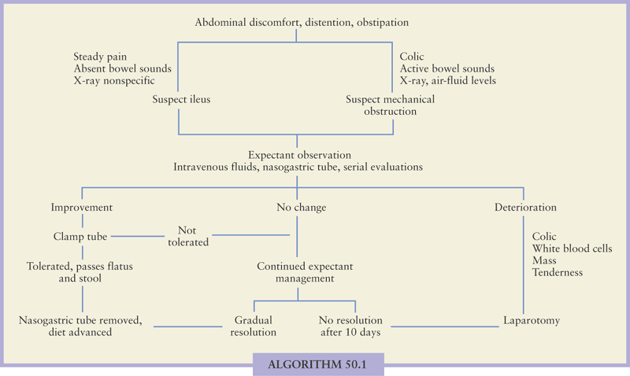

Slide 37
Acute Mesenteric Ischemia
Notes:
One of the most difficult consults we receive are ones for acute intestinal ischemia,

Slide 38
Acute Mesenteric Ischemia
Definition:
It is defined as an occlusive or non-occlusive mechanism leading to hypoperfusion of one or more mesenteric vessels.
Notes:
Acute mesenteric occlusion has been described as early as 1921 as

Slide 39
Acute Mesenteric Ischemia
Incidence: relatively rare. More in older population
Survival & Mortality: Survival is v. bad, although there has been a reduction in mortality but it remained around 60-70% since then..
Mortality is high because usually the diagnosis is made after infarction, damage proceeds even after revascularization, and concomitant medical problems affect long-term outcomes
There is significant morbidity associated with acute mesenteric ischemia and up to 30% of patients become TPN dependent.
Recurrence of disease is common
Notes:
Given the unreliability of the physical exam and laboratory values until permanent injury has taken place, imaging has become a crucial tool in securing an early diagnosis. Improved imaging technology is one of the reasons that reductions in mortality have been achieved.

Slide 40
Mesenteric Ischemia
CAUSES:
1. Arterial embolic disease
2. Arterial thrombotic disease
3. Low flow status.non-occlusive disease.
4. Venous thrombotic disease
5. Atherosclerosis. (chronic)
Notes:
mesenteric ischemia can be classified into 5 distinct pathophysiologic categories:

Slide 41
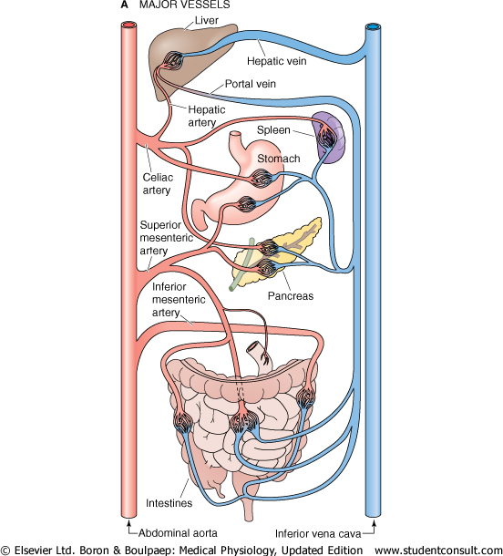

Slide 42
Mesenteric arterial embolism
The classic presentation is severe abdominal pain that is out of proportion to minimal or absent physical signs
Most common cause of acute mesenteric ischemia
Embolic sources: 80% cardiac. Others..
in SMA: Jejunal & ileal branches of SMA are affected more cuz they r end arteries (no anastomosis )
History:
1.Sudden and severe epigastric or mid-abdominal pain
2. Vomiting and explosive diarrhea
3. 25% of patients have had previous embolic events
Notes:
Atrial fibrillation
Myocardial infarction
Arrythmia
Intra-cardiac tumor such as atrial myxoma or a paradoxical embolus
Others such as aortic plaques ..etc

Slide 43
Mesenteric arterial embolism
Examination findings:
Cardiac
The abdominal examination:
- may be normal initially with signs of acute abdomen later
- Slight to moderate abdominal distension is common
- Bowel sounds are highly variable
- Peritoneal signs or blood in the stools are late ominous signs implying infarction
Notes:
4. The underlying cardiac disorder may be evident in physical examination
Irregular irregular rhthym
Mitral stenosis
Enlarged heart

Slide 44
Mesenteric arterial embolism
Investigations:
The diagnosis usually depends on clinical suspicion
Initially the standard hematological and biochemical studies are unrewarding..
Plain AXR
CT Scan(It is the most imp & the Ix of choice here)
Occasionally US
Angiography:
Embolic lodging in thr SMA is often just past the inferior pancreaticoduodenal and middle colic arteries thus isolting the small bowel from its major collateral circulation
Notes:
-Hem concentration
-Leucocytosis
- Acidosis

Slide 45
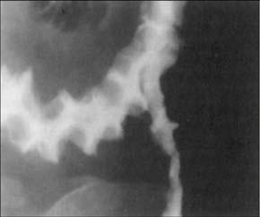
Plain AXR
The purpose of doing it is mainly to exclude other pathologies that could present in the same way.
Shown here is the thumb print sign which is a late sign that indicates infarction of the bowel
Notes:
Given the unreliability of the physical exam and laboratory values until permanent injury has taken place, imaging has become a crucial tool in securing an early diagnosis. Improved imaging technology is one of the reasons that reductions in mortality have been achieved.

Slide 46
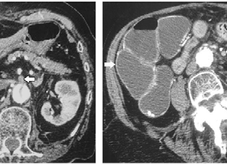
CT Scan
SMA embolus Bowel wall thickening
Notes:
SMA embolus Bowel wall thickening

Slide 47
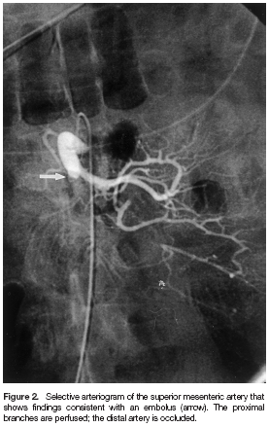
Angiography
Notes:
Angiography is still the gold standard for diagnosis( however not in acute unstable pts cuz its invasive!!!!! V. imp), given the anatomic and dynamic information it yields.
Anatomic delineation of occlusion and collaterals 􀀹 Plan operative revascularization 􀀹 Allow infusion of therapeutic agents (lytics, vasodilators)

Slide 48
Principles of Treatment
1.Diagnose
2. Restore Flow (surgical embolectomy)
3. Resect non-viable tissue
4. Supportive Care
5.Reevaluation( second look operation)
Notes:
If you took the pt to OR & when u opened him you found the whole small bowel gangrenous you do nothing. Just call a colleague to witness the case then close & go to talk to family & explain that the pt’s case is not compatible w/ life & there’s nothing more u can offer to him.

Slide 49
Acute Arterial Mesenteric Thrombosis
A less common cause
Follows thrombosis of an underlying diseased SMA (Found at ostium of SMA)
Cause:
Thrombosis on top of an ruptured atheromatous plaque w/ exposed intima

Slide 50
Mesenteric venous thrombosis
Clinically:
The presentation is of an acute abdominal catastrophe less abrupt than seen with the SMA embolus with eventual development of severe mid-abdominal pain
These symptoms may occur de novo or be superimposed on a background of chronic intestinal ischemia

Slide 51
Mesenteric venous thrombosis
Investigations
The venous phase of selective angiography may reveal the thrombus. CT Scan often demonstrates a thrombus within the portal vein and the superios mesenteric vein

Slide 52
Treatment:-
Surgery: resection of non viable bowel, thrombectomy and anticoagulants.
Correction of hypercoagulable states (heparinization)

Slide 53
Low-flow nonocclusive mesenteric ischemia
20-30% of acute intestinal ischemia
Response to systemic hypoperfusion
Sympathetic adrenergic system mediated visceral vasoconstriction/shunting for cerebral protection
Causes: any severe systemic illness:
Diminished cardiad output
Shock
Hypovolemia
Dehydration
Use of vaso-active medications
Mucosal sloughing and bleeding may be present
The diagnosis may be established with angiography
Notes:
cocaine, ergot alkaloids, digitalis, β-blockers, α-agonist

Slide 54
Low-flow nonocclusive mesenteric ischemia
Treatment
Optimize hemodynamics and volume status
Correct contributing medical conditions
Eliminate adverse pharmacologic agents
Pharmacologic support of the circulation with the relief of the vasoconstriction
Selective intra-arterial perfusion of vasodilators as papaverine and glucagon
Notes:
Pharmacologic support of the circulation with the relief of the vasoconstriction

Slide 55
Iatrogenic acute splanchnic ischemia
Results from catheter related procedures as:
1. Diagnostic or theraputic angiography may cause ischemia due to dissection or embolization
2. Aortic aneurysm resection
These patients often present with diarrhea and the stools are usually grossly bloody
If the ischemia is profound and infarction occurs resection is required

Slide 56
Chronic arteriosclerotic splanchnic ischemia
Due to atherosclerosis affecting the origin of:
Celiac, SMA, IMA
There is food fear and intestinal angina
Profound weight loss.
Investigations:
Duplex scan, CT Scanning support the diagnosis
Aortogram
Treatment:
Elective intestinal revascularization
Notes:
Peri-umbilical discomfort 15-30 minutes after food intake and lasting 1 to 4 hours.

Slide 57
Thank You

