Slide 1
IBD
Ahmed AlFaraj
Saqar Al Thonyan
Waled Al Harthi
Notes:
a group of chronic disorders that cause inflammation or ulceration in the small and large intestines.

Slide 2
Notes are in RED !

Slide 3
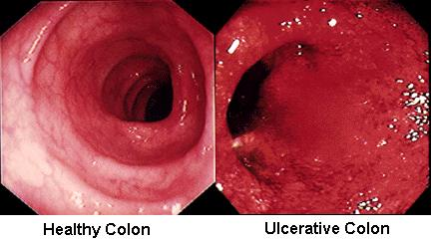
Ulcerative Colitis

Slide 4
Definition
Idiopathic.
Chronic.
Inflammation.
Colon & Rectum.
Mucosa.
No skipping lesions. (continues)
Sequels: Ulceration, edema, bleeding, & fluid/electrolytes disturbance.

Slide 5
Epidemiology
Females.
Bimodal distribution.
1st :15-25 years.
2nd : 55-65 years.
Northern locations.
Smoking+appeindectomy.

Slide 6
Signs & Symptoms: Intracolonic manifestation
Bleeding with bowel movements. MCC
Bloody diarrhea.
Urgency.
↓ Pain.
Weight lose.
Notes:
Depending on the extents of the disease. The presentation is with

Slide 7
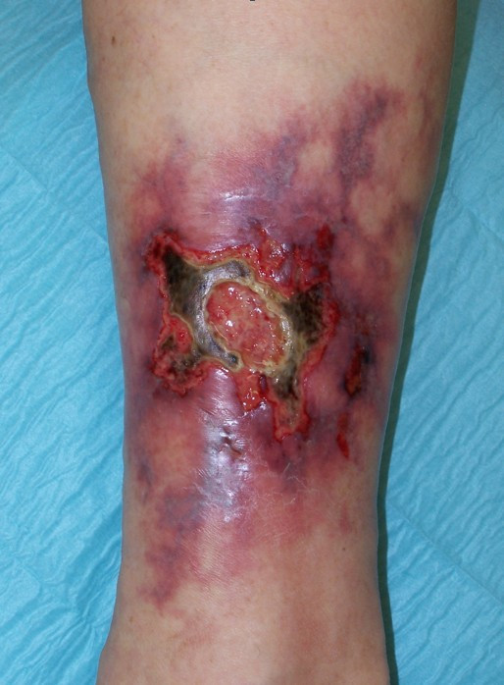
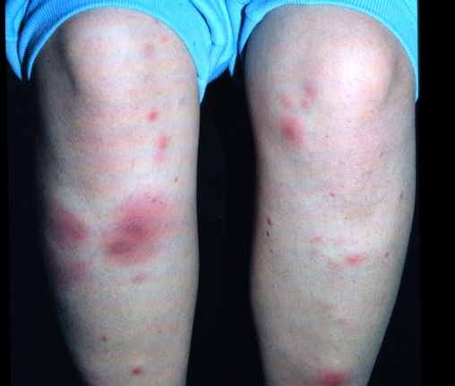
Signs & Symptoms: extracolonic manifestation
Skin lesions:
Erythema nodosum.
Pyoderma gangrenosum.
Notes:
the patient complaining of this symptom WONT get better after colectomy

Slide 8
Signs & Symptoms: extracolonic manifestation
Joints:
Synovitis.
Ankylosing spondylitis.
WONT get better after colectomy.
Notes:
Could be the initial symptoms for a teenger girl .the patient complaining of ankylosing WONT get better after colectomy.

Slide 9
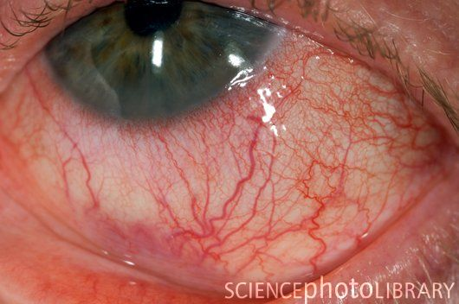
Signs & Symptoms: extracolonic manifestation
Eyes:
Episcleritis
Iritis
Notes:
In the end, it’s all inflammation process.

Slide 10
Signs & Symptoms: extracolonic manifestation
Liver:
Primary sclerosing cholangitis. WONT get better after colectomy.
Hypoalbuminemia
Notes:
the patient complaining of PSC WONT get better after colectomy

Slide 11
Colorectal Cancer:
Significant after 10 years. So we always do screening colonscopy after around 8 years
Depending on the extent. Pancollitis vs rectum alone , 70 Years Vs 21 Years old
5%
Screening colonoscopy.
Notes:
Any stricture in the IBD is malignant until proven otherwise

Slide 12
Investigations:
CBC.
↑ ESR. Very Imp for seeing activity of the disease and regression
↑ CRP.
Hypokalemia. Diarrhea related
Hypomagnesemia. Diarrhea related
↑ Alkaline phosphatase. Remember PSC
Stool study. Excluding infectious causes
Notes:
CBC: anemia, and high WBC in acute exacerbation.
ESR and CRP are inflammation related.
Stool study for the sake of the blood and excluding infections.

Slide 13
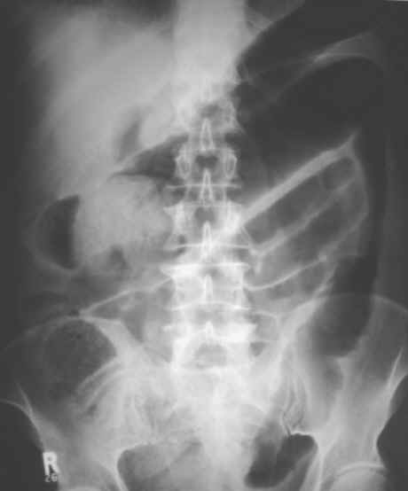
AXR
Dilatation of colon.
Obstruction.
Thumb print signs.
Notes:
Dilatation of colon: may lead to megatoxic colon in acute attacks,, and preforation and illeus.
Obstruction in case of cancer.
Thumb print signs are thinkening of the mocusa.

Slide 14
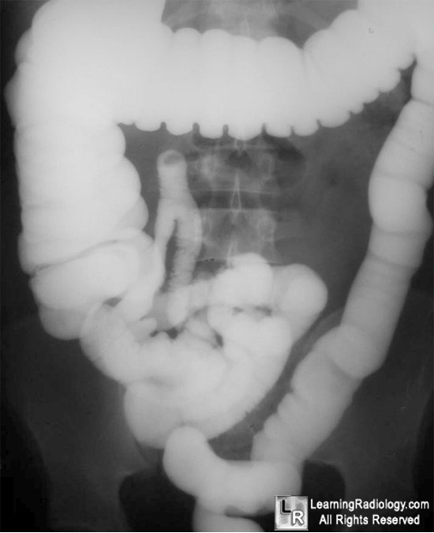
Barium enemas
Avoid it in sever case, it may cause perforation.
It’s a history, nobody do it nowadays.

Slide 15
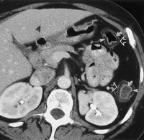
CT Scan
With contrast.
Exclude Crohn’s.
Thickening of colon wall.
Biliary dilatation.

Slide 16
Procedures
Flexible Sigmoidoscopy: for diagnosis.
colonoscopy with biopsy: for confirmation, extent of the disease, and malignancy survey.
Extent of the disease:
Proctitis: limited to rectum.
Proctosigmoiditis: rectum+sigmoid.
Left-sided colitis: descending colon up to splenic fissure.
Pancolitis: all the colon until the cecum.
Notes:
flexible sigmoidoscopy: in the rectum, as it’s always involved, so we can see inflammation, bleeding, and ulcers.
colonoscopy with biopsy: Also, this is useful for documenting the extent of the disease, for monitoring disease activity, and for surveillance for dysplasia or cancer. gastroenterologist took random biopsy,” blind biopsy” every 10 cm or every 20 cm, 2 biopsies using sigmoidoscopy , so if I found an area with low grade dysplasia, there may be other areas with high grades or carcinoma in situ

Slide 17
Drug Therapy
Immunosuppressent:
Aminosalicylates.
Sulfasalazine.
Corticosteroids.
Azathioprine.
Notes:
Sulfasalazine: for mild cases.
Corticosteroids: in acute attacks.
Azathioprine: for maintance.

Slide 18
Surgical Thereby:
Emergency Indications:
We give steroid and see after 48 H for improvement .. If not we do pancolectomy First .. Then pouch when the patients is stable
Fulminant colitis.
Severe hemorrhage.
Toxic megacolon not responding for pharamcolgical treatment
Perforation.
Complete obstruction.
Notes:
Fullminant colitis: sever attack with or without megacolon.
Severe hemorrhage: rare but may come with fullminant colitits.
complete obstruction: indicates poor surveillance, the idea to catch them in dysplastic phase

Slide 19
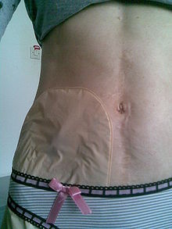
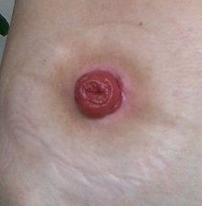
Emergency Surgeries:
total colectomy-and ileostomy:
Preserve anal verge, J pouch.
2 stages:
1. Remove all the colon + leave the rectum + end ileostomy.
Notes:
remove all colon + rectum “total rectocolectomy” + part of anal canal.
Illeostomy: it’s the ileum outside the skin on the right side and connect it to a bag.

Slide 20
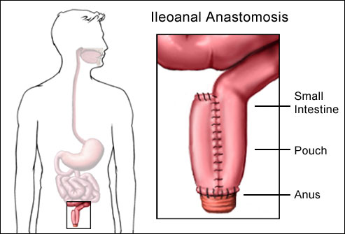
Emergency Surgeries:
total colectomy-and ileostomy:
Preserve anal verge, J pouch.
2 stages:
2. after 2-3 months , remove the rectum & createJ pouch.
Notes:
remove all colon + rectum “total rectocolectomy” + part of anal canal.
Illeostomy: it’s the ileum outside the skin on the right side and connect it to a bag. And this is loop ileostomy, temporary one.

Slide 21
elective indications:
Duration: 8 yrs for pancolitis. 10 yrs for distal colitis. The dr said its not an indication
Steroid dependent. IMP
Failure of medications.
Evidence of dysplasia or malignancy. IMP
FTT in children.

Slide 22
Elective Surgeries.
total proctocolictomy – ileal pouch- anal anastomosis.
Remove the rectum & colon – j pouch – attached to anal canal
One stage procedure unless the patient is steroid dependent.

Slide 23
Elective Surgeries.
total proctocolectomy – ileal pouch- anal anastomosis.
Remove the rectum & colon – j pouch – attached to anal canal
One stage procedure unless the patient is steroid dependent.
Notes:
1\ leak
2\ incontinence
And old people do end ileostomy

Slide 24
Crohn’s Disease
We can see , erythema , thickend bowel , fat creep

Slide 25
chronic granulomatous inflammatory disease of unknown etiology
May occur anywhere in GI tract “ Mouth to anus “
Common sites :
“ileocecal”Terminal ileum:commonest 40%
Small bowel 30%
colon 20%
Prianal disease 5% only pure prianal disease

Slide 26
Risk Factors
Age: Crohn's disease may be diagnosed at any age, although most diagnoses are made between the ages 15 to 35
Family History.
Smoking: Smoking appears to increase the risk of developing Crohns disease, and can worsen the course of the disease

Slide 27
symptoms
Abdominal pain: usually in RLQ remember illicecal
Malabsorption and weight loss
Chronic Diarrhea: usually without blood
Fever and fatigue
Poor appetite
Extraintestinal manifestations( uveitis artheritis & oral ulcer ….)

Slide 28
Examination
Physical signs are few, apart from loss of weight and general ill-health, Aphthous ulceration of the mouth is often seen.
Abdominal examination is normal although tenderness right iliac fossa mass are occasionally found.
The anus should always be examined to look for edematous anal tags, fissures or peianal abscesses.
Extra gastrointestinal features should always be preformed in patients with Crohn's disease.

Slide 29
How we can differentiate between UC, crohn’s & undetermined colitis?
The inflammation of Crohn's disease may be discontinuous, meaning that areas of involvement in the intestine may be separated by normal, unaffected segments of intestine. The affected areas are called "regional enteritis," while the normal areas are called "skip areas."
The inflammation of Crohn's disease affects all the layers of the intestinal wall, while ulcerative colitis affects only the lining of the intestine.

Slide 30
investigation
Hb : anemia of chronic disease
ESR elevated & Thrombocytosis
Endoscopy with biopsy
Radiographs :
AXR : Obstruction, perforation, toxic dilation
Small bowel enema and barium enema :

Slide 31
Complications “it could be presentations”
Abscess due to perforated bowel
Fistulas : Abscesses and fistulas commonly affect the area around the anus and rectum
Obstruction it could be fibrotic “strictures” which needs surgery or just inflammatory which is only edema & treated conservatively
Perforation→ localized or generalized peritonitis
Malabsorption and growth retardation
Toxic megacolon:
Bleeding “rare”
Nephrolithiasis due to increase absorption of oxalate
Carcinoma

Slide 32
Skip lesions in small bowel

Slide 33
Strictures skip lesions

Slide 34
Treatment don’t worry about the doses
Correction of fluid and electrolyte imbalance
Nutritional support
Sulfasalazine
Acute exacerbation : prednisolone 40 mg daily, 80% will respond & the rest 20% are steroids resistance so surgery is the only option for them
Immunosuppressant: azathioprine, cyclosporine
Rectal disease : prednisolone enemas
In case of perforation with localized abscess, → drain the abscess with Abx

Slide 35
In acute exacerbation give the patient steroids if he don’t respond after 2-3 days do surgery “ it is not recommended to give immunosuppressant “
Most of them eventually will need elective surgery
Remember we mentioned earlier !! Steroid → 48 hours → see improvement !

Slide 36
Indications for surgical management :
Emergency surgery is indicated for patients with life-threatening complications, such as intestinal perforation, refractory bleeding, or toxic megacolon, that do not respond to pharmacotherapy .
Elective surgery is indicated for patients with dysplasia or malignancy, a refractory disease course, or intolerance to long-term immunosuppression or other pharmacological therapies.
Specific indications for surgery in Crohn’s disease include the formation of fibrotic strictures causing partial or total intestinal obstruction, internal complicated fistulae, abdominal abscesses, and enterovesical, enterovaginal, and enterocutaneous fistulae

Slide 37
Strictureplasty:
Strictureplasty :surgical enlargement of the caliber of a constricted bowel segment
lengthwise cut in the intestine and then sews the opening together in the opposite direction. This makes the intestine wider
Up to 10 cm stricture we can do stricturoplasty
Strictureplasty is used when we trying to save as much of the intestine as possible.
Stricturoplasty is only for small bowl contraindicated in colon because the Risk of cancer & recurrence rate

Slide 38
Resection
The diseased portion of the intestines is removed, and the healthy ends of the intestine are reattached.
If there is multiple strictures & the area between them less than 5-10 cm we have to resect that segment
Resection surgery does not cure Crohn's disease.

Slide 39
Perianal fistulas
Diseased rectum →Perforation → abscess → fistula
Treat it by treat the cause
drain the abscess first by incision & drainage
Give anti-crohn’s enemas “Infliximab”
Usually recurrent so with repeated fistulotomy you will end by incontinence

Slide 40
GOOD LUCK !
The Doc Emphasized about knowing the difference appearnce of UC and chrons , hiso and gross !!
Also sumthing called true love whiitte criteria , I think its In the female notes
Also . He said be careful , not every UC symptoms coming from UC ,, it maybe chrons ,, they interchane , called undetermined or chron collitis ..

